Slide 1


Salt Lake City, UT 29 January 2020 – Salt Lake City, UT
airU Google Cloud Platform Solution
Project Update
Department of Electrical and Computer Engineering – University of Utah
**Questions encouraged throughout the briefing**

Slide 2
Agenda
Project update
Way forward
Questions

Slide 3
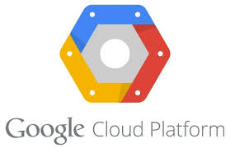
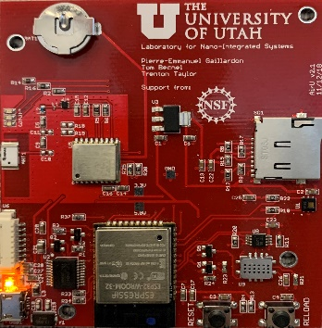

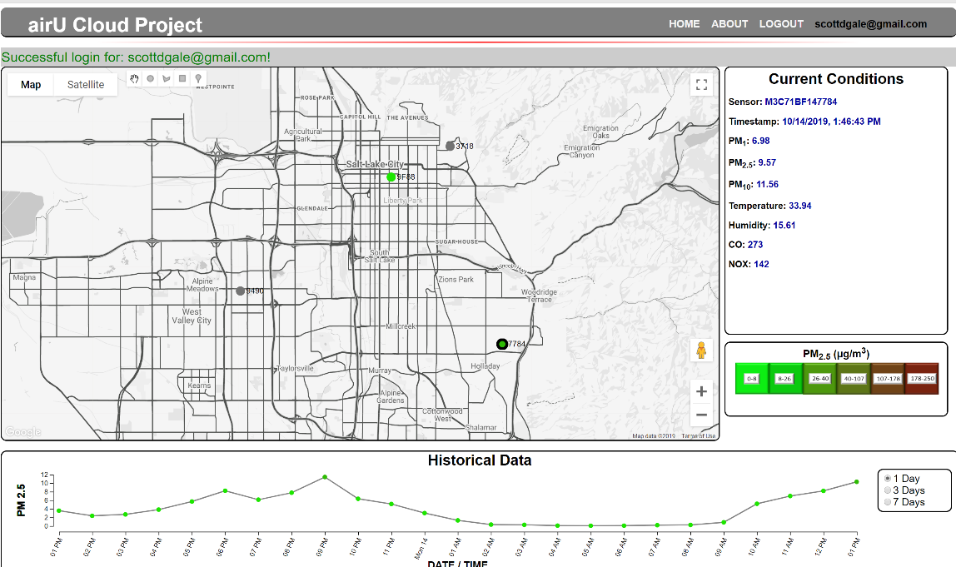
Overview
Device / Sensor
Databases
GCP
BigQuery
GCP
Storage
Bucket
Cloud
Function
MQTT
*Publish
*Subscribe
Web Interface
GCP
IoT Core
Sensor Data
Data Communication
Notes:
Highlight that green is sensor data pathway
Orange is other data communication (firmware, configuration, authentication, and user data)
Briefly discuss each component and the changes required to transform this to a cloud based system
Start with IoT, Cloud Function, Databases

Slide 4
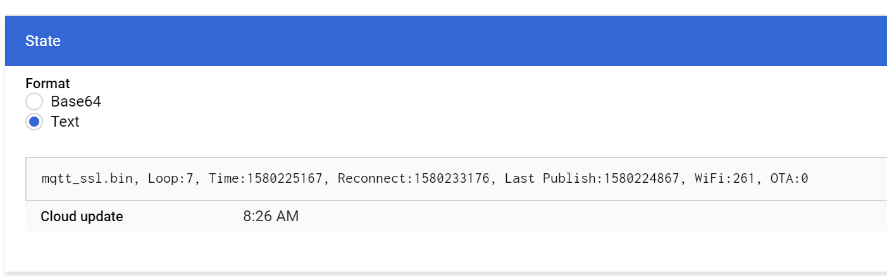
Sensor Reliability (1 of 2)
Reporting ‘more’ State . . .
Firmware version
Internal publishing loop
Reconnect time with GCP
Last GCP publish time
WiFi status bits
OTA in progress
Notes:
Enhance Reliability
Better understand what is going on with deployed sensors (more than just binary publishing / not publishing)
Explain each of the state variables

Slide 5
Sensor Reliability (1 of 2)
The ‘Watchdog Task’
30-minute intervals
Low power / low demand
Check WiFi status bits
Check last publication time
Error recovery
Watchdog Task
Monitor WiFi Task
Monitor MQTT Task
WIFI Task
Connect / configure WiFi settings through device
Establish / maintain WiFi connectivity
MQTT Task
Connection with GCP
Publish sensor data
OTA updates
Respond to commands
Notes:
WiFi and MQTT are two separate tasks operating asynchronously
MQTT DEPENDENT ON WIFI
Experiencing non determinant errros . . . Within either the WIFI or MQTT task
Created a parent task to monitor the children . . .
Deployed before Christmas – no reported issues

Slide 6

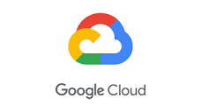
V1 Server Script
CADE LAB
SERVER
(MQTT BROKER)
Subscribe
GCP Infrastructure
(MQTT Broker)
Publish
V1 certificate limitations
Multi threaded producer / consumer script
Routes V1 sensor data into BigQuery DB
Stop gap – reliable solution for now
V1
Sensor

Slide 7
API
Endpoint /request_sensor_data
Supports query of 1, many, all sensors
Specify number of days into the past to retrieve
Returns PM2.5 data only
Supports mobile app and
Endpoint /request_model_data
Given center point, radius, date range
Return all specified sensor data (every publication)
Looking at aggregation options
Supports model development
Legacy to GCP lash up . . .
Notes:
API – Conform to industry norms / standards
Documentation https://github.com/aqandu/airu_gcp_webapp

Slide 8
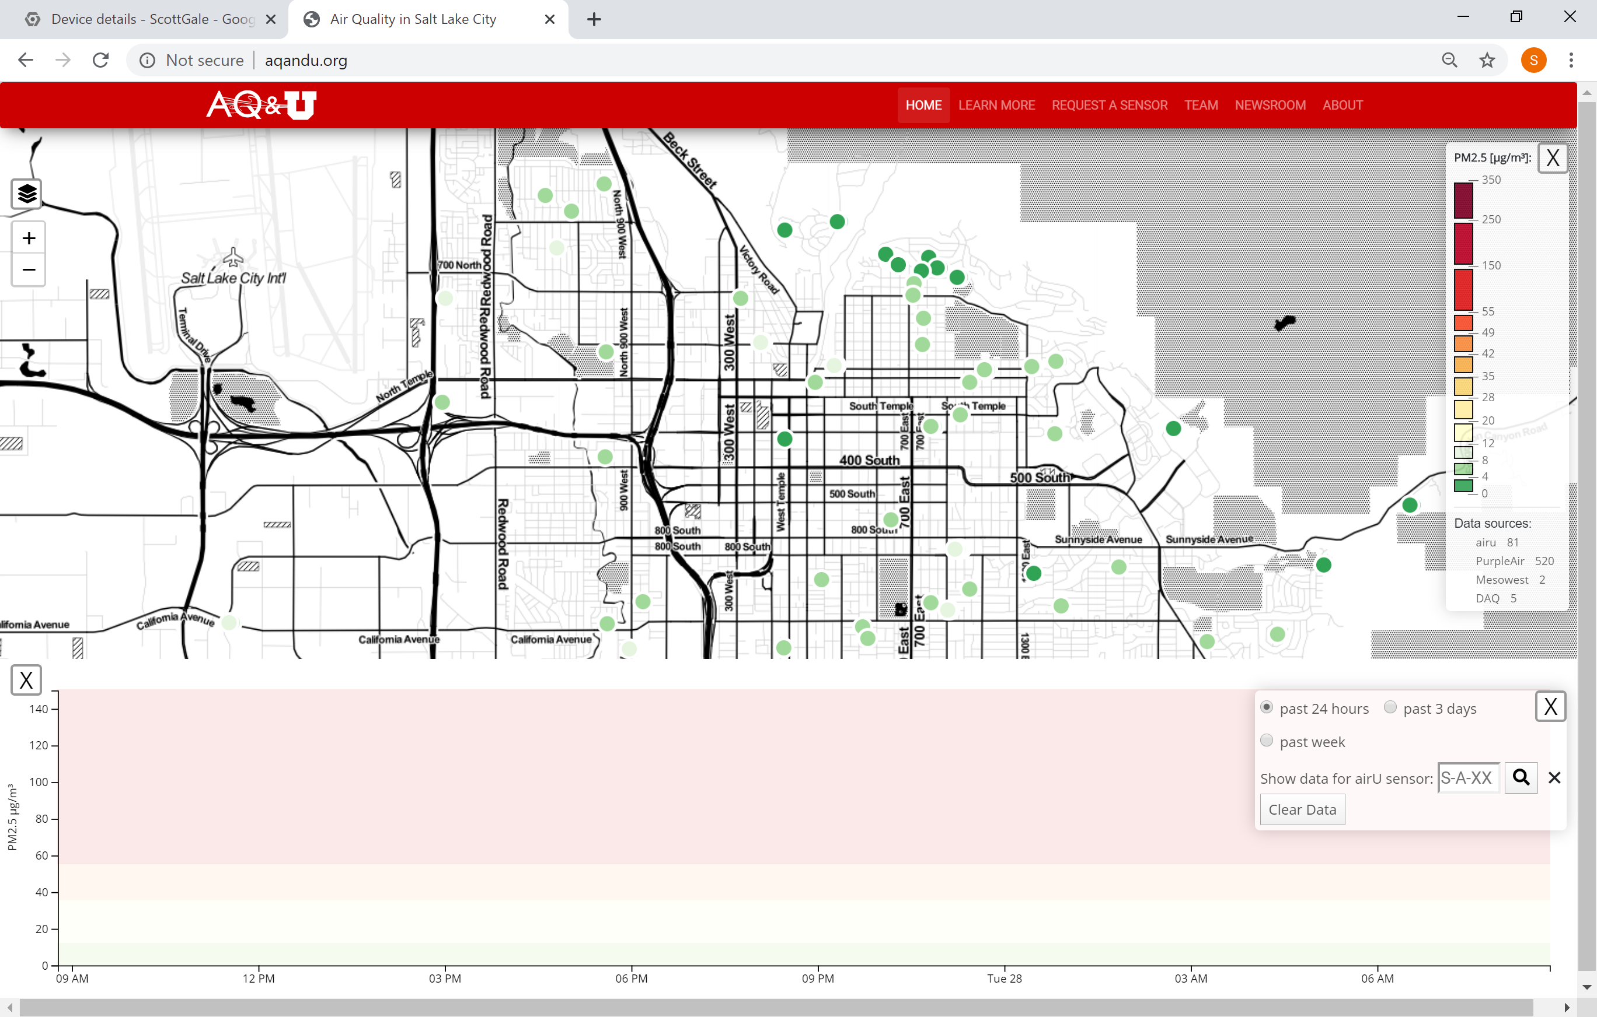
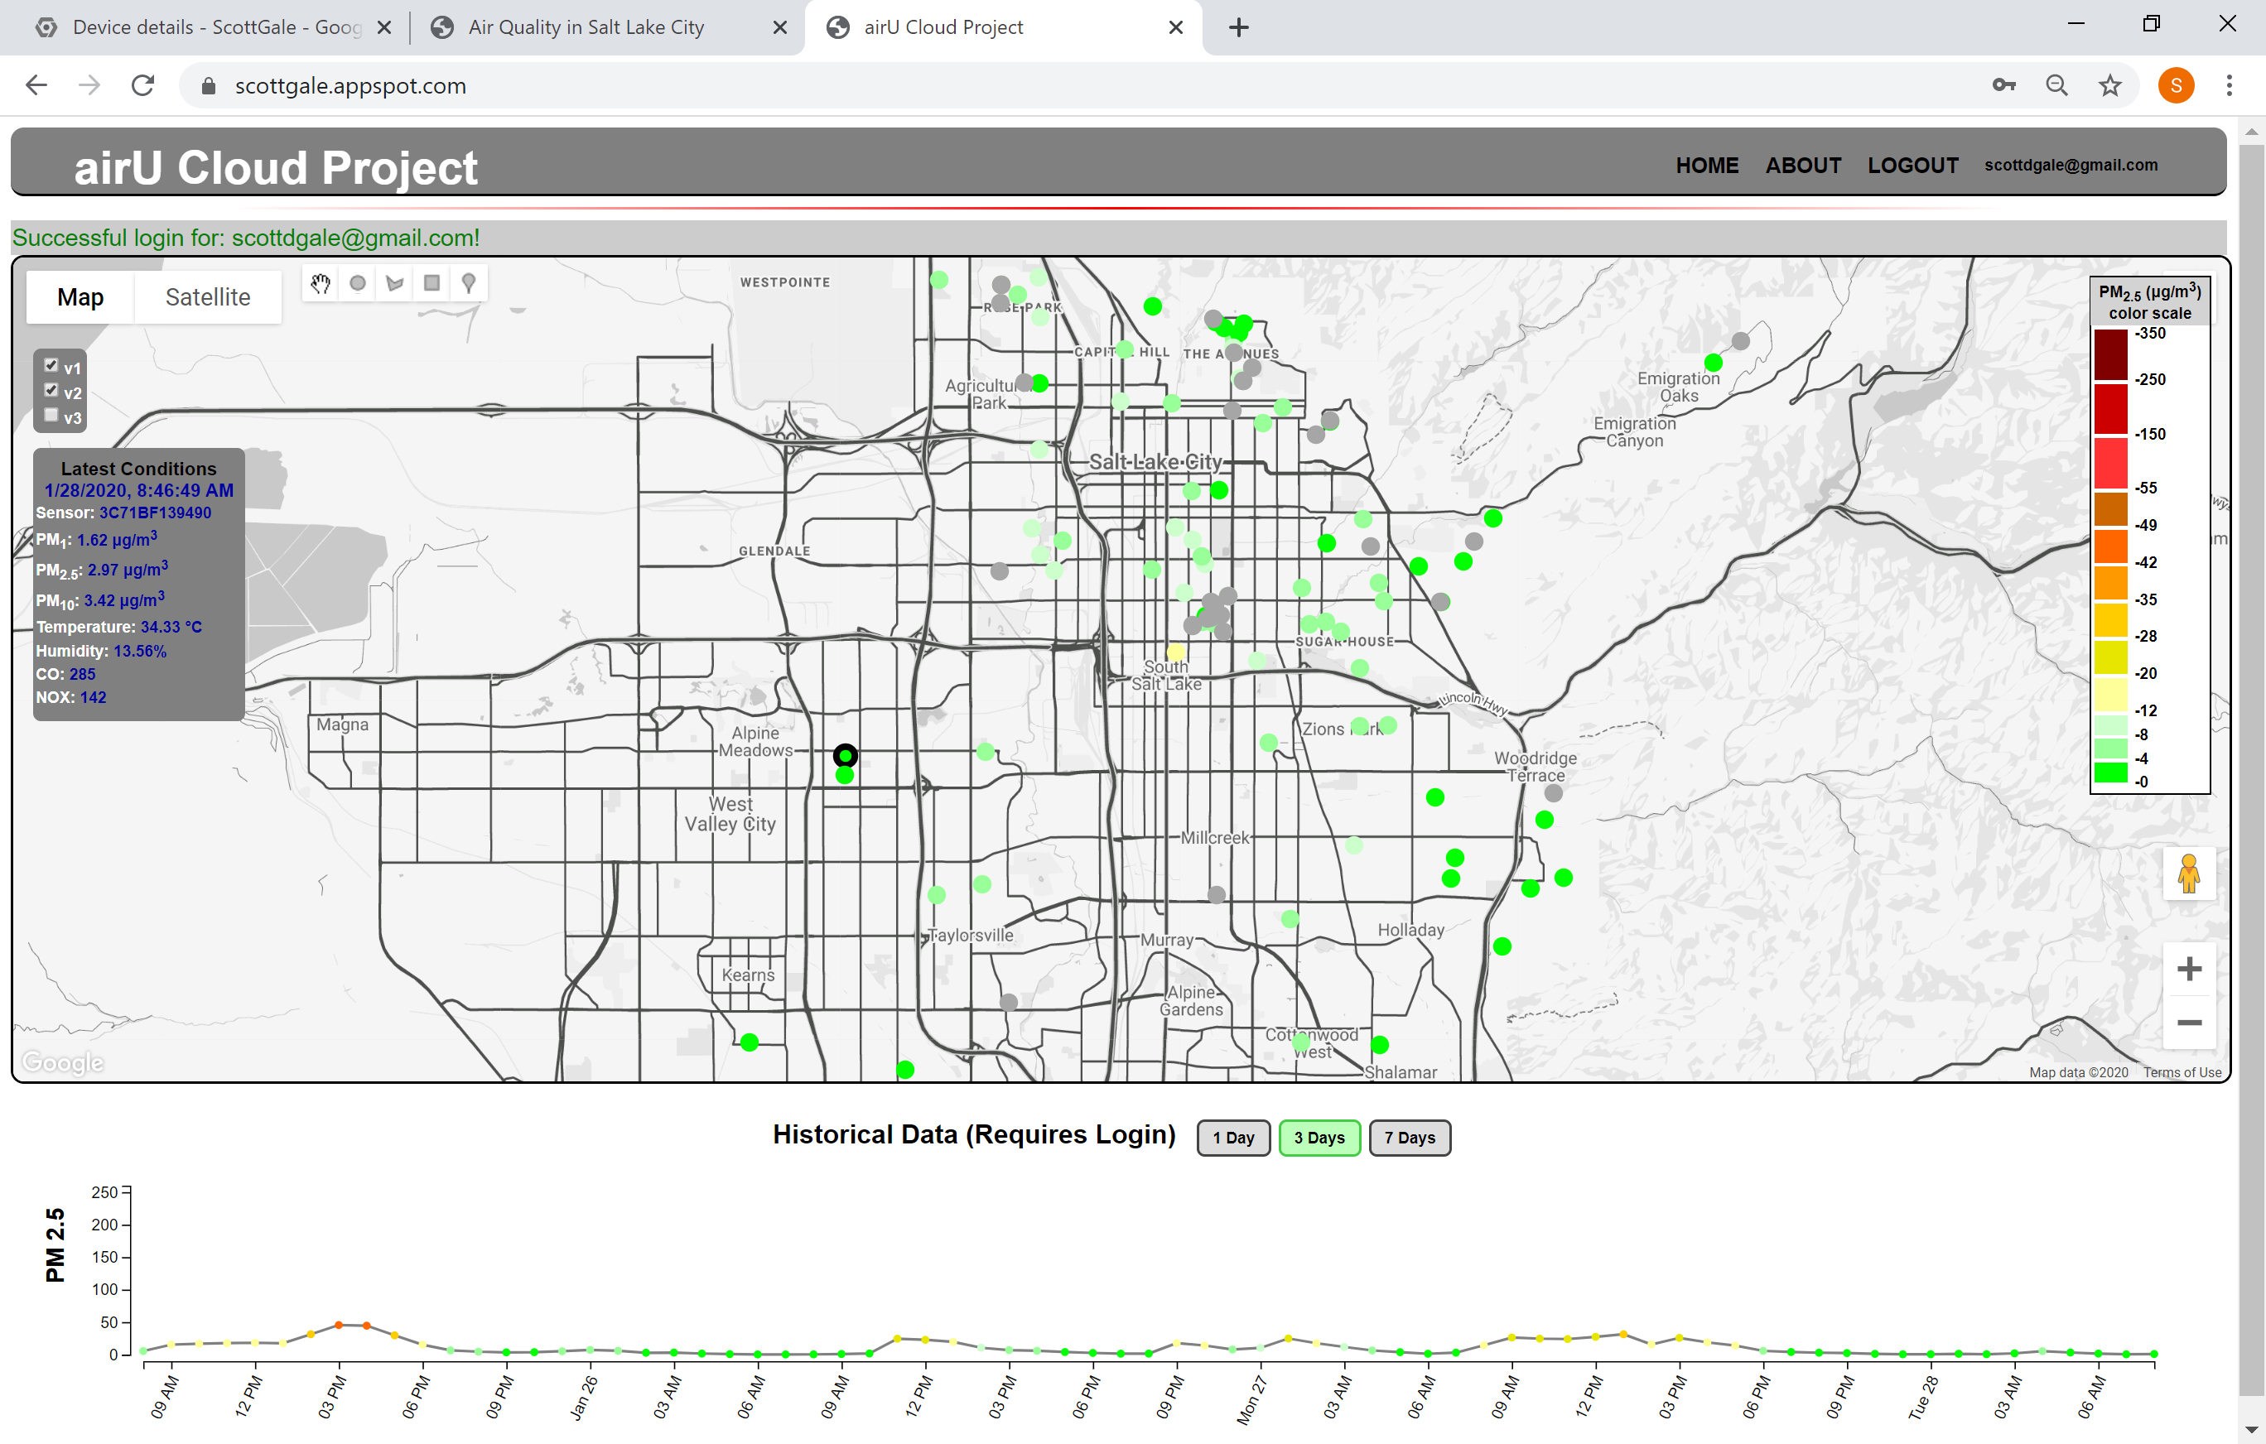
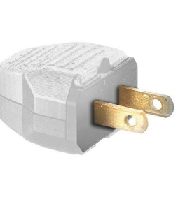
Way Forward
CADE LAB
SERVER
GCP Infrastructure
Notes:
Scalability! Databases scale automatically, no management
Ease of administration (hands off credential management)

Slide 9
Conclusion
Databases
Device / Sensor
GCP
BigQuery
GCP
Storage
Bucket
Cloud
Function
MQTT
*Publish
*Subscribe
Web Interface
GCP
IoT Core
AQANDU.ORG
Sensor Data
Data Communication

Slide 10
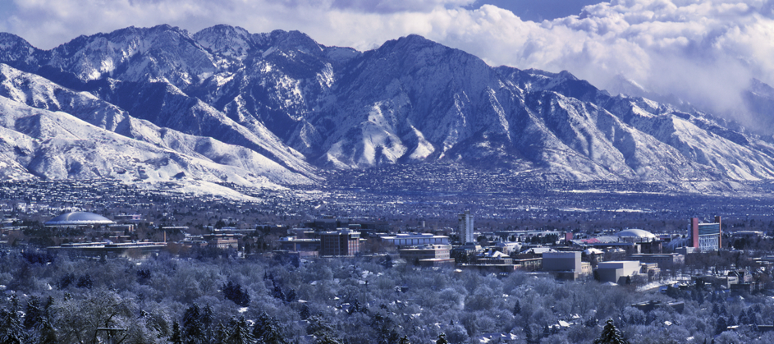

Laboratory for NanoIntegrated Systems Department of Electrical and Computer Engineering MEB building – University of Utah – Salt Lake City – UT – USA
Questions
Notes:
Lessons learned:

