Slide 1
Chapter 11 Inheritance and Polymorphism (Polymorphism)
1

Slide 2
Objectives
To discover polymorphism and dynamic binding (§§11.7–11.8).
To describe casting and explain why explicit downcasting is necessary (§11.9).
To explore the equals method in the Object class (§11.10).
To store, retrieve, and manipulate objects in an ArrayList (§11.11).
To implement a Stack class using ArrayList (§11.12).
2

Slide 3

Polymorphism
The three pillars of object-oriented programming are:
Encapsulation
Inheritance
Polymorphism

Slide 4
The Pillars of OOP

Slide 5
Polymorphism
Polymorphism is a Greek word; (poly) means many and (morph) means shapes.
The term Polymorphism literally means "having many forms".
Polymorphism means that a variable of a supertype can refer to a subtype object.
5

Slide 6
Polymorphism
A class defines a type.
A type defined by a subclass is called a subtype.
A type defined by its superclass is called a supertype.
Therefore, you can say that Circle is a subtype of Shape and Shape is a supertype for Circle.
PolymorphismDemo
Run
6

Slide 7
Animals make sounds
The inheritance relationship enables a subclass to inherit features from its superclass with additional new features.
Dog
Sound()
Animal
Rooster
Sound()
Sound()
Cat
A subclass is a specialization of its superclass; every instance of a subclass is also an instance of its superclass, but not vice versa.
Sound()
7

Slide 8
References and Inheritance
The Animal class is used to derive a class called Cat. A cat is an animal. Therefore, Animal reference could be used to point to a Cat object.
All Animals make sounds. But each one has its own sound.
Animal
Animal animal;
animal = new Cat();
Cat
© 2004 Pearson Addison-Wesley. All rights reserved
9-8

Slide 9
Declared type and Actual type
A variable must be declared a type.
Object o = new GeometricObject();
o’s declared type is Object.
A variable of a reference type can hold a null value or a reference to an instance of the declared type.
The actual type of the variable is the actual class for the object referenced by the variable.
Object o = new GeometricObject();
o’s actual type is GeometricObject.

Slide 10
References and Inheritance
An object reference can refer to an object of its class, or to an object of any class related to it by inheritance.
Animal animal = new Cat();
animal.sound();
animal = new Duck();
animal.sound();
A polymorphic reference is a variable that can refer to different types of objects at different points in time.
9-10

Slide 11
References and Inheritance
Animal animal = new Cat();
animal.sound();
animal = new Duck();
animal.sound();
The method invoked through a polymorphic reference can change from one invocation to the next.
It is the type of the object being referenced (actual), not the reference (declared) type, that determines which method is invoked.
9-11

Slide 12
Polymorphic call
The inheritance relationship enables a subclass to inherit features from its superclass with additional new features.
A subclass is a specialization of its superclass; every instance of a subclass is also an instance of its superclass, but not vice versa.
For example, every circle is a geometric object, but not every geometric object is a circle.
Therefore, you can always pass an instance of a subclass to a parameter of its superclass type.

Slide 13
public class PolymorphismDemo {
/** Main method */
public static void main(String[] args) {
// Display circle and rectangle properties
displayObject(new Circle (1, "red", false));
displayObject(new Rectangle (1, 1, "black", true));
}
/** Display geometric object properties */
public static void displayObject(Shape object)
{
System.out.println("Created on " + object.getDateCreated() +
". Color is " + object.getColor());
}
}
Polymorphic call
An object of a subclass can be used wherever its superclass object is used.
13

Slide 14
public class PolymorphismDemo {
/** Main method */
public static void main(String[] args) {
// Display circle and rectangle properties
displayObject(new Circle (1, "red", false));
displayObject(new Rectangle (1, 1, "black", true));
}
/** Display geometric object properties */
public static void displayObject(Shape object)
{
System.out.println("Created on " + object.getDateCreated() +
". Color is " + object.getColor());
}
}
Polymorphic call
An object of a subclass can be used wherever its superclass object is used.
Created on Mon Mar 09 19:25:20 EDT 2011. Color is red
Created on Mon Mar 09 19:25:20 EDT 2011. Color is black
14

Slide 15

Suppose the Mammal class has a method called run, and the Horse class overrides it.
Now consider the following invocation:
animal.run();
Which run version will be invoked?
9-15

Slide 16
Polymorphism
class Person {
public String toString() {
return "Person";
}
}
//****************************
class Student extends Person {
public String toString() {
return "Student";
}
}
//****************************
class GraduateStudent
extends Student {
}
public class PolymorphismDemo {
public static void
main(String[] args) {
m(new GraduateStudent());
m(new Student());
m(new Person());
m(new Object());
}
public static void m(Object x) {
System.out.println(x.toString());
}
}
Method m takes a parameter of the Object type. You can invoke it with any object.

Slide 17
Polymorphism
class Person {
public String toString() {
return "Person";
}
}
//****************************
class Student extends Person {
public String toString() {
return "Student";
}
}
//****************************
class GraduateStudent
extends Student {
}
public class PolymorphismDemo {
public static void
main(String[] args) {
m(new GraduateStudent());
m(new Student());
m(new Person());
m(new Object());
}
public static void m(Object x) {
System.out.println(x.toString());
}
}
This feature is known as polymorphism.
Object x = new GraduateStudent();
Object x = new Student();
Object x = new Person();
Object x = new Object();

Slide 18
Generic Programming
class Person {
public String toString() {
return "Person";
}
}
//****************************
class Student extends Person {
public String toString() {
return "Student";
}
}
//****************************
class GraduateStudent
extends Student {
}
public class PolymorphismDemo {
public static void
main(String[] args) {
m(new GraduateStudent());
m(new Student());
m(new Person());
m(new Object());
}
public static void m(Object x) {
System.out.println(x.toString());
}
}
Polymorphism allows methods to be used generically for a wide range of object arguments. This is known as generic programming.

Slide 19
Dynamic Binding
class Person {
public String toString() {
return "Person";
}
}
//****************************
class Student extends Person {
public String toString() {
return "Student";
}
}
//****************************
class GraduateStudent
extends Student {
}
public class PolymorphismDemo {
public static void
main(String[] args) {
m(new GraduateStudent());
m(new Student());
m(new Person());
m(new Object());
}
public static void m(Object x) {
System.out.println(x.toString());
}
}
Which toString() method will be invoked?
Which implementation is used will be determined dynamically by the Java Virtual Machine at runtime.
This capability is known as dynamic binding.

Slide 20
Dynamic Binding
class Person {
public String toString() {
return "Person";
}
}
//****************************
class Student extends Person {
public String toString() {
return "Student";
}
}
//****************************
class GraduateStudent
extends Student {
}
public class PolymorphismDemo {
public static void
main(String[] args) {
m(new GraduateStudent());
m(new Student());
m(new Person());
m(new Object());
}
public static void m(Object x) {
System.out.println(x.toString());
}
}
Which toString() method will be invoked?
Which implementation is used will be determined dynamically by the Java Virtual Machine at runtime.
This capability is known as dynamic binding.
Student
Student
Person
Java.lang.Object@130c19b

Slide 21
Dynamic Binding
A method can be implemented in several classes along the inheritance chain. The JVM decides which method is invoked at runtime.

Slide 22
Dynamic Binding
A method can be defined in a superclass and overridden in its subclass.
For example, the toString() method is defined in the Object class and overridden in GeometricObject.
Consider the following code:
Object o = new GeometricObject(); System.out.println(o.toString());
Which toString() method is invoked by o?

Slide 23
Dynamic Binding
Suppose:
C₁ o = new C₁();
o.m();
Which m will be implemented?
C_{n}
m()
C₃
m()
C₂
m()
C₁
m()
23

Slide 24
Dynamic Binding
Suppose:
C₁ o = new C₁();
o.m();
Which m will be implemented?
C_{n}
m()
C₃
m()
C₂
m()
C₁
24

Slide 25
Dynamic Binding
Suppose:
C₁ o = new C₁();
o.m();
Which m will be implemented?
C_{n}
m()
C₃
C₂
C₁
25

Slide 26
Dynamic Binding
Suppose:
C₃ o = new C₂();
o.m();
Which m will be implemented?
C_{n}
m()
C₃
m()
C₂
m()
C₁
m()
26

Slide 27
Dynamic Binding
Suppose:
C₃ o = new C₁();
o.m();
Which m will be implemented?
C_{n}
m()
C₃
C₂
m()
C₁
27

Slide 28
Dynamic Binding
Suppose:
C₃ o = new C₂();
o.m();
Which m will be implemented?
C_{n}
m()
C₃
m()
C₂
C₁
m()
28

Slide 29
Dynamic Binding
Suppose:
C₃ o = new C₂();
o.m();
Which m will be implemented?
C_{n}
C₃
m()
C₂
m()
C₁
m()
29

Slide 30
Dynamic Binding
Suppose:
C_{n} o = new C₂();
o.m();
Which m will be implemented?
Error
Declared type should have the invoked method.
C_{n}
C₃
m()
C₂
m()
C₁
m()
30

Slide 31
Dynamic Binding
C_{n}
m()
the JVM searches the implementation for the method m in C₁, C₂, ..., C_{n-1} and C_{n}, in this order, until it is found. Once an implementation is found, the search stops, and the first-found implementation is invoked.
C₃
m()
C₂
m()
C₁
m()
31

Slide 32
Method Matching vs. Binding
Matching a method signature and binding a method implementation are two issues.
The declared type of the reference variable decides which method to match at compile time.
Animal animal = new Cat();
animal.sound();
Run time
Animal
Cat
Sound()
Sound()
Compile time
32

Slide 33
Method Matching vs. Binding
The compiler finds a matching method according to parameter type, number of parameters, and order of the parameters at compilation time.
methodA(int a, char b)
A method may be implemented in several subclasses.
The Java Virtual Machine dynamically binds the implementation of the method at runtime.
33

Slide 34
What is wrong in the following code?
1 public class Test {
2 public static void main(String[] args) {
3 Integer[] list1 = {12, 24, 55, 1};
4 Double[] list2 = {12.4, 24.0, 55.2, 1.0};
5 int[] list3 = {1, 2, 3};
6 printArray(list1);
7 printArray(list2);
8 printArray(list3);
9 }
10
11 public static void printArray(Object[] list) {
12 for (Object o: list)
13 System.out.print(o + " ");
14 System.out.println();
15 }
16 }

Slide 35
What is wrong in the following code?
1 public class Test {
2 public static void main(String[] args) {
3 Integer[] list1 = {12, 24, 55, 1};
4 Double[] list2 = {12.4, 24.0, 55.2, 1.0};
5 int[] list3 = {1, 2, 3};
6 printArray(list1);
7 printArray(list2);
8 printArray(list3);
9 }
10
11 public static void printArray(Object[] list) {
12 for (Object o: list)
13 System.out.print(o + " ");
14 System.out.println();
15 }
16 }
int[] cannot be passed to Object[].

Slide 36

Polymorphism Exercise
5 Groups of three.
Implement each class according to the UML and the inheritance relationship.
Each group will implement a class.
36

Slide 37
Polymorphism Example
Consider the following class hierarchy:
StaffMember
Volunteer
Employee
Executive
Hourly
9-37

Slide 38
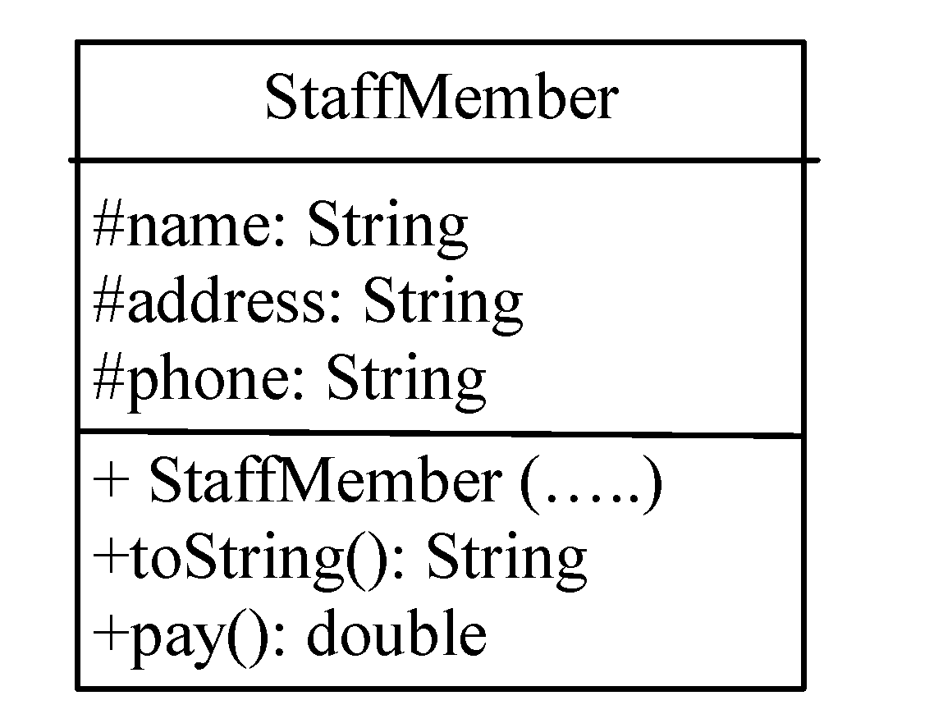
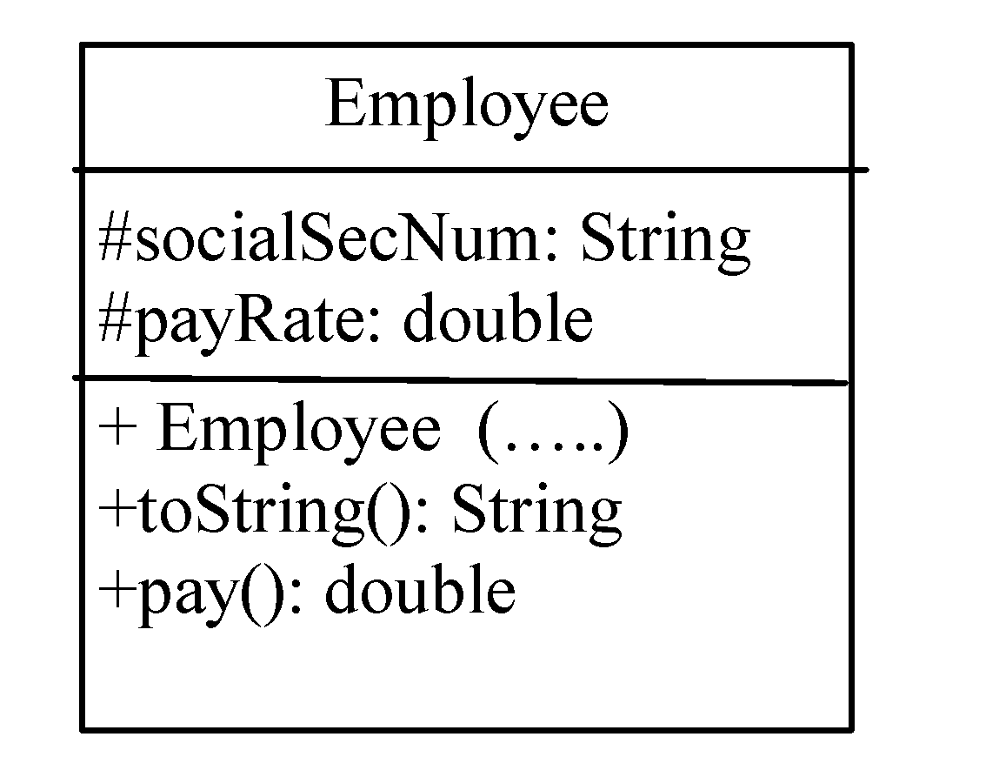
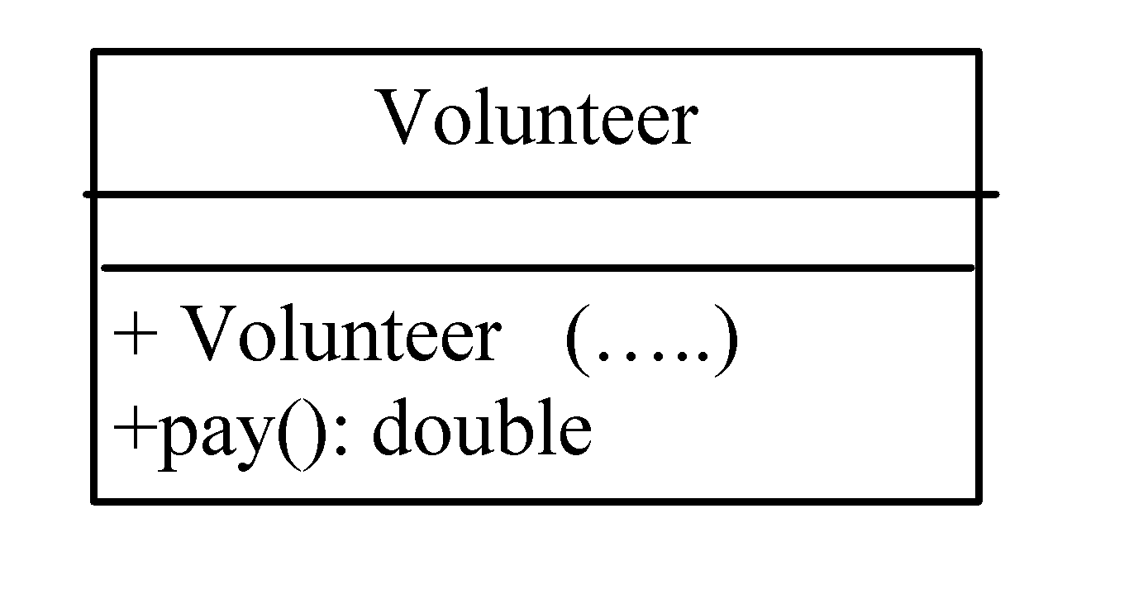
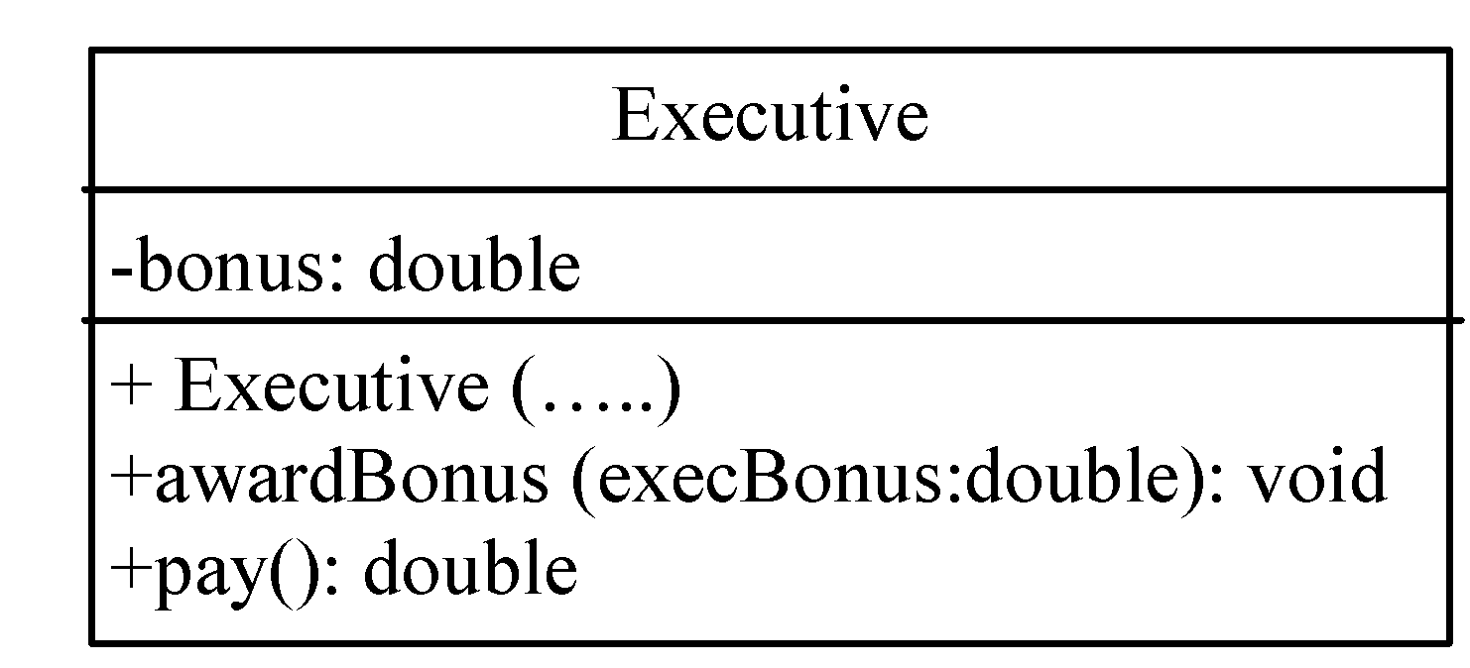
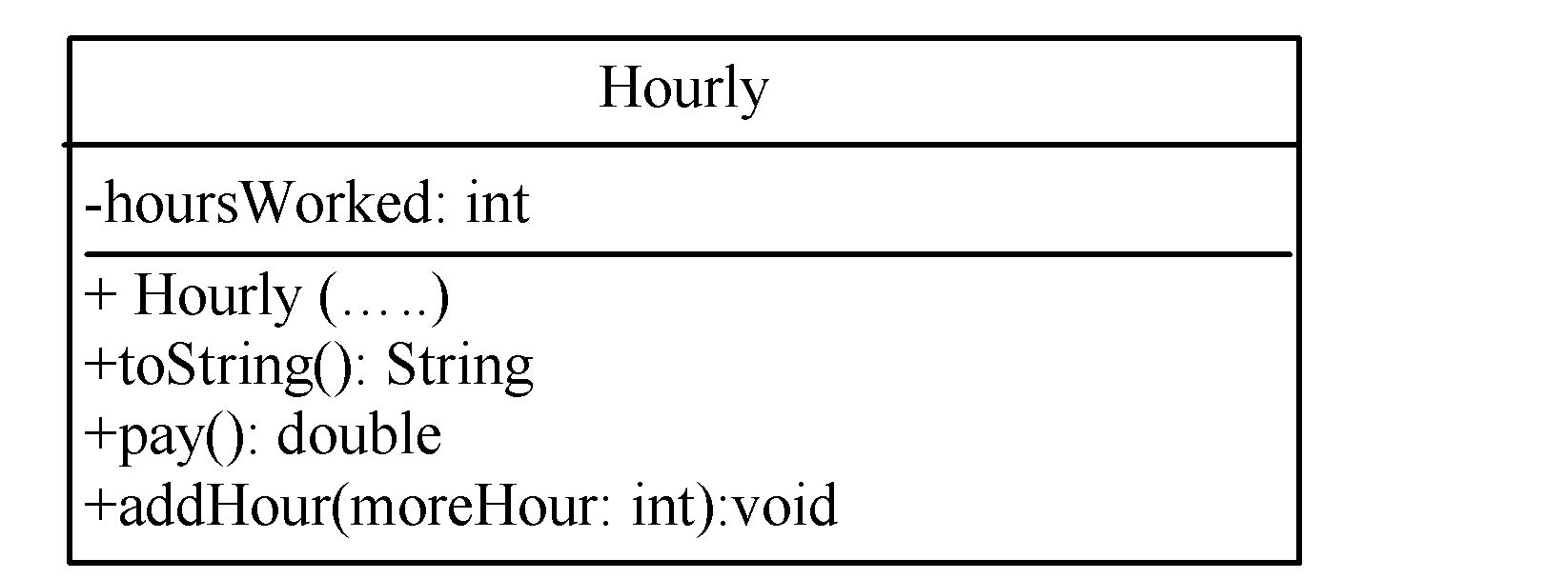
38

Slide 39
public class StaffMember
{
protected String name;
protected String address;
protected String phone;
//------------------------------------------------------------------------------------------
public StaffMember (String eName, String eAddress, String ePhone)
{
name = eName; address = eAddress; phone = ePhone;
}
//------------------------------------------------------------------------------------------
public String toString() {
String result = "Name: " + name + "\n";
result += "Address: " + address + "\n";
result += "Phone: " + phone;
return result;
}
//------------------------------------------------------------------------------------------
public double pay() {return 0;}
}
9-39

Slide 40
public class Volunteer extends StaffMember
{
public Volunteer (String eName, String eAddress, String ePhone)
{
super (eName, eAddress, ePhone);
}
//------------------------------------------------------------------------------------------
public double pay() { return 0.0; }
}
© 2004 Pearson Addison-Wesley. All rights reserved
9-40

Slide 41
public class Employee extends StaffMember
{
protected String socialSecNum;
protected double payRate;
//------------------------------------------------------------------------------------------
public Employee (String eName, String eAddress, String ePhone, String socSecNumber,
double rate){
super (eName, eAddress, ePhone);
socialSecurityNumber = socSecNumber;
payRate = rate;
}
//------------------------------------------------------------------------------------------
public String toString()
{
String result = super.toString();
result += "\nSocial Security Number: " + socialSecurityNumber;
return result;
}
//------------------------------------------------------------------------------------------
public double pay() { return payRate; }
}
9-41

Slide 42
public class Executive extends Employee
{
private double bonus;
//------------------------------------------------------------------------------------------
public Executive (String eName, String eAddress, String ePhone, String socSecNumber,
double rate) {
super (eName, eAddress, ePhone, socSecNumber, rate);
bonus = 0; // bonus has yet to be awarded
}
//------------------------------------------------------------------------------------------
public void awardBonus (double execBonus)
{ bonus = execBonus; }
//------------------------------------------------------------------------------------------
public double pay()
{ double payment = super.pay() + bonus;
bonus = 0;
return payment;
}
}
9-42

Slide 43
public class Hourly extends Employee
{
private int hoursWorked;
//------------------------------------------------------------------------------------------
public Hourly (String eName, String eAddress, String ePhone, String socSecNumber,
double rate) {
super (eName, eAddress, ePhone, socSecNumber, rate);
hoursWorked = 0;
}
//------------------------------------------------------------------------------------------
public void addHours (int moreHours) { hoursWorked += moreHours; }
//------------------------------------------------------------------------------------------
public double pay() {
double payment = payRate * hoursWorked;
hoursWorked = 0;
return payment;
}
//------------------------------------------------------------------------------------------
public String toString() {
String result = super.toString();
result += "\nCurrent hours: " + hoursWorked;
return result;
}
}
9-43

Slide 44
public class Staff {
private StaffMember[] staffList;
//------------------------------------------------------------------------------------------
public Staff ()
{
staffList = new StaffMember[6];
staffList[0] = new Executive ("Sam", "123 Main Line“, "555-0469", "123-45-6789", 2423.07);
staffList[1] = new Employee ("Carla", "456 Off Line“, "555-0101", "987-65-4321", 1246.15);
staffList[2] = new Employee ("Woody", "789 Off Rocker“, "555-0000", "010-20-3040", 1169.23);
staffList[3] = new Hourly ("Diane", "678 Fifth Ave.“, "555-0690", "958-47-3625", 10.55);
staffList[4] = new Volunteer ("Norm", "987 Suds Blvd.“, "555-8374");
staffList[5] = new Volunteer ("Cliff", "321 Duds Lane“, "555-7282");
}
//------------------------------------------------------------------------------------------
public void payday () {
double amount;
for (int count=0; count < staffList.length; count++)
{
System.out.println (staffList[count]);
amount = staffList[count].pay(); // polymorphic
if (amount == 0.0) System.out.println ("Thanks!");
else System.out.println ("Paid: " + amount);
}
}
}
© 2004 Pearson Addison-Wesley. All rights reserved
9-44

Slide 45
public class Firm
{
//-----------------------------------------------------------------
// Creates a staff of employees for a firm and pays them.
//-----------------------------------------------------------------
public static void main (String[] args)
{
Staff personnel = new Staff();
personnel.payday();
}
}
9-45

Slide 46
Did the hourly employee receive any salary? Why? What do we need to do?
Did the Executive employee get bonus? What do we do?
9-46

Slide 47
public class Firm
{
//-----------------------------------------------------------------
// Creates a staff of employees for a firm and pays them.
//-----------------------------------------------------------------
public static void main (String[] args)
{
Staff personnel = new Staff();
personnel.addHours (40);
personnel.addBouns (10000);
personnel.payday();
}
}
9-47

Slide 48
public class Staff {
private StaffMember[] staffList;
//------------------------------------------------------------------------------------------
public Staff ()
{
staffList = new StaffMember[6];
staffList[0] = new Executive ("Sam", "123 Main Line“, "555-0469", "123-45-6789", 2423.07);
staffList[1] = new Employee ("Carla", "456 Off Line“, "555-0101", "987-65-4321", 1246.15);
staffList[2] = new Employee ("Woody", "789 Off Rocker“, "555-0000", "010-20-3040", 1169.23);
staffList[3] = new Hourly ("Diane", "678 Fifth Ave.“, "555-0690", "958-47-3625", 10.55);
staffList[4] = new Volunteer ("Norm", "987 Suds Blvd.“, "555-8374");
staffList[5] = new Volunteer ("Cliff", "321 Duds Lane“, "555-7282");
}
//----------------------------------------------------------------
public void addHours ( int hour)
{
staffList[3].addHours (hour);
}
//---------------------------------------------------------
public void addBouns ( double bonus)
{
staffList[0].awardBonus (bouns);
}
……
}
a staffMember object is not nessarly an Hourly or Executive object. StaffMember class does not have addHours or addBouns methods.
Even though you can see that staffList[3] is really an Hourly object, the compiler is not so clever to know it.
X
((Hourly)staffList[3]).addHours (hour);
X
((Executive)staffList[0]).awardBonus (bouns);
To tell the compiler that staffList[3] is an Hourly object, use an explicit casting.
© 2004 Pearson Addison-Wesley. All rights reserved
9-48

Slide 49
Legal assignments
class Test { public static void main(String args[]) { double d; int i;
} }
Since double is bigger data type than int, you can simply downcast double to int in Java. double is 64-bit primitive value and when you cast it to 32-bit integer, anything after the decimal point is lost.
d = 5; i = 3.5; i = (int) 3.5;
√
X
√
Widening is legal
Narrowing is illegal (unless you cast)
49

Slide 50
Casting Objects
You have already used the casting operator to convert variables of one primitive type to another. Casting can also be used to convert an object of one class type to another within an inheritance hierarchy.
m(new Student());
public static void m(Object x)
Object x = new Student();
The statement is known as implicit casting, is legal because an instance of Student is automatically an instance of Object.
50

Slide 51
m(new Object());
public static void m(Student x)
Student x = new Object();
X
Why does the statement Object x = new Student() work, but the statement Student x = new Object() doesn’t?
This is because a Student object is always an instance of Object, but an Object is not necessarily an instance of Student.
51

Slide 52
When Casting is Necessary?
m(new Student());
public static void m(Object x)→ Object x = new student ();
Suppose you want to assign the object reference x to a variable of the Student type using the following statement:
Student a= x;
X
Even though you can see that x is really a Student object, the compiler is not so clever to know it.
What do we do?
Use an explicit casting.
Student a = (Student) x;
52

Slide 53
You may also consider the analogy of fruit, apple, and orange with the Fruit class as the superclass for Apple and Orange.
Fruit fruit= new Apple();
Apple x = fruit;
Apple x = (Apple)fruit;
Orange x = (Orange)fruit;
53

Slide 54
You may also consider the analogy of fruit, apple, and orange with the Fruit class as the superclass for Apple and Orange.
Fruit fruit= new Apple();
Apple x = fruit;
Apple x = (Apple)fruit;
Orange x = (Orange)fruit;
An apple is a fruit,
X a fruit is not necessarily an apple
√ so you have to use explicit casting to assign an instance of Fruit to a variable of Apple
X Exception
54

Slide 55
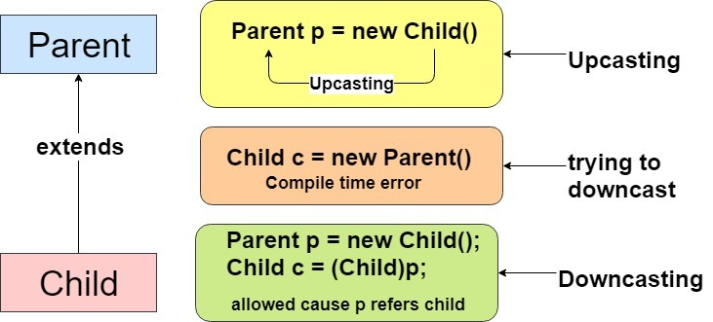
Upcasting vs. Downcasting
It is always possible to cast an instance of a subclass to a variable of a superclass (known as upcasting), because an instance of a subclass is always an instance of its superclass.

Slide 56
Upcasting vs. Downcasting
When casting an instance of a superclass to a variable of its subclass (known as downcasting), explicit casting must be used to confirm your intention to the compiler with the (SubclassName) cast notation.

Slide 57
Casting from Superclass to Subclass
Explicit casting must be used when casting an object from a superclass to a subclass. This type of casting may not always succeed.
57

Slide 58
Casting from Superclass to Subclass
For the casting to be successful, you must make sure that the object to be cast is an instance of the subclass.
If the superclass object is not an instance of the subclass, a runtime ClassCastException occurs.
For example, if an object is not an instance of Student, it cannot be cast into a variable of Student.
It is a good practice, therefore, to ensure that the object is an instance of another object before attempting a casting.
This can be accomplished using the instanceof operator.
58

Slide 59
The instanceof Operator
Use the instanceof operator to test whether an object is an instance of a class:
Object myObject = new Circle();
... // Some lines of code
/** Perform casting if myObject is an instance of Circle */
if (myObject instanceof Circle) {
System.out.println("The circle diameter is " +
((Circle)myObject).getDiameter());
...
}
The variable myObject is declared as Object. The declared type decides which method to match at compile time.
Using myObject.getDiameter() would cause a compile error, because the Object class does not have the getDiameter method. The compiler cannot find a match for myObject.getDiameter().
Therefore, it is necessary to cast myObject into the Circle type to tell the compiler that myObject is also an instance of Circle.
59

Slide 60
public class Staff {
……..
public void addHours ( int hour)
{ ((Hourly)staffList[3]).addHours (hour); }
//---------------------------------------------------------
public void addBouns ( double bonus)
{ ((Executive)staffList[0]).awardBonus (bouns); }
……
}
We don’t know that staffList[3] is an Hour object , Or
staffList[0] is an Executive object…
So, what do we do?
Use the instanceof operator

Slide 61
The instanceof Operator
Use the instanceof operator to test whether an object is an instance of a class:
public void addHours ( int hour)
{
/** Perform casting if s is an instance of Hourly*/
for(StaffMember s: staffList)
if (s instanceof Hourly)
((Hourly)s).addHours (hour);
}
//---------------------------------------------------------
public void addBouns ( double bonus)
{ for(int i=0; i< staffList.length; ++i)
if (staffList[i] instanceof Executive)
((Executive)staffList[i]).awardBonus (bouns);
}
61

Slide 62
Example: Demonstrating Polymorphism and Casting
The program creates two objects: a circle, and a rectangle, then invokes the displayObject method to display the objects. The displayObject displays the diameter if the object is a circle and displays the area if the object is a rectangle.
CastingDemo
Run
62

Slide 63
public class CastingDemo {
public static void main(String[] args) {
// Create and initialize two objects
Object object1 = new Circle (1);
Object object2 = new Rectangle (1, 1);
// Display circle and rectangle
displayObject(object1);
displayObject(object2);
}
/** A method for displaying an object */
public static void displayObject(Object object) {
if (object instanceof Circle) {
System.out.println("The circle diameter is " +
((Circle)object).getDiameter());
}
else if (object instanceof Rectangle) {
System.out.println("The rectangle area is " + ((Rectangle)object).getArea());
}
}
}
63

Slide 64
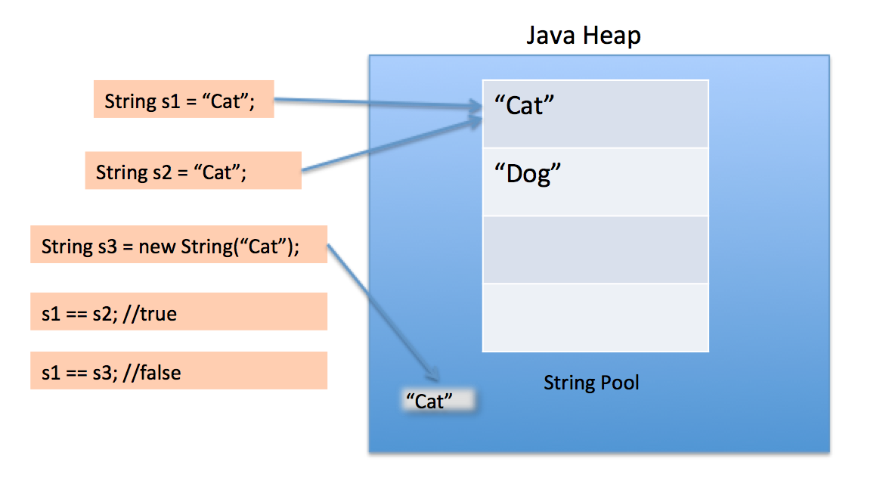

Slide 65
Equality
Consider these two assignments: Thing thing1 = new Thing(); Thing thing2 = new Thing();
Are these two “Things” equal?
That’s up to the programmer!
Consider: Thing thing3 = new Thing(); Thing thing4 = thing3;
Are these two “Things” equal?
Yes, because they are the same Thing!

Slide 66
== operand
int x=9;
int y=9;
if (x==y)
Primitives can always be tested for equality with ==
66

Slide 67
== operand
Integer x = new Integer (9); or String x = new String(“abc”);
Integer y = new Integer (9); or String y = new String(“abc”);
if(x==y) ➔ No
9
X
9
Y
For objects, == tests whether the two are the same object.
Two Integers or Strings may or may not be == !
67

Slide 68
== operand
Integer x = new Integer (9); or String x =new String(“abc”);
Integer y = 9; or String y =“abc”;
if(x==y) ➔ No
For objects, == tests whether the two are the same object
Two Integers or Strings may or may not be == !
abc
X
String pool
abc
cba
Y
68

Slide 69
== operand
Integer x = 9 or String x =“abc”;
Integer y = 9; or String y =“abc”;
if(x==y) ➔ Yes
For objects, == tests whether the two are the same object
Two Integers or Strings may or may not be == !
abc
X
String pool
abc
cba
Y
69

Slide 70
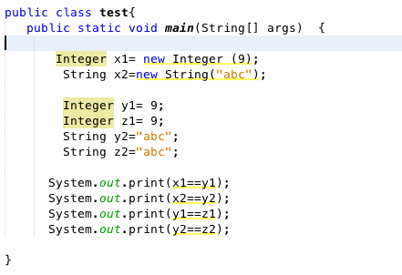
Notes:
False false true true

Slide 71
false
false
true
true
Notes:
False false true true

Slide 72
The equals method
Objects can be tested with the method public boolean equals(Object o) in Object Class.
Obj1.equals(Obj2);
What does it do?
The default implementation of the equals method in the Object class is as follows:
public boolean equals(Object obj) {
return this == obj;
}
This implementation checks whether two reference variables point to the same object using the == operator.
72

Slide 73
The equals method
The equals() method compares the contents of two objects.
You should override this method in your custom class to test whether two distinct objects have the same content.
The equals method is overridden in many classes in the Java API, such as java.lang.String and java.util.Date, to compare whether the contents of two objects are equal.
73

Slide 74
The equal method
Obj1 and Obj2 are Strings,
Obj1.equals(Obj2);
What does it do?
It is overridden in the class String
Obj1 and Obj2 are arrays,
Obj1.equals(Obj2);
What does it do?
It is not overridden for arrays; == tests if its operands are the same array.
74

Slide 75
Morals
Never use == to test equality of Strings or arrays or other objects.
Use equals for Strings, java.util.Arrays.equals(a1, a2) for arrays.
If you test your own objects for equality, override equals.
For example, the equals method is overridden in the Circle class.
public boolean equals(Object o) {
if (o instanceof Circle) {
return radius == ((Circle)o).radius;
}
else
return false;
}
75

Slide 76
public class Test {
public static void main(String[] args) {
Object circle1 = new Circle();
Object circle2 = new Circle(); System.out.println(circle1.equals(circle2));
}
}
class Circle {
double radius;
public boolean equals(Circle circle)
{ return this.radius == circle.radius; }
}
(b) class Circle {
double radius;
public boolean equals(Object o)
{ return this.radius == ((Circle)o).radius; }
}
public boolean equals(Object obj) {
return this == obj;
}

Slide 77
public class Test { public static void main(String[] args) {
Object circle1 = new Circle();
Object circle2 = new Circle(); System.out.println(circle1.equals(circle2)); }
}
class Circle {
double radius;
public boolean equals(Circle circle)
{ return this.radius == circle.radius; }
}
(b) class Circle {
double radius;
public boolean equals(Object o)
{ return this.radius == ((Circle)o).radius; }
}
public boolean equals(Object obj) {
return this == obj;
}
Overload
Override

Slide 78
The output is false if the Circle class in (a) is used.
The Circle class has two overloaded methods: equals(Circle circle) defined in the Circle class and equals(Object o) defined in the Object class, inherited by the Circle class. At compile time, circle1.equals(circle2) is matched to equals(Object o), because the declared type for circle1 and circle2 is Object. (Note that either the declared type for circle1 and circle2 is Object would cause circle1.equals(circle2) to match circle1.equals(Object circle) by the compiler.
In (a), method equals(Object o) is used at both compile time and run time. circle1 and circle2 have different addresses, leading to "false" output. Method overriding follows dynamic binding (determined by the actual type), but method overloading is always determined by the declared type.
The output is true if the Circle class in (b) is used.
The Circle class overrides the equals(Object o) method defined in the Object class. At compile time, circle1.equals(circle2) is matched to equals(Object o) and at runtime the equals(Object o) method implemented in the Circle class is invoked.

Slide 79
NOTE
== | equals
is used for comparing two primitive data type values or for determining whether two objects have the same references. | is intended to test whether two objects have the same contents, provided that the method is modified in the defining class of the objects.
The == operator is stronger than the equals method, in that the == operator checks whether the two reference variables refer to the same object.
79

Slide 80
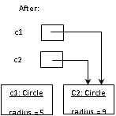
Aliases
aliases
Two or more references that refer to the same object are called aliases of each other.
One object can be accessed using multiple reference variables (C1 and C2).
© 2004 Pearson Addison-Wesley. All rights reserved
3-80

Slide 81
Aliases
Aliases can be useful but should be managed carefully.
Changing an object through one reference changes it for all of its aliases, because there is really only one object. (this doesn’t work for Strings)
© 2004 Pearson Addison-Wesley. All rights reserved
3-81

Slide 82
What do you do if you want to save 100 student’s records?
Student[] array = new Students[100];
You can create an array to store objects. But the array’s size is fixed once the array is created.
What if the number of students increases?
copy the array to bigger one
What if you don’t know the size?
ArrayList class;

Slide 83
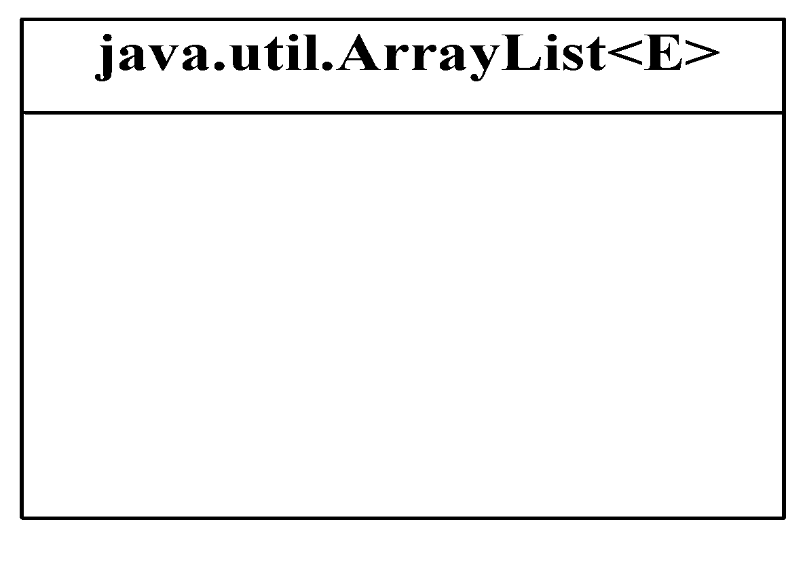
The ArrayList Class
Java provides the ArrayList class that can be used to store an unlimited number of objects.
Creating and adding contents:
+ArrayList()
+add(o: E) : void
+add(index: int, o: E) : void
+set(index: int, o: E) : E
Creates an empty list.
Appends a new element o at the end of this list.
Adds a new element o at the specified index in this list.
Sets the element at the specified index. Return and remove the current one.
83

Slide 84
Differences and Similarities between Arrays and ArrayList
Operation | Array | ArrayList
Creating an array/ArrayList | String[] a = new String[10] | ArrayList<String> list = new ArrayList<>();
Adding a new element | a[size-1] = “London”; | list.add("London");
Inserting a new element | Needs shifting procedures a[index] = "London"; | list.add(index, "London");
Updating an element | a[index] = "London"; | list.set(index, "London");
84

Slide 85
The ArrayList Class
Removing contents and checking status:
+clear(): void
+remove(o: Object): boolean
+remove(index: int): boolean
+contains(o: Object): boolean
+isEmpty(): boolean
+size(): int
Removes all the elements from this list.
Removes the element o from this list.
Removes the element at the specified index.
Returns true if this list contains the element o.
Returns true if this list contains no elements.
Returns the number of elements in this list.
Operation | Array | ArrayList
Removing an element | Needs shifting procedures | list.remove(index);
Removing an element |  | list.remove(Object);
Removing all elements | a = null; | list.clear();
Returning size | a.length | list.size();
85

Slide 86
The ArrayList Class
a
Searching for contents:
+get(index: int): E
+indexOf(o: Object): int
+lastIndexOf(o: Object): int
Returns the element from this list at the specified index.
Returns the index of the first matching element in this list.
Returns the index of the last matching element in this list.
Operation | Array | ArrayList
Accessing an element | a[index] | list.get(index);
86

Slide 87
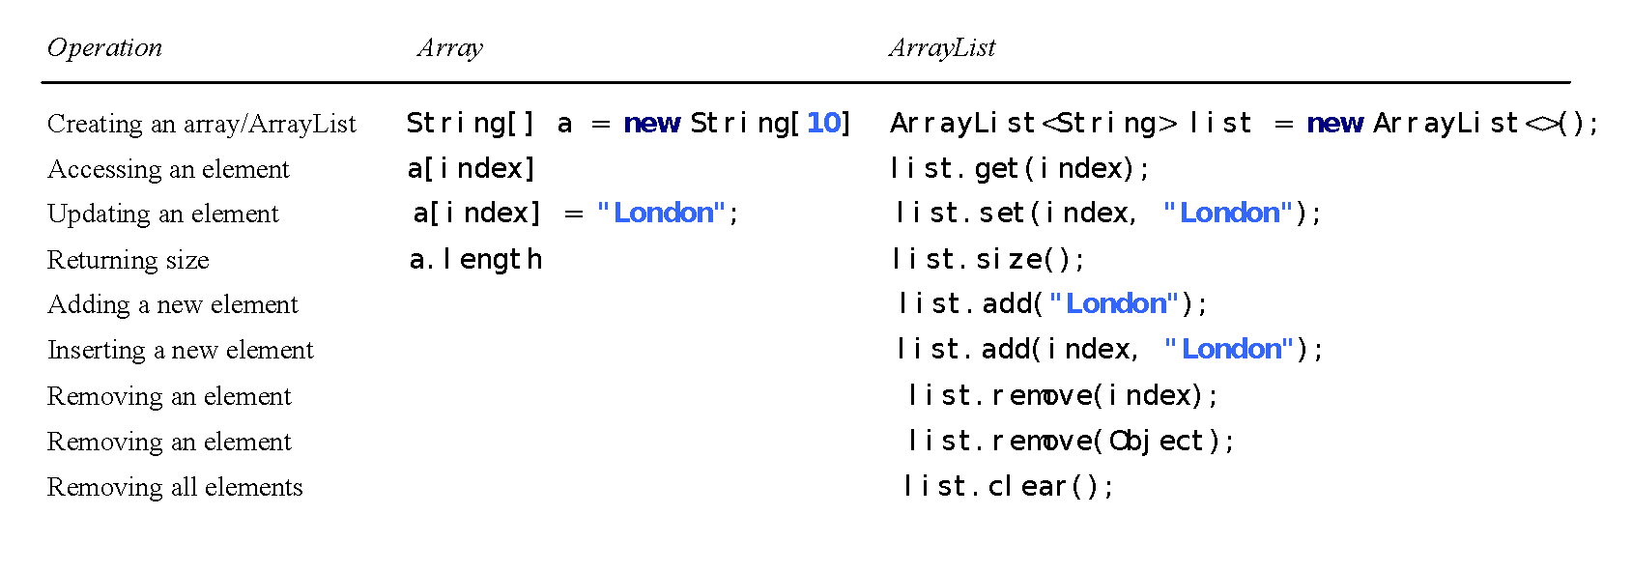
Differences and Similarities between Arrays and ArrayList
DistinctNumbers
Run
87

Slide 88
Array Vs. ArrayList
String [] s = new String [10];
s[0]=“One”; s[1]=“two”; ….
This is a specific kind of array with particular size.
ArrayList s = new ArrayList ();
ArrayList <E> s = new ArrayList<E> ();
s.add(“One”); s.add(“two”); ….
Use generic ArrayList.
<E> is called generic type. You can replace it with concrete object type
88

Slide 89
Create ArrayList
ArrayList s = new ArrayList ();
ArrayList <E> s = new ArrayList<E> ();
s.add(“One”); s.add(“two”); ….
Use generic ArrayList.
<E> is called generic type. You can replace it with concrete object type.
ArrayList is known as a generic class with a generic type E. You can specify a concrete type to replace E when creating an ArrayList.
89

Slide 90
Generic Type
You can specify a concrete type to replace E when creating an ArrayList.
For example,
This ArrayList object can be used to store strings.
ArrayList<String> cities = new ArrayList<String>();
ArrayList<String> cities = new ArrayList<>();
TestArrayList
Run
90

Slide 91
ArrayList s = new ArrayList();
s.add(“one”);
String n = s.get(0);
ERROR → Requires Casting
ArrayList s = new ArrayList();
s.add(“one”);
String n = (String) s.get(0);
SOLUTION → Explicit Casting
ArrayList <Sting> s = new ArrayList<String>();
s.add(“one”);
String n = s.get(0);
SOLUTION → Concrete Type
91

Slide 92
public class TestArrayList
{
public static void main(String[] args)
{
// Create a list to store cities
ArrayList<String> cityList = new ArrayList<>();
// Add some cities in the list
cityList.add("London");
// cityList now contains [London]
cityList.add("Denver");
// cityList now contains [London, Denver]
cityList.add("Paris");
// cityList now contains [London, Denver, Paris]
cityList.add("Miami");
// cityList now contains [London, Denver, Paris, Miami]
cityList.add("Seoul");
// contains [London, Denver, Paris, Miami, Seoul]
cityList.add("Tokyo");
// contains [London, Denver, Paris, Miami, Seoul, Tokyo]
92

Slide 93
System.out.println("List size? " + cityList.size());
System.out.println("Is Miami in the list? " + cityList.contains("Miami"));
System.out.println("The location of Denver in the list? " +
cityList.indexOf("Denver"));
System.out.println("Is the list empty? " + cityList.isEmpty());
// Print false
// Insert a new city at index 2
cityList.add(2, "Xian");
// contains [London, Denver, Xian, Paris, Miami, Seoul, Tokyo]
// set a city at index 3
cityList.set(3, "Jeddah");
// contains [London, Denver, Xian, Jeddah, Miami, Seoul, Tokyo]
// Remove a city from the list
cityList.remove("Miami");
// contains [London, Denver, Xian, Jeddah, Seoul, Tokyo]
// Remove a city at index 1
cityList.remove(1);
// contains [London, Xian, Jeddah, Seoul, Tokyo]
// Display the contents in the list
System.out.println(cityList.toString());
93

Slide 94
// Display the contents in the list in reverse order
for (int i = cityList.size() - 1; i >= 0; i--)
System.out.print(cityList.get(i) + " ");
System.out.println();
// Create a list to store two circles
java.util.ArrayList<Circle> list = new java.util.ArrayList<>();
// Add two circles
list.add(new Circle (2));
list.add(new Circle(3));
// Display the area of the first circle in the list
System.out.println("The area of the circle? " + list.get(0).getArea());
}
}
94

Slide 95
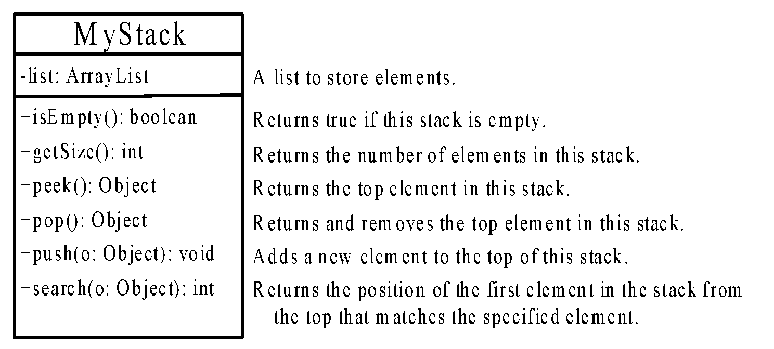
The MyStack Classes
MyStack
Implement each Method
95

Slide 96
import java.util.ArrayList;
public class MyStack
{
private ArrayList<Object> list = new ArrayList<>();
public boolean isEmpty()
{ return list.isEmpty(); }
public int getSize()
{ return list.size(); }
public Object peek()
{ return list.get(getSize() - 1); }
public Object pop()
{
Object o = list.get(getSize() - 1);
list.remove(getSize() - 1);
return o;
}
public void push(Object o)
{ list.add(o); }
@Override /** Override the toString in the Object class */
public String toString()
{ return "stack: " + list.toString(); }
}
96

Slide 97
Array Lists from/to Arrays
We can convert primitive type to objects using Wrapper classes. Can we convert ArrayList to array and vice versa?
YES
Using the Static method “asList” in the Arrays Class, we can convert an array to an ArrayList.
String[] array = {"red", "green", "blue"};
ArrayList<String> list = new ArrayList<>(Arrays.asList(array));
97

Slide 98
Array Lists from/to Arrays
We can convert primitive type to objects using Wrapper classes. Can we convert ArrayList to array and vice versa?
YES
Using the method “toArray” in the ArrayList, we can convert an ArrayList to an array.
String[] array1 = new String[list.size()];
list.toArray(array1);
98

Slide 99
If you want to sort, find max/min, or shuffle an array, what do you do?
Use an Algorithm that needs many statements and looping.
Are there other easier solutions?
Yes. Use the static methods “sort”, “max”, “min” and “Shuffle” in the java.util.Collections class, but the objects in the ArrayList must be comparable (Wrappers and Strings) objects to perform the tasks.
99

Slide 100
sort,max,min and shuffle in an Array List
Integer[] array ={5,8,2,9,4};
ArrayList<Integer> list = new ArrayList<>(Arrays.asList(array));
Collections.sort(list);
System.out.println(list);
System.out.println(Collections.max(list));
System.out.println(Collections.min(list));
Collections.shuffle(list);
System.out.println(list);
[2, 4, 5, 8, 9]
9
2
[4, 5, 9, 2, 8]
100

