Slide 1


Slide 2


IoT-Based Anti-Theft Floor Mat with Email Alerts
A project proposal from the Department of Electrical Engineering, University of Engineering and Technology, Peshawar.
University of Engineering & Technology Peshawar Jalozai Campus

Slide 3

Project Team & Supervision
Supervisor:
Engr. Abid Ullah
abidullah@uetpeshawar.edu.pk
Submitted By:
Aqeel Khan (22JZELE0461)
Mashal Ahmad (22JZELE0466)
Mobeen Dawood Khan (22JZELE0493)
University of Engineering & Technology Peshawar Jalozai Campus

Slide 4

Addressing a Critical Need
The increasing demand for smart security systems highlights a gap in the market. Traditional security solutions often fall short due to high costs, complex installations, or a lack of immediate remote notification capabilities.
Conventional Systems
Our Solution
Costly CCTV setups
Low-cost & efficient
Complex infrared alarms
Portable design
Limited portability
Instant Gmail alerts
Lack of instant alerts
Easy installation
University of Engineering & Technology Peshawar Jalozai Campus

Slide 5

Project Objectives
This project aims to develop a cost-effective, portable, and efficient anti-theft solution.
01
Design & Develop
Create an anti-theft floor mat utilizing a Piezoelectric vibration sensor.
02
Interface & Communicate
Integrate Arduino and NodeMCU (ESP8266) for signal processing and wireless communication.
03
Real-time Alerts
Implement IFTTT webhooks to send instant Gmail alerts upon vibration or pressure detection.
04
Evaluate Performance
Assess system accuracy and response time for effective intrusion detection.
University of Engineering & Technology Peshawar Jalozai Campus

Slide 6

System Overview: How It Works
The system uses a piezoelectric sensor to detect mechanical stress, triggering an alert via a Wi-Fi-connected NodeMCU.
Detect Vibration
Process Signal
Send Alert
Notify via IFTTT
This seamless integration ensures immediate notification of potential security breaches.
University of Engineering & Technology Peshawar Jalozai Campus

Slide 7
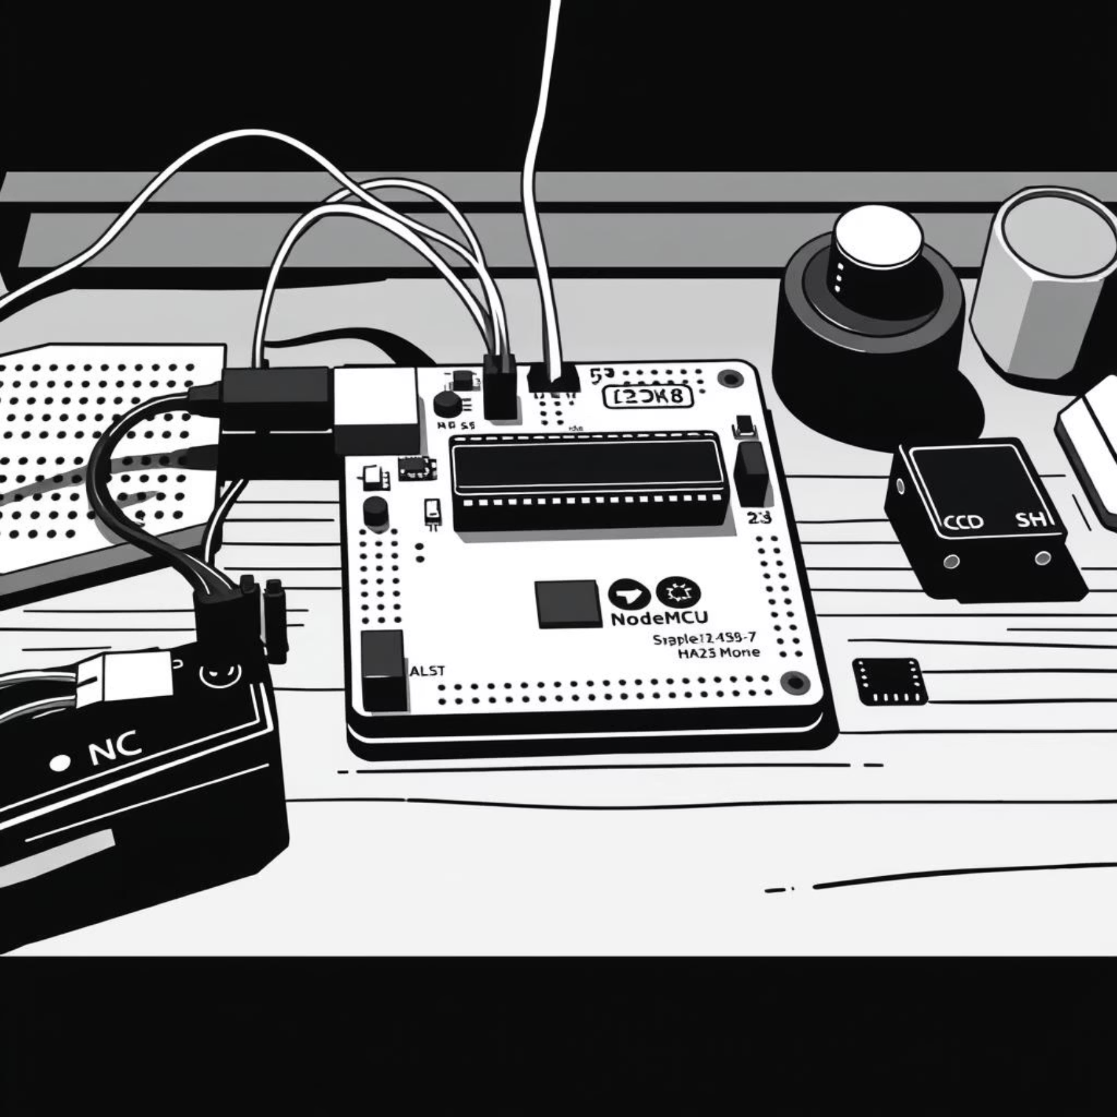
Hardware & Software Essentials
Hardware Requirements
Software Requirements
Component
Description
Arduino IDE (for coding)
IFTTT Account (for Gmail alerts)
Arduino UNO / Nano
Reads analog signal from Piezo sensor
Wi-Fi Connection
NodeMCU (ESP8266)
Wi-Fi connectivity, sends alerts
Gmail Account (for receiving alerts)
Piezoelectric Sensor
Detects vibration/mechanical stress
10kΩ Resistor
Voltage divider circuit
Breadboard & Wires
Circuit connections
Power Supply
Powers Arduino & NodeMCU
University of Engineering & Technology Peshawar Jalozai Campus

Slide 8
Working Principle in Detail
Vibration Detection
Piezo sensor under the mat detects vibrations from footsteps or tampering.
Signal Generation
Sensor generates analog voltage proportional to vibration intensity.
Threshold Check
Arduino reads and checks if sensor value exceeds a defined threshold.
Message Transmission
If triggered, Arduino sends an "ALERT" message to NodeMCU via serial communication.
Webhook Activation
Wi-Fi-connected NodeMCU sends a web request to IFTTT, which executes the Gmail service.
Email Notification
An email like "Alert! Vibration detected on floor mat — possible intrusion." is sent.
University of Engineering & Technology Peshawar Jalozai Campus

Slide 9


Expected Outcomes & Versatile Applications
Expected Results
Key Applications
Successful vibration detection by Piezo sensor.
Home and office entry monitoring.
Gmail alert within 5–10 seconds of detection.
Securing valuable items or safes.
Minimal false triggers post-calibration.
Detecting intrusion in restricted areas.
Development of a low-cost, portable anti-theft system.
Portable security for exhibitions or shops.
University of Engineering & Technology Peshawar Jalozai Campus

Slide 10
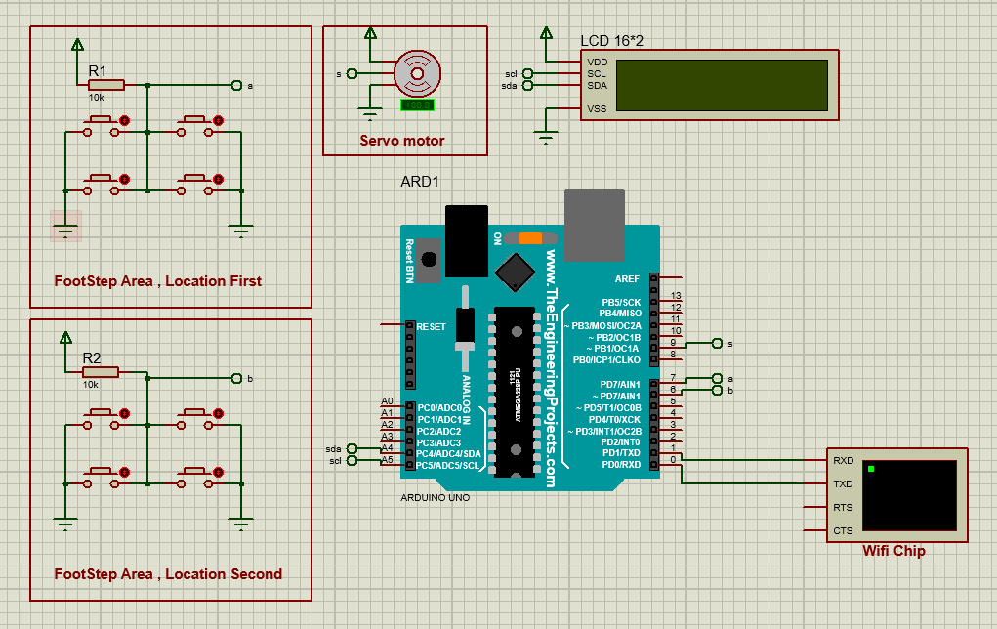
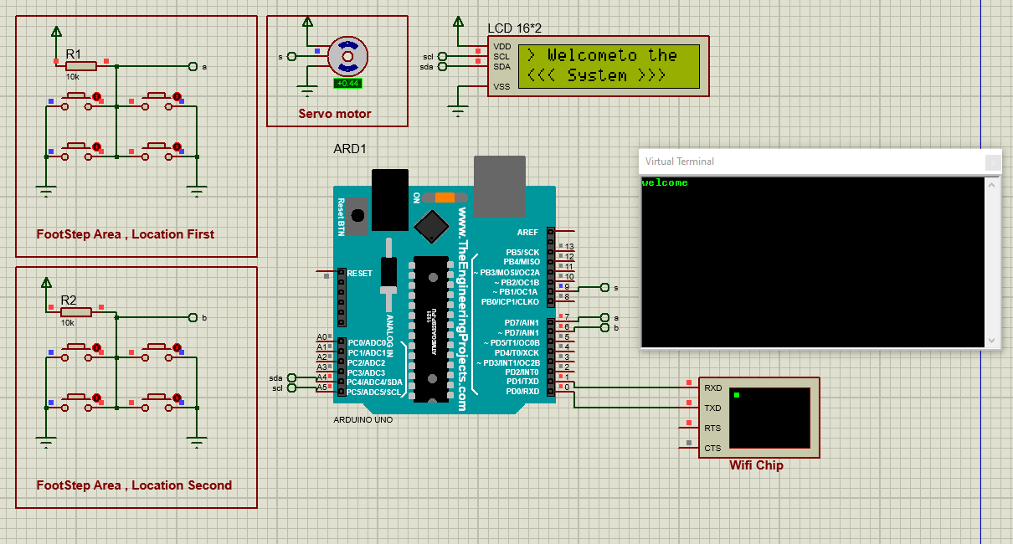
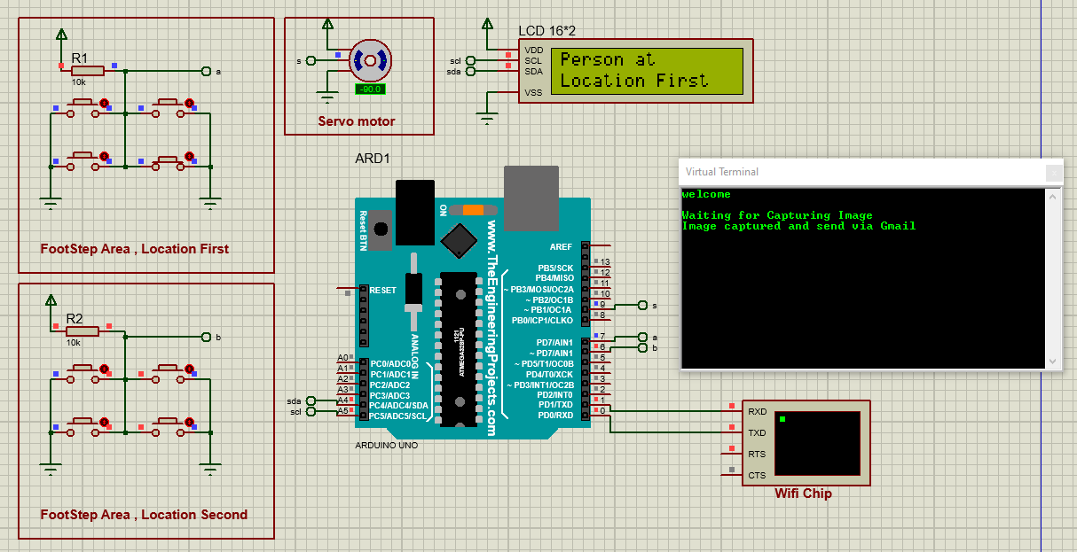
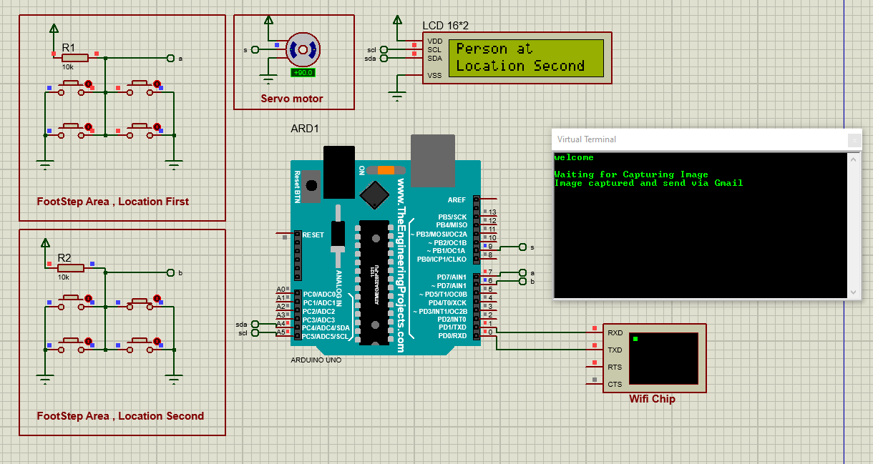
Simulations
When The System Activated
When the piezo detect someone on location 1st location
When the piezo detect someone on location 2nd location
University of Engineering & Technology Peshawar Jalozai Campus

Slide 11

Advantages & Future Expansion
Cost-Effective
Wireless Alerts
Low-cost, easy-to-build IoT security system.
Instant notifications directly to Gmail.
Quick Response
Scalable
Highly sensitive detection with fast alert times.
Customizable for various security needs.
Future Enhancements
Integrate Blynk or Telegram for mobile notifications.
Add local buzzer and LED indicators.
Use multiple piezo sensors for wider coverage.
Store intrusion logs in Google Sheets.
Include a camera module for intruder image capture.
University of Engineering & Technology Peshawar Jalozai Campus

Slide 12

Conclusion: A New Era of Anti-Theft Security
This project successfully demonstrates a low-cost, IoT-based anti-theft system. By effectively combining a Piezoelectric vibration sensor, Arduino, and NodeMCU, we provide an innovative and practical solution for theft prevention.
"Our system detects vibration events and sends instant Gmail alerts, offering enhanced security for residential and commercial environments."
University of Engineering & Technology Peshawar Jalozai Campus

Slide 13

University of Engineering & Technology Peshawar Jalozai Campus

