Slide 1


Slide 2
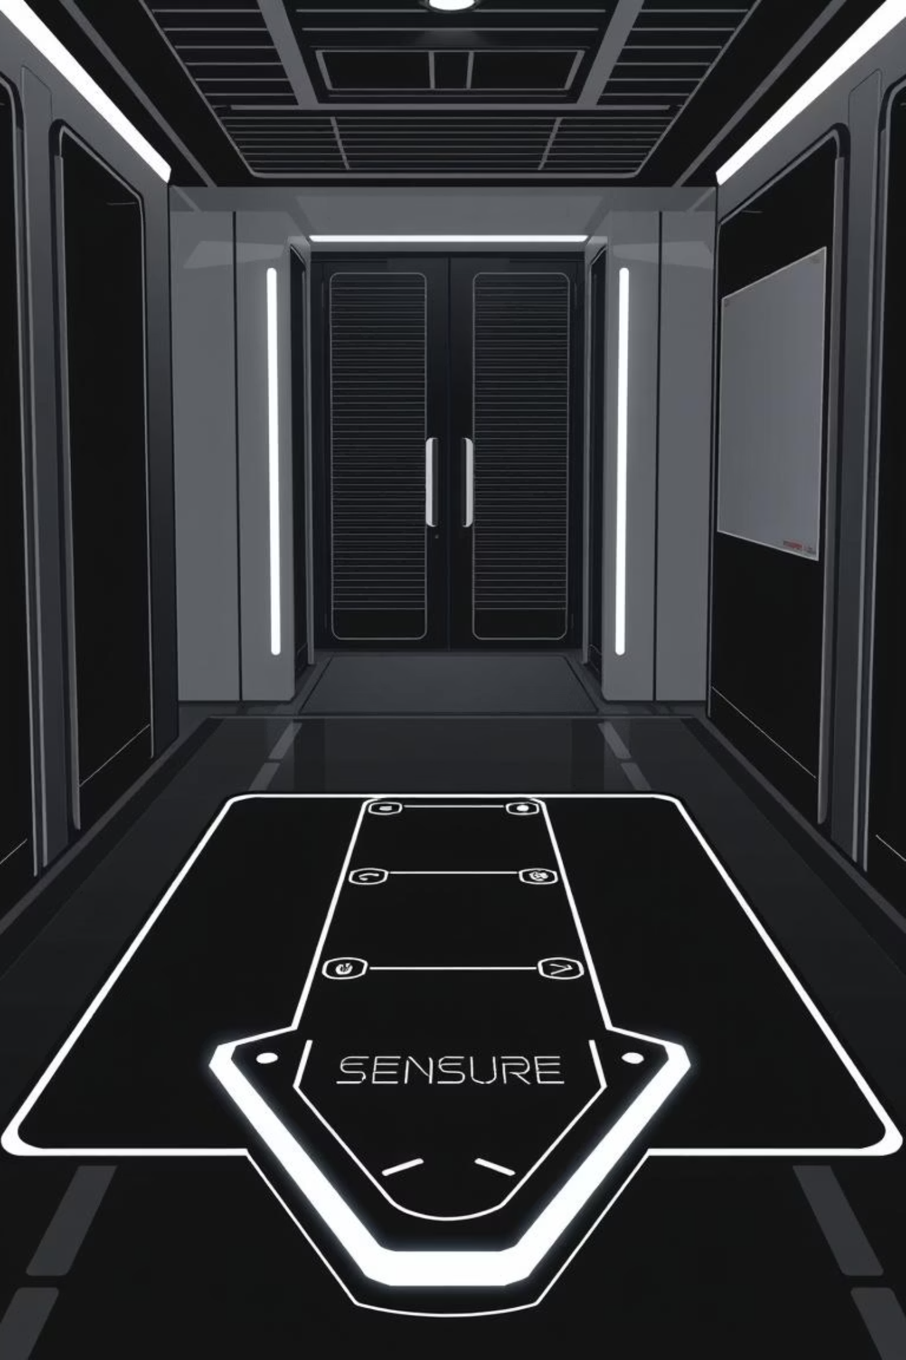

IoT-Based Anti-Theft Floor Mat with Email Alerts
Final presentation
University of Engineering & Technology Peshawar Nowshehra Campus

Slide 3

Project Team & Supervision
Supervisor:
Engr. Abid Ullah
abidullah@uetpeshawar.edu.pk
Submitted By:
Aqeel Khan (22JZELE0461)
Mashal Ahmad (22JZELE0466)
Mobeen Dawood Khan (22JZELE0493)
University of Engineering & Technology Peshawar Nowshehra Campus

Slide 4

Project Objectives
This project aims to develop a cost-effective, portable, and efficient anti-theft solution.
01
Design And Develop
Create an anti-theft floor mat utilizing a Piezoelectric vibration sensor.
02
Interface And Communicate
Integrate Arduino and NodeMCU (ESP8266) for signal processing and wireless communication.
03
Real-time Alerts
Integrate pycharm for object detection and face recognition
04
Real-time Alerts
Implement IFTTT webhooks to send instant Gmail alerts upon vibration or pressure detection
University of Engineering & Technology Peshawar Nowshehra Campus

Slide 5
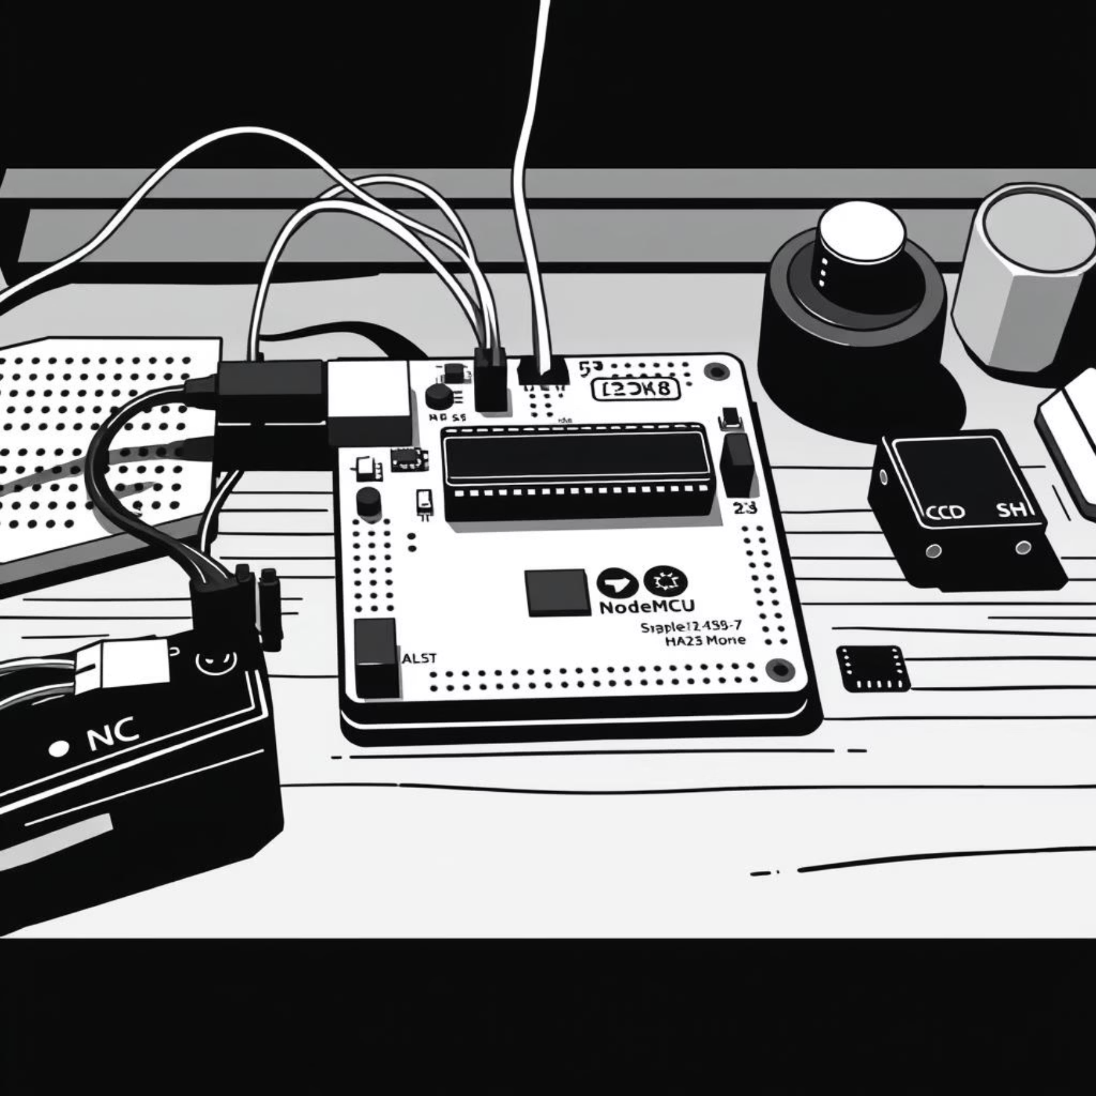
Hardware & Software Essentials
Hardware Requirements
Software Requirements
Arduino IDE (for coding)
Component
Description
IFTTT Account (for Gmail alerts)
Arduino UNO / Nano
Reads analog signal from Piezo sensor
Wi-Fi Connection
Gmail Account (for receiving alerts)
NodeMCU (ESP8266)
Wi-Fi connectivity, sends alerts
OpenCV + Face recognition
Piezoelectric Sensor
Detects vibration/mechanical stress
10kΩ Resistor
Voltage divider circuit
Breadboard & Wires
Circuit connections
Power Supply
Powers Arduino & NodeMCU
University of Engineering & Technology Peshawar Nowshehra Campus

Slide 6
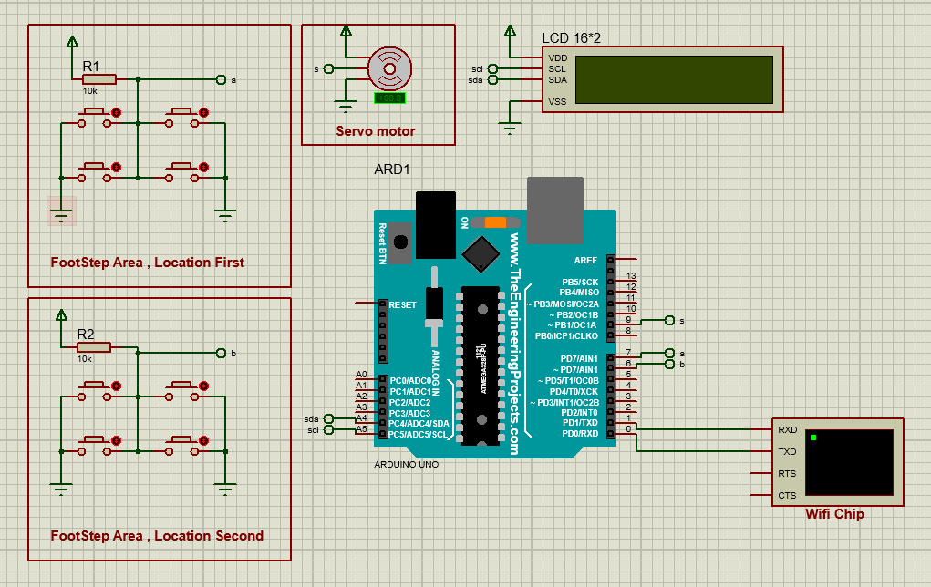
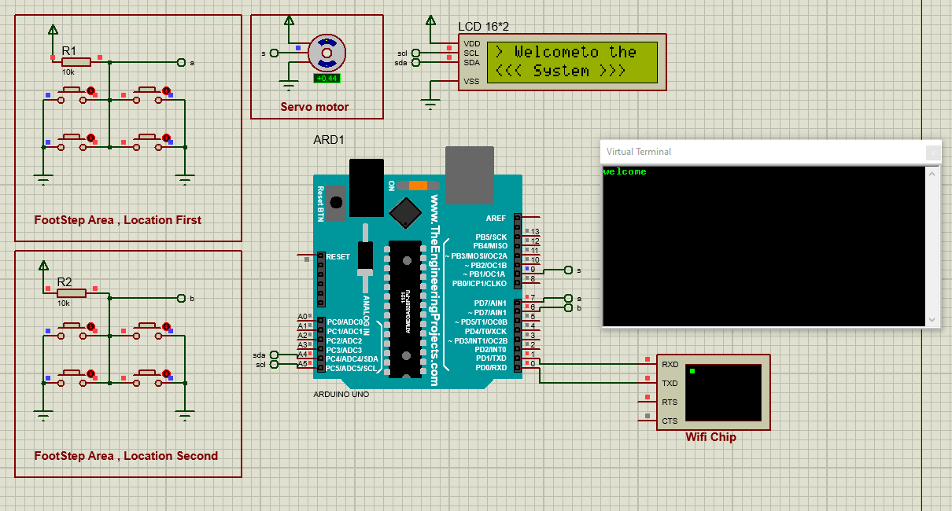
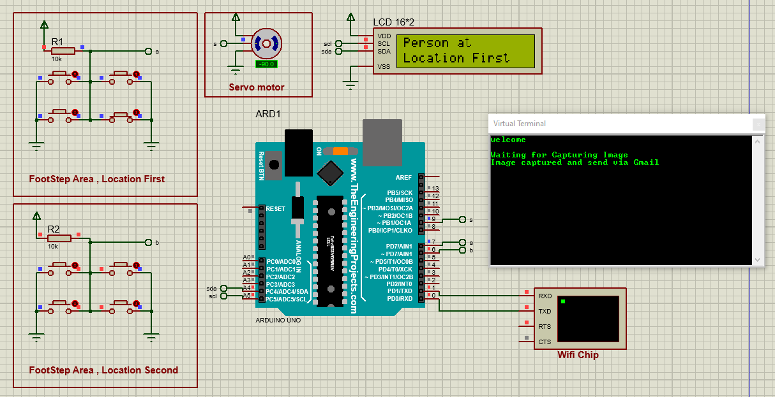
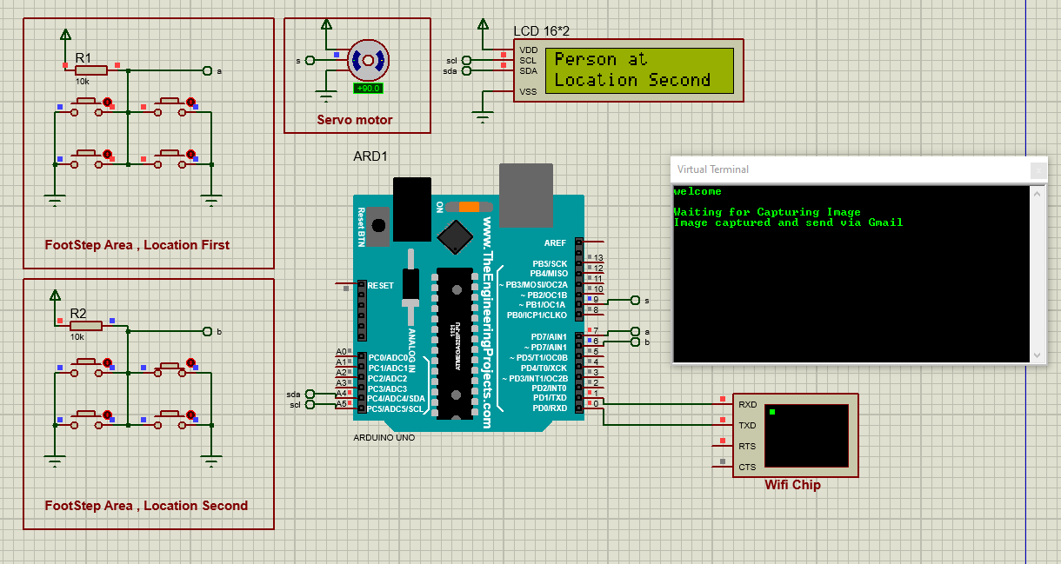
Simulations
When The System Activated
When the piezo detect someone on location 1st location
When the piezo detect someone on location 2nd location
University of Engineering & Technology Peshawar Nowshehra Campus

Slide 7
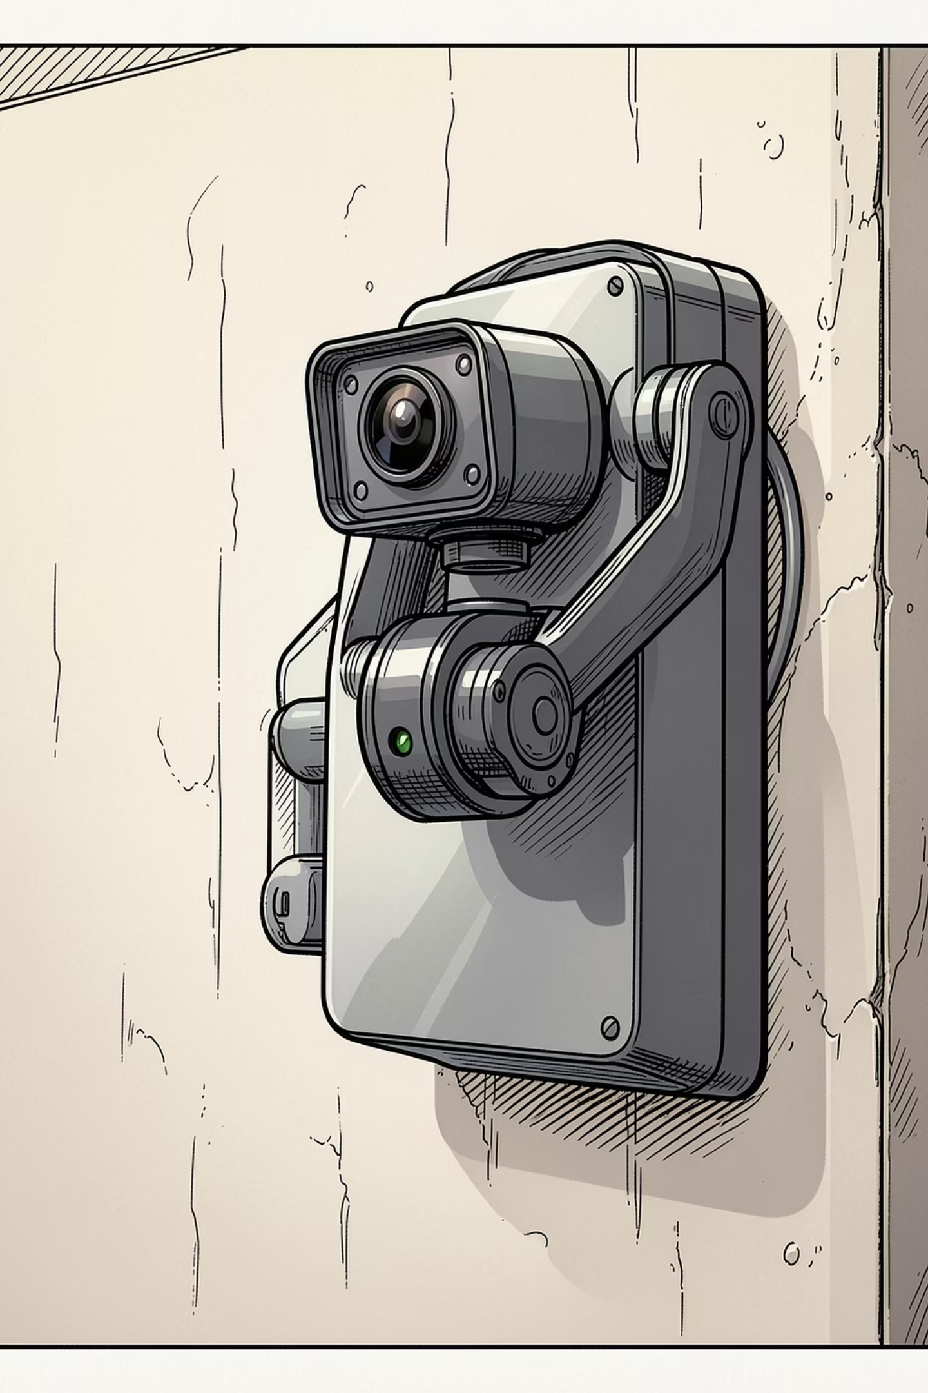
The Sentinel: Autonomous Face Recognition Security
A compact, responsive system that fuses piezoelectric triggers, Arduino Nano actuation, and Python/OpenCV face recognition to detect, track, and validate visitors — then respond automatically.
University of Engineering & Technology Peshawar Nowshehra Campus

Slide 8
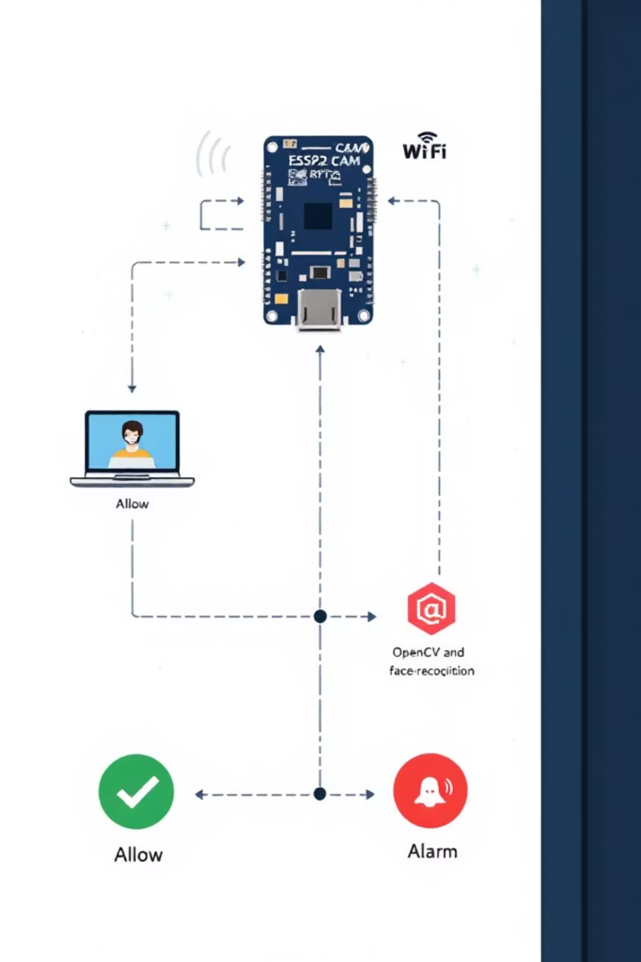
System Architecture Overview
Flow at a glance:
USB Webcam-CAM: captures and streams video (MJPEG/RTSP or HTTP frames)
Network transport: local Wi‑Fi, optional port forwarding for remote access
Laptop (PyCharm): receives stream, decodes frames with OpenCV
face_recognition: encodes faces, compares against stored encodings
Decision: known → continue monitoring; unknown → raise alarm (notification, sound, record)
University of Engineering & Technology Peshawar Jalozai Campus

Slide 9
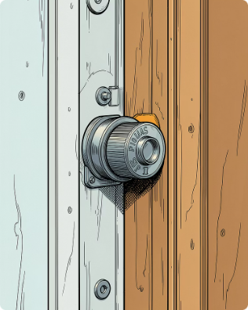
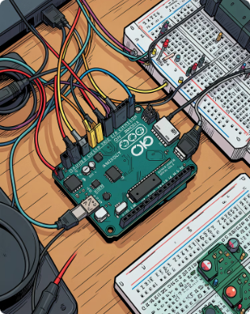
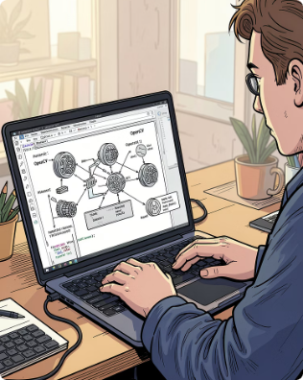
The Concept: Bridging Physical and Digital Worlds
Trigger: Sensor
Response: Actuation
Intelligence: Recognition
Piezoelectric sensor senses vibration or pressure at floor and sends an interrupt to the Arduino Nano.
Arduino Nano processes the sensor event and drives a motorized gimbal to orient the webcam toward the source.
Python (PyCharm) runs OpenCV + face_recognition to capture frames, extract encodings, and validate identities against a local database.
University of Engineering & Technology Peshawar Nowshehra Campus

Slide 10
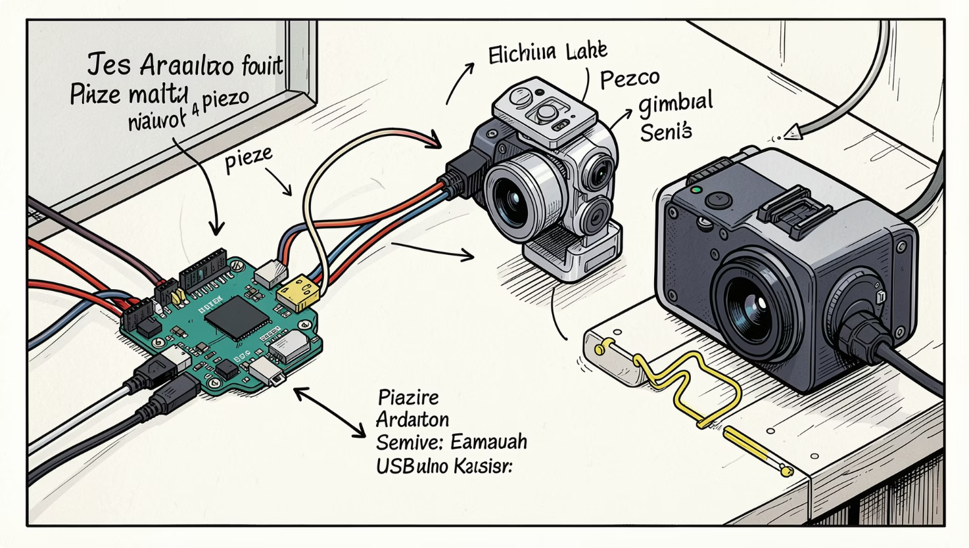
Hardware Architecture
Input
Control
Piezoelectric sensor (edge-mounted) generates analog pulses on impact or sustained pressure.
Arduino Nano reads analog threshold, debounces the signal, and issues servo PWM commands via libraries like Servo.h.
Vision
Power & Wiring
USB webcam mounted on a 2-axis gimbal provides HD frames (30–60 FPS) streamed to the Python host for immediate processing.
Separate regulated supplies for motors and logic; common ground and transient suppression for sensor lines.
University of Engineering & Technology Peshawar Nowshehra Campus

Slide 11
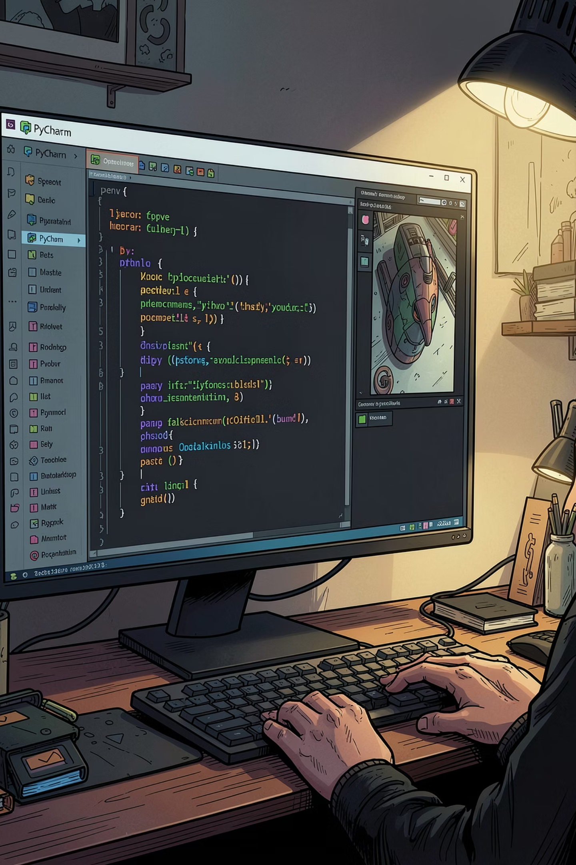

The Intelligence Pipeline
Sensor Trigger
Face Detection
Interrupt signals event
Detects faces and computes encodings
Camera Orient
Matching & Response
Arduino aims and captures frame
Compare encodings and emit verdict
From interrupt to decision: sensor event → Arduino aims camera → Python captures frames, detects faces (Haar/SSD), computes encodings (face_recognition) → compares against authorized encodings and emits a verdict in milliseconds.
University of Engineering & Technology Peshawar Nowshehra Campus

Slide 12

Authorized vs. Unauthorized Flow
01
Authorized
Match found: Log event (timestamp + image), send 'unlock' or 'track' command to Arduino, update local audit trail.
02
Unauthorized
No match: Capture multiple frames, escalate to alert protocols (visual, auditory, and remote notifications), and store images for review.
03
Logging
All events saved locally (SQLite or flat files) with hashed encoding references for privacy and tamper-evident timestamps.
University of Engineering & Technology Peshawar Nowshehra Campus

Slide 13

The Future of Automated Security
Scalability
Integration
Deploy multiple sentinels with coordinated tracking, centralized logs, and federated model updates to scale from single doorway to campus coverage.
Fuse additional sensors — PIR, ultrasonic, door contacts — and ML models (anti-spoofing, liveness detection) for robust authorization.
Goals
Create a responsive, privacy-aware system that minimizes false positives, accelerates response, and preserves auditability.
Next steps: Prototype wiring diagram, Arduino firmware sketch, Python proof-of-concept, integration test plan.
University of Engineering & Technology Peshawar Nowshehra Campus

Slide 14

University of Engineering & Technology Peshawar Jalozai Campus

