Slide 1


Slide 2
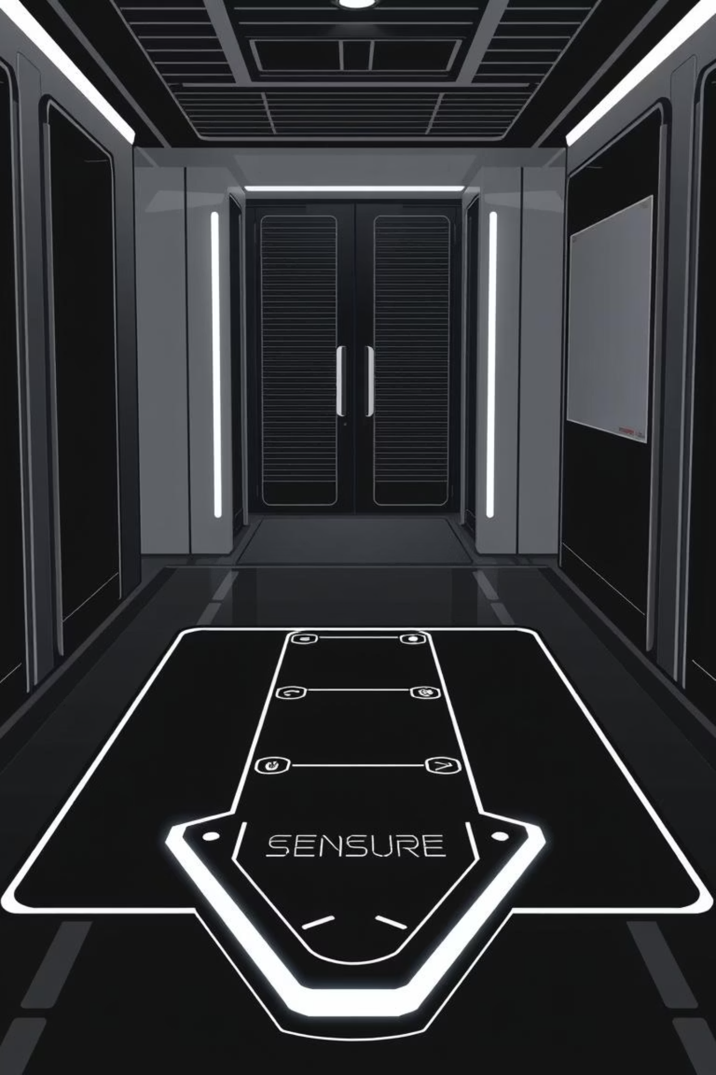

IoT-Based Anti-Theft Floor Mat with Email Alerts
Progress Presentation
University of Engineering & Technology Peshawar Jalozai Campus

Slide 3

Project Team & Supervision
Supervisor:
Engr. Abid Ullah
abidullah@uetpeshawar.edu.pk
Submitted By:
Aqeel Khan (22JZELE0461)
Mashal Ahmad (22JZELE0466)
Mobeen Dawood Khan (22JZELE0493)
University of Engineering & Technology Peshawar Jalozai Campus

Slide 4

Project Objectives
This project aims to develop a cost-effective, portable, and efficient anti-theft solution.
01
Design And Develop
Create an anti-theft floor mat utilizing a Piezoelectric vibration sensor.
02
Interface And Communicate
Integrate Arduino and NodeMCU (ESP8266) for signal processing and wireless communication.
03
Integrate OpenCV
Integrate openCV for object detection and face recognition
04
Real-time Alerts
Implement IFTTT webhooks to send instant Gmail alerts upon vibration or pressure detection
University of Engineering & Technology Peshawar Jalozai Campus

Slide 5
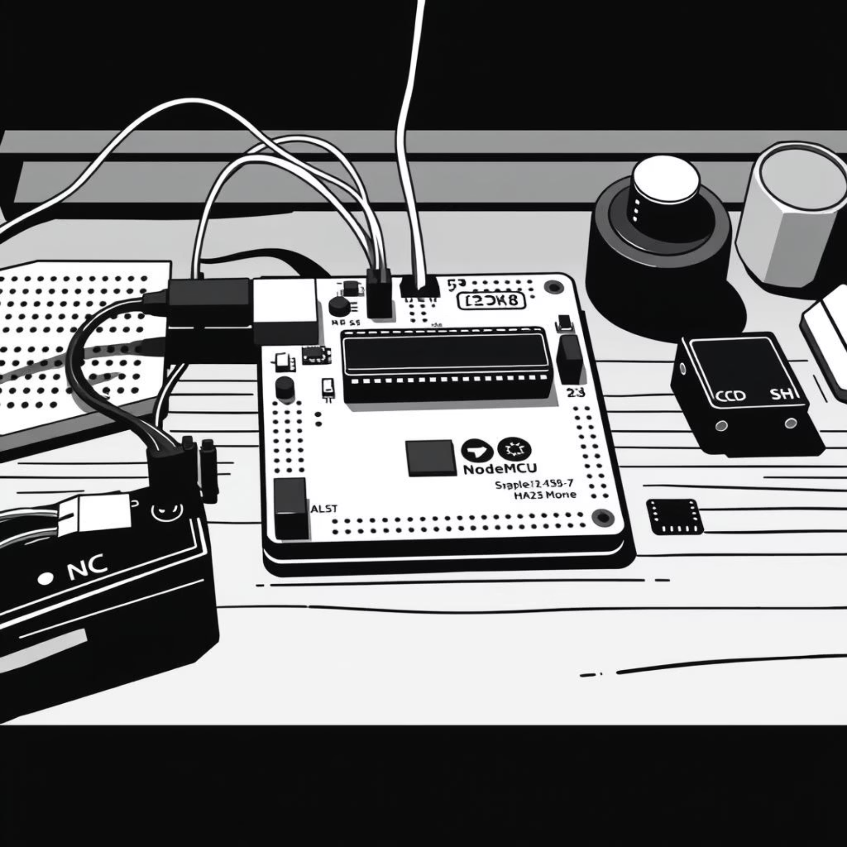
Hardware & Software Essentials
Hardware Requirements
Software Requirements
Arduino IDE (for coding)
Component
Description
IFTTT Account (for Gmail alerts)
Arduino UNO / Nano
Reads analog signal from Piezo sensor
Wi-Fi Connection
Gmail Account (for receiving alerts)
NodeMCU (ESP8266)
Wi-Fi connectivity, sends alerts
OpenCV + Face recognition
Piezoelectric Sensor
Detects vibration/mechanical stress
10kΩ Resistor
Voltage divider circuit
Breadboard & Wires
Circuit connections
Power Supply
Powers Arduino & NodeMCU
University of Engineering & Technology Peshawar Jalozai Campus

Slide 6
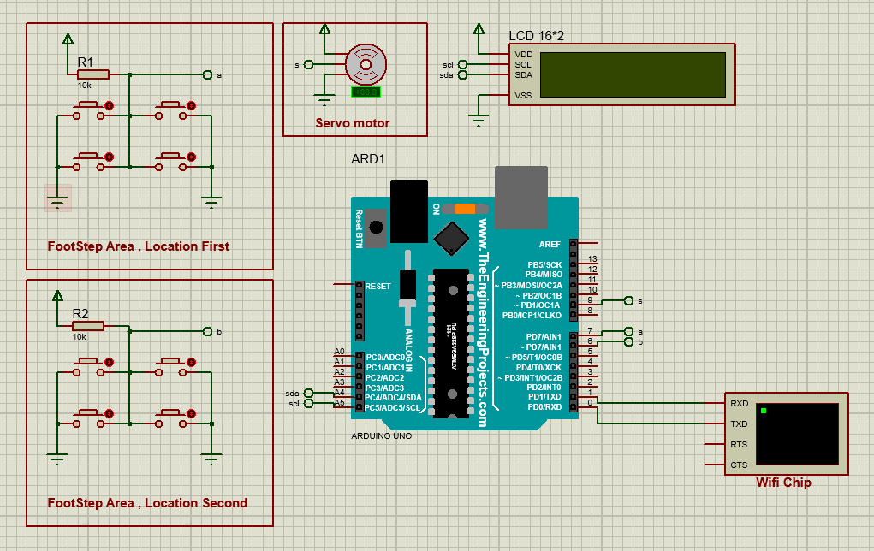
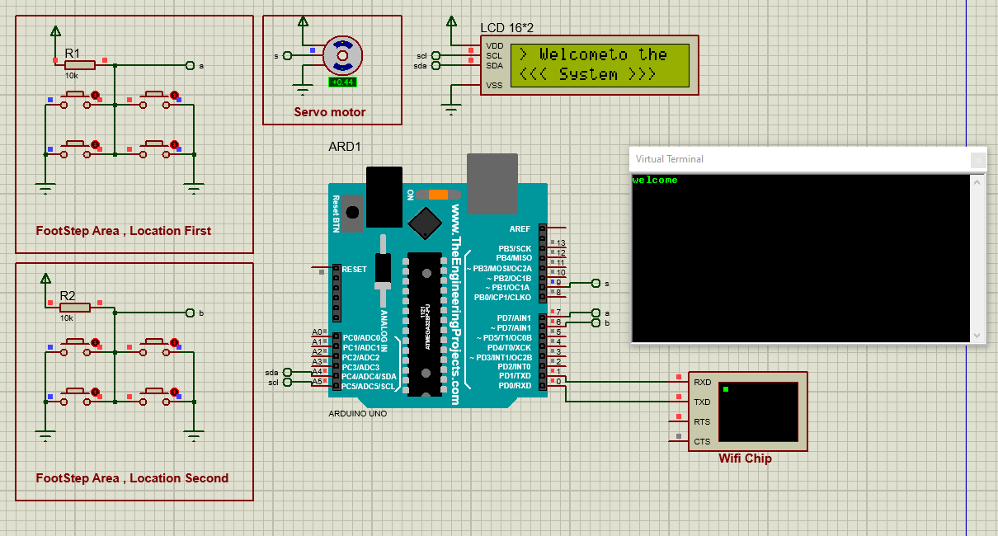
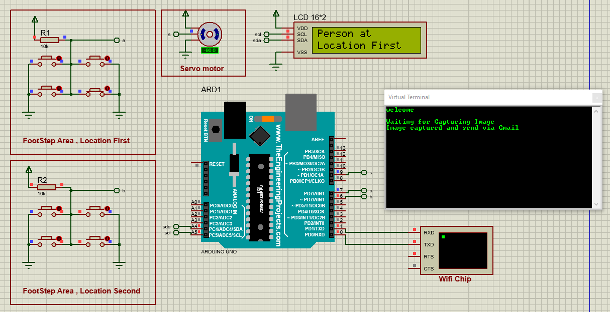
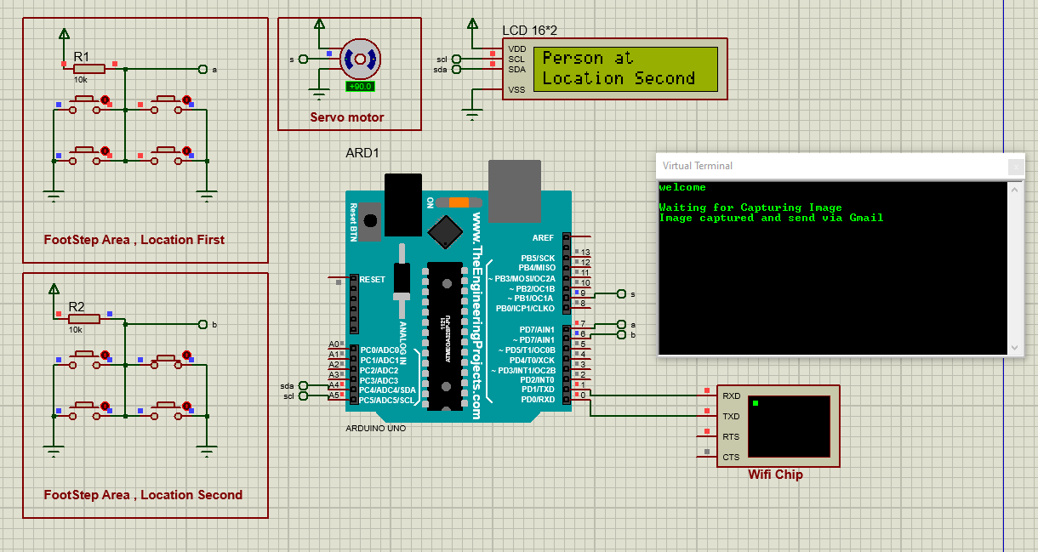
Simulations
When The System Activated
When the piezo detect someone on location 1st location
When the piezo detect someone on location 2nd location
University of Engineering & Technology Peshawar Jalozai Campus

Slide 7
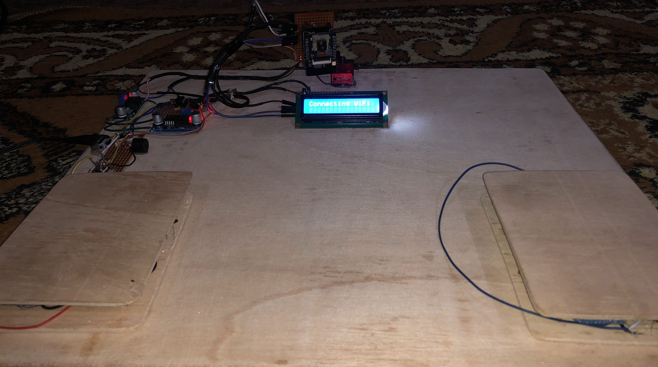
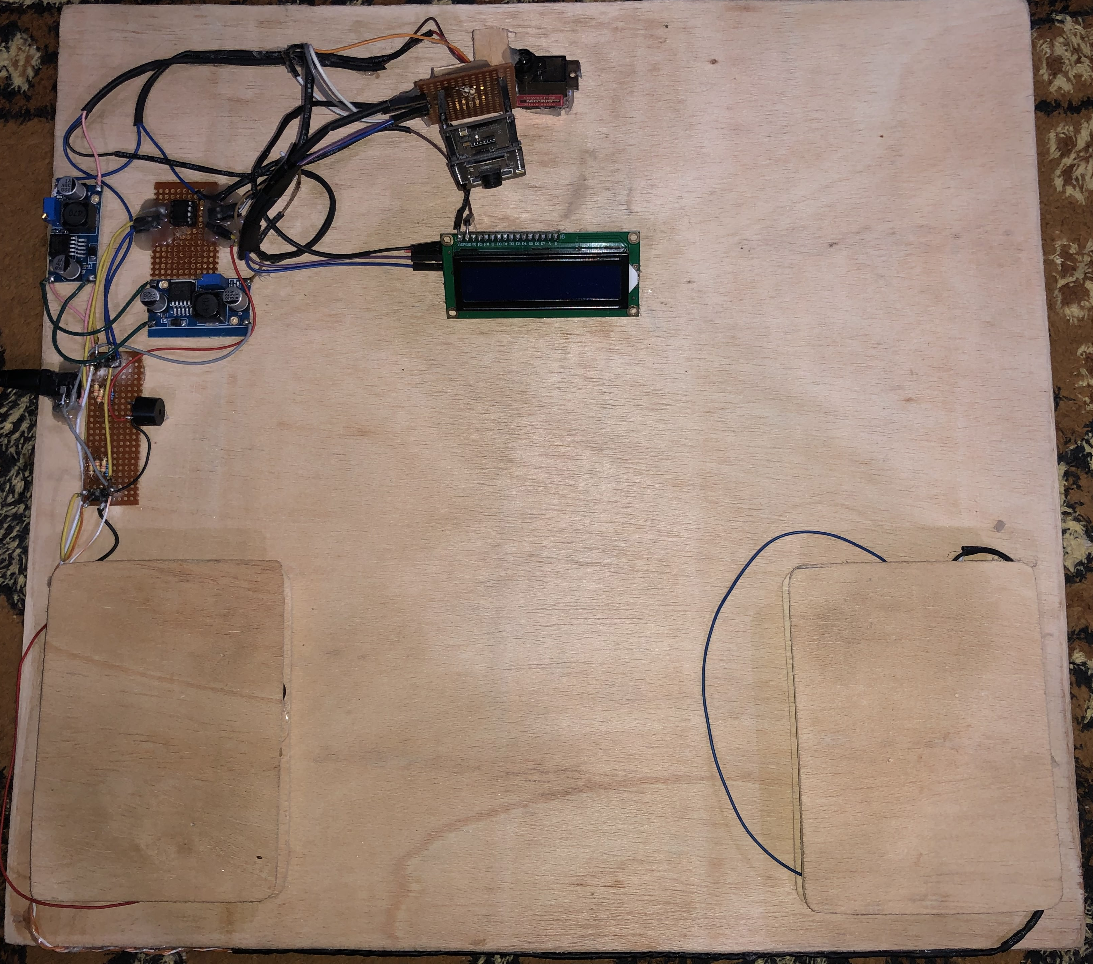
Hardware Implementation
University of Engineering & Technology Peshawar Jalozai Campus

Slide 8
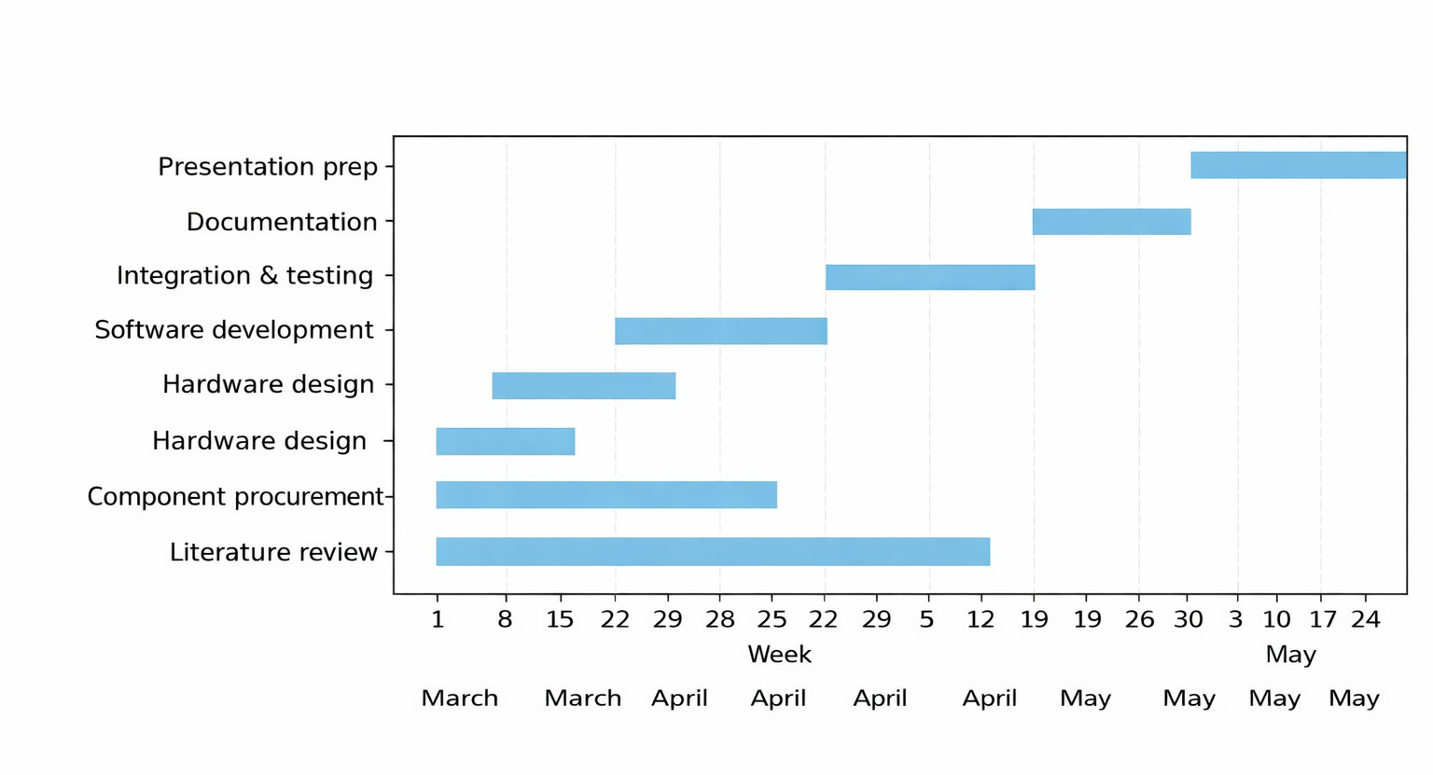
Week Schedule

Slide 9
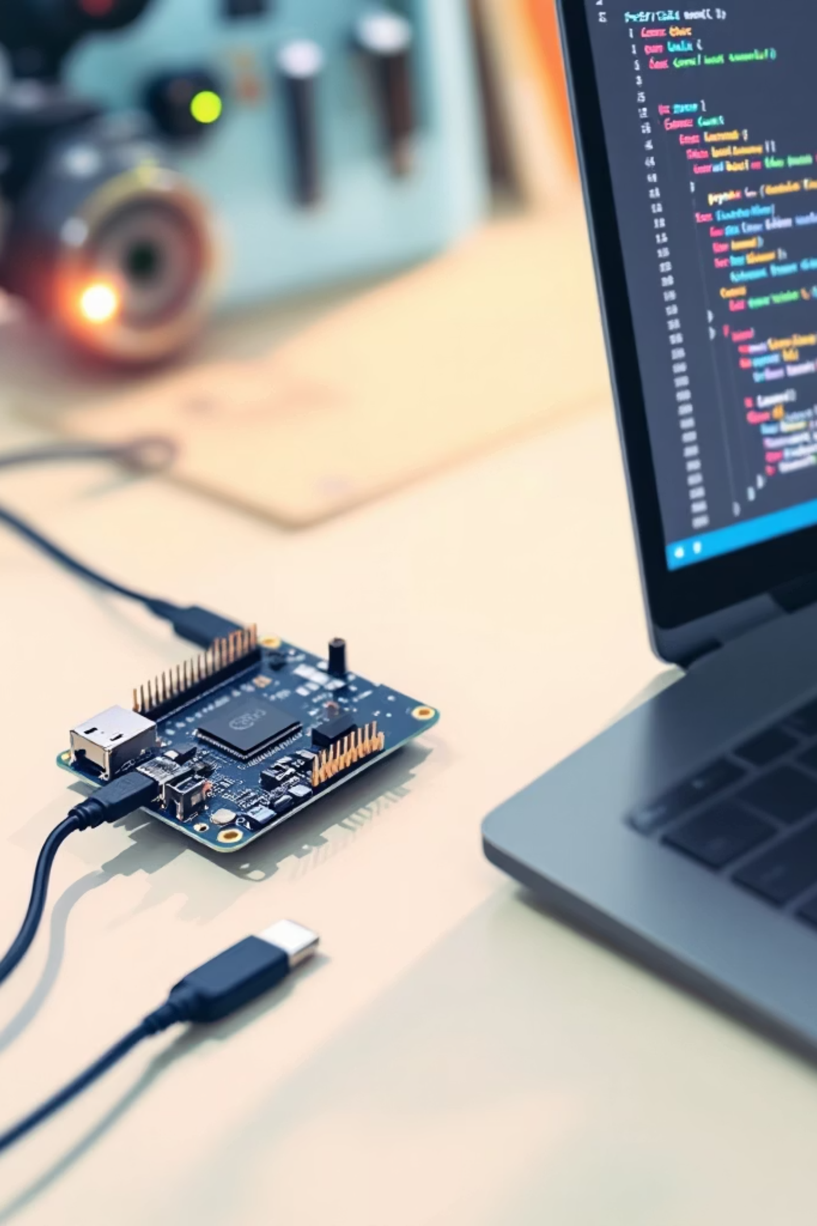
Remaining work
Real-time Face-Recognition Security with ESP32 + OpenCV
End-to-end plan: stream video from an ESP32 camera to a laptop (PyCharm), run OpenCV + face_recognition to match live faces against a stored whitelist, and trigger an alarm for unknown visitors — low-cost, real-time, developer-focused.
University of Engineering & Technology Peshawar Jalozai Campus

Slide 10
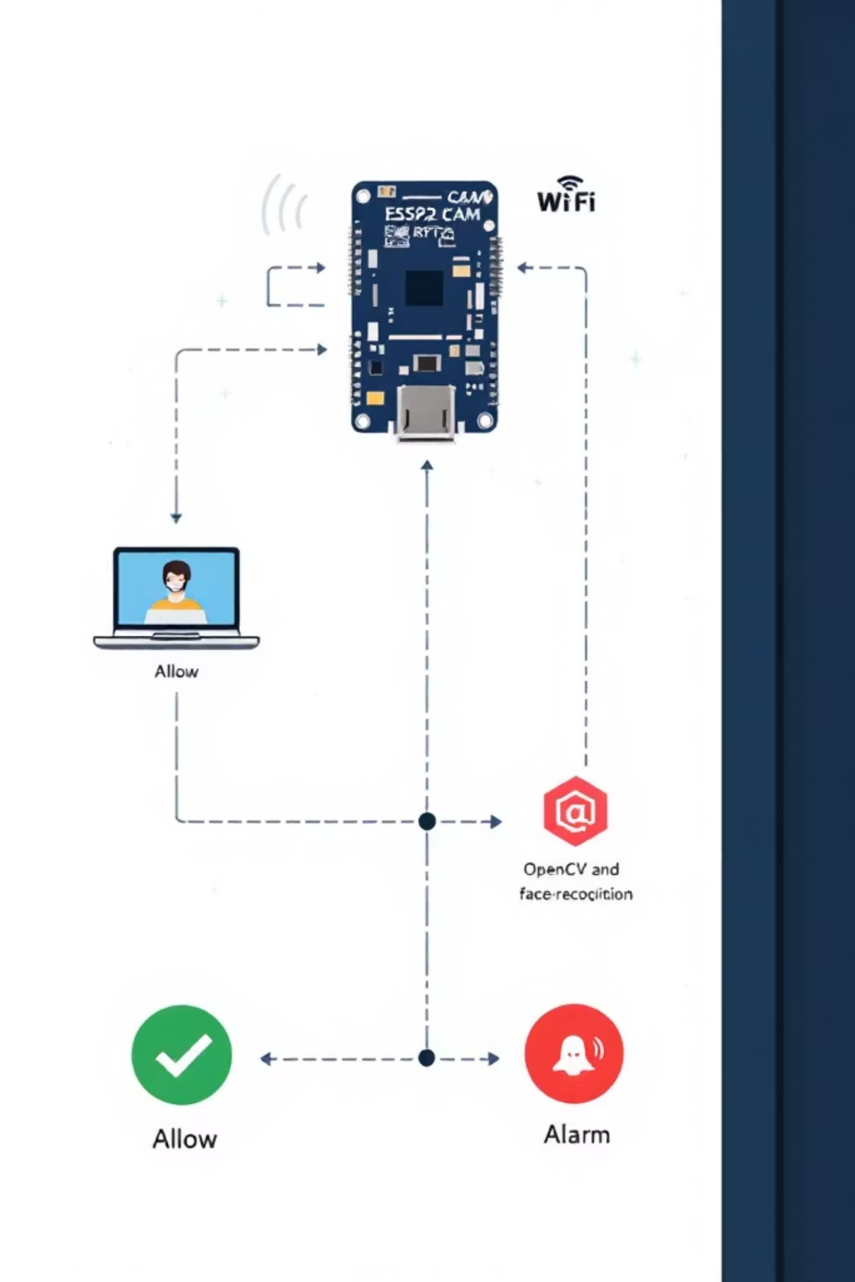
System Architecture Overview
Flow at a glance:
ESP32-CAM: captures and streams video (MJPEG/RTSP or HTTP frames)
Network transport: local Wi‑Fi, optional port forwarding for remote access
Laptop (PyCharm): receives stream, decodes frames with OpenCV
face_recognition: encodes faces, compares against stored encodings
Decision: known → continue monitoring; unknown → raise alarm (notification, sound, record)
University of Engineering & Technology Peshawar Jalozai Campus

Slide 11

Implementation Steps (Dev-Focused)
01
1. Stream from ESP32
Flash ESP32-CAM firmware (Arduino or ESP-IDF). Configure camera and stream endpoint (MJPEG or RTSP). Verify URL in browser or VLC.
02
2. Capture frames in Python
Use OpenCV: cv2.VideoCapture(stream_url). Read frames, handle reconnection/backoff.
03
3. Load known faces
Precompute face encodings: face_recognition.face_encodings for each reference image. Store encodings (pickle or JSON+base64) with metadata.
04
4. Real-time detection & match
Detect face locations, compute encodings, compare with known list using face_distance and a threshold. Debounce across N frames to reduce false positives.
05
5. Alarm & logging
On unknown match: trigger alarm (local speaker, push notification, webhook), save clip, and log timestamp + snapshot.
University of Engineering & Technology Peshawar Jalozai Campus

Slide 12

University of Engineering & Technology Peshawar Jalozai Campus

