Slide 1

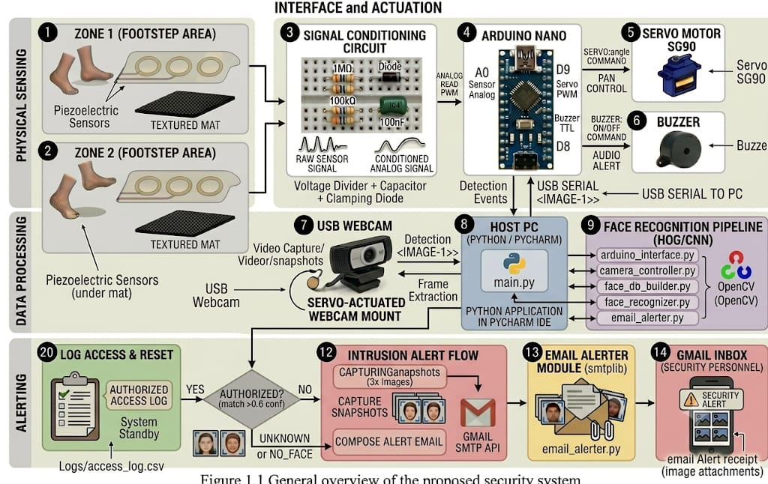
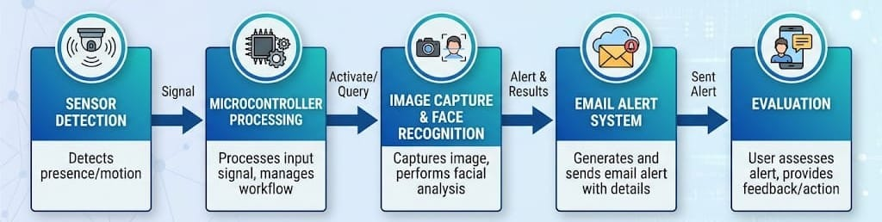
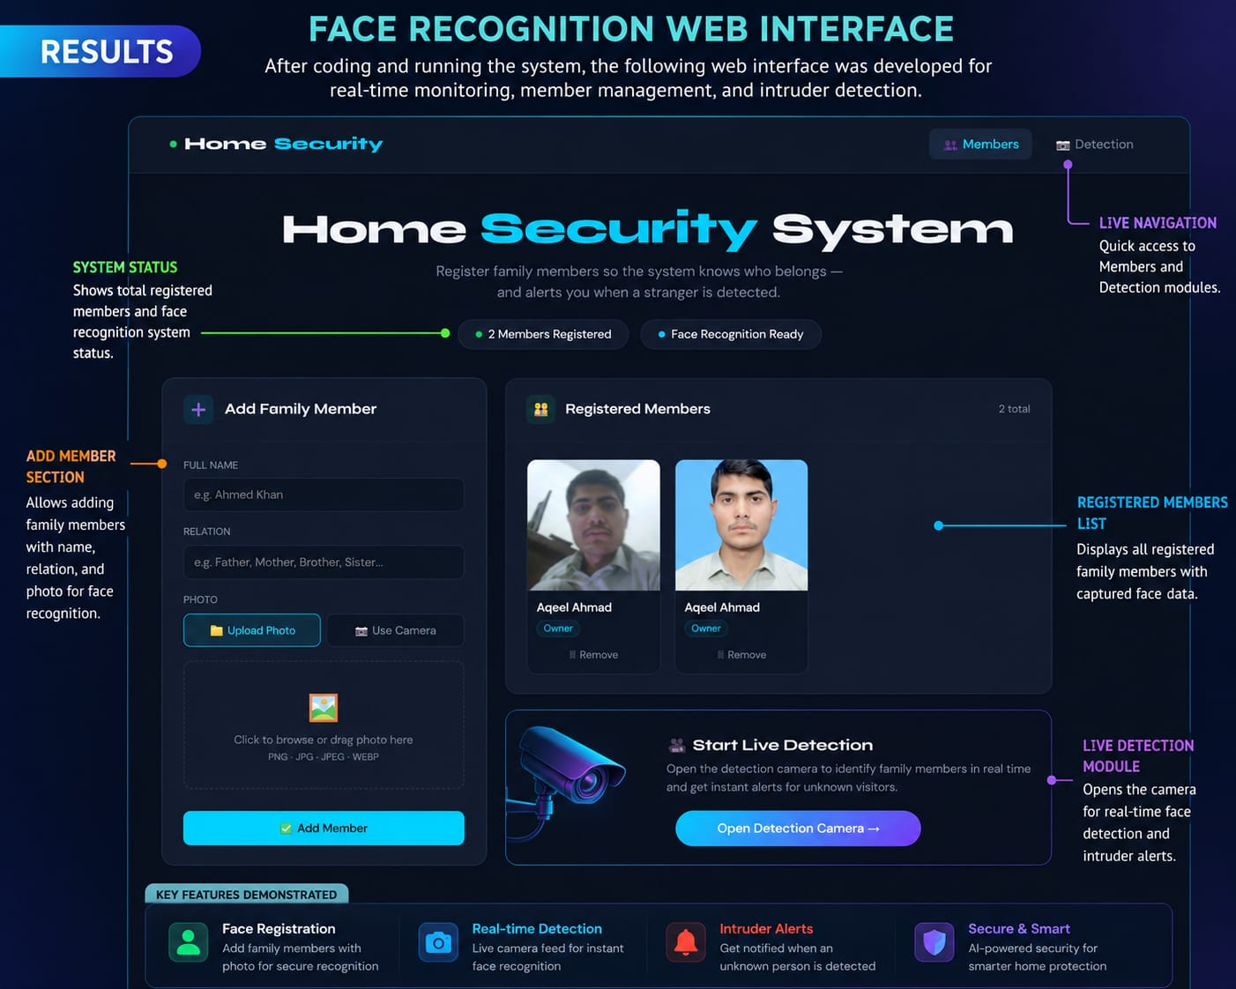
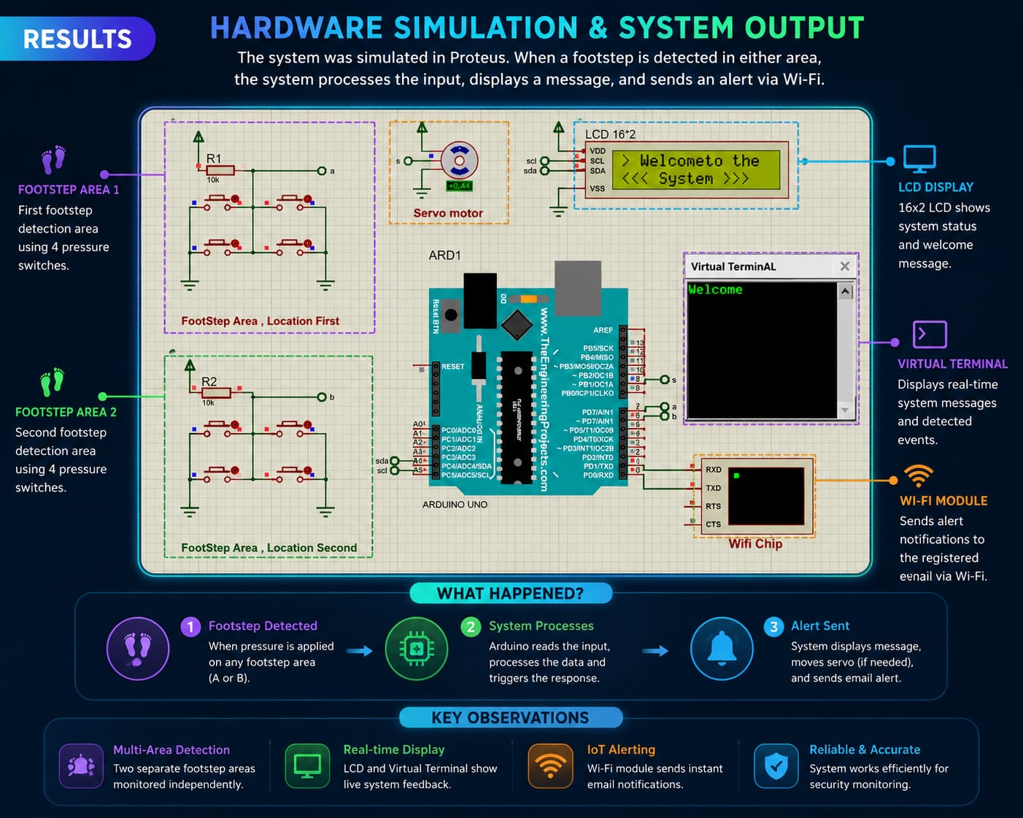
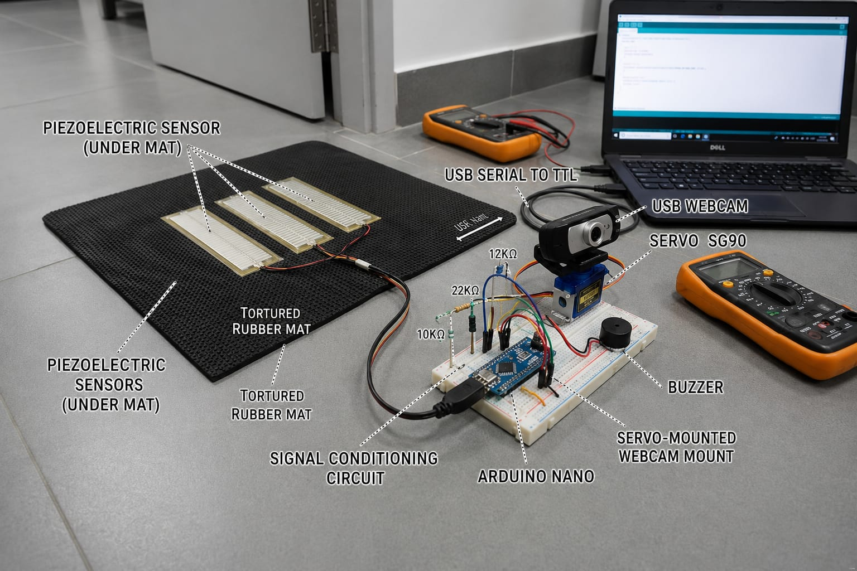
IoT-Based Anti-Theft Floor Mat with Face Recognition and Email Alert System
Members: Aqeel khan, Mashal Ahmad, Mobeen Dawood Khan
Supervisor: Dr. Abid Ullah
Department of Electrical Engineering
University of Engineering & Technology Peshawar, Jalozai Campus
SUMMARY & MOTIVATION:
Affordable security systems today either just record passively (CCTV) or sound a blind alarm (PIR sensors) — neither can tell an intruder from an authorized person, and PIR sensors falsely trigger from heat, sunlight, or HVAC airflow.
This project replaces the trigger and adds intelligence: a piezoelectric sensor hidden under a floor mat detects a footstep, an Arduino Nano reads it, a servo-mounted webcam turns and captures the person's face, and Python (OpenCV + face_recognition/dlib) checks it against a pre-enrolled authorized-person database
If the person is unauthorized, the system sounds a buzzer and instantly emails their photo to the owner via Gmail SMTP — no human has to be watching
Result: 94.7% face recognition accuracy, ~13.5 s from footstep to email alert, and a total hardware cost of only ~$30.
METHODOLOGY :
RESULTS & DISCUSSIONS:
DESIGN:
Hardware: 3× 27 mm piezoelectric discs wired in parallel (detection area), Arduino Nano (ATmega328P), SG90 micro servo, 720p USB webcam, 5V active buzzer, signal-conditioning circuit (1MΩ + 100kΩ divider, 1N4148 diode, 100nF capacitor).
Software stack: Python 3.9+, OpenCV 4.8.0, face_recognition 1.3.0, dlib 19.24.0, pyserial, smtplib, PyCharm IDE.
Total bill of materials: ≈ $30 USD
IMPLEMENTATION:
The system integrates piezo sensors with an Arduino Nano and a servo-mounted webcam, communicating with a host PC via serial connection.
When a footstep is detected, the Arduino sends a trigger signal, prompting the Python program to rotate the camera, record video, and perform face recognition on extracted frames.
If a match is identified, access is logged and the system resets; otherwise, a buzzer alert is activated and snapshots are emailed to the user.
TESTING & EVALUATION:
The system was evaluated using 5 authorized and 3 unauthorized subjects, each tested 20 times under varying conditions including lighting (bright, dim, daylight), face angles up to 45°, and with/without masks.
Results showed that all key objectives—including detection rate, false-positive rate, recognition accuracy, latency, email reliability, cost efficiency, and servo accuracy—were successfully achieved or exceeded.
CONCLUSION:
Combines piezo sensor, face recognition, and email alerts for a low-cost, secure system.
Achieved 95.8% detection, 0% false positives, 94.7% accuracy, 13.5 s alerts, 100% email success (~$30 cost).
Future work: multi-zone sensing, better recognition, IR/depth cameras, SMS alerts, and liveness detection.
REFRENCES:
[1] J. Koh, J. Park, and Y. Yang, "False alarm reduction in PIR-based security systems," Sensors and Actuators A: Physical, vol. 150, no. 1, pp. 40–47, 2009.
[2] A. Geitgey, face_recognition: The World's Simplest Facial Recognition API for Python and the Command Line, GitHub Repository, 2016.
[3] F. Schroff, D. Kalenichenko, and J. Philbin, "FaceNet: A unified embedding for
face recognition and clustering," in Proc. IE CVPR, 2015, pp. 815–823.
[4] A. O. Raji and A. M. Zungeru, "Face recognition-based door access control using Raspberry Pi and OpenCV LBPH," TELKOMNIKA, vol. 18, no. 5, pp. 2618–2627, 2020

