Slide 1


Hassanuddin Bin Muhammad Amin
52216119490
Syed Ahmad Umar Imran Bin Syed Ab Rahaman
52216119406

Slide 2

Logo

Slide 3
Whoa!
This game solo is a player,
Players are compulsory to get the point and kill the enemy to win the game.

Slide 4
Contents of this Game
Salvager is new game for solo player by using unity this is collaboration Hassan and Syed and together which is to create the game
You play as a protagonist who his work is to salvage abandoned area. Recently he learned that there was a castle in the forest which contains Life-time worth of golds.
He is eager to salvage the place, but he also learned that it is infested with monsters.

Slide 5
Mobility
Support Android and Desktop Version

Slide 6
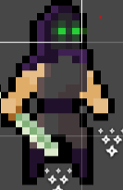
Character
Player
This is the main player for this game
Objective this player to kill the enemy

Slide 7
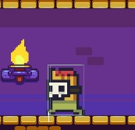
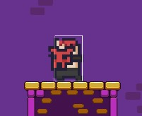

Enemy
02
Monster Level 1
This Enemy will hit you and try to kill you
Monster Level 2
This Enemy will hit you and try to kill you
Monster Level 3
This Enemy will hit you and try to kill you

Slide 8
How to Play?
If you’re kill the enemy and collect point you will be a winner
You will be the winner if you’re the highest score. Enjoy the game with your friend to play this game
Players click button and play the game
Step 1
Step 3
Step 4
Step 2
If you’re new to this game please read instruction

Slide 9
HAVE FUN ENJOY!

