Slide 1



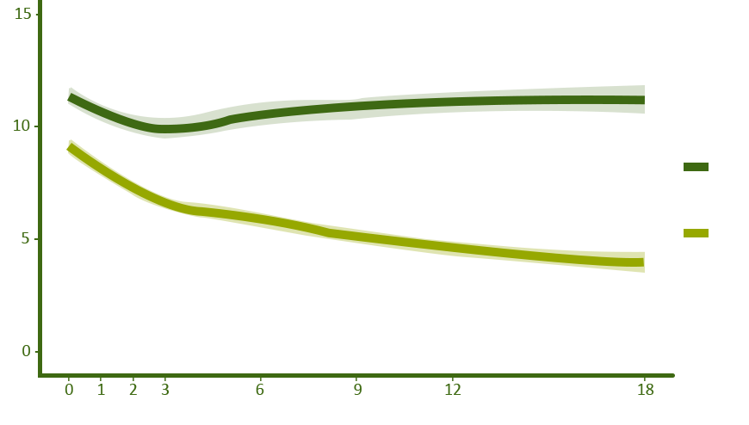
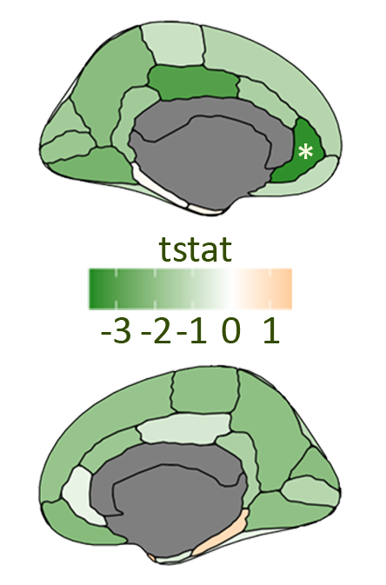

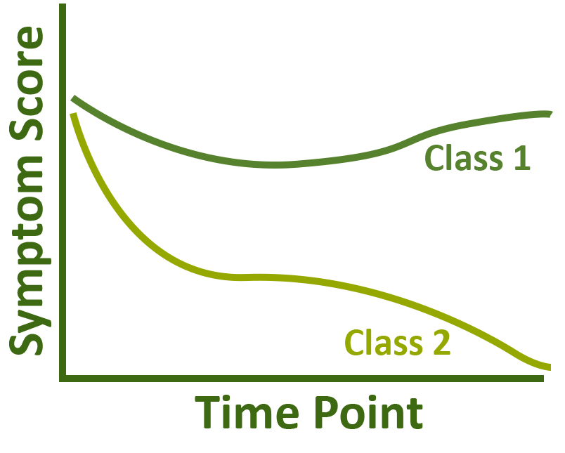





Modeling Negative Symptom Trajectories in Early Psychoses
Alyssa Qian^{1,2}, Sierra Vaillancourt^{1,2}, Julia Gallucci^{1,2}, Lindsay Oliver^{1,2}, Colin Hawco^{1,2}, Aristotle Voineskos^{1,2}
[1] Institute of Medical Science, University of Toronto, Toronto, Canada
[2] Centre for Addiction and Mental Health, Toronto, Canada
Background
Preliminary Results
Interventions of early psychoses improve long-term outcome.¹
Negative symptoms influence recovery but exhibit heterogeneity.^{2,3}
Purpose
Identify negative symptom trajectories based on the Scale for the Assessment of Negative Symptoms (SANS) in early psychoses using growth mixture modelling (GMM).
Explore baseline predictors of class membership.
Table 1. Demographics of study population.
29.2% (n = 185)
 | Overall (n = 634)
Age (years)
Mean (SD) | 23.7 (4.74)
Median [Min, Max] | 23.0 [14.8, 36.2]
Gender
Male | 439 (69.2%)
Female | 192 (30.3%)
Other | 3 (0.5%)
Ethnicity
White | 376 (59.3%)
Black | 77 (12.1%)
Asian | 51 (8.0%)
Arab | 27 (4.3%)
Other | 103 (16.2%)
Diagnosis at Presentation
Schizophrenia | 310 (48.9%)
Psychoses | 104 (16.4%)
Bipolar | 101 (16.0%)
Other | 119 (18.8%)
Baseline Negative Symptom Score (SANS)
Mean (SD) | 9.96 (3.82)
Median [Min, Max] | 10 [0,19]
Baseline Social and Occupational Functioning Assessment Scale (SOFAS)
Mean (SD) | 40.9 (12.9)
Median [Min, Max] | 40 [15, 85]
Latent Class
SANS Composite Score
Persistent
High
Remitting
70.8% (n = 449)
Methods
Time Point (Months)
Data: Prevention and Early Intervention Program for Psychoses (PEPP-Montreal) -- Douglas Research Institute, McGill University.⁴
Figure 1 (Left). Estimated latent trajectories of negative symptoms over 18 months.
Figure 2 (Right). Cortical thickness differences between negative symptom trajectories classes. Green (negative t-stat) indicates thinner cortex in Remitting vs. Persistent High group. *p < 0.05.
Structural (n = 132): Remitting class (n = 93) showed reduced left rostral anterior cingulate cortical thickness than Persistent High class (n = 39) [t(84.131) = -3.5652, p = 0.047] (Fig. 2).
Clinical: Higher baseline functioning scores (SOFAS) indicated greater odds of being in the Remitting class [odds ratio (OR) = 1.027, p = 0.001].
Aim 1
n = 634
SANS @ baseline, 1, 2, 3, 6, 9, 12, 18 months
Generate GMM trajectories for negative symptoms
Conclusion
}
The study identified distinct negative symptom trajectories. Differences in baseline functioning and cortical thickness highlight the potential to refine predictive variables and enable more personalized treatment for early psychoses.
1 1 2 1 2
Demographics
Clinical
Aim 2
1 1 2 2 1
References
1. Correll CU et al. JAMA Psychiatry. 2018;75(6):555-565. doi:10.1001/jamapsychiatry.2018.0623.
2. Engen MJ et al. Front Psychiatry. 2022;13:841057. doi:10.3389/fpsyt.2022.841057.
3. Shinn AK et al. Early Interv Psychiatry. 2017;11(1):83-90. doi:10.1111/eip.12299.
4. Percie du Sert O et al. Schizophr Bull. 2025. doi:10.1093/schbul/sbaf045.
Cognitive
Structural
Baseline Data
Predict Class Membership

