Slide 1
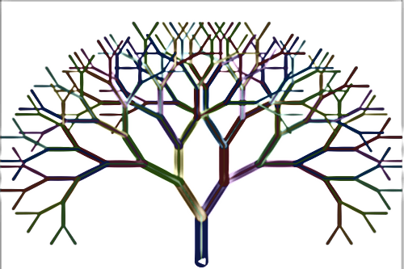
Predicting Claim Amounts with Random Forests
Aqib Majid

Slide 2
Introduction
Aim
Our goal is to build a model which predicts final claim amounts for head-on-collision accidents. We have historic claims data from April 2003 to June 2015, and the claim figures in this data are assumed to be the final claim amounts for our modelling purposes.
Content
Data checks
Feature engineering
Model building, evaluation and future improvements
Challenges of implementing model
Note: all work carried out in Python

Slide 3

Data Checks
Checked numerical data by producing summary stats (mean/min/max)
Numerical Data Checks
Feature | Observation | Action taken
Notification period | 3 negative instances | Taken absolute values
Incurred claims | 48 negative instances | None, assumed to reflect subrogation income following legal proceedings
Capped claims | Max capped claim 72,728 | Set maximum of claims incurred to 72,728
Notes:
Negative instances made up 0.6% of the dataset, if incorrect step, not major issue, plus RF good with noise.
- Intentionally used maximum cap claim, as that is the true cost faced by insurer, by setting that maximum, make data more consistent. Could argue either way,

Slide 4
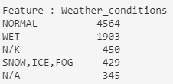
Data Checks (continued)
2. Checked categorical data by producing summary counts, as per example below:
Categorical Data Checks
Feature | Observation | Action taken
Location of incident | 56 N/A values | Changed to ‘not known’
Weather conditions | 345 N/A values | Changed to ‘not known’
PH considered TP at fault | 1 instance of ‘#’ | Changed to ‘not known’
Notes:
Initially thought weather conditions N/A were valid, e.g. collision inside a tunnel, however when looked at location of incident for some, saw that weather would be a factor e.g. minor road.
Alternative method to changing to ‘not known’, mention in model improvements

Slide 5

Feature Engineering
Model inputs needs to be numerical, so we converted categorical features via ‘one-hot-encoding’ method, example below.
‘We also created features from the datetime column, which represented the month, day of week (e.g. Mon/Tues), and time of day (e.g. morning/noon)
Once all new features were added, we had a total of 82 potential features for our model.
Example of ‘one-hot-encoding’
PH_considered_TP_at_fault
Y
N
n/k
PH_considered_TP_ at_fault_Y | PH_considered_TP_ at_fault_N | PH_considered_TP_ at_fault_n/k
1 | 0 | 0
0 | 1 | 0
0 | 0 | 1
Notes:
Label encoding suited for ordeded categorical data, e.g. cold/warm/hot
Time of day had extra step in creating new labels based on hour of the day
82 features with about 7,700 samples. Need to consider number of features vs sample size. For RF, this is ok, as model doesn’t necessarily use all features

Slide 6
Model building, evaluation and future improvements
Why Random Forest?
Advantages over traditional GLMs used in insurance: do not need to specify a distribution, or select combination of ‘risk factors’
Can extract feature importance, helps with interpretability
Can handle large feature space
Model approaches
Model A : 2003-2014 data Model B : 2010-2014 data Test set: 2015 (Jan-June)
Hyper-parameter optimisation via grid search, total of 48 combinations
Evaluated test set performance with Mean Absolute Error (MAE)
Grid Search Table
Parameter | Range of values
Number of trees | [10, 50, 100, 500]
Maximum depth of tree | [2, 4, 8, None]
Maximum number of features | [25, 30, 35]
Notes:
Ensemble approach of decision trees
Each tree uses bootstrapped sample of training data, randomly chooses features, and randomly chooses features to split nodes in
Some disadvantages of RF, can be slow if too many trees
Why Model A and B? To see/quantify difference of using only more recent data vs older data
Used 2015 Jan-June data only because in practice we feel a real model wouldn’t be used for an entire year, continuously improved and deployed. So think this is good from an evaluation context

Slide 7
Model building, evaluation and future improvements
Evaluation
Note on evaluation metric: Changed from default R² to MAE because R² metric involves computing mean of true claims data, but this is not best practice for long-tailed data.
Results
 | Model A (2003-2014 data) | Model B (2010-2014)
MAE (£) | 4,310 | 4,150
Number of trees | 50 | 50
Max depth of tree | 8 | 8
Max features | 25 | 35
Total predicted claims (£) | 5,360,180 (109% of actual) | 4,979,030 (102% of actual)
Total difference (£) (predicted – actual) | 458,170 | 77,020
Notes:
Using more recent data model much better.
Both have similar no of trees and max depth, B has more features
When looking at the aggregate of claims in 2015, both were overestimates, but model B was only out by 2% which is impressive.

Slide 8
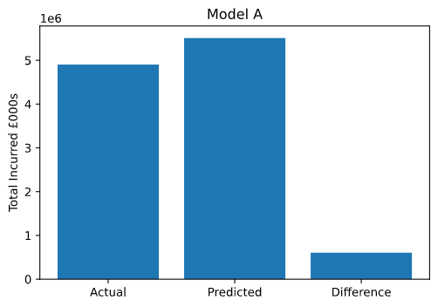
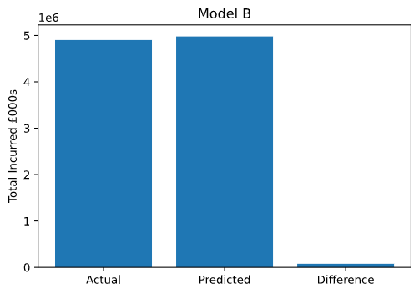
Model building, evaluation and future improvements
Evaluation
Visualising the aggregate of actual vs predicted (see notebook for interactive regression plot)

Slide 9
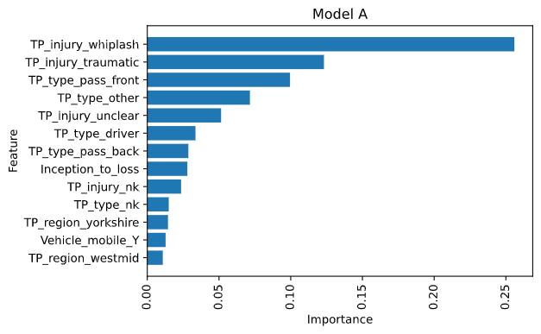
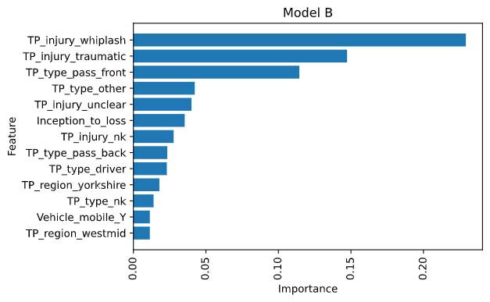
Model building, evaluation and future improvements
Evaluation
Visualising feature importance
Notes:
In RF, all feature’s importance values sum to 1. The importance figure quantifies by how good it is at splitting the data at a node in a tree.
Note this does not give us any descriptive information, i.e. that whiplash results in higher/lower claims, or the relationship between these features

Slide 10
Model building, evaluation and future improvements
Improving data pre-processing
Update ‘not known’ weather entries via historic weather data
Estimate ‘not knowns’ by classification model like K-nearest neighbours
Source additional data, e.g. speed limit, single/double carriage road
Look at statistical distribution of claim data by year, e.g. fitting gamma distribution, as an additional step when deciding on which years to use as training data
Improving modelling
Expand grid search
Use ‘mean absolute error’ criterion when measuring quality of splits in trees at training stage (current Python implementation is O(N²) )
When evaluating best models on test set, use ‘mean gamma deviance’ as metric to minimise, as this reflects claims data better
Use gradient boosting (e.g. XGB)

Slide 11
Challenges of implementing model
Data and infrastructure
Converting from POC to live deployment
Data generated via different sources and technologies, e.g. police reports/ PH statement / medical reports, need to have a data pipeline which can ingest this efficiently
Broker data – different formats - would need data harmonising step in model pipeline
Ongoing improvement of model requires new data, however new claims take time to settle, so there is a lag time for obtaining complete data
In our training data we have the majority of information (except some n/k) as these are old claims. However, information for new claims may trickle in slowly, meaning that many variables will be unknown
Business perspective
Model is a predictive and not descriptive, i.e. we can’t explicitly understand the relationships between different features/variables, valuable information for insurers as desire to quantify risk factors, e.g. for premium pricing models
No confidence values for predictions

Slide 12
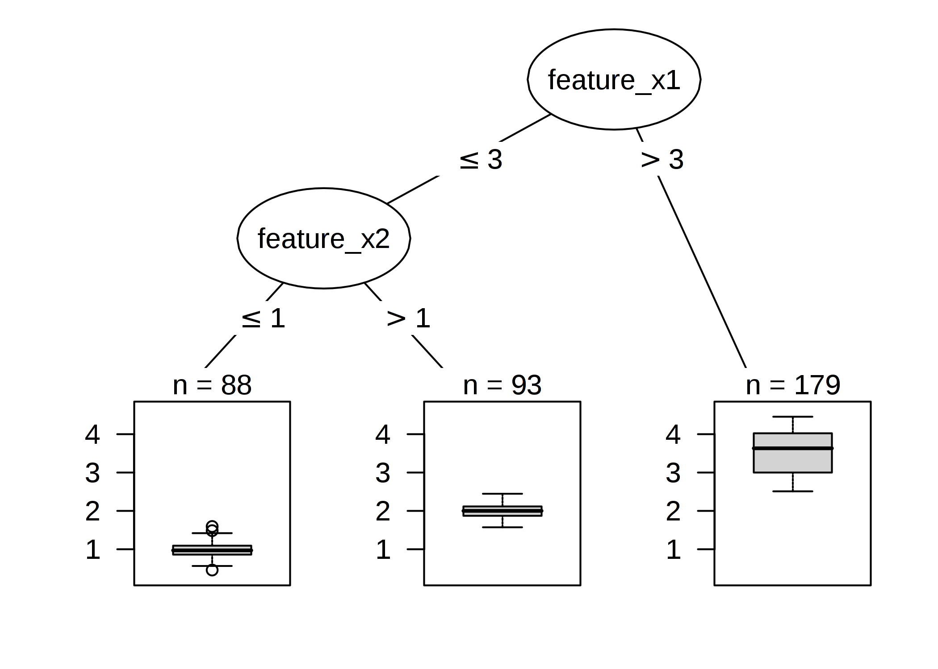
Appendix 1
Regression Tree Visualisation
Source: https://christophm.github.io/interpretable-ml-book/tree.html

Slide 13
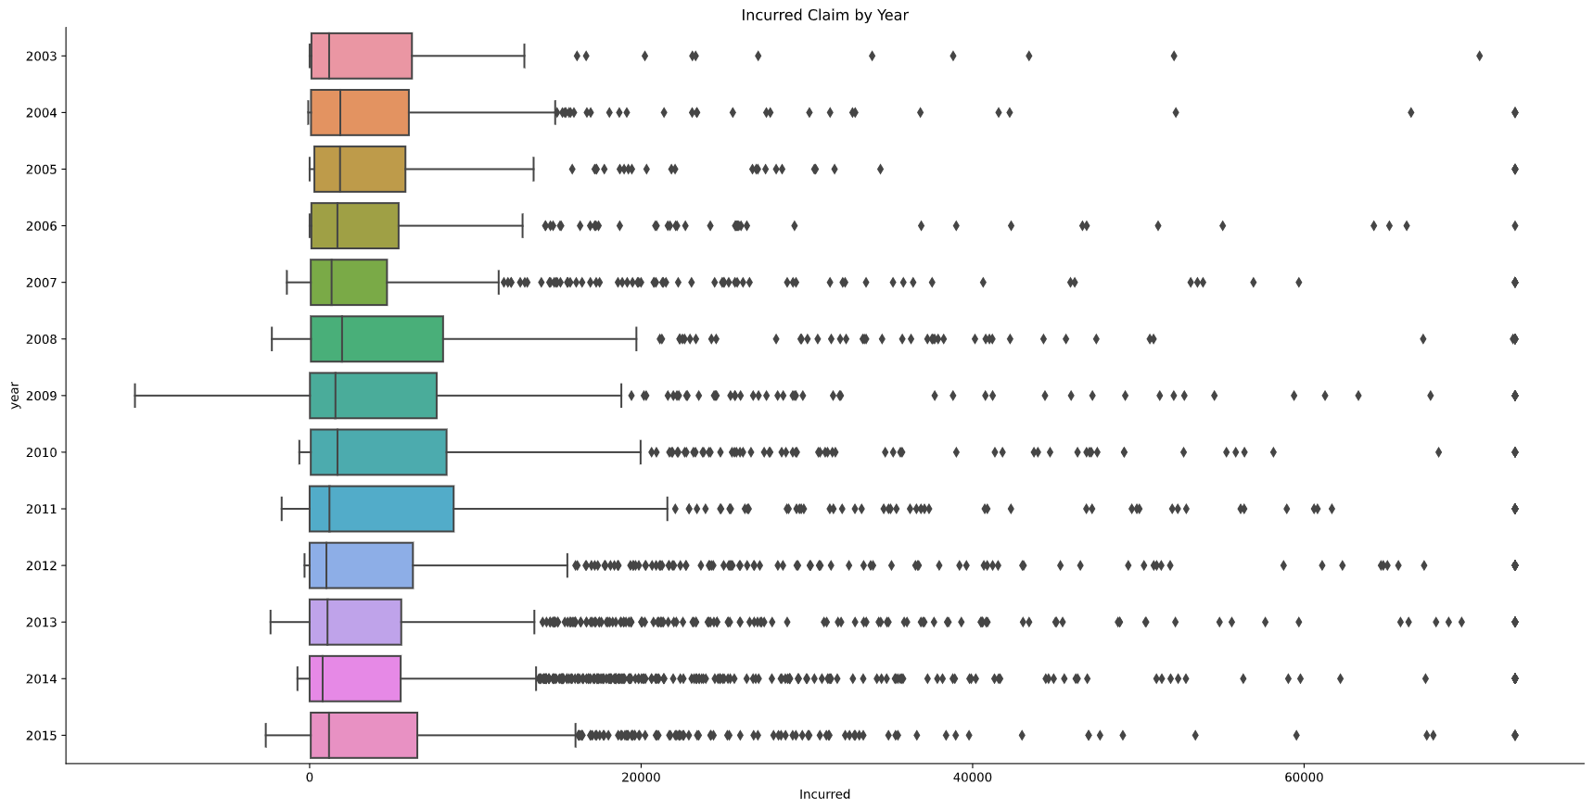
Appendix 2 : Distribution of claims by year
Notes:
Not full picture, as distribution may be the same, but the relationship between features may have changed. E.g. 2004 and 2013 look similar, though 2013 has many more outliers
Maximum is 72k as per capped incurred
Things change over time, e.g. new road layouts, decreasing speed limit in residential areas, car safety features, societal changes like less people smoking/drinking, more marketing about claims for accidents/compensation
Ignored 2003 and 2015 here as not complete data for year (2003: April onwards, 2015: till June)

