Slide 1

PAKISTANI FASHION INTELLIGENCE
Fashion Brand
Competitive Price
Analytics
A data-driven comparison of J., Maria.B, and Sana Safinaz
Prepared by: Aqib Hanif
Assigned by: Mam Sumayyea Salahuddin
Arfa Karim Incubation Center, Peshawar

Slide 2
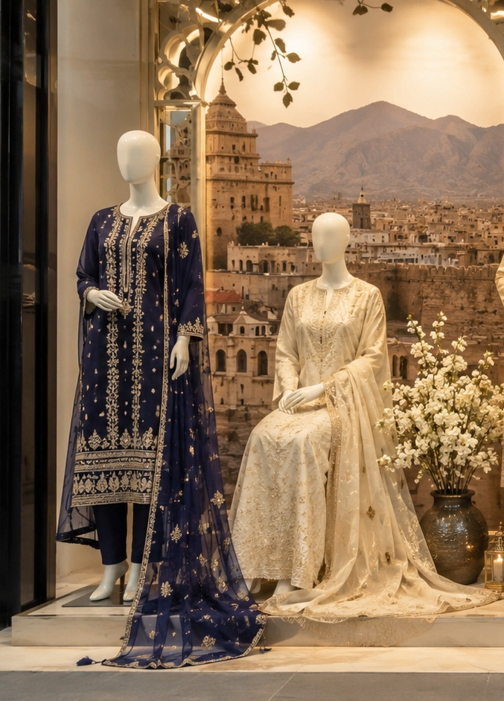
BUSINESS PROBLEM
Why I built this project
Fashion brands can sell similar categories, but their pricing, discounts, and positioning can be very different.
I used the same method for each brand, so the comparison becomes fair and easy to explain.
Price
Discounts
Categories
Positioning
Aqib Hanif | Pakistani Fashion Intelligence
02

Slide 3
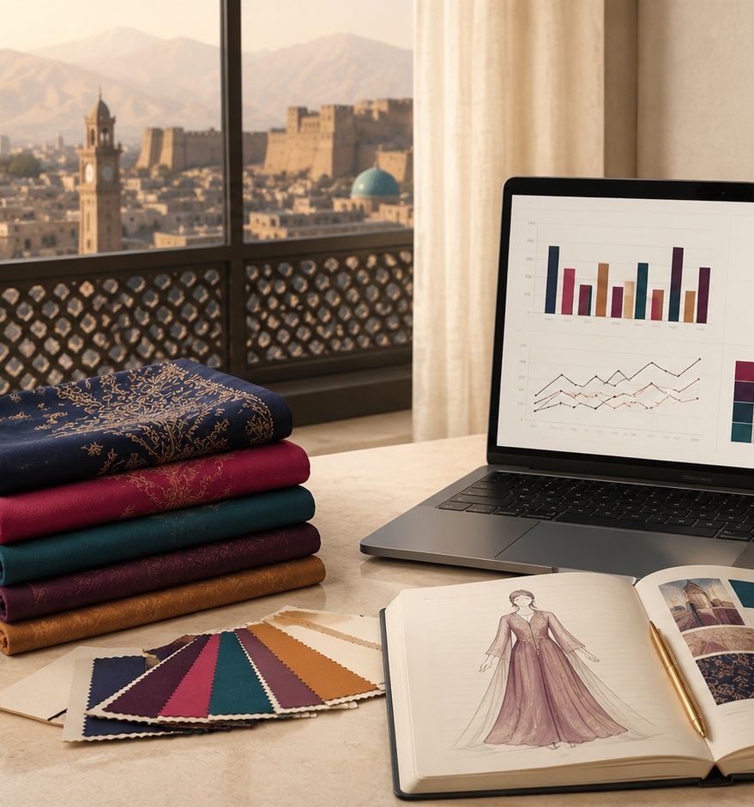
DATA SNAPSHOT
Project scope in one view
3
281
5
brands analyzed
products collected
main categories
PKR 12,990
4.62%
13.88%
overall median price
average discount
products on sale
Peshawar is used for weather and regional context. I do not claim that weather directly caused the prices.
Aqib Hanif | Pakistani Fashion Intelligence
03

Slide 4
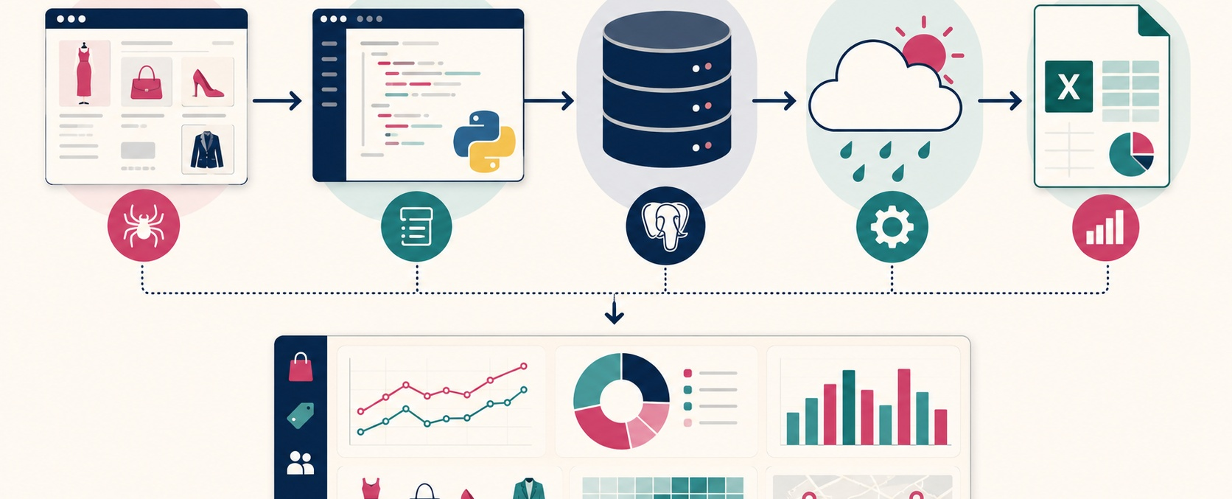
MY PROCESS
How I moved from raw data to insights
Web scraping → Python cleaning → PostgreSQL analysis → Open-Meteo context → Excel dashboard
Aqib Hanif | Pakistani Fashion Intelligence
04

Slide 5
DATA PREPARATION
I cleaned the data before comparing brands
Raw to processed
Main steps I applied
281
• standardized category names and text fields
• converted prices and dates correctly
• recalculated discounts from cleaned prices
• created sale status, price segments, and price index
records stayed valid
after cleaning
Aqib Hanif | Pakistani Fashion Intelligence
05

Slide 6
PRICING
Price positioning tells the first story
Main insight
Maria.B sits clearly in a premium price position.
J. and Sana Safinaz are closer to the affordable range in this product sample.
Maria.B: PKR 23,990
Sana: PKR 8,999
Aqib Hanif | Pakistani Fashion Intelligence
06

Slide 7
PROMOTION
Discount activity changes the picture
Average discount %
Products on sale %
Sana Safinaz leads both discount metrics in this snapshot.
Aqib Hanif | Pakistani Fashion Intelligence
07

Slide 8
CATEGORY MIX
The market sample is led by Unstitched
84
Unstitched products
This category has the largest product count, so it is important for price comparison.
Formal: 63
Pret: 59
Aqib Hanif | Pakistani Fashion Intelligence
08

Slide 9
BRAND INTELLIGENCE
One score made the comparison easier
Score weights
30%
Price competitiveness
25%
Discount strategy
25%
Product variety
20%
Availability
Sana Safinaz has the strongest total score in this analysis.
Aqib Hanif | Pakistani Fashion Intelligence
09

Slide 10
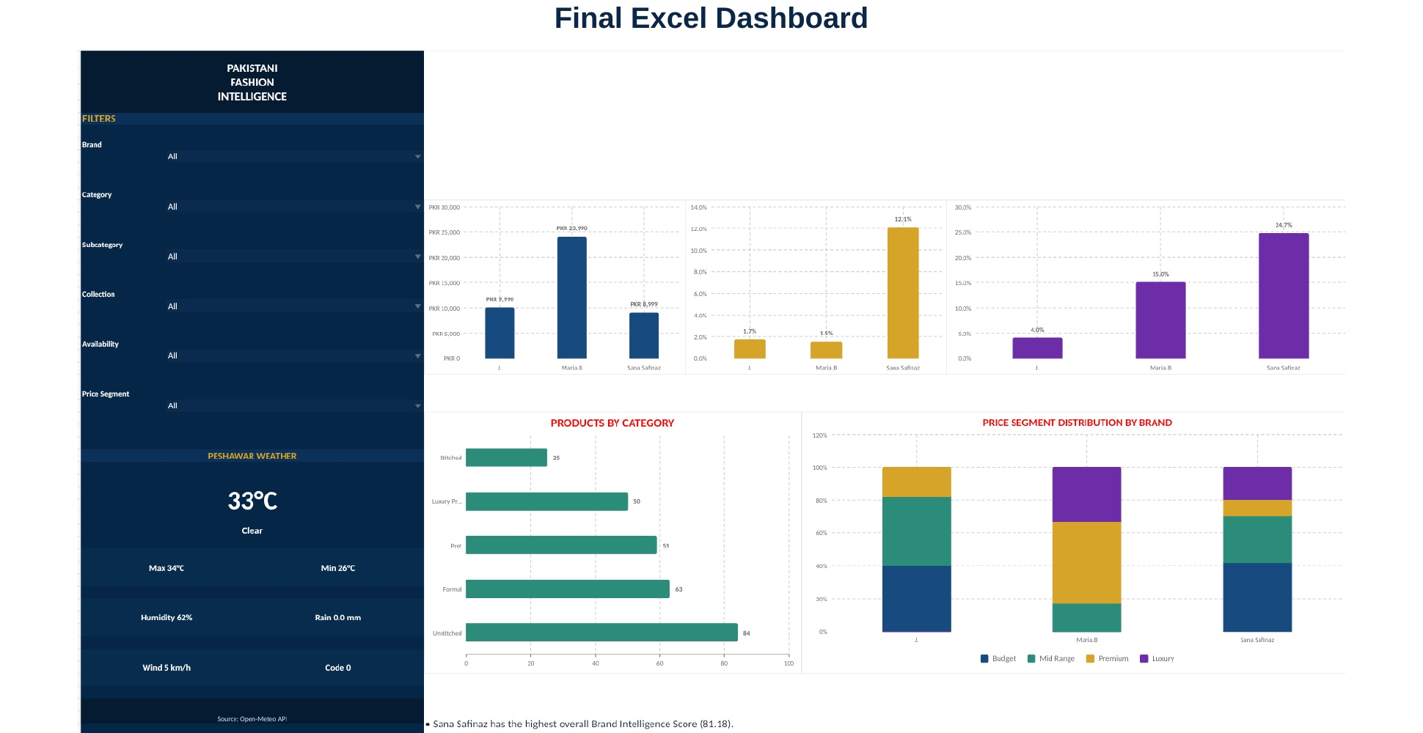
DASHBOARD
The final output is an interactive Excel dashboard
Filters, KPI cards, charts, and Peshawar weather make the story easy to present.
Aqib Hanif | Pakistani Fashion Intelligence
10

Slide 11
RECOMMENDATIONS
My business recommendations
J.
Maria.B
Sana Safinaz
Protect the affordable price position. Use targeted deals on higher-priced items.
Keep the premium image. Use selective campaigns to improve conversion.
Continue careful discount activity because it leads the current score.
Next: repeat the scraping process regularly and add sales or customer demand data.
Aqib Hanif | Pakistani Fashion Intelligence
11

Slide 12

Final takeaway
A good dashboard is not only about charts. It is about making the brand story clear.
What I learned
Real data becomes useful when it is cleaned, compared, and explained simply.
Thank you
Aqib Hanif

