Slide 1
Chughgai AI helpdesk
Intelligent Voice-Based Customer Support System for Clinical Laboratory Services
CLIENT
PLATFORM
LANGUAGE
STATUS
Chughtai Lab
AI Voice Assistant
Urdu / Punjabi / English
Active Development

Slide 2
Project Introduction
01
An AI-powered voice assistant handling inbound customer calls for Pakistan's largest diagnostic lab
🎯 Purpose
💡 Business Value
Automate routine customer support calls — test info, pricing, appointments, home sampling — reducing wait times and freeing agents for complex queries.
Handle thousands of daily calls simultaneously. Provide consistent, accurate information with zero hold time. No per-call cloud costs.
🗣️ Customer Interaction
🔒 Fully On-Premise
Patients call the lab's phone number. AI answers in Urdu, understands the question, retrieves relevant data, and responds naturally.
All processing on local infrastructure. No cloud dependency. Complete data privacy and control over patient information.

Slide 3
Project Progress So Far
02
Key milestones achieved during development
✓ Telephony Infrastructure
Asterisk PBX + PTCL SIP trunk integration — full call handling pipeline operational
✓ Audio Processing Pipeline
Real-time voice capture, G.711 codec, noise handling, audio streaming — fully functional
✓ Speech-to-Text Engine
Urdu/Punjabi speech recognition integrated, processing live audio with local ASR model
✓ Knowledge Base Development
Comprehensive KB from 20+ data sheets — tests, doctors, pricing, centers, services
✓ Intent Detection System
AI-driven classifier handles 16+ intent categories with intelligent routing
✓ AI Response Generation
LLM-powered natural Urdu responses generated from KB data
✓ Admin Panel (CRM)
Web dashboard: live monitoring, transcripts, analytics, workflow management
✓ Workflow Automation
Multi-turn conversation flows for home sampling, consultations, bookings

Slide 4
Core Modules Developed
03
High-level overview of primary system components
📞 AI Call Handling
Automated answering, conversation management, multi-turn dialogue, intelligent escalation to human agents.
🔌 Telephony Integration
MicroSIP + Asterisk PBX with PTCL SIP trunk. Call routing, audio bridging, standard phone line support.
🎤 Speech-to-Text
Real-time Urdu/Punjabi voice recognition on local hardware. No cloud dependency.
🧠 Intent Detection
Understands caller needs — pricing, doctors, home sampling, promotions — routes to correct handler.
📚 Knowledge Base
500+ tests, doctor schedules, center locations, pricing, preparation instructions.

Slide 5
Core Modules Developed (cont.)
04
🤖 AI Response Generation
Natural Urdu responses using LLM + KB data. Context-aware, conversational replies.
🖥️ Admin Panel
Web CRM dashboard — live calls, transcripts, analytics, workflow management.
📊 Call History & Analytics
Complete logs, intent breakdown, resolution rates, performance metrics.
⚙️ Workflow Automation
Visual builder for multi-step processes — home sampling, appointments, guided consultations.
🏠 Home Sampling Support
End-to-end booking: collects patient name, phone, address, test, time through natural conversation.

Slide 6
System Workflow
05
How a customer call is processed end-to-end
1 Customer Places Call
2 AI Bot Receives Call
3 Voice → Text Conversion
4 AI Understands Intent
5 Knowledge Base Retrieval
6 AI Generates Response
7 Voice Response to Caller
→
→
→
→
→
→
PTCL Phone Line → Asterisk PBX (SIP/G.711) → AI Stasis App → Audio Processing (decode, resample 8→16kHz, silence detection) → Speech-to-Text (local Urdu ASR model) → Intent Detection (16+ categories) → Knowledge Base Retrieval (tests, doctors, pricing, centers) → AI Response Generation (LLM + KB context) → Text-to-Speech (Urdu) → Caller hears response → If unresolved: Smart escalation to live human agent

Slide 7
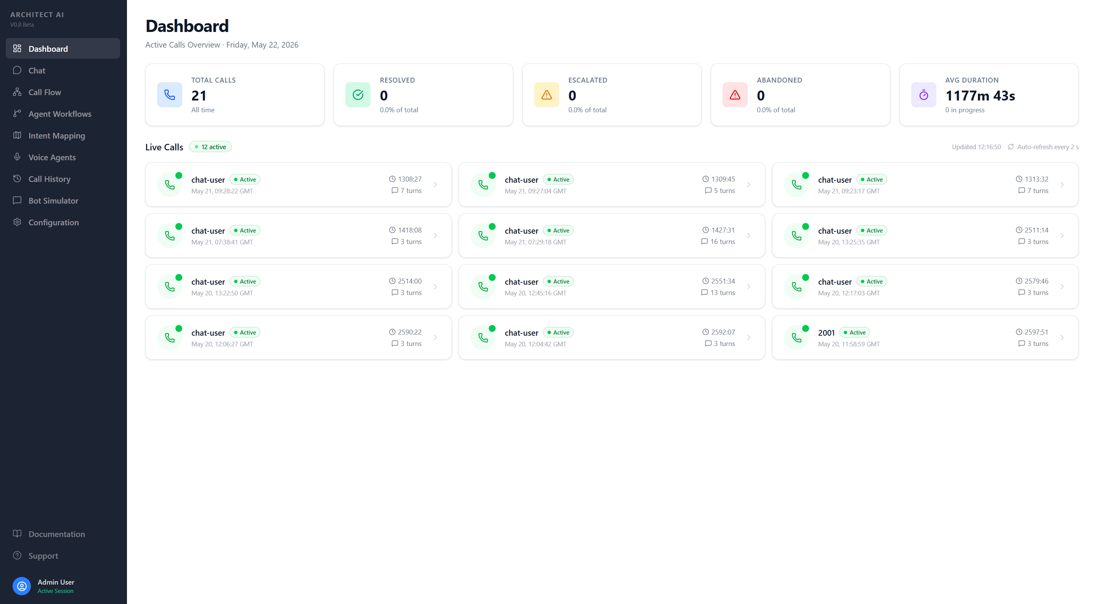
Admin Panel — Dashboard
06
Real-time overview of system performance and active calls
Features: Real-time stats (total, resolved, escalated, abandoned), live call cards with caller number, and duration. Auto-refreshing interface for continuous monitoring.

Slide 8
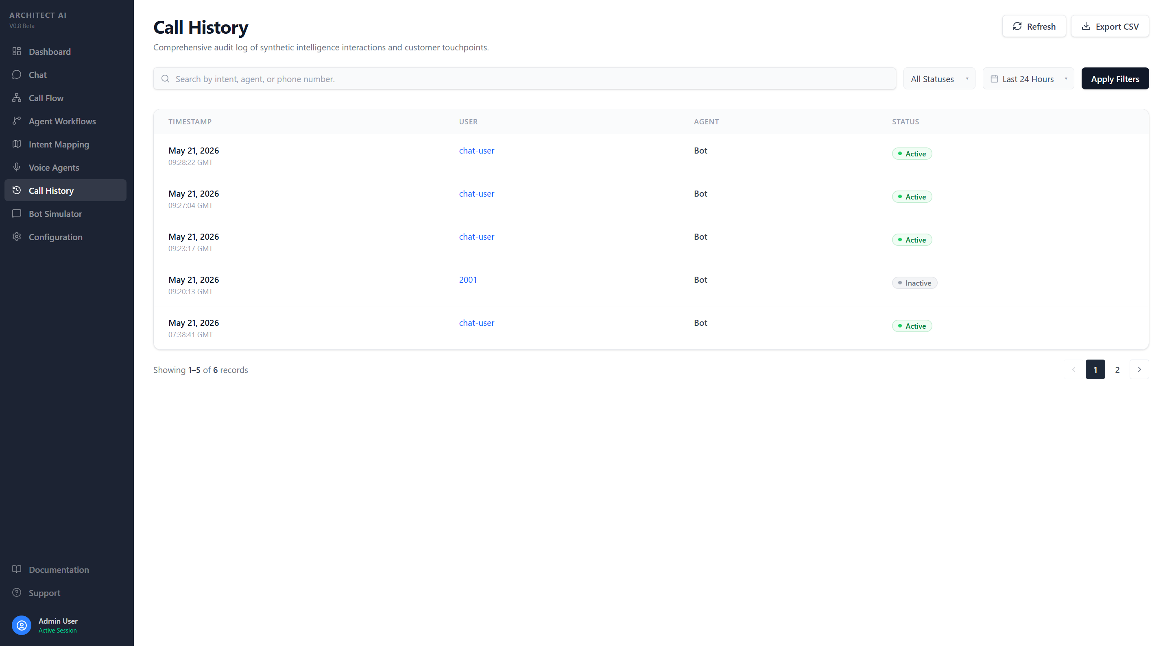
Admin Panel — Call History
07
Complete searchable log of all calls with transcripts
Features: Each call includes a complete transcript showing caller-AI conversation with intent classification and confidence scores.

Slide 9
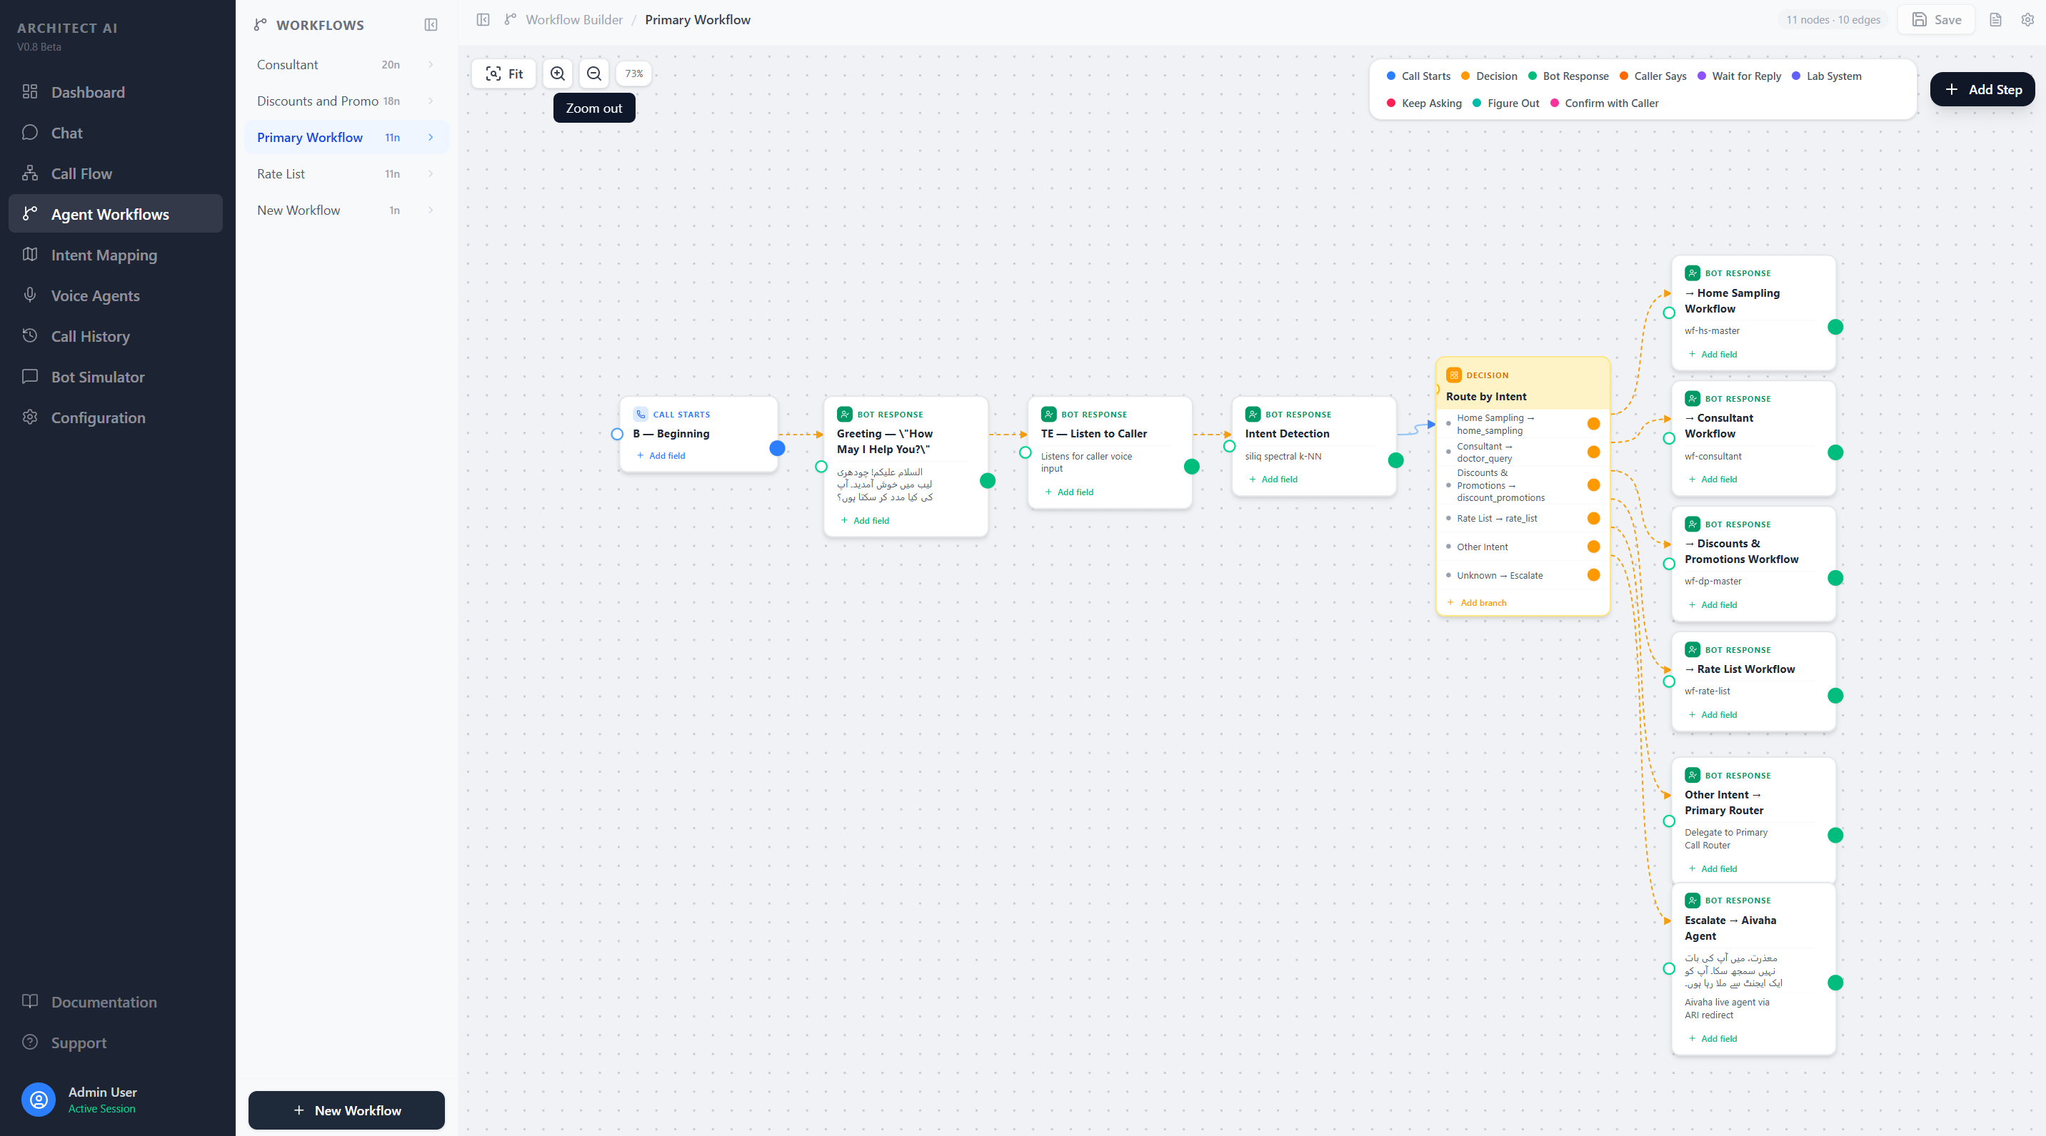
Admin Panel — Workflow Builder
08
Visual workflow builder for multi-step conversation flows

Slide 10
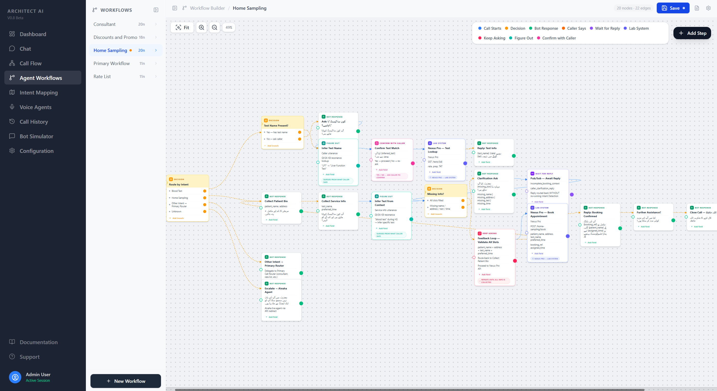
Admin Panel — Home Sampling Workflow
09
Multi-step booking flow: patient info → address → test → time → confirmation

Slide 11
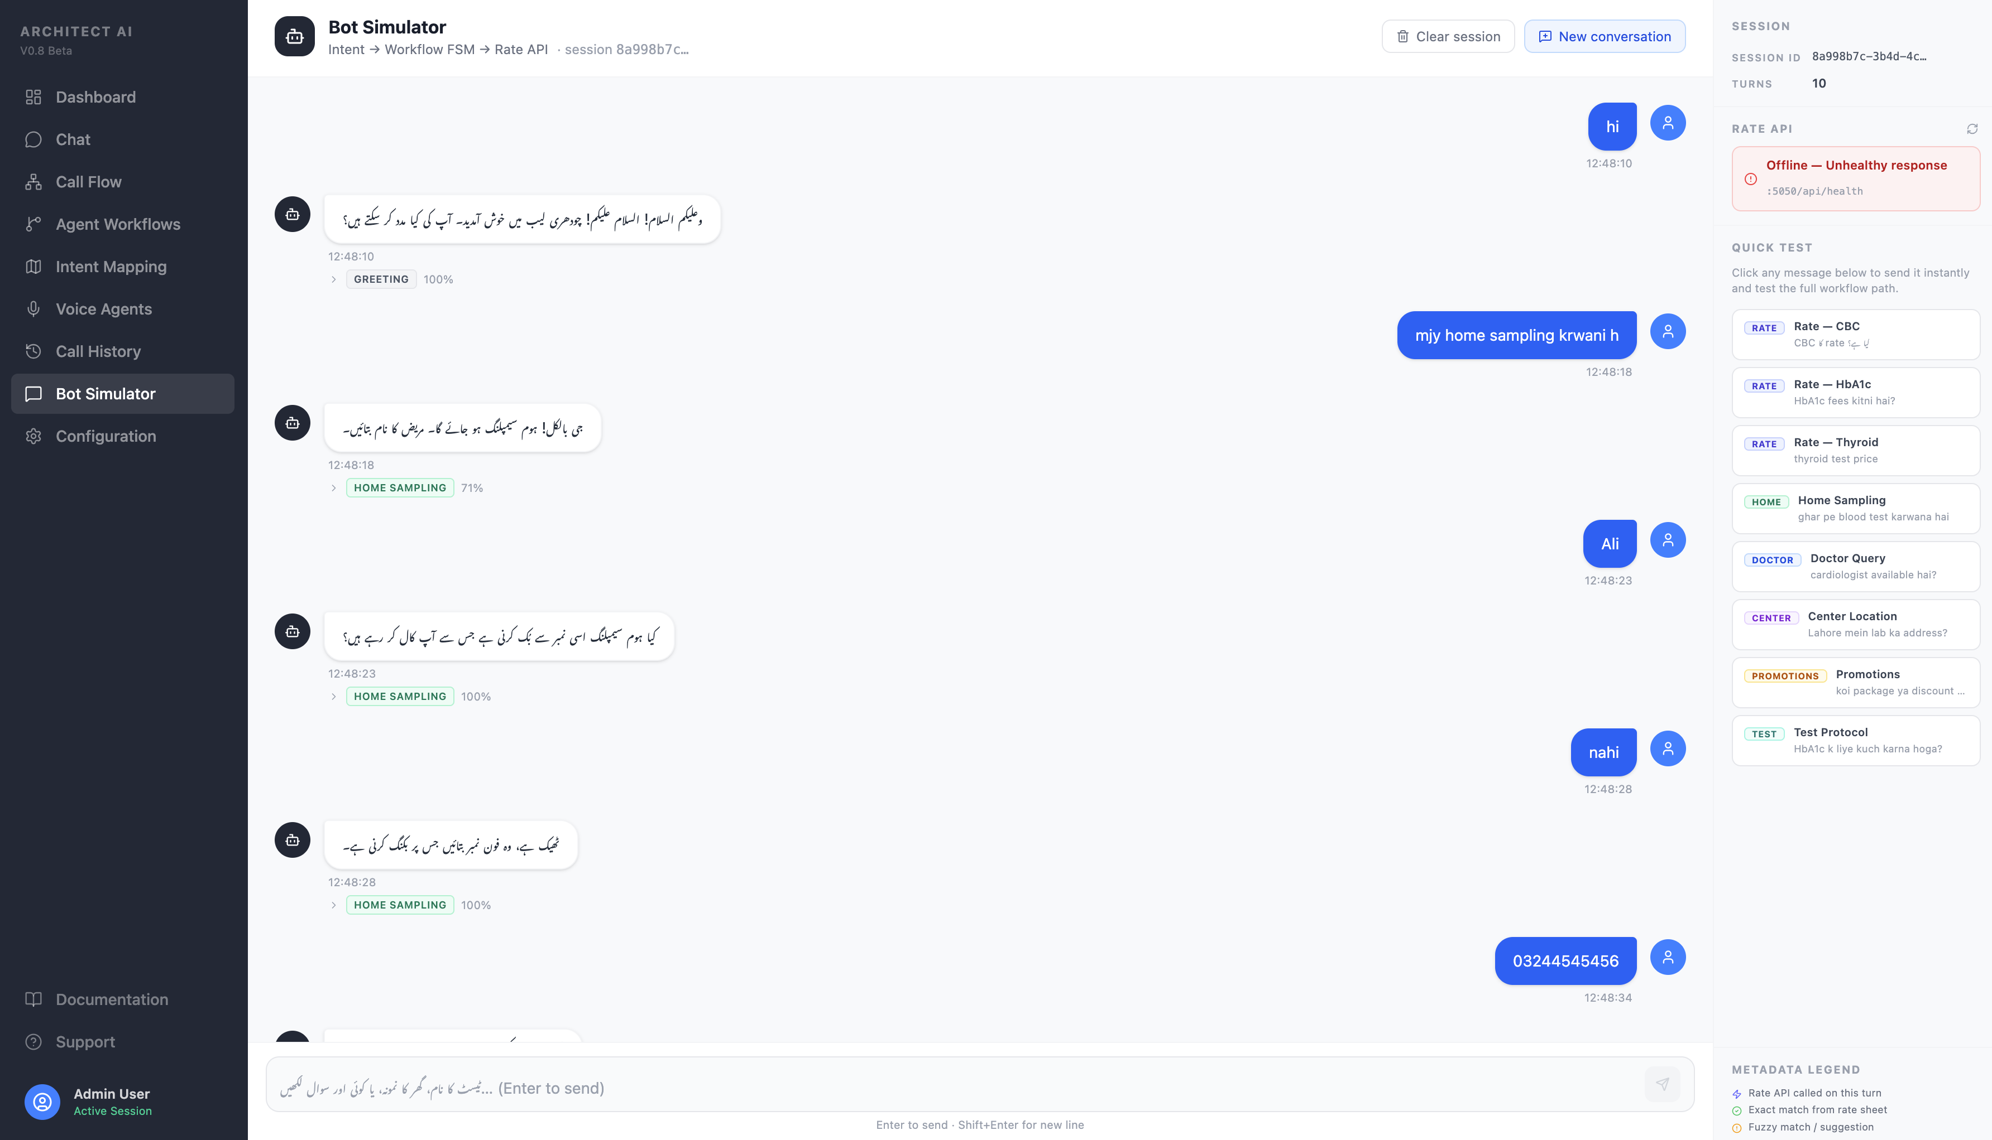
Admin Panel — Analytics & AI Interaction
09
Intent breakdown, metrics, and direct bot testing

Slide 12
Current Challenges & Solutions
10
Transparent overview of ongoing optimization areas
⚠️ Current Challenge: Speech Recognition Accuracy
• The ASR model occasionally struggles with accurate Urdu transcription in noisy environments • Some regional accents and dialectal variations (Punjabi/Urdu mix) reduce accuracy • When transcription is inaccurate, intent detection may not correctly identify the caller's request
📋 Work Completed
🔧 Resolution Approach
✅ Extensive KB data preparation & structuring ✅ Multiple testing & optimization cycles ✅ Audio preprocessing optimized for noise ✅ Silence detection algorithms refined ✅ Intent fallback mechanisms implemented
🔄 Continuous ASR model optimization 🔄 Improving audio preprocessing & noise handling 🔄 Refining training datasets with more samples 🔄 Enhancing intent detection fallbacks 🔄 Smart escalation when confidence is low

Slide 13
Speech-to-Text (STT) Challenges — Part 1
A
Recording quality and speaker challenges in telephony
⚠️ 8 kHz Telephony vs 16 kHz ASR
• Telephony (G.711 codec) records at 8 kHz
• Urdu fricatives (ش، س، ز، ف، خ، غ) live in this band
• ASR models require 16 kHz — upsampling recovers nothing
• Higher WER on fricative-heavy Urdu medical vocabulary
• High-frequency band (4–8 kHz) permanently lost at codec stage
• Mitigation: capture 16 kHz before codec; spectral enhancement
👥 Dual-Speaker Audio on One Channel
• Caller (patient): normal volume — model handles adequately
• Agent utterances transcribed with higher error rate
• Agent: low volume (distant mic) + very fast professional speech
• Fast speech causes word merging; low volume drowned by caller
• Single mixed audio channel — no speaker separation possible
• Mitigation: two-channel PBX recording; VAD + diarisation

Slide 14
STT: Language & Training Challenges — Part 2
B
Urdu-specific language gaps and model training limitations
🌐 Language-Hint Dilemma
• No "language Urdu" — model treats Urdu speech as Hindi
• Root cause: Urdu not in model supported language list
• Hindi hint: correct content but drops nuktas (ز→ج، ف→پھ، ق→ک)
• Fix: fine-tune on Urdu + nukta-aware post-processing
• English hint: preserves nuktas but outputs Latin phrases
💊 Code-Switching & Medical Vocabulary
• Callers mix Urdu, English medical terms (CBC, creatinine) and Punjabi
• General ASR has no exposure to clinical lab domain language
• Medical terms (lab tests, drug names, anatomy) are out-of-vocabulary
• Fix: domain fine-tuning on helpdesk audio + proper-noun lexicon
• Doctor/test/branch names (Johar Town, Gulberg, Liberty) mis-transcribed
📚 Training Data & Domain Gap
• Scarcity in Urdu telephony corpus — CommonVoice (~100 hrs) is read-speech only
• Standard WER ignores script normalisation (alef variants: ا، آ، أ)
• In-domain audio needs native annotators; labels must be orthographically consistent
• Urdu accents across Lahore, Karachi, Peshawar, Faisalabad not uniformly covered
• Fine-tuning needs GPU + careful LR scheduling; risks catastrophic forgetting

Slide 15
STT Progress: Hindi → Roman Urdu — Part 3
C
Custom post-processing pipeline built at BitLogix to bridge the Urdu ASR gap
Qwen3-ASR outputs Hindi Devanagari for Urdu speech. A 3-layer deterministic model converts Devanagari → Roman Urdu for downstream NLP.
1️⃣ ASR Output
2️⃣ Phoneme Map
3️⃣ Schwa Deletion
4️⃣ Lexicon Correction
Qwen3-ASR transcribes Urdu speech as Hindi Devanagari
Each Devanagari char → Roman Urdu equivalent
Sanskrit schwa (/ə/) is silent in Urdu words
~985 word corrections + ~286 proper nouns
e.g. زندگی → ज़िंदगी | قابل → क़ाबिल
Nuktas resolved: फ़→f ज़→z क़→q ख़→kh
Rule-based: करम→karam (not karama)
Medical vocab, Urdu phonology, names
✅ What It Solves
⚠️ Current Limitations
• No native Urdu ASR → Devanagari re-mapped to Roman Urdu for NLP
• Lexicon must be maintained manually as new vocab is encountered
• Nukta omission → English hint + nukta-aware map (फ़→f, ज़→z, क़→q)
• Regional accent variation produces Devanagari forms that miss lexicon
• Urdu phonology (ph→f, j→z) → closed rules; open sets via lexicon
• Nukta emission is inconsistent across varying audio quality levels
• Medical & proper nouns → proper-noun dictionary (branches, doctors)
• Script mismatch → clean Roman Urdu for intent classifier & LLM
• No automatic detection of lexicon gaps — errors surface only in QA

Slide 16
Text-to-Speech (TTS) Challenges — Part 1
D
Infrastructure and model limitations for on-premises Urdu TTS
📞 Telephony Downsampling: 16→8 kHz
• TTS models generate audio at 16–24 kHz (full bandwidth)
• Urdu fricatives (ش،س،ز،خ) especially degraded by codec
• PTCL SIP / G.711 delivers to caller at only 8 kHz
• Mitigation: codec-aware TTS training; high-shelf boost before downsampling
• High-frequency band collapses — synthesised voice sounds muffled
🔇 Scarce On-Premises Urdu Models
• Cloud (Google WaveNet, Azure Neural, Amazon Polly) — excluded, data privacy policy
• Target: VITS or XTTS fine-tuned on Urdu — needs custom dataset + GPU training
• Research models (IMS-Toucan, MMS-TTS) — Urdu quality inconsistent, not production-ready
• Fine-tuning needs large number of hrs clean professionally recorded Urdu speech
• Open on-prem (Coqui XTTS, Piper TTS) — limited Urdu data; naturalness issues
🔤 Missing Diacritics (Aerab) Problem
• Urdu Nastaliq written without short vowels (زبر، زیر، پیش) in all practical sources
• LLM-generated text always lacks aerab — no practical way to enforce it
• Same written word → multiple valid pronunciations without aerab context
• Mitigation: G2P model with context; constrained vocab for domain terms
• "کرم" = karam (grace) or kirm (worm) — TTS must guess and may be wrong

Slide 17
Text-to-Speech (TTS) Challenges — Part 2
E
Content rendering, quality and deployment challenges
🌐 Mixed-Language Pronunciation
• LLM output mixes Urdu, English medical terms and numbers in one sentence
• Needs per-token language ID + multilingual TTS or separate English synthesis pass
• "CBC test کے لیے Johar Town آئیں" — 3 scripts in a single utterance
• Mitigation: language-aware pipeline with per-word language detection and routing
• Naive TTS applies Urdu phonology to English words → foreign accent on medical terms
🔢 Number, Price & Date Normalisation
• LLM outputs raw: Rs. 1,450 / 12 May 2026 / 10:30 AM / CBC (Complete Blood Count)
• Edge cases: ranges (500–1500), abbreviations (Dr., Dept.), mixed units
• TTS needs Urdu: "ایک ہزار چار سو پچاس روپے" / "بارہ مئی دو ہزار چھبیس"
• Mitigation: custom Urdu normalisation module as pre-processing before TTS
• No robust Urdu text normalisation library — must be built from scratch
🎙️ Prosody, Latency & Brand Voice
• Helpdesk requires TTS response within ~1 second — needs chunked sentence streaming
• RTF: HMM < 0.1× CPU (robotic) | VITS ~0.3–0.5× GPU | XTTS v2 ~1–2× (8GB VRAM)
• On-prem models produce flat monotone speech; question intonation often incorrect
• Brand voice: custom cloning needs 5–30 min recordings; consistency across all calls required
• Patients need empathetic, unhurried delivery — current models lack emotional register

Slide 18
Current Status
11
What's working, what's being optimized
✅ Fully Working
🔄 Under Optimization
• Telephony integration (PTCL → Asterisk → Bot)
• ASR accuracy for regional accents
• Real-time audio capture and processing
• Intent confidence threshold tuning
• Speech-to-Text conversion (Urdu)
• Response naturalness in edge cases
• Intent detection and classification (16+ types)
• Call flow smoothness improvements
• Knowledge base retrieval and responses
• AI response generation (LLM-based)
• KB coverage for rare queries
• Text-to-Speech for Urdu responses
• Multi-turn workflows (Home Sampling, etc.)
• Admin panel with live monitoring
📈 System Stability
• Call history and transcript storage
• Workflow builder and management
• Core pipeline: Stable and reliable • Admin panel: Production-ready • Telephony: Handles concurrent calls • KB: Comprehensive coverage • Uptime: Consistent with auto-recovery
• Bot Chat testing interface
• Escalation to human agents

Slide 19
Project Achievements
12
Key outcomes delivered so far
✓ Customer Support Automation
✓ Faster Query Handling
AI handles routine inquiries end-to-end — pricing, availability, preparation — without human intervention.
Average call under 2 minutes. Zero hold time — instant responses without waiting in a queue.
✓ Reduced Manual Workload
✓ Better Customer Experience
Repetitive queries (pricing, test info, locations) handled by AI — agents focus on complex cases.
Natural Urdu conversation, 24/7 availability, consistent accuracy from a single source of truth.
✓ Scalable AI Infrastructure
✓ Centralized Admin Monitoring
On-premise architecture handles multiple simultaneous calls. No per-call API costs.
Complete visibility — live calls, transcripts, analytics, workflows — all from one dashboard.

Slide 20
Conclusion & Next Steps
The AI Helpdesk system has been successfully developed with all core modules operational. The platform is actively handling calls and delivering measurable value.
✓ End-to-end voice AI pipeline (telephony → STT → intent → KB → LLM → TTS) ✓ 16+ intent categories with intelligent routing ✓ Comprehensive knowledge base covering all lab services ✓ Multi-turn workflow automation (home sampling, appointments) ✓ Full-featured admin panel with real-time monitoring ✓ Smart escalation to human agents for unresolved queries
Thank you for your continued partnership.

