Slide 1
Chughgai AI helpdesk
Intelligent Voice-Based Customer Support System for Clinical Laboratory Services
CLIENT
PLATFORM
LANGUAGE
STATUS
Chughtai Lab
AI Voice Assistant
Urdu / Punjabi / English
Active Development

Slide 2
Project Introduction
01
An AI-powered voice assistant handling inbound customer calls for Pakistan's largest diagnostic lab
🎯 Purpose
💡 Business Value
Automate routine customer support calls — test info, pricing, appointments, home sampling — reducing wait times and freeing agents for complex queries.
Handle thousands of daily calls simultaneously. Provide consistent, accurate information with zero hold time. No per-call cloud costs.
🗣️ Customer Interaction
🔒 Fully On-Premise
Patients call the lab's phone number. AI answers in Urdu, understands the question, retrieves relevant data, and responds naturally.
All processing on local infrastructure. No cloud dependency. Complete data privacy and control over patient information.

Slide 3
Project Progress So Far
02
Key milestones achieved during development
✓ Telephony Infrastructure
Asterisk PBX + PTCL SIP trunk integration — full call handling pipeline operational
✓ Audio Processing Pipeline
Real-time voice capture, G.711 codec, noise handling, audio streaming — fully functional
✓ Speech-to-Text Engine
Urdu/Punjabi speech recognition integrated, processing live audio with local ASR model
✓ Knowledge Base Development
Comprehensive KB from 20+ data sheets — tests, doctors, pricing, centers, services
✓ Intent Detection System
AI-driven classifier handles 16+ intent categories with intelligent routing
✓ AI Response Generation
LLM-powered natural Urdu responses generated from KB data
✓ Admin Panel (CRM)
Web dashboard: live monitoring, transcripts, analytics, workflow management
✓ Workflow Automation
Multi-turn conversation flows for home sampling, consultations, bookings

Slide 4
Core Modules Developed
03
High-level overview of primary system components
📞 AI Call Handling
Automated answering, conversation management, multi-turn dialogue, intelligent escalation to human agents.
🔌 Telephony Integration
MicroSIP + Asterisk PBX with PTCL SIP trunk. Call routing, audio bridging, standard phone line support.
🎤 Speech-to-Text
Real-time Urdu/Punjabi voice recognition on local hardware. No cloud dependency.
🧠 Intent Detection
Understands caller needs — pricing, doctors, home sampling, promotions — routes to correct handler.
📚 Knowledge Base
500+ tests, doctor schedules, center locations, pricing, preparation instructions.

Slide 5
Core Modules Developed (cont.)
04
🤖 AI Response Generation
Natural Urdu responses using LLM + KB data. Context-aware, conversational replies.
🖥️ Admin Panel
Web CRM dashboard — live calls, transcripts, analytics, workflow management.
📊 Call History & Analytics
Complete logs, intent breakdown, resolution rates, performance metrics.
⚙️ Workflow Automation
Visual builder for multi-step processes — home sampling, appointments, guided consultations.
🏠 Home Sampling Support
End-to-end booking: collects patient name, phone, address, test, time through natural conversation.

Slide 6
System Workflow
05
How a customer call is processed end-to-end
1 Customer Places Call
2 AI Bot Receives Call
3 Voice → Text Conversion
4 AI Understands Intent
5 Knowledge Base Retrieval
6 AI Generates Response
7 Voice Response to Caller
→
→
→
→
→
→
PTCL Phone Line → Asterisk PBX (SIP/G.711) → AI Stasis App → Audio Processing (decode, resample 8→16kHz, silence detection) → Speech-to-Text (local Urdu ASR model) → Intent Detection (16+ categories) → Knowledge Base Retrieval (tests, doctors, pricing, centers) → AI Response Generation (LLM + KB context) → Text-to-Speech (Urdu) → Caller hears response → If unresolved: Smart escalation to live human agent

Slide 7
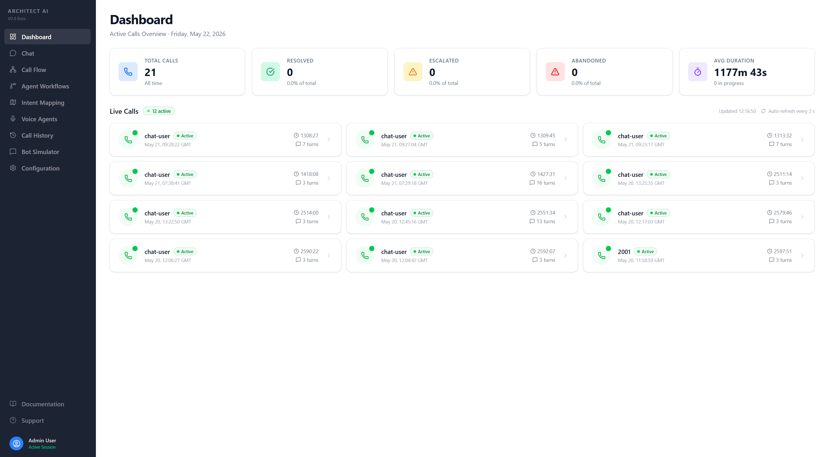
Admin Panel — Dashboard
06
Real-time overview of system performance and active calls
Features: Real-time stats (total, resolved, escalated, abandoned), live call cards with caller number, and duration. Auto-refreshing interface for continuous monitoring.

Slide 8
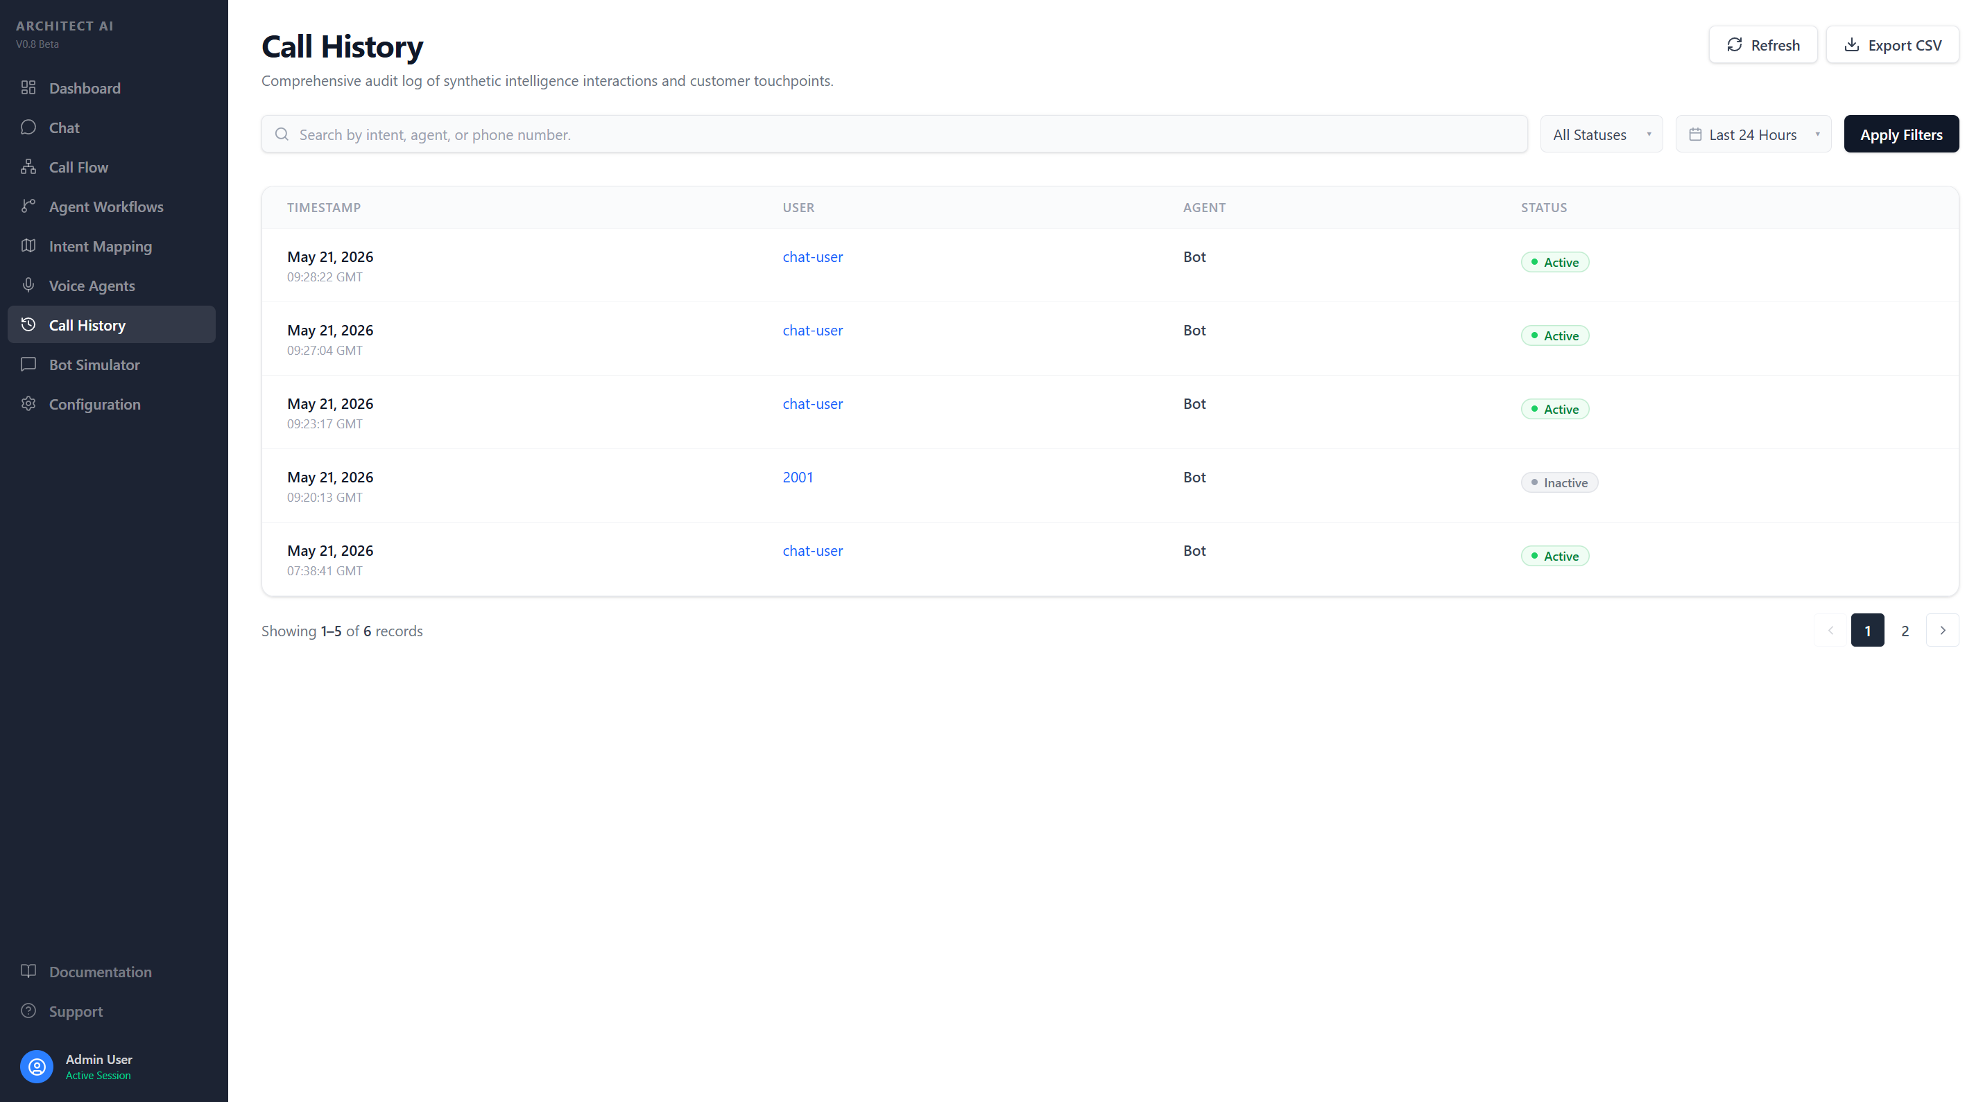
Admin Panel — Call History
07
Complete searchable log of all calls with transcripts
Features: Each call includes a complete transcript showing caller-AI conversation with intent classification and confidence scores.

Slide 9
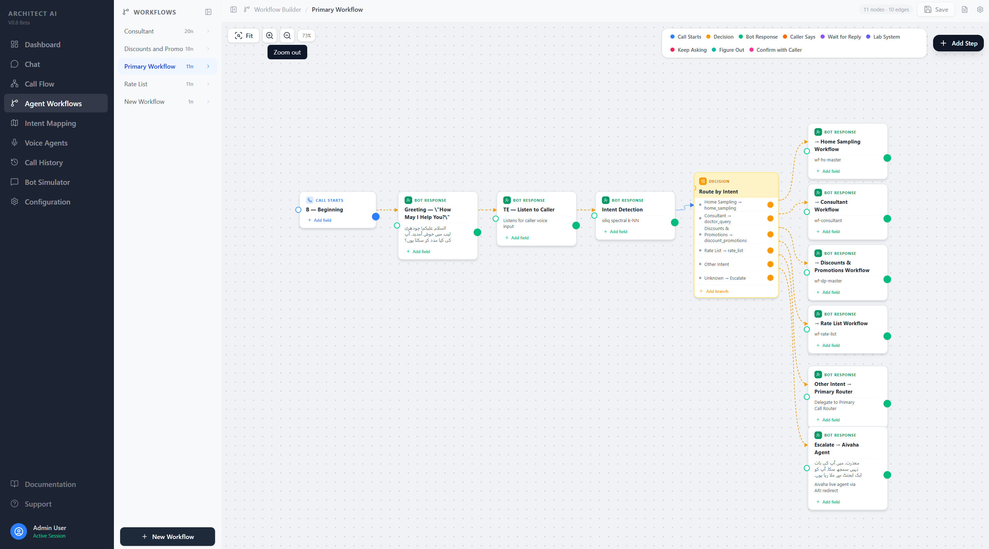
Admin Panel — Workflow Builder
08
Visual workflow builder for multi-step conversation flows

Slide 10
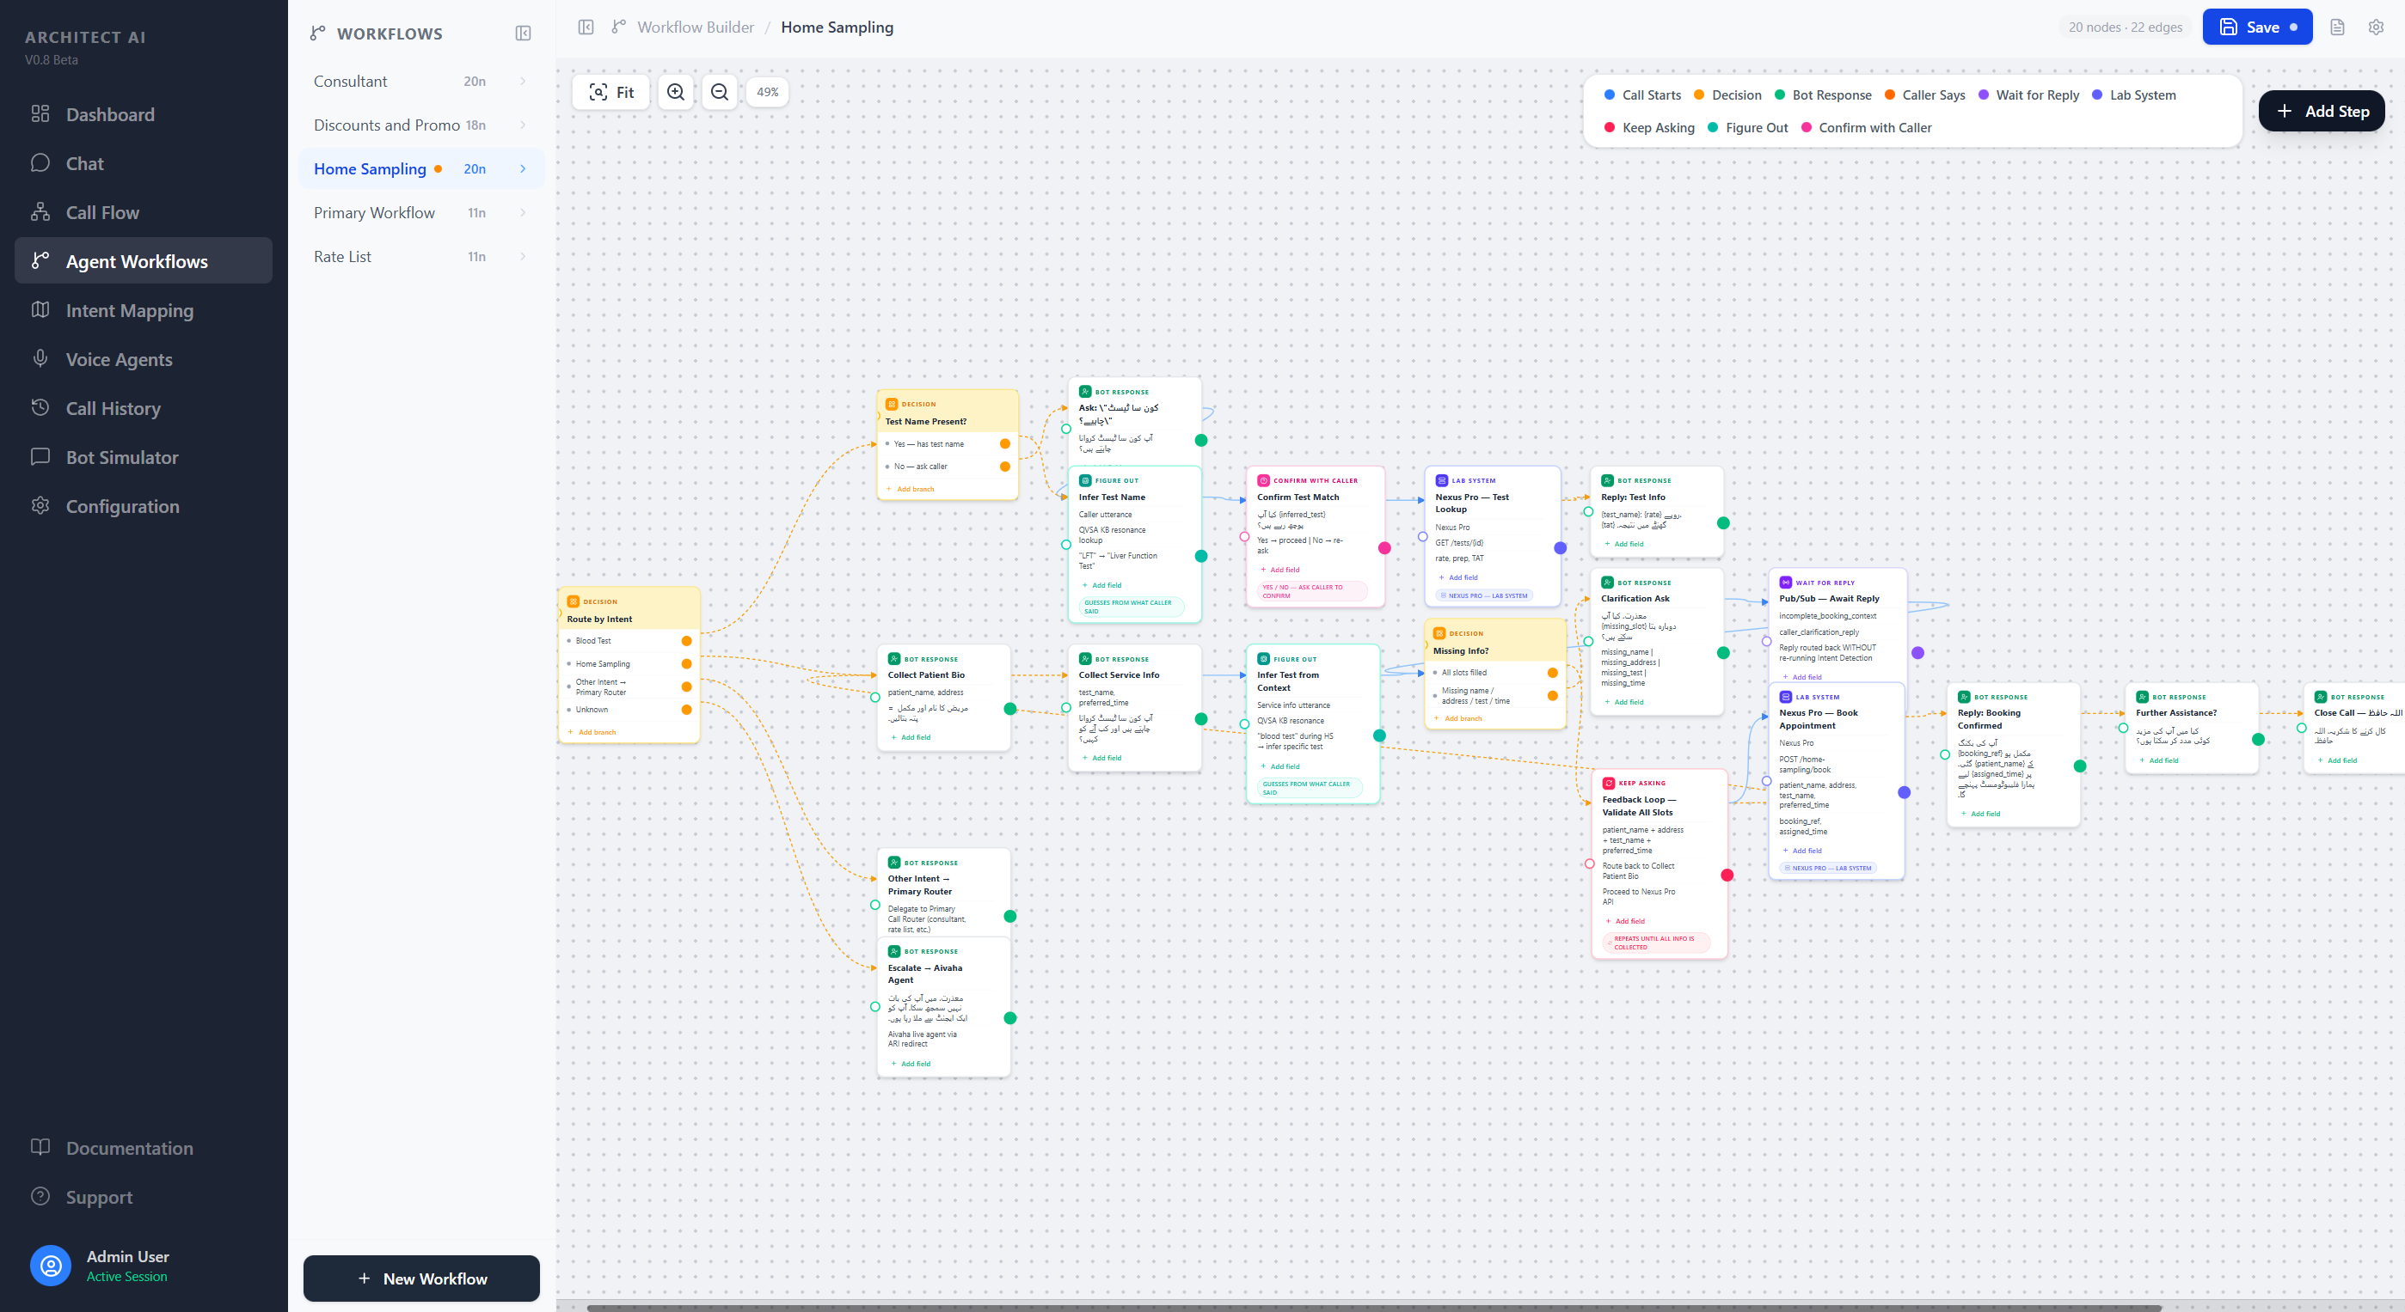
Admin Panel — Home Sampling Workflow
09
Multi-step booking flow: patient info → address → test → time → confirmation

Slide 11
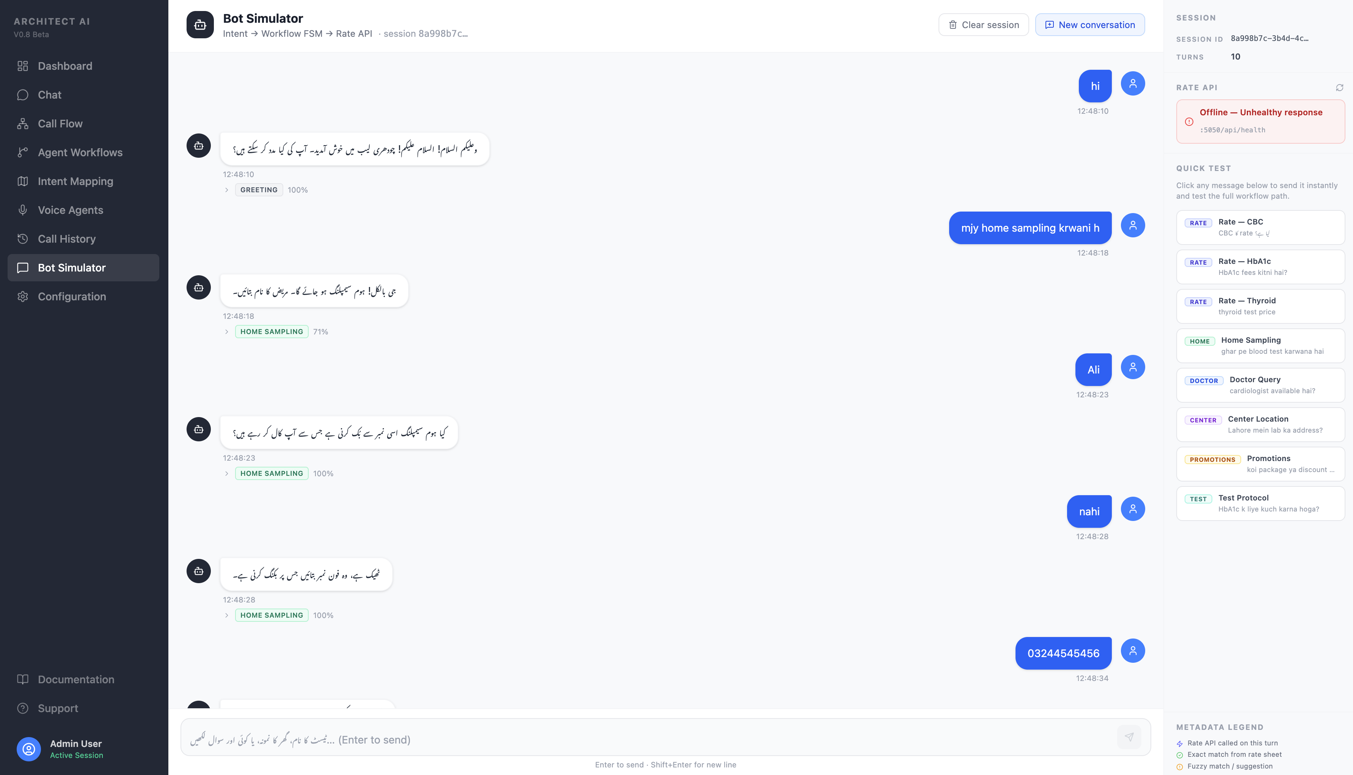
Admin Panel — Analytics & AI Interaction
09
Intent breakdown, metrics, and direct bot testing

Slide 12
Current Challenges & Solutions
10
Transparent overview of ongoing optimization areas
⚠️ Current Challenge: Speech Recognition Accuracy
• The ASR model occasionally struggles with accurate Urdu transcription in noisy environments • Some regional accents and dialectal variations (Punjabi/Urdu mix) reduce accuracy • When transcription is inaccurate, intent detection may not correctly identify the caller's request
📋 Work Completed
🔧 Resolution Approach
✅ Extensive KB data preparation & structuring ✅ Multiple testing & optimization cycles ✅ Audio preprocessing optimized for noise ✅ Silence detection algorithms refined ✅ Intent fallback mechanisms implemented
🔄 Continuous ASR model optimization 🔄 Improving audio preprocessing & noise handling 🔄 Refining training datasets with more samples 🔄 Enhancing intent detection fallbacks 🔄 Smart escalation when confidence is low

Slide 13
Current Status
11
What's working, what's being optimized
✅ Fully Working
🔄 Under Optimization
• Telephony integration (PTCL → Asterisk → Bot)
• ASR accuracy for regional accents
• Real-time audio capture and processing
• Intent confidence threshold tuning
• Speech-to-Text conversion (Urdu)
• Response naturalness in edge cases
• Intent detection and classification (16+ types)
• Call flow smoothness improvements
• Knowledge base retrieval and responses
• AI response generation (LLM-based)
• KB coverage for rare queries
• Text-to-Speech for Urdu responses
• Multi-turn workflows (Home Sampling, etc.)
• Admin panel with live monitoring
📈 System Stability
• Call history and transcript storage
• Workflow builder and management
• Core pipeline: Stable and reliable • Admin panel: Production-ready • Telephony: Handles concurrent calls • KB: Comprehensive coverage • Uptime: Consistent with auto-recovery
• Bot Chat testing interface
• Escalation to human agents

Slide 14
Project Achievements
12
Key outcomes delivered so far
✓ Customer Support Automation
✓ Faster Query Handling
AI handles routine inquiries end-to-end — pricing, availability, preparation — without human intervention.
Average call under 2 minutes. Zero hold time — instant responses without waiting in a queue.
✓ Reduced Manual Workload
✓ Better Customer Experience
Repetitive queries (pricing, test info, locations) handled by AI — agents focus on complex cases.
Natural Urdu conversation, 24/7 availability, consistent accuracy from a single source of truth.
✓ Scalable AI Infrastructure
✓ Centralized Admin Monitoring
On-premise architecture handles multiple simultaneous calls. No per-call API costs.
Complete visibility — live calls, transcripts, analytics, workflows — all from one dashboard.

Slide 15
Conclusion & Next Steps
The AI Helpdesk system has been successfully developed with all core modules operational. The platform is actively handling calls and delivering measurable value.
✓ End-to-end voice AI pipeline (telephony → STT → intent → KB → LLM → TTS) ✓ 16+ intent categories with intelligent routing ✓ Comprehensive knowledge base covering all lab services ✓ Multi-turn workflow automation (home sampling, appointments) ✓ Full-featured admin panel with real-time monitoring ✓ Smart escalation to human agents for unresolved queries
Thank you for your continued partnership.

