Slide 1
Neuroevolution in Games: State of the Art and Open Challenges
Aqiff Mursyideen bin Shamsul Safuan
WID170005 17141207/1

Slide 2
Introduction
In neuroevolution (NE), artificial neural networks are trained through evolutionary algorithms, taking inspiration from the way biological brains evolved, Artificial Neural Network (ANN) lookalike.
Analyze application of NE
Role NE is chosen to play in a game
Different types of Neural Networks used
How the networks are evolved
How the fitness is determined
Type of input the network received
Open Challenges

Slide 3
Motivation of the paper
Neuroevolution has been considered as an important method that has seen continued popularity since inception where numerous existing applications in games and even more potential applications
Games are excellent testbeds for neuroevolution research that have many advantages over existed testbeds
Basic NE Algorithm
A population of genotypes that ANN encoded is evolved to find a network
Each genotype is encoded into neural network
Tested on specific task for a certain amount of time and performance fitness is then recorded
New population is generated by changing slightly changing the ANN-encoding through mutation or cross-over
Then, it is repeated until finding better performing networks

Slide 4
Basic NE Algorithm
A population of genotypes that ANN encoded is evolved to find a network
Each genotype is encoded into neural network
Tested on specific task for a certain amount of time and performance fitness is then recorded
New population is generated by changing slightly changing the ANN-encoding through mutation or cross-over
Then, it is repeated until finding better performing networks

Slide 5
Benefits of NE | Drawbacks of NE
Record-beating performance: provides the best performance in competition with other learning methods | “Black box” properties: Human cannot easily work out what they do by looking at them
Broad applicability: it can be used for supervised, unsupervised and reinforcement learning tasks | Problem for game development and QA: It is hard to debug their learnt behaviours
Diversity: enables NE methods to achieve several forms of diversity among its results, and so deliver sets of meaningful strategies, controllers, models or content | Can clash with traditional design principles: Hard to predict the kind of behaviour will be learned
Scalability: NE seems to handle large action or state spaces very well when it is used for direct action selection
Open-Ended Learning: NE can be used for RL in the same way TD-learning where behavior of complexity and sophistication could emerge
Enables new kinds of games: New and unique games can be implemented with NE such as Galactic Arms Race and Petalz

Slide 6
Role of Neuroevolution
Use to learn to play a game or control an NPC in a game
Neural network can have two roles; to evaluate the value of states or actions or directly select actions to take in a given state
Procedural content generation (PCG) can be used to represent content by evolvable neural networks
NE can also predict the experience or preferences of players

Slide 7
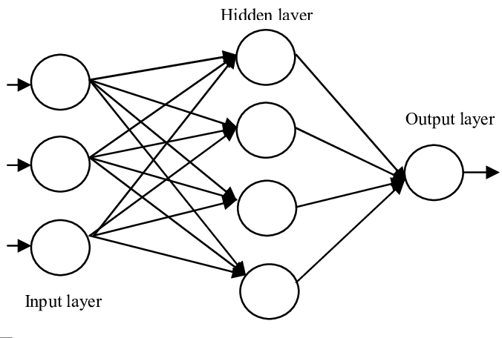
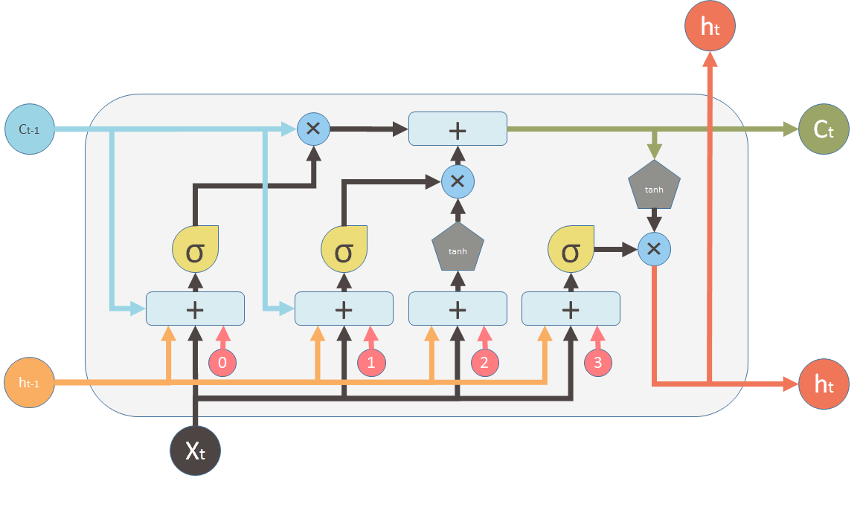
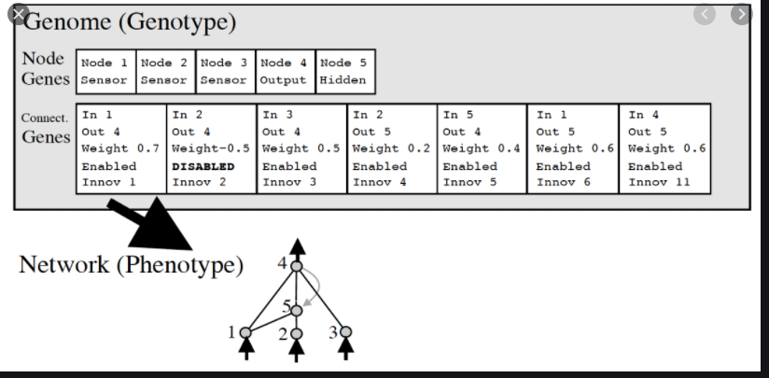
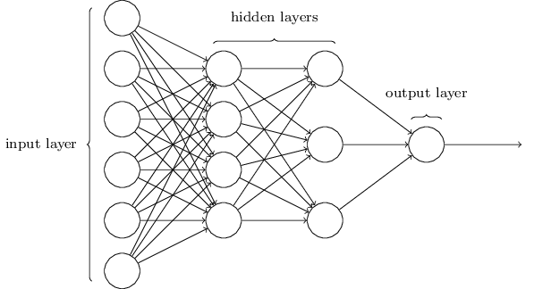
Types of ANN that are found in NE
Feedforward
Recurrent
Modular
Artificial Neural Network
Long Short Term Memory (LSTM)
Neuroevolution of Augmenting
Topologies (NEAT)
Multilayer Perceptron

Slide 8
How the networks are evolved
1. Evolve the weights of a network with a fixed user-defined topology
Simplest direct representation in the earliest NE methods
Each connection is encoded by a single real value called conventional neuroevolution (CNE)
Allows the use of any evolutionary algorithm which works on vectors of real numbers including highly efficient algorithms like Covariance Matrix Adaptation Evolution Strategy (CMA-ES)
Drawback:
Fixed topology approach that user has to choose the appropriate topology and number of hidden nodes a priori
2. Evolve the network topology together with the weights
Often outperforms the approach that evolve the weights alone
Allow the evolution of recurrent networks that can solve different non-Markovian control problems
Increase the performance in strategic-decision making problems
Drawback:
Parts of the solution that are similar must be discovered separately by evolution

Slide 9
3. Interest in indirect encoding
CPPNs often function as pattern-generators and have shown promise in the context of procedurally generated content.
to exploit geometric domain properties to compactly describe the connectivity pattern of a large-scale ANN by using HyperNEAT.
This growth process is based on an evolved genetic program that processes inputs from the board.

Slide 10
How the fitness is determined
Fitness of a board value estimator or ANN controlled NPC traditionally determined based on its performance in a particular domain
Many games are non-deterministic leading to noisy fitness evaluation, evaluating the performance of a controller in multiple independent plays and averaging the resulting scores can be beneficial
if the problem becomes too complex, it can be difficult to evolve the necessary behaviors directly

Slide 11
How the fitness is determined (cont.)
Staging and/or incremental evolution
Incremental evolutionary approach, neurocontrollers with general driving skills evolve.
Incremental evolution can also be combined with modularization of neural networks so that each time a new fitness function is added, a new neural network module is added to the mix. Hence, it allows evolution to solve the problem where acquisition of a new competence conflicts with an existing competence

Slide 12
How the fitness is determined (cont.)
Competitive Coevolution
Fitness of one AI controlled player depends on its performance when competing against another player drawn from the same population of from another population.
Thus, competitive coevolution can be said to perform a kind of automated incremental of the problem; ideally, this would lead to open-ended evolution, where the sophistication and performance of evolved agents would continue increasing indefinitely

Slide 13
How the fitness is determined (cont.)
Multiobjective evolution
Multiobjective evolution has been used to balance between pure performance and other objectives in several ways
simply increase game-playing performance by rewarding the various components of good game-playing behavior separately

Slide 14
How the fitness is determined (cont.)
Interaction Evolution
Allow a human player to interact with evolution by explicitly setting objectives during the evolutionary process, or even to act as a fitness function him or herself
curriculum consists of a sequence of training exercises that can become increasingly difficult.
One approach is the advice method, in which users write short examples of code that are automatically converted into a partial ANN; these networks are then spliced into the evolving population.
Shaping in which users can influence the training by modifying the environment
The last approach was demonstration, in which users can control the agent manually and the recorded data is used to train the evolving networks in a supervised fashion.

Slide 15
Type of input the network received
Choosing the right representation can significantly influence the ability of an algorithm to learn autonomously
Type of input can significantly bias the evolutionary and dictate which strategies and behaviors can ultimately be discovered

Slide 16
Different types of input representation
1. Straight line sensors and pie slice sensors
Simple car racing game where the best results were achieved by using egocentric first-person information such as the car's position in the track's frame of reference
Can also be found in First Person Shooter (FPS) game, where an agent has rangefinder sensors to determine their distance from other objects and walls.
2. Angle Sensors and Relative Position Sensors
Reports the angle to a particular object, or the nearest of some class of object
Car racing experiments, such sensors were used for sensing waypoints which were regularly spaced out on the track
Evolving combat bots for Quake used angle sensors for positions of enemies and weapon pick-ups

Slide 17
Different types of input representation
3. Pathfinding Sensors
takes the topology of the environment into consideration, is the pathfinding sensor.
A pathfinding sensor reports the distance to the closest of some type of entity along the shortest path
play Ms. Pac-Man using distances along the shortest path to each ghost and to the nearest pill and power pill
4. Third person input
receives additional input beyond its firstperson sensors that is not tied to a specific frame of reference
neural network typically only receives third-person input. This could include such quantities as the piece difference and the type of piece occupying each square on the board in games like Chess

Slide 18
5. Learning from Raw Sensory Data
might help us understand what aspects of the game’s visual space
forcing games to only rely on the very same information the human player gets can make it a fair comparison

Slide 19
Open Challenges
1. Reaching record-beating performance
Monte Carlo Tree Search (MCTS) provided record-beating performance in many game domains
Improve NE by taking clues from other family of algorithms or hybridisations
2. Comparing and combining evolution with other learning methods
Parameterizable benchmarks to help us chart the problem space from the vantage point of algorithm performance
Start inventing hybrid algorithms that combine the strengths of both neuroevolution and its alternatives, in particular TD-learning and GP.
3. Learning from high-dimensional / raw data
High-dimensional unprocessed data / raw images are difficult to learn from
promise significantly improved performance. It seems like very interesting work would result from the sustained application.

Slide 20
Open Challenges
4. General Video Game Playing
Same algorithm can be applied with few tweaks to a large number of different game-related tasks
A controller architecturethat could be evolved to play any game from a large set would be a step towards more generic AI capabilities
5. Combining NE with lifelong learning
Evolving a single ANN that could learn and adapt continuously
6. Competitive and Cooperation Coevolution
Competitive Coevolution enable open-ended revolution through arm races
Cooperative coevolution could help find solutions to complex problems through automatically decompose the problems
7. Fast and reliable methods for commercial games

