Slide 1
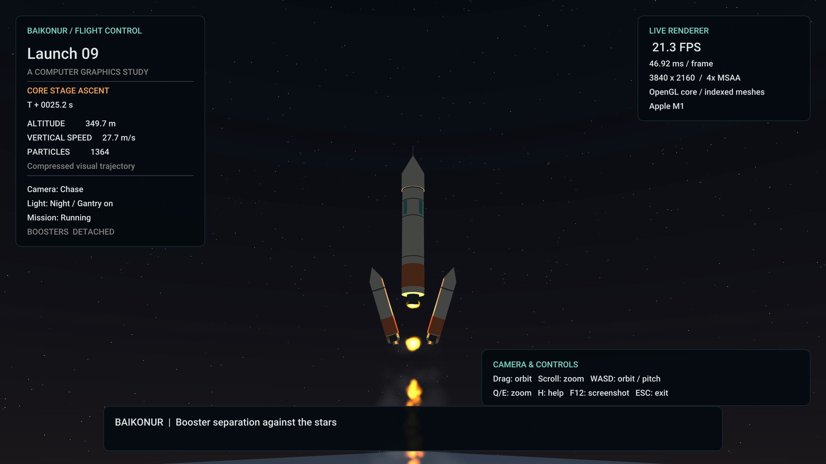
Baikonur Rocket Launch
An interactive OpenGL graphics project
Akbope Bakytkeldy · SE2426
Moldir Omar · SE2426
Ayaulym Talgat · SE2427
Talant Altaikhan · SE2425
Computer Graphics Fundamentals
Instructor: Nazira Shaimerdenova
01
Notes:
Suggested presenter: Akbope. Target: 40 seconds. Introduce the selected Baikonur topic and the four members. The application is a stylized graphics study, not an aerospace simulator. It combines scene construction, shaders, transformations, lights, textures, input and particles. The final image is a real application capture. Source: docs/evidence/finale.png. See the report AI Use Note for substantial OpenAI Codex assistance; do not claim individual development work that has not occurred.

Slide 2
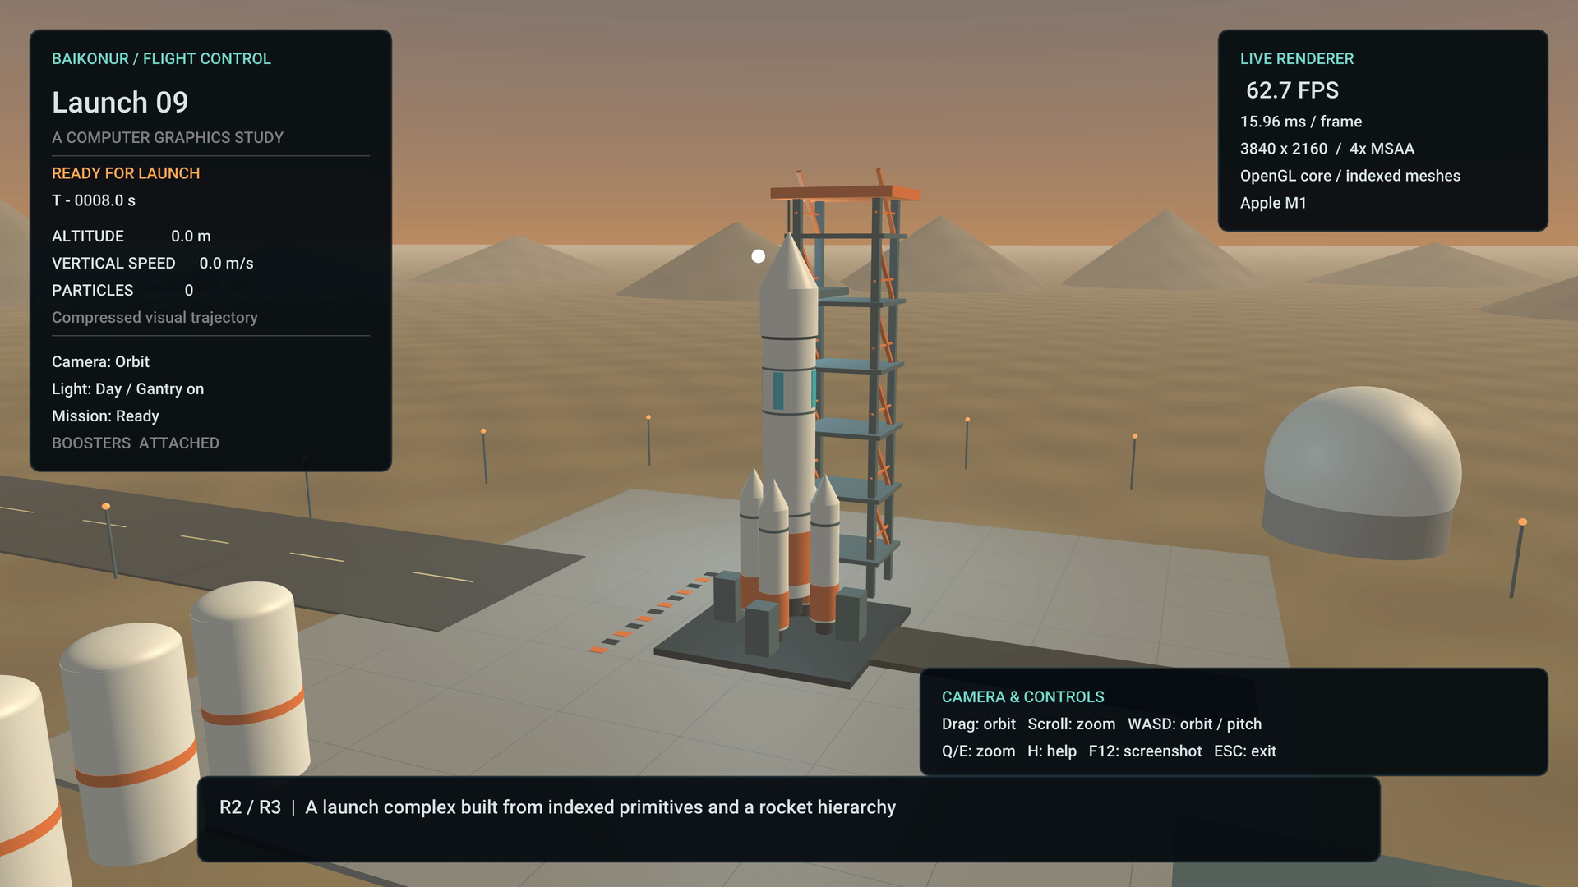
Project scope and requirements
A complete launch sequence
Countdown and ignition
Ascent with a chase camera
Independent booster separation
OpenGL 3.3 core
Original GLSL and indexed meshes
Interactive controls and live FPS
Visual flight timing and stylized geometry
02
Notes:
Suggested presenter: Akbope. Target: 50 seconds. Explain the problem: coordinate several graphics systems while preserving a responsive scene. There are more than five distinct object types, including pad, rocket, gantry, buildings, tanks and radome. R1–R8 guide the implementation. All three topic stretch features are present. The source and libraries are bundled. R7 performance on the TA machine and R8 exact course-setup compatibility still require team verification. Source: supplied final brief and topics; screenshot docs/evidence/day.png.

Slide 3
Pipeline and module architecture
Input and mission
main / Mission
World transforms
Scene / Camera
Indexed geometry
Mesh / Texture
GLSL shading
Shader
pclip = P × V × Mparent × Mlocal × pobject
One vertex crosses object, world, view and clip space.
The fragment stage combines material, normal and light data.
Render order: sky, opaque scene, smoke, fire, interface
03
Notes:
Suggested presenter: Moldir. Target: 60 seconds. Walk one cylinder vertex through the pipeline. Mesh stores vertex positions, normals and UVs in a VBO and triangle indices in an EBO. The VAO describes that layout. Transform order uses column vectors; local operations happen first. Scene supplies world matrices, Camera supplies view, and the application uses perspective projection. Shaders interpolate world position, UV and normal before lighting. Module arrows describe data flow, not ownership or a claimed thread architecture. Sources: src/Mesh.cpp, src/Scene.cpp, shaders/scene.vert; course L-4-1 and L-5-1.

Slide 4
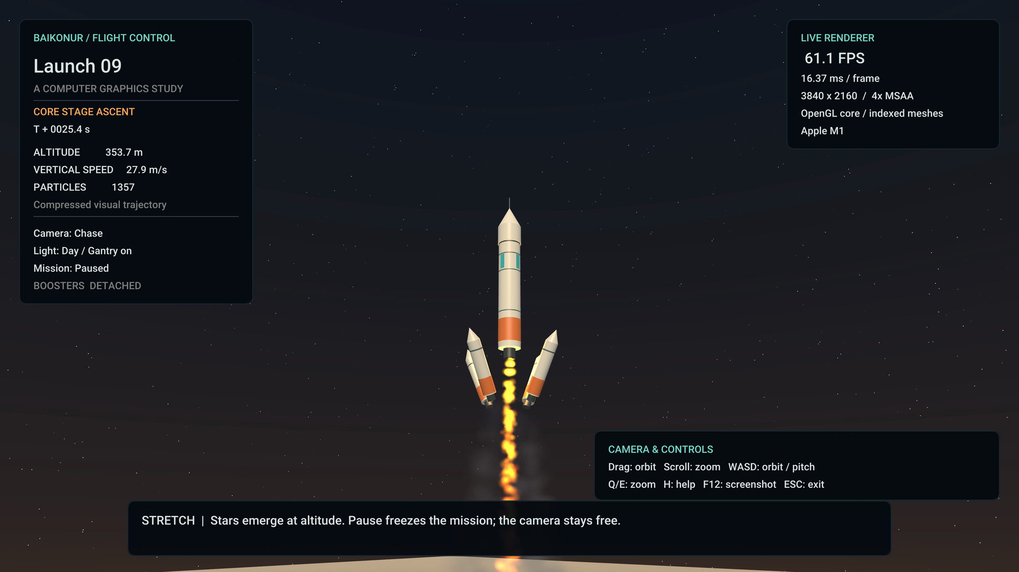
Hierarchy and booster separation
Rocket parent
Altitude h(t)
Core body
and nose
Four booster
transforms
Both groups inherit the rocket parent
Detachment preserves world position
and initial upward velocity
04
Notes:
Suggested presenter: Moldir. Target: 50 seconds. The core body and boosters both inherit the rocket parent. Before separation, the booster world matrix equals the rocket matrix times its local radial translation. At separation, the independent trajectory begins at the same world position and uses the current vertical velocity. An automated test compares matrices at detachment. Four radial directions create the falling formation. Sources: Simulation.hpp, Scene.cpp and docs/evidence/separation.png.

Slide 5
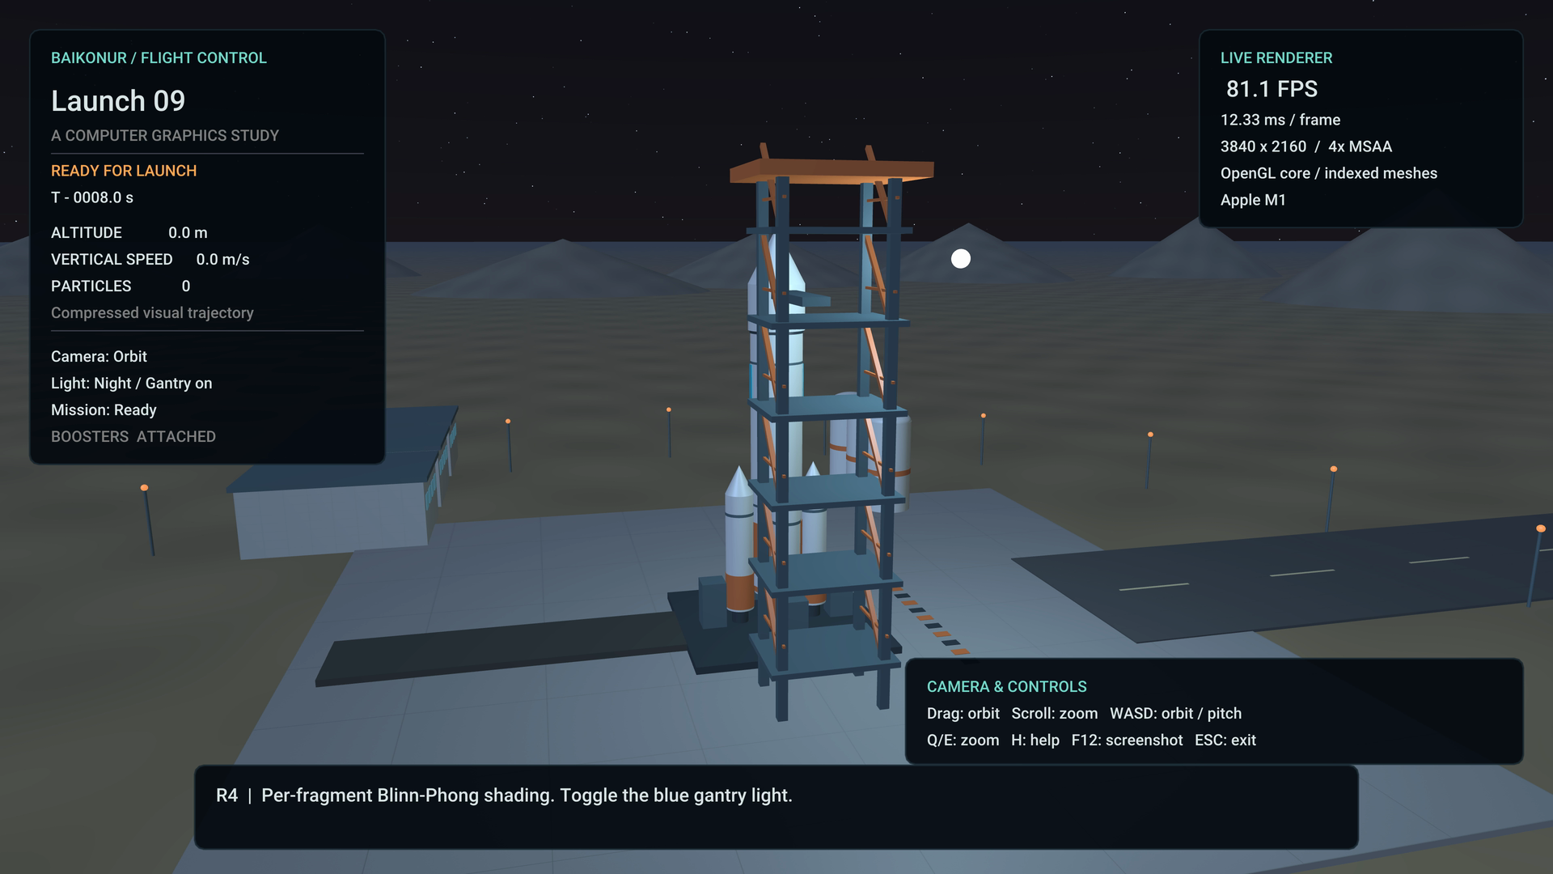
Per-fragment lighting
Blinn-Phong model
Ambient + diffuse + specular
Sun and toggled gantry light
Engine light follows the rocket
H = normalize(L + V)
specular = max(N · H, 0)ˢ
Normals use the inverse transpose
05
Notes:
Suggested presenter: Ayaulym. Target: 60 seconds. Name ambient, diffuse and specular contributions and the three light contributions. Diffuse uses the angle between normal and light; specular uses the half-vector. Clamp diffuse at zero and avoid highlights when the light is behind the surface. Nonuniform scaling requires inverse-transpose normal transformation; normalize after interpolation. Distinguish this from Cook-Torrance PBR, which is reviewed but not implemented. Source: shaders/scene.vert and scene.frag, course L-5-2 pp. 29 and 66-70; report reference [2] for the comparison.

Slide 6
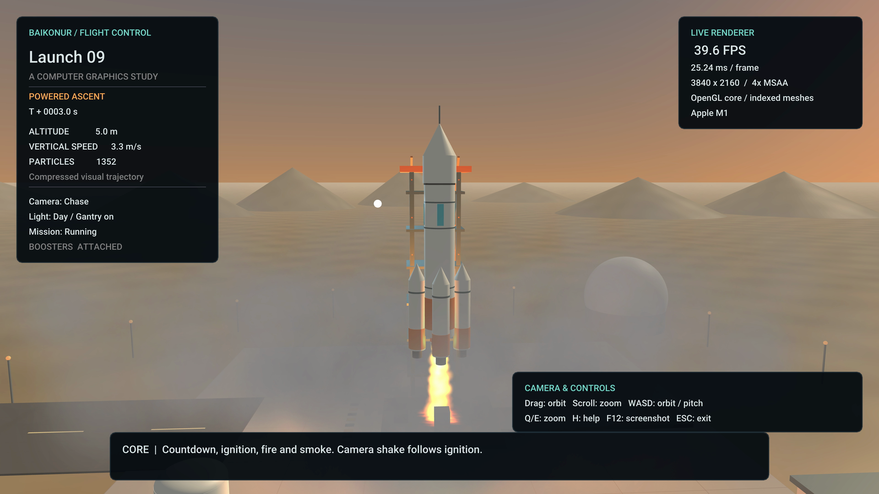
Texture sampling and particle lifecycles
Concrete texture
Correct UVs, repeat wrapping
Mipmaps reduce minification shimmer
Fire and smoke
Birth, motion, aging and removal
3,600-particle capacity
Two instanced billboard passes
Smoke: sorted alpha Fire: additive
06
Notes:
Suggested presenter: Ayaulym. Target: 60 seconds. The concrete image is generated once at 1024 by 1024 and receives a mip chain. The ground pattern is an original trigonometric procedural texture, not Perlin noise. Each particle carries position, velocity, age, lifetime, size and material. Smoke expands and fades; fire is short-lived. A shared quad with per-instance attributes reduces draw calls to two. Smoke is sorted back to front; both passes disable depth writes but retain depth tests. Source: Texture.cpp and Particles.cpp. Research context: Reeves [1], Nguyen et al. [5], Lamorlette and Foster [6]. The implementation is simpler than physical fluid simulation.

Slide 7
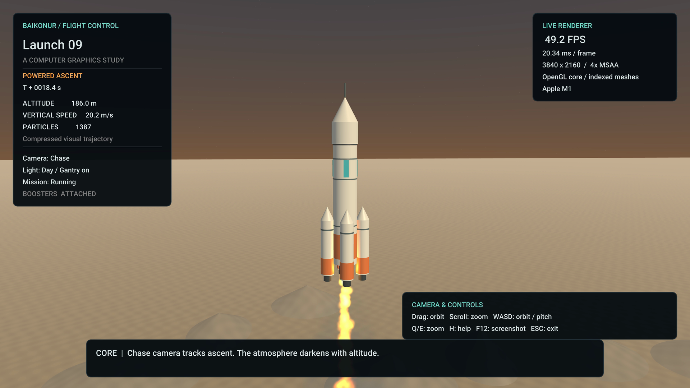
Altitude and the final launch moment
Three stretch features
Booster detachment
Ignition camera shake
Stars at altitude
Sky blend = clamp(h / 450, 0, 1)
07
Notes:
Suggested presenter: Ayaulym. Target: 50 seconds. The mission clock drives altitude, the chase target and the sky blend. Stars use a direction-based procedural pattern and fade in with the darkening sky. Ignition shake is a decaying camera offset that can be disabled. No physical atmosphere or planetary geometry is claimed. Explain why the sky transition is compressed to fit the demonstration. Research comparison: Bruneton and Neyret [12], Hosek and Wilkie [13], Hillaire [14]. Source screenshot: docs/evidence/ascent.png.

Slide 8
Interaction and replay
Action | Control
Start launch / pause | Space / P
Orbit and zoom | Drag, WASD, wheel, Q/E
Chase / separate | C / B
Light / night / wireframe | L / N / F
Reset / help / screenshot | R / H / F12
Pause the simulation
Keep exploring with the camera
Reset and replay the mission
On-screen help and FPS remain available
08
Notes:
Suggested presenter: Talant. Target: 45 seconds. Demonstrate that camera and simulation are separate: pause freezes the rocket and particles, but the camera can still orbit. Reset clears mission state and particles. The scripted video uses the same rendering and mission code with timed commands and locked manual input. Normal interactive mode leaves all controls enabled. Manual separation is allowed after T+5 and automatic separation occurs at T+24. Source: main.cpp, UI.cpp and README controls.

Slide 9
Measured performance and validation
Scene | Mean FPS | p95 frame time
Ready | 1068.3 | 1.32 ms
Ignition and ascent | 699.0 | 2.44 ms
Separation and stars | 929.9 | 1.76 ms
Apple M1, 8 GiB RAM, macOS 26.3.1
1280 × 720, Release, VSync off, 12 s runs, first 2 s excluded
Simulation tests pass. TA-machine verification remains required.
09
Notes:
Suggested presenter: Talant. Target: 60 seconds. Explain measurement conditions before quoting values. Mean FPS is measured frame-loop throughput, not a GPU timer. p95 is the 95th percentile of frame duration, so lower is better. Raw CSVs accompany the submission. A ready-scene frame outlier occurred during the local run; report does not claim a strict all-frame minimum. Tests check timing, reset, pause, frame-rate consistency and detachment continuity. Local OpenGL checks reported zero errors. Repeat the test on the actual TA machine. Source: docs/evidence/metrics.json and raw CSV/log files.

Slide 10
Results, limitations and next steps
A complete interactive launch
Working core pipeline and all three topic stretch features
Reproducible build, measured evidence and captioned demo
Next graphics work
AI use and team review
Shadows, curl-noise smoke
and physical atmosphere
Substantial Codex assistance disclosed
Each member must verify and explain the code
10
Notes:
Suggested presenter: Talant. Target: 45 seconds. State the limits honestly: visual rocket timing, flat terrain, no collision solver, no shadow mapping and no physical combustion. Future graphics work should be profiled incrementally. Explicitly acknowledge substantial OpenAI Codex assistance in code and writing, recorded in README and report. Team members must confirm actual contributions, make genuine review commits and understand the code. End by introducing the 3 minute 20 second video. Sources: report Sections 7 and 9; comparison with curl-noise [10] and atmosphere [12]-[14].

