Slide 1
Introduction to Stompc
Zhang Xiaoqing
2010.04
Notes:
感谢大家参加
可能比较无聊，希望对想学C的人有所帮助

Slide 2
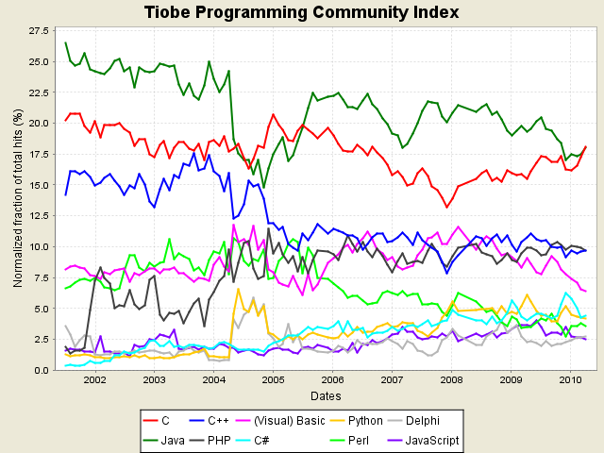
Why Stompc
Notes:
2010年4月份: 时隔4年多，C重新排上语言排行榜第一名

Slide 3
Why Stompc
Practice C language
TDD and Refactoring of C
Well/Not well tools
Sum up best practices of C language
Notes:
Huawei has many c projects, however, only Yuan Ying/Zheng Ye/Guanglei…
对c的一些介绍，没有深入

Slide 4

What is Stomp
Stomp
a simple text oriented messaging protocol
Commands
CONNECT DISCONNECT
SEND SUBSCRIBE UNSUBSCRIBE
BEGIN COMMIT ABORT ACK
Notes:
subscribe to destination and then send/receive messasges;
support transaction
协议只有3页

Slide 5
What is Stomp
Usages
Apache ActiveMQ
Practice Language
Challenges
Socket Programming
Multiple threads
Performance
Notes:
C Socket Programming: 自己接受字节流，自己解析

Slide 6






Project Progress
Stomperl: 1week
Stompc: >1month
Notes:
Michael: setup(2009.12.18)
Ye Zheng: Write make file(2009.12.18)
Liang Huang: start developing(2010.01.20)
Zhang Xiaoqing: Start developing(2010.02.01)
Stompc Works: 2010.03.08
Xiong Jie: stomperl, 1week spare time
Stompc: 1 month spare time
Transactional support
Selector support
Functional Test
Performance improvement

Slide 7
Practice in C
Testable
Reusable
Maintainable
Unit test
Mock
Encapulate
…
All In One: Modular C
Notes:
面向对象的封装、继承、多态
SOLID五原则
Testable C
──很多经验可以借鉴到C，这其中Modular C是关键

Slide 8
Practice-Modular C
What is Moduler C
Define opetations of a data type within 1 module
Encapulate
Data Module over Function Module
Encapulate
Notes:
(Example: scs.h, scs.c)
Bad example: stomp-frame.h

Slide 9
Practice-Modular C
Function:
Header file describe interface
Hide implementaion details in source file
Use static to hide private functions
Never use extern except …
Variable:
Define it as late as possible to limit visibility/scope
Use static to hide information
Abstract Data Type
In header: typedef struct datatype *datatype;
Notes:
Example: scs.h
Bad example: stomp_frame.h
Limit scope:
Define as late as possible
Define static within 1 function

Slide 10
Practice-Modular C
Name Convension
Prefix method name with module data type name.
Static over public/private
#define public
#define private static
Notes:
不要使用extern，除非
用extern "C"告诉C++编译器按照C语言处

Slide 11

Practice-UT
XUnit
Test Double(Mock)
TDD&Refactor
Notes:
Junit/Nunit
Unittest++, testcpp; google test; cunit, cppUtest
Spring: Dependecy Injection
EasyMock
Mockito：
PowerMock
Java/Ruby…

Slide 12
Practice-UT

Slide 13
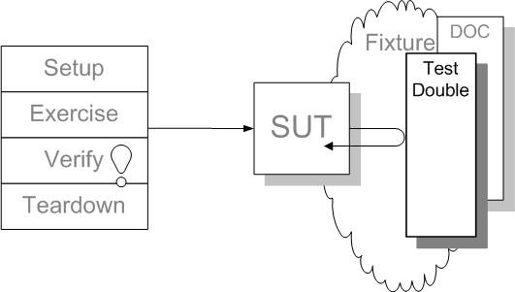
Practice-UT
Test Double Pattern
Notes:
Spring: Dependecy Injection
EasyMock
Mockito：
PowerMock
C?

Slide 14
Practice-UT
Link-Time substitution
Function pointer substitution
Preprocessor substitution

Slide 15
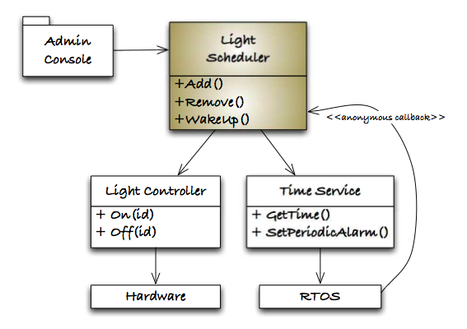
Practice-UT
Link-Time substitution
Notes:
Design

Slide 16
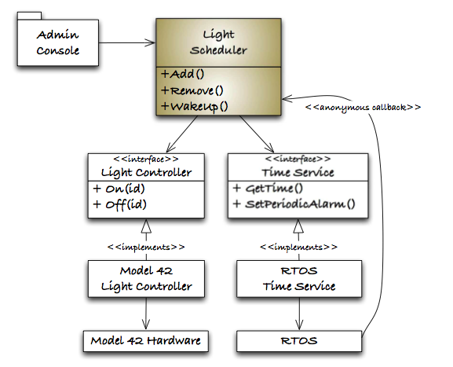
Practice-UT
Link-Time substitution
Notes:
Seperation interface from implementation
LightScheduler is bound to production code implementation at link-time

Slide 17
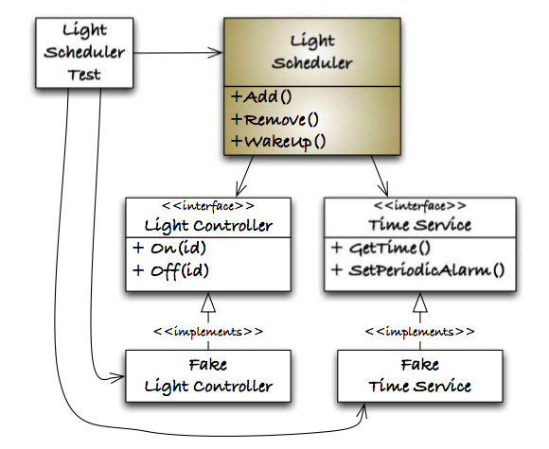
Practice-UT
Link-Time substitution
Notes:
Seperation interface from implementation
LightScheduler is bound to production code implementation at link-time
Do not mock every time: only when it’s of high cost if not mock.

Slide 18
Practice-UT
Function pointer substitution
Notes:
Stomp_protocol_test.cpp
与Java中的Mock比较类似

Slide 19
Practice-UT
Preprocessor substitution

Slide 20
Practice-UT
Refactor&&TDD
Remove duplication code
Short method
Descriptive name
Remove unused comments
Copy/Paste
Small Step
Notes:
, use unit test as safty net

Slide 21
Resources
http://stomp.codehaus.org/Home
http://www.nighttale.net/resources/stomp-and-json.html
http://www.infoq.com/cn/articles/stomperl-messaging-middleware
http://github.com/mechiland/stompc
Modular C
Test Driven Development for Embedded C
Notes:
Say thanks to:
Fake Ren
Peng Xiao
Li Guanglei
Yuan Yingjie/Zheng Ye

Slide 22
QA?

