Slide 1
Testing CSP and processing disconnected SMILES

Slide 2
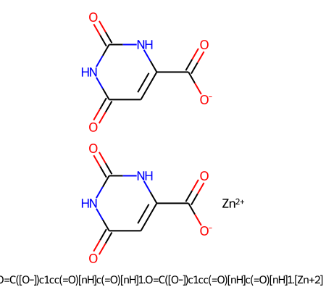
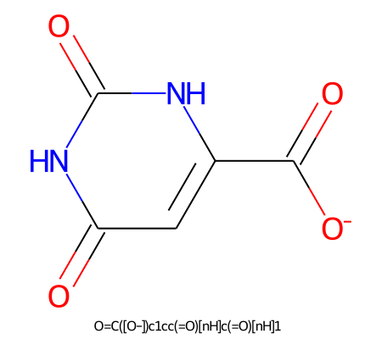
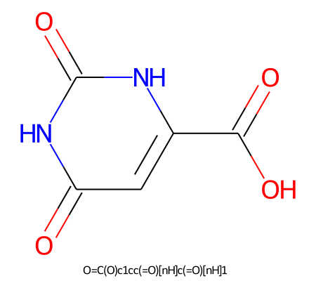
Example 1
Original SMILES is salt: inorganic cation + organic anion
[Zn++].[O-]C(=O)c1cc(=O)[nH]c(=O)[nH]1.[O-]C(=O)c1cc(=O)[nH]c(=O)[nH]1
Processing with CSP only
Process disconnection only
CSP -> disconnection
Disconnection -> CSP

Slide 3
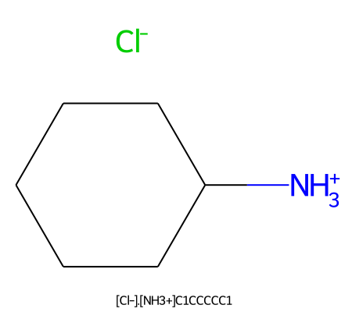
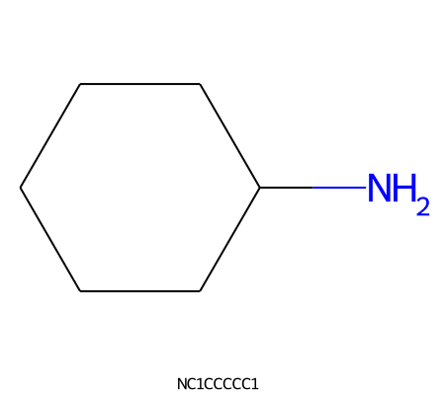

Example 2
Original SMILES is salt: organic cation + inorganic anion (able to remove H⁺ from cation)
[Cl-].[NH3+]C1CCCCC1
Processing with CSP only
Process disconnection only
CSP -> disconnection
Disconnection -> CSP

Slide 4
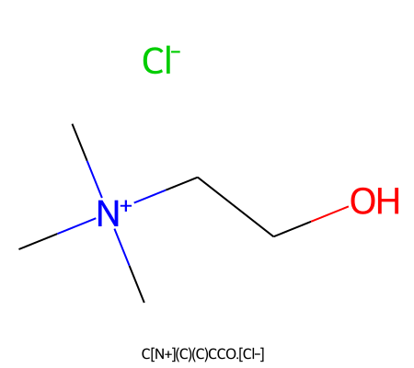
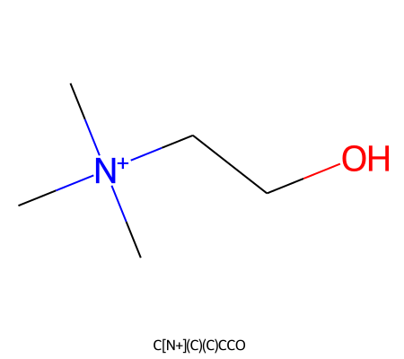
Example 3
Original SMILES is salt: organic cation + inorganic anion (not able to remove H⁺ from cation)
[Cl-].C[N+](C)(C)CCO
Processing with CSP only
Process disconnection only
CSP -> disconnection
Disconnection -> CSP

Slide 5
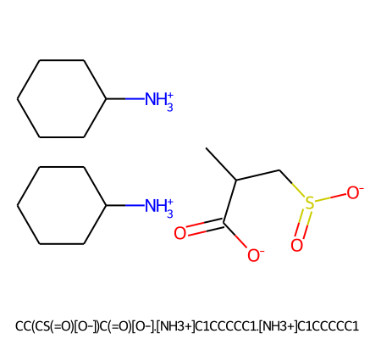
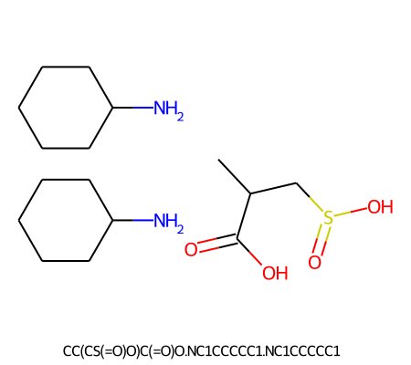
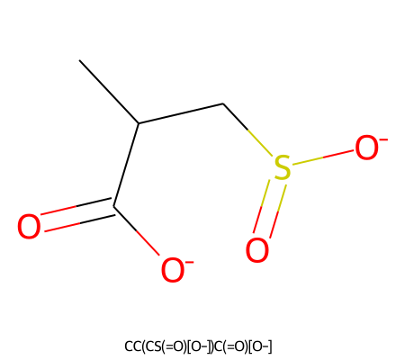
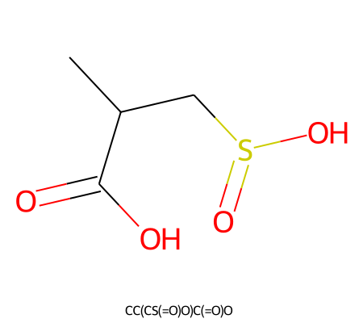
Example 4
Original SMILES is salt: organic cation + organic anion
S(=O)(CC(C(=O)[O-])C)[O-].[NH3+]C1CCCCC1.[NH3+]C1CCCCC1
Processing with CSP only
Process disconnection only
CSP -> disconnection
Disconnection -> CSP

Slide 6
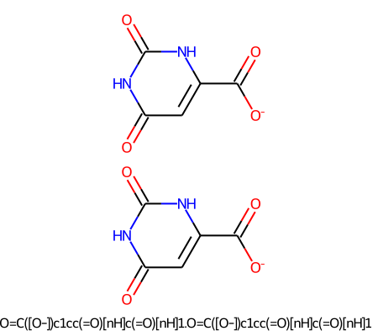
Example 5
Original SMILES is ion: organic anion
[O-]C(=O)c1cc(=O)[nH]c(=O)[nH]1.[O-]C(=O)c1cc(=O)[nH]c(=O)[nH]1
Processing with CSP only
Process disconnection only
CSP -> disconnection
Disconnection -> CSP

Slide 7
Example 6
Original SMILES is ion: organic cation (able to remove H⁺ from cation)
[NH3+]C1CCCCC1
Processing with CSP only
Process disconnection only
CSP -> disconnection
Disconnection -> CSP

Slide 8
Example 7
Original SMILES is ion: organic cation (not able to remove H⁺ from cation)
C[N+](C)(C)CCO
Processing with CSP only
Process disconnection only
CSP -> disconnection
Disconnection -> CSP

Slide 9
Conclusion
CSP: neutralize molecule, via adding H⁺ to anion and removing H⁺ from cation if possible; remove neutral inorganic molecule.
Salt remover: keep ion form; remove the part with less atoms.
Chem. AddHs will NOT change the ion/neutral form.

