Slide 1

Crowdfunding Kickstarter Data Analysis & Dashboard
Group Three
Team Members: Abdul Qadir Khan, Fathima Saina Ajumal, Bolerao Ramya, Pooja Jaiswal, Harshitha Kommareddy, Santosh Kumar, Mitali Sharma
Tools Used: Excel | SQL | Tableau | Power BI

Slide 2
Business Problem & Objective
Business Problem:
Crowdfunding platforms generate large amounts of raw data (Epoch timestamps, currencies) that make trend analysis difficult.
Objective:
To clean, model, and visualize crowdfunding data for insights into project success, funding amounts, and backer engagement.

Slide 3
Data Sources
Projects.xlsx – Details of all crowdfunding projects (goal, amount raised, dates).
Category.xlsx – Project categories for analysis.
Location.xlsx – Geographic location data for projects.
Creator.xlsx – Information about project creators.
Projects.sql- SQL file containing project database setup or queries
Excel – Data cleaning and preparation
Power BI – Dashboard building and reporting
Tableau – Data visualization and analysis
SQL – Data querying and joins

Slide 4
Data Preparation Steps
1. Convert Epoch time → Natural date
2. Build Calendar table with fiscal metrics
3. Create data model linking all files
4. Convert Goal to USD using static rate
5. Build KPIs in Power BI/Tableau

Slide 5
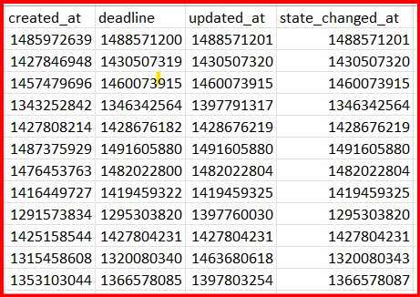
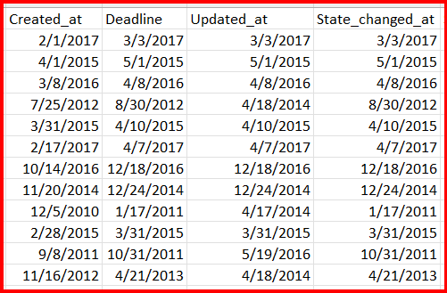
Data transformation epoch to natural time Example

Slide 6
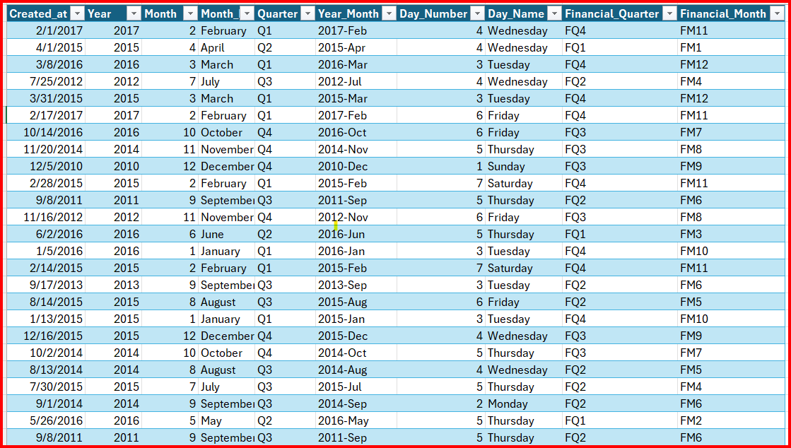
Calendar Table Example

Slide 7
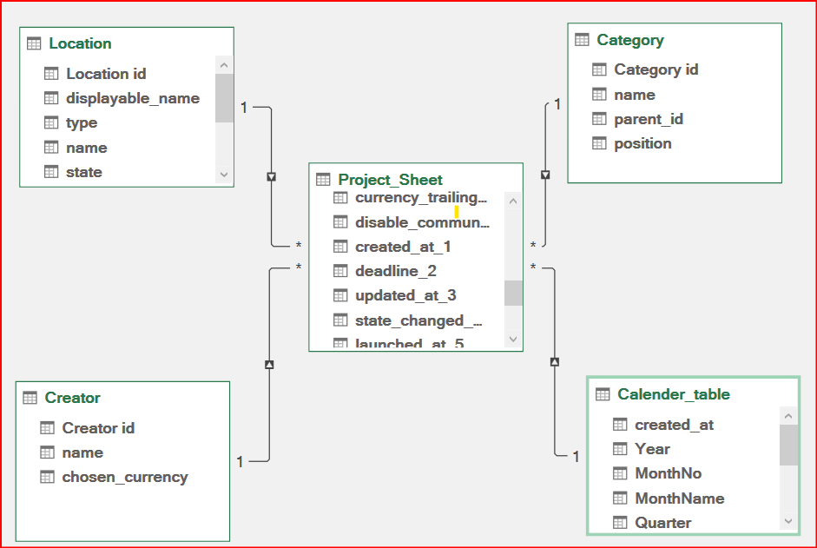
Data Model

Slide 8
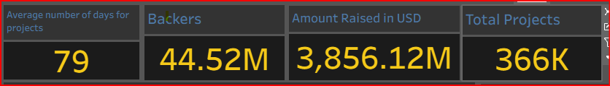
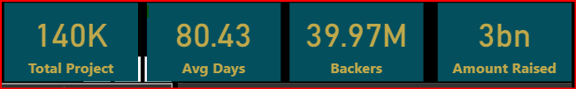
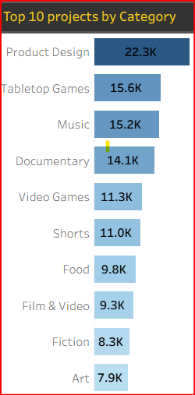
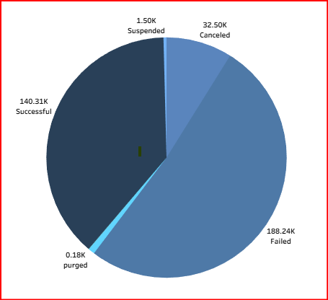
KPIs & Insights
KPIs
Successful Projects Overview

Slide 9
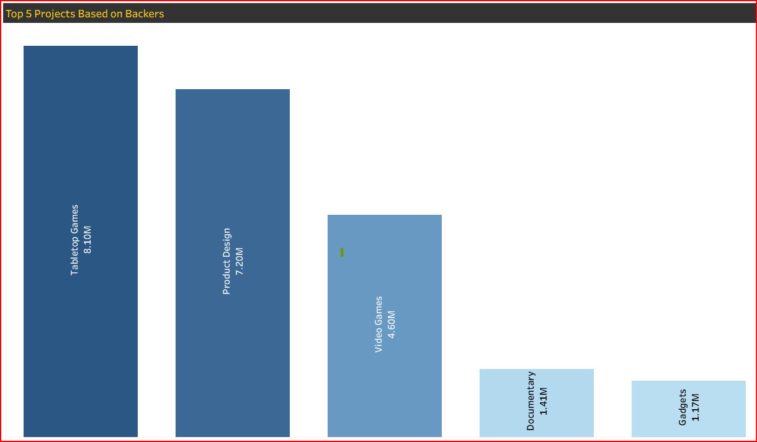
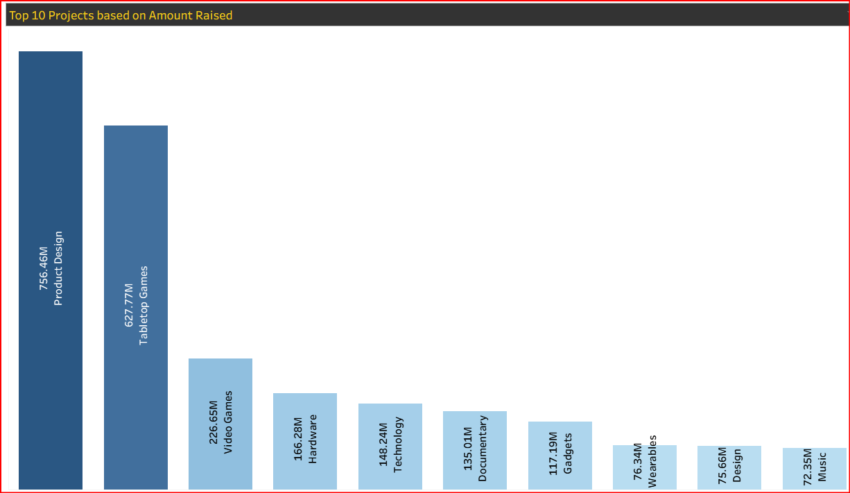
Top Performing Projects

Slide 10
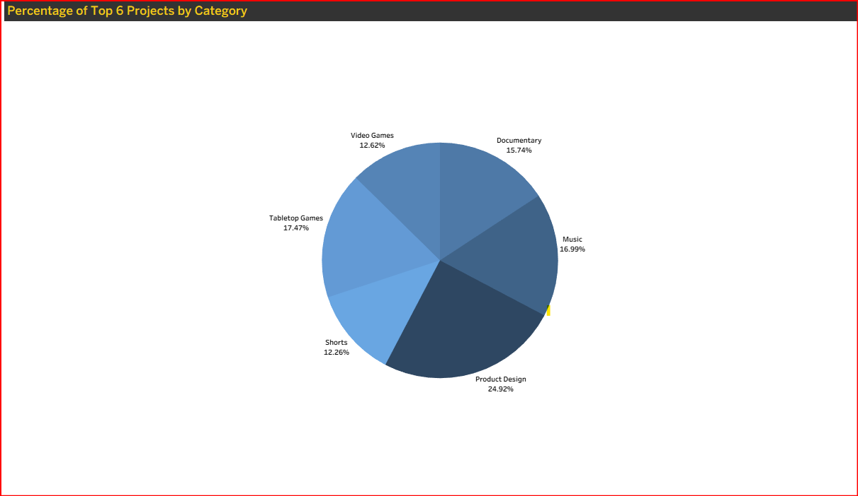
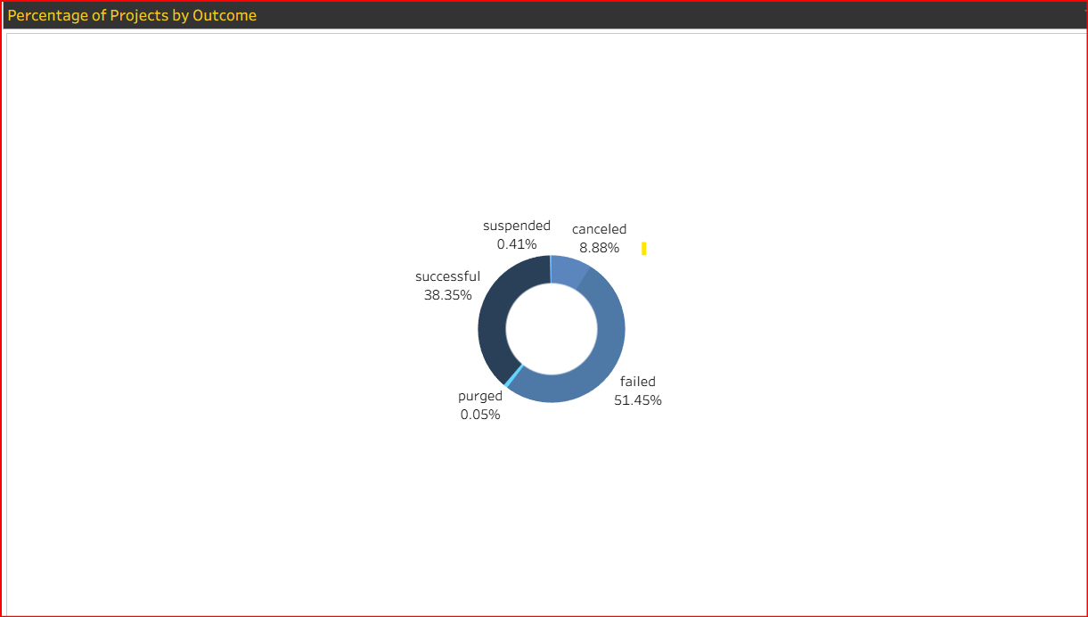
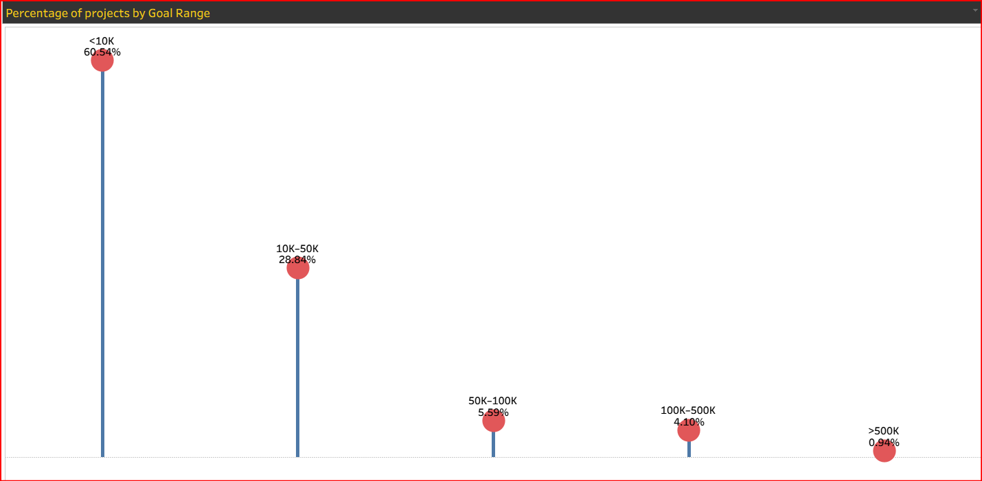
Success Percentage Analysis

Slide 11
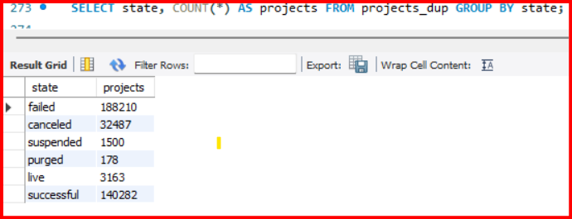
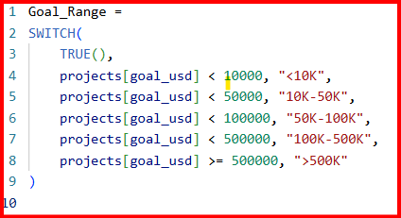
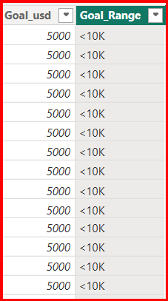
SQL & DAX Highlights

Slide 12
Key Findings
Top Project categories: Product Design, Tabletop Games, Video Games, Hardware, Technology, Shorts, Documentary, Gadgets, Music
Higher rates for projects with goals under $10K
Lower rates for projects with goals above or equal to $500K
Highest number of projects observed in the United States
Lowest number of projects observed in the Togo, Seychelles, São Tomé and Príncipe
Seasonal trend: Most projects Created in Q3 (July–September)
Highest number of successful projects observed in Q1 (January–March)
Lowest project success rate recorded in Q4 (October–December)

Slide 13
Conclusion & Next Steps
Conclusion:
Data reveals key drivers of crowdfunding success
Next Steps:
Deploy dashboards online
Automate currency updates
Integrate live data APIs

Slide 14
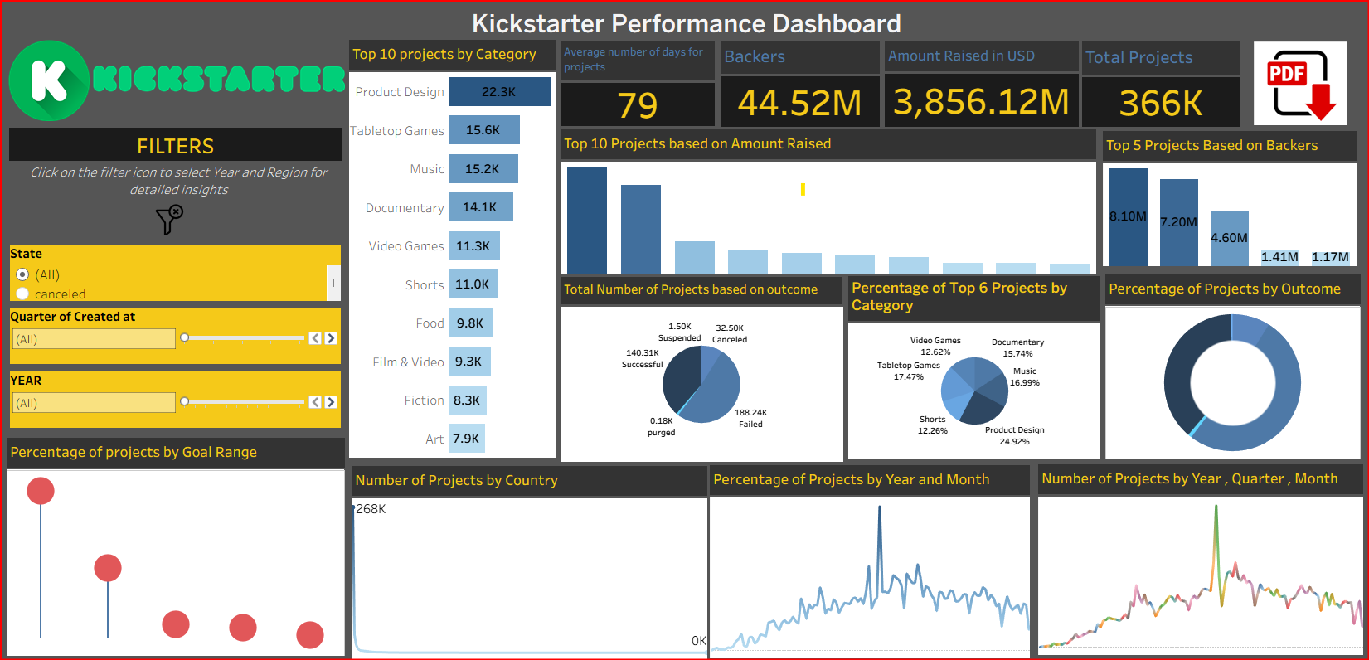
Dashboard

Slide 15
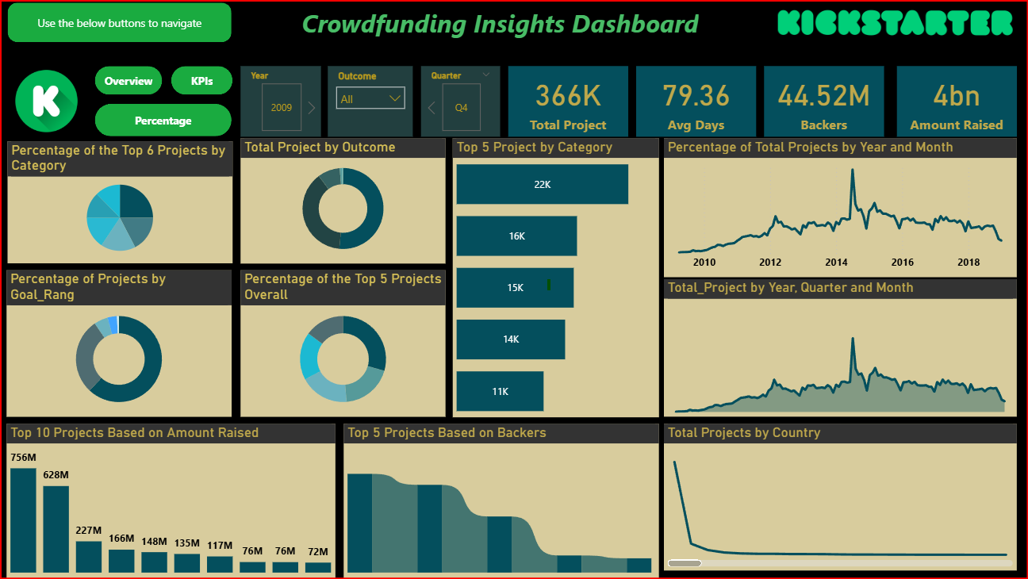

Slide 16
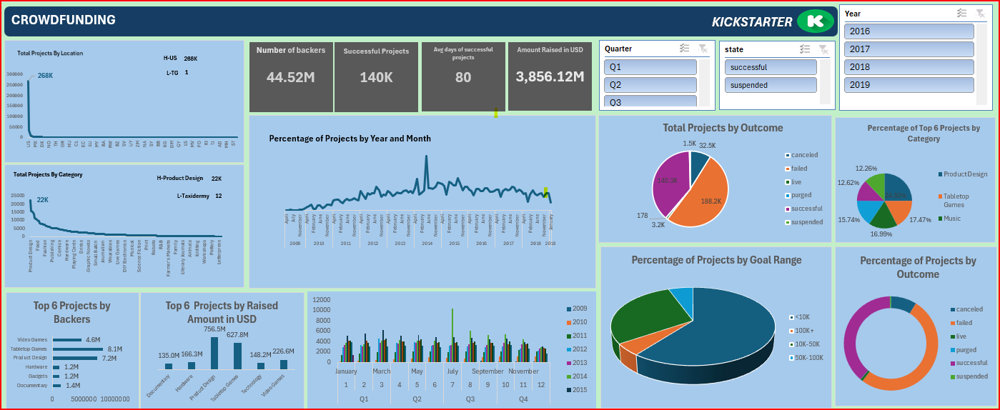

Slide 17
Thank you!

