Slide 1
The Discrete-Time Kalman Filter and Its Applications
Jonathan Bush, Alec Knutsen
April 23, 2016
Notes:
JB
Hook:
[Have some energy, be excited]
What is the discrete–time Kalman Filter? At the most basic level, the Kalman Filter is an algorithm.
Algorithms are tools that provide scientists and engineers solutions to complex problems, often implemented with computer coding and simulation.
The Kalman Filter can accurately track the position and velocity of an incoming missile and can safely guide the landing of a minilab for the exploration of Mars. In the near future, the algorithm will aid in guiding our self-driving cars and planes.
Clearly, this is a powerful algorithm. Our paper will not only explain this power, but will also mathematically prove it.

Slide 2
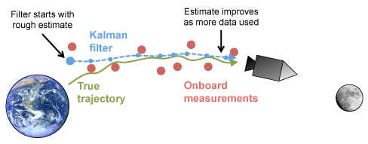
History and Applications of the Kalman Filter
History: Dr. Rudolf Kalman’s paper
Other Uses:
Signal Processing
Robotics
Navigation
Financial Systems (stocks and market trends)
Neurology
Notes:
JB
History/Lit Review.
“A New Approach to Linear Filtering and Prediction Problems” -
Kalman first derived his discrete-time Kalman Filter.
At first, the paper was highly criticized as most could not believe the precision and optimization of the Kalman Filter.
However, the filter’s power became evident when it was successfully used to guide some of the first Apollo missions for NASA.
Since then, it has been used across a wide variety of fields such as …

Slide 3
Noise and Filtering
Noise - Some unexplained variations in a measurement sample
Filtering - A technique used to minimize the noise in a sample to produce more accurate measurements
Notes:
Alec
Context: What is Filtering?
Noise - Can be thought of as uncertainty in measurement/observation due to a measuring device or other error, but in general can be used to introduce any expected error that would occur in any part of the system we are modeling and estimating.
Filtering – A way to remove the unplexained variation to give a more accurate representation of some measurement.
Use the figure as a guide.

Slide 4
Motivation for the Kalman Filter
Importance:
To give a more accurate representation of some measurement sample
Advantages:
Recursively updates in real-time
Statistical properties
Cross-Boundary Nature:
Derivation and application
Notes:
Alec
Context: Why does the Kalman Filter Matter
Gives a more accurate measurement - Explain in the context of missiles and spacecraft.
Advantages over other filters: The power of the Kalman filter comes from its properties.
Cross-boundary nature –The Kalman filter algorithm is utilized across all STEM fields and can additionally be derived in different settings calling on properties from other fields of study.

Slide 5
Research Goals
Goal 1: Provide an undergraduate-level derivation
Goal 2: MATLAB sample implementation
Notes:
JB
Goal 1: Explain how we did not prove anything new, but how our goal was to provide a proof of the algorithm that was accessible to undergraduate students.
Methods:
Explain how we used lecture notes and filled in the gaps.
Start with a model and some basic statiscal properties and proof techniques that we have learned in our undergraduate curriculum. Use these techniques to come up with a derivation of the Kalman Filter.
Goal 2: Provide sample implementations of the Kalman Filter to illustrate its practical utility.

Slide 6
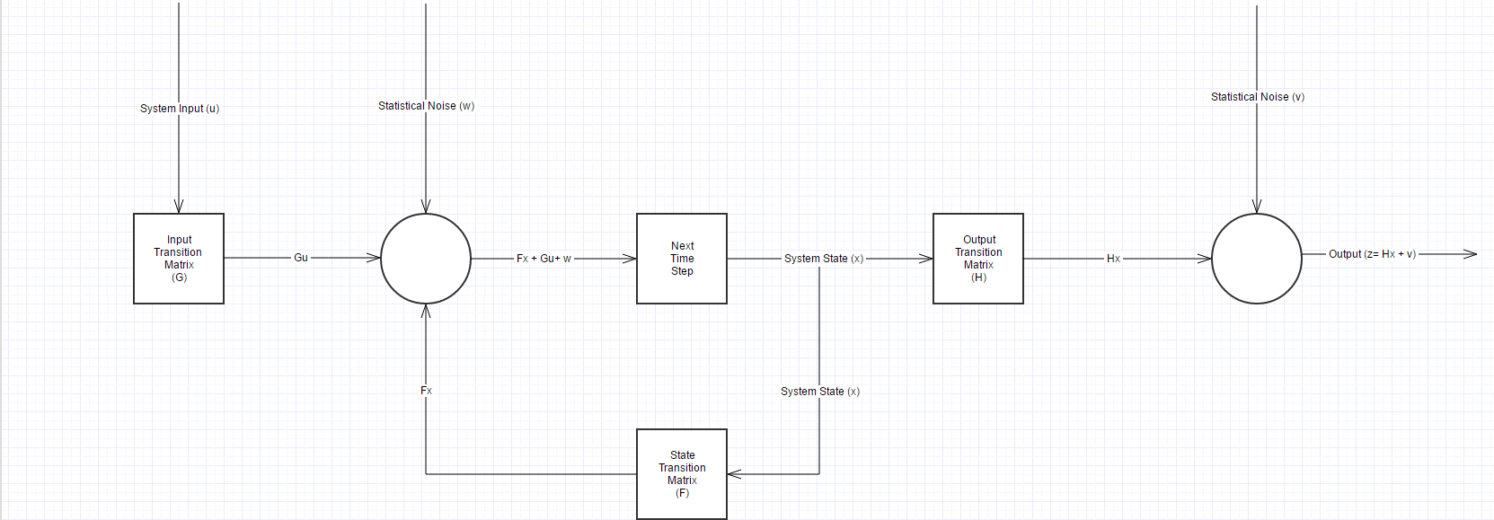
Method: State-Space Model
Noise
Noise
System Output/
Observation
System State
Governing Equations:
x_{k+1} = F_{k}x_{k} + G_{k}u_{k} + w_{k}
z_{k} = H_{k}x_{k} + v_{k}
Notes:
Alec
A state-space model is a model of a physical system.
F, G, and H are matrices which are chosen depending on the system one is modeling.
W and V represent the noise one wishes to filter out.
X – A vector representing the system state [unknown quantity the Kalman Filter estimates].
Z – A vector representing the measurements of the system [data collected during an experiment].

Slide 7
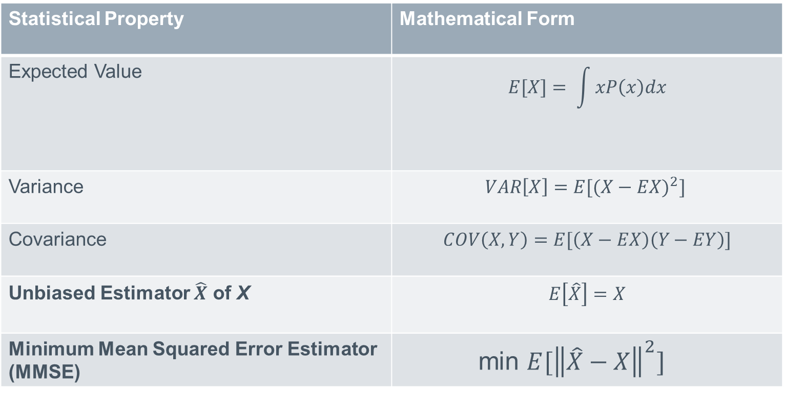
Method: Statistical Properties
Statistical Property | Mathematical Form
Expected Value | $$E[X]= \int{xP\left(x\right)dx}$$
Variance | $$VAR\left[X\right]=E[(X−{EX)}^{2}]$$
Covariance | $$COV\left(X,Y\right)=E[\left(X−EX\right)\left(Y−EY\right)]$$
Unbiased Estimator $\hat{X}$ of X | $$E\left[\hat{X}\right]=X$$
Minimum Mean Squared Error Estimator (MMSE) | $$\text{min} {E[\left\|\hat{X}−X\right\|}^{2}]$$
Notes:
JB
The derivation is based on statistical properties that one can learn in most upper-level undergraduate statistical courses.
Try to explain at a high-level:
Expected Value - Long-run average value of repetitions of the experiment it represents
Variance – Spread of the data
Covariance – The measure of how changes in one variable are associated with changes in a second variable
Unbiased – On the average, the value of the estimator you are using is equal to the actual value of the variable
MMSE – The error between your estimate and the actual value is minimized

Slide 8
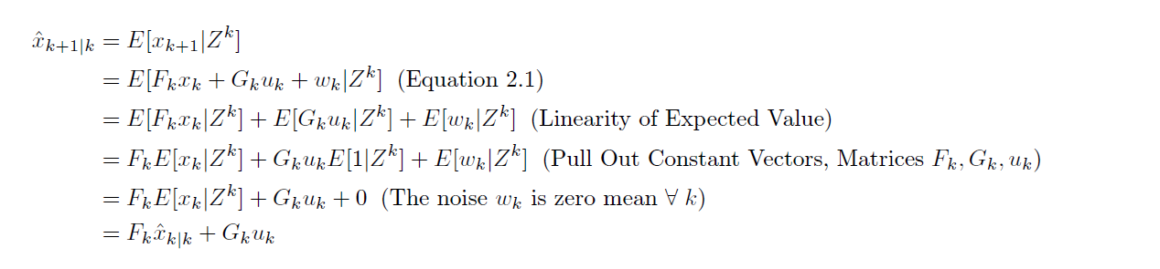
Method: Proof Techniques
Direct Proof
Use established facts and theorems
Green = Model Assumptions
Blue = Statistical Properties
Red = End Result
Notes:
Alec
Direct Proof:
Proof statement of the form if p then q
Assume p
Use established facts and theorems to deduce that q is true

Slide 9
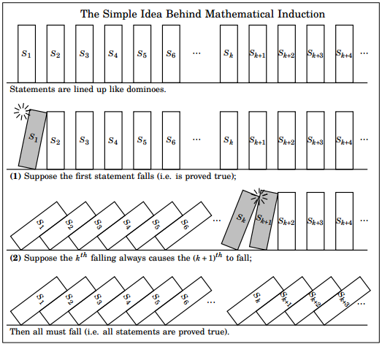
Method: Proof Techniques
Proof by Induction
Form of a direct proof that uses a trick (induction)
Notes:
JB
Proof by Induction:
Form of direct proof
Base Case:
Inductive Step: Assume k, prove for k+1
Domino example

Slide 10
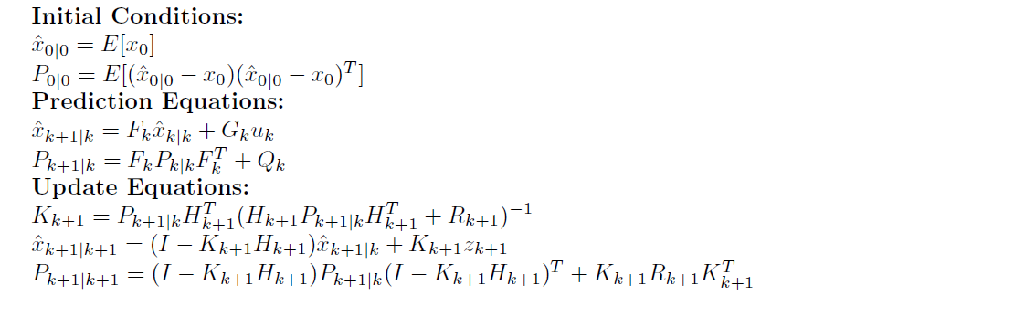
Results: Kalman Filter Algorithm
Resulting Equations:
Limitations:
Discrete-time and linear model
Notes:
Alec
We derive the following Kalman Filter Equations.
Highlight the two estimators and that we proved the estimators are unbiased, MMSE, and recursive.
Discuss limitations:
Limitations restrict the types of systems one can model
However, there are variations of the Kalman Filter which deal with these limitations

Slide 11
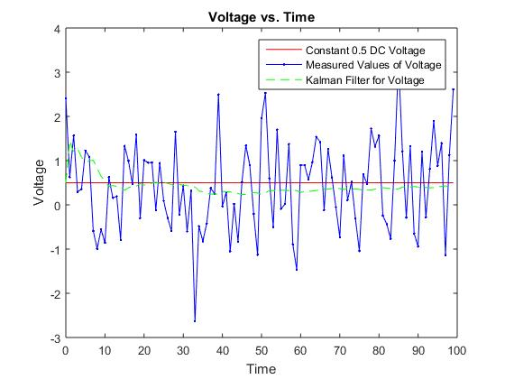
Results: Implementation One
Example: Voltmeter
Simulate noisy voltmeter measurements
Apply the Kalman Filter to the measurements
Notes:
Alec

Slide 12
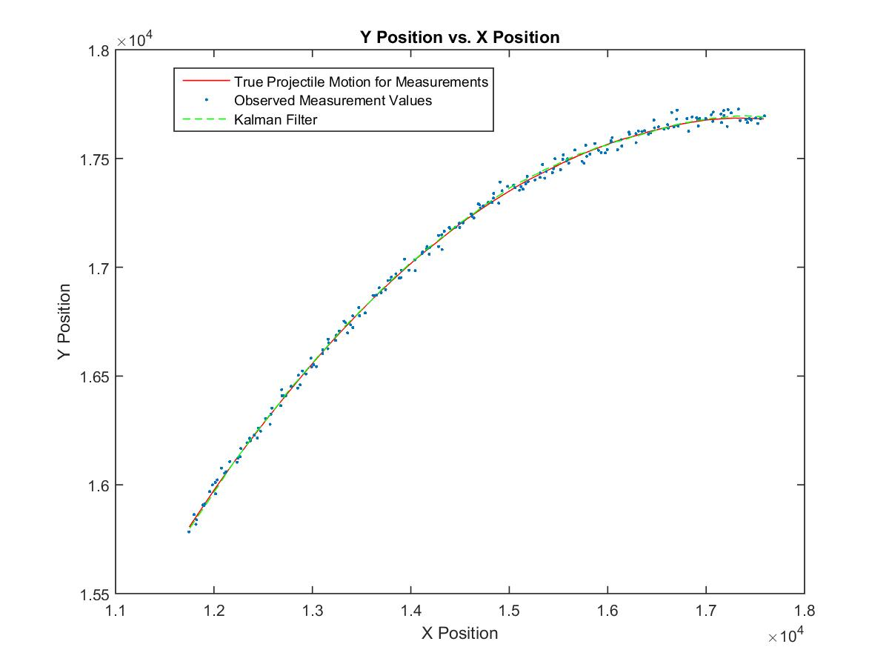
Results: Implementation Two
Example: Projectile Motion
Generate some noisy (x,y) position measurements according to projectile motion equations with drift
Apply the Kalman Filter to the noisy measurements
Notes:
JB

Slide 13
References
[1] Greg Czerniak. “Kalman Filters for Undergrads 1". Online resource at http://greg.czerniak.info/guides/kalman1/.
2015.
[2] Jeffrey Humpherys, Preston Redd, and Jeremy West. “A Fresh Look at the Kalman Filter". In: SIAM
REVIEW 54.4 (2012).
[3] R. E. KALMAN. “A New Approach to Linear Filtering and Prediction Problems". In: Transactions of
the ASME Journal of Basic Engineering 82 (1960), pp. 35-45.
[4] Alan V. Oppenheim and George C. Verghese. “Estimation with Minimum Mean Square Error". Online
resource found through http://ocw.mit.edu. 2010.
[5] Dr. Pasik-Duncan. “Stochastic Adaptive Control". Lecture Notes from a class at the University of
Kansas. 2015.
[6] Ian Reid and Hilary Term. “Estimation II". Lecture notes found online at http://www.robots.ox.ac.uk/ ian/Teach-
ing/Estimation/LectureNotes2.pdf. 2001.
[7] Johannes Traa. “Matrix Calculus - Notes on the derivative of a trace". Online resource. 2010. url:
http://cal.cs.illinois.edu/~johannes/research/matrix%20calculus.pdf.

Slide 14
Acknowledgements
Research Support: NSF Grant under Professors Tyrone Duncan and Bozenna Pasik-Duncan

Slide 15

Questions

