Slide 1
Section 3 CAPSTONE EXERCISEs

Slide 2
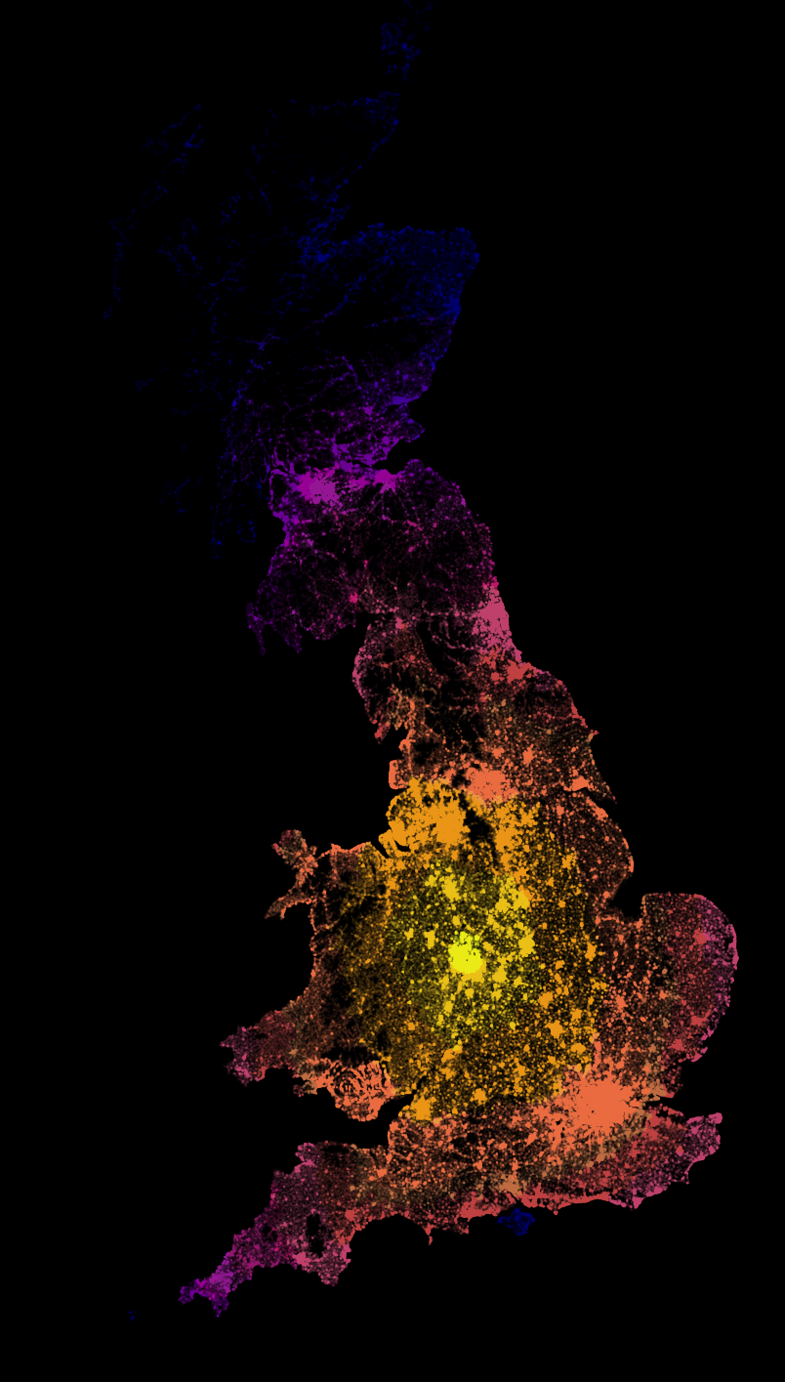
Biodefense
Simulation/exercise
Multiple weeks of a virulent epidemic
Performing analytics for national health authorities
Different tasks each week as the virus spreads
Note: sim was created in summer 2019 and modeled on medical research on Ebolavirus risk factors

Slide 3
Week 1: Containment
Known infected: 18,000
A virus has been spreading through the UK population for an unknown amount of time, and symptomatic individuals have started showing up in hospitals by the thousands.
We need to get a handle on this—work with your team to see if you can identify any geographic areas of greatest concern. Maybe we can still contain the virus to specific regions.
Key goal: Find dense geographic clusters of infected people
Optional goals:
Calculate measures of geographic spread for each cluster
Compare the density of infected vs uninfected people in each cluster region

Slide 4
Week 2: response logistics
Known infected: 71,000
Efforts at containment have been unsuccessful, and known infections are over triple last week’s count.
We are shifting to prioritize efficient mitigation—and that starts with logistics. Work with your team to identify likely capacity requirements for each medical facility.
Key goal: Find the nearest hospital or clinic to each infected person so we can estimate capacity needs
Optional goals:
For each hospital, calculate the number of individuals who are nearest to that hospital
Prepare road directions for ambulances coming from a hospital to a given set of coordinates

Slide 5
Week 3: crisis management
Estimated infected: 294,000
Infections have reached about 1 in every 200 people, but there is still time to bend the infection curve.
We are trying to prioritize scarce resources and need to know who is most at risk. Work with your team to analyze demographic and employment data so we can target interventions most effectively.
Key goal: Identify factors associated with higher rates of infection
Optional goals:
Complete a regression or decision tree analysis of the data to understand the magnitude of different factors’ relative impact on risk

Slide 6
Conclusion

Slide 7
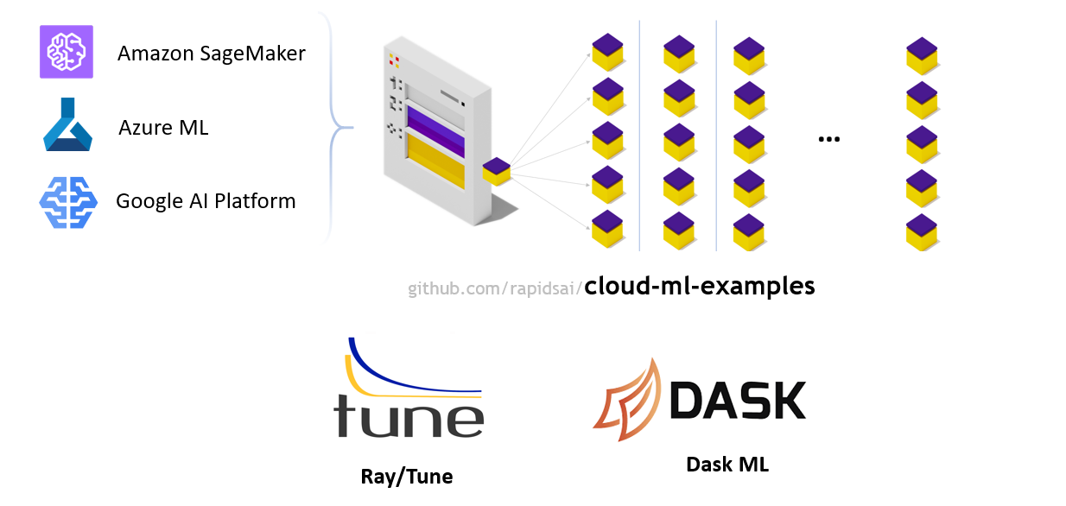
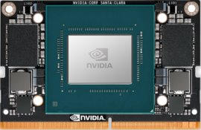
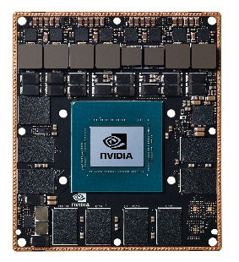

RAPIDS at every scale
Jetson Xavier NX
Jetson Xavier
A100 Tensor Core

Slide 8
What you learned today
(a lot)
You learned why RAPIDS is being built and how it fits in the data science ecosystem
You learned how to use GPUs for everyday and advanced data science tasks
You learned the tricks to get next-level performance from common algorithms
You solved real-world problems with real-world data
What will you do next?

