Slide 1

Introduction to Hadoop Ecosystem: Blocks, Yarn, and MapReduce
This presentation covers the core components of the Hadoop ecosystem, focusing on HDFS block replication, Yarn, and MapReduce. We'll explore their vital roles in big data storage and processing.

Slide 2
Block Replication Architecture in HDFS
File Block Splitting
1
Files are divided into large blocks, typically 128MB or 256MB, for efficient storage and processing.
Fault Tolerant Replication
2
Each block is replicated three times across different DataNodes to ensure data availability and fault tolerance.
Intelligent Replica Placement
3
Replicas are strategically placed, usually one local and two on different racks, to optimize reliability and network traffic.
NameNode Management
4
The NameNode centrally manages metadata, block locations, and orchestrates the replication process.
Automatic Re-replication
5
In case of a DataNode failure, HDFS automatically re-replicates missing blocks, ensuring continuous data accessibility.

Slide 3





Yarn: Yet Another Resource Negotiator
Yarn serves as Hadoop's critical resource management layer, efficiently allocating cluster resources and scheduling applications.
Resource Management
Manages and allocates computational resources within the Hadoop cluster.
Application Scheduling
Schedules and oversees the execution of various applications.
Decoupled Processing
Separates resource management from data processing engines like MapReduce and Spark.
Scalability & Efficiency
Enables multi-tenant, scalable, and highly efficient cluster utilization.

Slide 4
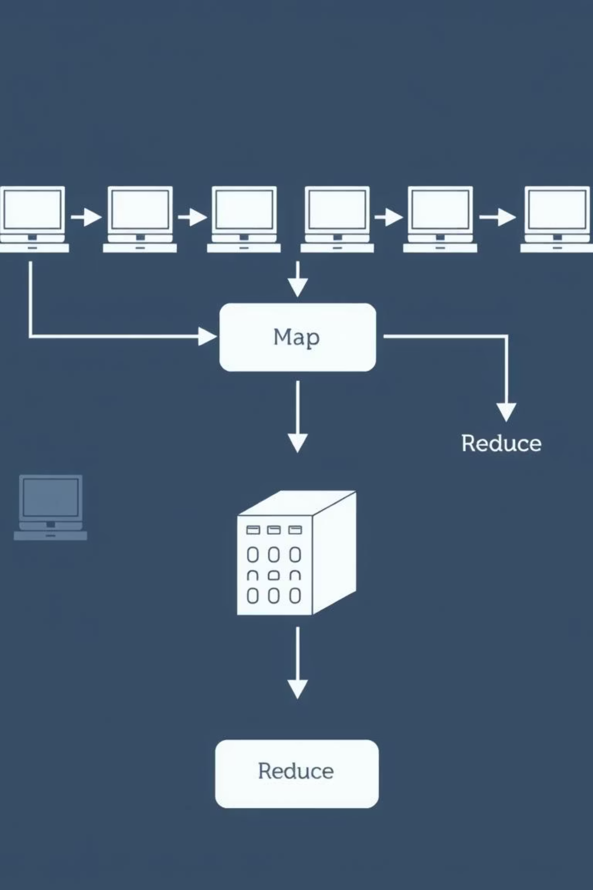

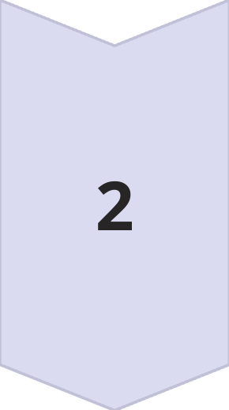
Introduction to MapReduce
MapReduce is a fundamental programming model designed for processing vast datasets in parallel across a distributed computing environment. It simplifies the development of scalable data processing applications by abstracting the complexities of distributed systems.
Map Phase
The Map phase involves filtering and sorting data. Input data is broken down into smaller chunks, processed by mapper tasks, and key-value pairs are generated.
Reduce Phase
The Reduce phase aggregates and summarizes the results. Output from the Map phase is shuffled and sorted, then processed by reducer tasks to produce the final output.

Slide 5




Why MapReduce? Unlocking Big Data Potential
Efficient Data Handling
Built-in Fault Tolerance
Processes massive data volumes efficiently through parallel computation.
Ensures robust processing by re-executing failed tasks automatically.
Optimized Data Locality
Simplified Programming
Minimizes network traffic by moving computation directly to the data's location.
Offers automatic parallelization, simplifying distributed application development.
MapReduce provides a powerful and resilient framework for handling the complexities of big data, making it an indispensable tool for large-scale data processing.

