Slide 1

Unlocking the Power of Big Data with Hadoop

Slide 2




Demystifying Big Data: The 4 V's
Volume
Velocity
Refers to the immense amounts of data generated daily, from terabytes to petabytes and beyond. This scale requires specialized storage and processing.
The speed at which data is generated, collected, and processed. Real-time analytics demands high velocity for immediate insights.
Variety
Veracity
Encompasses the diverse types of data: structured (databases), semi-structured (XML, JSON), and unstructured (text, images, video).
Pertains to the quality and trustworthiness of data. Big Data sources can be inconsistent, incomplete, or ambiguous, requiring validation.

Slide 3
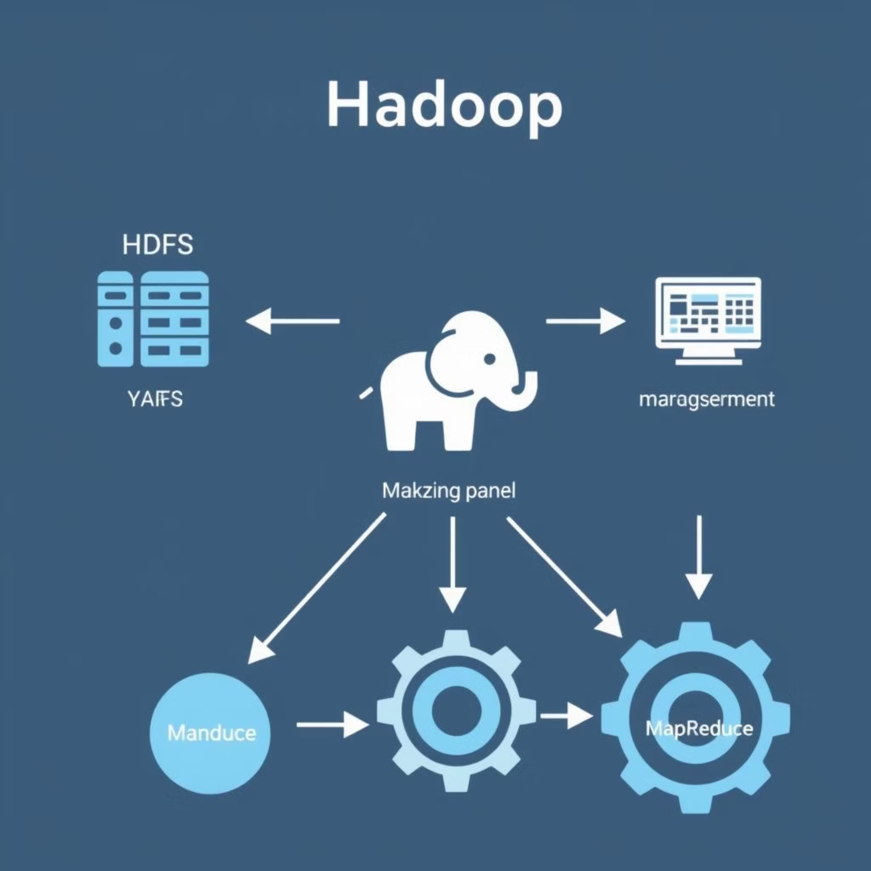
Hadoop: The Foundation of Big Data Processing
What is Hadoop?
Hadoop is an open-source framework designed for distributed storage and processing of very large datasets across clusters of computers. It emerged from Google's research papers on GFS and MapReduce, providing a robust solution for handling data that traditional systems can't.
Started in 2005 by Doug Cutting
Crucial for scalable data operations

Slide 4
Diving Deeper: Hadoop's Core Architecture
1
2
3
HDFS: Hadoop Distributed File System
YARN: Yet Another Resource Negotiator
MapReduce
A programming model for processing large datasets with a parallel, distributed algorithm on a cluster. It consists of two main phases: Map and Reduce.
A highly fault-tolerant, scalable storage system that breaks files into blocks and distributes them across nodes, replicating data for reliability.
Hadoop's operating system, responsible for managing computing resources and scheduling applications across the cluster, enhancing efficiency.

Slide 5
Why Choose Hadoop for Big Data?
Scalability
Fault Tolerance
Flexibility
Hadoop can scale horizontally by simply adding more commodity hardware, making it cost-effective for growing data volumes without major infrastructure overhauls.
Through data replication (typically 3 copies of each block in HDFS) and automatic re-execution of failed tasks, Hadoop ensures data availability and integrity even if nodes fail.
It handles various data types (structured, semi-structured, unstructured) and integrates with a wide array of tools, adapting to diverse analytical needs.

Slide 6
Beyond the Core: The Hadoop Ecosystem
Hadoop is more than just HDFS and MapReduce; it's a rich ecosystem of tools designed to simplify and extend Big Data capabilities.
Hive
Data warehousing software facilitates querying and managing large datasets residing in distributed storage.
Pig
High-level platform for creating MapReduce programs used for ETL and large-scale data processing.
HBase
NoSQL database for random, real-time read/write access to Big Data, running on top of HDFS.
Flume
Service for collecting, aggregating, and moving large amounts of log data from various sources into HDFS.
Sqoop
Tool for transferring data between Hadoop and relational databases (SQL databases).
ZooKeeper
Centralized service for maintaining configuration information, naming, providing distributed synchronization, and group services.
Oozie
Workflow scheduler system to manage Hadoop jobs, allowing for complex data processing pipelines.

Slide 7
Quiz Time: Test Your Hadoop Knowledge!
Ready to check your understanding of Big Data and Hadoop? Let's tackle some common questions.
The 5th V of Big Data: Beyond Volume, Velocity, Variety, and Veracity, what is often considered the fifth 'V' of Big Data, emphasizing the insights derived from it?
Hadoop Components: Which core Hadoop component is responsible for resource management and job scheduling in a cluster?
Data Duplication: In HDFS, how does Hadoop achieve fault tolerance and data reliability?
Hive vs. Pig: Briefly explain the primary difference in purpose between Apache Hive and Apache Pig within the Hadoop ecosystem.
YARN's Role: Describe a key advantage of YARN's introduction to the Hadoop ecosystem.

Slide 8



Key Takeaways & Next Steps
Core Insights
Your Next Steps
Hadoop empowers distributed storage and processing for massive datasets.
Explore Further
Scalability and fault tolerance are fundamental to Big Data systems.
Dive into specific Hadoop tools like Spark or Kafka.
The rich Hadoop ecosystem provides tools for every stage of the data lifecycle.
Hands-On Practice
Understanding the 4 (or 5) V's of Big Data is crucial for effective management.
Set up a mini Hadoop cluster or try cloud-based services.
Certifications
Consider professional certifications in Big Data or Hadoop.

