Slide 1
IT3081 Statistical Modelling
Credit Card Customer Retention
Evidence and recommendations for the Board of Directors
Group 2026-DS-77 | Academic consultancy • Public-data case study
Notes:
Timing: 0:00–0:35 (35 seconds).
Memory cue: Customer uses the card less → what should the bank do?
Good morning, Chair and members of the Board. We are Group 2026-DS-77, presenting as your statistical consultancy team. Consider a customer who uses their credit card less. Should the bank contact them, investigate further, or take no action? We have examined the evidence and built a prototype to support that review. Today, we recommend what the organization should validate before investing in operational use.
Sources: Report Tasks 1 and 12

Slide 2
TASK 1
2
The decision before the board
Limited resources call for informed review and staged investment
•
Business concern: staff need a defensible way to prioritize review.
•
Evidence: activity differs between recorded customer groups.
•
Proposal: combine model scores with contextual staff review.
•
Decision: authorize validation before considering a controlled pilot.
Group 2026-DS-77 | Credit Card Customer Retention | Academic board briefing
Notes:
Timing: 0:35–1:35 (60 seconds).
Memory cue: Limited resources → informed review → staged investment
The management challenge is deciding where to focus attention. A retention team has limited time, and contacting every customer may be expensive or unnecessary. Equally, waiting until a customer has already left may leave little opportunity to help. We therefore investigated whether data could support a more structured review process. Our recommendation is a staged investment: validate the approach with the bank’s own information, assess whether staff can use it effectively, and then test whether an approved retention action improves outcomes. The decision we are asking for is approval to develop that evidence.
Sources: Report Tasks 1, 10 and 12

Slide 3
TASK 2
3
Research separates prediction from retention
Identifying risk does not establish that a retention action will help
What research supports
What remains unresolved
Behavioural information can improve churn models.
Interpretable and regularized models provide useful baselines.
High risk does not establish responsiveness to an offer.
The model needs testing on the bank’s own data before use.
16 studies: 11 journal articles and 5 conference papers. Seven core journal articles: 2022–2025.
Key sources: Brito et al. (2024); Ascarza (2018); Lemmens and Gupta (2020).
Group 2026-DS-77 | Credit Card Customer Retention | Academic board briefing
Notes:
Timing: 1:35–2:25 (50 seconds).
Memory cue: Identify risk ≠ prove an action will help
Our review covered sixteen research studies, including eleven journal articles. Seven core journal papers were published between 2022 and 2025. Studies such as Brito and colleagues support using behavioural information in churn modelling. However, studies use different outcomes and observation periods, so their reported accuracies are not directly comparable. Research by Ascarza, and by Lemmens and Gupta, adds a crucial business distinction: identifying high risk does not establish that an offer will change the outcome. This led us to compare interpretable models and propose a separate pilot to test intervention value.
Sources: Report Task 2; references [1], [3], [4], [7], [8]

Slide 4
TASK 3
4
The dataset provides a useful starting point
10,127 records and 16.07% recorded attrition in a public-data case study
10,127
customer records
16.07% recorded attrition
Sample proportion, not an annual bank rate.
Source: BankChurners, Kaggle (S. Goyal). Public benchmark, not client-bank records.
Group 2026-DS-77 | Credit Card Customer Retention | Academic board briefing
Notes:
Timing: 2:25–3:05 (40 seconds).
Memory cue: 10,127 records → 16.07% attrited → public-data case study
We used the publicly available BankChurners dataset, containing 10,127 customer records. Approximately 84% were labelled existing customers, while 16% were labelled attrited customers. The dataset includes customer characteristics, account relationships and transaction activity, making it suitable for investigating this problem. However, these are not records supplied by the organization we are advising. The attrition percentage describes this particular sample; it is not an estimate of the bank’s own attrition rate. We use the dataset to develop and assess an approach that would require local validation.
Sources: BankChurners [2]; Report Task 3

Slide 5
TASK 3
5
Data preparation preserved information
Retain unknown categories and valid extremes; exclude unsuitable inputs
•
30.08% of records contain an Unknown demographic category.
•
Unusual values remain unless there is evidence of an error.
•
Exclude customer ID and both supplied classifier-output columns.
•
Remove available credit because two other inputs determine it.
Group 2026-DS-77 | Credit Card Customer Retention | Academic board briefing
Notes:
Timing: 3:05–3:45 (40 seconds).
Memory cue: Unknown values → retain genuine extremes → exclude unsuitable inputs
We first checked whether the data was suitable for analysis. There were no duplicate records or conventional missing values. However, around 30% of records contained an “Unknown” demographic category. We retained those categories rather than inventing information. We also retained unusual values unless there was evidence that they were errors. For modelling, we excluded customer identifiers and the supplied classifier-output columns. We removed available credit because other retained variables already determine it. These steps helped preserve useful information while avoiding unsuitable or redundant model inputs.
Sources: Report Tasks 3 and 5

Slide 6
TASK 3
6
Attrited customers recorded lower activity
About 69 versus 45 transactions, with several possible explanations
Mean transaction count
Mean total transaction amount
Amounts use the dataset’s supplied monetary units.
Group 2026-DS-77 | Credit Card Customer Retention | Academic board briefing
Notes:
Timing: 3:45–4:30 (45 seconds).
Memory cue: About 69 versus 45 transactions → useful signal, several explanations
The clearest descriptive pattern was lower recorded activity among attrited customers. Existing customers averaged approximately 69 transactions, compared with approximately 45 among attrited customers. Their average total transaction amount was also higher, as the second chart shows. This makes activity a useful area for investigation. But the comparison does not establish why a customer left or whether reduced activity came before departure. For example, the customer might mainly use another bank’s card. Our recommendation is therefore to investigate the context behind lower activity, rather than assume it always indicates dissatisfaction.
Sources: Numeric_Comparison_By_Attrition.csv; Report Task 3

Slide 7
TASK 4
7
Inference supports differences, not causes
Four tests support differences, while business actions need further evidence
Question | Result | Decision implication
Mean activity: Welch t-test | 23.74 more transactions 95% CI: 22.88–24.60 | Investigate engagement
Attrition by gender: proportion test | 2.74 percentage-point gap | Do not target by gender alone
Amount spread: Brown–Forsythe | Spread differs | Averages conceal variation
Relationship groups: Welch ANOVA | At least one mean differs | Do not infer all pairs differ
All four Holm-adjusted p-values < 0.001 (α = 0.05). Exact values: appendix slide 31.
Individual 95% confidence intervals are not adjusted for multiple comparisons.
Group 2026-DS-77 | Credit Card Customer Retention | Academic board briefing
Notes:
Timing: 4:30–5:30 (60 seconds).
Memory cue: Four tests → evidence of differences → no automatic business rules
We used four tests matched to the questions and data. Welch’s t-test found that existing customers averaged 23.74 more transactions, with a 95 percent confidence interval of 22.88 to 24.60. The proportion test found a 2.74 percentage-point gender difference. Brown–Forsythe assessed transaction-amount spread, while Welch ANOVA compared mean counts across relationship groups. All four adjusted p-values were below 0.001 after Holm correction. The exact values and hypotheses are in the appendix. These results support differences within this dataset, but do not establish causes. Gender alone should not determine contact, and the overall ANOVA does not tell us which pairs differ.
Sources: Task4_Primary_Tests_Holm_Adjusted.csv and component test CSVs

Slide 8
TASK 5
8
Model development used a separate holdout
Develop on 8,101 records, freeze choices, then evaluate on 2,026
10,127
records
8,101
development
Shared
10-fold CV
Freeze model
& threshold
2,026
evaluation
→
→
→
→
Development: fitting, comparison and threshold selection
Earlier whole-data exploration limits independence of the overall evaluation.
Group 2026-DS-77 | Credit Card Customer Retention | Academic board briefing
Notes:
Timing: 5:30–6:20 (50 seconds).
Memory cue: Develop on 8,101 → freeze choices → evaluate on 2,026
Next, we investigated whether combinations of customer information could estimate recorded attrition status. We used 8,101 records to develop and compare models. Within that group, cross-validation repeatedly evaluated models on records excluded from each fitted version. We selected the model and decision threshold using this development data, then evaluated the fixed approach on the remaining 2,026 records. Those final records were excluded from model fitting. However, earlier exploration had examined the complete dataset and may have influenced broader design choices. We therefore describe the results as an internal holdout evaluation, with that limitation disclosed.
Sources: Report Task 5; Final_Model_Selection_Record.csv

Slide 9
TASK 5
9
Flexible logistic regression led the comparison
Natural splines allow curvature in transaction count, transaction amount and revolving balance
≈ 24.9% lower log loss than the linear baseline
Group 2026-DS-77 | Credit Card Customer Retention | Academic board briefing
Notes:
Timing: 6:20–7:15 (55 seconds).
Memory cue: Compare alternatives → curved relationships → lower log loss
We compared standard logistic regression with ridge, LASSO, elastic net and a flexible spline model. Logistic regression combines customer information to estimate recorded attrition probability. The spline version allows curved relationships for transaction count, transaction amount and revolving balance. Lower log loss means better probability predictions in this comparison. The spline achieved 0.1761, compared with 0.2344 for the baseline, a reduction of approximately 24.9 percent. Curvature helped more than shrinkage alone in the specifications we tested. These are development results, so we then evaluated the selected model on the held-out records.
Sources: OOF_Model_Comparison.csv; Report Task 5

Slide 10
TASK 5
10
The holdout makes the errors visible
259 attrited records identified, 67 missed and 101 existing records flagged
Recorded status | Flagged | Not flagged
Attrited | 259 identified | 67 missed
Existing | 101 false flags | 1,599 correctly unflagged
79.45% recall
71.94% precision
259 of 326 attrited records found
259 of 360 flags were attrited
Internal test ROC-AUC: 0.9599. Full probability metrics and uncertainty: appendix slide 34.
Group 2026-DS-77 | Credit Card Customer Retention | Academic board briefing
Notes:
Timing: 7:15–8:10 (55 seconds).
Memory cue: Found 259 → missed 67 → falsely flagged 101
Among the 2,026 test records, 326 customers were labelled attrited. Our selected rule identified 259 and missed 67. It also incorrectly flagged 101 existing customers. Recall was approximately 79 percent: the proportion of attrited records identified. Precision was approximately 72 percent: the proportion of flagged records actually labelled attrited. Test ROC-AUC was 0.9599, indicating strong ranking within this dataset, not a percentage of customers retained. The appendix provides probability metrics, calibration and uncertainty. For the Board, the implication is that the model can support review, but its errors and retrospective outcome prevent treating a flag as certainty of future departure.
Sources: Final_Test_Confusion_Matrix.csv; Final_Test_Probability_Performance.csv

Slide 11
TASK 5
11
Greater coverage requires more review
75 additional flags include 33 more attrited records and 42 more false flags
Fixed rule | Flagged records | Attrited identified | Existing flagged
0.50 reference | 285 | 226 | 59
0.3392 selected | 360 | 259 | 101
75 additional records flagged for potential review
Threshold maximized training out-of-fold F1 and was fixed before test evaluation.
Operating decisions also require capacity, costs and intervention evidence.
Group 2026-DS-77 | Credit Card Customer Retention | Academic board briefing
Notes:
Timing: 8:10–9:05 (55 seconds).
Memory cue: 75 additional flags: 33 more identified and 42 more false flags
The threshold affects coverage and workload. We selected approximately 0.3392 by maximizing F1 using training out-of-fold predictions, then fixed it before test evaluation. F1 balances precision and recall; it does not measure business profit. At the reference threshold of 0.50, 285 records were flagged. At our selected threshold, 360 were flagged. That is 75 additional records for potential review: 33 more attrited records identified and 42 more false flags. These were not completed customer reviews. An operating rule would also need evidence about capacity, costs, preferences and whether contact helps.
Sources: Final_Test_Threshold_Comparison.csv

Slide 12
TASK 5
12
Operational readiness requires new evidence
Internal performance is promising; advance warning remains unproven
What we established
What needs testing
Strong internal ranking and classification.
A documented comparison with alternative models.
Predictor availability before departure.
Performance on dated bank data.
Whether contact changes outcomes.
Group 2026-DS-77 | Credit Card Customer Retention | Academic board briefing
Notes:
Timing: 9:05–9:45 (40 seconds).
Memory cue: What works here → what remains unproven
We can now separate what we established from what still needs testing. The model performed well at distinguishing recorded attrition status in this dataset. We have not established how early it could warn the bank before a customer leaves, whether it would perform similarly on the bank’s own records, or whether contacting flagged customers would improve retention. Those limitations shape our recommendation. Before operational use, we need information that was available before departure, followed by later outcomes. We also need evidence about the practical value of acting on the model’s results.
Sources: Report Tasks 3, 5 and 12

Slide 13
TASK 6
13
A controlled pilot can test additional retention
A future pilot would compare an approved action with usual service
Completely randomized design
Randomized complete blocks
Randomly assign eligible customers to action or usual service.
Simple; small groups may be unbalanced.
Form blocks using pre-treatment characteristics, then randomize within each block.
Potential precision gain; harder coordination.
Predefine outcomes • Control contamination • Analyse assigned groups
Group 2026-DS-77 | Credit Card Customer Retention | Academic board briefing
Notes:
Timing: 9:45–10:40 (55 seconds).
Memory cue: Action versus usual service → randomization → measure the difference
A controlled pilot could establish whether an approved retention action improves outcomes. Under a completely randomized design, eligible customers would be assigned randomly to that action or usual service. A randomized complete block design would first form blocks using relevant pre-treatment characteristics, then randomize treatments within each block. With two treatments, matched pairs could place one customer in each condition within every pair. Blocking may improve precision, but adds coordination and requires suitable information. Both approaches need predefined outcomes, sample size, follow-up and protection against overlapping campaigns. We recommend such an experiment after local validation; we have not conducted it.
Sources: Report Task 6; [19], [20]; [3], [8]

Slide 14
TASK 7
14
PCA offers limited value for this dataset
With 18 original predictors, interpretability takes priority over compression
Current recommendation
When PCA could help
Keep original variables for interpretation.
Only 18 original predictors enter the model.
Remove known redundancy directly.
Hundreds of correlated history features.
Compression or visualization needs.
Compare predictive value within validation.
Group 2026-DS-77 | Credit Card Customer Retention | Academic board briefing
Notes:
Timing: 10:40–11:20 (40 seconds).
Memory cue: Only 18 predictors → interpretability matters → reconsider with larger
histories We also considered whether dimensionality reduction would help. PCA combines variables into components that summarize variation. It can be useful when a dataset contains many correlated measurements. Our current model uses only 18 original predictors, so dimensionality is manageable. Components could also make customer-level explanations less straightforward, and high variation does not necessarily mean strong relevance to attrition. We therefore recommend retaining the original variables for this project. If future analysis introduces hundreds of monthly activity measures, PCA could be reconsidered and compared within the validation process.
Sources: Report Task 7; [21]–[23]

Slide 15
TASK 8
15
Bayesian methods could support uncertain decisions
Potential extensions for uncertain estimates and decisions about costs
Approach | Potential value | Main limitation
Naïve Bayes | Fast benchmark | Correlated inputs challenge assumptions
Bayesian regression | Stabilize sparse-group estimates; quantify uncertainty | Priors and sensitivity checks needed
Bayesian decisions | Combine benefit, cost and uncertainty | Intervention-response evidence missing
Future options; none was fitted or shown superior in this project.
Group 2026-DS-77 | Credit Card Customer Retention | Academic board briefing
Notes:
Timing: 11:20–12:00 (40 seconds).
Memory cue: Simple benchmark → uncertainty → costs and benefits
Bayesian methods offer further possibilities. Naïve Bayes provides a simple benchmark, although related transaction and balance measures challenge its assumptions. Bayesian regression could help express uncertainty and stabilize estimates for smaller customer groups, provided the prior assumptions are justified and checked. Bayesian decision-making could combine uncertainty about intervention benefits with contact costs and customer value. However, we currently lack evidence about how customers respond to proposed interventions. These methods are potential extensions, not approaches we have already shown to outperform the selected model.
Sources: Report Task 8; [24], [25], [3], [8]

Slide 16
TASK 9
16
Dated histories would enable trend analysis
Dated histories could reveal change, seasonality and future workloads
Use | Potential business value
Trend and seasonality | Separate sustained change from recurring activity
Forecasting | Plan aggregate review workload
ARIMA / seasonal ARIMA | Model serial dependence when history supports it
Rolling-origin evaluation | Compare against simple and seasonal-naïve forecasts
No time-series model was fitted; consistent dated observations are required.
Group 2026-DS-77 | Credit Card Customer Retention | Academic board briefing
Notes:
Timing: 12:00–12:40 (40 seconds).
Memory cue: Change over time → seasonality → forecast workload
Historical information would let us ask whether a customer’s activity is changing over time. We could distinguish a sustained reduction from a recurring seasonal pattern. Aggregate forecasts could also help management anticipate review workloads. ARIMA or seasonal ARIMA may be suitable when the available history supports their assumptions. We would compare them with simple forecasts using evaluations that respect the order of time. The current dataset does not contain the repeated calendar-time observations needed for this work. Consistent dated histories are therefore a data requirement, rather than something we can replace with a more complex model.
Sources: Report Task 9; [26]–[28]; expert Q8

Slide 17
TASK 10
17
The proposed operating framework
Validated scores support staff review, with later outcomes recorded
Dated data
& outcome
Validated
model
Capacity-led
review queue
Staff context
& action
Outcome
register
→
→
→
→
Model monitoring: ranking, calibration and data change
Controlled evaluation: did the action cause additional benefit?
Group 2026-DS-77 | Credit Card Customer Retention | Academic board briefing
Notes:
Timing: 12:40–13:25 (45 seconds).
Memory cue: Data → score → review → action → outcomes
These considerations informed our proposed operating framework. First, the organization needs dated information and an agreed outcome definition. A locally validated model then supports a queue that matches the team’s review capacity. Staff examine each customer’s circumstances and decide whether an approved action—or no action—is appropriate. The organization records the decision and follows later outcomes. Model monitoring checks whether predictions remain useful. Controlled evaluation checks whether the action improves results. Keeping both checks in the process helps management assess the quality of the analytics and the value of the retention programme separately.
Sources: Report Task 10 conceptual framework; [3], [8]

Slide 18
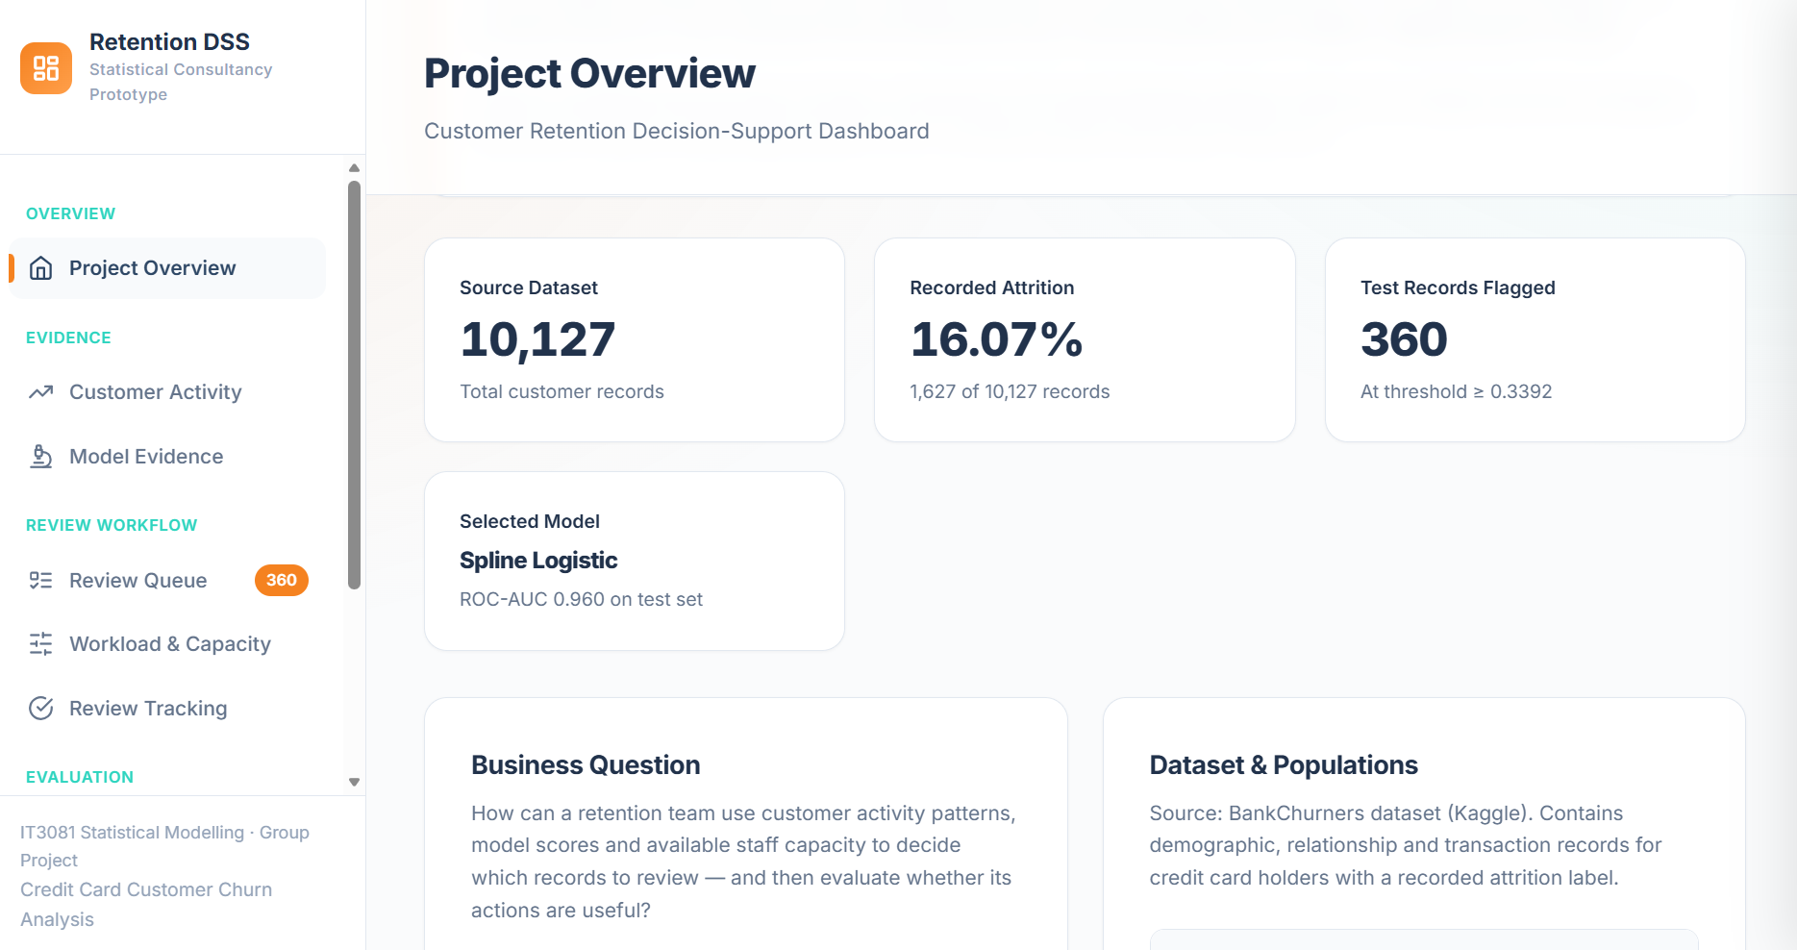
TASK 10
18
The prototype demonstrates a review process
Public-data prototype demonstrating a possible staff review process
Inspect the evidence
Review customer context
Record a staff decision
Group 2026-DS-77 | Credit Card Customer Retention | Academic board briefing
Notes:
Timing: 13:25–13:40 (15 seconds).
Memory cue: Evidence becomes a staff workflow
We built this dashboard prototype to demonstrate that process. The following screens show how staff could organize records, examine customer information, consider workload and document a decision. The demonstration uses public data and simulated review activity.
Sources: Project report and supplied analysis outputs.

Slide 19
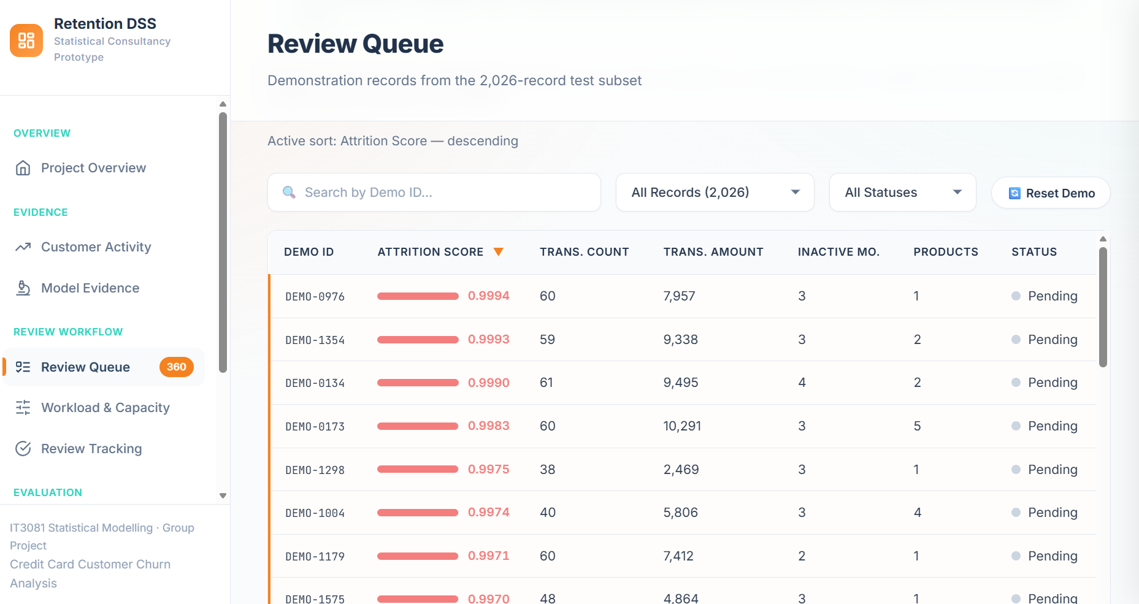
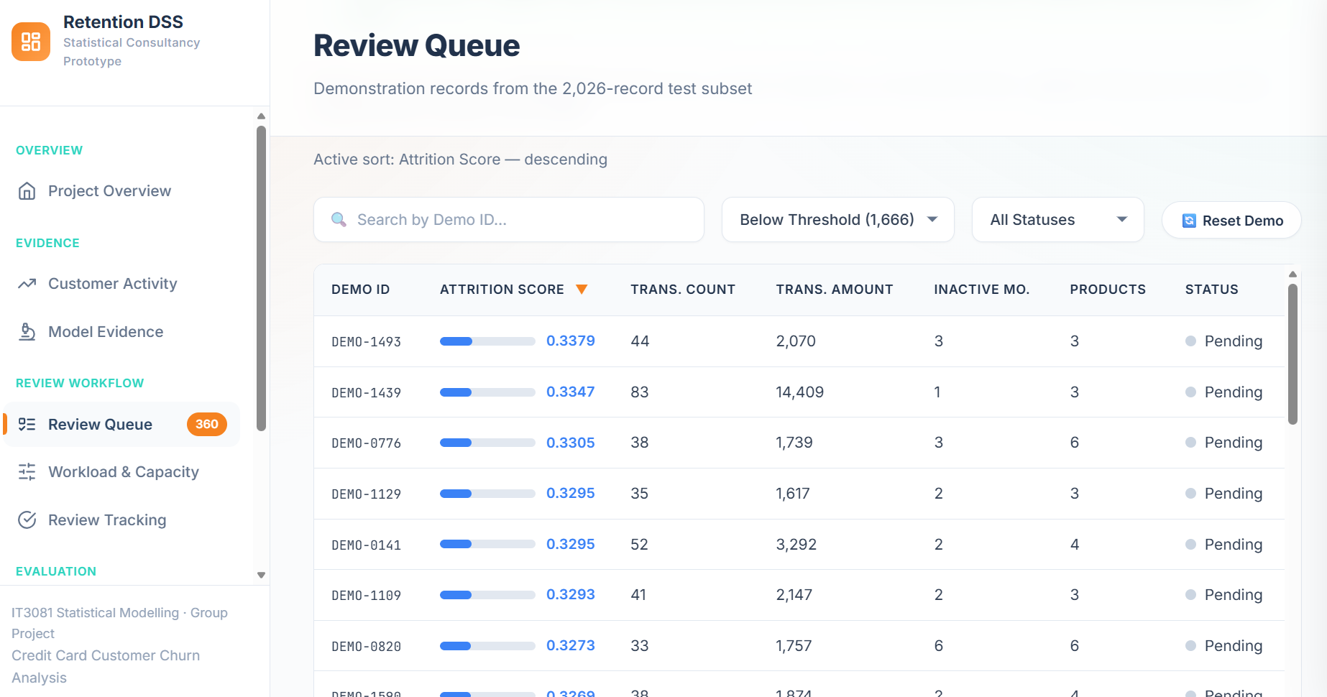
TASK 10
19
Customer review queue
360 flags organize review; they do not automatically trigger contact
Currency symbols follow prototype formatting; the currency is unverified.
360 flagged records at the fixed threshold of 0.3392
Group 2026-DS-77 | Credit Card Customer Retention | Academic board briefing
Notes:
Timing: 13:40–14:10 (30 seconds).
Memory cue: 360 flags → organized review → no automatic contact
The review queue is the starting point. It can display the 360 records flagged at the training-selected threshold, alongside account and activity information. Staff can filter and inspect records rather than act on a score alone. Actual attrition labels are excluded from the operational view. This is a retrospective demonstration using public records, not a live customer list or an authorization to contact anyone.
Sources: Project report and supplied analysis outputs.

Slide 20
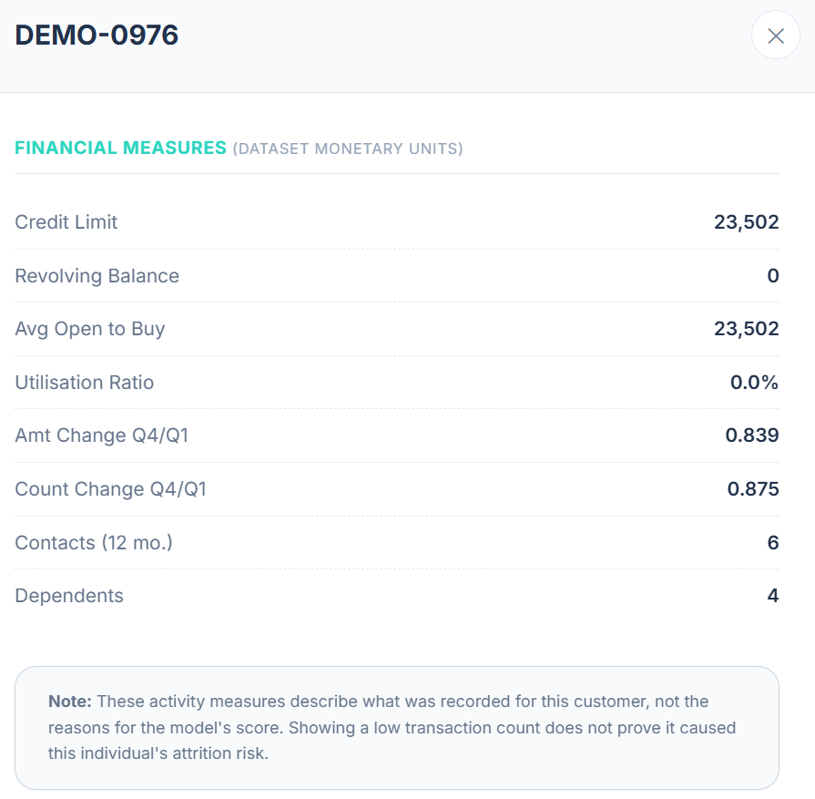
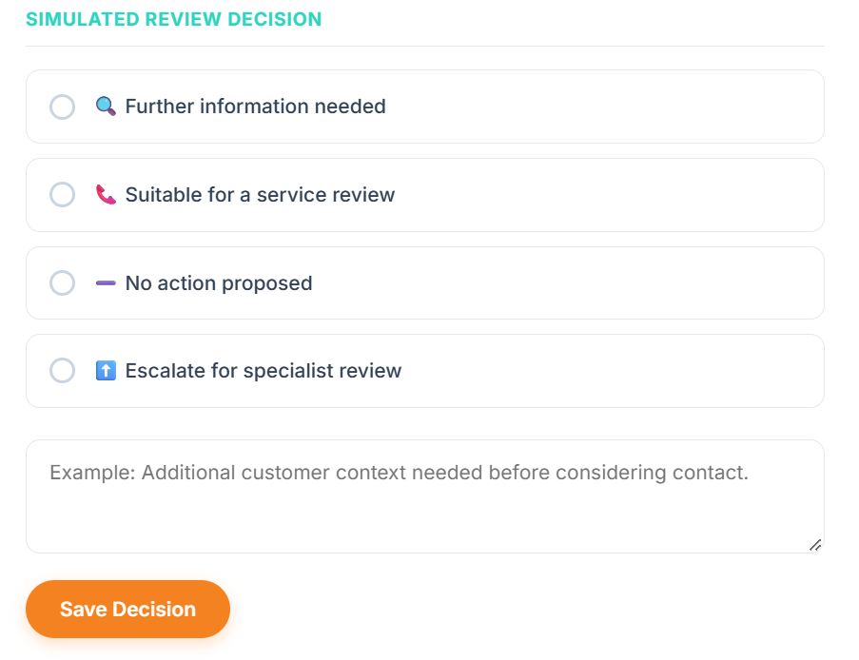
TASK 10
20
Customer context and review decisions
Staff examine context, choose a next step and record their reasoning
Prototype currency is unverified. Decisions shown are simulated.
Group 2026-DS-77 | Credit Card Customer Retention | Academic board briefing
Notes:
Timing: 14:10–14:45 (35 seconds).
Memory cue: Examine the record → choose a next step → record why
Opening a record provides account information and possible next steps. Staff could request further information, consider a service review, propose no action or escalate for specialist attention. The screen shows a simulated escalation, not advice for this customer. The displayed measures provide context; they are not a proven explanation of the model’s score. Before operational use, staff would need an approved review policy and should record why a decision was made.
Sources: Project report and supplied analysis outputs.

Slide 21
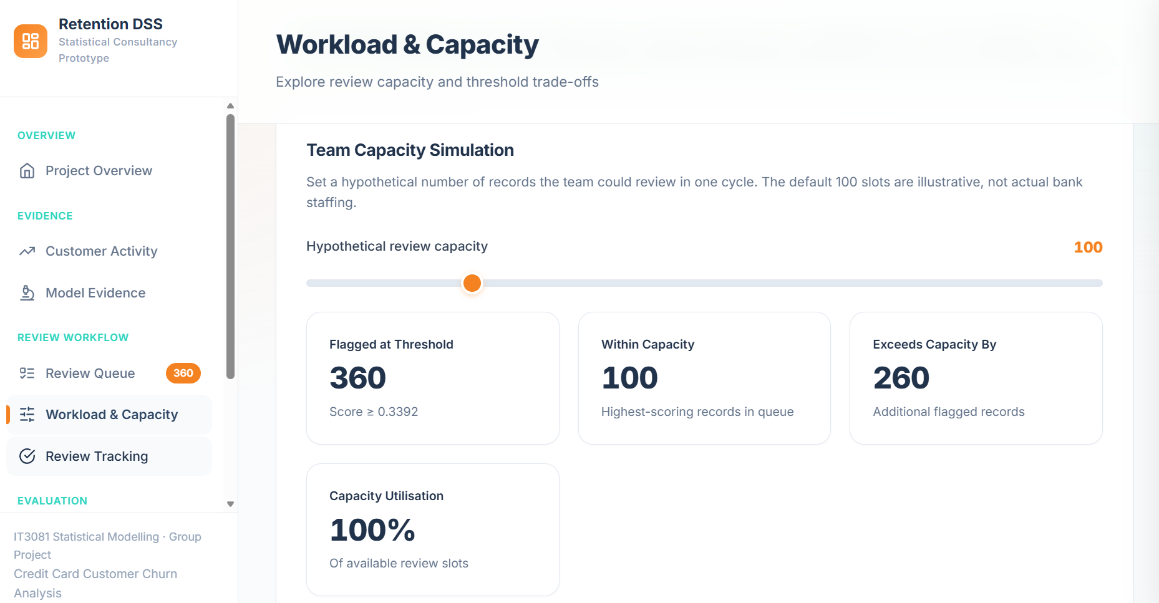
TASK 10
21
Review workload and available capacity
360 flagged records, 100 assumed review slots and a gap of 260
Illustrative capacity: 100 reviews. The flagged queue exceeds this by 260.
Group 2026-DS-77 | Credit Card Customer Retention | Academic board briefing
Notes:
Timing: 14:45–15:15 (30 seconds).
Memory cue: 360 flagged → capacity 100 → gap 260
This screen connects the proposal to available resources. In the illustration, 360 records are flagged, but the team has capacity to review only 100 during one cycle. That leaves 260 beyond the assumed capacity. The setting is hypothetical. Management would need realistic estimates of review time, staffing and cost before choosing an operating rule. The prototype’s contribution is to make the workload constraint visible, rather than assume that every flagged record can immediately receive attention.
Sources: Project report and supplied analysis outputs.

Slide 22
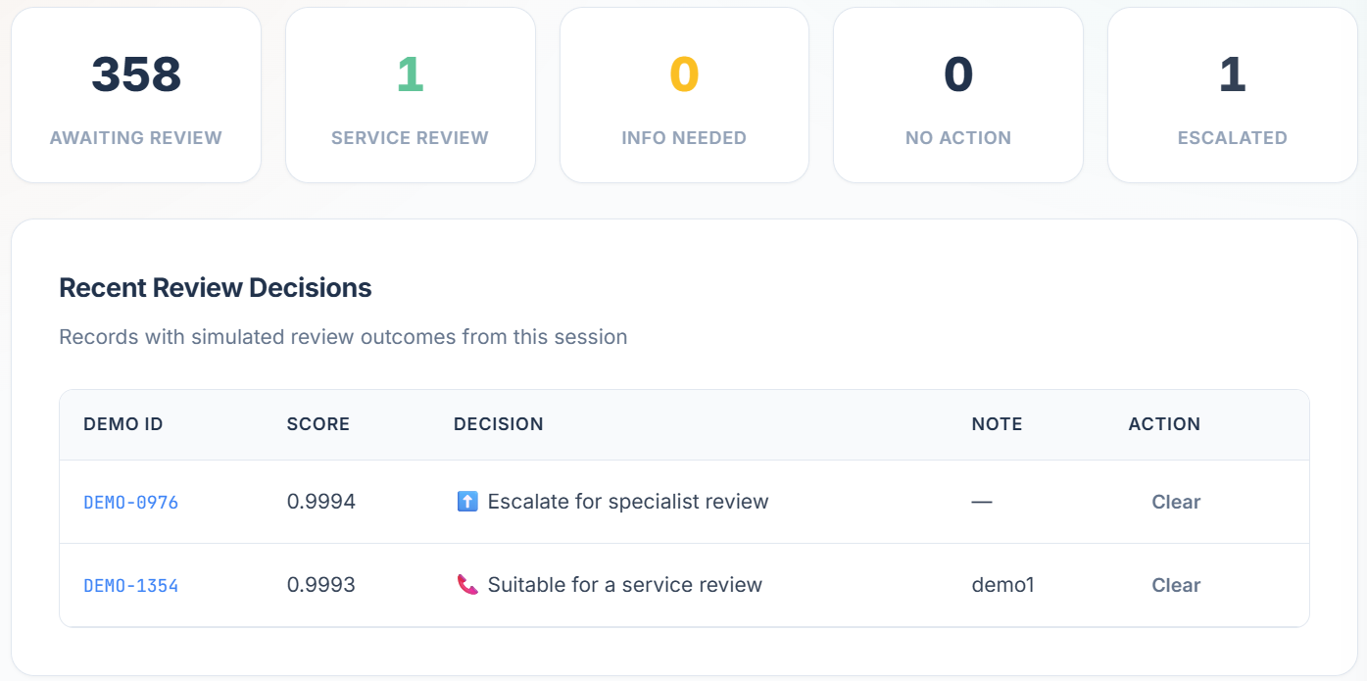
TASK 10
22
Simulated review tracking
Recorded review decisions are demonstration activity, not retention outcomes
358 awaiting review, 1 service review and 1 escalation in this demonstration.
Group 2026-DS-77 | Credit Card Customer Retention | Academic board briefing
Notes:
Timing: 15:15–15:45 (30 seconds).
Memory cue: Decisions recorded → work remains → outcomes still needed
The tracking screen shows the result of saving simulated decisions: one service-review decision, one escalation and 358 records awaiting review. This demonstrates how the team could monitor review activity. It does not measure calls completed or customers retained. Business impact would require later outcomes and a controlled comparison to determine whether the actions helped.
Sources: Project report and supplied analysis outputs.

Slide 23
TASK 11
23
Expert feedback changed the proposal
Written feedback form, 29 September 2026; anonymized professional consultation
Professional feedback | Change to the proposal
Inactivity may precede closure | Define separate activity outcomes
Low use may reflect a secondary card | Require contextual staff review
Use 12–24 months of history | Request dated transactions and payments
Test actual-system data | Add local validation before contact
Anonymized paraphrase • One expert • Not institutional endorsement
Group 2026-DS-77 | Credit Card Customer Retention | Academic board briefing
Notes:
Timing: 15:45–16:45 (60 seconds).
Memory cue: Low use has alternatives → longer histories → actual-system testing
We obtained a completed written feedback form on 29 September 2026 from an experienced card-centre banking professional. It covered relevance, practicality, feasibility and potential impact. We paraphrase the feedback anonymously under the permissions provided. The expert highlighted inactivity and reduced spending, but noted that low use may reflect a secondary card. We therefore strengthened contextual review, requested twelve to twenty-four months of dated transaction and payment histories, and added actual-system validation. We also incorporated action guidance and pilot outcomes covering retention, activation and spending. An ambiguous sixty-day activation comment was deferred for clarification. The consultation improved the proposal; it was not institutional approval or independent model validation.
Sources: Completed Expert Feedback Form, 29 September 2026, Q1–Q8; anonymized paraphrase

Slide 24
TASK 10 AND TASK 12
24
Implementation proceeds through evidence gates
Local validation precedes shadow review, a controlled pilot and expansion
Stage | Owner / resources | Gate before progressing
Prototype • completed | Academic team; public data | Demonstration only
Data and local validation | Analytics + IT; authorized histories | Timing and performance verified
Shadow review | Retention staff; training and access | Usable queue and feasible workload
Controlled pilot | Operations + finance + sponsor | Additional value and acceptable outcomes
Group 2026-DS-77 | Credit Card Customer Retention | Academic board briefing
Notes:
Timing: 16:45–17:30 (45 seconds).
Memory cue: Validate → shadow review → controlled pilot → expansion decision
We recommend implementation in stages. The academic prototype is complete. The next stage would involve analytics and IT establishing data availability, agreeing definitions and validating the approach locally. A shadow-review stage would then allow retention staff to assess the workload and usability without scores triggering customer contact. If that stage is satisfactory, the organization could consider a controlled pilot involving operations, finance and a business sponsor. Each stage should have a decision point. A costed plan should return to management once the actual data, systems and resource requirements are understood.
Sources: Report Tasks 10–12; expert Q4–Q6

Slide 25
TASK 12
25
Customer safeguards belong in the workflow
Human judgment, appropriate contact and documented accountability
•
Human review and documented reasons for action or no action.
•
Contact preferences, frequency limits and complaint monitoring.
•
Authorized access, audit records and controlled model updates.
•
Subgroup assessment before demographic inputs influence decisions.
Group 2026-DS-77 | Credit Card Customer Retention | Academic board briefing
Notes:
Timing: 17:30–18:05 (35 seconds).
Memory cue: Human judgment → appropriate contact → accountability
The review process needs clear safeguards. Staff should record the reasons for action or no action. Customer contact preferences and frequency limits should be respected. Access should match staff responsibilities, and changes to the model should be controlled and documented. Performance should also be examined across relevant customer groups before operational use. These safeguards address the consequences of errors. False flags may create unnecessary contact, while missed cases reduce coverage. The objective is proportionate, informed customer review.
Sources: Report Tasks 4, 5 and 12; expert Q3–Q6

Slide 26
TASK 12
26
Success means useful incremental outcomes
Compare retention with usual service, alongside costs and customer experience
Customer and business outcomes
Feasibility and safeguards
Additional retention versus usual service.
Activation or reactivation where relevant.
Spending over a defined follow-up.
Staff time and contact costs.
Complaints and customer experience.
Incremental net contribution.
Group 2026-DS-77 | Credit Card Customer Retention | Academic board briefing
Notes:
Timing: 18:05–18:45 (40 seconds).
Memory cue: Better retention than usual service → costs → customer experience
How should the Board judge whether a pilot succeeds? The main question is whether the action improves retention compared with usual service over an agreed period. Activation, spending and customer experience may provide additional information, depending on the eligible customer group. The bank should also measure staff time, contact costs and complaints. Finance can then assess whether the additional benefit justifies the cost. More calls or more completed reviews show activity. The pilot must establish whether that activity creates useful outcomes for the bank and its customers.
Sources: Report Tasks 10–12; expert Q7; [3], [8]

Slide 27
TASK 12
27
Our recommendation is a staged investment
Statistical evidence, research and expert feedback support staged validation
Evidence source | What it supports
Statistical analysis | Retain spline model as the leading candidate
Published research | Separate risk prediction from intervention value
Industry expert | Obtain longer histories and validate actual-system data
Integrated recommendation | Validate locally, then test a staff-led pilot
Group 2026-DS-77 | Credit Card Customer Retention | Academic board briefing
Notes:
Timing: 18:45–19:25 (40 seconds).
Memory cue: Statistics + research + expert feedback → validate before expansion
Our final recommendation draws on three sources of evidence. The statistical analysis supports transaction activity as a useful area for investigation and identifies the flexible logistic model as our leading candidate. The literature explains why predicting attrition and improving retention require separate evaluation. The expert feedback emphasizes longer histories, actual-system validation and practical staff guidance. Together, these support local validation, followed by a manageable review process and a controlled pilot. We recommend resolving those operational questions before investing in further model complexity or expanding customer contact.
Sources: Report Task 12; [1], [3], [8]; expert Q3–Q8

Slide 28
TASK 12
28
Board decision requested
Appoint a sponsor and request a costed validation and pilot plan
01
Appoint a sponsor and approve scoped data discovery.
02
Require a costed validation and pilot plan before customer contact.
03
Return with operational evidence and a clear scale decision.
Group 2026-DS-77 | Credit Card Customer Retention | Academic board briefing
Notes:
Timing: 19:25–20:00 (35 seconds).
Memory cue: Sponsor → scoped validation → costed pilot plan
Chair and members of the Board, we have delivered statistical analysis, a comparison of predictive models, a working academic prototype and professional feedback. We recommend appointing a sponsor and approving scoped data discovery and local validation. Before customer contact begins, the team should return with a costed pilot plan, assigned responsibilities and agreed measures of success. That gives the organization an evidence-based decision about whether to proceed and expand. Thank you. We welcome your questions.
Sources: Report Tasks 10–12

Slide 29
APPENDIX
29
Technical evidence for board questions
Backup slides follow the 20-minute presentation
•
Inference hypotheses and results
•
Complete model comparison and assumptions
•
Calibration, uncertainty and expert evidence
•
Literature sources and task coverage
Group 2026-DS-77 | Credit Card Customer Retention | Backup evidence
Notes:
Backup: use only for questions.
Backup slides support discussion and viva questions. They remain hidden during the main slide show.
Sources:

Slide 30
TASK 4 BACKUP
30
Inference hypotheses and justification
Two-sided alternatives where applicable
Analysis | Null hypothesis | Why this method
Welch t-test | Equal mean counts by status | Independent groups, unequal variance allowed
Proportions | Equal attrition proportions by gender | Binary outcome, large group counts
Brown–Forsythe | Equal mean absolute deviations from medians | Robust spread comparison under skewness
Welch ANOVA | Equal mean counts across six groups | More than two groups, unequal variance allowed
Group 2026-DS-77 | Credit Card Customer Retention | Backup evidence
Notes:
Backup: use only for questions.
Alternatives are differences for means, proportions and absolute deviations, and at least one differing mean for ANOVA. Brown–Forsythe is not an assumption-free test of identical variances when shapes differ. Independence is assumed but the sampling frame is unverified. Four primary tests use Holm adjustment. Individual confidence intervals are not adjusted for multiplicity.
Sources: Report Task 4; component test CSVs

Slide 31
TASK 4 BACKUP
31
Inference estimates and decisions
Exploratory evidence within the available dataset
Analysis | Estimate or statistic | Holm-adjusted p
Mean transaction count | Difference 23.739 CI 22.879–24.599 | < 2.2 × 10⁻¹⁶
Attrition by gender | F minus M: 2.742 pp CI 1.316–4.168 | 0.0001763
Transaction-amount spread | F(1, 10125) = 99.405 | 5.2716 × 10⁻²³
Relationship-group means | F(5, 4033.336) = 154.880 | 1.9921 × 10⁻¹⁵⁰
Group 2026-DS-77 | Credit Card Customer Retention | Backup evidence
Notes:
Backup: use only for questions.
Reject all four null hypotheses at five percent after Holm adjustment. Welch t = 54.142, df = 3386.112; proportion z = 3.751. The first raw p-value underflowed numerically; never report it as literally zero. Existing-to-attrited variance ratio = 2.316 descriptively. ANOVA does not establish every pairwise difference. Gender differences are unadjusted associations.
Sources: Task4_Primary_Tests_Holm_Adjusted.csv and component test CSVs

Slide 32
TASK 5 BACKUP
32
Complete training comparison
Shared 10-fold out-of-fold predictions
Model | Log loss | Brier | ROC-AUC | Avg. precision
Spline | 0.1761 | 0.0516 | 0.9597 | 0.8579
LASSO | 0.2342 | 0.0696 | 0.9241 | 0.7621
ElasticNet_075 | 0.2343 | 0.0696 | 0.9240 | 0.7623
ElasticNet_050 | 0.2343 | 0.0696 | 0.9239 | 0.7624
ElasticNet_025 | 0.2343 | 0.0696 | 0.9239 | 0.7624
Ridge | 0.2344 | 0.0696 | 0.9239 | 0.7624
Baseline | 0.2344 | 0.0696 | 0.9240 | 0.7620
LASSO_1SE | 0.2396 | 0.0710 | 0.9217 | 0.7585
Group 2026-DS-77 | Credit Card Customer Retention | Backup evidence
Notes:
Backup: use only for questions.
Log loss was primary. Ridge used the corrected extended grid with an interior selected lambda approximately 0.000227556. Elastic Net mixes were 0.25, 0.50 and 0.75. LASSO 1SE trades fit for stronger penalty. Tuning and model selection reused development folds; scores are not nested independent estimates of the entire selection procedure.
Sources: OOF_Model_Comparison.csv; Ridge_Corrected_Search_Summary.csv
Development limitation: minima use the tuning folds, and the spline functional form was developed on training data. These are not fully nested estimates of the entire model-selection process. Corrected ridge search: extending smaller penalties changed CV log loss from 0.251500 to 0.234359 and produced an interior optimum. The corrected fit is used here.

Slide 33
TASK 5 BACKUP
33
Model assumptions and diagnostics
Better functional form does not resolve data provenance
•
Binary outcome and independent records assumed.
•
Natural splines with 3 df on count, amount and revolving balance.
•
Converged fit with 38 parameters and no aliased coefficients.
•
Sparse groups and influential observations limit certainty.
Training diagnostic: Δdeviance = 959.399 (6 df); p = 5.394 × 10⁻²⁰⁴.
AIC: 3,791.459 to 2,844.061. Predictive value was assessed separately.
Group 2026-DS-77 | Credit Card Customer Retention | Backup evidence
Notes:
Backup: use only for questions.
Baseline had 32 parameters, spline 38. LRT improvement = 959.399 on six degrees of freedom, p approximately 5.394 × 10^-204. AIC decreased from 3791.459 to 2844.061. These are training diagnostics, not prediction evaluation. Logistic regression does not require normally distributed predictors. Only fourteen Platinum customers occurred in training, including three attrited cases. Influential records were retained pending evidence of error.
Sources: Report Task 5; Functional_Form_LRT_Result.csv

Slide 34
TASK 5 BACKUP
34
Calibration and uncertainty
Test: log loss 0.179839; Brier 0.055005; ROC-AUC 0.959861; average precision 0.847478
Recall 95% CI: 74.73–83.48% Precision: 67.09–76.33%
Intervals are conditional on the selected model and threshold; selection uncertainty is excluded.
Group 2026-DS-77 | Credit Card Customer Retention | Backup evidence
Notes:
Backup: use only for questions.
Highest group: 89.63 percent predicted versus 90.05 percent observed. Group eight: 15.18 versus 19.59 percent. Agreement is not uniform. Wilson recall interval is 74.73–83.48 percent, precision 67.09–76.33 percent. These are conditional on the selected model and threshold, excluding full model-selection uncertainty. Test log loss = 0.179839, Brier = 0.055005, average precision = 0.847478.
Sources: Final_Test_Calibration_Table.csv; Final_Test_Metric_Intervals.csv

Slide 35
TASKS 9–12 BACKUP
35
Definitions for a future pilot
Outcome timing must precede operational claims
Term | Distinction | Status in this project
Recorded attrition | Existing versus attrited label | Completed classification outcome
Inactivity | No qualifying activity in an agreed window | Future definition and validation
Reduced spend | Change from a dated baseline | Future longitudinal measure
Activation / reactivation | First activation versus resumed use | Separate eligible populations
Group 2026-DS-77 | Credit Card Customer Retention | Backup evidence
Notes:
Backup: use only for questions.
These are not interchangeable outcomes. The sixty-day non-activation comment has unresolved scope and is excluded from policy recommendations. Agree observation and outcome windows before collecting modelling evidence.
Sources: Expert Q1, Q4, Q8; Report Tasks 9–12

Slide 36
TASK 11 BACKUP
36
Expert evidence and permission record
Anonymized paraphrase of the completed form
Area | Rating | Substantive feedback
Relevance | 5/5 | Prioritize inactivity and reduced spending
Practicality | 5/5 | Calls or SMS and suitable action guidance
Feasibility | 5/5 | Actual-system testing and longer histories
Potential impact | 5/5 | Retention, activation and spending
Group 2026-DS-77 | Credit Card Customer Retention | Backup evidence
Notes:
Backup: use only for questions.
Form dated 29 September 2026; respondent reports twenty-one years of experience. Academic permission allows anonymous role and organization-type description. Public permission allows an anonymized summary without identifying details. Neither quotation option was selected, so we paraphrase. The return email confirms receipt but the identifying signature is not reproduced. One expert does not establish consensus or bank endorsement. Originals remain in the restricted evidence archive.
Sources: Completed Expert Feedback Form and supplied return-email screenshot

Slide 37
SOURCES
37
Research references 1 to 5
Reference numbers match the report and slide notes
[1] J. B. G. Brito et al., “A framework to improve churn prediction performance in retail banking,” Financial Innovation, vol. 10, Art. no. 17, 2024, doi: 10.1186/s40854-023-00558-3. https://doi.org/10.1186/s40854-023-00558-3
[2] S. Goyal, “Credit Card customers,” Kaggle, dataset. Accessed: Sep. 20, 2026. [Online]. Available: https://www.kaggle.com/datasets/sakshigoyal7/credit-card-customers
[3] E. Ascarza, “Retention futility: Targeting high-risk customers might be ineffective,” Journal of Marketing Research, vol. 55, no. 1, pp. 80–98, 2018, doi: 10.1509/jmr.16.0163. https://doi.org/10.1509/jmr.16.0163
[4] R. A. de Lima Lemos, T. C. Silva, and B. M. Tabak, “Propension to customer churn in a financial institution: a machine learning approach,” Neural Computing and Applications, vol. 34, pp. 11751–11768, 2022, doi: 10.1007/s00521-022-07067-x. https://doi.org/10.1007/s00521-022-07067-x
[5] L. Dheekollu et al., “Modeling approaches for Silent Attrition prediction in Payment networks,” in Proc. 2021 IEEE International Conference on Machine Learning and Applications (ICMLA), 2021, pp. 409–414, doi: 10.1109/ICMLA52953.2021.00070. https://doi.org/10.1109/ICMLA52953.2021.00070
Group 2026-DS-77 | Credit Card Customer Retention | Backup evidence
Notes:
Backup: use only for questions.
References retained from the supplied report. Numerical results come from the R outputs cited in relevant notes. The deck summarizes the reviewed findings and does not claim independent replication.
Sources: [1] J. B. G. Brito et al., “A framework to improve churn prediction performance in retail banking,” Financial Innovation, vol. 10, Art. no. 17, 2024, doi: 10.1186/s40854-023-00558-3. https://doi.org/10.1186/s40854-023-00558-3
[2] S. Goyal, “Credit Card customers,” Kaggle, dataset. Accessed: Sep. 20, 2026. [Online]. Available: https://www.kaggle.com/datasets/sakshigoyal7/credit-card-customers
[3] E. Ascarza, “Retention futility: Targeting high-risk customers might be ineffective,” Journal of Marketing Research, vol. 55, no. 1, pp. 80–98, 2018, doi: 10.1509/jmr.16.0163. https://doi.org/10.1509/jmr.16.0163
[4] R. A. de Lima Lemos, T. C. Silva, and B. M. Tabak, “Propension to customer churn in a financial institution: a machine learning approach,” Neural Computing and Applications, vol. 34, pp. 11751–11768, 2022, doi: 10.1007/s00521-022-07067-x. https://doi.org/10.1007/s00521-022-07067-x
[5] L. Dheekollu et al., “Modeling approaches for Silent Attrition prediction in Payment networks,” in Proc. 2021 IEEE International Conference on Machine Learning and Applications (ICMLA), 2021, pp. 409–414, doi: 10.1109/ICMLA52953.2021.00070. https://doi.org/10.1109/ICMLA52953.2021.00070

Slide 38
SOURCES
38
Research references 6 to 10
Reference numbers match the report and slide notes
[6] A. Keramati, H. Ghaneei, and S. M. Mirmohammadi, “Developing a prediction model for customer churn from electronic banking services using data mining,” Financial Innovation, vol. 2, Art. no. 10, 2016, doi: 10.1186/s40854-016-0029-6. https://doi.org/10.1186/s40854-016-0029-6
[7] E. Kaya, X. Dong, Y. Suhara, S. Balcisoy, B. Bozkaya, and A. S. Pentland, “Behavioral attributes and financial churn prediction,” EPJ Data Science, vol. 7, Art. no. 41, 2018, doi: 10.1140/epjds/s13688-018-0165-5. https://doi.org/10.1140/epjds/s13688-018-0165-5
[8] A. Lemmens and S. Gupta, “Managing Churn to Maximize Profits,” Marketing Science, vol. 39, no. 5, pp. 956–973, 2020, doi: 10.1287/mksc.2020.1229. https://doi.org/10.1287/mksc.2020.1229
[9] J. Burez and D. Van den Poel, “Handling class imbalance in customer churn prediction,” Expert Systems with Applications, vol. 36, no. 3, pp. 4626–4636, 2009, doi: 10.1016/j.eswa.2008.05.027. https://doi.org/10.1016/j.eswa.2008.05.027
[10] D. AL-Najjar, N. Al-Rousan, and H. AL-Najjar, “Machine Learning to Develop Credit Card Customer Churn Prediction,” Journal of Theoretical and Applied Electronic Commerce Research, vol. 17, no. 4, pp. 1529–1542, 2022, doi: 10.3390/jtaer17040077. https://doi.org/10.3390/jtaer17040077
Group 2026-DS-77 | Credit Card Customer Retention | Backup evidence
Notes:
Backup: use only for questions.
References retained from the supplied report. Numerical results come from the R outputs cited in relevant notes. The deck summarizes the reviewed findings and does not claim independent replication.
Sources: [6] A. Keramati, H. Ghaneei, and S. M. Mirmohammadi, “Developing a prediction model for customer churn from electronic banking services using data mining,” Financial Innovation, vol. 2, Art. no. 10, 2016, doi: 10.1186/s40854-016-0029-6. https://doi.org/10.1186/s40854-016-0029-6
[7] E. Kaya, X. Dong, Y. Suhara, S. Balcisoy, B. Bozkaya, and A. S. Pentland, “Behavioral attributes and financial churn prediction,” EPJ Data Science, vol. 7, Art. no. 41, 2018, doi: 10.1140/epjds/s13688-018-0165-5. https://doi.org/10.1140/epjds/s13688-018-0165-5
[8] A. Lemmens and S. Gupta, “Managing Churn to Maximize Profits,” Marketing Science, vol. 39, no. 5, pp. 956–973, 2020, doi: 10.1287/mksc.2020.1229. https://doi.org/10.1287/mksc.2020.1229
[9] J. Burez and D. Van den Poel, “Handling class imbalance in customer churn prediction,” Expert Systems with Applications, vol. 36, no. 3, pp. 4626–4636, 2009, doi: 10.1016/j.eswa.2008.05.027. https://doi.org/10.1016/j.eswa.2008.05.027
[10] D. AL-Najjar, N. Al-Rousan, and H. AL-Najjar, “Machine Learning to Develop Credit Card Customer Churn Prediction,” Journal of Theoretical and Applied Electronic Commerce Research, vol. 17, no. 4, pp. 1529–1542, 2022, doi: 10.3390/jtaer17040077. https://doi.org/10.3390/jtaer17040077

Slide 39
SOURCES
39
Research references 11 to 15
Reference numbers match the report and slide notes
[11] K. Peng, Y. Peng, and W. Li, “Research on customer churn prediction and model interpretability analysis,” PLOS ONE, vol. 18, no. 12, Art. no. e0289724, 2023, doi: 10.1371/journal.pone.0289724. https://doi.org/10.1371/journal.pone.0289724
[12] M. H. Calp, “Predicting of Credit Card Customer Churn Using Machine Learning Methods,” Gazi Journal of Engineering Sciences, vol. 11, no. 1, pp. 16–34, 2025, doi: 10.30855/gmbd.070525N02. https://doi.org/10.30855/gmbd.070525N02
[13] Y. Li and K. Yan, “Prediction of bank credit customers churn based on machine learning and interpretability analysis,” Data Science in Finance and Economics, vol. 5, no. 1, pp. 19–34, 2025, doi: 10.3934/DSFE.2025002. https://doi.org/10.3934/DSFE.2025002
[14] Y. Xu, C. Rao, X. Xiao, and F. Hu, “Novel Early-Warning Model for Customer Churn of Credit Card Based on GSAIBAS-CatBoost,” Computer Modeling in Engineering & Sciences, vol. 137, no. 3, pp. 2715–2742, 2023, doi: 10.32604/cmes.2023.029023. https://doi.org/10.32604/cmes.2023.029023
[15] L. Jovanovic, M. Kljajic, V. Mizdrakovic, V. Marevic, M. Zivkovic, and N. Bacanin, “Predicting Credit Card Churn: Application of XGBoost Tuned by Modified Sine Cosine Algorithm,” in Proc. 2023 3rd International Conference on Smart Data Intelligence (ICSMDI), 2023, pp. 55–62, doi: 10.1109/ICSMDI57622.2023.00018. https://doi.org/10.1109/ICSMDI57622.2023.00018
Group 2026-DS-77 | Credit Card Customer Retention | Backup evidence
Notes:
Backup: use only for questions.
References retained from the supplied report. Numerical results come from the R outputs cited in relevant notes. The deck summarizes the reviewed findings and does not claim independent replication.
Sources: [11] K. Peng, Y. Peng, and W. Li, “Research on customer churn prediction and model interpretability analysis,” PLOS ONE, vol. 18, no. 12, Art. no. e0289724, 2023, doi: 10.1371/journal.pone.0289724. https://doi.org/10.1371/journal.pone.0289724
[12] M. H. Calp, “Predicting of Credit Card Customer Churn Using Machine Learning Methods,” Gazi Journal of Engineering Sciences, vol. 11, no. 1, pp. 16–34, 2025, doi: 10.30855/gmbd.070525N02. https://doi.org/10.30855/gmbd.070525N02
[13] Y. Li and K. Yan, “Prediction of bank credit customers churn based on machine learning and interpretability analysis,” Data Science in Finance and Economics, vol. 5, no. 1, pp. 19–34, 2025, doi: 10.3934/DSFE.2025002. https://doi.org/10.3934/DSFE.2025002
[14] Y. Xu, C. Rao, X. Xiao, and F. Hu, “Novel Early-Warning Model for Customer Churn of Credit Card Based on GSAIBAS-CatBoost,” Computer Modeling in Engineering & Sciences, vol. 137, no. 3, pp. 2715–2742, 2023, doi: 10.32604/cmes.2023.029023. https://doi.org/10.32604/cmes.2023.029023
[15] L. Jovanovic, M. Kljajic, V. Mizdrakovic, V. Marevic, M. Zivkovic, and N. Bacanin, “Predicting Credit Card Churn: Application of XGBoost Tuned by Modified Sine Cosine Algorithm,” in Proc. 2023 3rd International Conference on Smart Data Intelligence (ICSMDI), 2023, pp. 55–62, doi: 10.1109/ICSMDI57622.2023.00018. https://doi.org/10.1109/ICSMDI57622.2023.00018

Slide 40
SOURCES
40
Research references 16 to 20
Reference numbers match the report and slide notes
[16] Y. Zheng and N. Zhang, “Research on Prediction Bank Credit Card User Churn Based on XGBoost,” in Proc. 2024 International Conference on Electronic Technology and Information Science (ICETIS), 2024, pp. 690–693, doi: 10.1109/ICETIS61828.2024.10593724. https://doi.org/10.1109/ICETIS61828.2024.10593724
[17] S. Murindanyi, B. W. Mugalu, J. Nakatumba-Nabende, and G. Marvin, “Interpretable Machine Learning for Predicting Customer Churn in Retail Banking,” in Proc. 2023 International Conference on Trends in Electronics and Informatics (ICOEI), 2023, pp. 967–974, doi: 10.1109/ICOEI56765.2023.10125859. https://doi.org/10.1109/ICOEI56765.2023.10125859
[18] B. Ni and B. Wu, “Usage-Based Decision Tree for Telco Churn Prediction,” in Proc. 2022 IEEE International Conference on Big Data, 2022, pp. 3796–3805, doi: 10.1109/BigData55660.2022.10020657. https://doi.org/10.1109/BigData55660.2022.10020657
[19] NIST/SEMATECH, “Randomized block designs,” e-Handbook of Statistical Methods, sec. 5.3.3.2. Accessed: Sep. 21, 2026. [Online]. Available: https://www.itl.nist.gov/div898/handbook/pri/section3/pri332.htm
[20] M. Bruhn and D. McKenzie, “In pursuit of balance: Randomization in practice in development field experiments,” American Economic Journal: Applied Economics, vol. 1, no. 4, pp. 200–232, 2009, doi: 10.1257/app.1.4.200. https://doi.org/10.1257/app.1.4.200
Group 2026-DS-77 | Credit Card Customer Retention | Backup evidence
Notes:
Backup: use only for questions.
References retained from the supplied report. Numerical results come from the R outputs cited in relevant notes. The deck summarizes the reviewed findings and does not claim independent replication.
Sources: [16] Y. Zheng and N. Zhang, “Research on Prediction Bank Credit Card User Churn Based on XGBoost,” in Proc. 2024 International Conference on Electronic Technology and Information Science (ICETIS), 2024, pp. 690–693, doi: 10.1109/ICETIS61828.2024.10593724. https://doi.org/10.1109/ICETIS61828.2024.10593724
[17] S. Murindanyi, B. W. Mugalu, J. Nakatumba-Nabende, and G. Marvin, “Interpretable Machine Learning for Predicting Customer Churn in Retail Banking,” in Proc. 2023 International Conference on Trends in Electronics and Informatics (ICOEI), 2023, pp. 967–974, doi: 10.1109/ICOEI56765.2023.10125859. https://doi.org/10.1109/ICOEI56765.2023.10125859
[18] B. Ni and B. Wu, “Usage-Based Decision Tree for Telco Churn Prediction,” in Proc. 2022 IEEE International Conference on Big Data, 2022, pp. 3796–3805, doi: 10.1109/BigData55660.2022.10020657. https://doi.org/10.1109/BigData55660.2022.10020657
[19] NIST/SEMATECH, “Randomized block designs,” e-Handbook of Statistical Methods, sec. 5.3.3.2. Accessed: Sep. 21, 2026. [Online]. Available: https://www.itl.nist.gov/div898/handbook/pri/section3/pri332.htm
[20] M. Bruhn and D. McKenzie, “In pursuit of balance: Randomization in practice in development field experiments,” American Economic Journal: Applied Economics, vol. 1, no. 4, pp. 200–232, 2009, doi: 10.1257/app.1.4.200. https://doi.org/10.1257/app.1.4.200

Slide 41
SOURCES
41
Research references 21 to 24
Reference numbers match the report and slide notes
[21] I. T. Jolliffe and J. Cadima, “Principal component analysis: A review and recent developments,” Philosophical Transactions of the Royal Society A, vol. 374, no. 2065, Art. no. 20150202, 2016, doi: 10.1098/rsta.2015.0202. https://doi.org/10.1098/rsta.2015.0202
[22] E. Bair, T. Hastie, D. Paul, and R. Tibshirani, “Prediction by supervised principal components,” Journal of the American Statistical Association, vol. 101, no. 473, pp. 119–137, 2006, doi: 10.1198/016214505000000628. https://doi.org/10.1198/016214505000000628
[23] M. Hubert, P. J. Rousseeuw, and K. Vanden Branden, “ROBPCA: A new approach to robust principal component analysis,” Technometrics, vol. 47, no. 1, pp. 64–79, 2005, doi: 10.1198/004017004000000563. https://doi.org/10.1198/004017004000000563
[24] P. Domingos and M. Pazzani, “On the optimality of the simple Bayesian classifier under zero-one loss,” Machine Learning, vol. 29, pp. 103–130, 1997, doi: 10.1023/A:1007413511361. https://doi.org/10.1023/A:1007413511361
Group 2026-DS-77 | Credit Card Customer Retention | Backup evidence
Notes:
Backup: use only for questions.
References retained from the supplied report. Numerical results come from the R outputs cited in relevant notes. The deck summarizes the reviewed findings and does not claim independent replication.
Sources: [21] I. T. Jolliffe and J. Cadima, “Principal component analysis: A review and recent developments,” Philosophical Transactions of the Royal Society A, vol. 374, no. 2065, Art. no. 20150202, 2016, doi: 10.1098/rsta.2015.0202. https://doi.org/10.1098/rsta.2015.0202
[22] E. Bair, T. Hastie, D. Paul, and R. Tibshirani, “Prediction by supervised principal components,” Journal of the American Statistical Association, vol. 101, no. 473, pp. 119–137, 2006, doi: 10.1198/016214505000000628. https://doi.org/10.1198/016214505000000628
[23] M. Hubert, P. J. Rousseeuw, and K. Vanden Branden, “ROBPCA: A new approach to robust principal component analysis,” Technometrics, vol. 47, no. 1, pp. 64–79, 2005, doi: 10.1198/004017004000000563. https://doi.org/10.1198/004017004000000563
[24] P. Domingos and M. Pazzani, “On the optimality of the simple Bayesian classifier under zero-one loss,” Machine Learning, vol. 29, pp. 103–130, 1997, doi: 10.1023/A:1007413511361. https://doi.org/10.1023/A:1007413511361

Slide 42
SOURCES
42
Research references 25 to 28
Reference numbers match the report and slide notes
[25] A. Gelman, A. Jakulin, M. G. Pittau, and Y.-S. Su, “A weakly informative default prior distribution for logistic and other regression models,” The Annals of Applied Statistics, vol. 2, no. 4, pp. 1360–1383, 2008, doi: 10.1214/08-AOAS191. https://doi.org/10.1214/08-AOAS191
[26] R. J. Hyndman and G. Athanasopoulos, Forecasting: Principles and Practice, 3rd ed. Melbourne, Australia: OTexts, 2021. [Online]. Available: https://otexts.com/fpp3/
[27] F. Petropoulos et al., “Forecasting: Theory and practice,” International Journal of Forecasting, vol. 38, no. 3, pp. 705–871, 2022, doi: 10.1016/j.ijforecast.2021.11.001. https://doi.org/10.1016/j.ijforecast.2021.11.001
[28] H. Hewamalage, K. Ackermann, and C. Bergmeir, “Forecast evaluation for data scientists: Common pitfalls and best practices,” Data Mining and Knowledge Discovery, vol. 37, pp. 788–832, 2023, doi: 10.1007/s10618-022-00894-5. https://doi.org/10.1007/s10618-022-00894-5
Group 2026-DS-77 | Credit Card Customer Retention | Backup evidence
Notes:
Backup: use only for questions.
References retained from the supplied report. Numerical results come from the R outputs cited in relevant notes. The deck summarizes the reviewed findings and does not claim independent replication.
Sources: [25] A. Gelman, A. Jakulin, M. G. Pittau, and Y.-S. Su, “A weakly informative default prior distribution for logistic and other regression models,” The Annals of Applied Statistics, vol. 2, no. 4, pp. 1360–1383, 2008, doi: 10.1214/08-AOAS191. https://doi.org/10.1214/08-AOAS191
[26] R. J. Hyndman and G. Athanasopoulos, Forecasting: Principles and Practice, 3rd ed. Melbourne, Australia: OTexts, 2021. [Online]. Available: https://otexts.com/fpp3/
[27] F. Petropoulos et al., “Forecasting: Theory and practice,” International Journal of Forecasting, vol. 38, no. 3, pp. 705–871, 2022, doi: 10.1016/j.ijforecast.2021.11.001. https://doi.org/10.1016/j.ijforecast.2021.11.001
[28] H. Hewamalage, K. Ackermann, and C. Bergmeir, “Forecast evaluation for data scientists: Common pitfalls and best practices,” Data Mining and Knowledge Discovery, vol. 37, pp. 788–832, 2023, doi: 10.1007/s10618-022-00894-5. https://doi.org/10.1007/s10618-022-00894-5

Slide 43
REHEARSAL
43
Presentation coverage and rehearsal
Main presentation totals 20 minutes
Story section | Main slides | Assignment coverage
Business problem and evidence | 1–6 | Tasks 1–3
Inference and model reliability | 7–12 | Tasks 4–5
Future methods and proposed solution | 13–22 | Tasks 6–10
Expert feedback and board recommendations | 23–28 | Tasks 11–12
Group 2026-DS-77 | Credit Card Customer Retention | Backup evidence
Notes:
Backup: use only for questions.
Allocate blocks across the team and rehearse handovers. Source workload notes do not provide final member names, so the deck uses the verified group identifier. All members should explain the holdout limitation, recall versus precision, and classification versus intervention effectiveness.
Sources:

