Slide 1
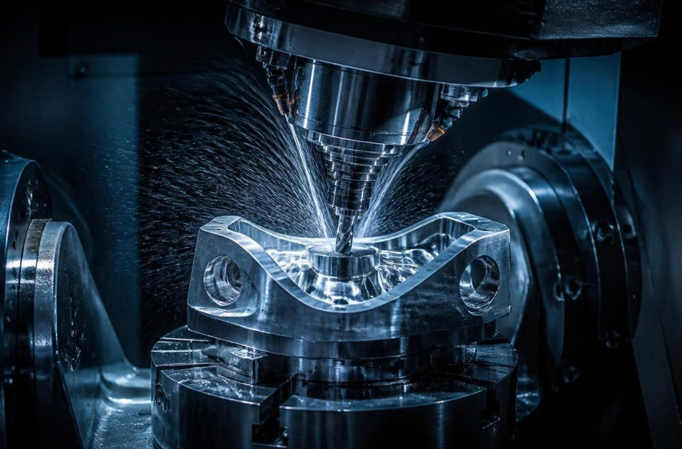
SPEC’26 AI HACKATHON · NEDUET
CNC Part Intelligence
Evidence-Grounded Analysis Across Excel, PDF and IGES
Illustrative CNC component
TEAM BYTE BUILDERS
Aqsa Wilayat Khan — Team Leader
Faryal Khan — Team Member
Notes:
Introduce CNC Part Intelligence. Emphasize that our solution tackles the multi-modal reality of precision manufacturing by cross-referencing Excel tabular data, PDF engineering drawings, and IGES 3D models.

Slide 2
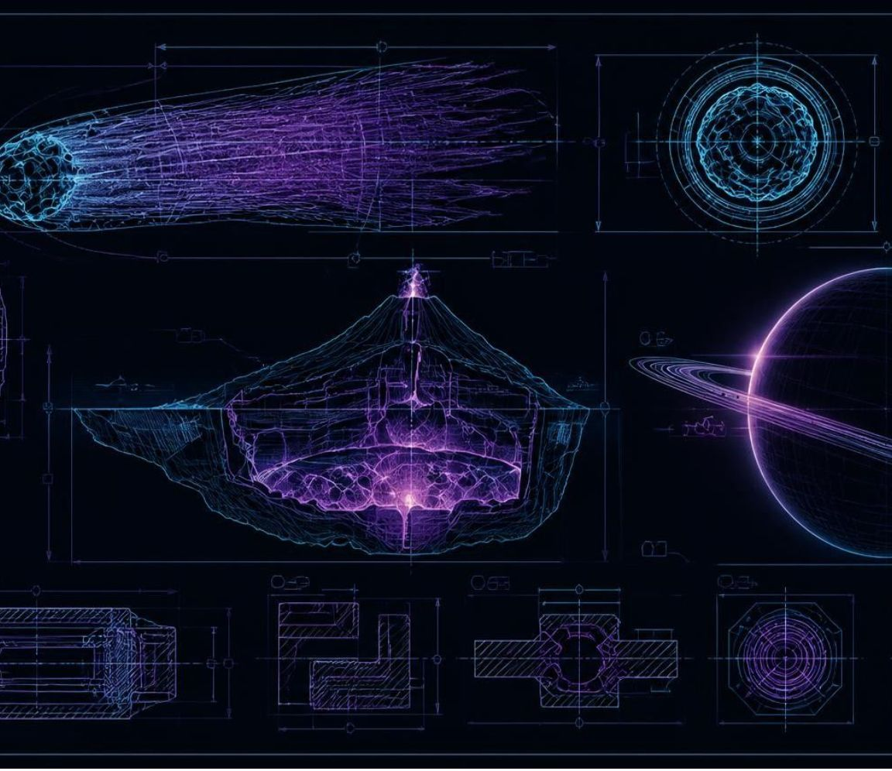

THE MANUFACTURING DATA SILO
Manufacturing data lives in three places, and engineers must join it by hand
CNC manufacturing information is distributed across Excel manufacturing records, PDF engineering drawings, and IGES 3D models.
Engineers often inspect and combine these disconnected sources manually.
Manual review takes time, requires engineering expertise, makes traceability difficult, and may miss cross-file inconsistencies.
The challenge is to accept a part number and return a concise, evidence-based analysis.
Conceptual drafting representation
CORE OBJECTIVE
“Our goal: one part number, three sources, one traceable engineering answer.”
Notes:
Highlight the operational friction: manufacturing release packages contain tabular specs, 2D PDF prints, and CAD geometry. Manual cross-referencing creates risk, delays production, and lacks an audit trail.

Slide 3

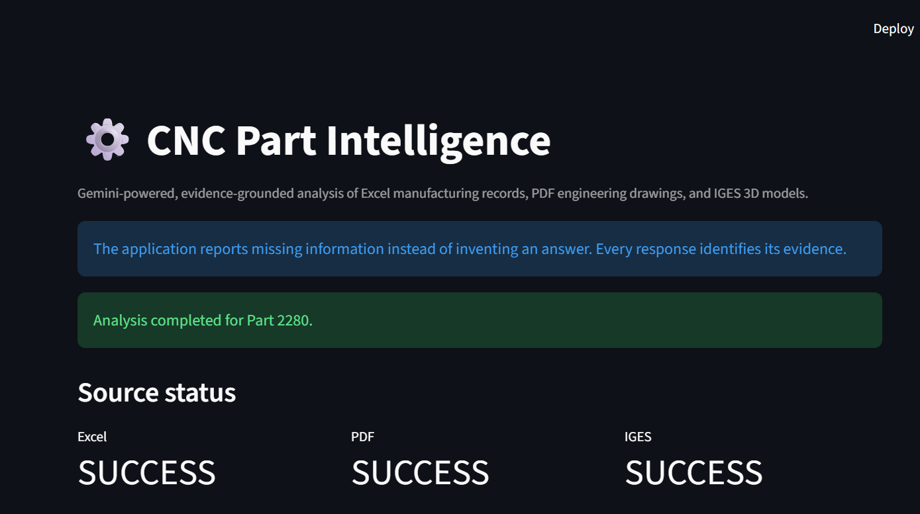

AUTOMATED CROSS-CHECKING PIPELINE
One part number in, one cross-checked answer out
Retrieves matching Excel manufacturing record
01
Finds matching workbook row; extracts available material, quantity, process, dimensions, and manufacturing fields.
Extracts facts from the PDF drawing
02
Uses PyMuPDF to extract machine-readable page text and identify available material, revision, tolerance, process, dimensions, and hole information.
SOURCE STATUS
Analyzes IGES geometry with FreeCAD
03
Uses FreeCADCmd to extract bounding-box dimensions, surface area, reported volume, topology counts, and geometry reliability status.
Cross-checks dimensions across all three sources
04
Achieved Level 3 with stretch-oriented support for uploaded jury files and different part numbers.
Deterministic Python validation uses a 0.10 mm comparison tolerance and flags dimensional disagreements.
Generates evidence-grounded answers
05
Google Gemini answers from extracted evidence, cites the supplied files, and refuses to invent missing information. A deterministic fallback handles common questions if the hosted LLM is unavailable.
Notes:
Walk through the five-stage pipeline. Emphasize: “Achieved Level 3 with stretch-oriented support for uploaded jury files and different part numbers.”

Slide 4


SYSTEM ARCHITECTURE
The LLM sees extracted evidence, not unrestricted technical data
FILE INGESTION AND PART MATCHING
Part Number + Uploaded Files
EXCEL →
PDF →
IGES →
pandas / openpyxl
Matching Manufacturing Record
Workbook, Worksheet and Row Citation
PyMuPDF
Drawing Text and Engineering Facts
Filename and Page Citation
FreeCADCmd
Bounding Box, Surface Area, Reported Volume and Reliability
IGES Filename Citation
Structured Evidence → Deterministic Cross-Check Engine
ANSWER PATH 1
ANSWER PATH 2
Google Gemini Grounded Q&A
Deterministic Offline Fallback if Gemini is unavailable
→ Answer + File Citations + Conflict or Missing-Data Warnings
Deterministic parsers convert supplied files into structured evidence. Python performs numerical validation; the LLM explains the extracted evidence in plain language.
Notes:
Clarify that the LLM is never given raw file dumps or asked to execute geometric math. Python does the parsing and numeric cross-checking; Gemini receives only structured facts and citations.

Slide 5



MULTI-MODAL EXTRACTION & CITATION
Each source gets its own extractor and its own citation
EXCEL
PDF
IGES
Searches multiple worksheets, detects common part-number column names, retrieves the matching row, and cites the workbook, worksheet, and row.
Uses PyMuPDF to extract machine-readable page text and identify available material, revision, tolerance, process, dimensions, and hole information. Cites the filename and page. Image-only scanned PDFs may require OCR.
Runs FreeCADCmd in the background and extracts bounding-box dimensions, surface area, reported volume, topology counts, and reliability status. Warns when geometry is not recognized as a closed solid and cites the IGES filename.
Technology stack: Python, Streamlit, pandas, openpyxl, xlrd, PyMuPDF, FreeCAD, python-dotenv, and Google Gemini API.
Notes:
Review the exact extractors: openpyxl/pandas for Excel, PyMuPDF for PDF prints, and headless FreeCADCmd for CAD models. Every extracted field carries granular source metadata.

Slide 6

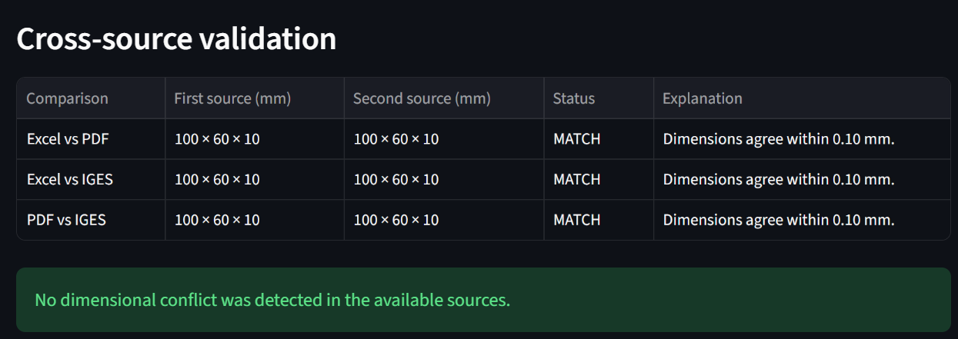
Python checks the numbers; the LLM explains the evidence
GROUNDING PRINCIPLES
Deterministic numerical comparison: Overall dimensions are compared in Python using a 0.10 mm tolerance.
Constrained LLM prompting: The model answers only from evidence extracted from the supplied files. Supported factual answers are designed to include source citations.
Refusal on missing information: Missing facts produce: “I cannot find that information in the supplied files.” Conflicts are displayed rather than hidden.
Deterministic offline fallback: If Gemini is overloaded or unavailable, a citation-based deterministic fallback handles common questions instead of allowing the application to crash or fabricate information.

Slide 7



LIVE DEMO VERIFICATION
Live demo: Part 2280 — Excel, PDF and IGES agree on overall dimensions
PART 2280 · CNC MOUNTING PLATE
CROSS-CHECK MATRIX
Material: Aluminium 6061-T6 (ASTM B209)
Dimensions: 100 × 60 × 10 mm (±0.10 mm)
Holes: 4× Ø8 mm through, 1× Ø20 mm center
Process: CNC milling & drilling (Ra 3.2 µm)
Qty / Rev: 25 units | Revision A
Comparison Pair | Comparison threshold | Status
Excel vs PDF Dimensions | ±0.10 mm | MATCH
Excel vs IGES Bounding Box | ±0.10 mm | MATCH
PDF vs IGES Dimensions | ±0.10 mm | MATCH
IGES CAD EXTRACTION
Bounds: 100 × 60 × 10 mm | Area: 15,803.186 mm²
Volume: 54,847.788 mm³ (surface-shell notice)
Dataset Disclosure: Team-created demonstration dataset, prepared because participants were instructed to source or create their own reference files.
Notes:
Walk through Part 2280: all three independent files align on 100 x 60 x 10 mm dimensions within the 0.10 mm threshold. Note our honest disclosure on volume reliability for open IGES surfaces.

Slide 8



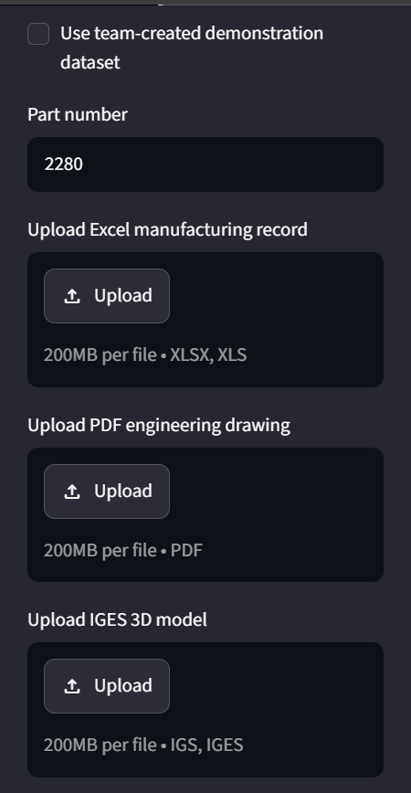
ENGINEERING VALUE AND ROBUSTNESS
Traceable engineering validation, not a generic chatbot
Innovation
Practical value
JURY INTERACTION
Combines tabular, drawing, and 3D CAD evidence in one workflow, and deterministic engineering validation with LLM explanation; provides file-level traceability instead of unsupported generic chatbot responses; automatically attempts multiple available Gemini models when one is temporarily unavailable; includes deterministic offline fallback for robustness.
Reduces manual file searching; helps identify dimensional disagreements; supports faster manufacturing-file review; accepts jury-supplied Excel, PDF, and IGES files; potential applications include quality review, quotation preparation, and design verification.
Three upload controls
Notes:
Highlight practical utility: this is not an open-ended chatbot that hallucinates specs. It is an industrial verification tool built to save engineering hours and catch expensive manufacturing mistakes before chips fly.

Slide 9
Known limits are clear, and the roadmap addresses them
IDENTIFIED LIMITATIONS
FUTURE WORK
Image-only scanned PDFs may require OCR; unusual Excel layouts may require manual field mapping; drawing terminology varies across organizations.
Some IGES files import as surfaces instead of closed solids; volume may be unreliable when a closed solid is not detected; bounding-box dimensions depend on model coordinate orientation.
Gemini requires internet and API availability, although a deterministic fallback is included; the configured FreeCAD executable path is currently Windows-specific; the application does not claim compatibility with every possible engineering-file structure.
OCR for scanned engineering drawings; automatic unit detection and conversion; flexible Excel and drawing schema mapping; browser-based 3D model visualization; expanded geometric feature recognition.
Drawing-to-model feature-level comparison; batch processing; downloadable engineering reports; local LLM deployment for fully offline operation; automatic FreeCAD path detection.
Conclusion: CNC Part Intelligence converts scattered manufacturing files into concise, traceable, and honest engineering answers.
Thank You — Questions? · Team Byte Builders

