Slide 1
Real-Time Image Processing for Autonomous Guidance of Maze Following Robot
Student’s Name: Aqsa Khan
Supervisor’s Name: Dr. Graeme M West

Slide 2
Objectives
Project starts with real-time image processing of the pictures taken by the robot using Raspberry Pi camera
Research about doing image processing and edge detection in Python
Image processing is performed on the images including rotation, noise reduction and edge detection
Canny edge detection operator is being used for edge detection because of its precision
Then it aims to detect walls using an algorithm for the robot to avoid collision
Logics for movement are aimed to design for the robot to move inside the maze

Slide 3
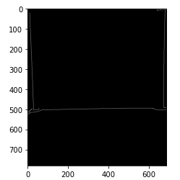
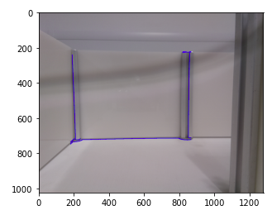
Wall Detection Algorithm
Wall detection algorithm is written on the logic based on the number of edges in the canny image
It first finds all the coordinates of ‘x’ and ‘y’ axes of the all the edges in the canny image
The algorithm works when the number of edges are found to be ‘3’ or ‘2’
The ‘x’ and ‘y’ coordinates of the required edges are evaluated
The image is then cropped and colored contours are drawn on the edges of the wall
Cropped image Contoured image

Slide 4
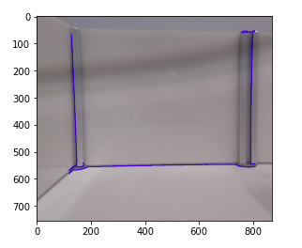
Forward Movement
The logic for forward movement starts working even if the image has more than ‘3’ edges with a timer of 10 seconds
Once the images with ‘3’ or ‘2’ edges are taken, the wall detection algorithm performed with a forward movement for 5 seconds
When the robot takes an image with ‘0’ edges, it will move ahead for 5 seconds and then stop to take turn
Forward logic

Slide 5
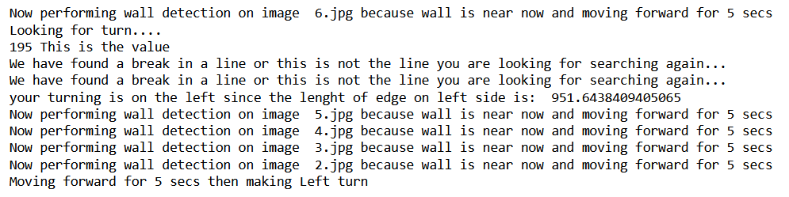
Left / Right Logic
The logic starts when three edges are found in the image
The decision of turning left or right depends on the lengthiest edge on the corner
It finds the starting coordinates of the lengthiest edge
It looks for similar ‘x’ axis coordinates at the middle and ending points of the image
It stores the ending coordinates of the lengthiest edge
It decides if the edge lies on the right or left side in the image with respect to ‘x’ axis
Left logic

Slide 6
Conclusion & Future Work
The project achieves the goal of guiding the robot autonomously in the maze by doing image processing
Real-time images are taken from the robot’s camera at the start of the coding
The algorithm identifies the walls ahead of the robot using canny edge detection on the images
Logic for movements are designed for the robot to move forward, left and right
Satisfied results are achieved using the images taken from the robot
Robot’s movement is tested using a simple Python code
The final code is not yet implemented on the robot so it can done to examine the integration of the code with the robot

