Slide 1
Patterns and Trends in Offuture Sales Data Between 2011-2014

Slide 2
Agenda
Sales & profit across the world
Growth of Offuture order count, sales and profit over time
Average shipping time and its impact on order count by region
Breakdown of profit & sales into segment, category, sub-category and products
Loss of profit causes and suggestions to prevent this
Key take aways from data analysis

Slide 3
Reach Of Offutures

Slide 4

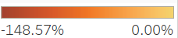

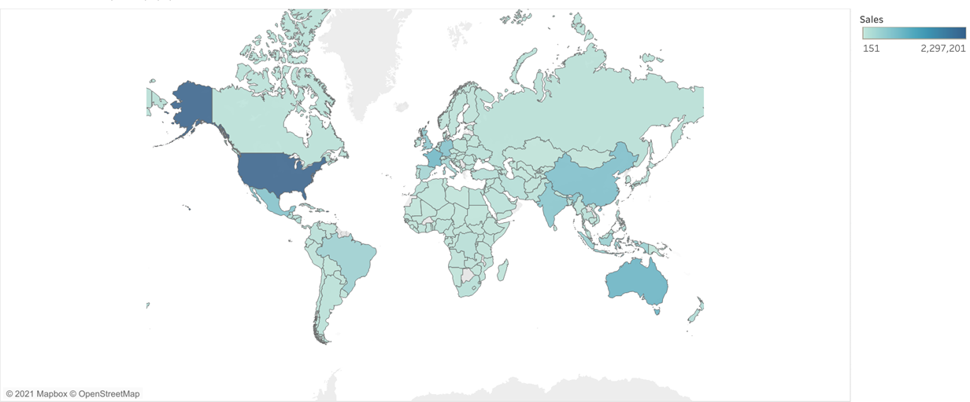
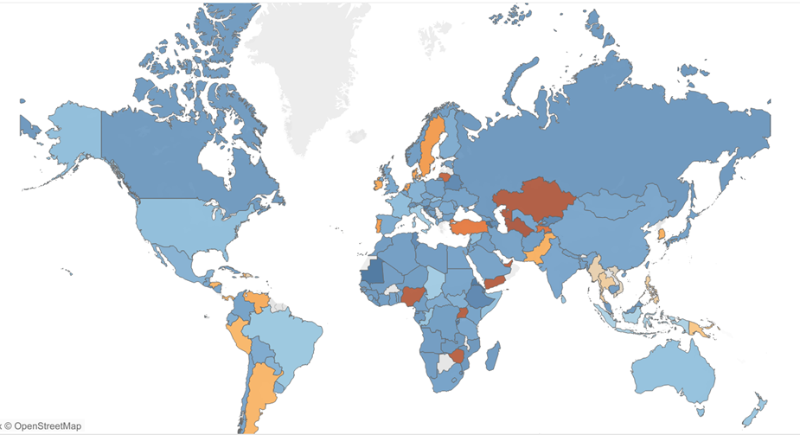
Sales & Profit Across the World
Profit Margin
Notes:
Future has a global reach shipping to 147 countries worldwide
You can see via the graphs that the countries where the profit margin was negative were not one of the countries with the highest sales.
Also you can see the the US clearly had the most sales but that didn’t equate to a large profit margin.

Slide 5
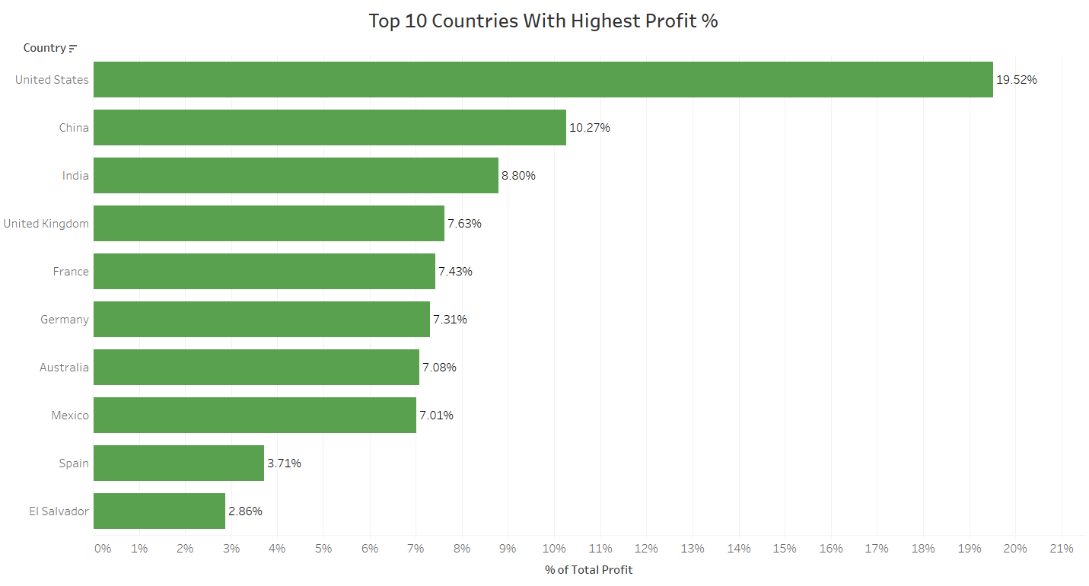
Notes:
Top 10 countries by profit. United states is the most profitable country.China and India are second and third in the list by profit.

Slide 6
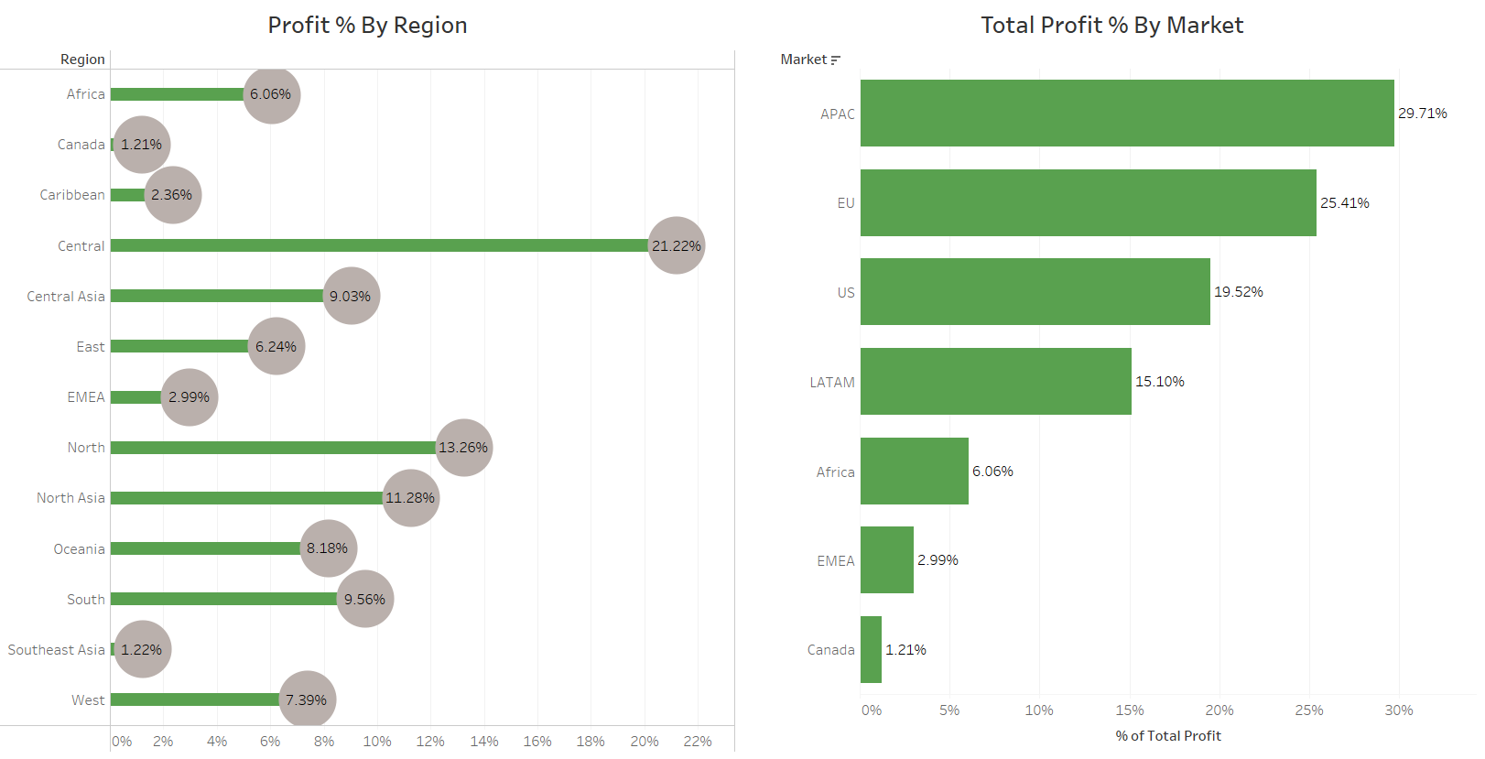
Notes:
Central region is the most profitable. Canada and southeast Asia are the least profitable regions. APAC is at top of the list in terms of profit. EU and US are at second and third number by profit. Canada market is the least gainful.

Slide 7
Growth of Offuture
By the Number of Orders

Slide 8
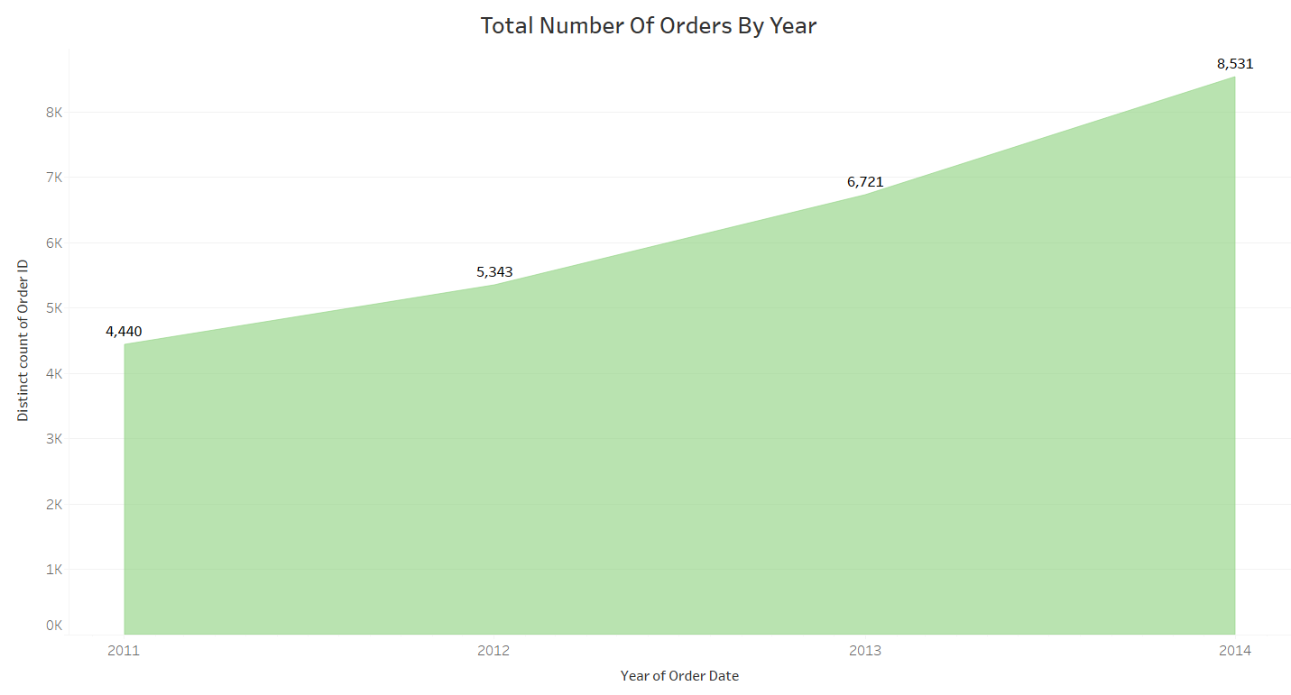
Growth of the Company by Order Count
Notes:
Upward trend
11 -> 12 : 20.34% increase
12 -> 13 : 25.79% increase
13 -> 14 : 26.93% increase

Slide 9
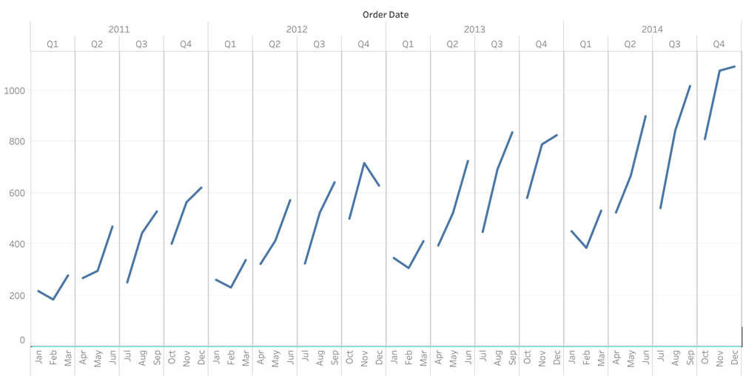
Total Number of Orders By Month and Quarter
No. of Orders
Notes:
Recurring pattern between quarters each year.
Uncharacteristic dip from nov - dec in 2012 q4

Slide 10
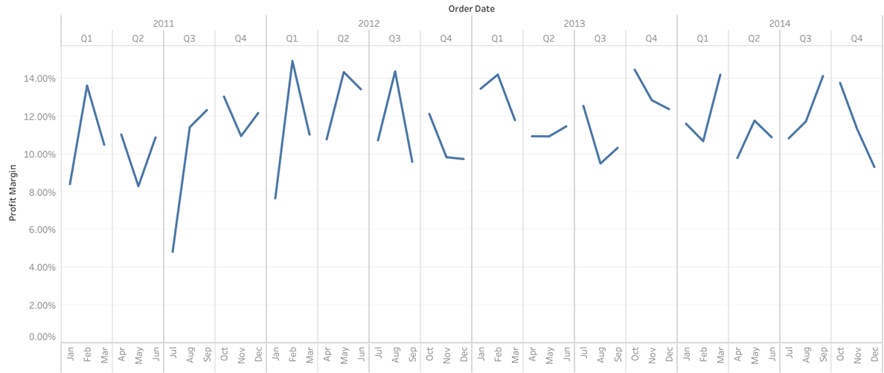
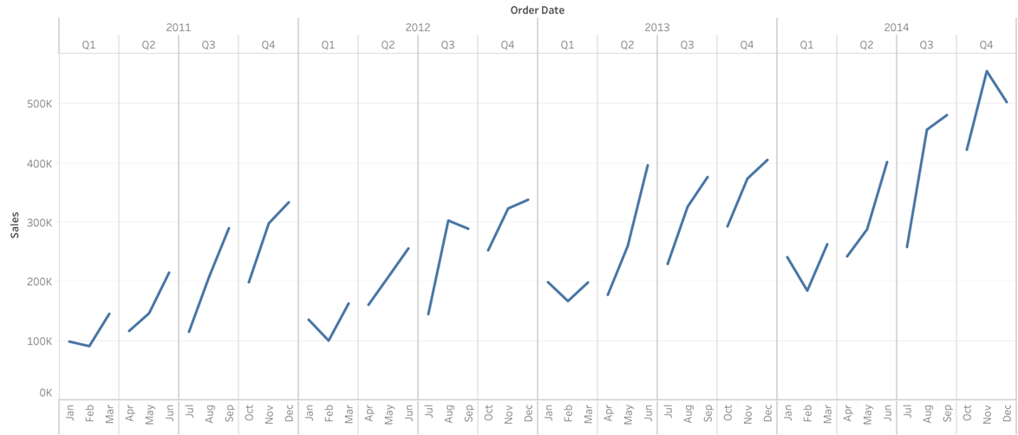
Comparing the Increase in Orders to Sales and Profit Margin across each Quarter
Notes:
Sales matches order count ( other than uncharacteristic dip from nov - dec in 2014 q4) increase but profit margin does not. No real pattern in the how the profit margin has changed from 2011 - 2014

Slide 11
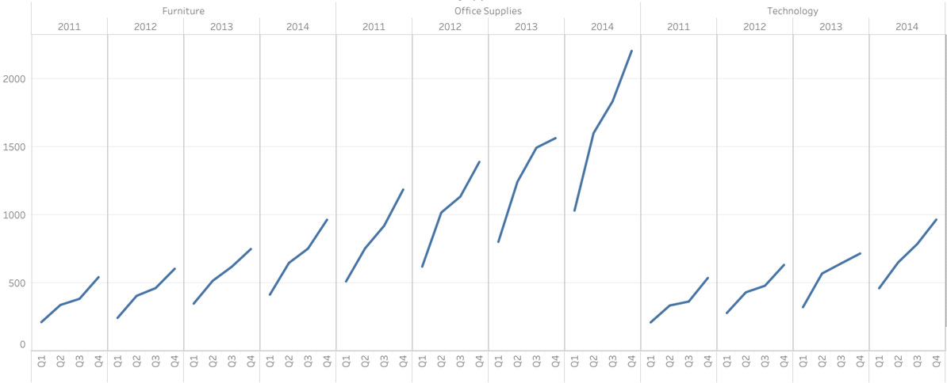
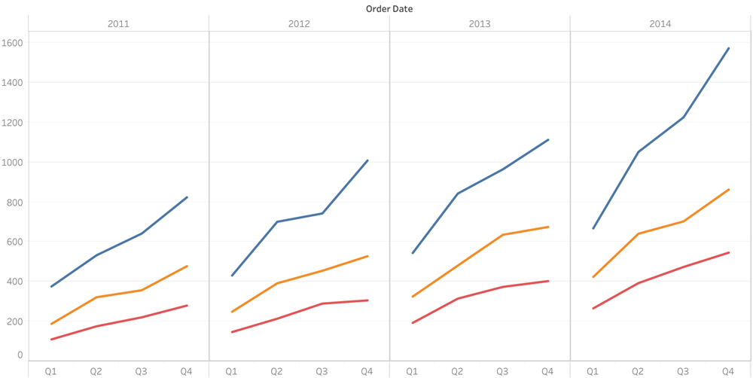
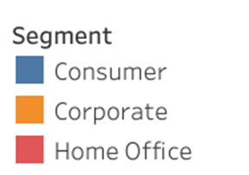
Breakdown of Order Count Against Category, Segment and Order Date
No. of Orders
No. of Orders
Notes:
Furniture avg(sales) = 416.25
Office supplies avg(sales) = 121.10
Technology avg(sales) = 467.86

Slide 12
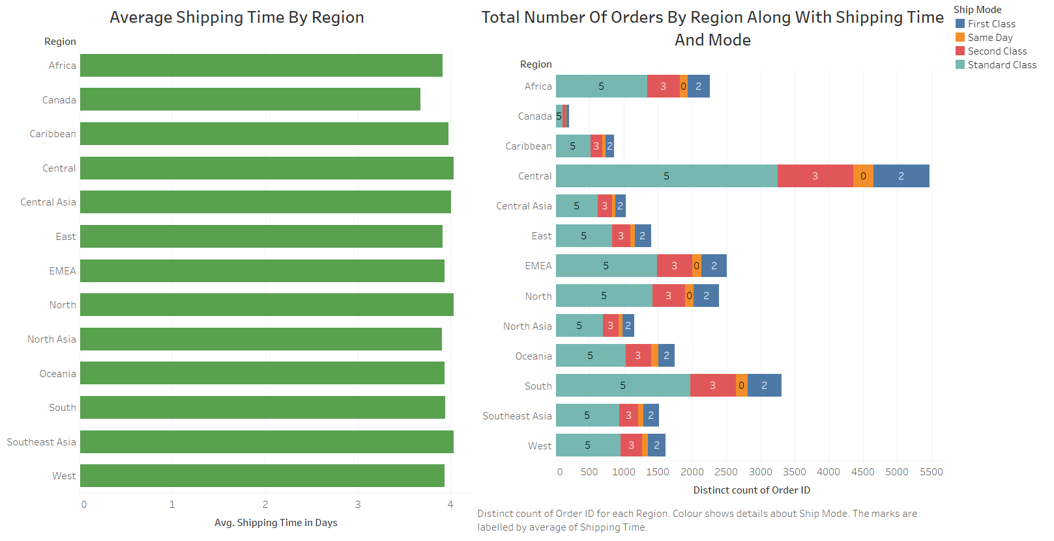
Average Shipping time and Order Count By Region
Notes:
What is average shipping time and did it affect order count by region?
Average shipping time is around 4 days.For standard class delivery, average shipping time is 5 days.Average shipping time for second class and first class is 3 and 2 days respectively.
Overall, standard class is the most chosen shipping mode and second class is the second popular shipping mode. First class shipping model is rarely chosen. The least chosen shipping mode is
Same day.The trend in shipping time is same across all regions. So it can be observed that, shipping time did not impact the purchases made by customers.
Central region has the highest number of orders while least number of order were received from Canada.

Slide 13
Breakdown of Offuture Profit and Sales

Slide 14
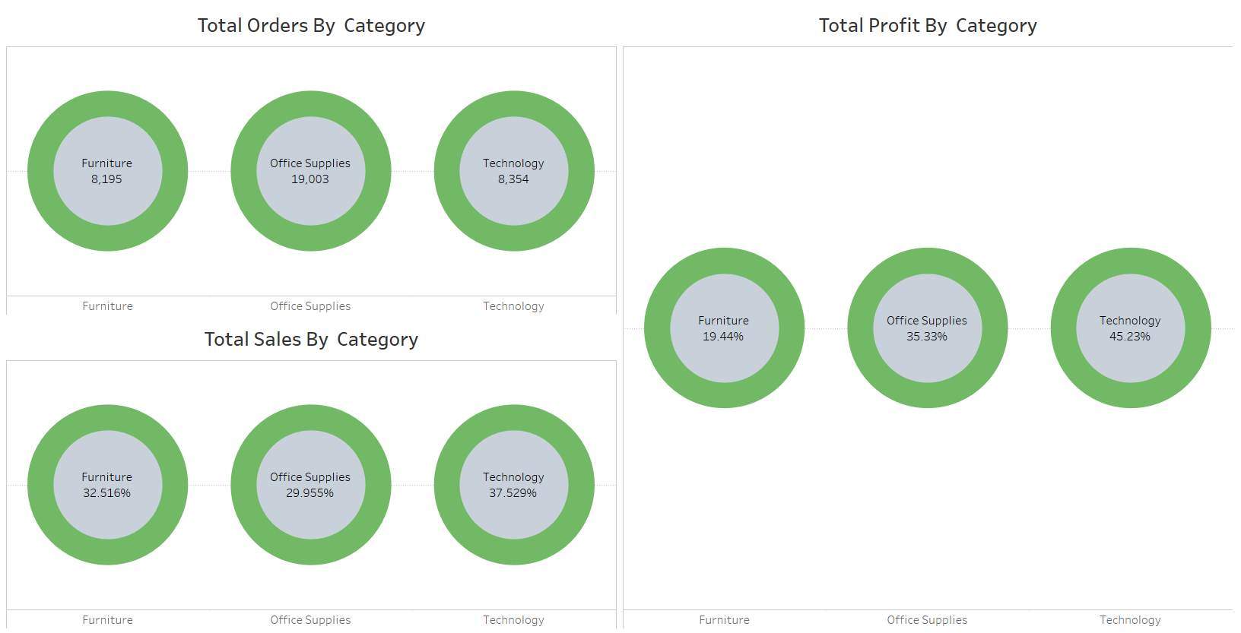
Sales and Profit by Category
Notes:
It is observed that office supplies has the maximum number of orders.
Technology category has the highest number of sales around the world.
The highest profitable category is Technology. An interesting point is that Furniture is the second most sold category but the least profitable category.

Slide 15
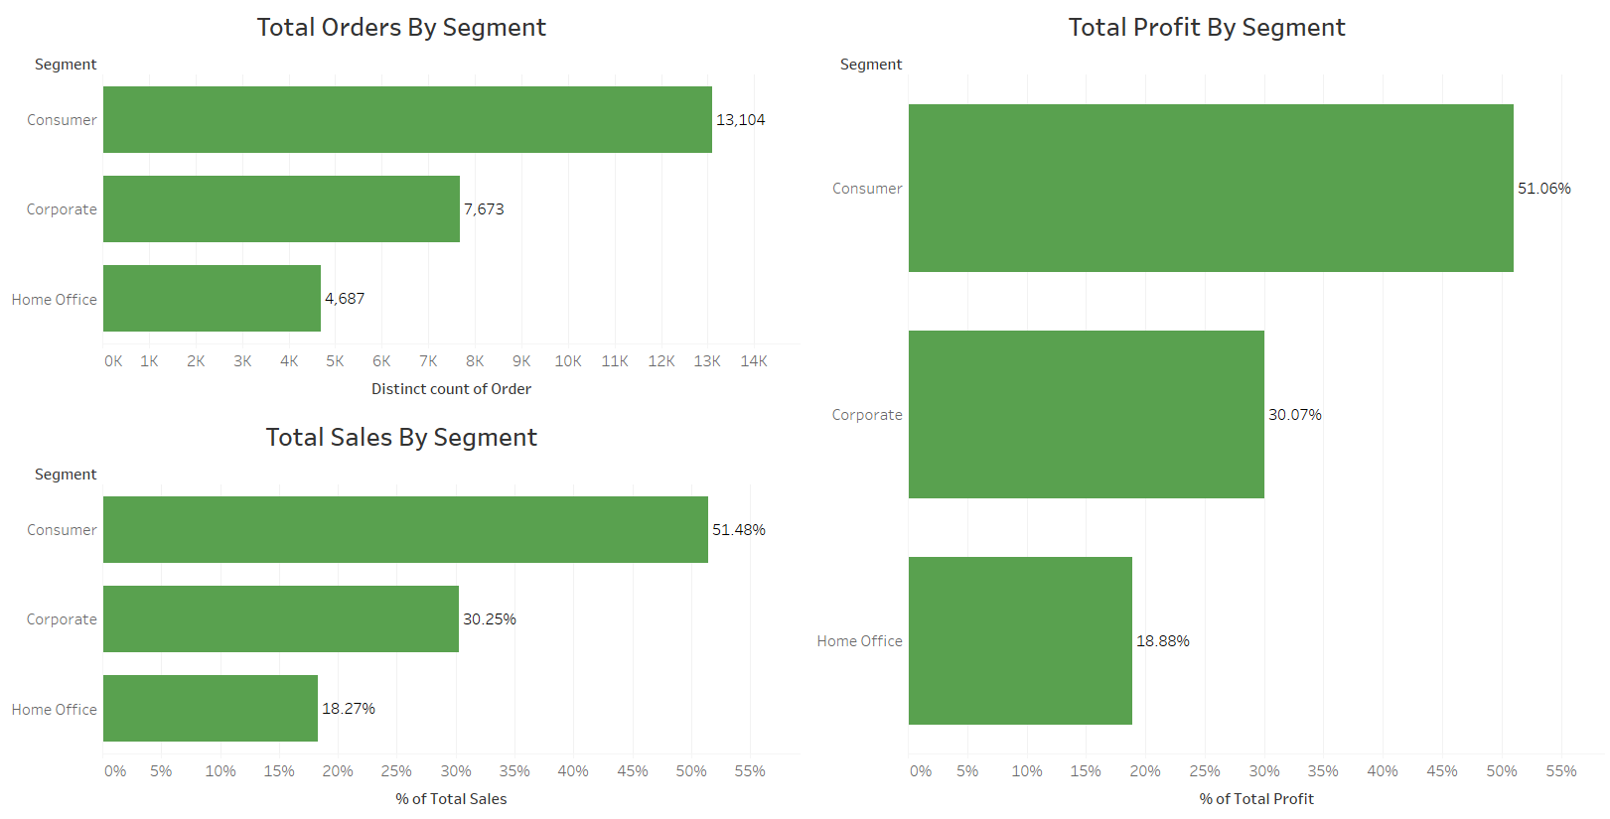
Sales and Profit By Segment
Notes:
Majority of our customers are consumers. Home office customers are the least. Most of the sales are made by consumers. Consumer segment is the most gainful for the offuture company.

Slide 16
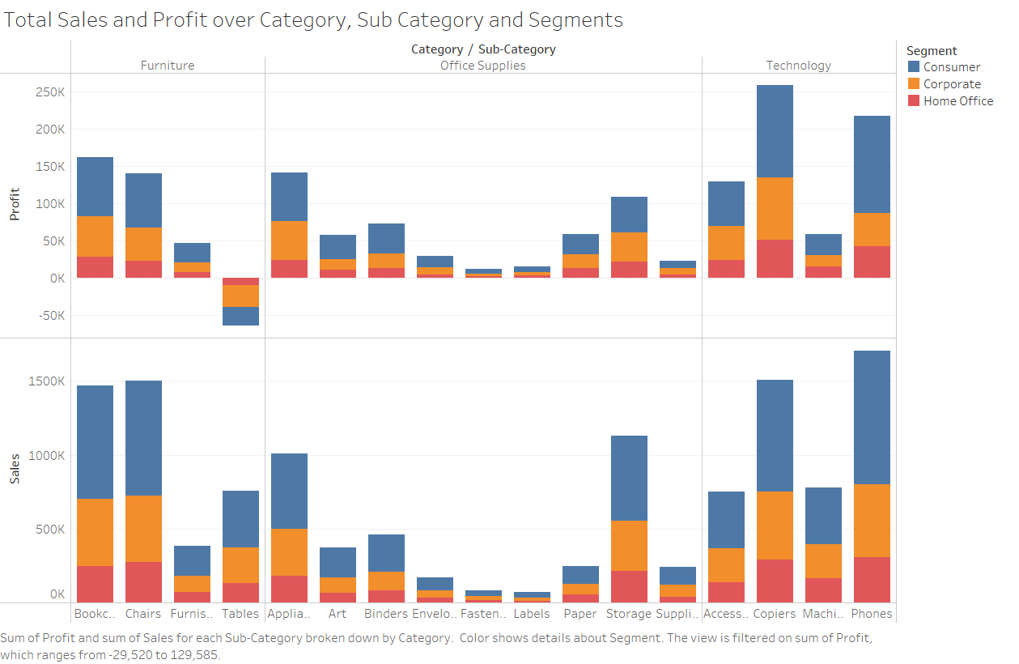
Sales and Profit By Sub-Category
Notes:
In Furniture category, chairs are most profitable and tables made negative profit of around -64K subcategory, whichObserving Office supplies category, Appliances contributed to the highest profit while fasteners added least to the total profit made by office supplies.Looking technology category,

Slide 17
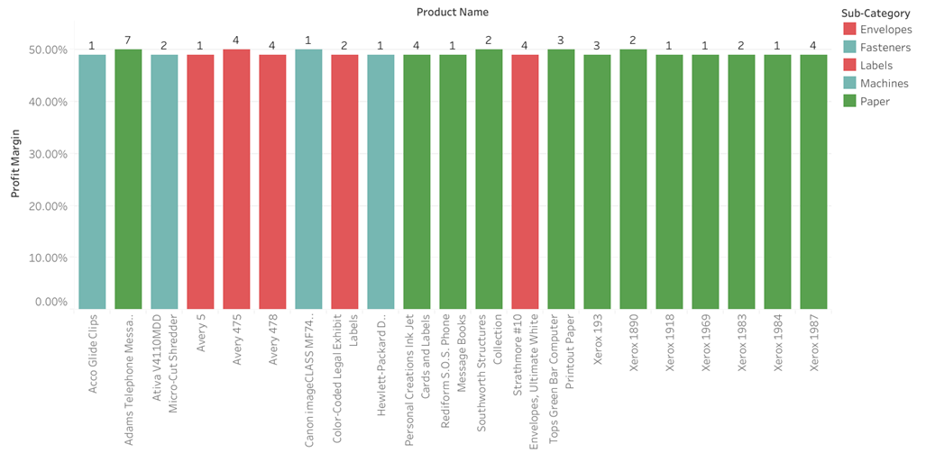
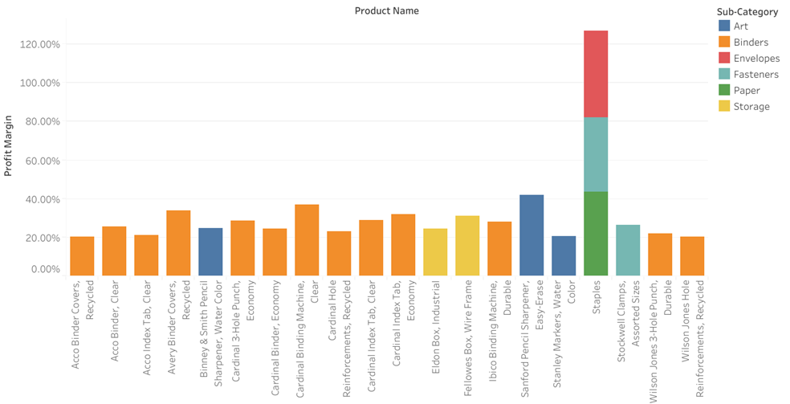
Most Profitable Products
Notes:
Figure on the left hand side shows profit margin of sub category broken down by product name.These are all the products which have profit margin above 40%. The number on the bar graph indicate the count of orders for each product.We can see that paper products have high profit margin on minimal sales so may we should push these products more.
Figure on the right hand side indicates the list of products which have the order count above 45 and profit margin more than 20%.we can see staples contribute to the highest profit whilst all other products did not show very high profit.
Above Figures show most profitable products. Paper products show high profit margin off minimal sales so maybe should push those products more

Slide 18
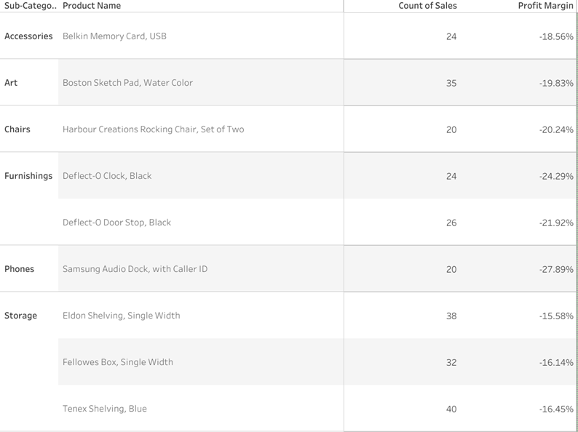
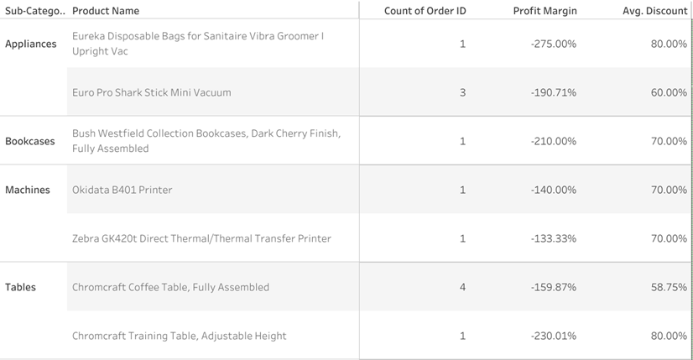
Least Profitable Products
Notes:
RightTop tables show least profitable products.
Left table shows subcategory broken down by products which have the highest negative profit margin.It shows most of the time these products were part of highly discounted orders.(In next slides, my colleague george will explain relationship between profit margin and discount it in more detail)
Right table demonstrated the list of products which have number of sales more than 20 but have negative profit margin. The product samsung audio Dock with caller ID in Phone subcategory contributed the highest in negative profit margin
Top left based of profit margin alone and showing that most of the time they were apart of highly discounted orders. Top right based off of profit margin and them being ordered over 20 different times.

Slide 19
Causes of Offuture Profit Loss

Slide 20
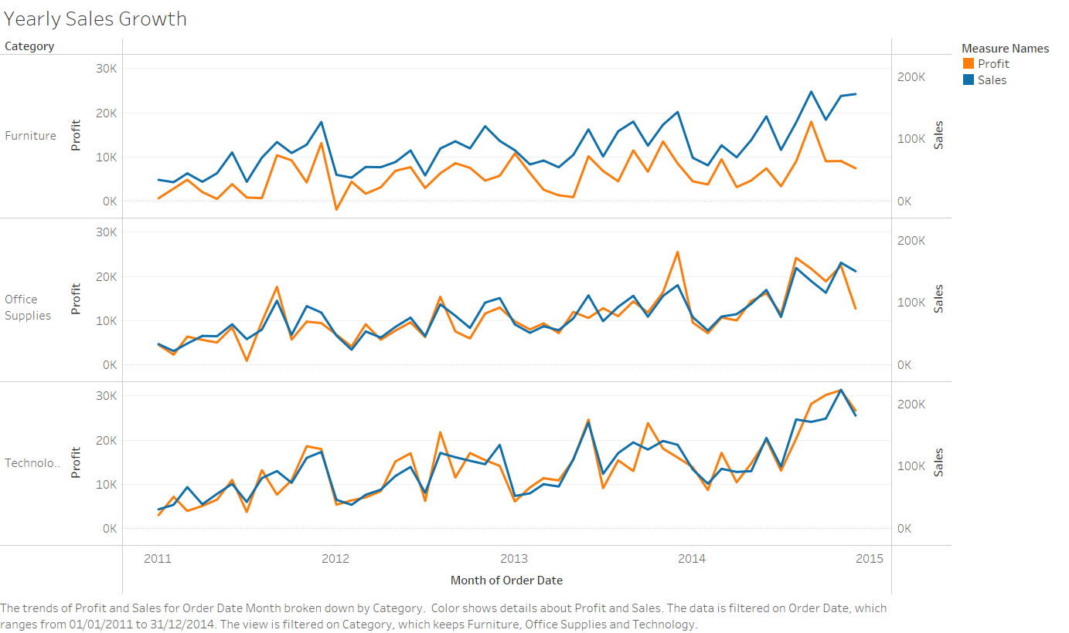
Notes:
These next few slides I will be discussing the matter of profit and how you can stop prevent the loss of it.
There is a reasonable correlation between sales and profit in office supplies and technology apart from some months. But in furniture there is clearly a larger divergence especially nearer to the end..One of the things that are affecting profit is the level of discount

Slide 21
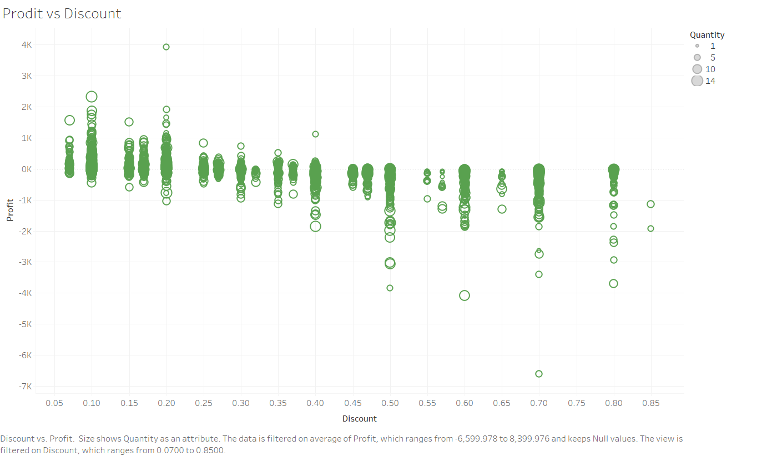
How much discount is given for every order.
We can see a large area of loss from a discount of 0.4 onwards.
Notes:
As we increase our level of discount, we move towards a loss making position. This especially shows where we give a discount of 40% or more.

Slide 22
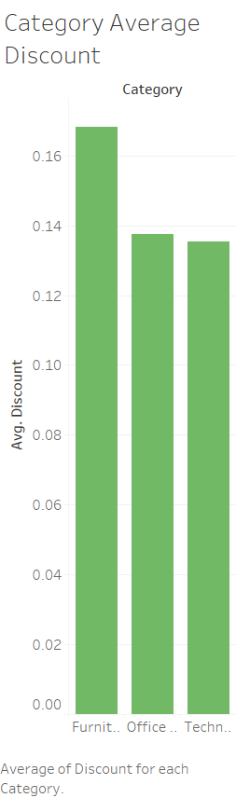
As we have mentioned that giving a product of a discount of 0.4 or more will generally give you a loss,
There are 163 Products with an average discount of 0.4 or more
36 of those are Furniture (4.3% of all furniture products)
30 are Technology (3.4% of all technology products)
97 are Office Supplies (4.7% of all office supplies products)
These Products have an average profit range from £95 to -£3,840
Notes:
This table here shows that furniture has a much higher average discount comparing to the other categories, however when we dissect and look into products that has been sold with an average discount of 0.4 or more, we can find that the amount of products with these discounts is quite balanced through all categories.

Slide 23
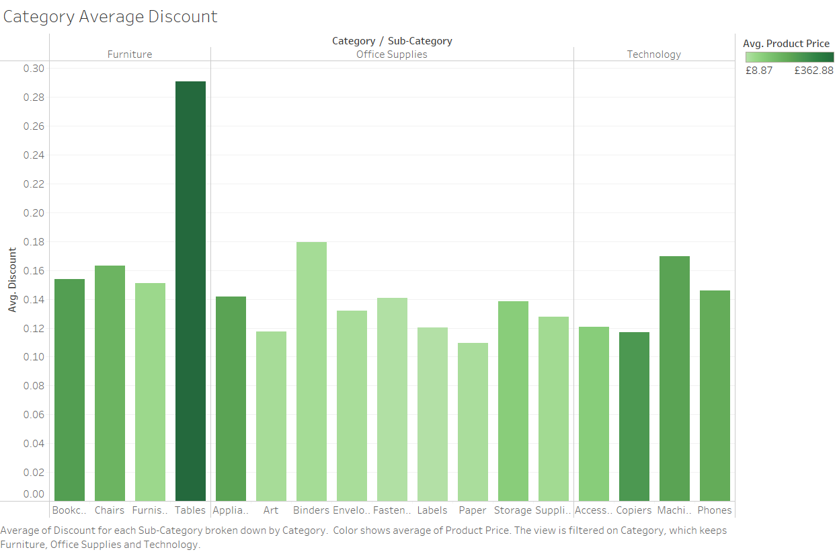
Notes:
Clearly in this graph, tables has the highest average discount but we can also see as it is the darkest shade of green which mean it is also the highest average product price, so as a consequence this is giving away more profit from our highest valued sub-category. As we have seen earlier, tables are the only sub-category that makes a loss, this is not surprising with the level of discount and high pricing.

Slide 24
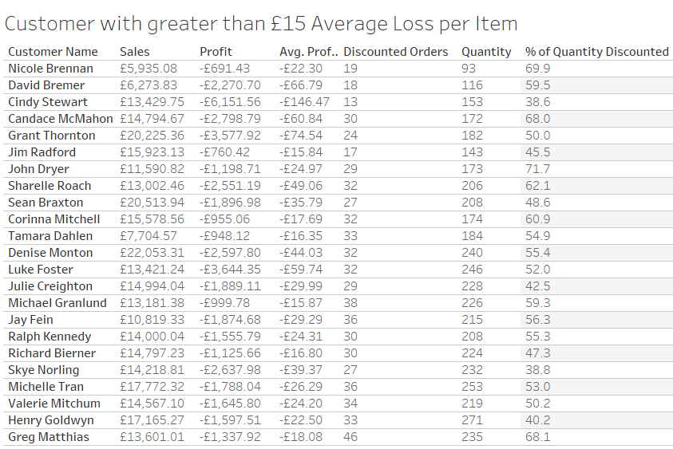
Customers with Greater than £15 Average Loss per Item
Notes:
In this table is a list of customers who generates a loss of more than £15 per item purchased and as you can see in the profit column, a lot of money is loss, in fact it is almost £50,000 just from 23 of your 795 customers! This is largely because almost all of these customers have a half of their quantity discounted.

Slide 25
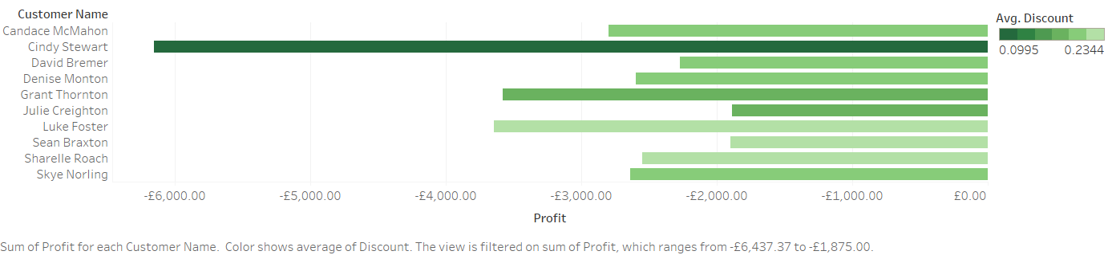
Top 10 Worst Customers Based off of Total Profit
(Average Discount they received per order coloured)
Notes:
All these customers have generated a loss of £1875 or more, this is mainly because the average discount is around 20% across all items. There is an exception with Cindy Stewart.
Cindy Stewart is anomalous as we can see that Cindy Stewart has a much lower average discount rate comparing to the other customers, the reason Cindy Stewart has a huge profit loss is one of the purchases was a 3D printer with a 70% discount and was already selling underpriced.This order alone has a loss of £6,600! Most of the other orders did not have a discount given to Cindy Stewart.

Slide 26
Key Take Aways
Overall performance of the business is strong, and revenue, profit and the number of orders received are increasing year on year.
Technology brings in the most profit and revenue whilst furniture brings in the least.
Tables is the only sub-category consistently making a loss, need a new strategy going forward
Consumer generates the most profit and home office generates the least
Need to rethink how you give and apply discounts to orders
48.5% of your orders between 2011-2014 had a discount applied
Cut out discounts of more than 40%, unless for an exceptional reason

Slide 27
Any Questions ?

