Slide 1

Sentiment Analysis of Customer Reviews
Aqsa Mahmood

Slide 2
Agenda
Motivation
Objective
Dataset Overview
Methodology
Results
Limitations and Improvements
Conclusion

Slide 3
Motivation
A huge amount of comments, opinions and reviews are shared on social medial and online resources everyday.
Most of these reviews are unstructured which makes it hard for businesses to analyse customers feedback at scale.
Being able to quickly determine the sentiment of these reviews helps businesses to identify customers views towards their product and services.
This allows organizations to make intelligent decisions, improve their products and services.

Slide 4
Objective
“This project intends to build a binary classification model (positive/ negative) for customer reviews.”

Slide 5
Dataset Overview
Reviews | Sentiment
i bought it for my mother and she had a problem with the battery. | 0
needless to say, i wasted my money. | 0
The mic is great. | 1
very good quality though | 1
The Sentiment Labelled Sentences dataset was obtained from the UCI Machine Learning repository.
The dataset is composed of 3000 text sentences extracted from reviews of products, movies and restaurants.
Each sentence is labelled positive or negative.
The reviews came from amazon, IMDb and yelp websites with equal ratio of positive and negative reviews.
Notes:
W aim to utilize relationship of words in the review to predict overall sentiment of it.
Sentiment analysis is process of determining feelings from the text. machine learning is adpted to do this automatically and useful to get insigtht of a person towards a product and service

Slide 6
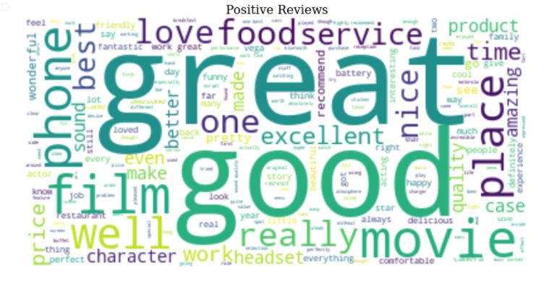
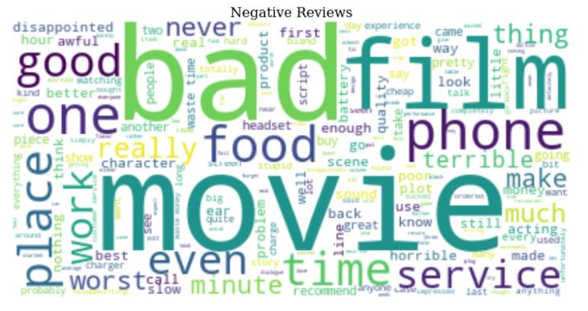
Dataset Overview

Slide 7
Dataset Overview
Reviews with Highest Polarity | Reviews with Lowest Polarity
Excellent bluetooth headset. | Worst customer service.
EXCELLENT SERVICE!!!!!!!!. | It's A PIECE OF CRAP!
best bluetooth on the market. | The movie is terribly boring in places.
I am also very happy with the price. | Food quality has been horrible.
The reception is excellent! | The kids play area is NASTY!

Slide 8
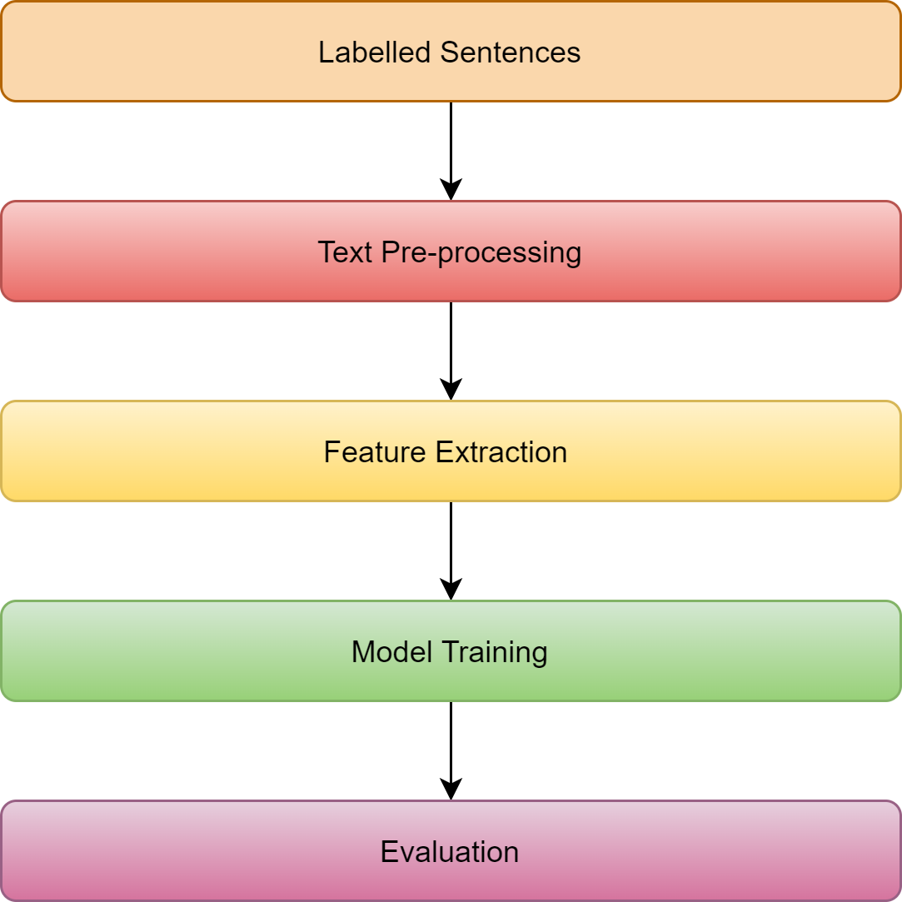
Methodology

Slide 9
Methodology: Data Cleaning
Converting text to lowercase
Removing stop words
Removing special characters and numbers
Tokenization
Lemmatization

Slide 10
Methodology: Feature Extraction
Bag of words
Captures presence of words within text data
TF-IDF
- Captures how frequently a word occurred in a document and the entire corpus.
Word Embeddings
- Vector representation of words
- Pretrained GloVe word embedding of 100 dimension trained using 6 billion words
- Contains 400,000 words in its vocabulary.
Notes:
Word embeddings are really powerful representation for text data, as they capture meaning and semantic of each word.
Pretrained Glove word embedding are freely available.
Glove stands for global vectors for word representations.
Glove uses word word co-occurrence matrix, nearest neighbours for word relationships to generate word embeddings.
Givem words from its context predict the word.
OR given the word, predict the word in its context.
Encode each word as vector of other words

Slide 11
Methodology: Machine Learning Models
The pre-processed dataset is divided into train (70%) and test sets (30%).
Bag of words and TF-IDF techniques were used to extract features from text.
The train dataset is used for training, validating and hyperparameter tuning model parameters.
Grid search with 10 fold cross validation was used to find optimal model parameters.
Two Machine learning models Support vector machine and Logistic regression were trained using BOW and TF-IDF features.

Slide 12
Methodology: Deep Learning Model
Pretrained GloVe embeddings were used to get vector representation of words.
Trained Bidirectional GRU model using generated word embeddings to determine sentiment of reviews.
Adam optimizer was used to train the model and binary cross entropy with logits function was used to calculate error.
The model was trained for 50 epochs.
Notes:
RNN
The input to rNN model is a word sequence
Bidirectional Rnn run words both forward and backward.
Embedding layer
The memory cell used to build our RNN is GRU (Gated Recurrent unit) cell.
The output hidden state of rnn is then passed to fully connected linear layer
Bi directional RNN and multi layer RNN
Which is the most performant form of Long short term memory cell
Apply bidirectional rnnto our embedded text
We have powerful RNN which is multi alyer and bidirectional
It can learn to keep only relevant information to make predictions, and forget non relevant data.
Then the RNN processes the sequence of vectors one by one.

Slide 13
Results
Model | Training Accuracy | Test Accuracy | Precision | Recall | F1 score
Logistic Regression with BOW | 90% | 77% | 74% | 77% | 76%
SVM with BOW | 96% | 79% | 78% | 78% | 78%
Logistic Regression with TFIDF | 88% | 75% | 87% | 69% | 77%
SVM with TFIDF | 94% | 78% | 78% | 76% | 77%
Gated Recurrent Unit(GRU) | 98% | 85% | 87% | 83% | 85%

Slide 14
Limitations and Improvements
Limitations:
-Grammatical errors
-Spelling mistakes
-Sarcasm in hate reviews is an unsolved problem.
Improvements
-Implementing this framework on large dataset of reviews
-Correcting Spelling mistakes and excluding non vocabulary words
-Considering learning word embeddings form scratch

Slide 15
Conclusion
We Classified text by sentiment using different feature extraction, Machine learning and Deep learning techniques.
Word Embedding is the most powerful feature extraction technique as compare to Bag of words and TFIDF.
Gated Recurrent Unit model outperforms SVM and Logistic Regression.

Slide 16
Thank You for Listening

