Slide 1
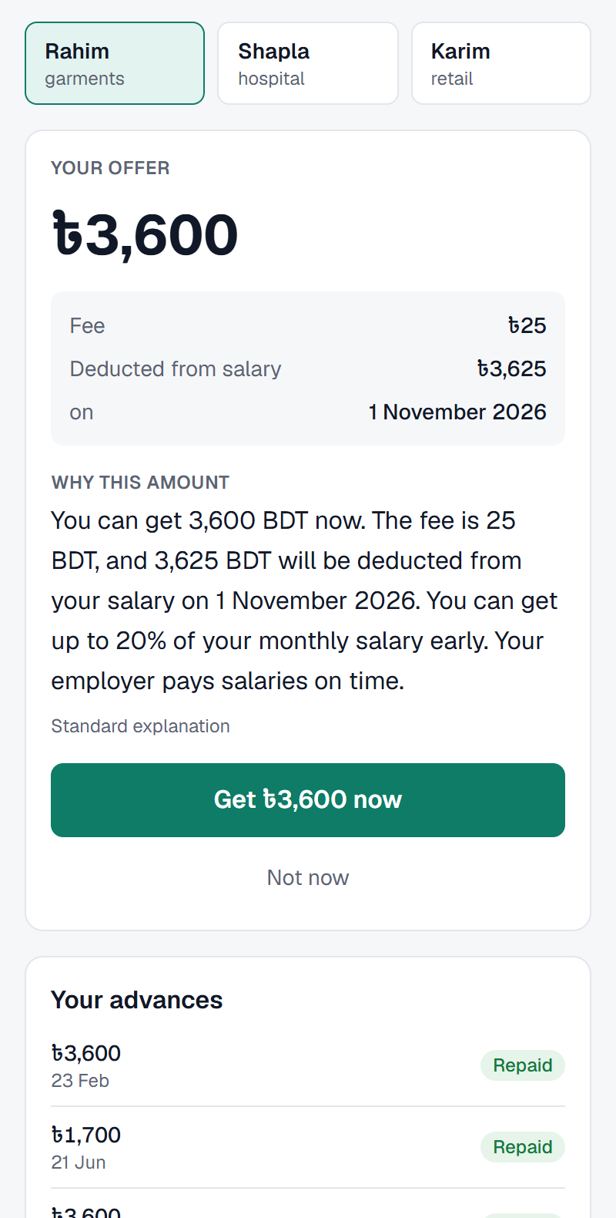
SalaryBridge
DIU CPC × upay AI HACKATHON 2026
Earned wages in the upay wallet before payday. AI sizes each advance, the employer repays it in one transfer, and every decision is explained.
বেতনের দিনের আগেই নিজের আয় করা টাকা, upay ওয়ালেটে
NeuroVerse
Md Abdul Quym Shanto · Sajid Ahasan · Sakibul Hasan Sakib
Daffodil International University ·
Track 03 · Customer Innovation & Financial Independence.
Notes:
Open with the one-line promise: workers reach wages they have already earned, inside upay, before payday. Replace the team placeholders before presenting. All data in the demo is synthetic.

Slide 2




By the 20th, wages are earned but out of reach
The gap is filled informally
Rahim, garment worker
Shop credit, advances from a supervisor or a moneylender: costly, opaque and outside any wallet.
Salary ৳18,000, paid on the 1st
Earned by 20 October
Lenders cannot see wages
৳11,612
Without payroll data nobody can size a safe advance, so the answer is usually no.
Reachable today without SalaryBridge
৳0
Employers will not run it
Cash advances mean paperwork, recovery work and risk that HR does not want.
Figures from the SalaryBridge sandbox (synthetic persona).
Notes:
Make the problem concrete with Rahim. On the 20th he has earned ৳11,612 but can reach none of it. The three gaps: informal credit, no wage data, and employers who will not take on the work. upay already has the wallet and the users; it lacks a safe way to lend against payroll.

Slide 3



How SalaryBridge works
1
2
3
4
Employer opts in
›
Worker asks in upay
›
Money in the wallet
›
Payday: one transfer
HR chooses a limit (up to 20% of salary). No cash, no paperwork.
AI sizes the offer in seconds and explains it in English or Bangla.
Flat ৳25 fee, no interest. The fee stays inside earned wages.
Employer remits one bulk total. Wallet auto-debit is the fallback.
≤ 20%
৳25
1
of monthly salary, and never more than earned minus owed
flat fee per advance: no interest, no late penalty
transfer per employer per payday, from a ready-made deduction list
Notes:
Four steps. The employer only opts in and, on payday, sends one transfer from a deduction list we generate. Hard cap = min(20% of salary, earned minus already owed); the fee stays inside earned wages. Rules decide eligibility; AI can only shrink an offer or send it to a person.

Slide 4
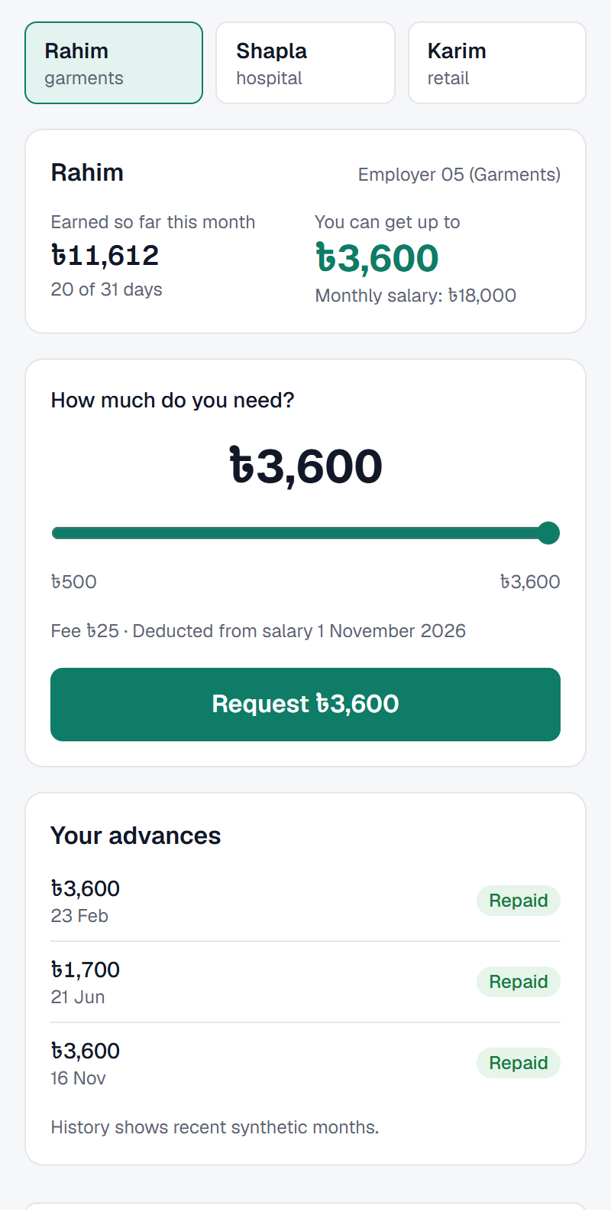
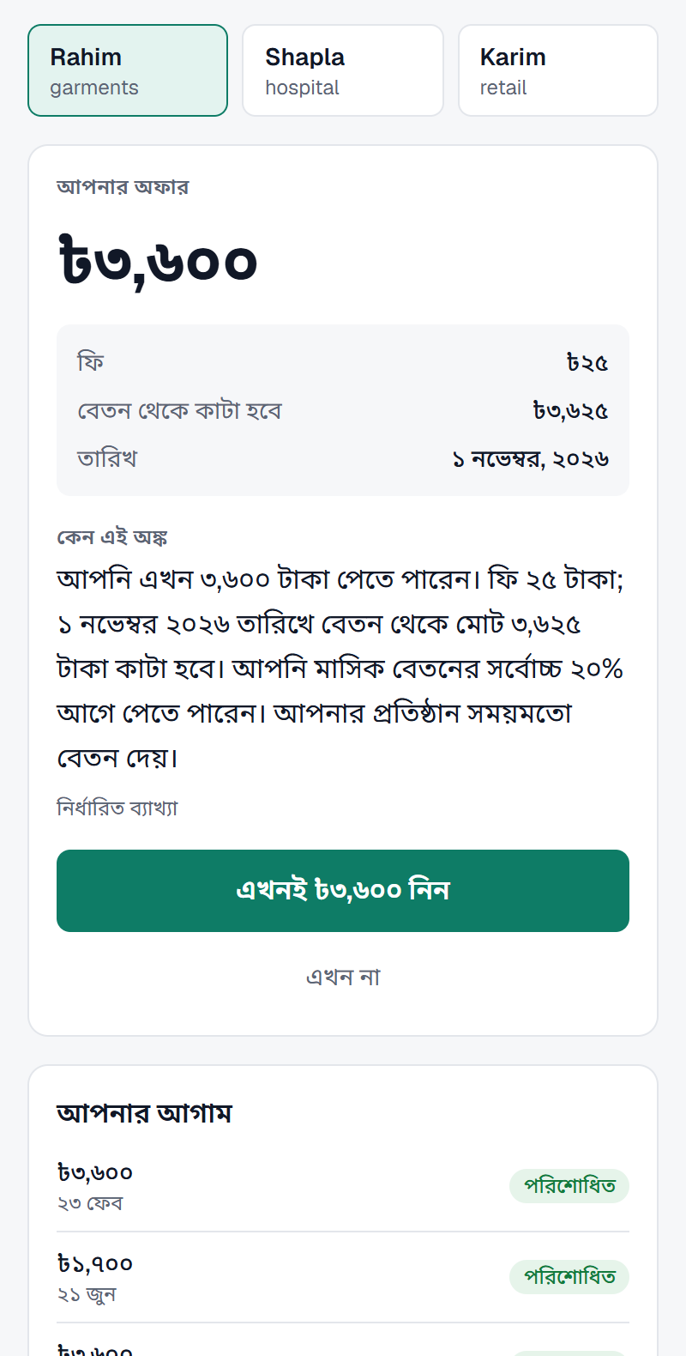
The worker's view: one slider, one plain reason
See what you have earned
Offer with a reason
Fully in Bangla
Earned to date and the safe limit, live from the simulated payroll.
Fee, total deduction and date, with why this amount, in plain words.
Every screen, number and explanation switches to Bangla.
Real screens from the running prototype (Rahim, synthetic data).
Notes:
Live demo path: Demo mode, Rahim asks for ৳3,600, sees the fee and the deduction date, and reads why. Switch to Bangla to show the same offer. These are real screenshots of the running app.

Slide 5
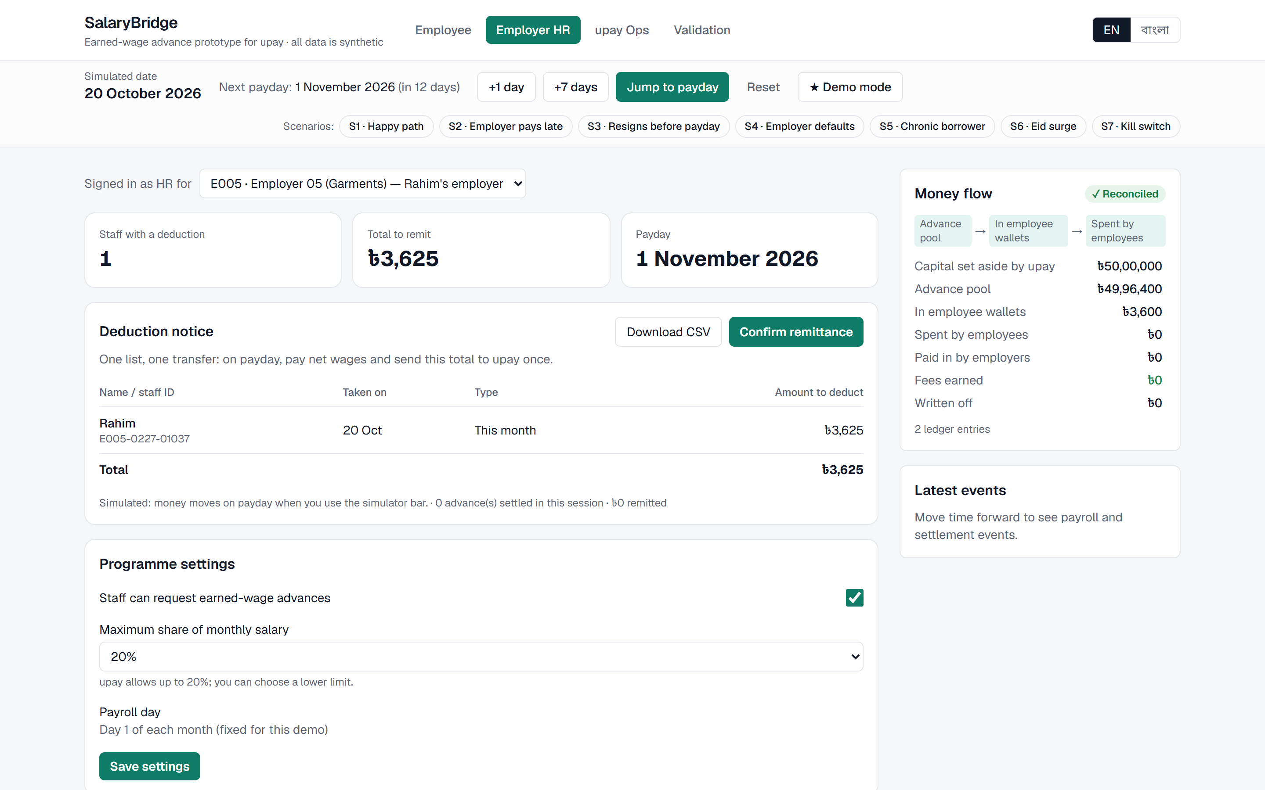
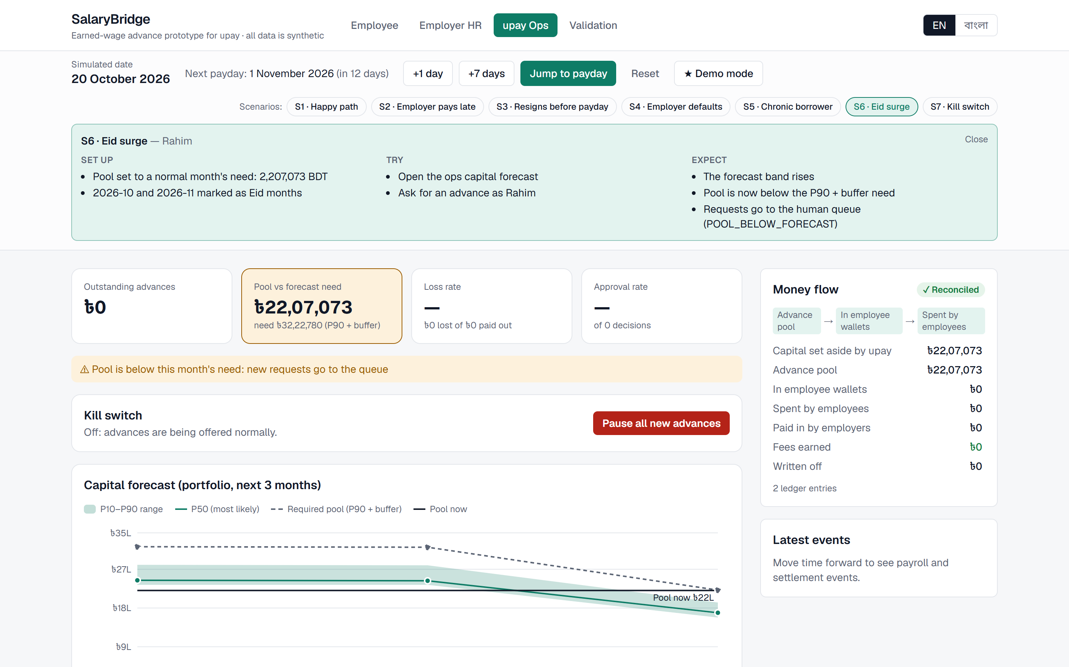
Employers get one list; upay ops sees the risk
Employer HR
upay operations
Deduction notice and CSV: who, how much, which payday
Confirm one remittance; HR can lower the limit or switch off
Capital forecast (P10–P90): an Eid surge pushes need above the pool
New requests queue for a person; kill switch pauses everything
Notes:
Left: HR sees Rahim's ৳3,625 on the deduction notice and confirms one remittance. Right: scenario S6, an Eid surge. The forecast's required pool (P90 + 15% buffer) rises above the ৳22 lakh pool, so new requests go to the human queue (POOL_BELOW_FORECAST). The money-flow ledger stays reconciled.

Slide 6





Five models; AI can shrink an offer, never decline one
M1 · Employer payroll risk
M2 · Repayment risk → tier
M3 · Leaving before payday
Will this employer pay late? LightGBM, calibrated, SHAP reasons.
Tier A/B/C/D sets 100% / 70% / 40% of the cap, or a person.
If ≥ 30%, the tier steps down one level.
ROC-AUC 0.91 vs 0.68 rule
ROC-AUC 0.88 vs 0.50 rule
ROC-AUC 0.82 vs 0.65 rule
M4 · Capital forecast
M5 · Borrowing monitor
Claude · explanations
Quantile LightGBM + conformal band; pool = P90 + 15%.
IsolationForest flags the top 2% for a person to review.
Writes EN/BN text from an allow-listed fact sheet only.
P10–P90 coverage 0.92 A · 0.76 B
Precision 0.63–0.83 at top 2%
Numbers checked; template fallback
Scores on unseen test months of the training world (Profile A); baselines are simple rules. Every model is point-in-time with leakage tests.
Notes:
Design rule: only rules can decline. Models size the offer (M2 tier, M3 downgrade), price the employer (M1), keep enough capital (M4) and spot abuse (M5). Claude only rewords facts we hand it; numbers are checked and a template is used without a key.

Slide 7
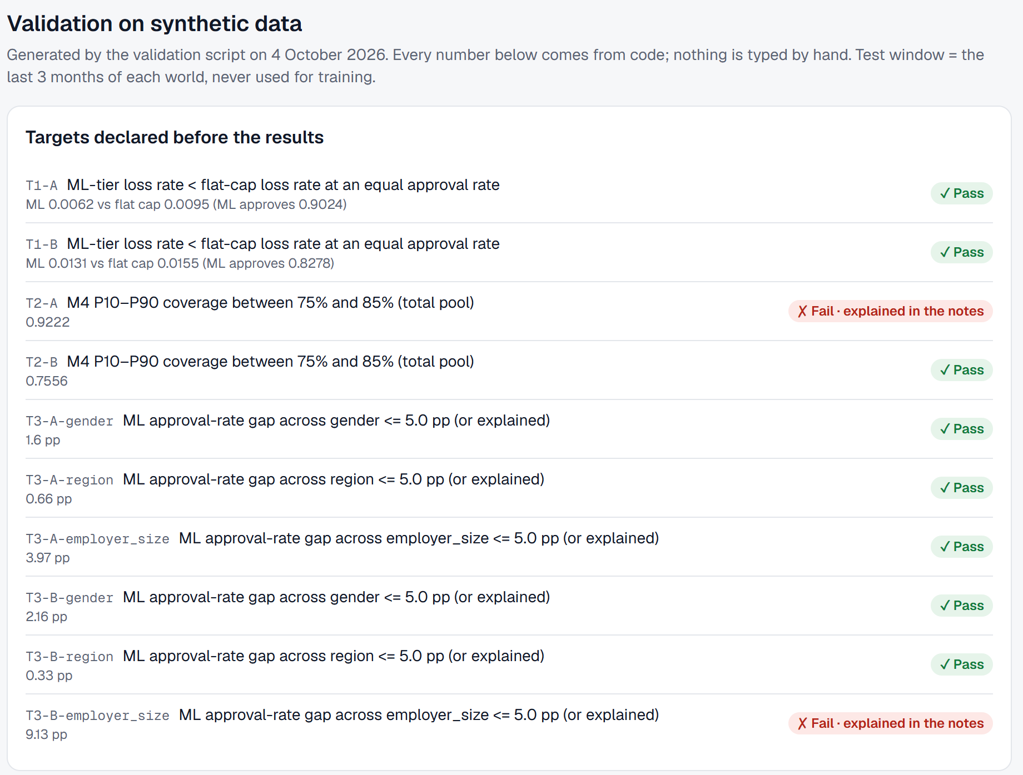
Tested before we believed it: ML tiers cut losses
At equal approval, ranking by M3 leaving-risk loses least: 0.62% (A), 1.15% (B).
8 of 10 targets declared up front pass. The 2 misses are shown, not hidden.
Notes:
Validation runs on 5 seeds and two worlds; the test window is the last 3 months, never trained on. Profile B is a harsher stress world. Misses: T2-A forecast band too wide (0.92 coverage, safe side) and T3-B employer-size approval gap 9.1 pp; the fix is retraining M2/M3 without employer headcount and re-running the audit.

Slide 8






Safe by design: 32 controls, each guarded by a test
No debt spiral
People decide the edges
Cap = min(20% of salary, earned − owed). Fee inside earned wages. No interest.
৳10,000+, tier D and flagged patterns go to a human queue.
Supportive pause
Fairness audit
After 3 months in a row, a cooling-off month, worded as protection.
Approval gaps by gender, region and employer size must be ≤ 5 pp or explained.
Capital guard + kill switch
Explained, in Bangla
Pool below P90 + 15% queues requests; one switch pauses all new advances.
Every decision lists reasons. The LLM sees only allow-listed facts.
229 automated tests · double-entry ledger reconciled to the paisa · synthetic data only, no real customer data
Notes:
Each control maps to code and a test in docs/responsible_ai.md. Lending to low-income workers needs guard-rails first: the cap, human review, cooling-off, the fairness audit and the kill switch.

Slide 9
Honest economics: ৳25 is too cheap, ৳49 breaks even
−৳10,876
net per month at ৳25 (Profile A)
৳49
break-even fee · ৳60 in stress world B
1.4%
one-time fee on a ৳3,600 advance at ৳49
Paths to viability
Employer co-pays part of the fee as a staff benefit
Value to upay beyond fees: payroll inflow and active wallets
Notes:
Assumptions are labelled in the app: 12% annual cost of capital, 15% idle buffer, ৳5 operations cost per advance. At the ৳25 fee the sandbox month loses ৳10,876; the break-even fee is ৳49 (A) and ৳60 (B). We show this openly; the economics slider on the Validation page lets judges change every assumption.

Slide 10
Next: a 3-month pilot with one employer
1
Fix the open finding
NeuroVerse
Retrain M2/M3 without employer headcount and re-run the fairness audit.
Md Abdul Quym Shanto
Leader , Frontend, Ai Engineer ·
CSE Department, Daffodil International University · quym241-15-053@diu.edu.bd
2
Pilot
One garment employer: real payroll file, upay sandbox wallets, weekly reviews.
Sajid Ahasan
Ai/ML ·
CSE Department, Daffodil International University · sajid241-15-909@diu.edu.bd
3
Integrate
Module inside the upay app, employer portal, upay KYC and ledger, regulatory review.
Sakibul Hasan Sakib
Backend Engineer ·
CSE Department, Daffodil International University · sakib241-15-048@diu.edu.bd
Code github.com/aqshanto/SalaryBridge
Live https://salary-bridge-iota.vercel.app
Notes:
Close on the ask: a pilot with one employer. Name the first next step plainly (retrain without employer headcount, re-run the audit). Replace the team and live-URL placeholders before presenting.

