Slide 1
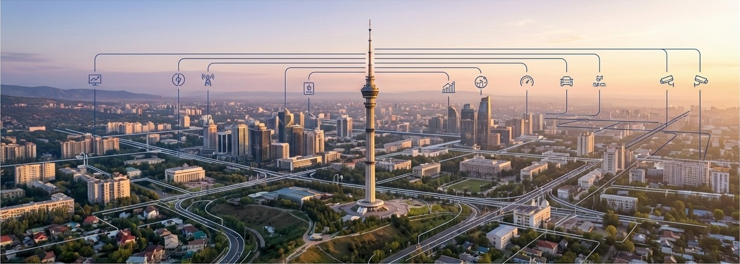
Smart City Almaty OS
An Al-Driven Digital Twin Ecosystem
Moving beyond static dashboards to a living, ‘thinking’ operating system for Almaty.

Slide 2




Almaty's Challenge: Complexity Without Cohesion
Data Fragmentation | Reactive Management | Environmental & Seismic Strain
Critical urban data from | Without predictive analytics, | Almaty's unique geography
transport, ecology, and public | city administration is forced into | presents persistent challenges,
services exists in isolated | a reactive cycle—addressing | from severe air quality(API)
systems, preventing holistic | traffic jams, pollution spikes, | issues to seismic risks,
analysis and cross- | and emergencies only after | demanding a more intelligent and
departmental strategy. | they occur. | proactive monitoring system.

Slide 3



A Three-Layered, Asynchronous Architecture
Layer 1: Interaction
(Frontend)
Stack: React 18, TypeScript, Tailwind CSS
Function: High-performance, real-time 3D visualization and interactive dashboards.
Data Flow
Layer 2: Intelligence (Backend & AI)
Stack: FastAPl (Python) for asynchronous, low-latency
processing.
Function: Hosts the 12-module ’Neural Brain’ and over 40 API endpoints for data orchestration and analysis.
Data Flow
Layer 3: Data (Persistence &
Real-Time Ingestion)
Stack:: SgLite with 30,000+ seeded local data points. Function: Live integration with external APls (Open- Meteo, OpenStreetMap) and loT sensor feeds.

Slide 4






Core Innovation: A Bespoke, Multi-Modal AI Engine
The ’Neural Brain,’ managed by our central ’enhanced_gpt_ai.py” orchestrator, is a purpose-built system for urban context, not a simple API call.
LSTN Intent Classifier
A fine-tuned LSTM V2 model achieves over 85^{O}/o accuracy in classifying citizen requests, routing them to the correct city service module.
Vision Engine
Utilizes computer vision to analyze user-submitted photos of urban issues(e.g., potholes, illegal dumping), automatically tagging them with location and category.
*enhanced_gpt_ai.py”
Grounded RAG Pipeline
A Retrieval-Augmented Generation model that grounds its responses using a verified local knowledge base of Almaty's laws, public transport routes, and historical data, ensuring accuracy and preventing hallucination.

Slide 5
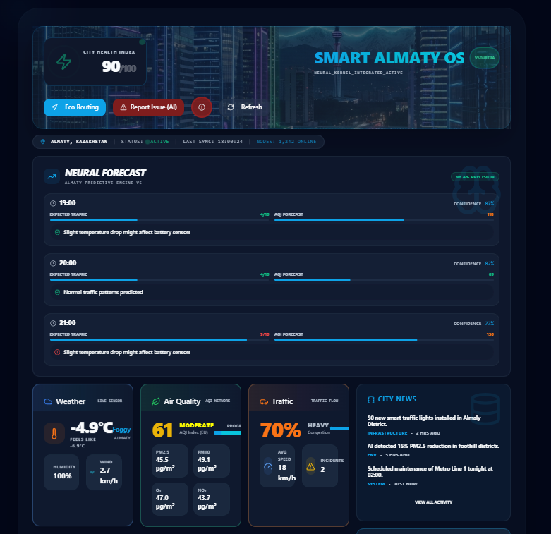
The Operating Center: A Real-Time View of the City
City Health Index (CHI): A composite score aggregating real-time data from transport, eco(ogy, and public service APIs to provide a single, understandable metric of urban well-being.
Live Air Quality Index (AQI): Real-time All data pulled from sensors, displayed on a map with color-coded heatmaps to identify pollution hotspots.
Active Alerts & Incidents: A live feed of active emergency alerts, traffic incidents, and citizen reported issues, prioritized by severity.
•

Slide 6
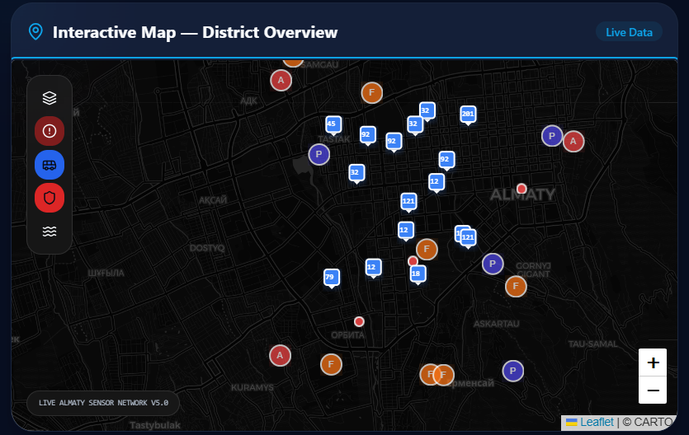


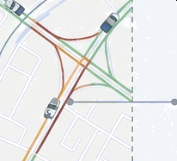


The Digital Twin: Visualizing a City in Motion
Live Public Transport Tracking: Real-time visualization of bus and marshrutka locations, sourced from our divert na nspn i t_a t i . py integration, allowing for dynamic route analysis.
Predictive Traffic Layers: Overlay of current and predicted traffic congestion levels, enabling proactive traffic management and citizen re-routing advisories.
Eco-Routing Analysis: An integrated tool that calculates routes based not only on time but also on minimizing CO2 emissions, promoting greener transportation choices.

Slide 7

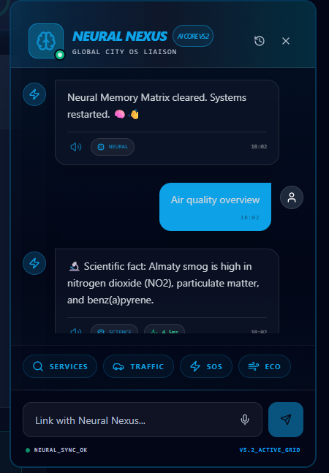






NeuralNexus: The AI Citizen Assistant
Key Capabilities
Multi-Modal Interaction: Citizens can type, use their voice (STT/TTS integration), or submit photos of issues directly within the chat interface.
Context-Aware Dialogue: Powered by the Neural Brain, the assistant engages in multi-turn conversations, understanding context to provide accurate information on city services, regulations, and events.
Actionable Intelligence: The assistant initiates workflows, logs service requests, and provides citizens with tracking numbers for their inquiries.
[INSERT REAL CHAT SCREENSHOT]
”
SR-#123456 « •

Slide 8
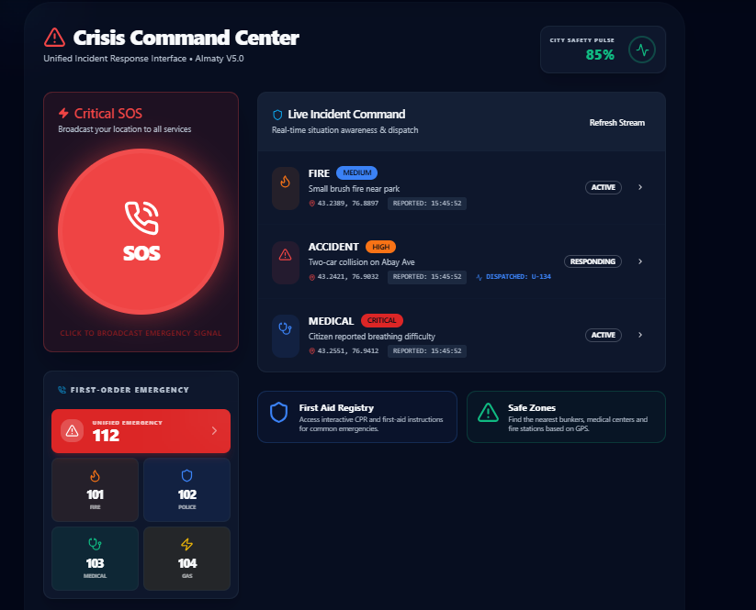




Proactive Safety: Integrated Emergency Response
SOS Signal Flow
1. Initiation: A citizen activates the SOS signal via the app's SOSButton.tsx component, instantly transmitting their precise GPS coordinates.
Triage & Dispatch: The signal appears on the Operations Dashboard. The system cross-references the location with nearby emergency units (police, ambulance).
Live Unit Tracking: Dispatched units are tracked in real-time on the digital twin
map, providing dispatchers with a live
operational view until the incident is
resolved.

Slide 9

Ready for Pilot Deployment
Backend Core & APIs: 100%
The FastAPl foundation is fully operational, stable, and load- tested. All 40+ endpoints are complete.
85%
AI Modules: 95%
All 12 "Neural Brain" engines are integrated and functioning. Final stage tuning and optimization are in prOgress.
Frontend UI/UX: 90%
22 interactive pages and the core 3D digital twin visualization are complete and connected to the backend.
Technical Readiness
Verification: The system has undergone rigorous unit testing and successful end-to-end simulations of all key workflows.

Slide 10





Digital Almaty 2O25
Digital Kazakhstan
This is a Working System, Not a Concept
Smart City Almaty OS is a fully-realized platform demonstrating technical innovation and a deep understanding of Almaty's specific needs.
Strategic Alignment
The project directly supports the core pillars of the "Digital Almaty 2025" and "Digital Kazakhstan" initiatives by enhancing public safety, improving ecology, and creating a more efficient, data-driven city administration.
Next Steps
Initiate a controlled pilot deployment in a designated city district.
Begin integration with city surveillance (CCTV) and a
broader IoT sensor network.
. .
Smart City Almaty OS is ready.

