Slide 1
Priority Queue
What is that?
Implementation with linked list with O(n) behaviour
The Heap (O(log(n))
An implementation using an array
Your mission …

Slide 2
Priority queue
Store a collection of prioritized elements
Elements are comparable
Allow insertion of an element
Can only remove the element with highest priority
Comes first in order
Q.insert(e)
e = Q.removeMin()
Q.size()
Q.isEmpty()
Q.min()
We present 3 implementations

Slide 3
Priority queue
Example applications of a priority queue
Dispatching processes in a computer
Hospital waiting lists
Standby passengers for a flight
Queuing at call centres
Internal data structure for another algorithm (graph algorithm)
…

Slide 4
How can we compare objects?
Priority queue
Store a collection of prioritized elements
Elements are comparable
Allow insertion of an element
Can only remove the element with highest priority
Comes first in order
Two examples on comparing things … …

Slide 5
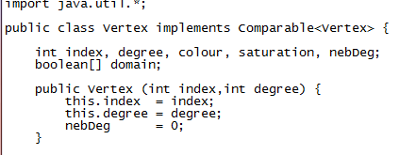
How can we compare objects?
An example
This is a Vertex

Slide 6
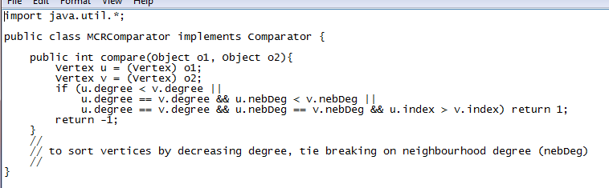
How can we compare objects?
An example
This is a Comparator for vertices

Slide 7
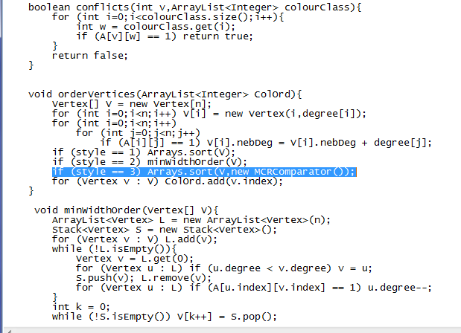
How can we compare objects?
An example
Using the comparator to sort an array of Vertex

Slide 8
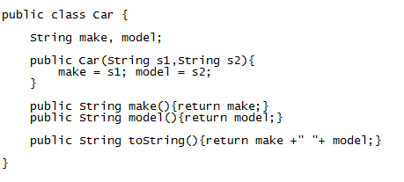
How can we compare objects?
An example
Another example: a Car

Slide 9
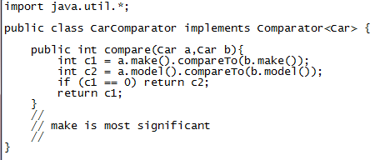
How can we compare objects?
An example
This is a CarComparator

Slide 10
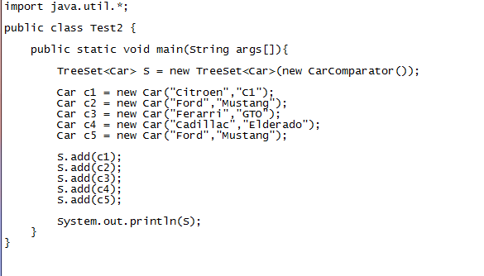
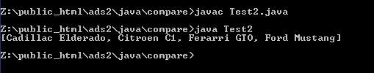
How can we compare objects?
An example
Using the CarComparator

Slide 11
Implementing a priority queue with an unsorted list
unsorted list
We might use a linked list
To insert we add to the front of the list
To find the minimum we must iterate over entire the list
To remove the minimum we must find the minimum and remove it
Maintain a counter of number of elements in the list
Method | Time
size | O(1)
isEmpty | O(1)
insert | O(1)
removeMin | O(n)
min | O(n)

Slide 12
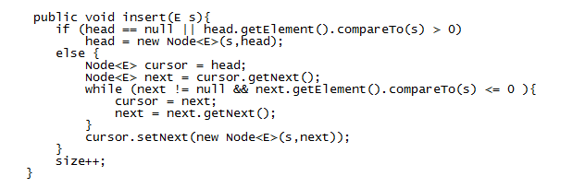
Implementing a priority queue with an sorted list
sorted list
We might use a linked list
The list is maintained in non-decreasing order
To insert we scan to find position and splice in (see below)
To find the minimum we deliver the first element in the list
To remove the minimum we return and remove the first element
Method | Time
size | O(1)
isEmpty | O(1)
insert | O(n)
removeMin | O(1)
min | O(1)

Slide 13
An alternative
THE HEAP

Slide 14
heap
a heap H is a binary tree

Slide 15
heap
a heap H is a binary tree
H is a complete binary tree

Slide 16
heap
a heap H is a binary tree
H is a complete binary tree
Fill up level d before moving to level d+1
each level but the last must be full
in last level fill from left to right

Slide 17
heap
a heap H is a binary tree
H is a complete binary tree
Fill up level d before moving to level d+1
each level but the last must be full
in last level fill from left to right

Slide 18
heap
a heap H is a binary tree
H is a complete binary tree
Fill up level d before moving to level d+1
each level but the last must be full
in last level fill from left to right

Slide 19
heap
a heap H is a binary tree
H is a complete binary tree
Fill up level d before moving to level d+1
each level but the last must be full
in last level fill from left to right
Not a heap!

Slide 20
heap
a heap H is a binary tree
H is a complete binary tree
heap order property is maintained

Slide 21
heap
a heap H is a binary tree
H is a complete binary tree
heap order property is maintained
Given a node v (not the root)
the parent of v is less than or equal to v

Slide 22
heap
a heap H is a binary tree
H is a complete binary tree
heap order property is maintained
4
Given a node v (not the root)
the parent of v is less than or equal to v
5
6
15
9
7
20

Slide 23
heap
a heap H is a binary tree
H is a complete binary tree
heap order property is maintained
4
Given a node v (not the root)
the parent of v is less than or equal to v
5
6
A heap H with n nodes has height O(log(n))
15
9
7
20

Slide 24
Example: adding to a heap

Slide 25
Example: adding to a heap
heap
4
5
6
15
9
7
20
16
25
14
12
11

Slide 26
Example: adding to a heap
heap
4
5
6
15
9
7
20
16
25
14
12
11
Insert 8

Slide 27
Example: adding to a heap
heap
4
5
6
15
9
7
20
16
25
14
12
11
8
Insert 8

Slide 28
Example: adding to a heap
heap
4
5
6
15
9
7
20
16
25
14
12
11
8
Insert 8
8 is greater than parent (7) ... done

Slide 29
Example: adding to a heap
heap
4
5
6
15
9
7
20
16
25
14
12
11
8

Slide 30
Example: adding to a heap
heap
4
5
6
15
9
7
20
16
25
14
12
11
8
Insert 2

Slide 31
Example: adding to a heap
heap
4
5
6
15
9
7
20
16
25
14
12
11
8
2
Insert 2

Slide 32
Example: adding to a heap
heap
4
5
6
15
9
7
20
16
25
14
12
11
8
2
Insert 2
2 is less than parent 20

Slide 33
Example: adding to a heap
heap
4
5
6
15
9
7
20
16
25
14
12
11
8
2
Insert 2
2 is less than parent 20 ... swap!

Slide 34
Example: adding to a heap
heap
4
5
6
15
9
7
2
16
25
14
12
11
8
20
Insert 2

Slide 35
Example: adding to a heap
heap
4
5
6
15
9
7
2
16
25
14
12
11
8
20
Insert 2

Slide 36
Example: adding to a heap
heap
4
5
6
15
9
7
2
16
25
14
12
11
8
20
Insert 2
2 is less than parent 6

Slide 37
Example: adding to a heap
heap
4
5
6
15
9
7
2
16
25
14
12
11
8
20
Insert 2
2 is less than parent 6 ... swap!

Slide 38
Example: adding to a heap
heap
4
5
2
15
9
7
6
16
25
14
12
11
8
20
Insert 2
2 is less than parent 6 ... swap!

Slide 39
Example: adding to a heap
heap
4
5
2
15
9
7
6
16
25
14
12
11
8
20
Insert 2

Slide 40
Example: adding to a heap
heap
4
5
2
15
9
7
6
16
25
14
12
11
8
20
Insert 2
2 is less than parent 4

Slide 41
Example: adding to a heap
heap
4
5
2
15
9
7
6
16
25
14
12
11
8
20
Insert 2
2 is less than parent 4 ... swap!

Slide 42
Example: adding to a heap
heap
2
5
4
15
9
7
6
16
25
14
12
11
8
20
Insert 2
2 is less than parent 4 ... swap!

Slide 43
Example: adding to a heap
heap
2
5
4
15
9
7
6
16
25
14
12
11
8
20
Insert 2

Slide 44
Example: adding to a heap
heap
2
5
4
15
9
7
6
16
25
14
12
11
8
20
Insert 2
Done!

Slide 45
Example: adding to a heap
heap
2
5
4
15
9
7
6
16
25
14
12
11
8
20

Slide 46
Example: removal from a heap
NOTE: it is a heap in a different state

Slide 47
Example: removal from a heap
heap
4
5
6
15
9
7
20
16
25
14
12
11
13

Slide 48
Example: removal from a heap
heap
4
5
6
15
9
7
20
16
25
14
12
11
13
Save off top of heap

Slide 49
Example: removal from a heap
heap
4
4
5
6
15
9
7
20
16
25
14
12
11
13
Save off top of heap

Slide 50
Example: removal from a heap
heap
4
4
5
6
15
9
7
20
16
25
14
12
11
13
Copy last item in heap to top of heap

Slide 51
Example: removal from a heap
heap
4
4
5
6
15
9
7
20
16
25
14
12
11
13
Copy last item in heap to top of heap

Slide 52
Example: removal from a heap
heap
4
4
5
6
15
9
7
20
16
25
14
12
11
13
Copy last item in heap to top of heap

Slide 53
Example: removal from a heap
heap
4
13
5
6
15
9
7
20
16
25
14
12
11
13
Copy last item in heap to top of heap

Slide 54
Example: removal from a heap
heap
4
13
5
6
15
9
7
20
16
25
14
12
11
13
Delete last item in heap

Slide 55
Example: removal from a heap
heap
4
13
5
6
15
9
7
20
16
25
14
12
11

Slide 56
Example: removal from a heap
heap
4
13
5
6
15
9
7
20
16
25
14
12
11
Compare current node with its children

Slide 57
Example: removal from a heap
heap
4
13
5
6
15
9
7
20
16
25
14
12
11
Compare current node with its children

Slide 58
Example: removal from a heap
heap
4
13
5
6
15
9
7
20
16
25
14
12
11
If greater then swap with smallest child

Slide 59
Example: removal from a heap
heap
4
13
5
6
15
9
7
20
16
25
14
12
11
If greater then swap with smallest child

Slide 60
Example: removal from a heap
heap
4
5
13
6
15
9
7
20
16
25
14
12
11
If greater then swap with smallest child

Slide 61
Example: removal from a heap
heap
4
5
13
6
15
9
7
20
16
25
14
12
11

Slide 62
Example: removal from a heap
heap
4
5
13
6
15
9
7
20
16
25
14
12
11
If greater then swap with smallest child
Compare current node with its children

Slide 63
Example: removal from a heap
heap
4
5
13
6
15
9
7
20
16
25
14
12
11
If greater then swap with smallest child

Slide 64
Example: removal from a heap
heap
4
5
13
6
15
9
7
20
16
25
14
12
11
If greater then swap with smallest child

Slide 65
Example: removal from a heap
heap
4
5
9
6
15
13
7
20
16
25
14
12
11
If greater then swap with smallest child

Slide 66
Example: removal from a heap
heap
4
5
9
6
15
13
7
20
16
25
14
12
11

Slide 67
Example: removal from a heap
heap
4
5
9
6
15
13
7
20
16
25
14
12
11
Compare current node with its children

Slide 68
Example: removal from a heap
heap
4
5
9
6
15
13
7
20
16
25
14
12
11
If greater then swap with smallest child

Slide 69
Example: removal from a heap
heap
4
5
9
6
15
13
7
20
16
25
14
12
11
If greater then swap with smallest child

Slide 70
Example: removal from a heap
heap
4
5
9
6
15
13
7
20
16
25
14
12
11
If greater then swap with smallest child

Slide 71
Example: removal from a heap
heap
4
5
9
6
15
12
7
20
16
25
14
13
11
If greater then swap with smallest child

Slide 72
Example: removal from a heap
heap
4
5
9
6
15
12
7
20
16
25
14
13
11

Slide 73
Example: removal from a heap
heap
4
5
9
6
15
12
7
20
16
25
14
13
11
Return result

Slide 74
Example: removal from a heap
heap
5
9
6
15
12
7
20
16
25
14
13
11
Done ☺

Slide 75
What we just saw
upheap bubbling: when we add to the heap
downheap bubbling: when we remove from the heap
Add and remove are O(log(n)) processes

Slide 76

An implementation of a Heap data structure

Slide 77
An implementation of a Heap data structure

Slide 78
Number the vertices as follows
An implementation of a Heap data structure

Slide 79
Number the vertices as follows
An implementation of a Heap data structure
1
2
3
4
5
6
7
8
9
10
11
12
13
14
15

Slide 80
Number the vertices as follows
An implementation of a Heap data structure
1
2
3
4
5
6
7
8
9
10
11
12
13
14
15
Note: parent of node i is i/2 ....

Slide 81
Number the vertices as follows
An implementation of a Heap data structure
1
2
3
4
5
6
7
8
9
10
11
12
13
14
15
Note: parent of node i is i/2 ....

Slide 82
Number the vertices as follows
An implementation of a Heap data structure
1
2
3
4
5
6
7
8
9
10
11
12
13
14
15
Note: parent of node i is i/2 ....

Slide 83
Number the vertices as follows
An implementation of a Heap data structure
1
2
3
4
5
6
7
8
9
10
11
12
13
14
15
Note: left child of i is i×2

Slide 84
Number the vertices as follows
An implementation of a Heap data structure
1
2
3
4
5
6
7
8
9
10
11
12
13
14
15
Note: right child of i is (i×2) +1

Slide 85
An implementation of a Heap data structure
1
2
3
4
5
6
7
8
9
10
11
12
13
14
15
Represent as a one dimensional array

Slide 86
Represent as a one dimensional array S
An implementation of a Heap data structure
1
2
3
4
5
6
7
8
9
10
11
12
13
14
15
0 | 1 | 2 | 3 | 4 | 5 | 6 | 7 | 8 | 9 | 10 | 11 | 12 | 13 | 14 | 15
S

Slide 87
Represent as a one dimensional array S
An implementation of a Heap data structure
1
2
3
4
5
6
7
8
9
10
11
12
13
14
15
**
0 | 1 | 2 | 3 | 4 | 5 | 6 | 7 | 8 | 9 | 10 | 11 | 12 | 13 | 14 | 15
S
To simplify implementation we do not use S[0]

Slide 88
Represent as a one dimensional array S
An implementation of a Heap data structure
**
0 | 1 | 2 | 3 | 4 | 5 | 6 | 7 | 8 | 9 | 10 | 11 | 12 | 13 | 14 | 15
S
Require two integer variables, last and capacity where last is initially 0
In our example capacity is 15

Slide 89
Represent as a one dimensional array S
An implementation of a Heap data structure
**
0 | 1 | 2 | 3 | 4 | 5 | 6 | 7 | 8 | 9 | 10 | 11 | 12 | 13 | 14 | 15
S
last: 0
capacity: 15

Slide 90
An implementation of a Heap data structure
Consider the following heap H

Slide 91
Consider the following heap H
An implementation of a Heap data structure
4
9
8
17
26
50
16
19
69
32
93
55
** | 4 | 9 | 8 | 17 | 26 | 50 | 16 | 19 | 69 | 32 | 93 | 55
0 | 1 | 2 | 3 | 4 | 5 | 6 | 7 | 8 | 9 | 10 | 11 | 12 | 13 | 14 | 15
S
last: 12
capacity: 15

Slide 92
An implementation of a Heap data structure
H.add(6)
4
9
8
17
26
50
16
19
69
32
93
55
** | 4 | 9 | 8 | 17 | 26 | 50 | 16 | 19 | 69 | 32 | 93 | 55
0 | 1 | 2 | 3 | 4 | 5 | 6 | 7 | 8 | 9 | 10 | 11 | 12 | 13 | 14 | 15
S
last: 12
capacity: 15

Slide 93
An implementation of a Heap data structure
S[last+1] = 6
4
9
8
17
26
50
16
19
69
32
93
55
6
** | 4 | 9 | 8 | 17 | 26 | 50 | 16 | 19 | 69 | 32 | 93 | 55 | 6
0 | 1 | 2 | 3 | 4 | 5 | 6 | 7 | 8 | 9 | 10 | 11 | 12 | 13 | 14 | 15
S
last: 12
capacity: 15

Slide 94
An implementation of a Heap data structure
last++
4
9
8
17
26
50
16
19
69
32
93
55
6
** | 4 | 9 | 8 | 17 | 26 | 50 | 16 | 19 | 69 | 32 | 93 | 55 | 6
0 | 1 | 2 | 3 | 4 | 5 | 6 | 7 | 8 | 9 | 10 | 11 | 12 | 13 | 14 | 15
S
last: 13
capacity: 15

Slide 95
An implementation of a Heap data structure
upheapBubble(13)
4
9
8
17
26
50
16
19
69
32
93
55
6
** | 4 | 9 | 8 | 17 | 26 | 50 | 16 | 19 | 69 | 32 | 93 | 55 | 6
0 | 1 | 2 | 3 | 4 | 5 | 6 | 7 | 8 | 9 | 10 | 11 | 12 | 13 | 14 | 15
S
last: 13
capacity: 15

Slide 96
An implementation of a Heap data structure
upheapBubble(13)
4
9
8
17
26
50
16
19
69
32
93
55
6
** | 4 | 9 | 8 | 17 | 26 | 50 | 16 | 19 | 69 | 32 | 93 | 55 | 6
0 | 1 | 2 | 3 | 4 | 5 | 6 | 7 | 8 | 9 | 10 | 11 | 12 | 13 | 14 | 15
S
last: 13
capacity: 15

Slide 97
An implementation of a Heap data structure
upheapBubble(13)
4
S[6] > S[13] ?
9
8
17
26
50
16
19
69
32
93
55
6
** | 4 | 9 | 8 | 17 | 26 | 50 | 16 | 19 | 69 | 32 | 93 | 55 | 6
0 | 1 | 2 | 3 | 4 | 5 | 6 | 7 | 8 | 9 | 10 | 11 | 12 | 13 | 14 | 15
S
last: 13
capacity: 15

Slide 98
An implementation of a Heap data structure
upheapBubble(13)
4
swap S[6] S[13]
9
8
17
26
6
16
19
69
32
93
55
50
** | 4 | 9 | 8 | 17 | 26 | 6 | 16 | 19 | 69 | 32 | 93 | 55 | 50
0 | 1 | 2 | 3 | 4 | 5 | 6 | 7 | 8 | 9 | 10 | 11 | 12 | 13 | 14 | 15
S
last: 13
capacity: 15

Slide 99
An implementation of a Heap data structure
4
9
8
17
26
6
16
19
69
32
93
55
50
** | 4 | 9 | 8 | 17 | 26 | 6 | 16 | 19 | 69 | 32 | 93 | 55 | 50
0 | 1 | 2 | 3 | 4 | 5 | 6 | 7 | 8 | 9 | 10 | 11 | 12 | 13 | 14 | 15
S
last: 13
capacity: 15

Slide 100
An implementation of a Heap data structure
upheapBubble(6)
4
9
8
17
26
6
16
19
69
32
93
55
50
** | 4 | 9 | 8 | 17 | 26 | 6 | 16 | 19 | 69 | 32 | 93 | 55 | 50
0 | 1 | 2 | 3 | 4 | 5 | 6 | 7 | 8 | 9 | 10 | 11 | 12 | 13 | 14 | 15
S
last: 13
capacity: 15

Slide 101
An implementation of a Heap data structure
upheapBubble(6)
4
9
8
17
26
6
16
19
69
32
93
55
50
** | 4 | 9 | 8 | 17 | 26 | 6 | 16 | 19 | 69 | 32 | 93 | 55 | 50
0 | 1 | 2 | 3 | 4 | 5 | 6 | 7 | 8 | 9 | 10 | 11 | 12 | 13 | 14 | 15
S
last: 13
capacity: 15

Slide 102
An implementation of a Heap data structure
upheapBubble(6)
4
S[3] > S[6] ?
9
8
17
26
6
16
19
69
32
93
55
50
** | 4 | 9 | 8 | 17 | 26 | 6 | 16 | 19 | 69 | 32 | 93 | 55 | 50
0 | 1 | 2 | 3 | 4 | 5 | 6 | 7 | 8 | 9 | 10 | 11 | 12 | 13 | 14 | 15
S
last: 13
capacity: 15

Slide 103
An implementation of a Heap data structure
upheapBubble(6)
4
swap S[3] S[6]
9
6
17
26
8
16
19
69
32
93
55
50
** | 4 | 9 | 6 | 17 | 26 | 8 | 16 | 19 | 69 | 32 | 93 | 55 | 50
0 | 1 | 2 | 3 | 4 | 5 | 6 | 7 | 8 | 9 | 10 | 11 | 12 | 13 | 14 | 15
S
last: 13
capacity: 15

Slide 104
An implementation of a Heap data structure
4
9
6
17
26
8
16
19
69
32
93
55
50
** | 4 | 9 | 6 | 17 | 26 | 8 | 16 | 19 | 69 | 32 | 93 | 55 | 50
0 | 1 | 2 | 3 | 4 | 5 | 6 | 7 | 8 | 9 | 10 | 11 | 12 | 13 | 14 | 15
S
last: 13
capacity: 15

Slide 105
An implementation of a Heap data structure
upheapBubble(3)
4
9
6
17
26
8
16
19
69
32
93
55
50
** | 4 | 9 | 6 | 17 | 26 | 8 | 16 | 19 | 69 | 32 | 93 | 55 | 50
0 | 1 | 2 | 3 | 4 | 5 | 6 | 7 | 8 | 9 | 10 | 11 | 12 | 13 | 14 | 15
S
last: 13
capacity: 15

Slide 106
An implementation of a Heap data structure
upheapBubble(3)
4
9
6
17
26
8
16
19
69
32
93
55
50
** | 4 | 9 | 6 | 17 | 26 | 8 | 16 | 19 | 69 | 32 | 93 | 55 | 50
0 | 1 | 2 | 3 | 4 | 5 | 6 | 7 | 8 | 9 | 10 | 11 | 12 | 13 | 14 | 15
S
last: 13
capacity: 15

Slide 107
An implementation of a Heap data structure
upheapBubble(3)
4
S[1] > S[3] ?
9
6
17
26
8
16
19
69
32
93
55
50
** | 4 | 9 | 6 | 17 | 26 | 8 | 16 | 19 | 69 | 32 | 93 | 55 | 50
0 | 1 | 2 | 3 | 4 | 5 | 6 | 7 | 8 | 9 | 10 | 11 | 12 | 13 | 14 | 15
S
last: 13
capacity: 15

Slide 108
An implementation of a Heap data structure
Done!
4
9
6
17
26
8
16
19
69
32
93
55
50
** | 4 | 9 | 6 | 17 | 26 | 8 | 16 | 19 | 69 | 32 | 93 | 55 | 50
0 | 1 | 2 | 3 | 4 | 5 | 6 | 7 | 8 | 9 | 10 | 11 | 12 | 13 | 14 | 15
S
last: 13
capacity: 15

Slide 109
Removal from the heap H

Slide 110
An implementation of a Heap data structure
H.remove()
4
9
6
17
26
8
16
19
69
32
93
55
50
** | 4 | 9 | 6 | 17 | 26 | 8 | 16 | 19 | 69 | 32 | 93 | 55 | 50
0 | 1 | 2 | 3 | 4 | 5 | 6 | 7 | 8 | 9 | 10 | 11 | 12 | 13 | 14 | 15
S
last: 13
capacity: 15

Slide 111
An implementation of a Heap data structure
4
4
Save S[1]
9
6
17
26
8
16
19
69
32
93
55
50
** | 4 | 9 | 6 | 17 | 26 | 8 | 16 | 19 | 69 | 32 | 93 | 55 | 50
0 | 1 | 2 | 3 | 4 | 5 | 6 | 7 | 8 | 9 | 10 | 11 | 12 | 13 | 14 | 15
S
last: 13
capacity: 15

Slide 112
An implementation of a Heap data structure
4
4
S[1] = S[last]
9
6
17
26
8
16
19
69
32
93
55
50
** | 4 | 9 | 6 | 17 | 26 | 8 | 16 | 19 | 69 | 32 | 93 | 55 | 50
0 | 1 | 2 | 3 | 4 | 5 | 6 | 7 | 8 | 9 | 10 | 11 | 12 | 13 | 14 | 15
S
last: 13
capacity: 15

Slide 113
An implementation of a Heap data structure
4
50
S[1] = S[last]
9
6
17
26
8
16
19
69
32
93
55
50
** | 50 | 9 | 6 | 17 | 26 | 8 | 16 | 19 | 69 | 32 | 93 | 55 | 50
0 | 1 | 2 | 3 | 4 | 5 | 6 | 7 | 8 | 9 | 10 | 11 | 12 | 13 | 14 | 15
S
last: 13
capacity: 15

Slide 114
An implementation of a Heap data structure
4
50
last--
9
6
17
26
8
16
19
69
32
93
55
** | 50 | 9 | 6 | 17 | 26 | 8 | 16 | 19 | 69 | 32 | 93 | 55
0 | 1 | 2 | 3 | 4 | 5 | 6 | 7 | 8 | 9 | 10 | 11 | 12 | 13 | 14 | 15
S
last: 12
capacity: 15

Slide 115
An implementation of a Heap data structure
4
downHeapBubble(1)
50
9
6
17
26
8
16
19
69
32
93
55
** | 50 | 9 | 6 | 17 | 26 | 8 | 16 | 19 | 69 | 32 | 93 | 55
0 | 1 | 2 | 3 | 4 | 5 | 6 | 7 | 8 | 9 | 10 | 11 | 12 | 13 | 14 | 15
S
last: 12
capacity: 15

Slide 116
An implementation of a Heap data structure
4
downHeapBubble(1)
50
findMin(S[2],S[3])
9
6
17
26
8
16
19
69
32
93
55
** | 50 | 9 | 6 | 17 | 26 | 8 | 16 | 19 | 69 | 32 | 93 | 55
0 | 1 | 2 | 3 | 4 | 5 | 6 | 7 | 8 | 9 | 10 | 11 | 12 | 13 | 14 | 15
S
last: 12
capacity: 15

Slide 117
An implementation of a Heap data structure
4
downHeapBubble(1)
50
findMin(S[2],S[3])
9
6
17
26
8
16
19
69
32
93
55
** | 50 | 9 | 6 | 17 | 26 | 8 | 16 | 19 | 69 | 32 | 93 | 55
0 | 1 | 2 | 3 | 4 | 5 | 6 | 7 | 8 | 9 | 10 | 11 | 12 | 13 | 14 | 15
S
last: 12
capacity: 15

Slide 118
An implementation of a Heap data structure
4
downHeapBubble(1)
50
swap(S[1],S[3])
9
6
17
26
8
16
19
69
32
93
55
** | 50 | 9 | 6 | 17 | 26 | 8 | 16 | 19 | 69 | 32 | 93 | 55
0 | 1 | 2 | 3 | 4 | 5 | 6 | 7 | 8 | 9 | 10 | 11 | 12 | 13 | 14 | 15
S
last: 12
capacity: 15

Slide 119
An implementation of a Heap data structure
4
downHeapBubble(1)
6
swap(S[1],S[3])
9
50
17
26
8
16
19
69
32
93
55
** | 6 | 9 | 50 | 17 | 26 | 8 | 16 | 19 | 69 | 32 | 93 | 55
0 | 1 | 2 | 3 | 4 | 5 | 6 | 7 | 8 | 9 | 10 | 11 | 12 | 13 | 14 | 15
S
last: 12
capacity: 15

Slide 120
An implementation of a Heap data structure
4
downHeapBubble(1)
6
9
50
17
26
8
16
19
69
32
93
55
** | 6 | 9 | 50 | 17 | 26 | 8 | 16 | 19 | 69 | 32 | 93 | 55
0 | 1 | 2 | 3 | 4 | 5 | 6 | 7 | 8 | 9 | 10 | 11 | 12 | 13 | 14 | 15
S
last: 12
capacity: 15

Slide 121
An implementation of a Heap data structure
4
downHeapBubble(3)
6
findMin(S[6],S[7])
9
50
17
26
8
16
19
69
32
93
55
** | 6 | 9 | 50 | 17 | 26 | 8 | 16 | 19 | 69 | 32 | 93 | 55
0 | 1 | 2 | 3 | 4 | 5 | 6 | 7 | 8 | 9 | 10 | 11 | 12 | 13 | 14 | 15
S
last: 12
capacity: 15

Slide 122
An implementation of a Heap data structure
4
downHeapBubble(3)
6
findMin(S[6],S[7])
9
50
17
26
8
16
19
69
32
93
55
** | 6 | 9 | 50 | 17 | 26 | 8 | 16 | 19 | 69 | 32 | 93 | 55
0 | 1 | 2 | 3 | 4 | 5 | 6 | 7 | 8 | 9 | 10 | 11 | 12 | 13 | 14 | 15
S
last: 12
capacity: 15

Slide 123
An implementation of a Heap data structure
4
downHeapBubble(3)
6
swap(S[3],S[6])
9
50
17
26
8
16
19
69
32
93
55
** | 6 | 9 | 50 | 17 | 26 | 8 | 16 | 19 | 69 | 32 | 93 | 55
0 | 1 | 2 | 3 | 4 | 5 | 6 | 7 | 8 | 9 | 10 | 11 | 12 | 13 | 14 | 15
S
last: 12
capacity: 15

Slide 124
An implementation of a Heap data structure
4
downHeapBubble(3)
6
swap(S[3],S[6])
9
8
17
26
50
16
19
69
32
93
55
** | 6 | 9 | 8 | 17 | 26 | 50 | 16 | 19 | 69 | 32 | 93 | 55
0 | 1 | 2 | 3 | 4 | 5 | 6 | 7 | 8 | 9 | 10 | 11 | 12 | 13 | 14 | 15
S
last: 12
capacity: 15

Slide 125
An implementation of a Heap data structure
4
downHeapBubble(6)
6
9
8
17
26
50
16
19
69
32
93
55
** | 6 | 9 | 8 | 17 | 26 | 50 | 16 | 19 | 69 | 32 | 93 | 55
0 | 1 | 2 | 3 | 4 | 5 | 6 | 7 | 8 | 9 | 10 | 11 | 12 | 13 | 14 | 15
S
last: 12
capacity: 15

Slide 126
An implementation of a Heap data structure
4
downHeapBubble(6)
6
findMin(S[12])
9
8
17
26
50
16
19
69
32
93
55
** | 6 | 9 | 8 | 17 | 26 | 50 | 16 | 19 | 69 | 32 | 93 | 55
0 | 1 | 2 | 3 | 4 | 5 | 6 | 7 | 8 | 9 | 10 | 11 | 12 | 13 | 14 | 15
S
last: 12
capacity: 15

Slide 127
An implementation of a Heap data structure
4
downHeapBubble(6)
6
No swap
9
8
17
26
50
16
19
69
32
93
55
** | 6 | 9 | 8 | 17 | 26 | 50 | 16 | 19 | 69 | 32 | 93 | 55
0 | 1 | 2 | 3 | 4 | 5 | 6 | 7 | 8 | 9 | 10 | 11 | 12 | 13 | 14 | 15
S
last: 12
capacity: 15

Slide 128
An implementation of a Heap data structure
4
downHeapBubble(6)
6
No swap
9
8
17
26
50
16
19
69
32
93
55
** | 6 | 9 | 8 | 17 | 26 | 50 | 16 | 19 | 69 | 32 | 93 | 55
0 | 1 | 2 | 3 | 4 | 5 | 6 | 7 | 8 | 9 | 10 | 11 | 12 | 13 | 14 | 15
S
last: 12
capacity: 15

Slide 129
4
An implementation of a Heap data structure
Return result
6
9
8
17
26
50
16
19
69
32
93
55
** | 6 | 9 | 8 | 17 | 26 | 50 | 16 | 19 | 69 | 32 | 93 | 55
0 | 1 | 2 | 3 | 4 | 5 | 6 | 7 | 8 | 9 | 10 | 11 | 12 | 13 | 14 | 15
S
last: 12
capacity: 15

Slide 130
heap
Method | Time
size | O(1)
isEmpty | O(1)
insert | O(log(n))
removeMin | O(log(n))
min | O(1)

Slide 131
Have a look at priority queue as given in Java distribution

Slide 132
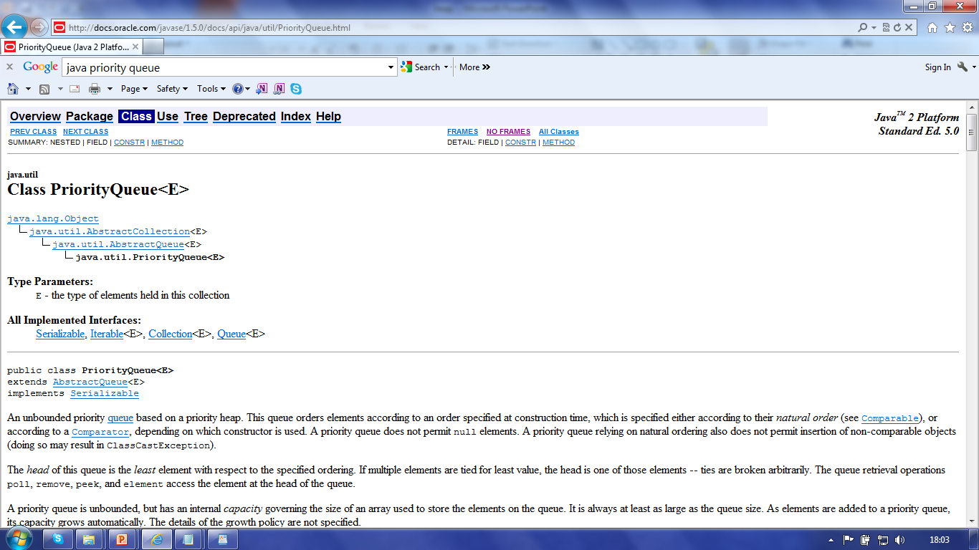

Slide 133
… based on a priority heap

Slide 134
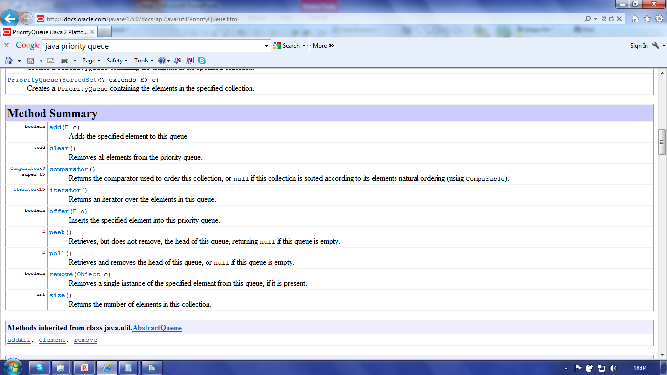
Different method names … add rather than insert

Slide 135

Your mission, should you choose to accept it …
Exercise 4 (assessed)
Implement the Heap
Use it for sorting

Slide 136
fin

