Slide 1
IBM University Engagement Project Submission
“Exploring the Power of Machine Learning with IBM Cloud”

Slide 2

Project Title – Predictive Maintenance of Industrial Machinery
Domain of Project – Manufacturing / Industrial Engineering
Student Name | Recent Passport Photo | Email ID | Mobile number [WhatsApp]
Atharva Madan Jadhav |  | AICTE/Edunet Registered – jatharvajadhav2007@gmail.com IBM SKILLBUILD – jatharvajadhav14@gmail.com | +91 9322829789

Slide 3
Problem Statement -
Problem Statement: Predictive Maintenance of Industrial Machinery (PS 39)
Industrial machines such as CNC mills, lathes, and pumps are critical to manufacturing but are vulnerable to unexpected failures that result in production downtime, expensive repairs, and reduced efficiency. Conventional maintenance strategies, whether reactive or time-based, often fail to detect early signs of failure, leading to unnecessary maintenance or sudden breakdowns. This project addresses the problem by developing a multi-class machine learning model that analyzes real-time sensor data, including air temperature, process temperature, rotational speed, torque, and tool wear, to accurately predict different machine failure types such as Tool Wear, Heat Dissipation, Power, and Overstrain Failures. The solution enables predictive maintenance, helping industries reduce downtime, optimize maintenance schedules, improve equipment reliability, and lower operational costs.

Slide 4
Proposed Solution -
A machine learning-based Predictive Maintenance System built on IBM watsonx.ai Studio using AutoAI. The Kaggle Machine Predictive Maintenance dataset was uploaded to the project and used to train a multi-class classification model. AutoAI automatically performed data preprocessing, feature engineering, algorithm selection, and hyperparameter optimization — generating 9 pipelines in under 5 minutes. The best-performing model, Batched Tree Ensemble Classifier — Snap Random Forest achieved 99.5% accuracy with HPO-1, FE, HPO-2, and BATCH enhancements. The model was saved, promoted to a deployment space, and deployed as an Online deployment using IBM WatsonMachineLearning (watsonx.ai Runtime) service — enabling real-time predictions of machine failure type including No Failure, Power Failure, Tool Wear Failure, Overstrain Failure, and Heat Dissipation Failure

Slide 5
Technology Used
IBM Cloud – Provides the infrastructure to build, deploy, and scale the Predictive Maintenance model. IBM Cloud enables a reliable, secure, and scalable environment for model training and deployment using watsonx.ai Studio.
ML Studio – IBM watsonx.ai Studio
ML Service – IBM WatsonMachineLearning
AutoML – AutoAI
Dataset - Kaggle
ML Algorithm / Model Used: Batched Tree Ensemble Classifier (Snap Random Forest Classifier)
Accuracy Obtained: 99.5% (Cross Validation Score)
Enhancements and Hyperparameter Tuning: HPO-1, Feature Engineering (FE), HPO-2, BATCH Specialization (INCR) — 9 Pipelines Generated.

Slide 6
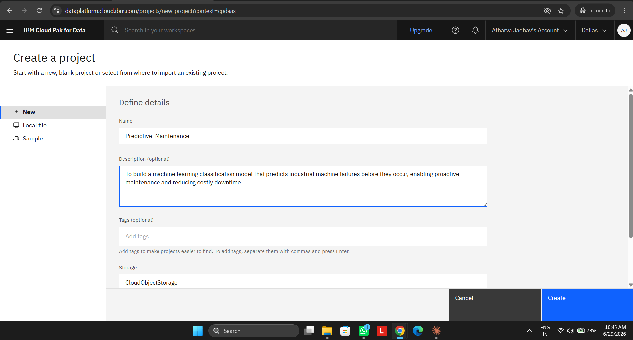
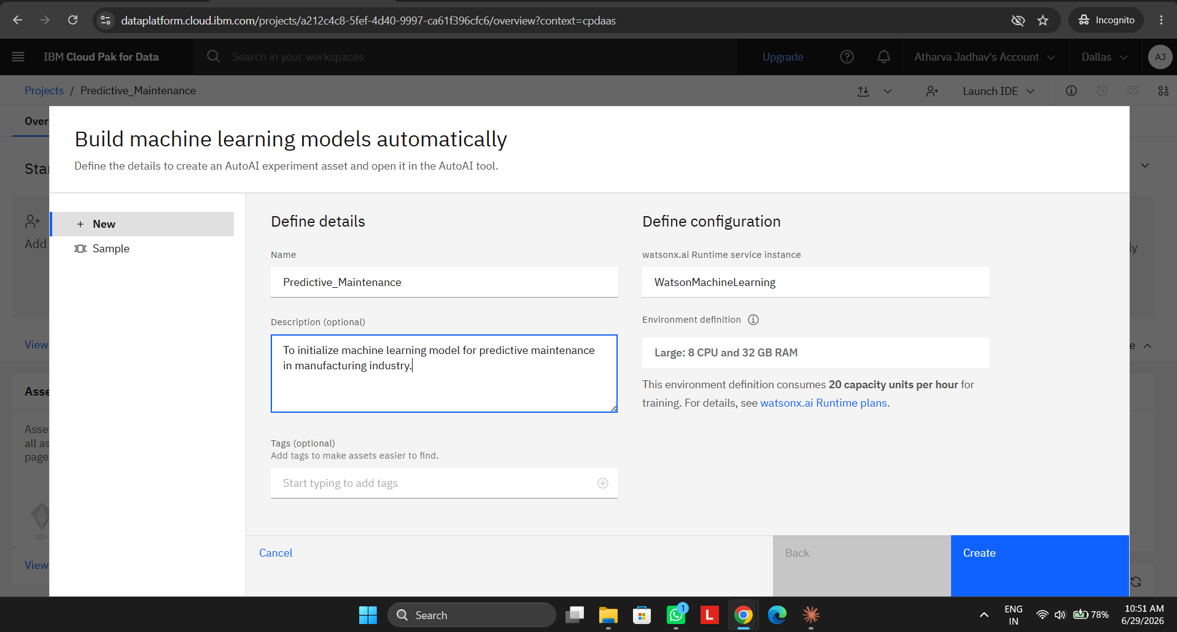

Slide 7
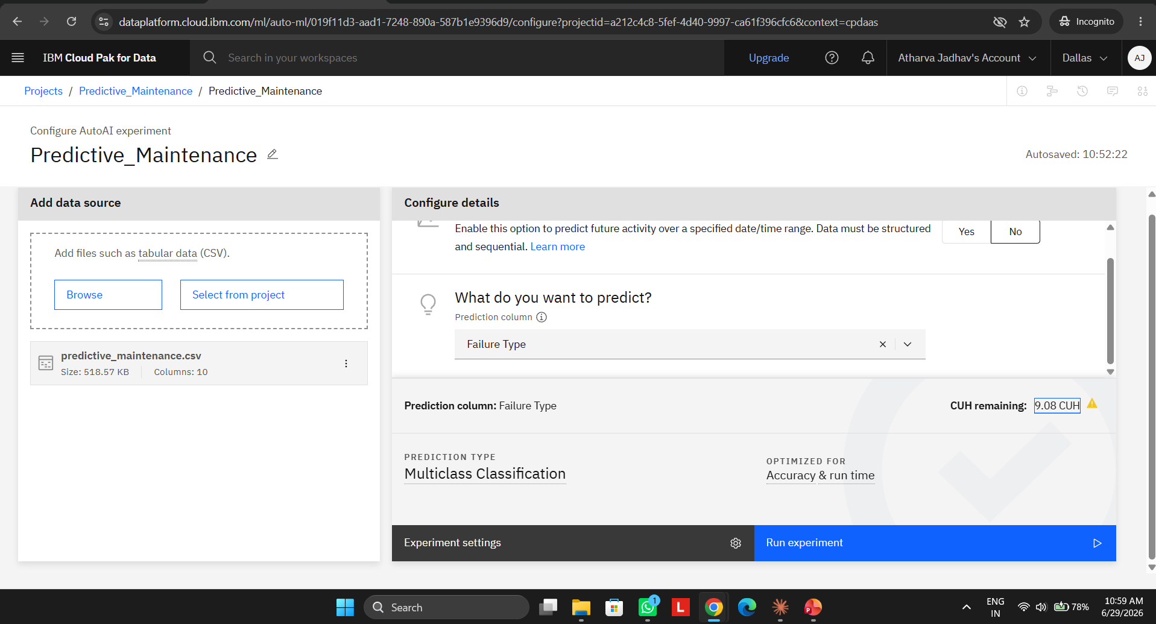

Slide 8
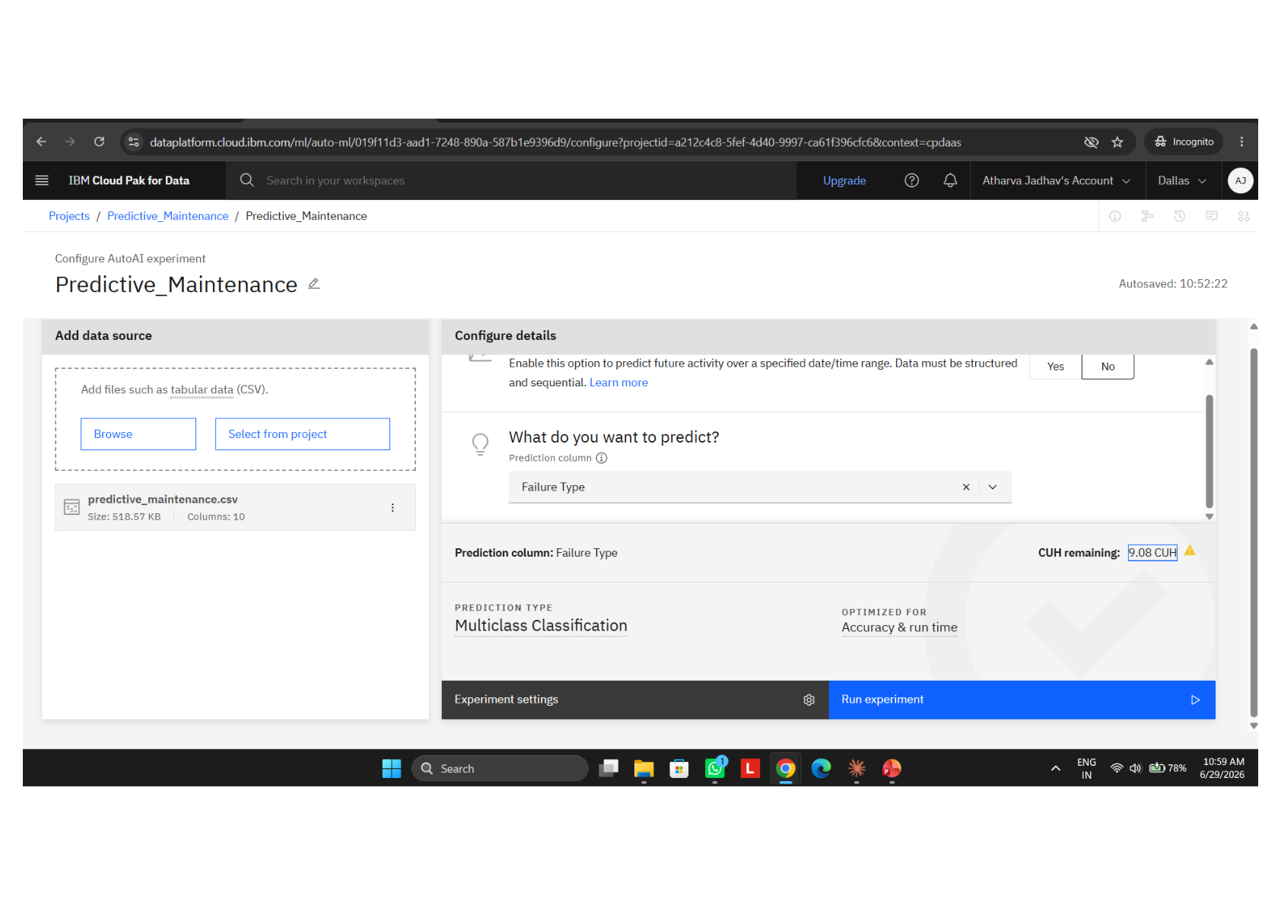
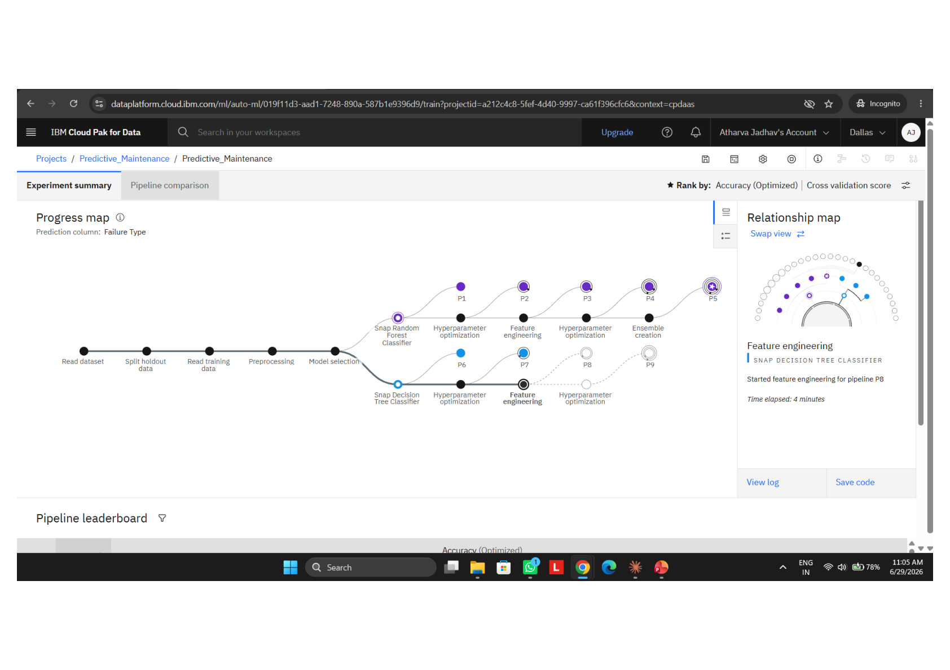
Training Screenshots-

Slide 9
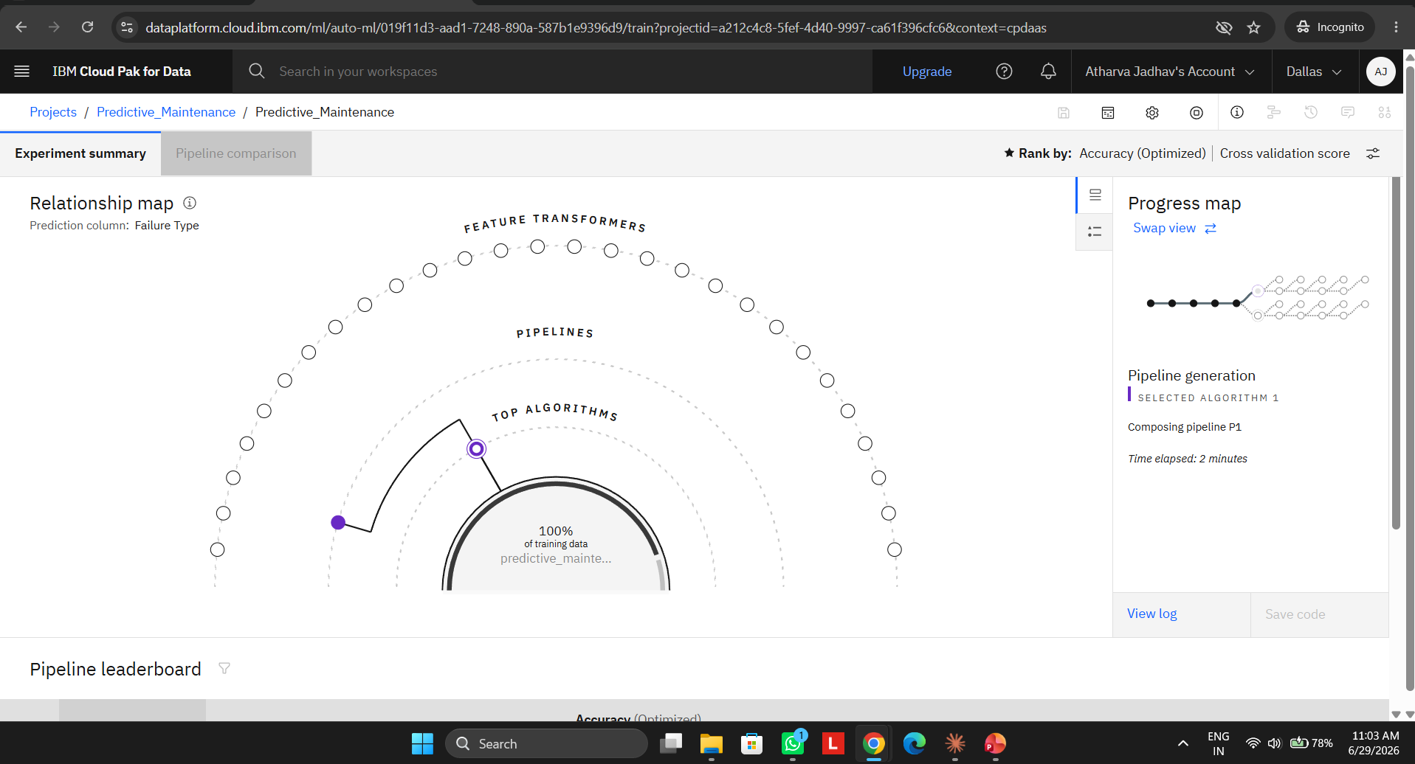
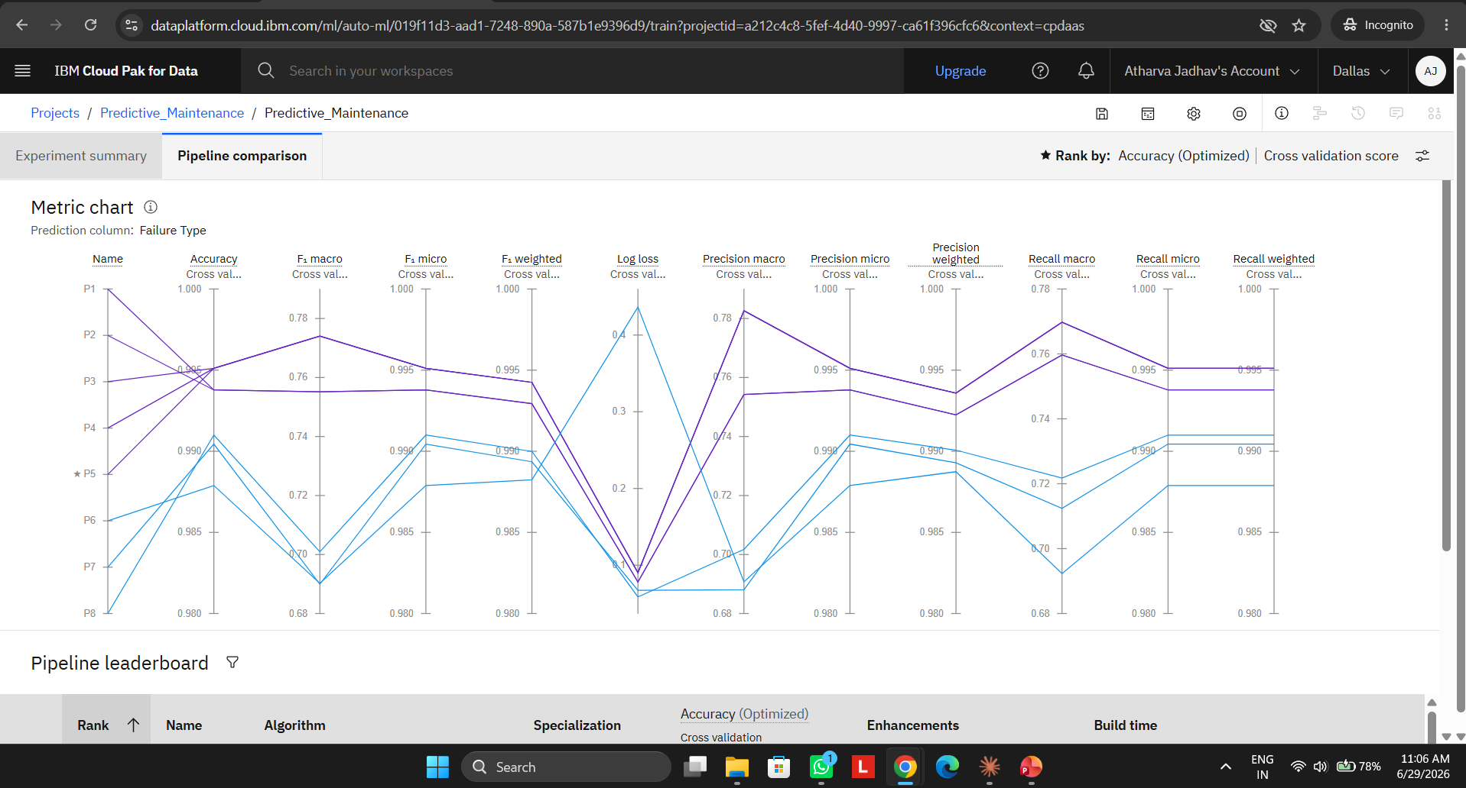
Training Screenshots-

Slide 10
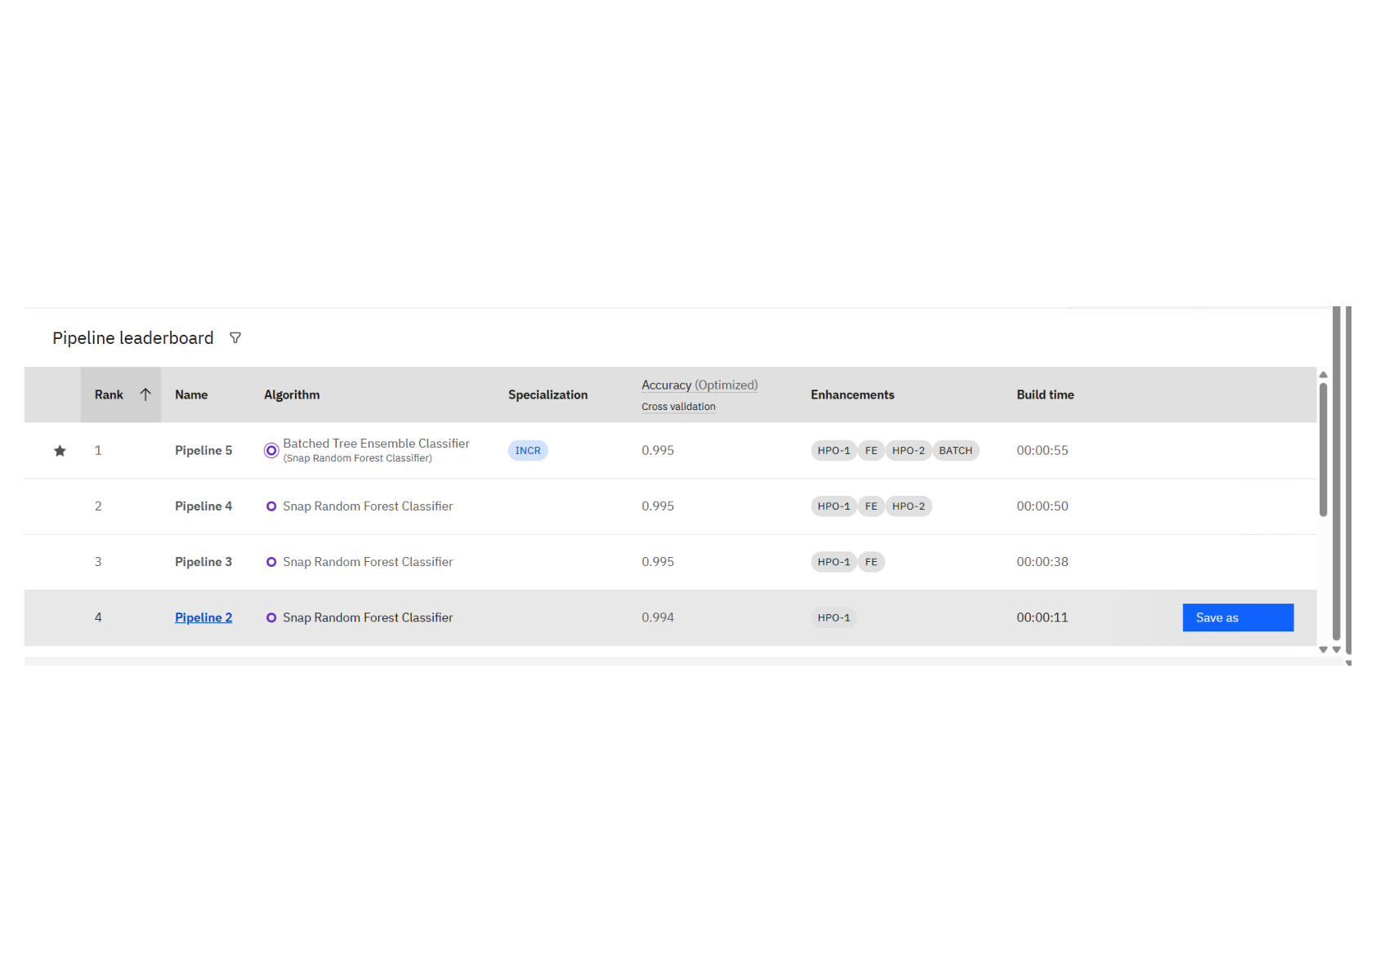
Best Model Screenshot:

Slide 11
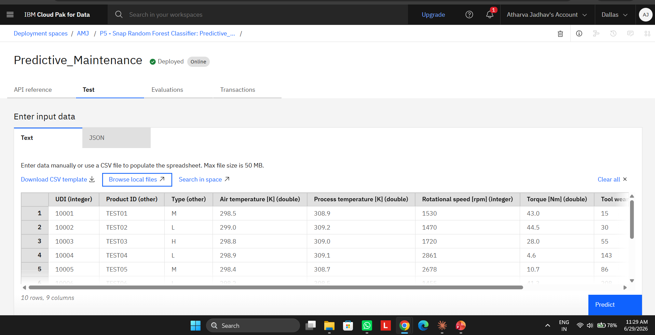
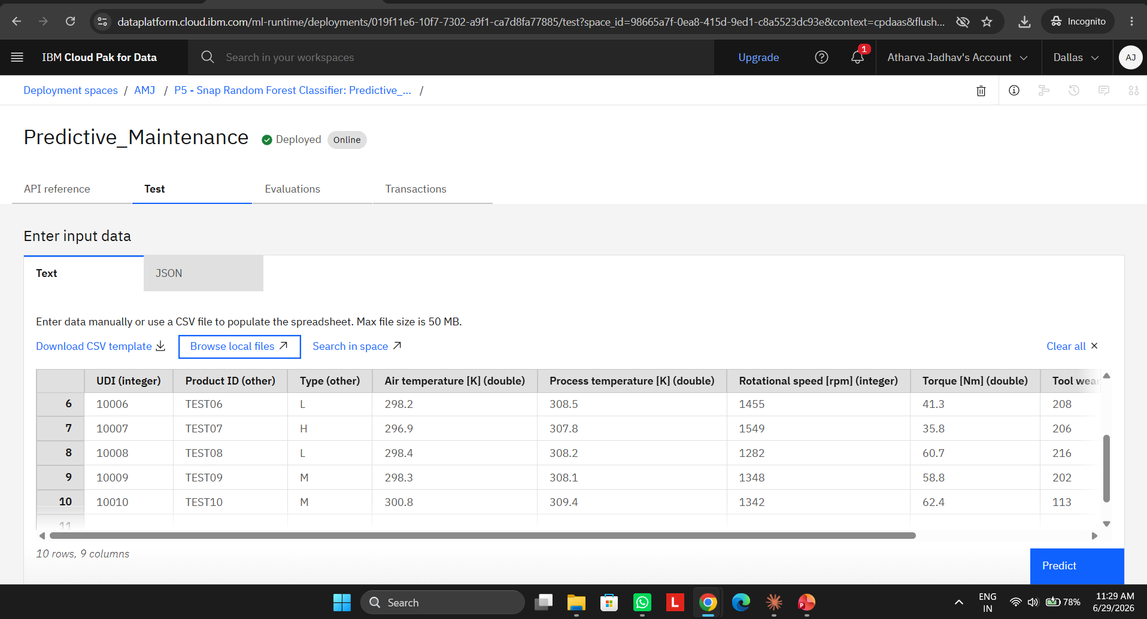
Testing Screenshot: Test1

Slide 12
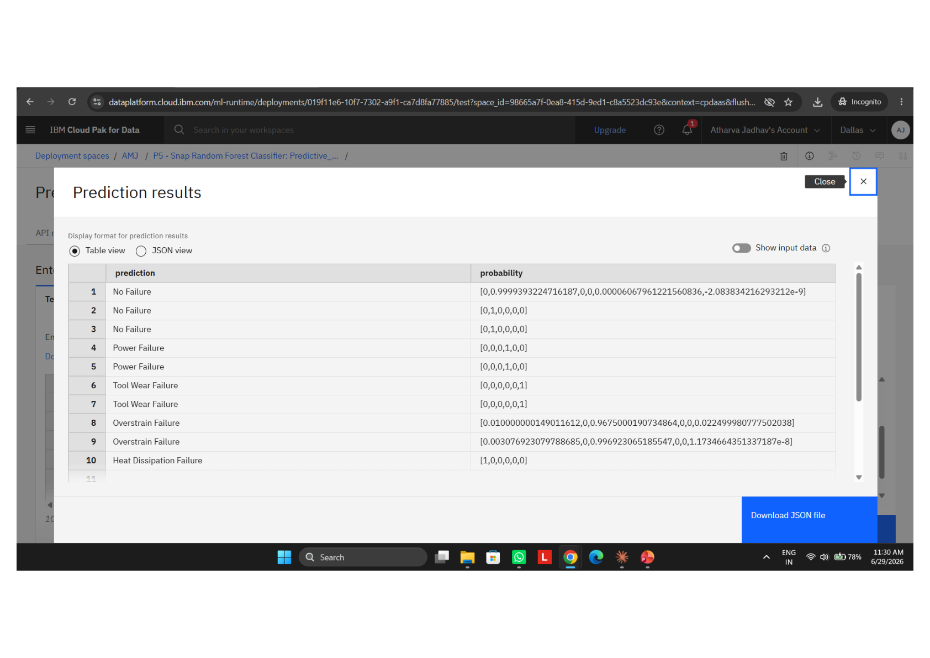
Testing Screenshot:

Slide 13
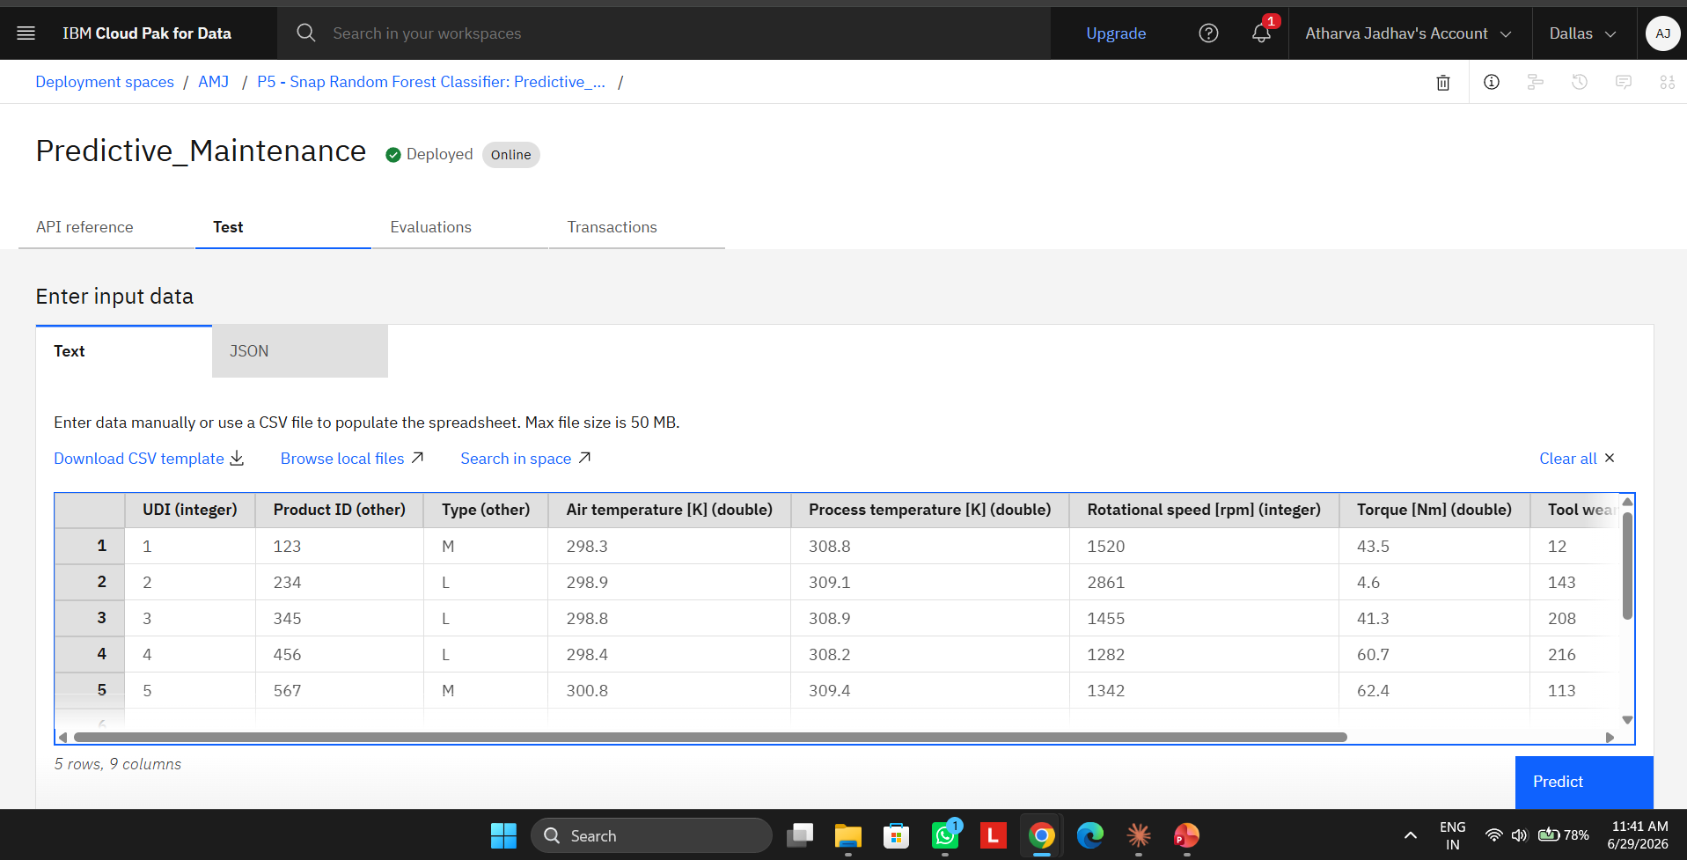
Testing Screenshot: Test2

Slide 14
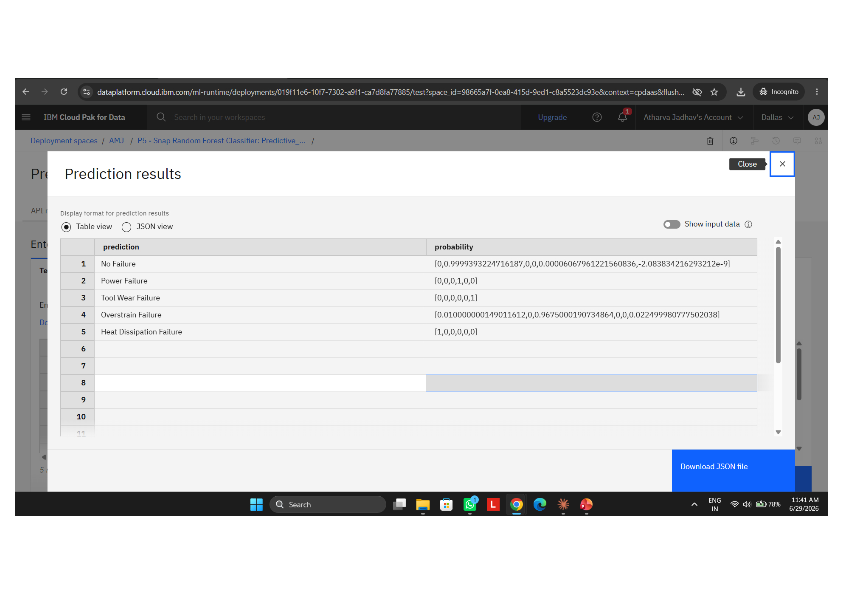
Testing Screenshot:

Slide 15
Novelty and Uniqueness
Shifts industrial maintenance from reactive/scheduled to intelligent predictive approach, preventing failures before they occur.
Uses IBM watsonx.ai AutoAI to automatically discover the best classification algorithm without manual coding — Batched Tree Ensemble Classifier achieved 99.5% accuracy.Uses IBM watsonx.ai AutoAI to automatically discover the best classification algorithm without manual coding — Batched Tree Ensemble Classifier achieved 99.5% accuracy.Uses IBM watsonx.ai AutoAI to automatically discover the best classification algorithm without manual coding — Batched Tree Ensemble Classifier achieved 99.5% accuracy.Uses IBM watsonx.ai AutoAI to automatically discover the best classification algorithm without manual coding — Batched Tree Ensemble Classifier achieved 99.5% accuracy.
Classifies the specific type of failure (Tool Wear, Power, Overstrain, Heat Dissipation) — not just whether failure will occur — enabling targeted maintenance actions.
Automated Feature Engineering (FE) and two rounds of Hyperparameter Optimization (HPO-1, HPO-2) ensure the model is fine-tuned for maximum performance.
Can be integrated with real-time IoT sensors on factory floors for live fault prediction and deployed across entire manufacturing plants at enterprise scale.

Slide 16
Git Hub Link
Create a public GitHub repository (enable Add README while creating) with format:
Paste your working GitHub URL here:
Link - https://github.com/aquaregia3213/Predictive_Maintenance_IBM
Upload these 4 files: 1) predictive_maintenance.csv 2) Problem_Statement_PS39.pdf 3) PS39_Predictive_Maintenance.pptx 4) AutoAI_Notebook.ipynb (download from IBM watsonx.ai)
·
·
·

Slide 17
Future Scope
Integration with live IoT sensor streams for real-time fault prediction and automated maintenance scheduling on factory floors.
Extend the model to support more machine types, failure categories, and industrial environments beyond manufacturing.
Deploy as an interactive dashboard for factory floor supervisors with real-time alert notifications and maintenance recommendations.
Incorporate deep learning models (LSTM, CNN) for improved accuracy on complex time-series failure pattern detection.
Scale across entire manufacturing plants and supply chains for enterprise-wide predictive maintenance and cost optimization.
·
·
·

Slide 18

Certificates Earned:
Replace this image with your IBM SkillsBuild Credly badge screenshot

Slide 19
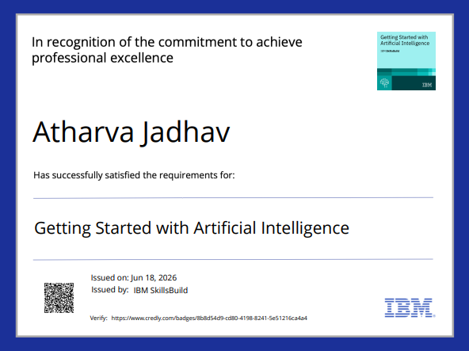
Certificates Earned:​
Replace this image with your IBM SkillsBuild course completion certificate

Slide 20
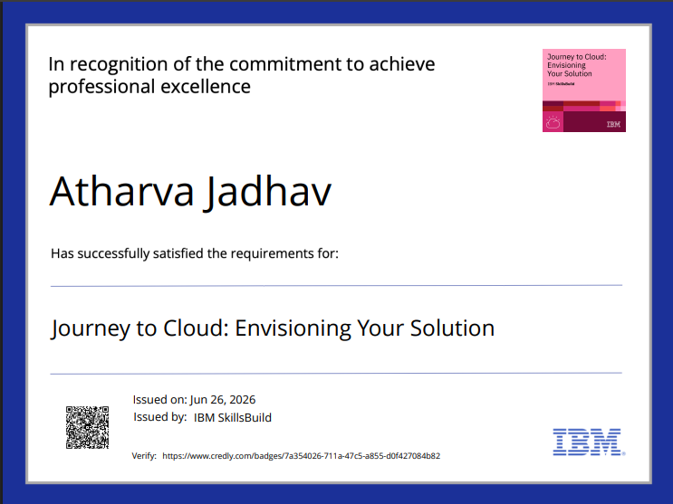

Slide 21
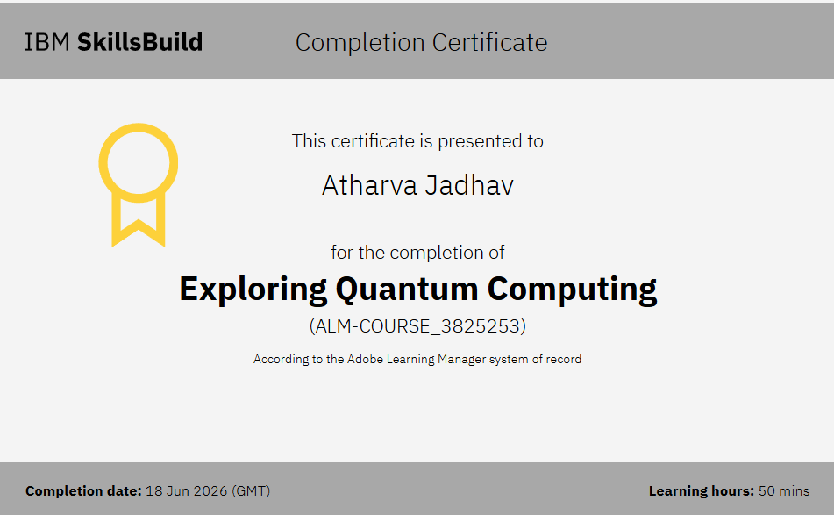
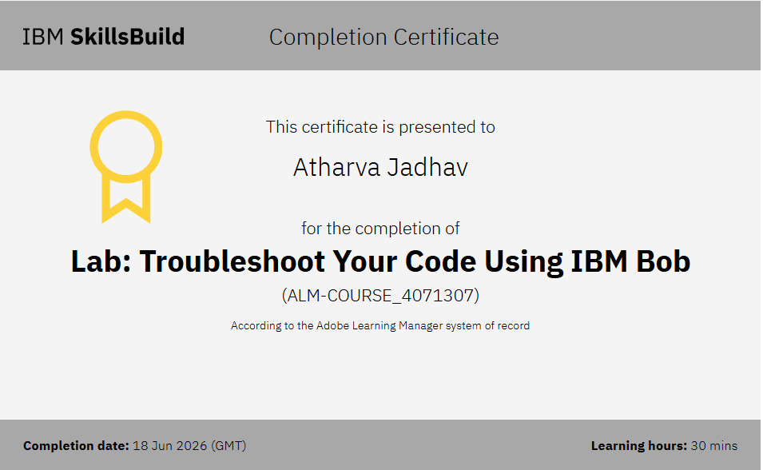


Slide 22


