Slide 1
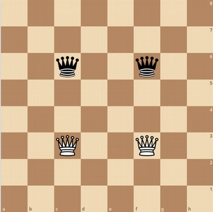
Board Game AI
Game of the Amazons
github/aquarial

Slide 2
Explain game
Intro to Min-max
Rust implementation

Slide 3
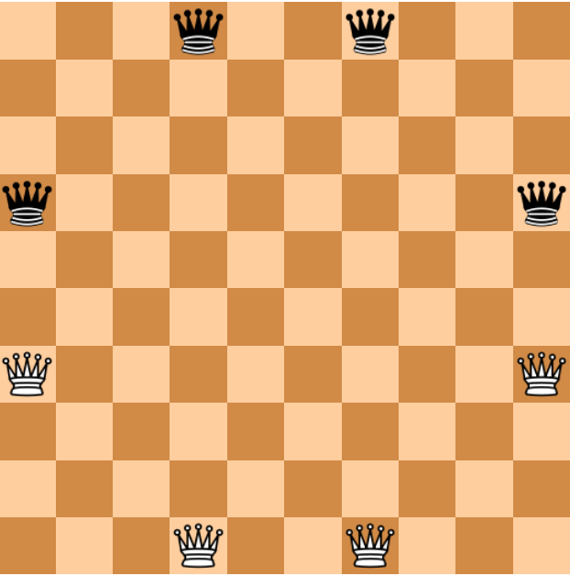
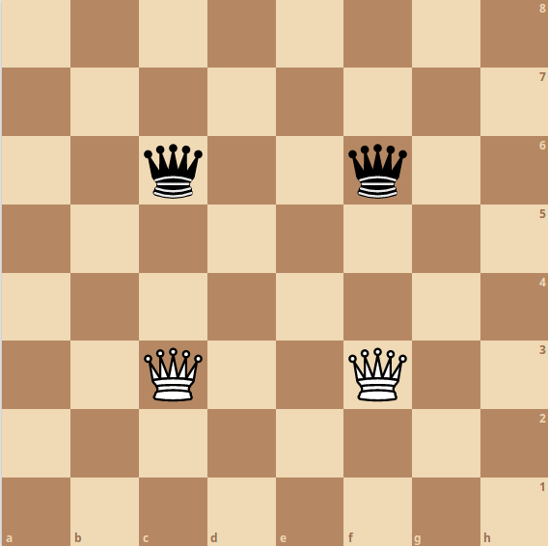
Two player abstract strategy game
Varying boards and layouts

Slide 4
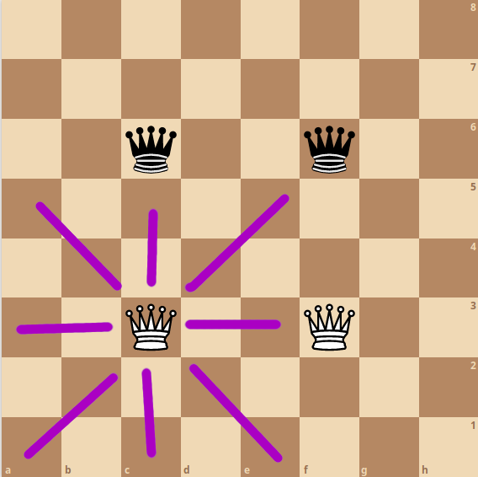
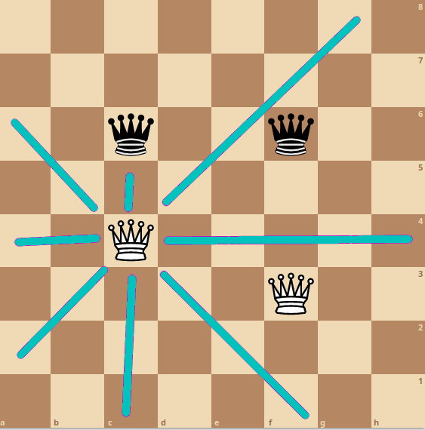
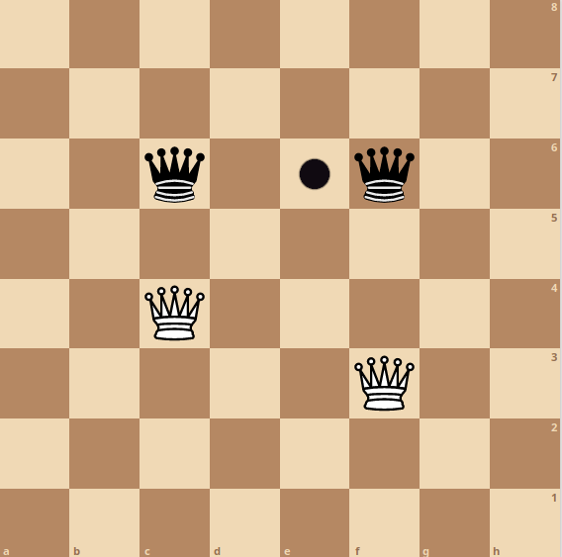
A move is: Move one piece like a queen
Place a token like a queen
Last player to make a move wins

Slide 5
Explain game
Intro to Min-max
Rust implementation

Slide 6
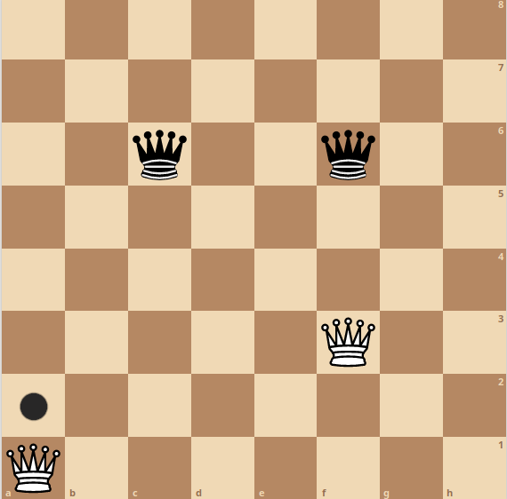
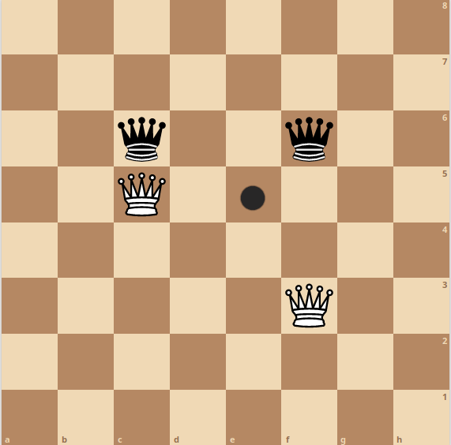
What is good move?
Bad?
Okay?
Good?

Slide 7
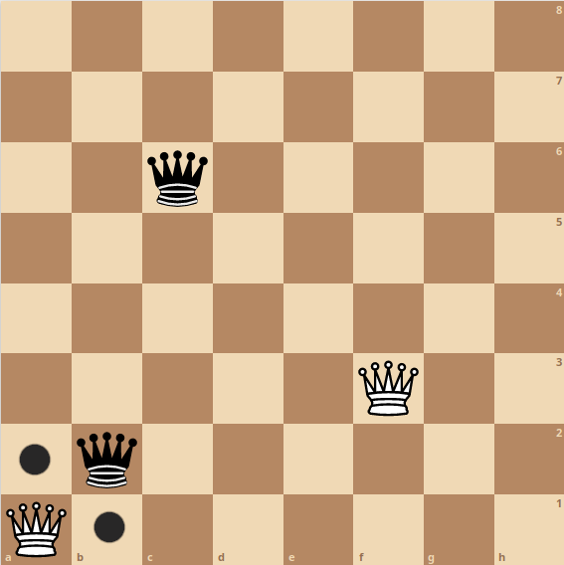
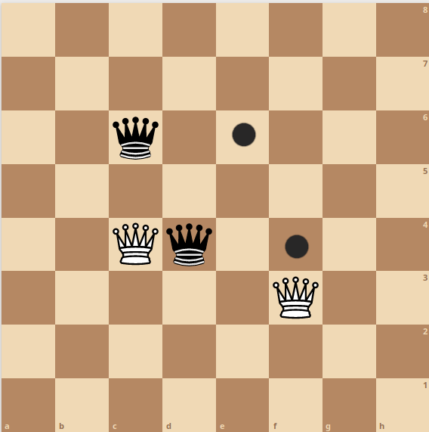
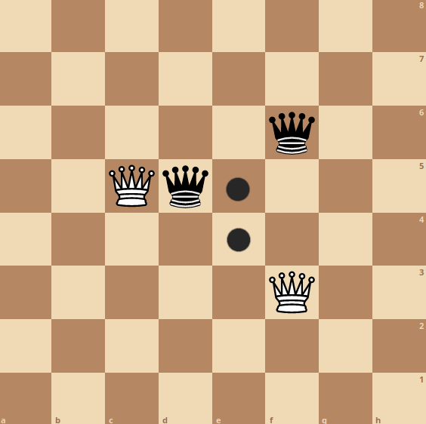
What is good move? 2 player game
Bad
Okay
Good

Slide 8
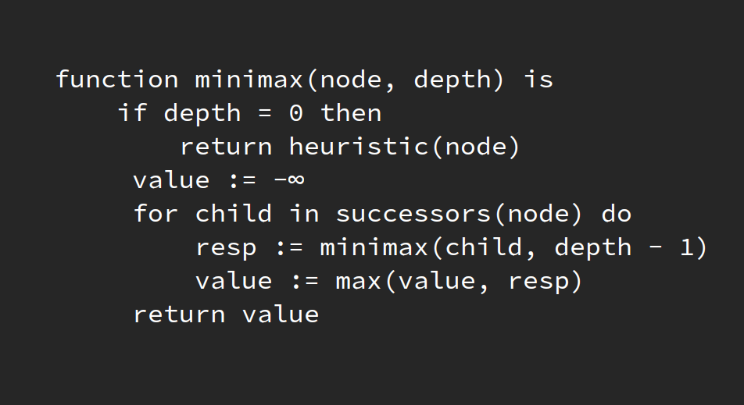
Min-max: evaluate board
https://en.wikipedia.org/wiki/Minimax#Pseudocode

Slide 9
Successors
Enumerate possible moves
Heuristic
Give a ‘score’ to board
+3 for black

Slide 10
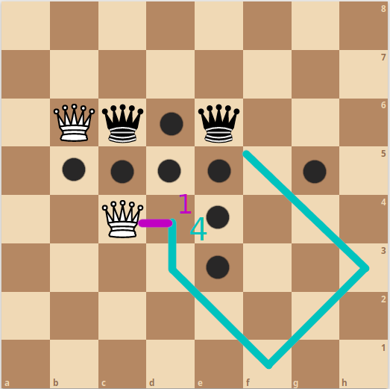
Heuristic
Score based on queen move distance
Breadth-First-Search for each team,
Add up distances

Slide 11
Explain game
Intro to Min-max
Rust implementation

Slide 12
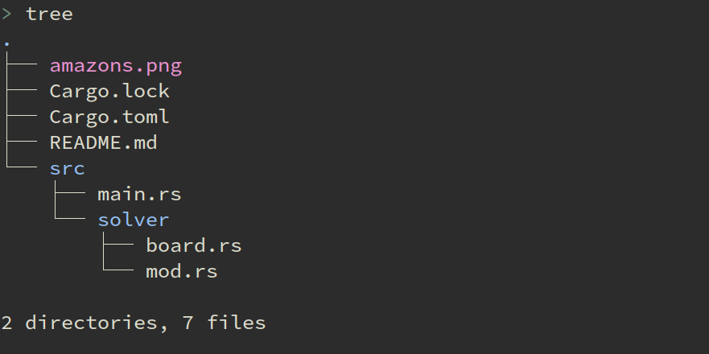
amazons.rs

Slide 13
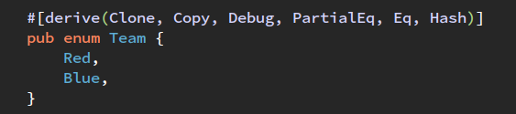
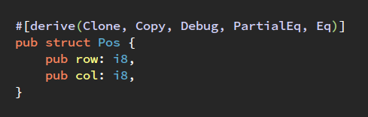
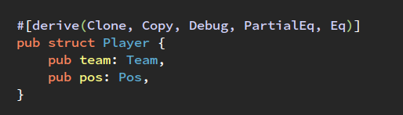
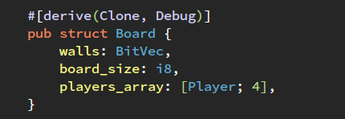
amazons.rs
Bit Vector for board
1 = blocked
0 = open
Array of player structs

Slide 14
amazons.rs
Successors
Enumerate possible moves
Heuristic
Give a ‘score’ to board

Slide 15
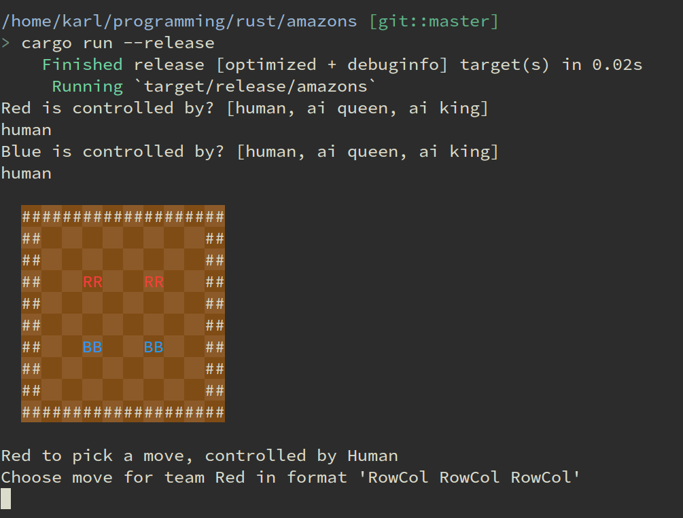
amazons.rs Terminal UI

Slide 16
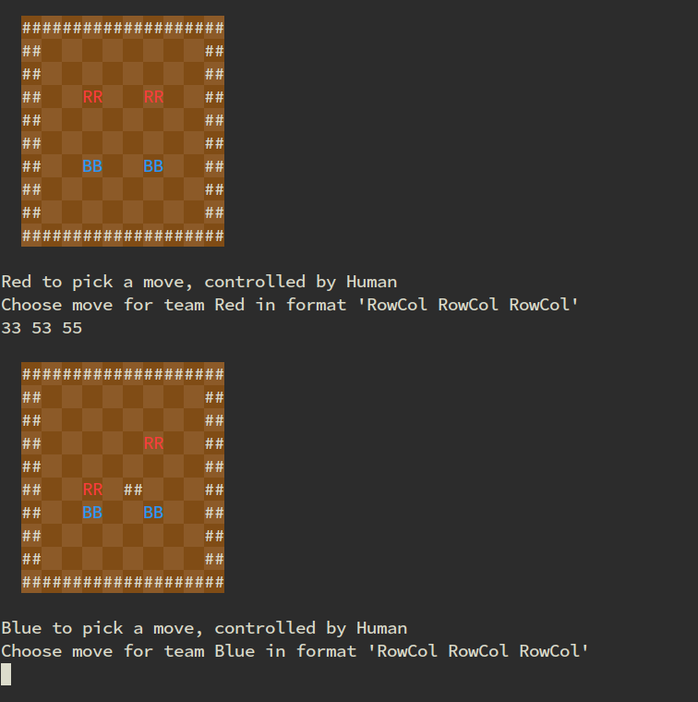
amazons.rs Terminal UI

Slide 17
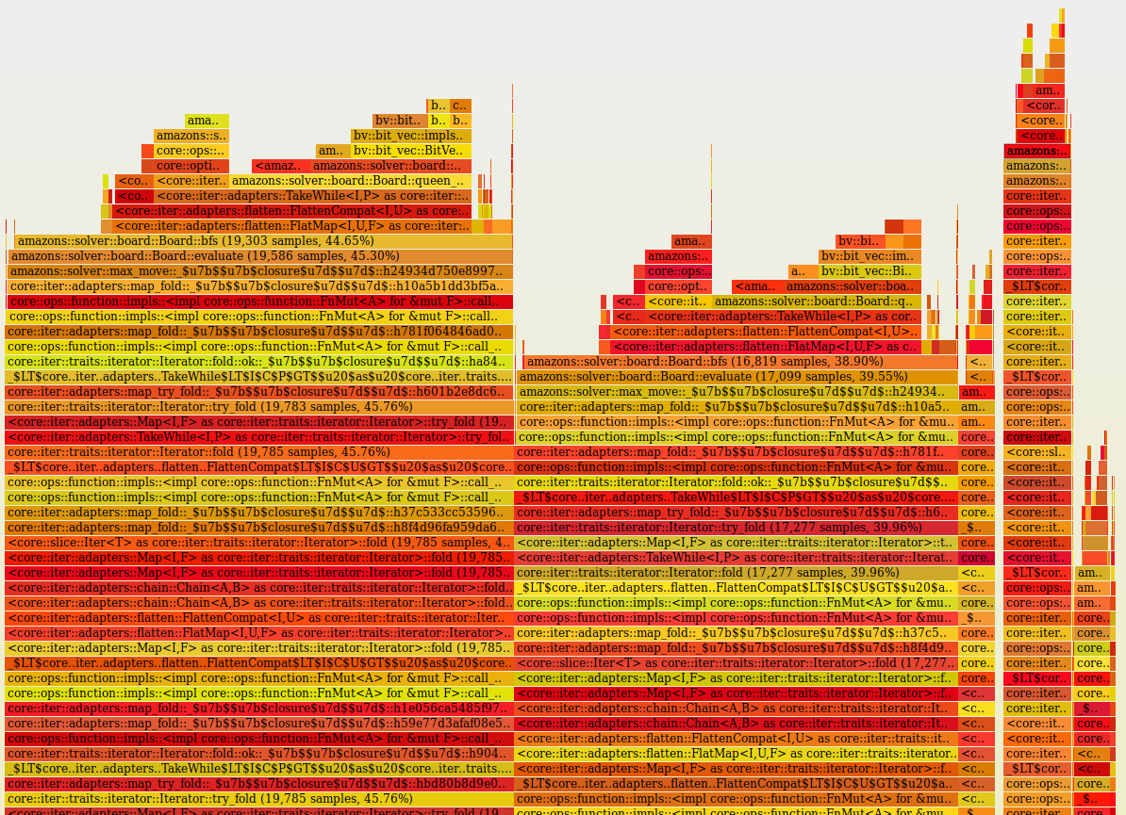
Flamegraph ???

