Slide 1
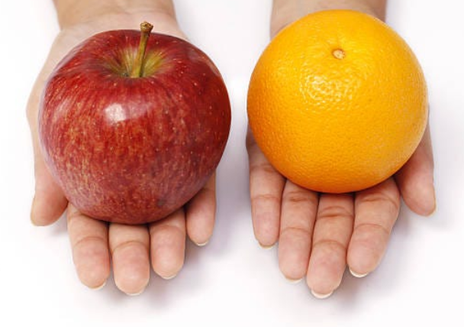
Options Arbitrage
Or how to compare apples to oranges

Slide 2
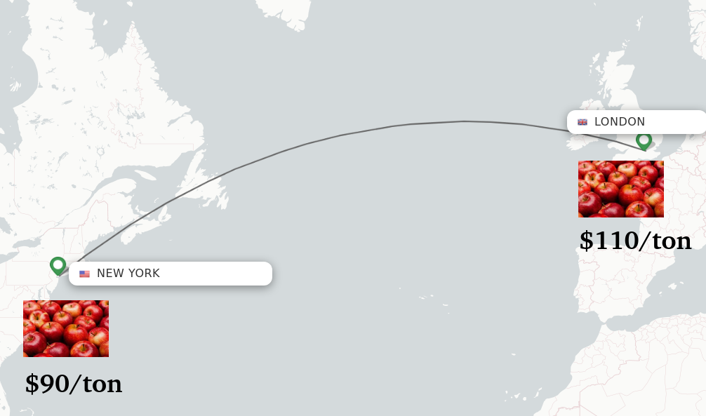
Classic Arbitrage
Same product, different markets, different prices. Buy low, sell high.

Slide 3
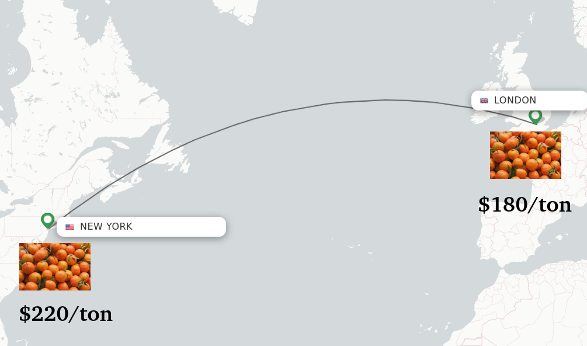
Classic Arbitrage
Sign the contracts at the same time. Delivery can wait.

Slide 4
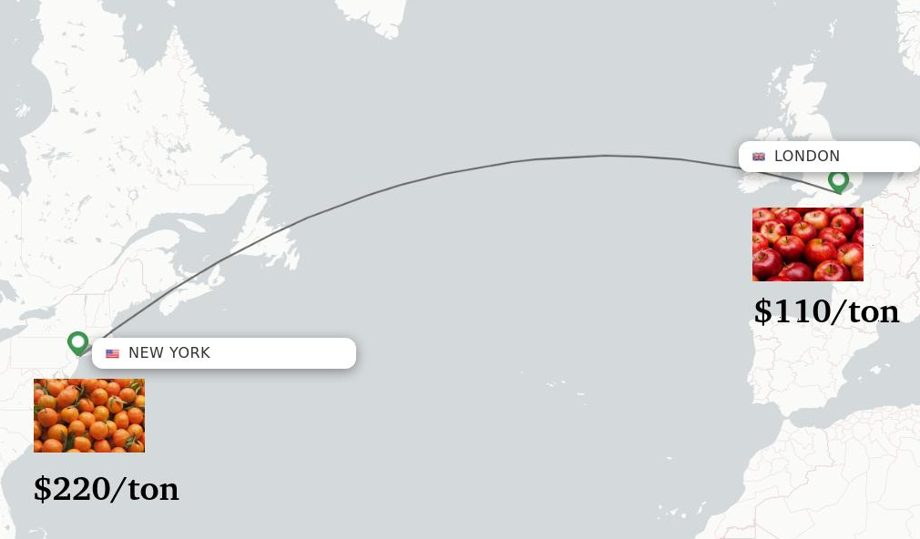
Comparing Apples to Oranges
Arbitrage needs the same product

Slide 5
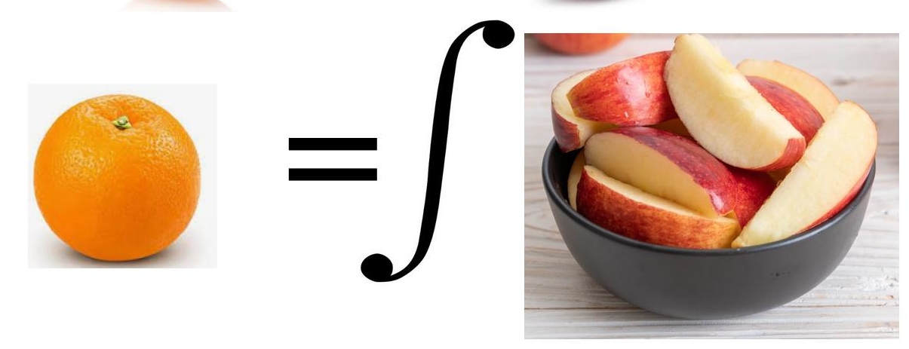
The Genius of Black-Scholes
Transforms apples into oranges

Slide 6
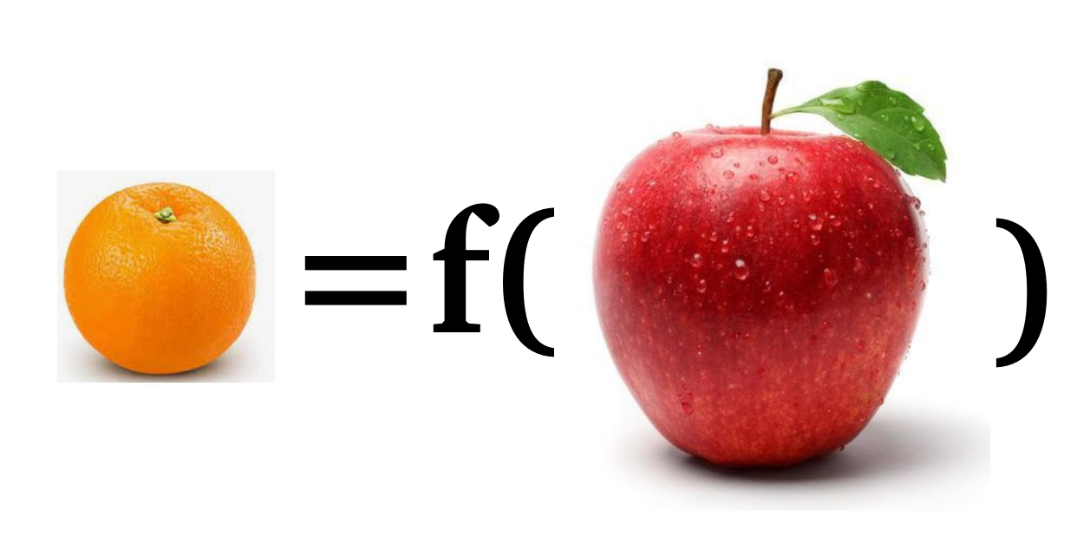
Option Price is a Function of Stock
Take a function y = f(x)
Option = f(Stock) = max(Stock-Strike,0)

Slide 7
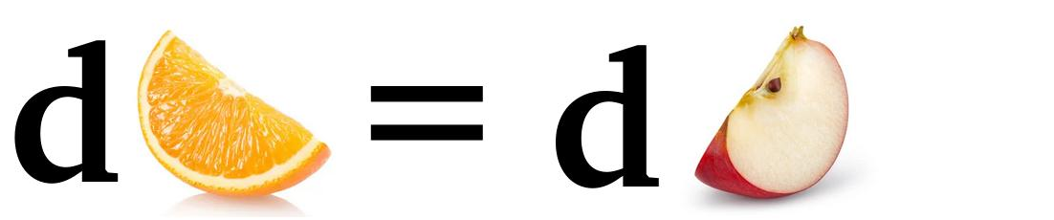
Taylor Series Expansion
dy =f’(x) dx
y1 – y0 = q (x1 – x0)

Slide 8
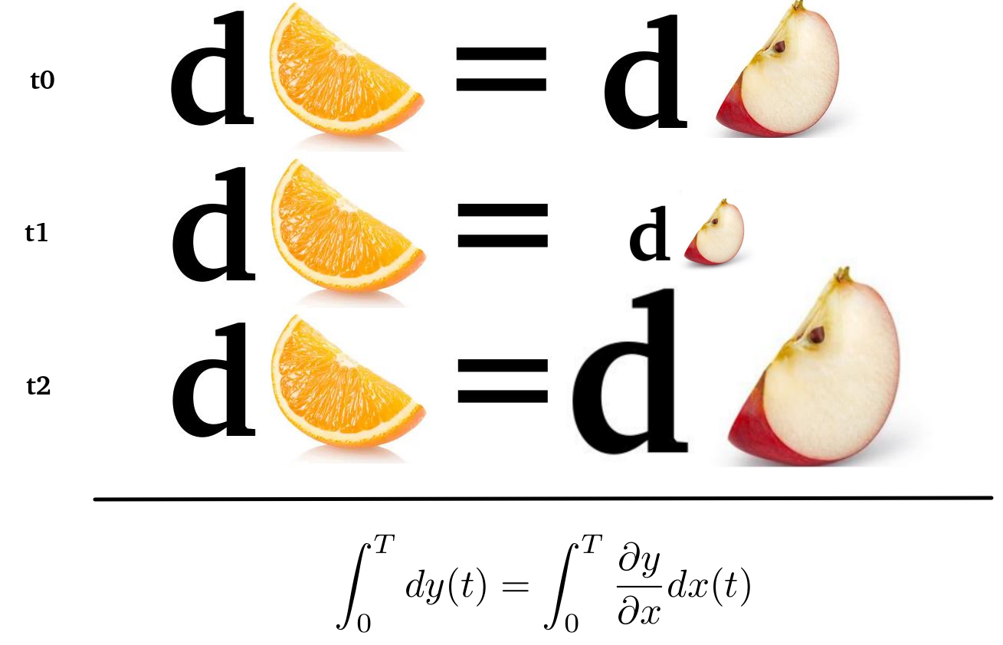
Integrate Over Time
Sum up

Slide 9
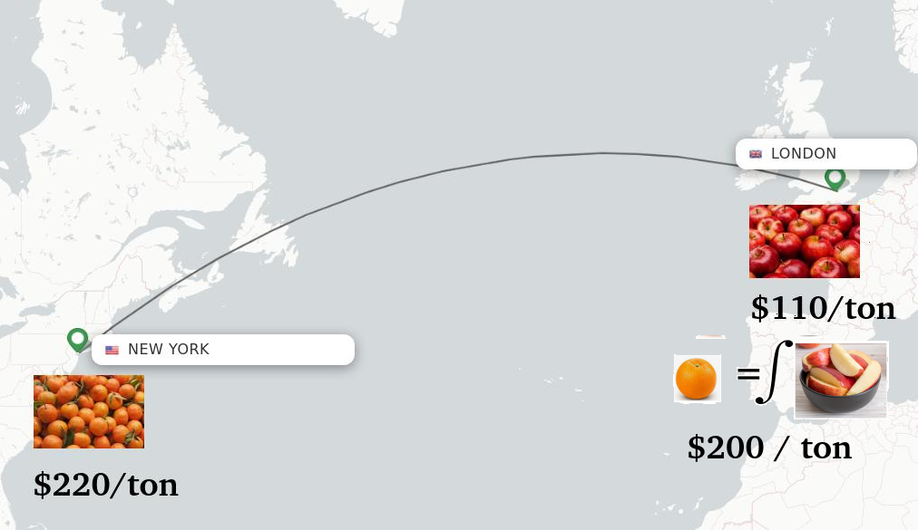
Voilà!
Made apples into oranges

