Slide 1

Multimodal Storytelling via Generative Adversarial Imitation Learning
Zhiqian Chen, Xuchao Zhang, Arnold Boedihardjo, Jing Dai, Chang-Tien Lu
Computer Science Department
Virginia Tech

Slide 2
Agenda
Background
Related works
Intuitive example
Challenge
Method
Evaluation
Conclusion

Slide 3
Background
Issue: Information Overload
Too many document
Too much time for reading
Solution: Entity Storytelling
Extract the key entities
Connect them to represent the original story

Slide 4
Related works
What makes a good story?
[1] Definition of storyline pattern
E.g., sum of link-wise coherence makes a good story (maximizing the weakest link makes good storylines). Merely keeping strong coherence on link dose not necessarily generate good story.
[ Issue ]: Current works employ strict assumptions on link, they cannot model users’ preference (real and complex patterns)
[2] Diversity of information
Current works only focus on textual modeling.
The inherent benefit of utilizing multimodal data is that humans often make inferences between the images and texts so as to resolve ambiguities.
[ Issue ]: No multimodal storytelling has been reported.

Slide 5
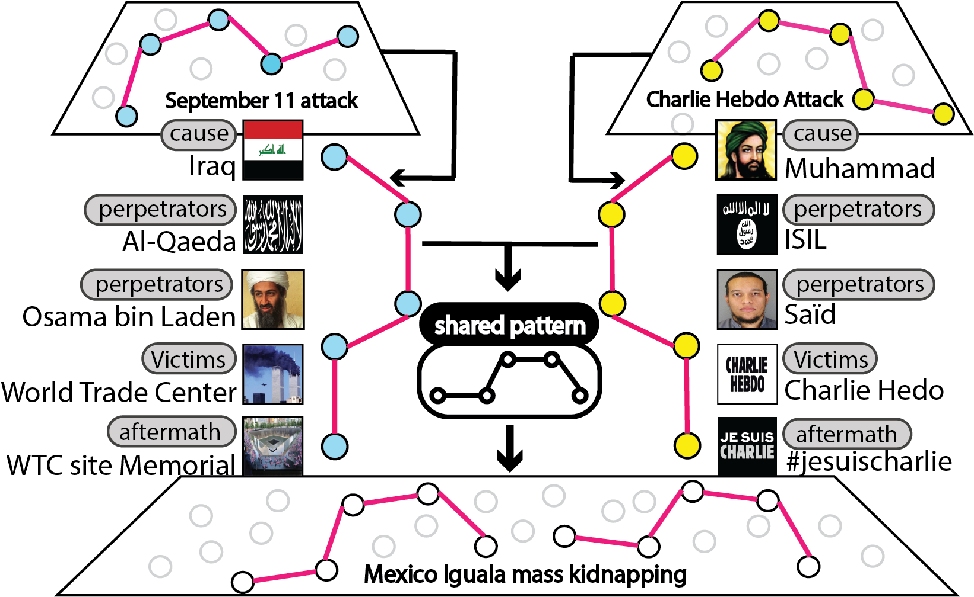
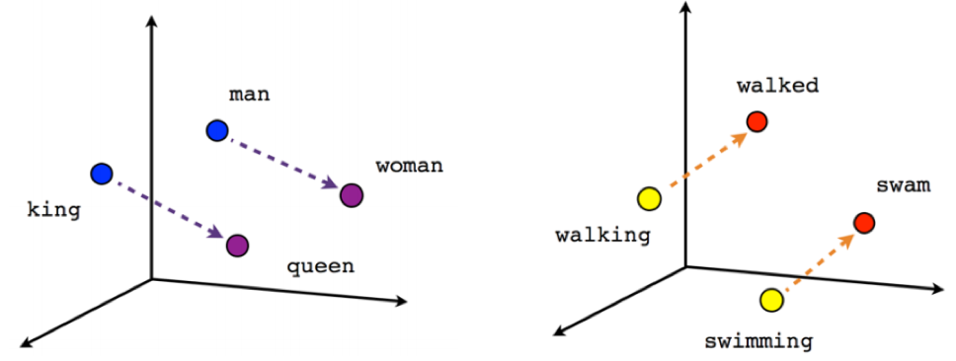
Intuitive example [ story pattern ]
We argue that similar storylines share the same structure in a certain embedding space:
cause - attacker - victims - aftermath
[king] - [man]
=
[queen] - [woman]

Slide 6
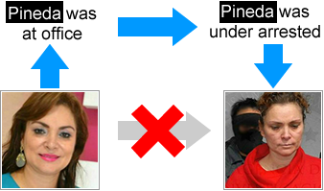
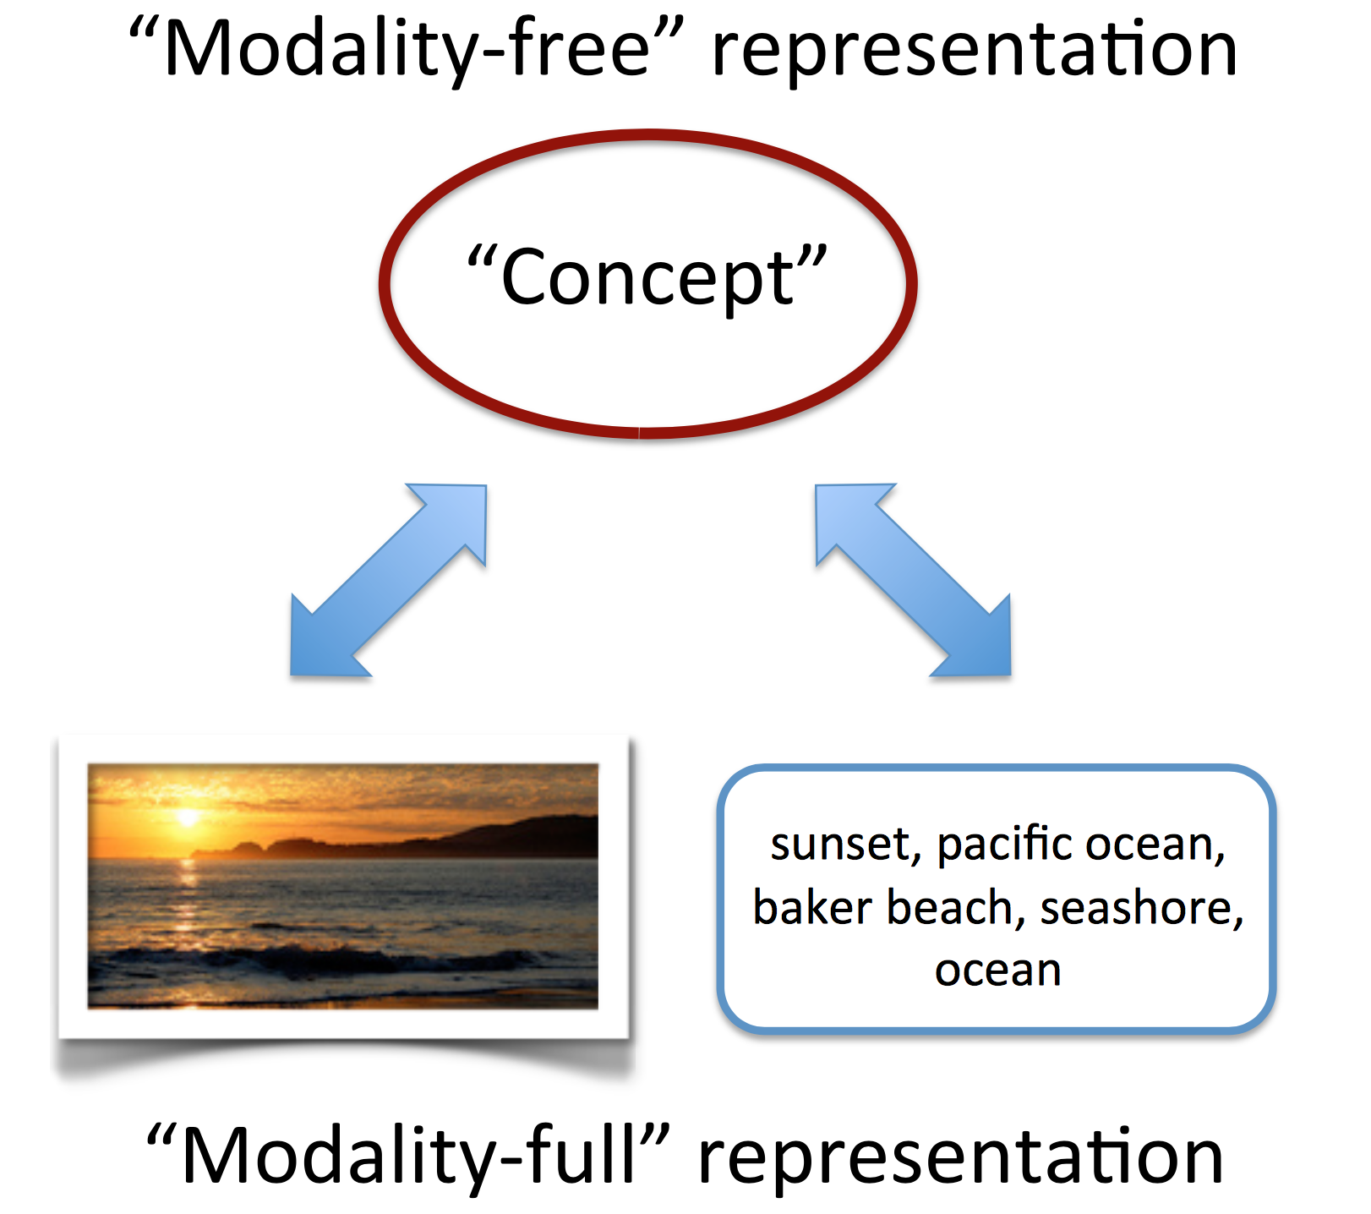
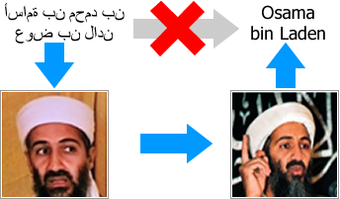
Intuitive example [ multimodal info ]
The inherent beneﬁt of utilizing multimodal data is that humans often make inferences between the images and texts so as to resolve ambiguities.
Multimodal learning
Extracts representations separately
Derives the relationship between

Slide 7
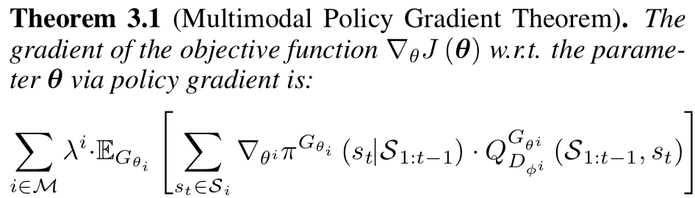
Challenge
How to model story patterns?
Imitation Learning (Inverse Reinforcement Learning)
Issue: instability and implicit policy [1]
Solution: generative adversarial learning
How to make use of multimodal information?
Additive / Multiplicative neural language models[2]
How to learn with GAN and multimodal info?
Following policy gradient[3], we have multimodal policy gradient:
[1] Unifying Visual-Semantic Embeddings with Multimodal Neural Language Models. TACL 2015. Ryan Kiros et al.
[2] Generative adversarial imitation learning. NIPS 2016. Jonathan Ho et al.
[3] Reinforcement learning: An introduction. Richard Sutton et al. Cambridge: MIT press, 1998.

Slide 8
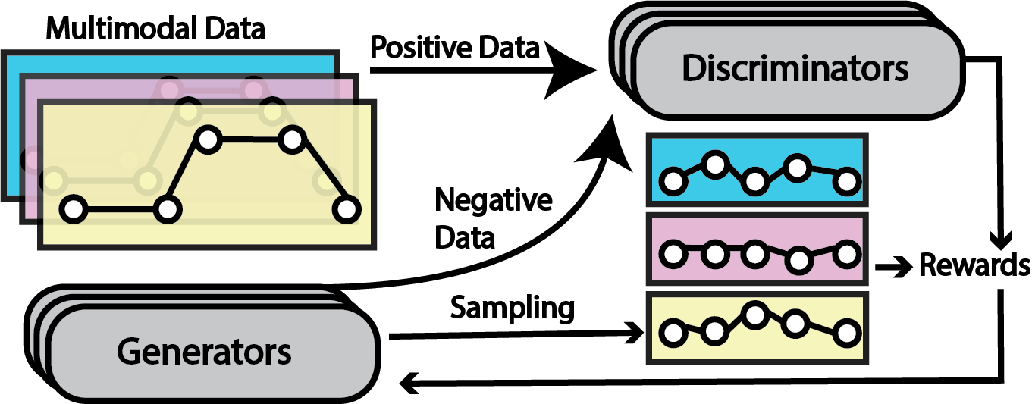

Method
* Large arrows show the data ﬂow in GAN training
* Small arrows indicate the process inside policy gradient
GAN iteratively train Discriminator and Generator in turns
Generator training:
Use MC sampling, generate sequence S
Treat the rating of S from discriminator as reward
Conduct reward based policy gradient to update generator’s parameters
Discriminator training:
User-provided storylines are treated as positive data to discriminator
Generated storylines are treated as negative data to discriminator

Slide 9
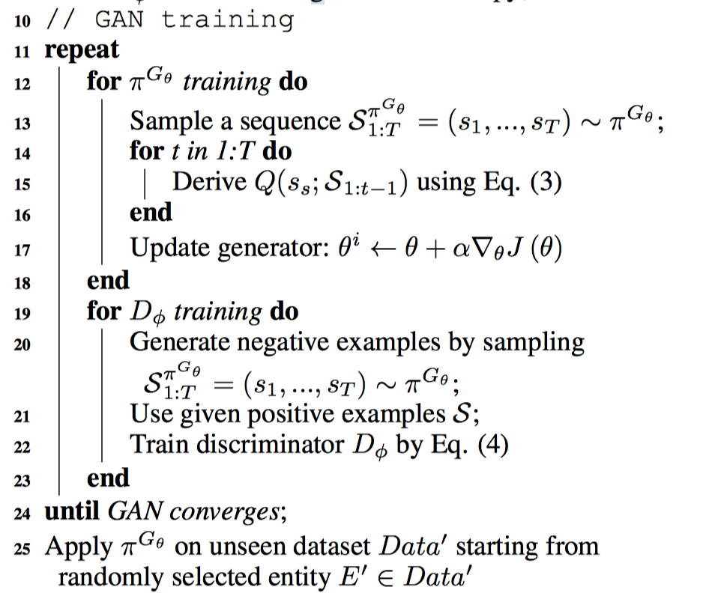
Method(cont.)
input: User-provided storylines
TextCNN
LSTM
output: Generated storylines

Slide 10
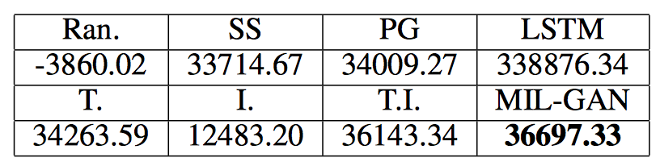
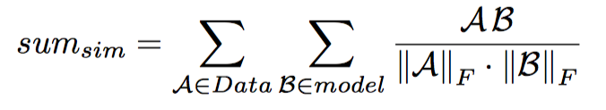
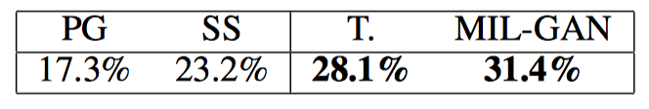
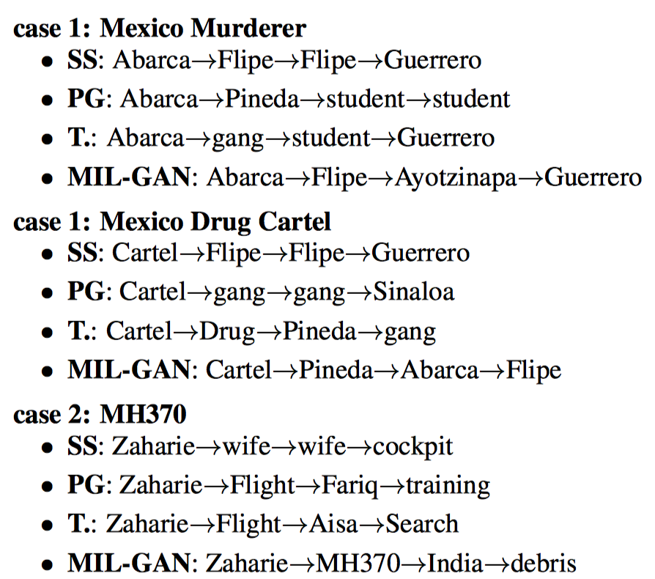
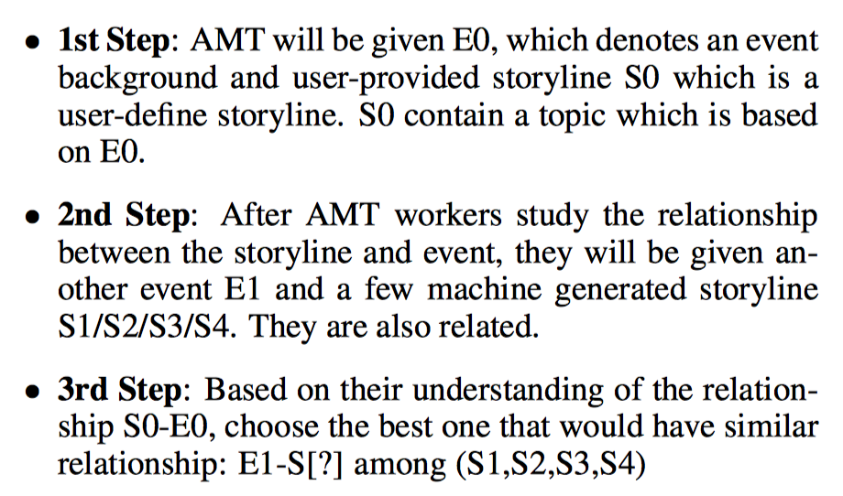
Evaluation
Semi-supervised task: 10 events in training:1310 Homicide storylines, while Protest chooses 934 storylines.
Similarity Test in the same event
Transferring Test in different event
ss: schedule sampling
pg: policy gradient

Slide 11
Conclusion
In this paper, we proposed a multimodal imitation learning approach for generating storyline on unseen events.
To avoid the reward function designing, GAN based imitation learning is introduced to learn the latent policy given users’ demonstrations.
To bridge the information gap between text and image, our model effectively integrates generative adversarial nets and multimodal learning via deterministic policy gradient. The different modalities learn from each other and potentially resolve confusion from each single modality.

Slide 12
Thank you!

