Slide 1

Absolute vs. Relative Paths/Links
A Step-by-Step Explanation and a Example Walkthrough

Slide 2
Absolute vs. Relative Paths/Links: Explanation

Slide 3
Absolute vs. Relative Paths/Links
One of the most common things newcomers to HTML get confused about is linking to other pages and sites, especially when absolute and relative paths come into play. But worry not! Creating links — relative and absolute alike — is actually fairly easy. Read on, and by the end of this presentation, you'll know the difference between these two types of links, as well as when and how to use them.
Of course, it's still important to understand how relative and absolute links work, so continue forward...

Slide 4
Absolute vs. Relative Paths/Links
First off, as you may or may not know, you would use the following code to create a link in HTML:
<a href="page2.html">Page 2</a>
page2.html would be the page you want to link to, and Page 2 would be the link that the page displays.
In the example above, we used a relative path.
You can tell if a link is relative if the path isn't a full website address. (A full website address includes http://www.)
As you may have guessed, an absolute path does provide the full website address.

Slide 5
Absolute vs. Relative Paths/Links
Here are a few basic examples of relative and absolute paths:
Relative Paths
index.html
/pages/page1.html
../resources/resource1.html
Absolute Paths
http://www.googgle.com
http://www.yahoo.com
http://www.bing.com
The first difference you'll notice between the two different types of links is that absolute paths always include the domain name of the website, including http://www., whereas relative links only point to a file or a file path. When a user clicks a relative link, the browser takes them to that location on the current site.
For that reason, you can only use relative links when linking to pages or files within your site, and you must use absolute links if you're linking to an external location on another website.

Slide 6
Absolute vs. Relative Paths/Links
When a user clicks a relative link, how does their browser know where to take them? Well, it looks for the location of the file relative to the page where the link appears. (That's where the name comes from!) Let's get back to our first example:
<a href="page2.html">Page 2</a>
This link points to a filename, with no path provided. This means that page2.html is located in the same folder as the page where this link appears.
If both files were located in the "root" directory of the website http://www.website.com, the actual website address the user would be taken to is http://www.website.com/page2.html.
If both files were located in a "sub" folder of the root directory called pages, the user would be taken to http://www.website.com/pages/page2.html.

Slide 7
Absolute vs. Relative Paths/Links
How about another example? Let's say we our http://www.website.com domain had a subfolder called resources. Inside the resources folder is a file called resources1.html. The full path to this page would be:
<a href="http://www.website.com/resources/resources1.html">Resources 1</a>
Still with me? Good. Let's say in this resources1.html file, we have a link:
<a href="resources2.html">Resources 2</a>
If someone clicked that, where do you think it would take them? If you said
http://www.website.com/resources/resources2.html
you'd be right!
You probably know why it would take them there -- because both files are saved in the resources subfolder.

Slide 8
Absolute vs. Relative Paths/Links
Now, what if we wanted to use a relative link to show a page in another folder?
If you want to link to a file in a subfolder of the current folder, provide the file path to that file, like so:
<a href="/oldresources/oldresources1.html">Old Resources 1</a>
In this example, you're telling the browser to look in the current folder (resources) for a subfolder (oldresources) that contains the file you want the user taken to (oldresources1.html). You can link to as many subfolders as you need using this method.

Slide 9
Absolute vs. Relative Paths/Links
What if you want to link to a file in a folder above or outside the current folder?
You have to tell the browser to move up one folder in your relative link by putting two periods and a slash (../) in front of the filename or path:
<a href="../resources1.html">Resources 1</a>
When the browser sees ../ in front of the filename, it looks in the folder above the current folder. You can use this as many times as you need to. You can also tell the browser to look in a subfolder of the directory above the current one.

Slide 10
Absolute vs. Relative Paths/Links
Using the same example website from above, let's say we wanted to create a link from a page in the oldresources folder that would take the user to a page in the resources folder and also create a link to the home page (index.html) in the root directory.
Here's how a relative link to this file would look going from a page in oldresources back to a page in resources:
<a href="../resources1.html">Home</a>
Here's how a relative link to the home page would look going from a page in oldresources back to the root folder:
<a href="../../index.html">Home</a>

Slide 11
Absolute vs. Relative Paths/Links
Now, let's talk about absolute paths. Like we mentioned earlier, absolute paths provide the complete website address where you want the user to go. An absolute link would look like this:
<a href="http://www.google.com">Google</a>
You must use absolute paths when linking to another Website, but you can also use absolute paths within your own website. This practice is generally frowned upon, though.
Relative links make it easy to do things like change your domain name without having to go through all your HTML pages, hunting down links and changing the names.
As an added bonus, they force you to keep your site structure neat and organized, which is always a good idea.

Slide 12
Absolute vs. Relative Paths/Links: Example Walkthrough

Slide 13
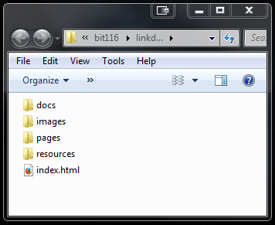
The "Root" Directory, index.html file, and "Sub" Folders
Let's say I have a folder with one (1) index.html file in it and four (4) sub folders called pages, resources, images, and docs.
The folder that holds this index.html file and the four sub folders is called the "root" directory.
Every website has a "root" directory and most websites have an index.html file which acts as its main "home" or portal page located in this "root" directory.
Link Demo Online: http://faculty.cascadia.edu/cduckett/bit116/linkdemo
Link Demo Download: http://faculty.cascadia.edu/cduckett/bit116/linkdemo.zip
Link Demo Video Walkthrough: http://faculty.cascadia.edu/cduckett/bit116/videos/linkdemo.mp4

Slide 14
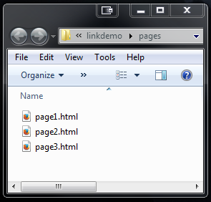
The pages folder
Inside the pages folder, I have three (3) html files named pages1.html, pages2.html, and pages3.html

Slide 15
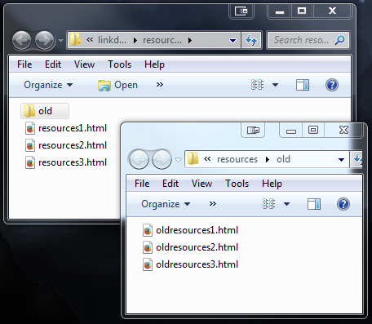
The resources folder
Inside the resources folder, I have three (3) html files named resources1.html, resources2.html, and resources3.html.
Also inside the resources folder is a sub folder called old which contain three html files called oldresources1.html, oldresources2.html, and oldresources3.html

Slide 16
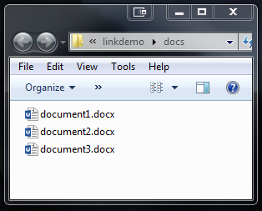
The docs folder
Inside the docs folder, I have three (3) Word document files named document1.docx, document2.docx, and document3.docx.

Slide 17
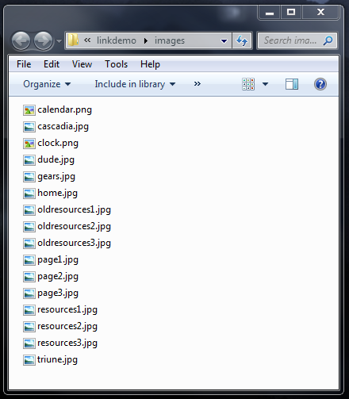
The images folder
Inside the images folder, I have several image files (jpg and png formats) which I can display as needed in my web pages

Slide 18
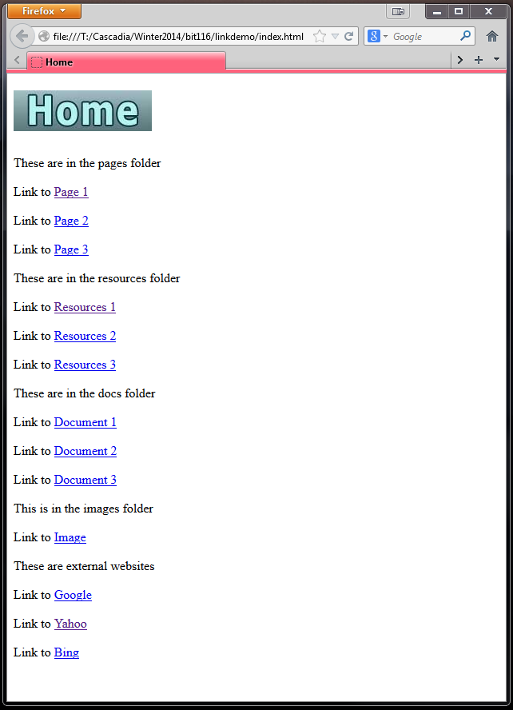
The index.html file
The index.html file is the "home" page which links to other pages in the site. In this example, the index.html is the only html page that is located in the "root" directory—all the other html pages in the site are located inside the pages and resources sub folders

Slide 19
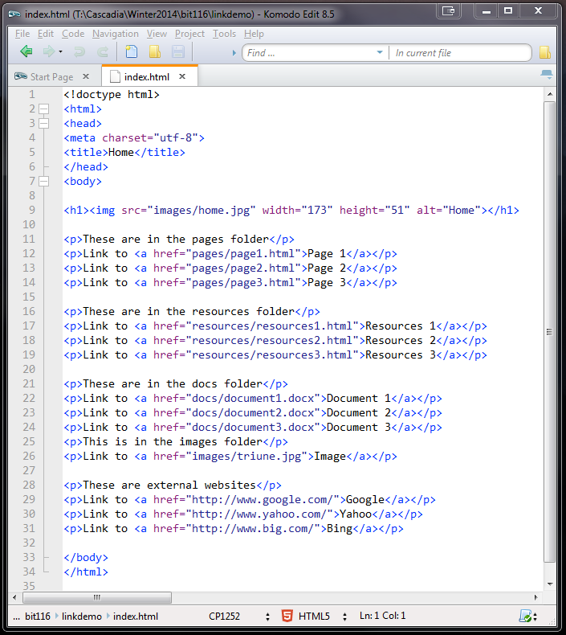
The index.html file
The index.html page links to pages inside of subfolders (e.g., pages1.html, resources1.html) using the relative linking method, and it also links to external pages (e.g., Google, Yahoo, Bing) using the absolute linking method.

Slide 20
The index.html file
When the index.html page links to a page inside of the pages subfolder that folder's name needs to be included as part of the link, like so:
<a href="pages/page1.html">Page 1</a>
Basically, what this link is saying is "look inside the pages folder for a file called page1.html and open it."

Slide 21
The index.html file
When the index.html page links to a page inside of the resources subfolder that folder's name needs to be included as part of the link, like so:
<a href="resources/resources1.html">Resources 1</a>
Basically, what this link is saying is "look inside the resources folder for a file called resources1.html and open it."

Slide 22
The index.html file
When the index.html page links to a page inside of the docs subfolder that folder's name needs to be included as part of the link, like so:
<a href="docs/document1.docx">Document 1</a>
Basically, what this link is saying is "look inside the docs folder for a file called document1.docx and open it."

Slide 23
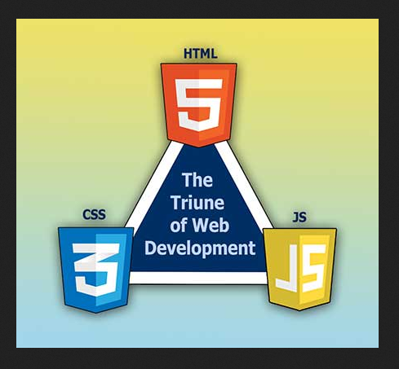
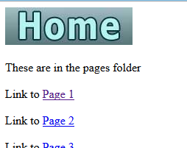
The index.html file
When the index.html page links to a page inside of the images subfolder that folder's name needs to be included as part of the link, like so:
<a href="images/triune.jpg">Image</a>
Basically, what this link is saying is "look inside the images folder for a file called triune.jpg and open it."
You can also use the img tag to link to and embed an image directly into a web page, using:
<img src="images/home.jpg">
triune.jpg as a page
home.jpg embedded

Slide 24
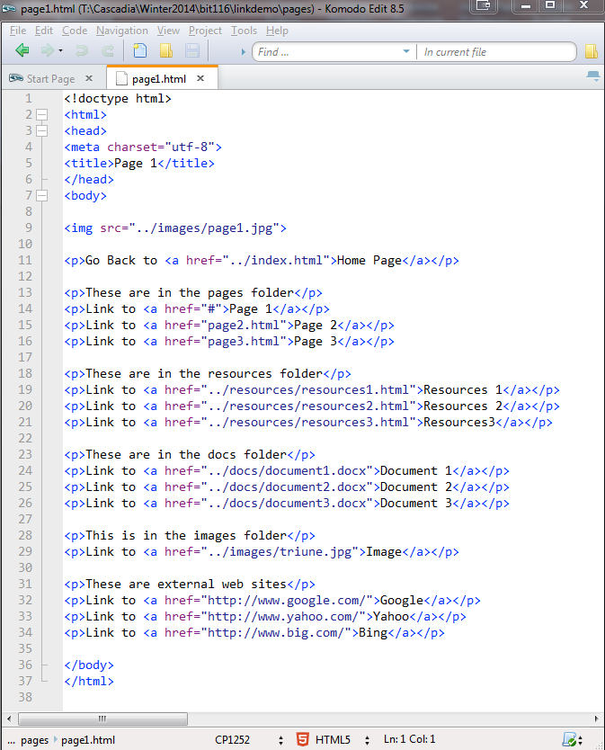
Linking from pages inside pages folder to pages outside pages folder
When linking to the index.html page from a page inside the pages folder, you need to include ../ (the "dot dot slash") as part of the link.
<a href="../index.html">Home</a>
The .. ("dot dot") part of the .. / ("dot dot slash") means "step outside of or 'back out' of the current folder."
The / ("slash") part of the .. / ("dot dot slash") means "look for the file or folder that comes after it, and open it."

Slide 25
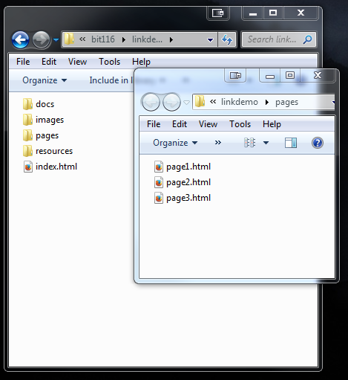
Linking from pages inside pages folder to pages outside pages folder
Looking at the folders we can see that the index.html page is one level outside of the pages folder; the ../ (the "dot dot slash") is telling the link to back out of the pages folder one level and then look for the index.html file and open it.
<a href="../index.html">Home</a>

Slide 26
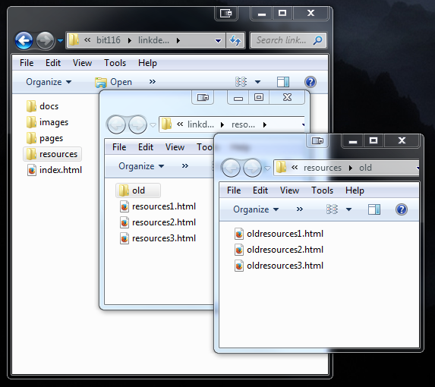
Linking from pages inside a folder inside a folder to a different folder
The resources folders has three html files in it as well as a subfolder called old which also has three html files in it.
To link to a file inside the old folder to a file inside the resources folder, you'd use ../ and the files name because you only have to back out one level
<a href="../resources1.html">Resources 1</a>
To link back to the index.html file from the old folder you'd have to use ../ twice because you have to back out two levels to find it:
<a href="../../index.html">Home</a>

Slide 27
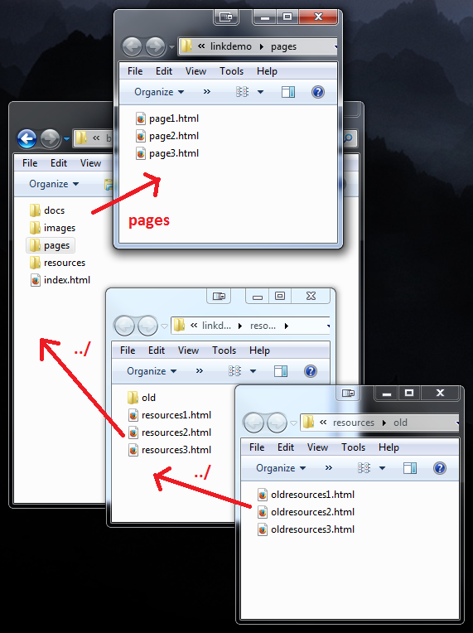
Linking from pages two levels out and into a different folder
To link to a file inside the old folder to a file inside the pages folder, you'd use ../ twice, then the name of the pages folder, and finally the filename because you have to back out two levels and before going into the pages folder to find the file
<a href="../../pages/pages.html">Page 1</a>
The same is true is you want to link to a file in the docs folder or the images folder.

