Slide 1
JavaScript Juggernauts

Slide 2

This will soon be you…
JavaScript Juggernauts.

Slide 3
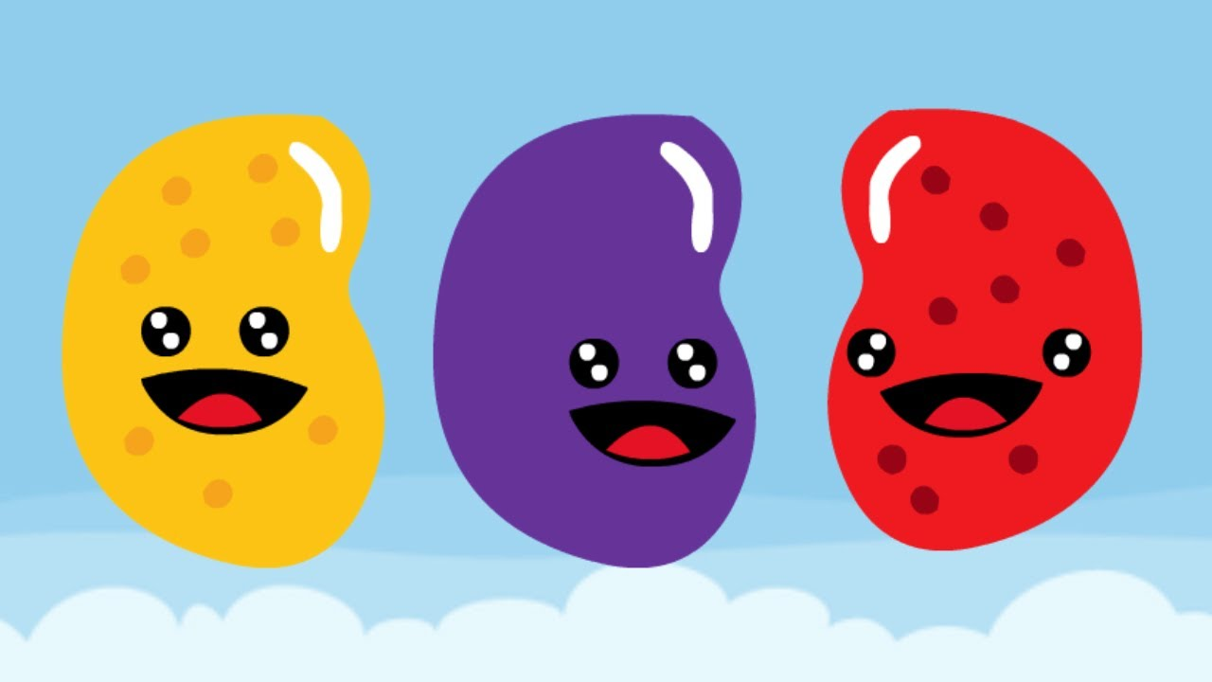
But right now…
Maybe feeling like
JavaScript Jellybeans.

Slide 4
Transformation to Come
HANG IN THERE!

Slide 5
Objects

Slide 6
Demo Time
Instructor: Demo
(GoodArray.html | 4-GoodArray)

Slide 7
Demo Time
Instructor: Demo
(JoanOfArcArrays.html | 5-JoanOfArcArrays)

Slide 8
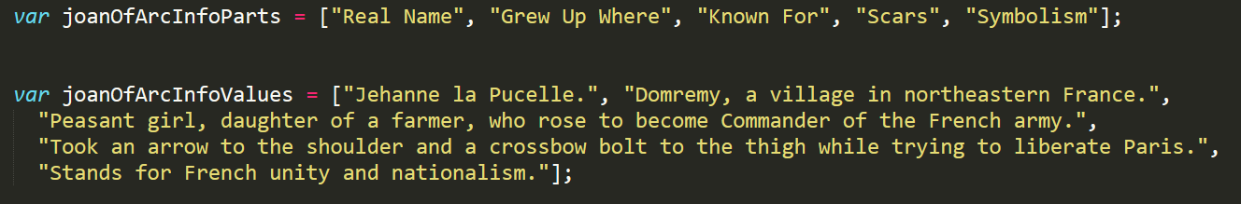
Associated Data ==/== Arrays
Relating two separate arrays is not fun.

Slide 9
Demo Time
Instructor: Demo
(gandalf-the-grey-objects.html | 30-GandalfTheGreyObjects)

Slide 10
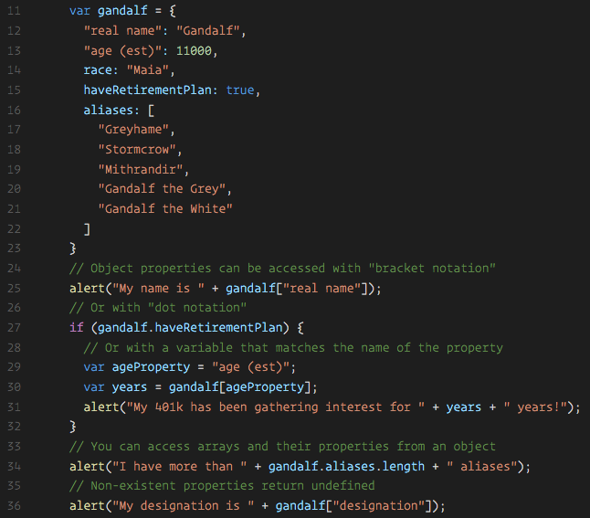
Gandalf – The Object
Gandalf’s “properties” and “values” are associated in object form, making it easy to recall specific data.

Slide 11
Objects Visualized
var gandalf
=
{
“real name”
:
“Gandalf”
,
“age (est)”
:
11000
,
“race”
:
“Maia”
}
This is Gandalf. According to code… Gandalf is an Object.

Slide 12
Objects Visualized
var gandalf
=
{
“real name”
:
“Gandalf”
,
“age (est)”
:
11000
,
“race”
:
“Maia”
}
These are Gandalf’s properties (like descriptors).

Slide 13
Objects Visualized
var gandalf
=
{
“real name”
:
“Gandalf”
,
“age (est)”
:
11000
,
“race”
:
“Maia”
}
These are the “values” of Gandalf’s properties.

Slide 14
Objects Visualized
var gandalf
=
{
“real name”
:
“Gandalf”
,
“age (est)”
:
11000
,
“race”
:
“Maia”
}
Thus: gandalf[“race”] = “Maia

Slide 15
Demo Time
Instructor: Repeat Demo
(gandalf-the-grey-objects.html | 30-GandalfTheGreyObjects)

Slide 16
> YOUR TURN!!
Activity: 7-MyFirstObject | Suggested Time: 15 min
Code Dissection / Creation: Basic Objects
With a partner, spend the next few moments studying the code just slacked to you.
Then, write code below each comment to log the relevant information about the provided car object.
Bonus: If you finish early, create a brand new object of your own. Slack out a snippet of the code to the class when you are done. Be Creative!

Slide 17
Demo Time
Instructor: Demo in Browser
(carGame_Solved.html | 8-CarGame)

Slide 18
> YOUR TURN!!
Activity: 8-CarGame | Suggested Time: 20-30 min
Code Creation: Run that Car!
Using the code from the previous activity as a starting point, create a complete application such that:
Users can enter keyboard input (letters).
Each of the car's methods are assigned to a key.
When the user presses a key it calls the appropriate function.
These letters also trigger a global function called reWriteStats() that logs the car’s make, model, color, mileage, and isWorking status to the console.
HINT: You will need to use the document.onkeyup() function to collect input from the user's keyboard.

Slide 19
Questions

