Slide 1
JS and jQuery Jubilee

Slide 2
This shouldn’t be you…

Slide 3
Remember this!
“You can’t tell whether you’re learning something when you’re learning it—in fact, learning feels a lot more like frustration.”
“What I’ve learned is that during this period of frustration is actually when people improve the most, and their improvements are usually obvious to an outsider. If you feel frustrated while trying to understand new concepts, try to remember that it might not feel like it, but you’re probably rapidly expanding your knowledge.”
Jeff Dickey, Author of Write Modern Web Apps with the MEAN Stack: Mongo, Express, AngularJS, and Node.JS

Slide 4

Feedback #1 – Pace is Fast!!!
That said, as instructors / TAs we are here to help.
As we fall into a class rhythm, feel encouraged to schedule a 1-1 during office hours.
In addition to using the time to understand concepts… it’s a great way for us to identify weaknesses and outline steps to get on the right track.
These might be before / after class.

Slide 5
Today’s Class

Slide 6
Objectives
Pretend to learn scoping
Build a jQuery Calculator

Slide 7
Lexical Scope

Slide 8

Shh… Just Between Us.
WARNING:
This next section is heavy on theory.
Disclaimer:
It’s not the end of the world if its confusing and/or you’re completely lost.

Slide 9
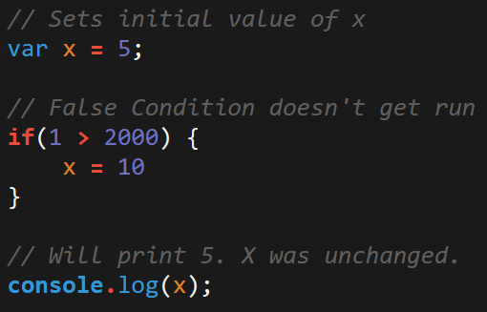
Javascript Scope
In Javascript curly brackets { } indicate blocks of code.
In order for the code inside the curly brackets to be executed, it must meet the condition or it must be called (example: functions).
These blocks of code have the power to affect variables outside the curly brackets if those variables were declared outside – so be careful!

Slide 10
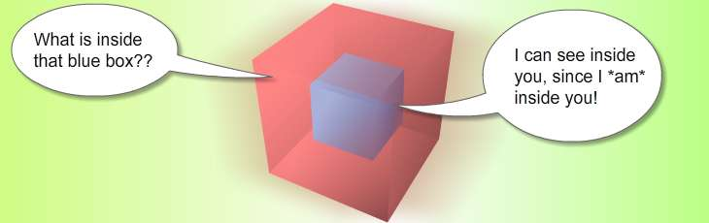
Scope = Boxes in Boxes
Scope impacts which variables can be accessed by which function.

Slide 11
Scope = Boxes in Boxes
function global()
function inner()
function eveninner()
function innest()

Slide 12
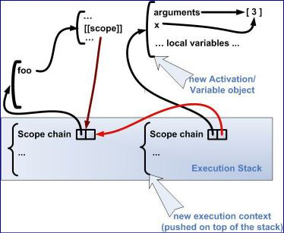

Javascript’s Odd Relationship with Scope
For those who have programmed in other languages, Javascript seemingly behaves in unpredictable ways.

Slide 13
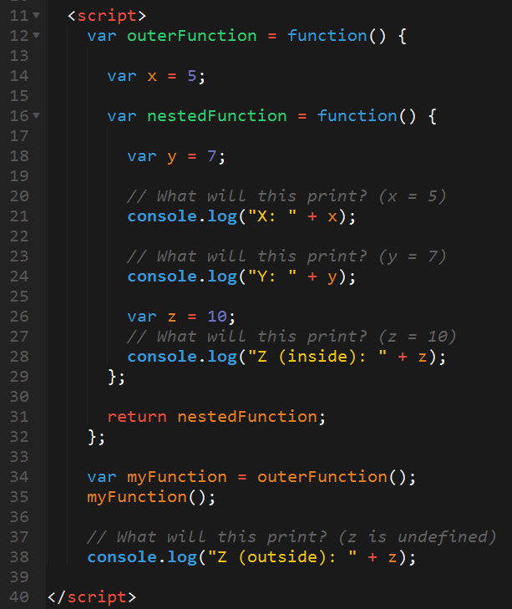
Javascript Scope Example (Tricky)
Here nested function is clearly able to access the variables of their parent function.
Whereas outer function has no idea what the variable z is because it was declared in a child function.

Slide 14
> YOUR TURN!!
Activity: 4-ScopeOne | Suggested Time: 5 min
Take a few moments dissecting what I just said.
Look at the file sent to you and explain to the person next to you what is meant by:
The terms parent function and child function
The concept that child functions can access parent variables but not vice versa.
Be prepared to share!

Slide 15
> YOUR TURN!!
Activity: 5-ScopeTwo | Suggested Time: 7 min
Take a few moments to dissect the code just sent to you.
Try to predict what will be printed in each of the examples.
Be prepared to share!
Note: Pay attention to the unusual use of the keyword: ‘this”

Slide 16
> YOUR TURN!!
Activity: 6-ScopeThree | Suggested Time: 7 min
Take a few moments to dissect the code just sent to you.
Try to predict what will be printed in each of the examples.
Be prepared to share!
Note: Pay attention to the unusual use of the keyword: ‘this”

Slide 17
> YOUR TURN!!
Activity: 6-ScopeThree | Suggested Time: 7 min
Take a few moments to dissect the code just sent to you.
Try to predict what will be printed in each of the examples.
Be prepared to share!
Note: Pay attention to the unusual use of the keyword: ‘this”

Slide 18
> YOUR TURN!!
Activity: 17-ScopeQuiz | Suggested Time: 7 min
Spend a few moments studying the codefile with the person sitting next to you.
Then run the program in the browser.
Once you run the program, you'll find that Code Block 1 leads to different alerts than Code Block 2.
Ask your partner which Code Block is behaving the way you would expect.
Then work with your partner to try and identify the specific difference that is causing the issue with the faulty block.
Once you spot the issue, try to explain to your partner why JavaScript is handling these Code Blocks differently.

Slide 19
> YOUR TURN!!
Activity: 18-ThisExample | Suggested Time: 10 min
Using the comments in the guide answer each of the questions asked in the file.
Focus your attention on trying to wrap your mind around the concept of "this" and the unique role it can play in code.
Then run the program in the browser.
Then try to explain to your partner how "this" works, focus on the first three examples.

Slide 20
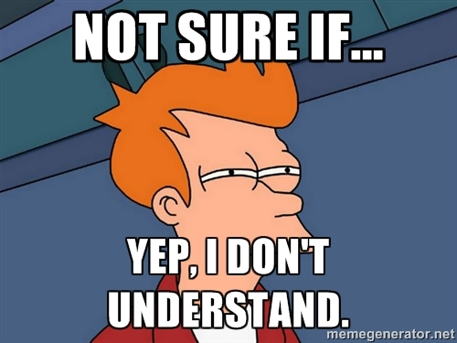
You Probably…

Slide 21
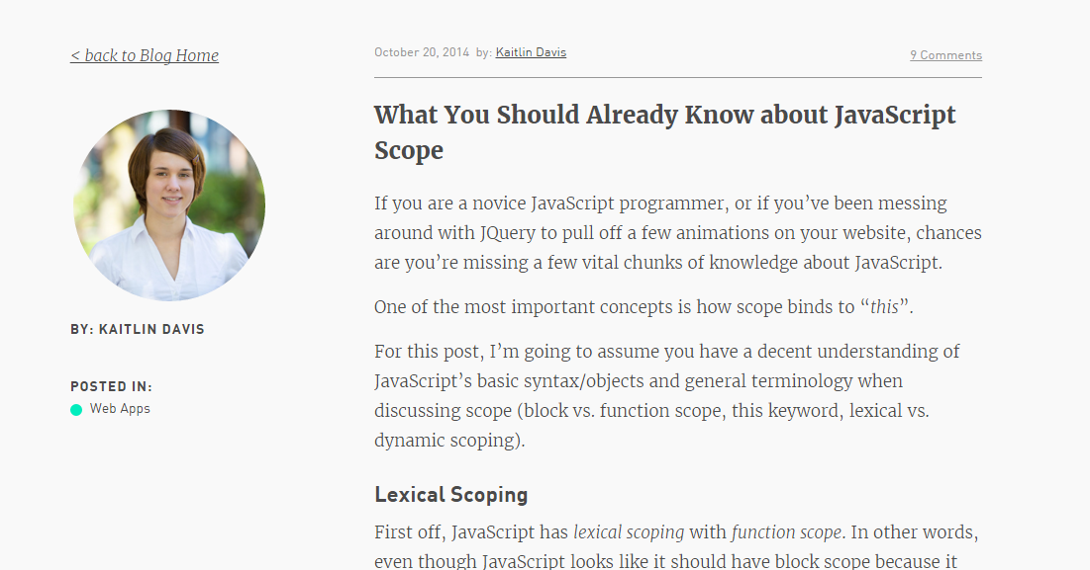
Helpful Article (If you’d like to learn more…)

Slide 22
Questions

