Slide 1
Handlebars

Slide 2
Objectives
To understand semantic templating using Handlebars
To understand the basic syntax for Handlebars-based web applications
To create an Express connection to a front-end application which takes in MySQL data and prints it to the screen using Handlebars
To use HTML/jQuery GET, POST, PUT, and DELETE commands
To create full-stack web applications that will Create, Read, Update, and Delete data from a MySQL database
To use Express.js, MySQL and Handlebars together to create a dynamic application

Slide 3
Demo: Handlebars Lunch
$ atom 04-HandlebarsLunch/server.js
$ node 04-HandlebarsLunch/server.js
http://localhost:3000/weekday
http://localhost:3000/weekend
http://localhost:3000/lunches
Like past activities, we are using Express
Unlike past activities, we are using Handlebars

Slide 4
Handlebars
http://handlebarsjs.com/
Handlebars is what is known as a "Semantic Templating" framework for JavaScript and HTML.
Frameworks like these are used as a replacement for constructing long strings of HTML within your JavaScript code while also providing programmers with a simpler method through which to dynamically create or to fill HTML elements.

Slide 5
Somebody Google ‘semantic’

Slide 6
Semantic templating creates a ‘common language’ between our HTML && JavaScript so we can keep them separate

Slide 7
{{ }}
Handlebars makes it so you can pass back-end variables to your front-end HTML simply by including the name of the variable you are sending from the server inside of two sets of curly-brackets within your front-end code.
Example: {{VALUE}}.

Slide 8
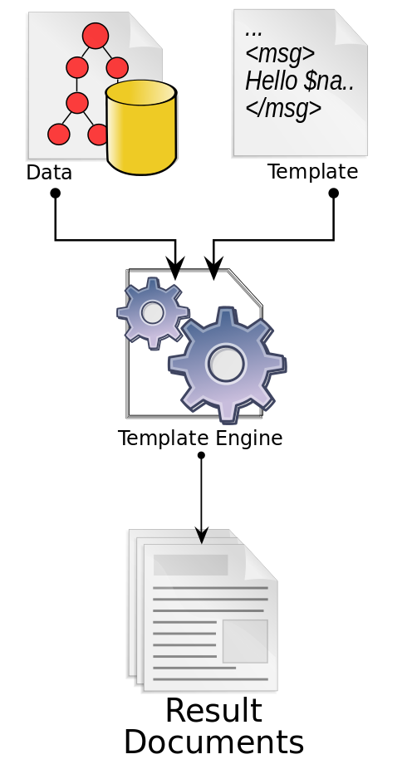
Template Engine || Processor || Parser
Software designed to combine templates with a data model to produce result documents
encourages organization of source code into operationally-distinct layers (see e.g., MVC)
enhances productivity by reducing unnecessary reproduction of effort
enhances teamwork by allowing separation of work based on skill-set (e.g., artistic vs. technical)
https://en.wikipedia.org/wiki/Template_processor

Slide 9
Review: Handlebars Lunch
Handlebars expects to find ‘views’ and ‘layouts’ directories in specific locations.
Take a look at the folder structure in 04-HandlebarsLunch
A views directory at root level
A layouts directory within that
Note in server.js we declare: defaultLayout: "main"

Slide 10
app.engine("handlebars", exphbs({ defaultLayout: "main" }));
Notes:
https://stackoverflow.com/questions/22954561/app-set-and-app-engine-in-express

Slide 11
We use the Express method .engine() to say that for any files in our template engine ending with ‘handlebars’ call exphbs() and use “main” as the defaultLayout

Slide 12
RTFM https://expressjs.com/en/4x/api.html#app.engine

Slide 13
app.set("view engine", "handlebars");

Slide 14
We set the ‘view engine’ of our Express app to ‘handlebars’

Slide 15
RTFM https://expressjs.com/en/guide/using-template-engines.html

Slide 16
app.get("/weekday", function(req, res) {
res.render("index", lunches[0]);
});

Slide 17
RTFM http://expressjs.com/en/api.html#app.render

Slide 18
.send() vs. .render()
one sends data
the other renders HTML

Slide 19
{{{ body }}}

Slide 20
We use triple curly-brackets to tell our program to read and render HTML elements

Slide 21
Double curly brackets are expressions and used to pass values

Slide 22
<h1>{{lunch}}</h1>

Slide 23
index.handlebars is taking in the variable {{lunch}} and is placing it within <h1> tags and then inserting itself into main.handlebars in {{{body}}}

Slide 24
Activity: Handlebars Lunches
With a partner, explain server.js, main.handlebars & index.handlebars
Research {{#each}} and be prepared to explain all-lunches.handlebars

Slide 25
{{#each}}

Slide 26
{{#each}} is a Handlebars helper.
It’s essentially a for-loop which iterates through an array and appends the values to your HTML

Slide 27
Activity: Ben & Jerry’s App (15 min)

Slide 28
Review: Ben & Jerry’s App

Slide 29
Demo: Handlebars Animals
$ node server.js
http://localhost:3000/dog
http://localhost:3000/all-pets
http://localhost:3000/all-non-pets

Slide 30
Activity: Handlebars Animals (20 min)
See 07-HandlebarsAnimalsBase for instructions

Slide 31
Review: Handlebars Animals

Slide 32
#parkinglot

Slide 33
What is REST?

Slide 34
What we’re all going to need after this

Slide 35
Representational State Transfer

Slide 36
REST is a Set of Standards for the Web
RESTful applications:
uniform interface (there are only a few basic requests you can make)
stateless (no information is retained by either sender or receiver)
keep the server separate from the client
layered system in that there may be intermediary servers between the client and the database with which they are working
cacheable (the ability to store copies of frequently accessed data in several places along the request-response path)
http://www.restapitutorial.com/lessons/whatisrest.html

Slide 37
What is a state?

Slide 38
In information technology and computer science, a program is described as stateful if it is designed to remember preceding events or user interactions; the remembered information is called the state of the system.

Slide 39
stateless
vs.
stateful

Slide 40
What is a URI?

Slide 41
Uniform Resource Identifier

Slide 42
A string of characters used to identify a resource

Slide 43
RTFM https://en.wikipedia.org/wiki/Uniform_Resource_Identifier

Slide 44
A URL is a URI, but not all URIs are URLs

Slide 45
RTFM https://en.wikipedia.org/wiki/Uniform_Resource_Name

Slide 46
What are the two HTTP requests we currently use?

Slide 47
GET && POST

Slide 48
Activity: PUT && DELETE
With your neighbor, research PUT && DELETE requests and be prepared to report back

Slide 49
Review: DELETE
DELETE requests are used to delete a row from a database

Slide 50
Review: PUT vs POST
PUT requests are used to update a row within a database
PUT requests are used when the client knows or specifies the URI
POST requests are used to create new data in a database
POST requests are used when the client is allowing the server to create a URI

Slide 51
idempotence

Slide 52
x = 1 * 1;

Slide 53
x += 1;

Slide 54
PUT is idempotent, so if you PUT an object twice, it has no effect.

Slide 55
RTFM https://en.wikipedia.org/wiki/Idempotence

Slide 56
SFW?

Slide 57
RESTful APIs
HTTP GET should be used for all retrieval. It should never be used to create, update, or do things.
HTTP POST should be used for creating. It shouldn’t be used to update or get a resource. If a URI had never existed before now and you’re going to create it and make it hold some data, use POST.
HTTP PUT should be used for updating — meaning replacing a collection with different data. The URI should have existed before.
HTTP DELETE should be used for deleting.

Slide 58
Lunch

Slide 59
Demo: Using HTTP Requests
$ cd 08-TaskSaver
$ node server.js
Look!
Lines 1-33 are boilerplate
We are collecting data from a MySQL database in our routes
We use POST in the index.handlebars form
In server.js, our .post route takes the HTML form POST and inserts it into our db with req.body.task

Slide 60
Activity: Using HTTP Requests (15 min)
See 08-TaskSaver
Set up the database and run the app
With your neighbor, go line-by-line through the code

Slide 61
Activity: Wishes (15 min)
See 09-Wishes for instructions

Slide 62
Review: Wishes

Slide 63
Demo: Putting & Deleting
Note
We require the ‘method-override’ package. Why?
DELETE and PUT were removed from HTML5 forms. Why?
No payload. Human error.
We use ‘method-override’ to build queries that force our form to send DELETE and PUT requests
?_method=DELETE
?_method=PUT

Slide 64
RTFM https://www.npmjs.com/package/method-override

Slide 65
Activity: Day Planner (15 min)
See 10-DayPlanner
Setup the database, npm install, and run the server
With your neighbor, walk through the code line-by-line

Slide 66
Activity: Watch List
See Slack for instructions

Slide 67
Review: Watch List

