Slide 1
NoSQL

Slide 2
Objectives
Introduction to NoSQL and MongoDB
Web scraping with Cheerio
MongoJS

Slide 3
MongoDB

Slide 4
What’s a SQL database?

Slide 5
What’s the structure of a SQL database?

Slide 6
What’s a NoSQL database?

Slide 7
A mechanism for storage and retrieval of data that is modeled in means other than tabular relations

Slide 8
RTFM https://en.wikipedia.org/wiki/NoSQL

Slide 9
MongoDB
MongoDB is a very popular noSQL Database
It uses a document-oriented model as opposed to a table-based relational model (SQL)
MongoDB stores data in BSON Format (effectively compressed JSONs)
MongoDB has tons of drivers and packages for connecting to Node, C++, Java, etc.

Slide 10
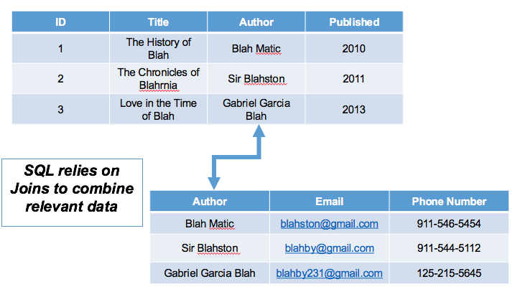
Relational Database

Slide 11
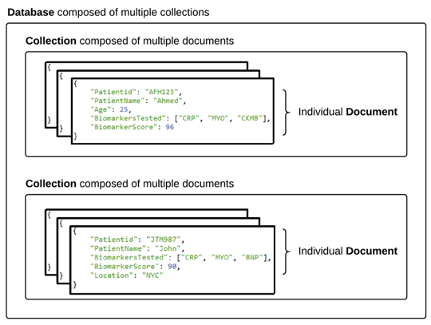
Document Database
RTFM https://www.mongodb.com/document-databases

Slide 12
SQL | NoSQL
Database | Database
Table | Collection
Row | Document
Column | Field

Slide 13
Activity: Research NoSQL && MongoDB
Work with your neighbors to research the following:
What are the advantages of using a noSQL database like MongoDB according to the MongoDB Website?
What are the advantages of using a noSQL database like MongoDB according to the web (places like Quora)?
What are the disadvantages of using a noSQL database like MongoDB according to the web (places like Quora)?

Slide 14
What are the advantages (according to MongoDB)?
Relational databases require that schemas be defined before you can add data. For example, you might want to store data about your customers such as phone numbers, first and last name, address, city and state – a SQL database needs to know what you are storing in advance.
Object-oriented programming that is easy to use and flexible.

Slide 15
OOP?

Slide 16
RTFM https://en.wikipedia.org/wiki/Object-oriented_programming
&& https://developer.mozilla.org/en-US/docs/Learn/JavaScript/Objects/Object-oriented_JS

Slide 17
What are the advantages
(according to the “experts”)?

Slide 18
What are the disadvantages
(according to the “experts”)?

Slide 19
Activity: Install MongoDB (20 min)
See Installing-MongoDB.md

Slide 20
mongod

Slide 21
Demo: MongoDB Basics
See 01-Create-Insert-and-Find
$ mongod
Leave it running; open a new Terminal
$ mongo

Slide 22
use <database name>

Slide 23
We use use to not only switch between databases, but to create a new database

Slide 24
But. Our new database doesn’t exist until we add a collection

Slide 25
db

Slide 26
In the mongo shell, db is the variable that references the current database.

Slide 27
show dbs

Slide 28
admin && local

Slide 29
RTFM https://docs.mongodb.com/manual/reference/local-database/
&& https://docs.mongodb.com/manual/reference/system-collections/

Slide 30
db.<collection-name>.insert()

Slide 31
{
"continent": "Africa",
"country":"Morocco",
"majorcities": [
"Casablanca",
"Fez",
"Marrakech"]
}

Slide 32
db.<collection-name>.find()

Slide 33
db.<collection-name>.pretty()

Slide 34
show collections

Slide 35
Activity: MongoDB Basics (15 min)
See 02-Starting-With-Mongo

Slide 36
Review: MongoDB Basics
Somebody Slack their solution to #class-instruction

Slide 37
$in

Slide 38
The $in operator selects the documents where the value of a field equals any value in the specified array.

Slide 39
db.classroom.find({"hobbies": {$in: ["Coding"]}})

Slide 40
RTFM https://docs.mongodb.com/manual/reference/operator/query/in/

Slide 41
Demo: Update, Remove and Drop
use lessondb

Slide 42
db.iWantToGoToThere.update({"country": "Morocco"}, {$set: {"continent":"Antarctica"}})

Slide 43
db.<collection-name>.update({“field”: “value”}, {$set: {“field”: “value”}})

Slide 44
$set

Slide 45
The $set operator replaces the value of a field with the specified value.

Slide 46
RTFM https://docs.mongodb.com/manual/reference/operator/update/set/

Slide 47
What about updating multiple entries?

Slide 48
{multi:true}

Slide 49
db.iWantToGoToThere.update({"country": "Morocco"}, {$set: {"continent":"Antarctica"}}, {multi:true})

Slide 50
What will happen when we run the following command?

Slide 51
db.places.update({"country": "Morocco"}, {$set: {"capital":"Rabat"}})

Slide 52
The field is created for us.

Slide 53
$push

Slide 54
The $push operator appends a specified value to an array.

Slide 55
db.places.update({"country": "Morocco"}, {$push: {"majorcities":"Agadir"}})

Slide 56
db.places.remove({"country":"Morocco"})

Slide 57
db.<collection-name>.remove()

Slide 58
Removes documents from a collection

Slide 59
db.<collection-name>.drop()

Slide 60
Removes a collection from a database

Slide 61
db.dropDatabase()

Slide 62
Activity: Taking Candy from Basket Weavers(20 min)
See 04-Update-Delete-and-Drop

Slide 63
Review: Taking Candy from Basket Weavers
Somebody Slack their solution to #class-instruction

Slide 64
Activity: Robomongo aka Robo 3T (5 min)
https://robomongo.org/download
If you don’t have one, create a new connection for localhost

Slide 65
Demo: Robo 3T

Slide 66
Activity: Robo 3T (and only Robo 3T!) (10 min)
Drop the classroom collection and create a new one
In a new classroom collection, reenter your name, os, and hobby info array. This should be entered using the right-click -> Insert Object method.
Next, Slack out your name, OS and hobbies into the classroom chat.
As student info comes in, add it into the database.
As students enter their BSON info into slack, insert it into your database.
By the end of the exercise, you should have every student's information in your classroom collection.

Slide 67
How do you learn more about the Mongo shell?

Slide 68
help

Slide 69
How do you exit the Mongo shell?

Slide 70
exit || quit()

Slide 71
Lunch?

Slide 72
What is web scraping?

Slide 73
A programmatic means of taking data from any web site.

Slide 74
What are some reasons we might want to scrape data?

Slide 75
Do you think there might be legal ramifications for scraping certain websites?

Slide 76
Cheerio

Slide 77
https://github.com/cheeriojs/cheerio

Slide 78
Demo: Web Scraping
See 05-Scraping
$ npm install
https://www.reddit.com/r/webdev/
$ node server.js
Watch the magic!

Slide 79
Review: server.js
Note:
the use of the "request" package to take in the HTML body
how Cheerio loads the HTML data and uses the $ as a var.
Why do you think we would use that symbol?
tto give it the same syntax as jQuery for selecting HTML elements
how we push the information into an empty array
how Cheerio's .children method can be used to select child elements within a selected element

Slide 80
Activity: Scrape
Run server2.js and server3.js
Discuss with your neighbor
Be prepared to report out on what you discover
P.S.: The awwwards.com site has since changed.
Can you debug server3.js to scrape image URLs?

Slide 81
Activity: My First Web Scraper (15 min)
See 06-Scrape-Starter
Students: Using this template, the cheerio documentation, and what you've learned in class so far, scrape a website of your choice, save information from the page in a result array, and log it to the console.

Slide 82
Review
Slack your scrapers to #class-instruction
Issues
Not all data is available just from requesting the HTML. Some HTML is generated client-side after the initial page load.
With scraping this way, you can only get the initial HTML sent from the server. Any HTML added with JavaScript won't be accessible via scraping.
You can check to see if the data will be available by disabling JavaScript in the browser and reloading the page (be sure to re-enable afterwards!).

Slide 83
Activity: Meanwhile, Back at MongoDB… (5 min)
See Slack for instructions

Slide 84
Demo: Animals
07-Insert Animals

Slide 85
Demo: Sorting
use zoo
Sort by id:
db.animals.find().sort({_id:1})
db.animals.find().sort({_id:-1})
Sort by integer
db.animals.find().sort({numlegs:1})
db.animals.find().sort({numlegs:-1})
Sort by string:
db.animals.find().sort({class:1})
db.animals.find().sort({class:-1})

Slide 86
Ascending: .sort({[field]:1})
Descending: .sort({[field]:-1})

Slide 87
MongoJS

Slide 88
https://www.npmjs.com/package/mongojs

Slide 89
Activity: RTFM
How would you use the following Mongo methods with MongoJS?
find
insert
remove
sort

Slide 90
Demo: MongoDB and Sorting
$ node 09-MongoDB-and-Sorting/Solved/server.js
http://localhost:3000/
http://localhost:3000/all
http://localhost:3000/name
http://localhost:3000/weight

Slide 91
Activity: MongoDB & Sorting (20 min)
See 09-MongoDB-and-Sorting
TODO: Make four routes that display results from your zoo collection 0: Root: Displays a simple "Hello World" message (no mongo required). 1: All: Send JSON response with all animals 2: Name: Send JSON response sorted by name in ascending order 3: Weight: Send JSON response sorted by weight in descending order

Slide 92
Review: MongoDB & Sorting

Slide 93
What’s missing from the full-stack?

Slide 94
Demo: MongoJS + The Front-End
$ node 10-MongoJS-and-the-Front-End/server.js
http://localhost:3000/
Note how it pulls in the information we typed in earlier for our zoo collection, and places it in an HTML table.

Slide 95
Activity: MongoJS + The Front-End (25 min)
See 10-MongoDB-and-the-Front-End
Make an AJAX function for loading the table in index.html with the data from your animals collection in MongoDB. Each row should have info for one animal.
Make two AJAX functions that fire when users click the two buttons on index.html.
When the user clicks the Weight button, the table should display the animal data sorted by weight.
When the user clicks the Name button, the table should display the animal data sorted by name.

Slide 96
Activity: Scrape to a Database (40 min)
See 11-Scraping-into-a-db
Using the tools and techniques you learned so far, you will scrape a website of your choice, then place the data in a MongoDB database. Be sure to make the database and collection before running this exercise. Consult the assignment files from earlier in the class if you need a refresher on Cheerio.

Slide 97
Review: Scrape to a Database
Each route starts with the usual Express method (app.get, app.post, etc.).
The route that retrieves the data is simply a MongoJS call wrapped in a get.
The scrape route consists of a cheerio call to scrape the site enclosing a MongoJS method that saves the site data to the server.

Slide 98
Further Reading
https://en.wikipedia.org/wiki/Robots_exclusion_standard

