Slide 1


Solving Large MultiZenoTravel
Benchmarks with
Divide-and-Evolve
Alexandre Quemy, Marc Schoenauer, Vincent Vidal, Johann Dréo, Pierre Savéant
INRIA Saclay
ONERA, Toulouse
Thalès R&D, Palaiseau
LION, Lille, Jan. 15. 2015
Notes:
Tao team

Slide 2
Agenda
AI Planning
Multi-objective Planning Benchmarks
Divide-and-Evolve (DaE)
Experiments
Conclusions

Slide 3
Agenda
AI Planning
Multi-objective Planning Benchmarks
Divide-and-Evolve (DaE)
Experiments
Conclusions

Slide 4
An AI Planning problem
Domain:
  State space S (set of predicates)
  Set of actions A
  with preconditions and effects
Instance:
  List of objects (instanciate predicates)
  Initial state I
  Goal state G
Find an optimal sequence of actions
mapping I to G

Slide 5
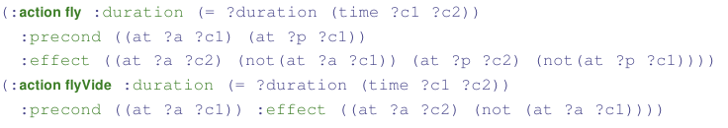
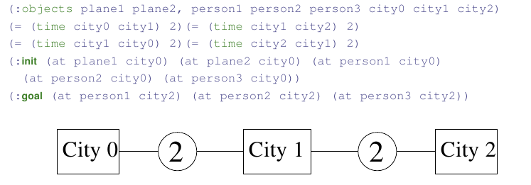
Teaser: MiniZeno (best makespan 8)
Domain: unique predicate at
Instance: 3 cities, 2 planes, 3 passengers

Slide 6
AI Planning
Yearly ICAPS conference since 1990
Biennal IPC (International Planning Competition)
  Since 1998 (7th in 20...11)
  Drive for PDDL design/improvements
Lots of exact or satisficing single-objective planners
Either cost-based (purely sequential)
or temporal (actions can be run in parallel)

Slide 7
Multi-objective AI Planning
PDDL 3.0 (2006) allows for several objectives
A multi-objective track in IPC 5 and IPC 6
… not in IPC 7
→ aggregation of objectives
+ recent approach [Sroka & Long, STAIRS 2012]
using LPG [Gerevini et al., AI 08] not Pareto-based
Lack of Benchmarks!

Slide 8
Agenda
AI Planning
Multi-objective Planning Benchmarks
Divide-and-Evolve (DaE)
Experiments
Conclusions

Slide 9
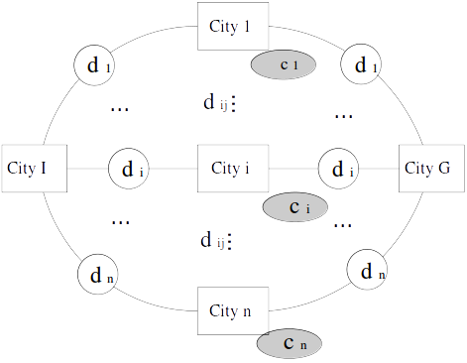
Multi-objective Zeno Benchmark
p planes to bring t persons
from City I to City G
Flight durations d
Costs c
Minimize makespan
and total cost
Two problems
  Cost: additive
  (tax at every landing)
  Risk: max
  (only highest value matters)

Slide 10
Multi-objective Zeno Benchmark
p planes to bring t persons
from City I to City G
Flight durations d
Costs c
Minimize makespan
and total cost
Two problems
  Cost: additive
  (tax at every landing)
  Risk: max
  (only highest value matters)

Slide 11
ZenoSolver
An exact solver finds the true Pareto front
  Proved if
  Hopefully true if
Pareto Optimal Plans use a single central city for each CI → CG connection westward and eastward
Possibly Pareto-optimal Plans uniquely defined by 2t-p central cities
Lower and upper bounds → PPP pruning

Slide 12
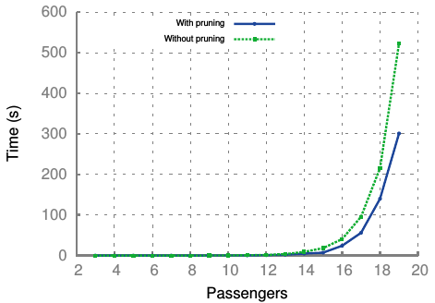
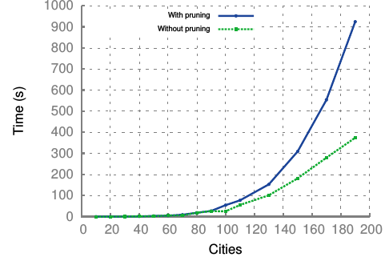
ZenoSolver complexity
3 cities 2 planes 3 passengers
Tractable up to 20 cities, 200 passengers
Previous work : 3 cities, 9 passengers

Slide 13


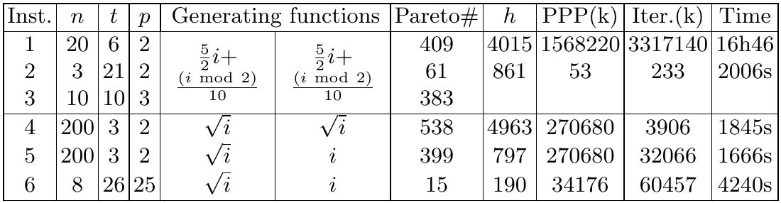
Large MultiZeno Instances
f and g increasing functions

Slide 14
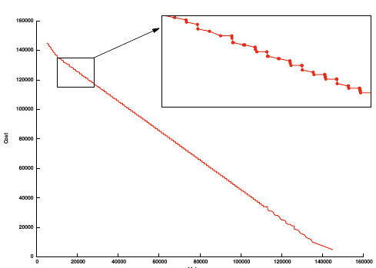
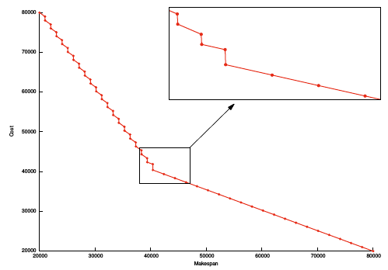
Sample Pareto Fronts
20 cities, 6 passengers, 2 planes
3 cities, 21 passengers, 2 planes

Slide 15
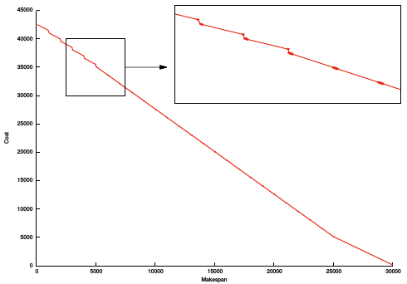
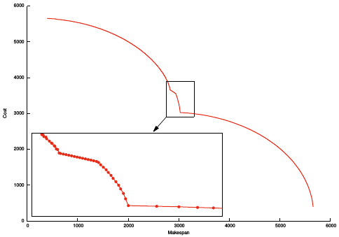
Sample Pareto Fronts (2)
10 cities, 10 passengers, 3 planes
200 cities, 3 passengers, 2 planes

Slide 16
Agenda
AI Planning
Multi-objective Planning Benchmarks
Divide-and-Evolve (DaE)
Experiments
Conclusions

Slide 17
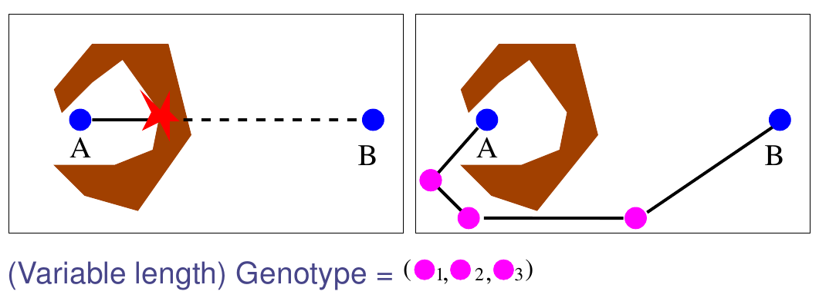
DaE: the Paradigm
Slicing the original problem into a series of (hopefully simpler) sub-problems
Using a 'dumb' solver on each sub-problem

Slide 18
DaE-YAHSP
Problem
<S, A, I, G> = PD(I,G)
Representation
Ordered list of partial states S₀= I, S₁, ..., S_{n}, S_{n+1}= G
Evaluation
Solve consecutive sub-problems PD(S_{k},S_{k+1})/ kϵ[0,n]
with embedded single-objective planner YAHSP [Vidal, ICAPS 04]
Fitness
All problems solved: concatenate partial plans
Fails solving PD(S_{l}, S_{l+1}): Penalization
Crossover: One-point crossover
Mutations : AddGoal, delGoal, addAtom, delAtom

Slide 19
Single-objective DAE-YAHSP
An original (intricate) memetization strategy
A very noisy fitness
but
YAHSP is both cost- and temporal planner
DAE-YASHP: state-of-the-art performance in both domains [Bibai et al., ICAPS 2010]
Silver medal, Humies Awards 2010
Ranked 1st, temporal satisficing, IPC 2011

Slide 20
Multi-objective DAE-YAHSP
YAHSP is both cost- and temporal planner
… optimizes one, computes the other
« Only » need to change the EC engine !
[Schoenauer, Saveant, Vidal, EvoCOP'06]
Two possible strategies for YAHSP:
Optimize makespan or cost/risk
  Some planners (e.g. LPG [Gerevini et al., AI'08]) can optimize
  λ mkspan + (1-λ) cost

Slide 21
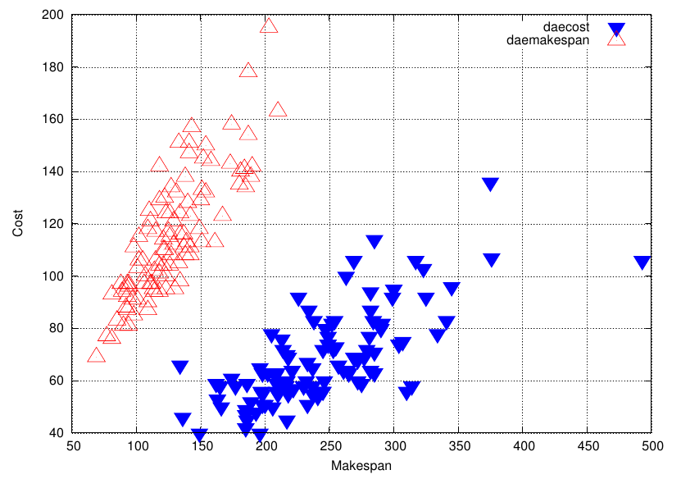
YAHSP strategy
Optimize cost or makespan?
→ randomize, and use weights (individual level)
Weight-makespan=1
Weight-cost=0
Weight-makespan=0
Weight-cost=1
Noisy fitness : objectives of a single individual computed by YAHSP with both pure strategies

Slide 22
Agenda
AI Planning
Multi-objective Planning Benchmarks
Divide-and-Evolve (DaE)
Experiments
Conclusions

Slide 23
Experimental Conditions
Implementation ParadisEO
EC engine IBEA-Hv [EMO 2013]
Aggregation λ = [0:0.1:1]
11 independent runs for each λ too
Stopping criterion
  ParamILS 24h for each λ too
  Optimization 5400s for each λ too

Slide 24
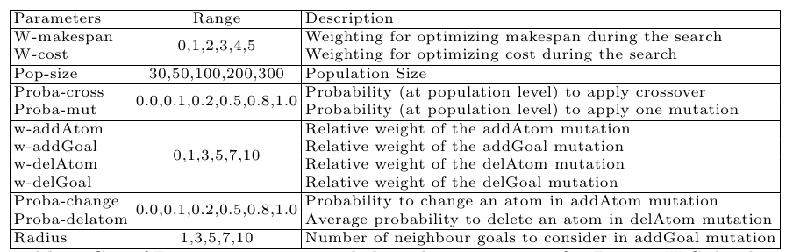
The Parameters
→ 1.5 * 10⁹ Possible configurations

Slide 25
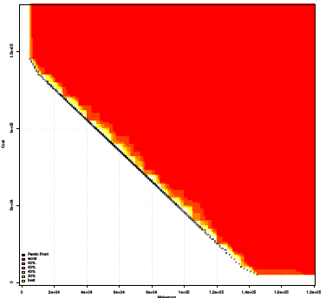
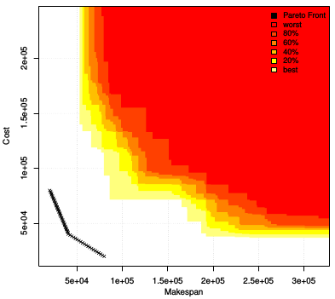
DaE First results
20 cities, 6 passengers, 2 planes
3 cities, 21 passengers, 2 planes

Slide 26
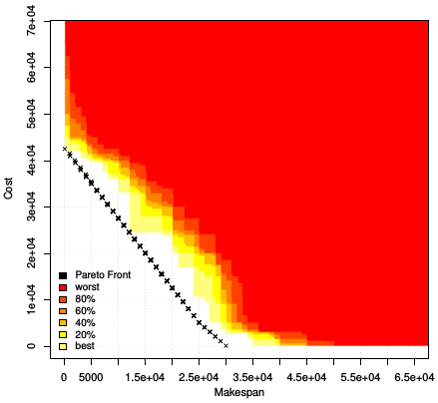
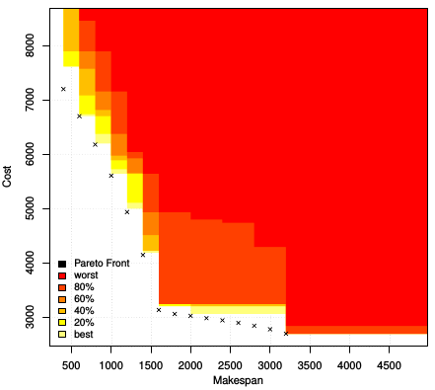
DaE First results
10 cities, 10 passengers, 3 planes
8 cities, 26 passengers, 25 planes

Slide 27
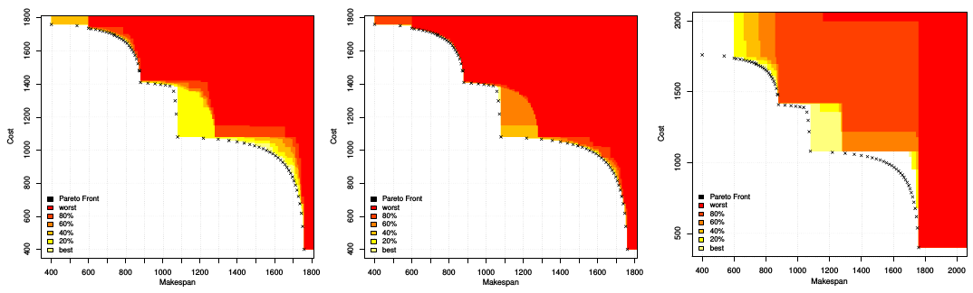
Comparison with aggregation
DAE - 900s DAE - 5400s Aggregation - 5400s
30 cities, 3 passengers, 2 planes

Slide 28
Conclusion
MiniZeno: A simple and tunable MO benchmark suite for AI Planning Zeno domain
ZenoSolver → true Pareto front for MiniZeno
DAE: multi-objective evolutionary planner using single-objective YAHSP planner
Randomized YAHSP strategy
Outperforms aggregation
Question: but does YAHSP need DAE?

Slide 29


