Slide 1



On Integrating and Classifying
Legal Text Documents
The European Court of Human Rights Database
Alexandre Quemy
IBM Data and AI Poznan University of Technology
Robert Wrembel Poznan University of Technology

Slide 2
Agenda
Introduction and Context
European Court of Human Rights Database
Experiments: Binary Classification
Conclusion
Notes:
Left censoring – a data point is below a certain value but it is unknown by how much.
Interval censoring – a data point is somewhere on an interval between two values.
Right censoring – a data point is above a certain value but it is unknown by how much.
Type I censoring occurs if an experiment has a set number of subjects or items and stops the experiment at a predetermined time, at which point any subjects remaining are right-censored.
Type II censoring occurs if an experiment has a set number of subjects or items and stops the experiment when a predetermined number are observed to have failed; the remaining subjects are then right-censored.
Random (or non-informative)

Slide 3
Introduction and Context

Slide 4
Legal Analytics
Predicting justice decision is hard 67.4% and 58% correct decisions in [1] 85.20% and 84.85% by Fantasy Scotus project
Mostly SCOTUS: SCOTUS Database (http://scdb.wustl.edu/)
Lack of resources for the other courts
Industrial attractivity (TAM for LegalTech > 16B USD/year)
[1] Ruger, T.W., Kim, P.T., Martin, A.D., Quinn, K.M.: The supreme court forecasting project: Legal and political science approaches to predicting supreme court decisionmaking. Columbia Law Review 104(4), 1150–1210 (2004)
Notes:
Not a problem since Microsft made it a requirement from 2008. However, it might happen that the EFI capabilities of the VBIOS is not properly loaded at boot in Linux and that you’ll need to dynamically load the VBIOS for your VM.

Slide 5

Legal Analytics
Previous work on ECHR:
79% accuracy But only 3 articles considered, 584 cases in total, data quality problem
75% accuracy Small undersampled training sets, few thousands cases in total
Aletras, N., Tsarapatsanis, D., Preoiuc-Pietro, D., Lampos, V.: Predicting judicial decisions of the European Court of Human Rights: a natural language processing perspective. PeerJ Computer Science 2, e93 (2016)
Medvedeva, M., Vols, M., Wieling, M.: Using machine learning to predict decisions
of the European Court of Human Rights. Artifficial Intelligence and Law (2019)
Both are using only the judgment documents
Notes:
Not a problem since Microsft made it a requirement from 2008. However, it might happen that the EFI capabilities of the VBIOS is not properly loaded at boot in Linux and that you’ll need to dynamically load the VBIOS for your VM.

Slide 6
European Court of Human Rights Database

Slide 7

ECHR-DB in Brief
Exhaustive (~13k cases) and high-quality database about the ECHR
Reusability, Quality, Availability 1. Each version is carefully versioned 2. Creation process and intermediate files are public 3. Metadata on top of (processed) judgements files
Database under Open Database License (ODbL)
Creation process under MIT Licence
Main website: https://echr-opendata.eu/ GitHub: https://github.com/echr-od/ECHR-OD_process
Notes:
Not a problem since Microsft made it a requirement from 2008. However, it might happen that the EFI capabilities of the VBIOS is not properly loaded at boot in Linux and that you’ll need to dynamically load the VBIOS for your VM.

Slide 8
ECHR-DB in Brief
What data is available? Structured, Unstructured, in JSON, CSV or SQL Raw and intermediate
How to retrieve the data? Direct download REST + GraphQL API Web Explorer
How to use? Pandas, Numpy compatible
Main website: https://echr-opendata.eu/ GitHub: https://github.com/echr-od/ECHR-OD_process
Notes:
Not a problem since Microsft made it a requirement from 2008. However, it might happen that the EFI capabilities of the VBIOS is not properly loaded at boot in Linux and that you’ll need to dynamically load the VBIOS for your VM.

Slide 9
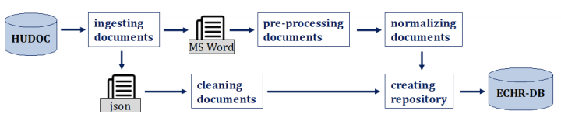
ECHR-DB creation process
Notes:
Not a problem since Microsft made it a requirement from 2008. However, it might happen that the EFI capabilities of the VBIOS is not properly loaded at boot in Linux and that you’ll need to dynamically load the VBIOS for your VM.

Slide 10
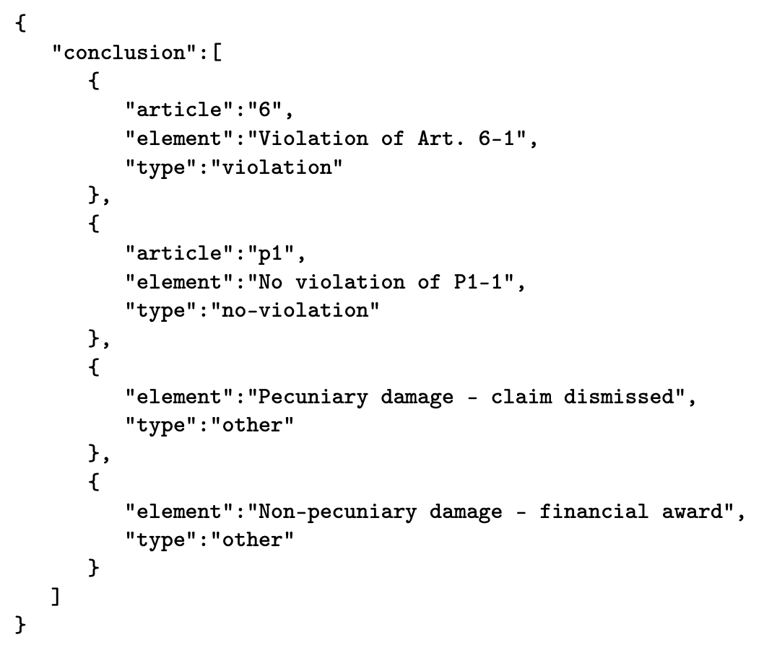
ECHR-DB creation process
Cleaning MetaData = Fine grain parsing + some attribute stats
Violation of Art. 6-1; No violation of P1-1; Pecuniary damage - claim dismissed; Non-pecuniary damage - financial award
Notes:
Not a problem since Microsft made it a requirement from 2008. However, it might happen that the EFI capabilities of the VBIOS is not properly loaded at boot in Linux and that you’ll need to dynamically load the VBIOS for your VM.

Slide 11
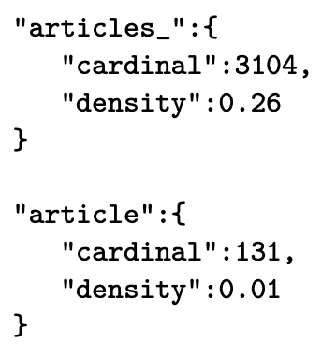
ECHR-DB creation process
Cleaning MetaData = Fine grain parsing + some attribute stats
Notes:
Not a problem since Microsft made it a requirement from 2008. However, it might happen that the EFI capabilities of the VBIOS is not properly loaded at boot in Linux and that you’ll need to dynamically load the VBIOS for your VM.

Slide 12
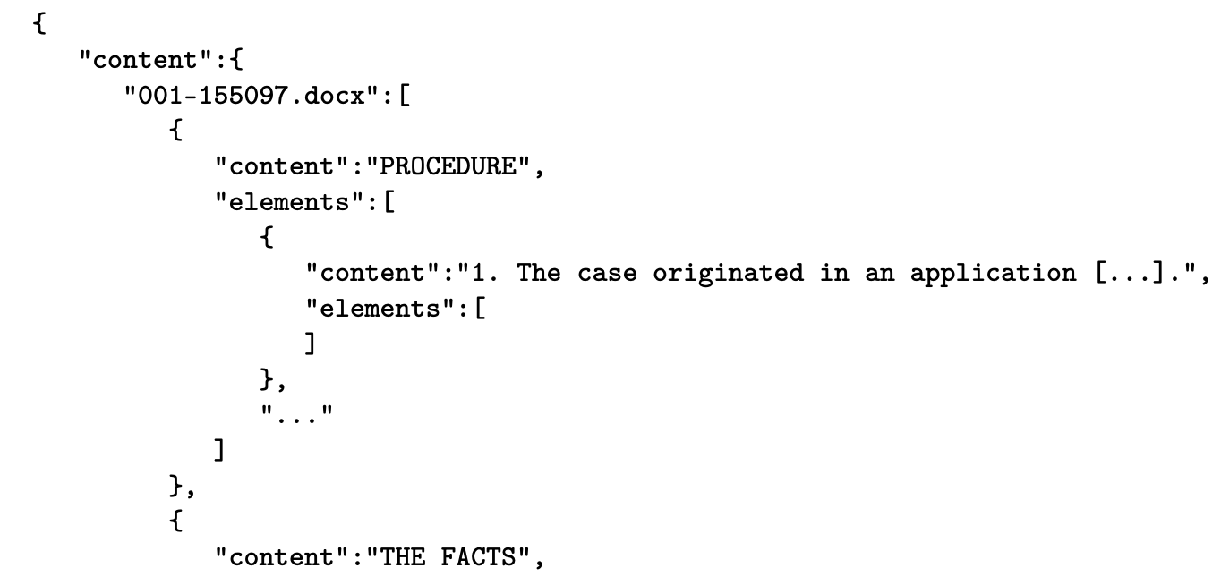
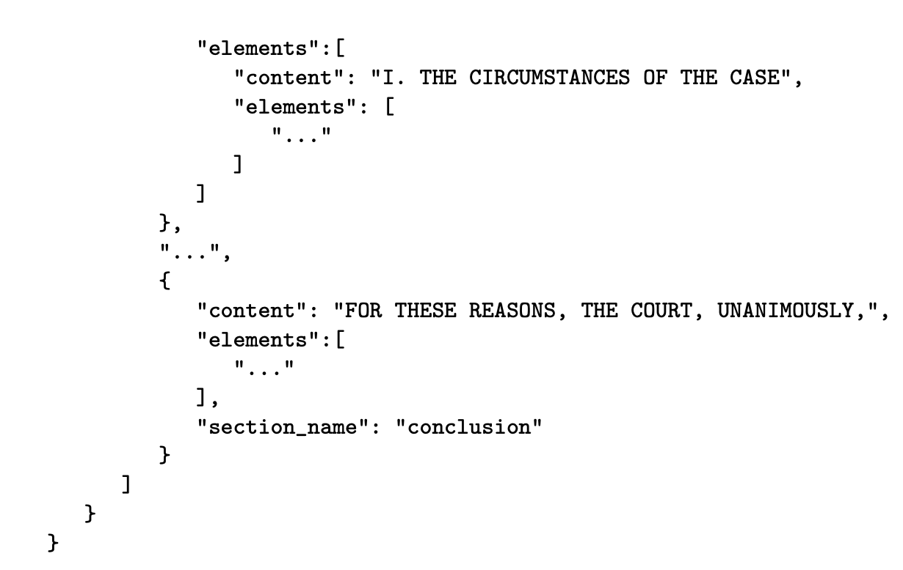
ECHR-DB creation process
Preprocessing documents = more fine grain parsing
Notes:
Not a problem since Microsft made it a requirement from 2008. However, it might happen that the EFI capabilities of the VBIOS is not properly loaded at boot in Linux and that you’ll need to dynamically load the VBIOS for your VM.

Slide 13
ECHR-DB creation process
Normalizing Documents
Part-of-Speech Tagging
Tokenization
Stopwords removal
N-gram generation from 1 to 4
Notes:
Not a problem since Microsft made it a requirement from 2008. However, it might happen that the EFI capabilities of the VBIOS is not properly loaded at boot in Linux and that you’ll need to dynamically load the VBIOS for your VM.

Slide 14
Experiments:
binary classification

Slide 15
Experiments: binary classification
The problem: given a case and an article, is the article violated or not?
Interests are twofold:
Predictibility offered by the data
Baseline for future work
Additional interests:
Are all articles equally predictable?
Are all types of data equal w.r.t. predictibility?
https://github.com/echr-od/ECHR-OD_predictions
Notes:
Not a problem since Microsft made it a requirement from 2008. However, it might happen that the EFI capabilities of the VBIOS is not properly loaded at boot in Linux and that you’ll need to dynamically load the VBIOS for your VM.

Slide 16
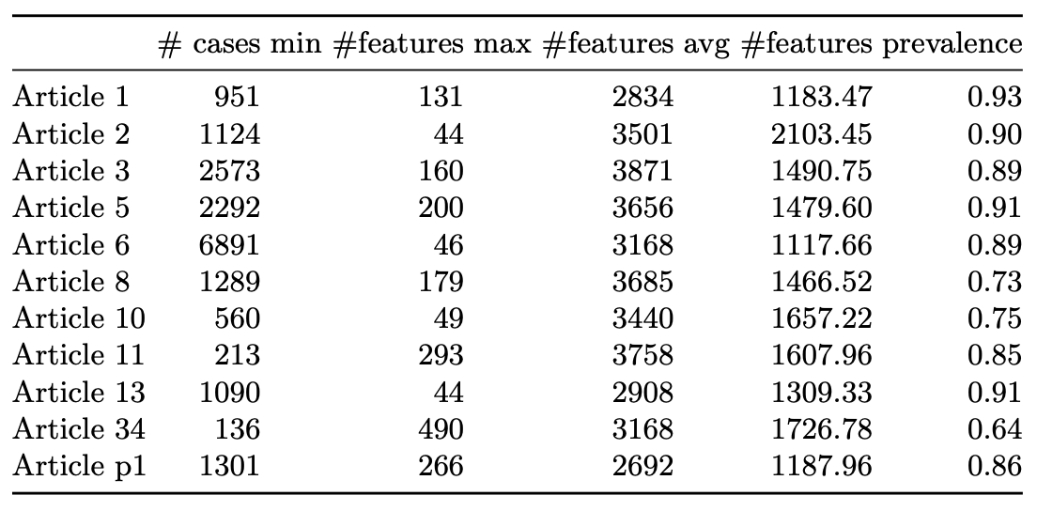
Experiments: binary classification
11 datasets (one per article)
Each dataset has 3 flavors (descriptive, BoW, desc+BoW)
Processing steps:
Articles with >100 cases
BoW over top 5000 tokens for n-grams from 1 to 4
hot-one encoded
Notes:
Not a problem since Microsft made it a requirement from 2008. However, it might happen that the EFI capabilities of the VBIOS is not properly loaded at boot in Linux and that you’ll need to dynamically load the VBIOS for your VM.

Slide 17
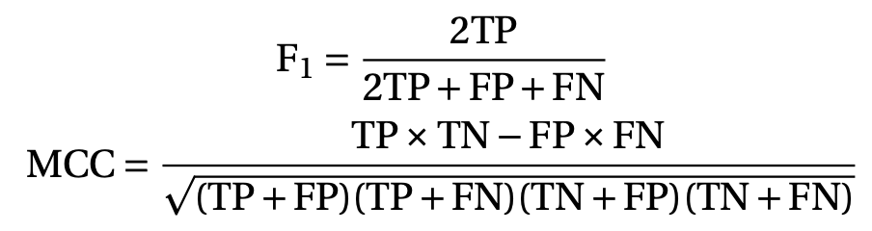
Experiments: binary classification
Protocol:
13 algorithms (scikit-learn)
Accuracy, F1-score and MCC as perf. metrics
10-folds cross-validation for each algorithm, each flavor of each dataset
Notes:
Not a problem since Microsft made it a requirement from 2008. However, it might happen that the EFI capabilities of the VBIOS is not properly loaded at boot in Linux and that you’ll need to dynamically load the VBIOS for your VM.

Slide 18
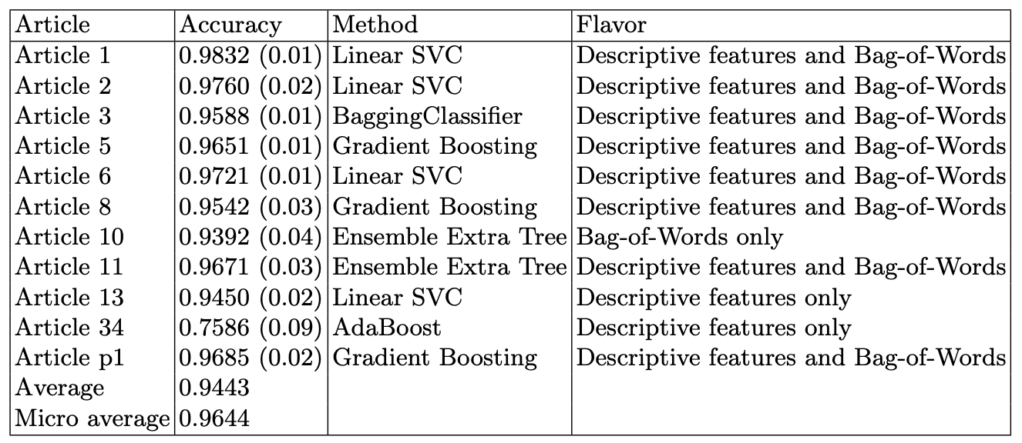
Experiments: binary classification
15pp higher than the previous study! But…
Notes:
Not a problem since Microsft made it a requirement from 2008. However, it might happen that the EFI capabilities of the VBIOS is not properly loaded at boot in Linux and that you’ll need to dynamically load the VBIOS for your VM.

Slide 19
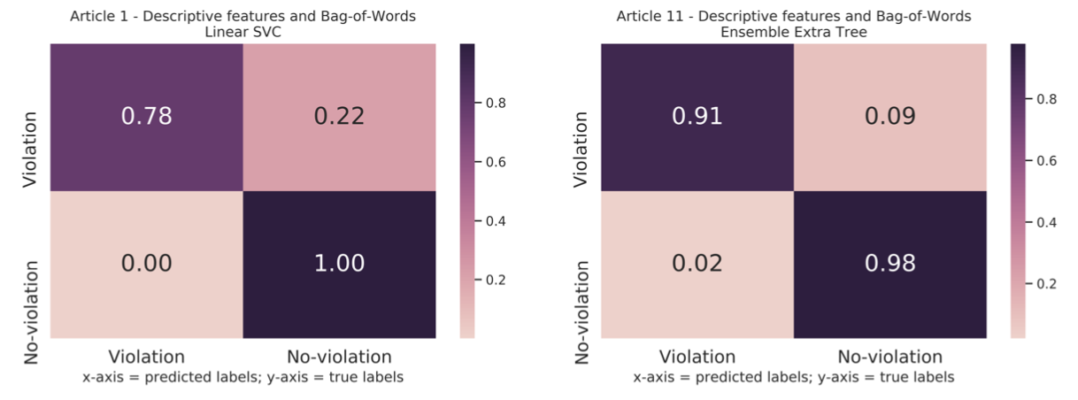
Experiments: binary classification
Fairly balanced despite the fact that the classes are highly imbalanced!
Notes:
Not a problem since Microsft made it a requirement from 2008. However, it might happen that the EFI capabilities of the VBIOS is not properly loaded at boot in Linux and that you’ll need to dynamically load the VBIOS for your VM.

Slide 20
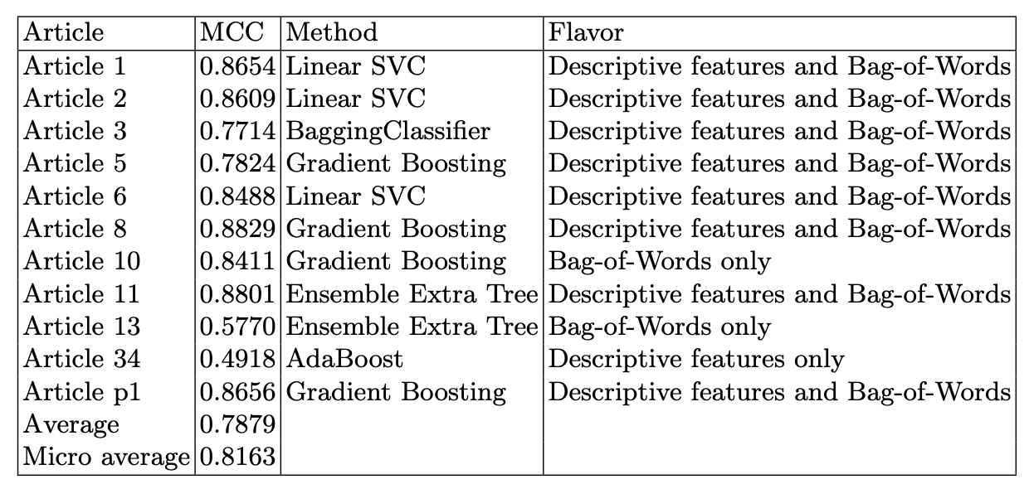
Experiments: binary classification
Wilcoxon test shows adding descriptive to BoW statistically improve the results
Notes:
Not a problem since Microsft made it a requirement from 2008. However, it might happen that the EFI capabilities of the VBIOS is not properly loaded at boot in Linux and that you’ll need to dynamically load the VBIOS for your VM.

Slide 21
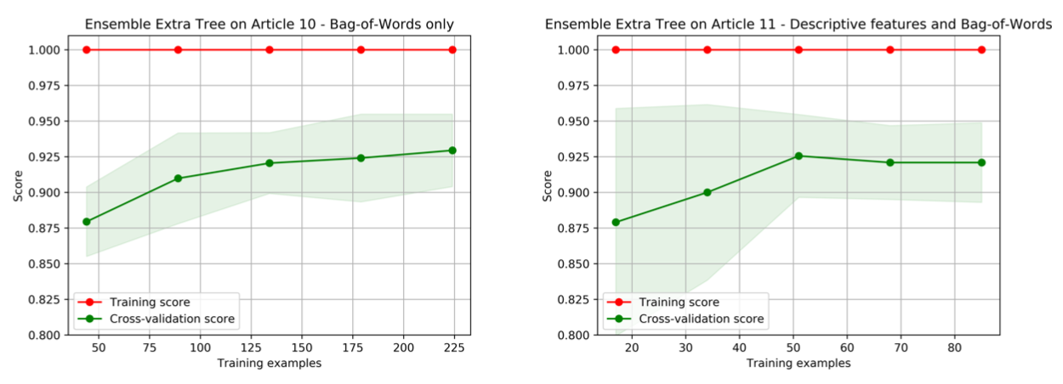
Experiments: binary classification
Underfit!
Notes:
Not a problem since Microsft made it a requirement from 2008. However, it might happen that the EFI capabilities of the VBIOS is not properly loaded at boot in Linux and that you’ll need to dynamically load the VBIOS for your VM.

Slide 22
Conclusion and WIP

Slide 23
Conclusions
Conclusions:
Strong predictibility!
The more, the better… but already exhaustive data
Do not always rebalance your datasets
Notes:
Not a problem since Microsft made it a requirement from 2008. However, it might happen that the EFI capabilities of the VBIOS is not properly loaded at boot in Linux and that you’ll need to dynamically load the VBIOS for your VM.

Slide 24
Work in Progress
Database WIP:
Automated database update (every month)
Additional cases (PDF) and data (judges, external law texts, tags)
GraphQL API
Experiments WIP:
Multiclass and multilabel classification
More advanced embeddings e.g. BERT
Network analysis (judges, cross-ref, etc)
Fine-grain hyperparameter tuning

Slide 25

Thank you
Main website: https://echr-opendata.eu/ GitHub: https://github.com/echr-od/ECHR-OD_process

