Slide 1




Data Pipeline Selection and Optimization
DOLAP 2019
Alexandre Quemy
IBM
Politechnika Poznańska

Slide 2
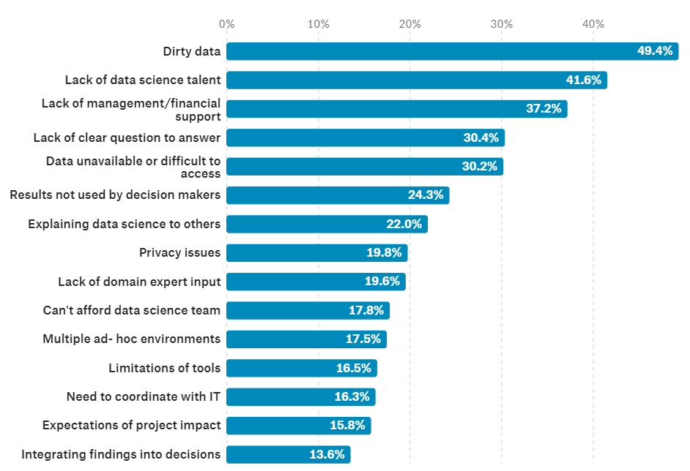
The hard life of data scientists
Question: If we know data are so important, why we treat them less seriously than algorithms?
Notes:
What do you see here?
Effect of regularisation of Big Data, i.e. Prevention of overfitting -> data ARE very important.

Slide 3
Data Pipeline Optimization
Dealing with missing value:
Discarding? Row? Column?
Imputation? What imputation? Mean? Median? Model-based? What model?
Imbalanced datasets:
Downsampling? Oversampling?
Nothing? What bias it implies?
Data too large:
Dimensional reductions: what algorithm? PCA? normalization or not?
Subsampling: what technique? what bias?
Outliers detection and curation:
What threshold? What deviation measure?
Trimming? Truncating? Censoring? Winsorizing?
Encoding for method domain requirements:
Discretization? Grid? What step? Cluster? What method? What hyperparameter?
Categorial encoder? Binary? Hot-One? Helmert? Backward Difference?
NLP:
How many tokens?
Size of m-grams?
Notes:
Left censoring – a data point is below a certain value but it is unknown by how much.
Interval censoring – a data point is somewhere on an interval between two values.
Right censoring – a data point is above a certain value but it is unknown by how much.
Type I censoring occurs if an experiment has a set number of subjects or items and stops the experiment at a predetermined time, at which point any subjects remaining are right-censored.
Type II censoring occurs if an experiment has a set number of subjects or items and stops the experiment when a predetermined number are observed to have failed; the remaining subjects are then right-censored.
Random (or non-informative)

Slide 4
Hyperparameter tuning
Sequential Model-Based Optimization (SMBO):
A configuration space over which to search
A metric to optimize (e.g. model accuracy, ROC AUC, etc.)
The surrogate model of the objective function
A criteria to select the next promising configuration
A history (score, configuration)
Also called SMAC (Sequential Model-based Algorithms Configuration):
Warmstarting of Model-Based Algorithm Configuration, Marius Lindauer, Frank Hutter, Conference on Artificial Intelligence (AAAI-18)
Notes:
Surrogate easier to optimize. Become less wrong with more data -> requires a sufficient amount of data

Slide 5
The usual workflow
Data collection
Data pipeline
Model selection
Model selection
Raw data
model 1
Operation 1
Operation 3
model 1
algorithm
Operation 2
algorithm
model 2
model 2
metric
metric
model 3
model 3
p
metaoptimizer
metaoptimizer
best model
best model

Slide 6
Updated workflow
Data collection
Data pipeline
Model selection
Raw data
O21
O22
metric?
Best pipeline
model 1
O11
algorithm
O12
O22
O23
model 2
metric
model 3
p
p
metaoptimizer
metaoptimizer
best model

Slide 7
Updated workflow
Data collection
Data pipeline
Model selection
Raw data
O21
O22
Best pipeline
model 1
O11
metric
algorithm
O12
O22
O23
model 2
metric
model 3
p
p
metaoptimizer
metaoptimizer
best model
Feedback
Notes:
Why not putting the data pipeline into the algorithm and extending the configuration space?
How do you detect good

Slide 8
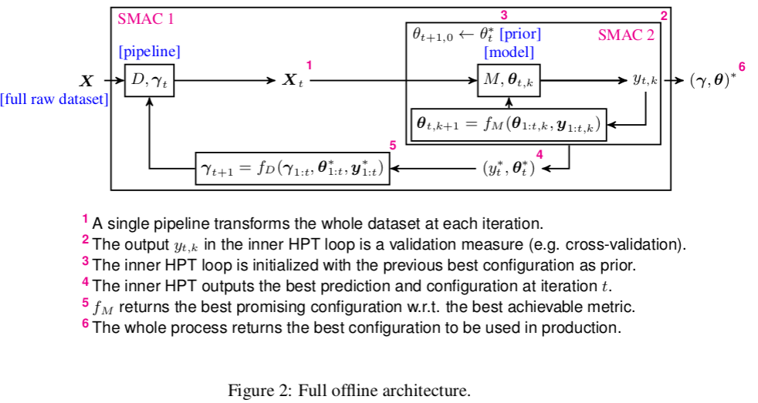
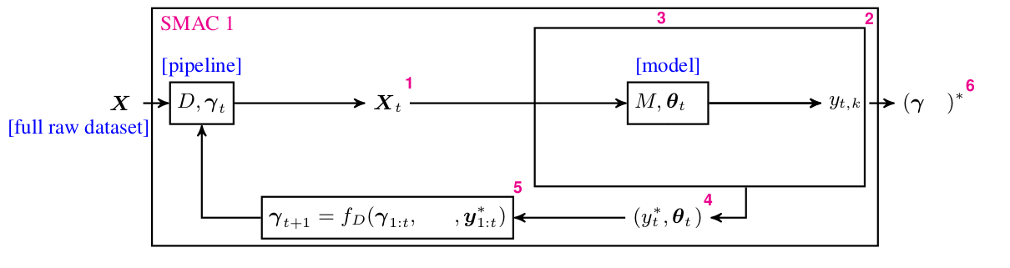
Data Pipeline Optimization
Notes:
What do you see here?
Effect of regularisation of Big Data, i.e. Prevention of overfitting -> data ARE very important.

Slide 9
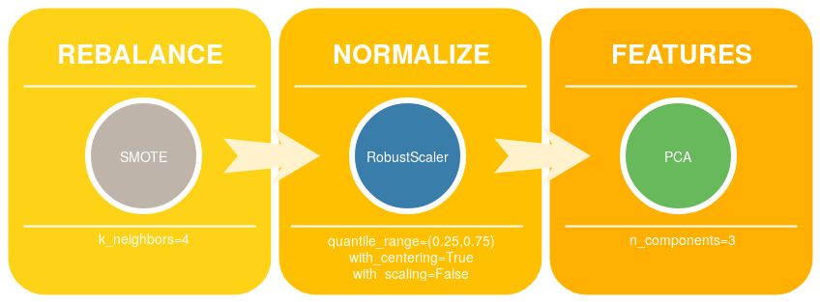
Pipeline prototype
Rebalance: 4 operators
Normalize: 5 operators
Features: 4 operators
Configuration space: 4750 configurations
Baseline: (Id, Id, Id)
Notes:
Explanation in three steps:
Blue area: points that are all forming a sample of the exact same points => clearly zero
For each green points, the blue points are really close, lowering the NMAP
Red points are very far from every other points on the second componant on the first parameters they are exactly matchin in a green sample such that it limitate the NMAP.

Slide 10
Protocole
Datasets: Breast, Iris, Wine.
Methods: SVM, Random Forest, Neural Network, Decision Tree.
Dataset split: 60% for training set, 40% for test set.
Pipeline configuration space size: 4750 configurations.
Metaoptimizer: Tree Parzen Estimator (hyperopt)
Performance metric: Cross-validation accuracy
Budget: 100 configurations (~2% of the space)
No algorithm hyperparameter tuning!
We want to quantify the influence of data pipeline
Exhaustive search to compare between baseline and max score.
Notes:
Explanation in three steps:
Blue area: points that are all forming a sample of the exact same points => clearly zero
For each green points, the blue points are really close, lowering the NMAP
Red points are very far from every other points on the second componant on the first parameters they are exactly matchin in a green sample such that it limitate the NMAP.

Slide 11
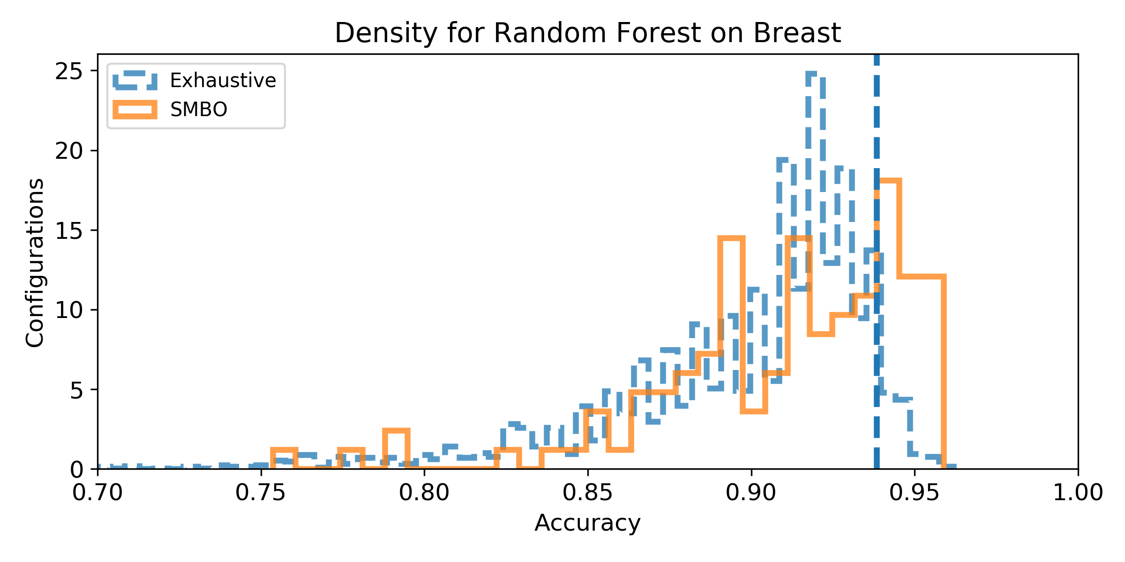
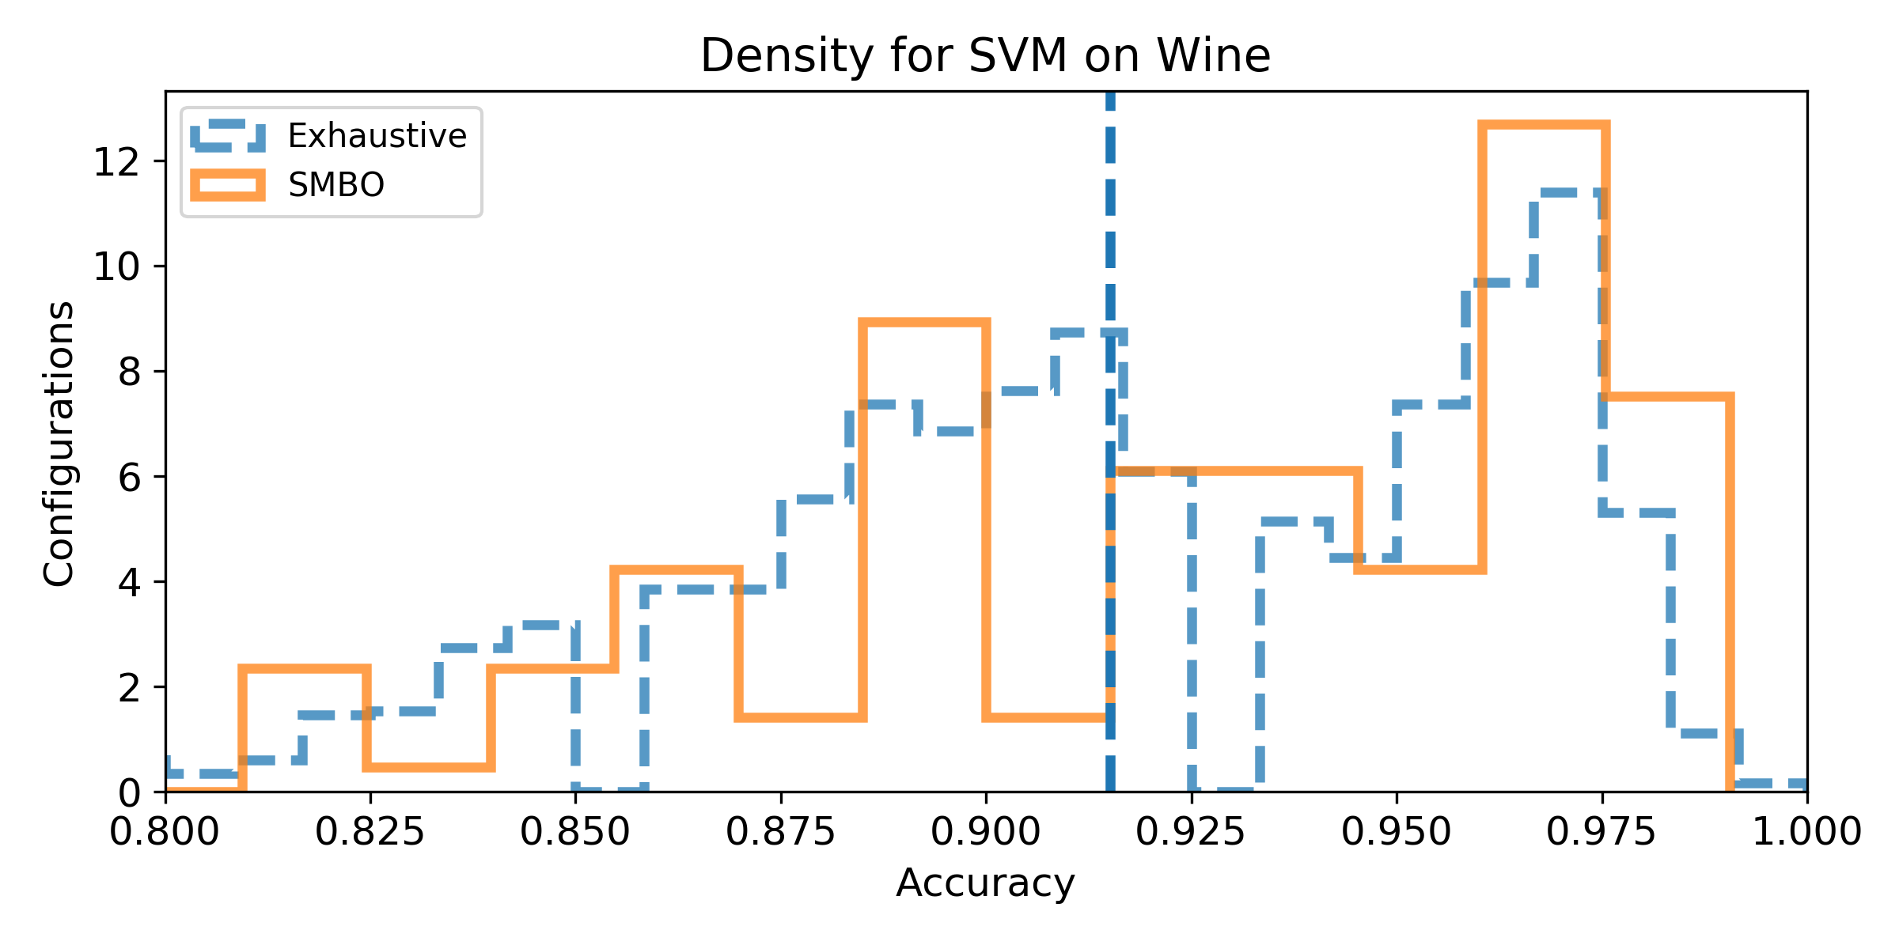
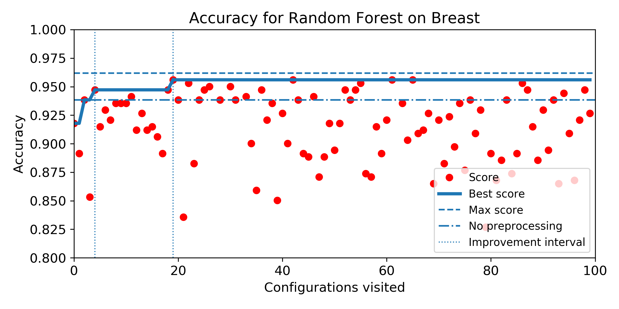
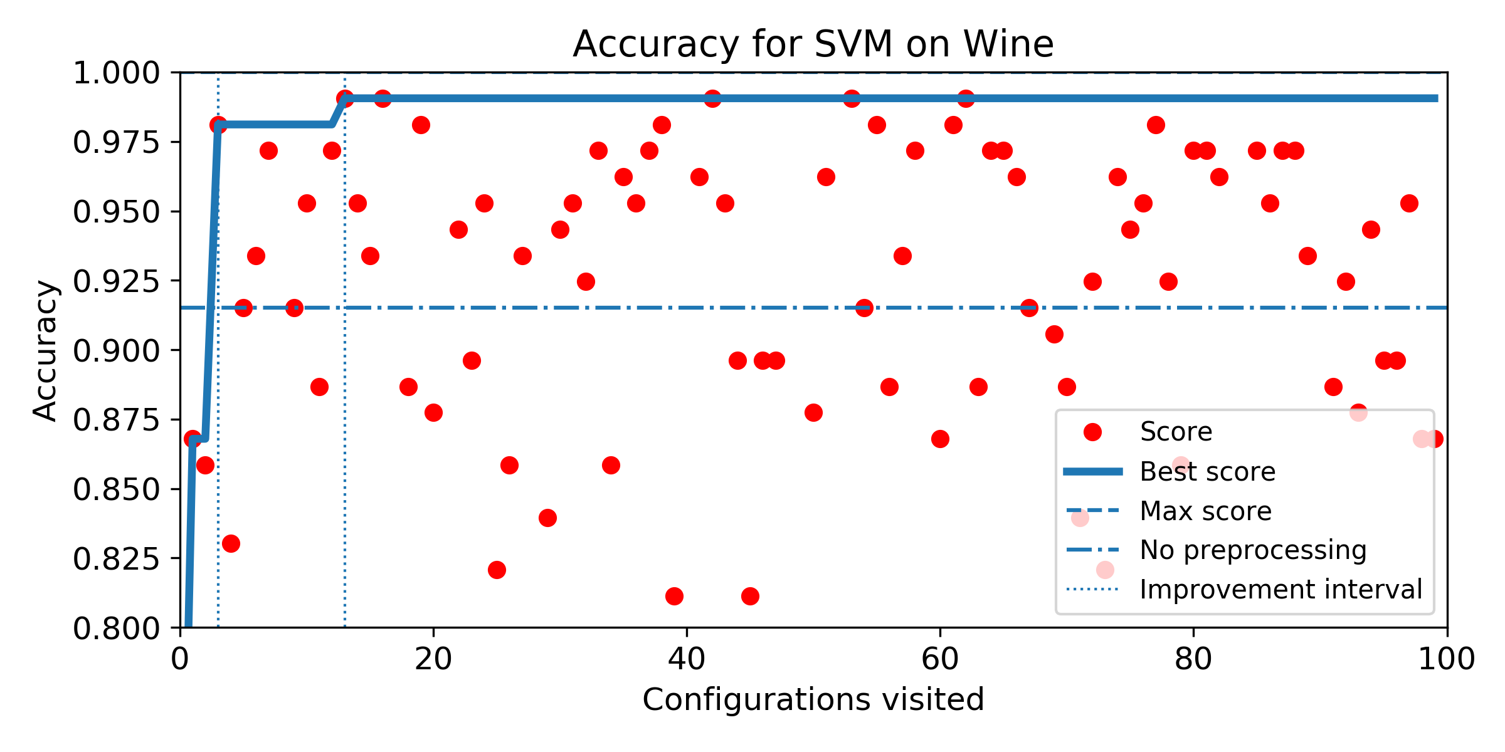
Results
Notes:
Explanation in three steps:
Blue area: points that are all forming a sample of the exact same points => clearly zero
For each green points, the blue points are really close, lowering the NMAP
Red points are very far from every other points on the second componant on the first parameters they are exactly matchin in a green sample such that it limitate the NMAP.

Slide 12
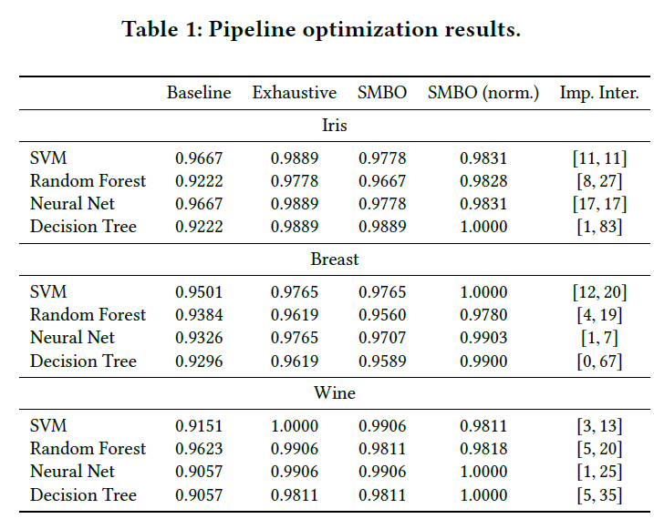
In average, with 20 iterations (0.42% of the search space):
decrease of error by 58% compared to the baseline
98.92% in the normalized score space)
Notes:
In general, the
score in the normalized score space belongs to [0.9780, 1.000]. To
summarize, in average, with 20 iterations (0.42% of the search
space) SMBO is able to decrease the error by 58.16% compared to
the baseline score and found configurations that score 98.92% in
the normalized score space.

Slide 13
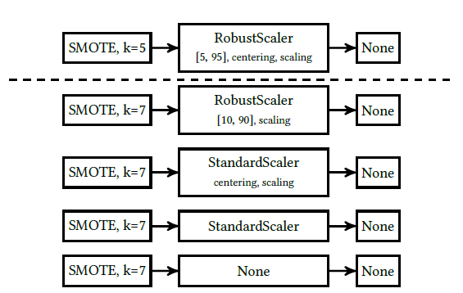
How close to the best pipeline, the good pipelines are?
Notes:
Random Forest on Breast.

Slide 14

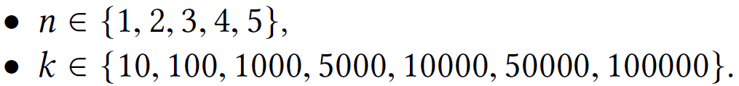
Data Pipeline Optimization
Raw data:
1000 judgements from HUDOC (prev. 0.5)
removing the conclusion section
Pipeline:
Tokenization
Stopword removal
P-o-S tagging
Lemmatization
N-gram generation
BoW projection
Configuration space:
Algorithms: Decision Tree, Neural Network, Random Forest and Linear SVM
Notes:
We perform two expriments:
Exhaustive grid search because it is small enough
SMBO techniques using hyperopt in Python

Slide 15
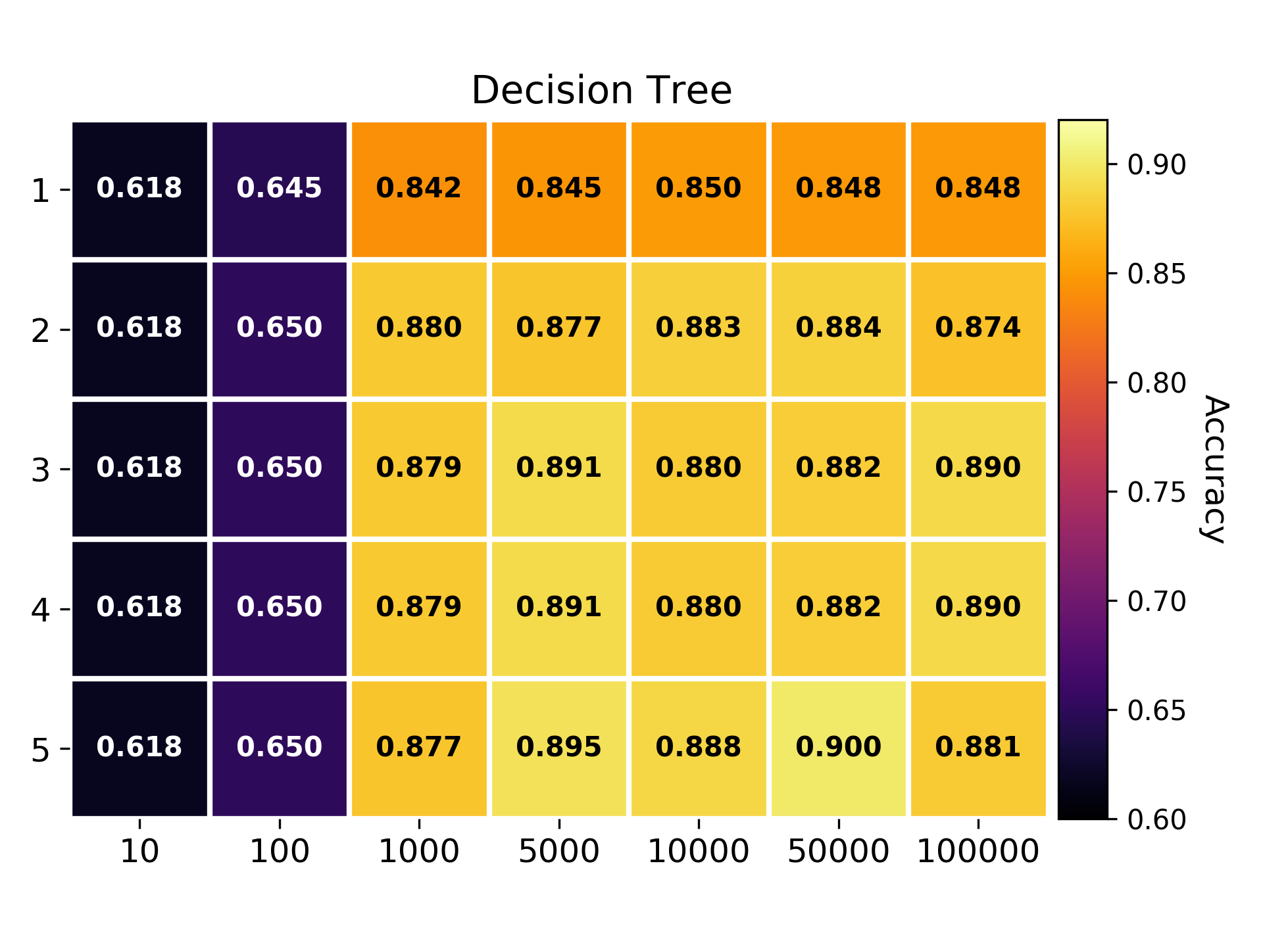
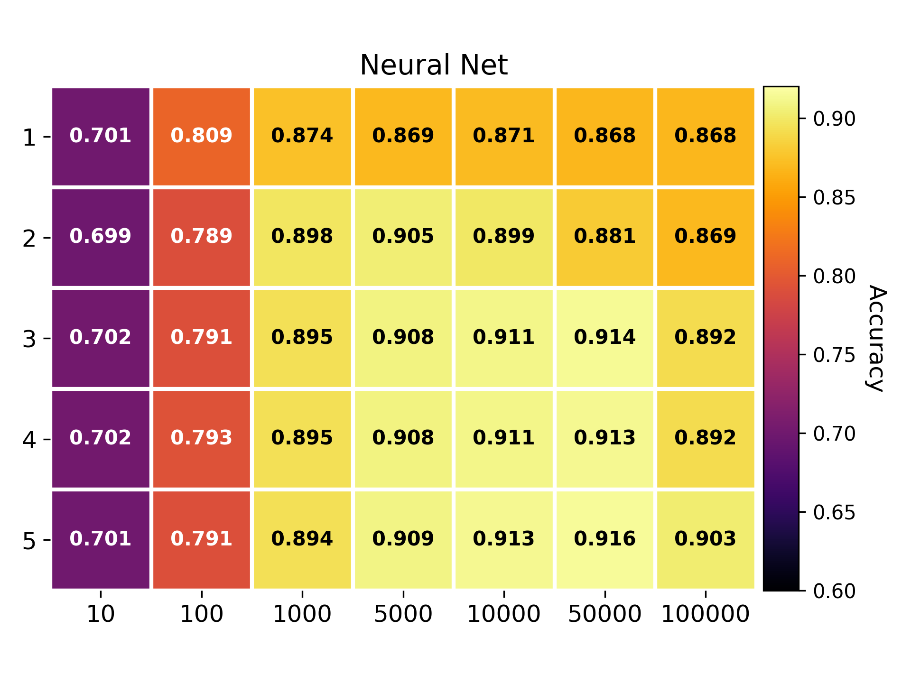
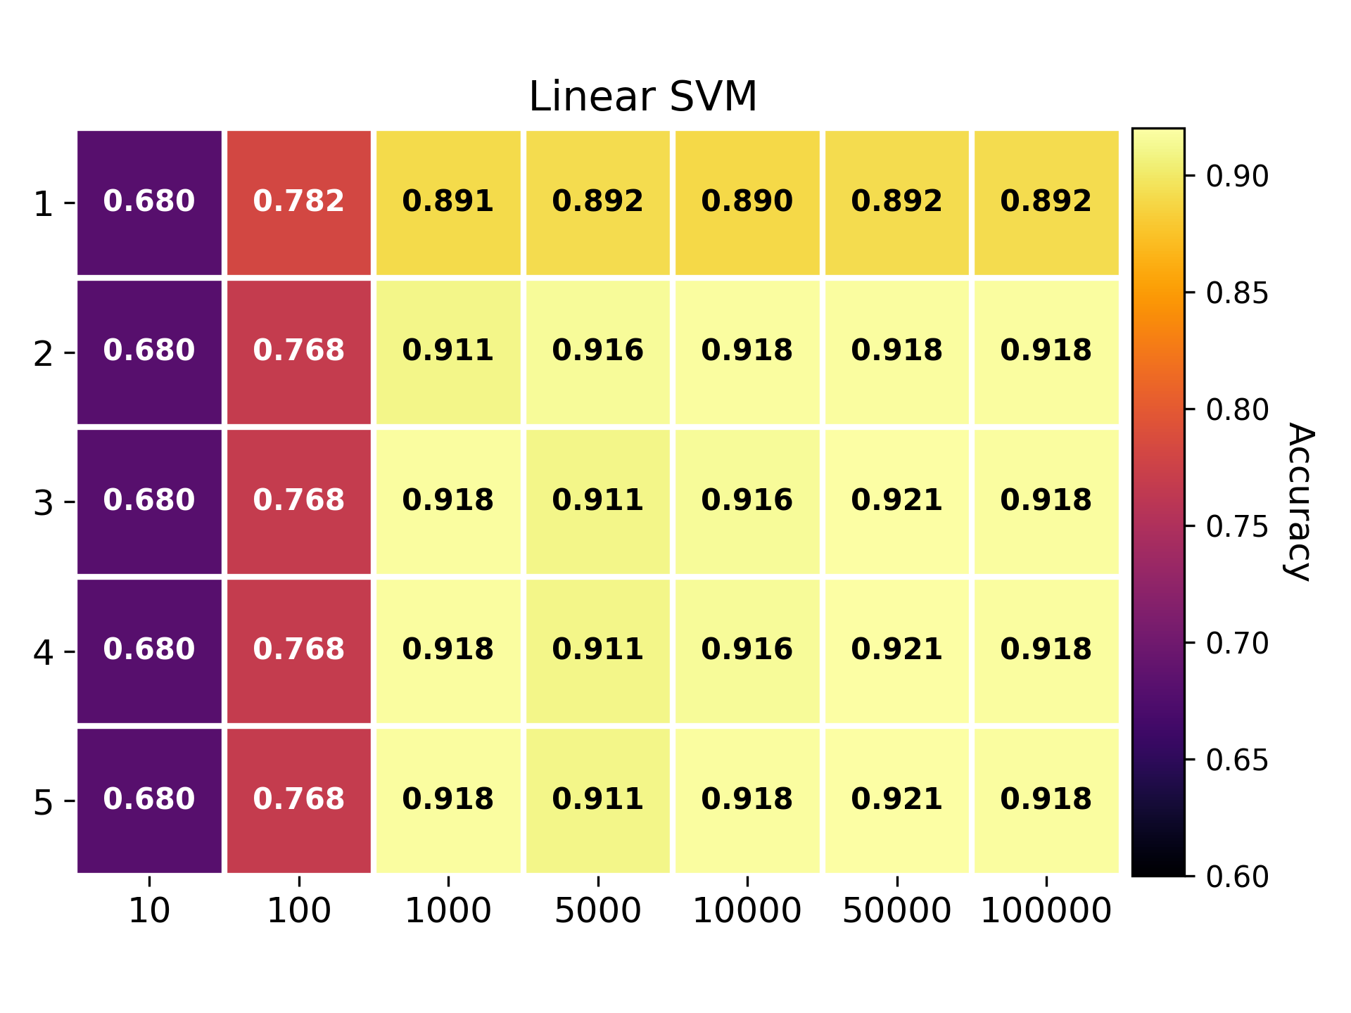
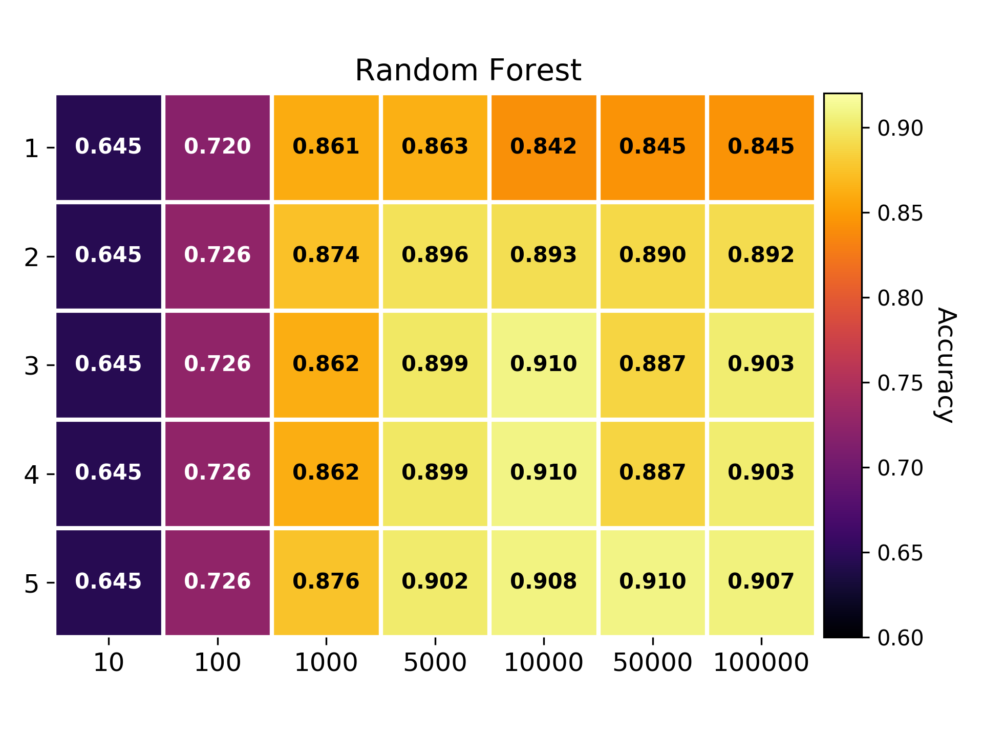
Notes:
Improvde in both directions. Especially if you isolate the plateau
K=10 = test/reference to see how it is expected to be bad

Slide 17
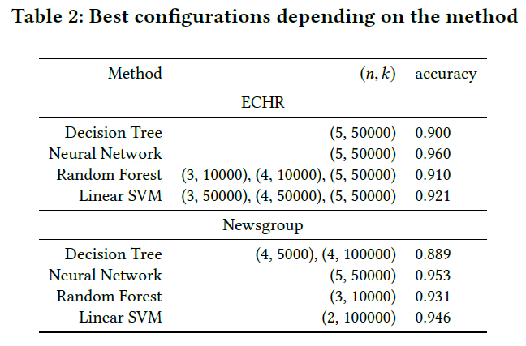
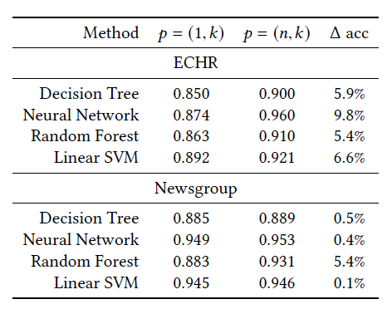
Data Pipeline Optimization

Slide 18
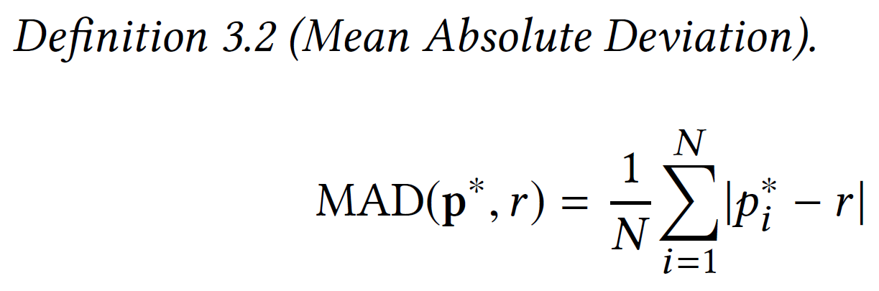
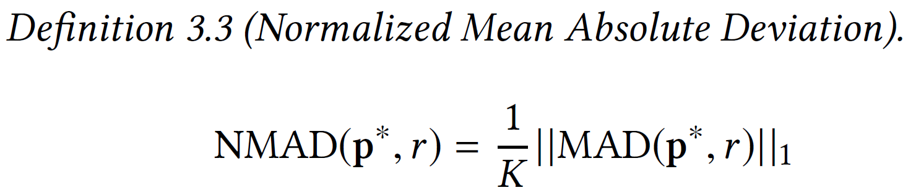
Data Pipeline Optimization
N: number of algorithms
K: dimension of the configuration space r: a reference point p*: sample of optimal configurations
For each optimal configuration r:
1. Build the sample w.r.t. to the algorithms:
For each algorithm, select the optimal point that is the closest from the reference point. 2.Express the sample in normalized conf. space
3.Calculate the NMAD on the sample
Notes:
If all points are the same, the distance is zero, and the further in average the points are from the reference point, the higher is the NMAD.

Slide 19
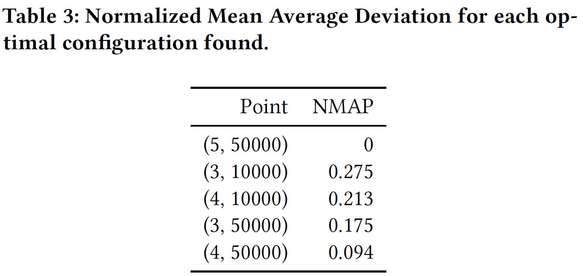
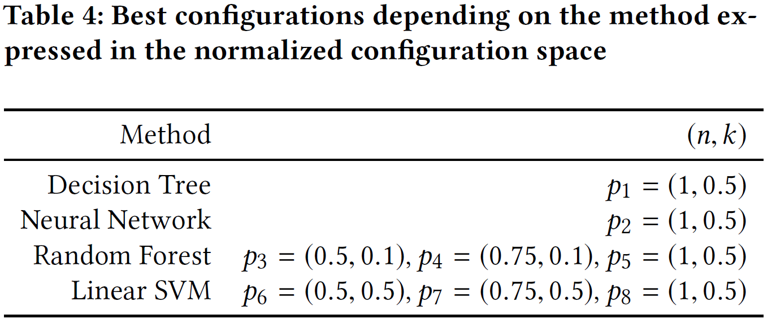
D
Notes:
Explanation in three steps:
Blue area: points that are all forming a sample of the exact same points => clearly zero
For each green points, the blue points are really close, lowering the NMAP
Red points are very far from every other points on the second componant on the first parameters they are exactly matchin in a green sample such that it limitate the NMAP.

Slide 20

Future work
Work in progress:
Tests on larger configuration spaces.
Online / offline architecture.
Metric between pipelines
Notes:
Explanation in three steps:
Blue area: points that are all forming a sample of the exact same points => clearly zero
For each green points, the blue points are really close, lowering the NMAP
Red points are very far from every other points on the second componant on the first parameters they are exactly matchin in a green sample such that it limitate the NMAP.

Slide 21

Thank you
Optimized Idea-generator Pipeline

