Slide 1
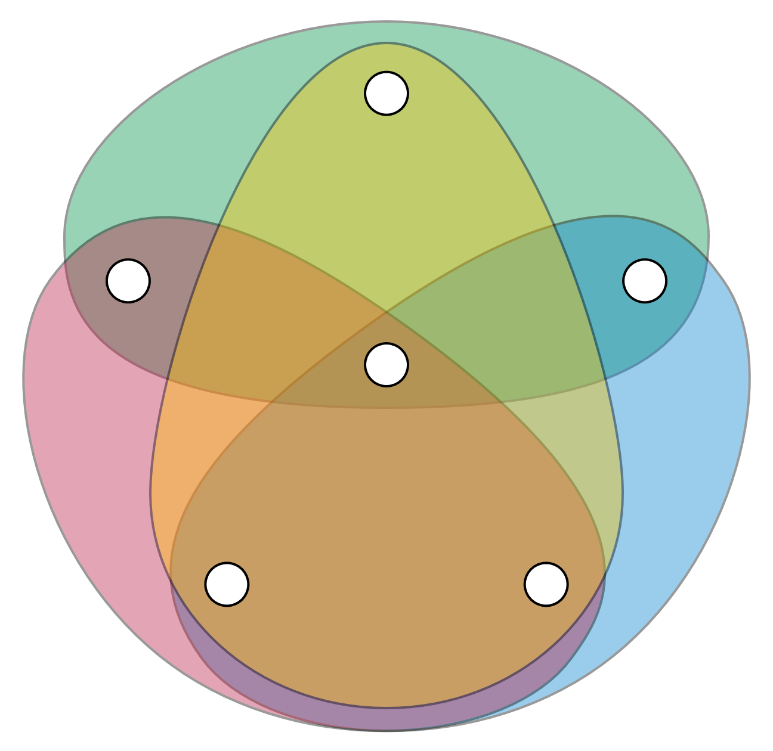



Binary Classification With Hypergraph Case-Based Reasoning
DOLAP 2018
Alexandre Quemy
IBM Analytics
Politechnika Poznańska

Slide 2
AGENDA
Binary classification problem Hypergraph representation
Model Space and Model Selection
Experiments & Results
Improvements, work in progress and future plans

Slide 3
Binary classification problem

Slide 4

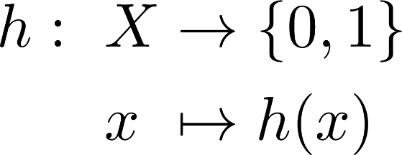

Binary Classification problem
Classical formulation:
In practice, ML algorithm select or build h from a model-space H made of restrictions or hypothesis on the „shape” of h based on the data.

Slide 5


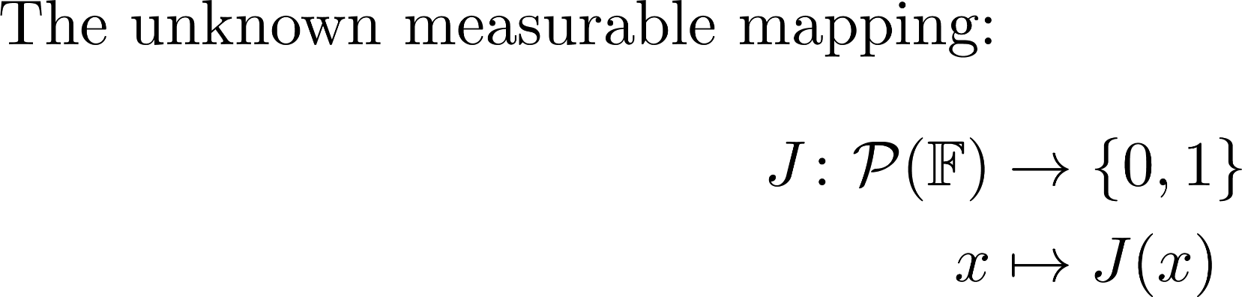
Binary Classification problem
Formulation:
Work Hypothesis: countable (finite) space and
Notes:
The abstract space can be a database, something not structured, well-structured, etc. It is not our matter here. Contrary to the initial formulation, the input vector space is not defined, can miss some elements, etc. You also do not need any metric or scalar product contrary to many other approach like SVM.
In practice, it is likely that only a subset of P may appear (e.g. Two contradictory proposition encoded by two elements of F)

Slide 6
Hypergraph representation

Slide 7
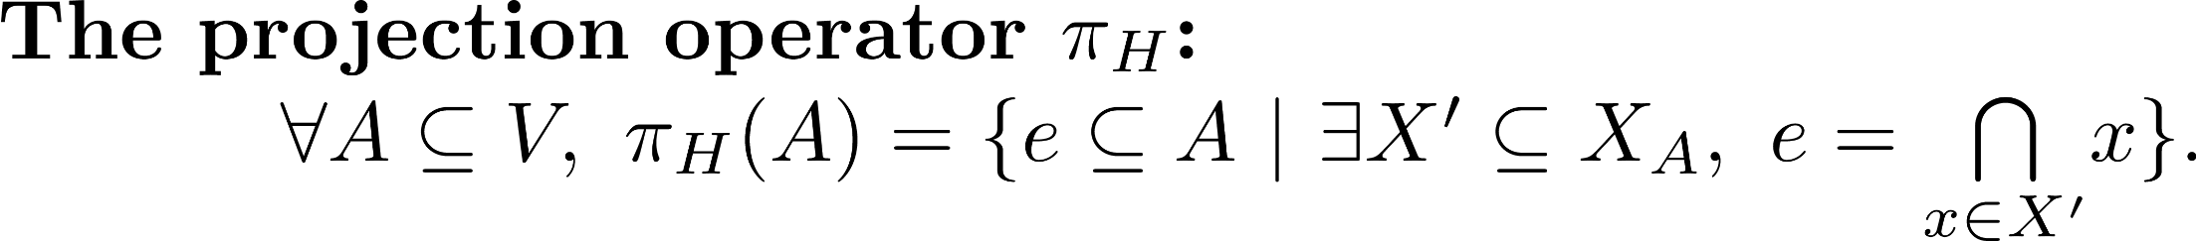
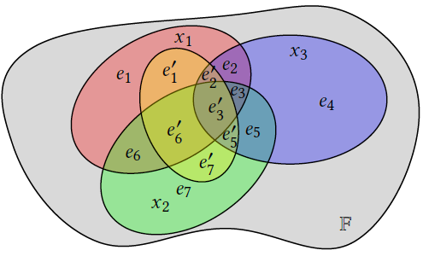
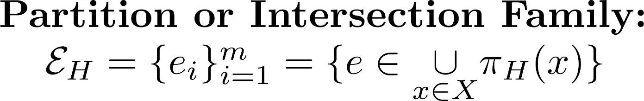
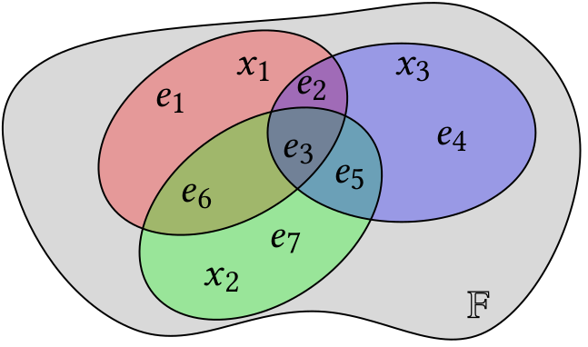
Hypergraph representation
Few definitions:
Notes:
Hypergraph is a generalization of a graph (2 vertices per edge)
A subhypergraph is like a „windows” on the the hypergraph.
E is a partition of V_X and e is a set of features, not a single feature.

Slide 8
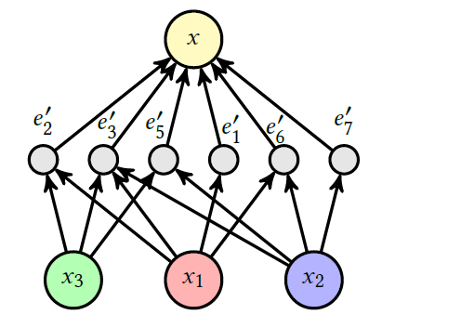
Hypergraph representation
A bit more of definitions:

Slide 9
Model Space and Model Selection

Slide 10
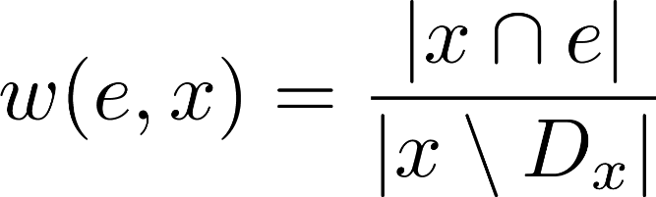
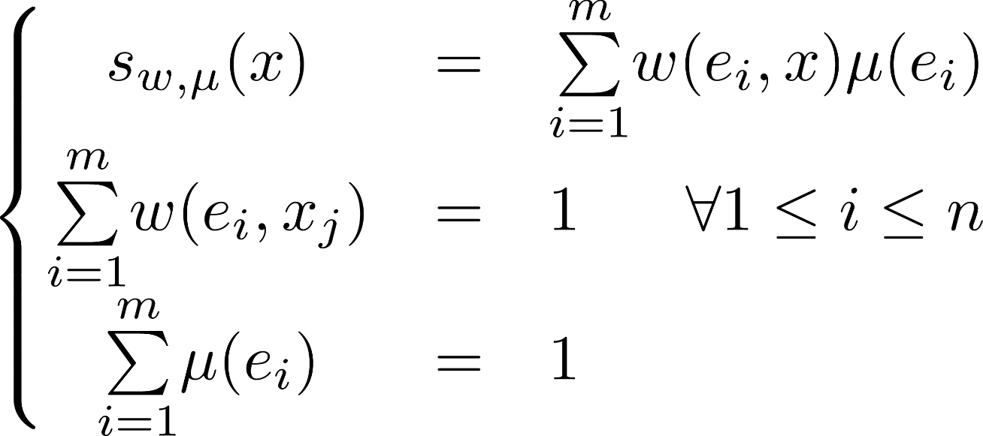
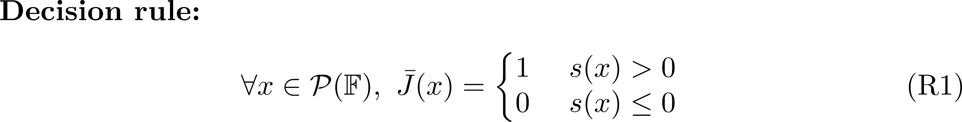
Model Space and Model Selection
Model Space:
Support
Importance of e in x
Intrinsic strength of e w.r.t. H
Notes:
Well, very large model space, product of two functional spaces. Advantage: no assumption on \mathbf F: works for incomplete systems, non-metric space, non-homogeneous space.
One big hypothesis is that if two cases are not sharing any features, they are independant in the sense they cannot help to understand each other or support.

Slide 11
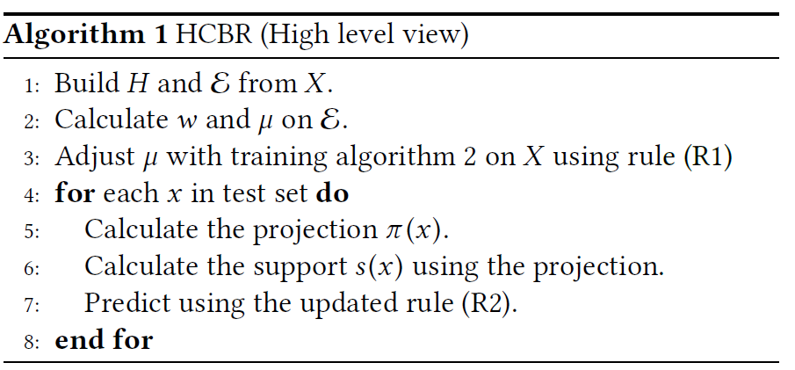
Model Space and Model Selection
Hypergraph Case-Based Reasoning:
Notes:
Well, very large model space, product of two functional spaces. Advantage: no assumption on \mathbf F: works for incomplete systems, non-metric space, non-homogeneous space

Slide 12
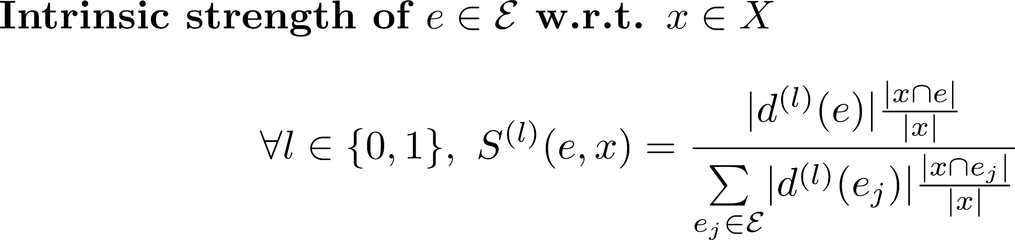
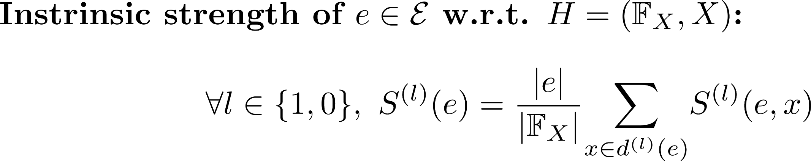
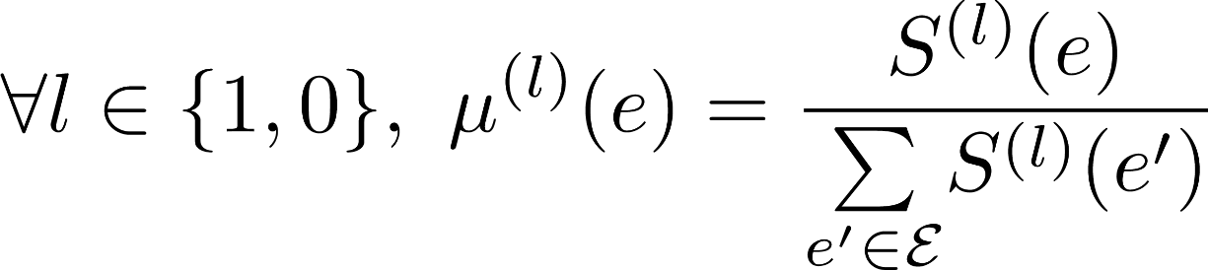
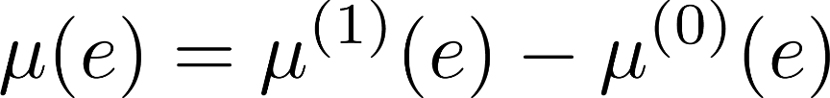
Model Space and Model Selection
Model Selection:

Slide 13
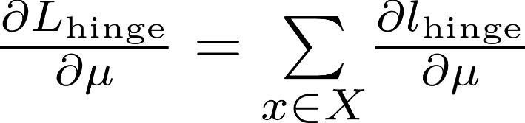
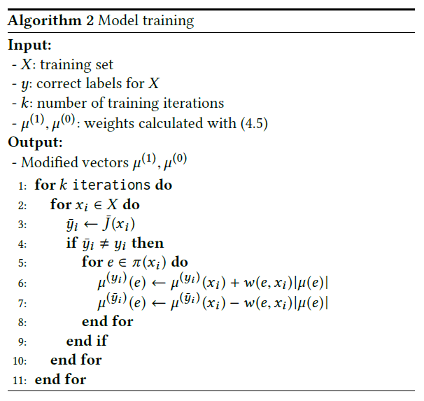
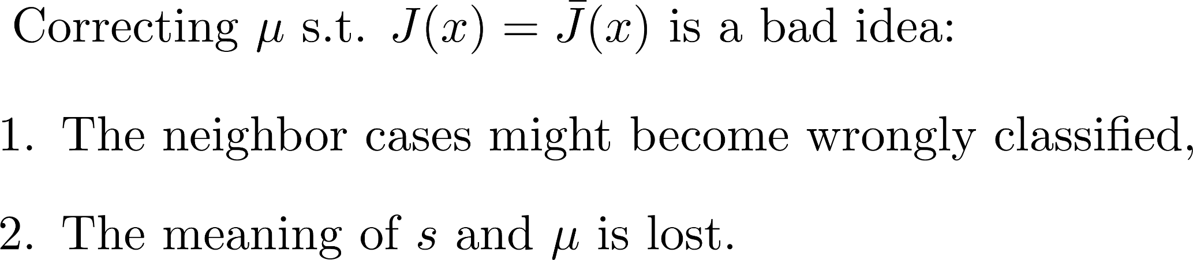
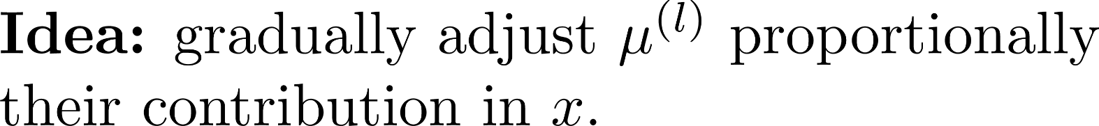
Model Training
Objective: Minimizing a sort of Hinge-loss
Notes:
But it is not enough. As the partition element represents some probabilities or likelihood,

Slide 14
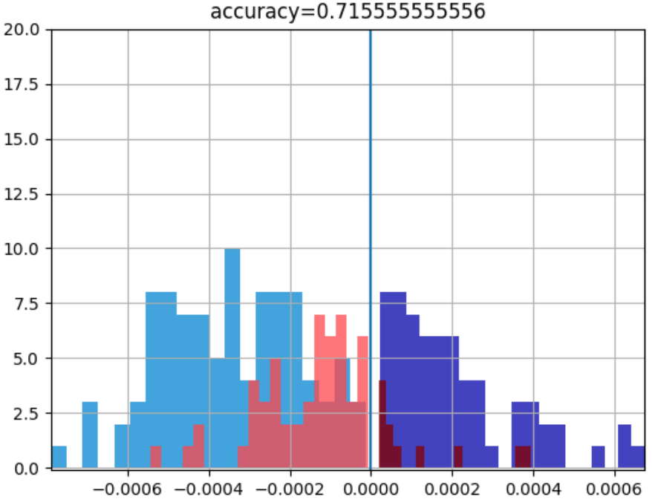
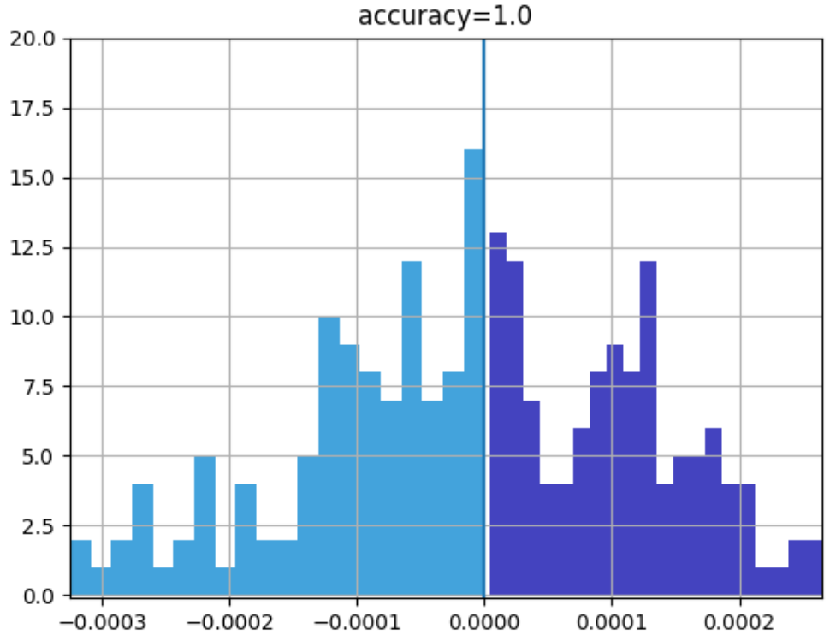
Model Training
Text classification
Notes:
But it is not enough. Brin As the partition element represents some probabilities or likelihood,

Slide 15
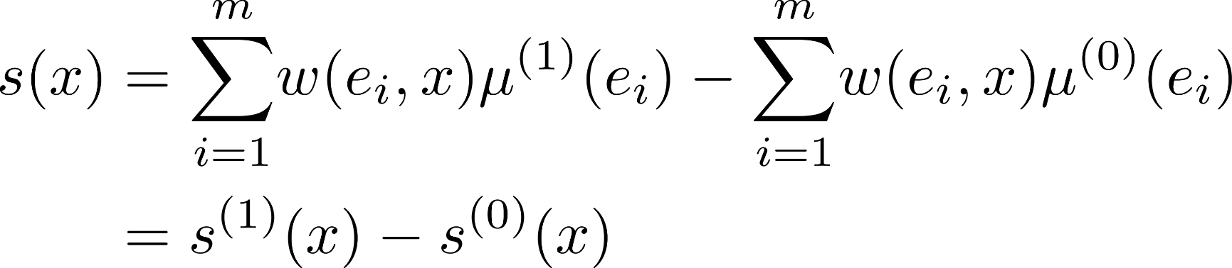
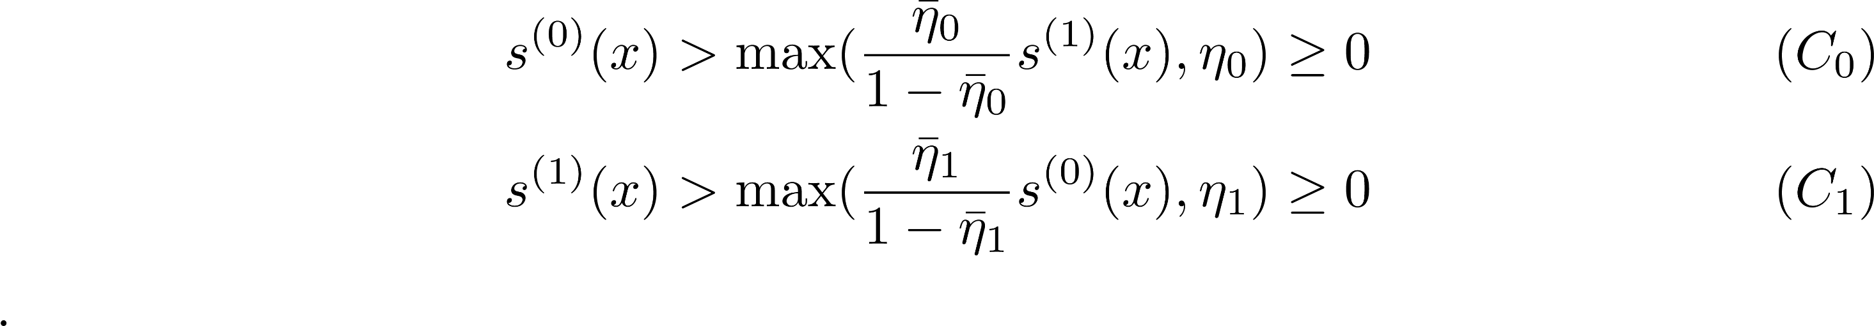
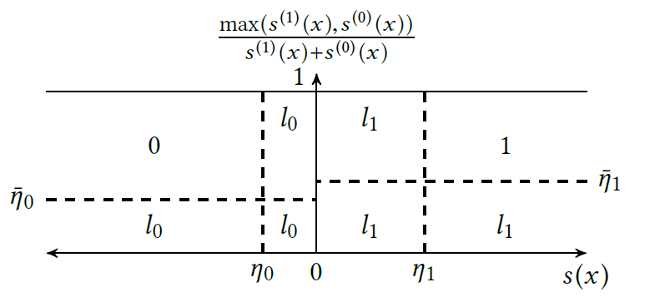
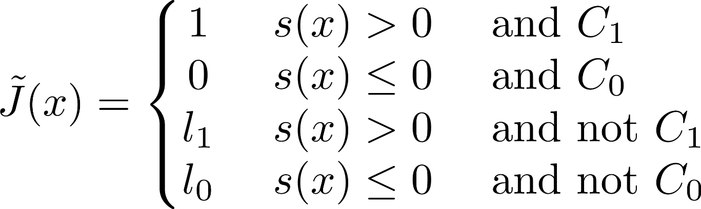
Prediction
Updated classification rule:
Notes:
The idea is to control how much evidence we need, either absolute quantity, or compared to the support toward the other class.

Slide 16
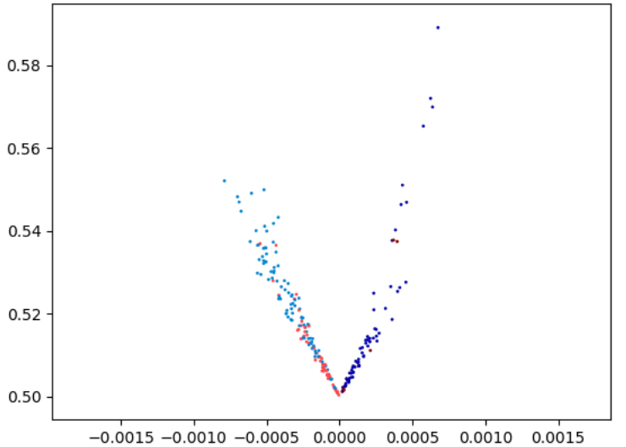
Prediction
0
1
1
0
Notes:
The idea is to control how much evidence we need, either absolute quantity, or compared to the support toward the other class.

Slide 17
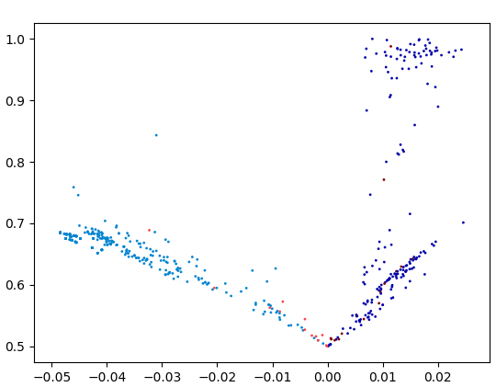
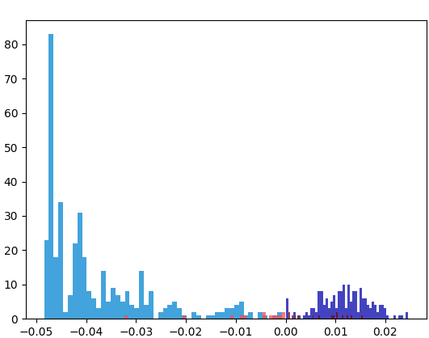
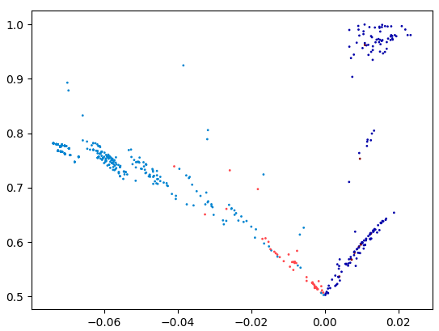
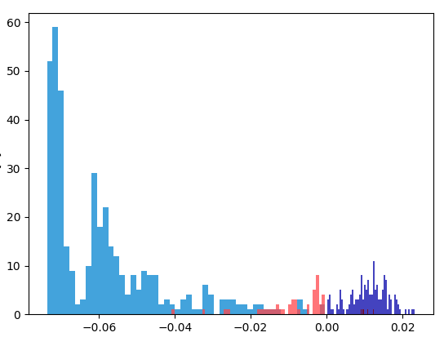
Prediction
Notes:
The idea is to control how much evidence we need, either absolute quantity, or compared to the support toward the other class.

Slide 18
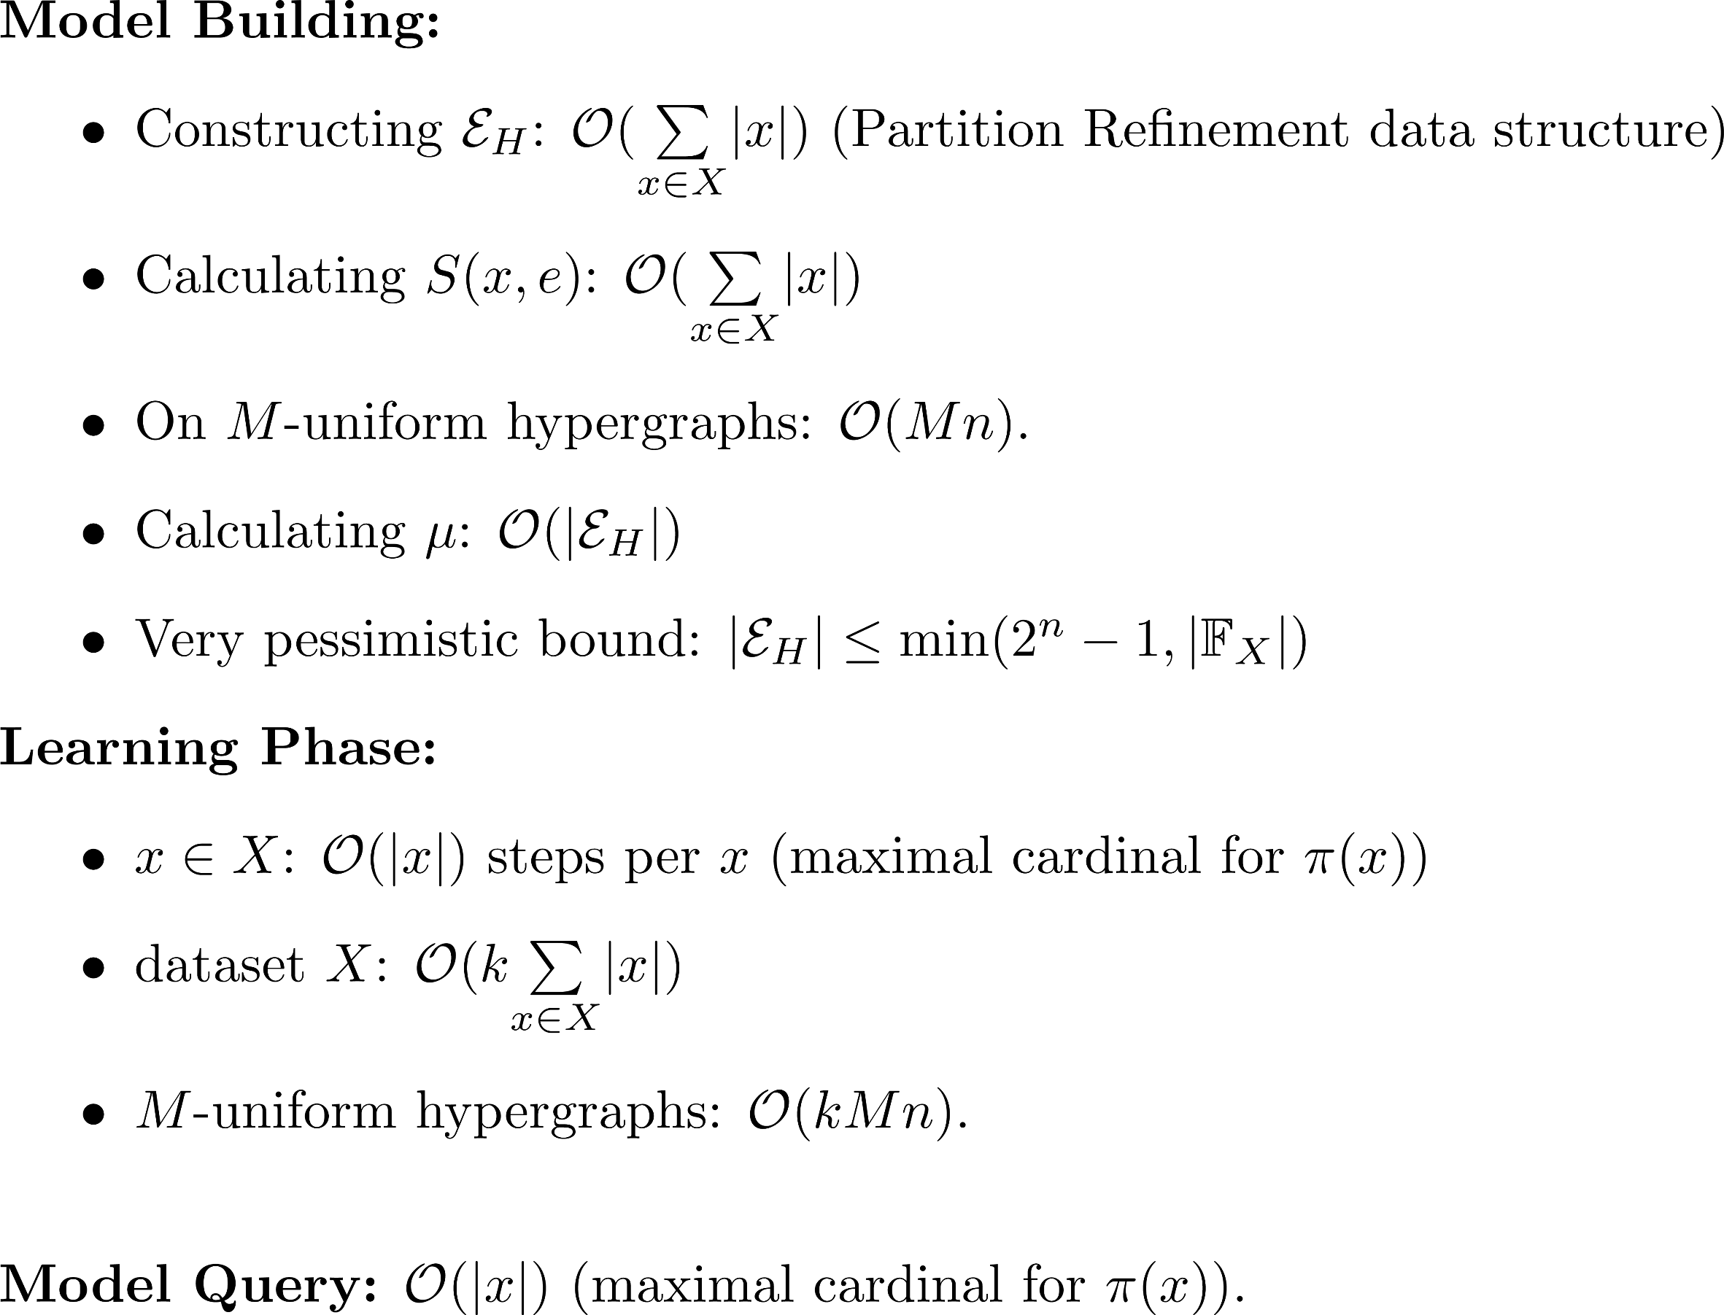
Complexity
Notes:
A video is a temporal signal on a time interval

Slide 19
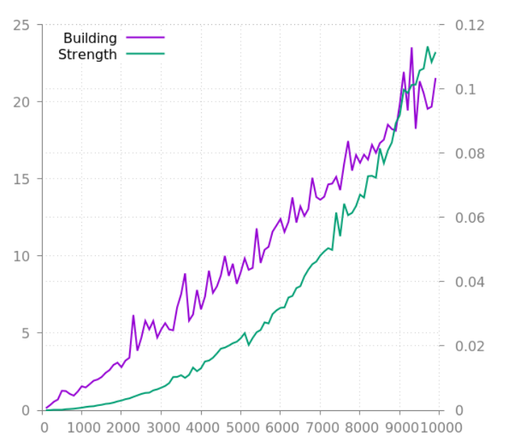
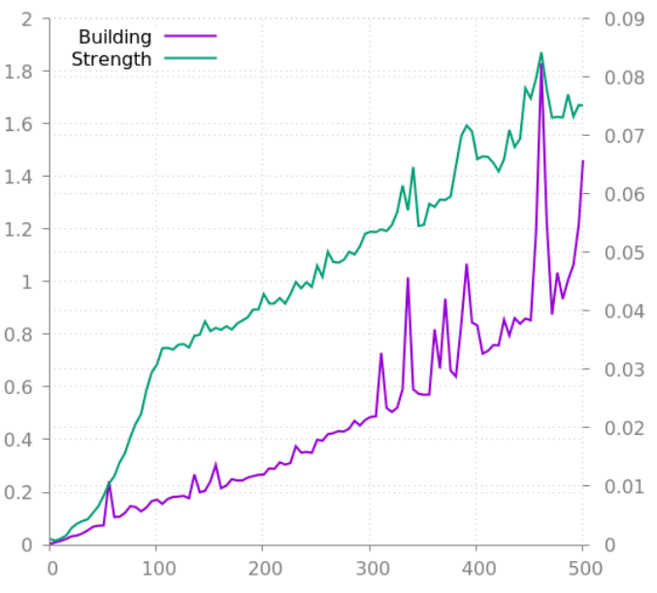
Complexity
In practice:
Strength
Building
Depending on n (m = 10)
Depending on m (n = 100)
Notes:
The case i is described by i, i+m such that each input vector is partitionned into m elements.

Slide 20
Experiments and Results
Code and experiment: github.com/aquemy/hcbr

Slide 21
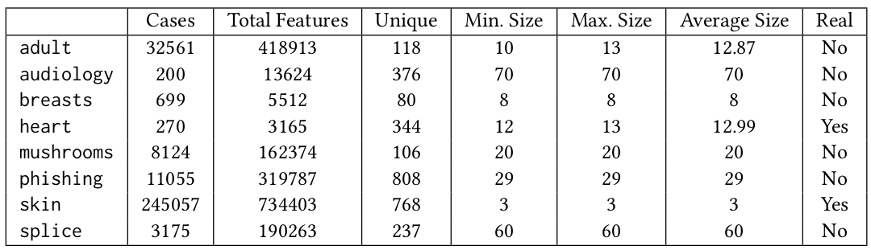
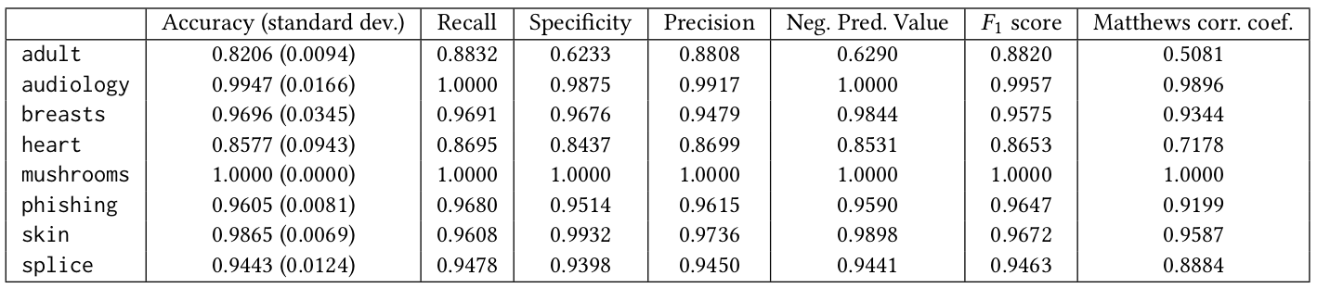
Experiments and Results

Slide 22
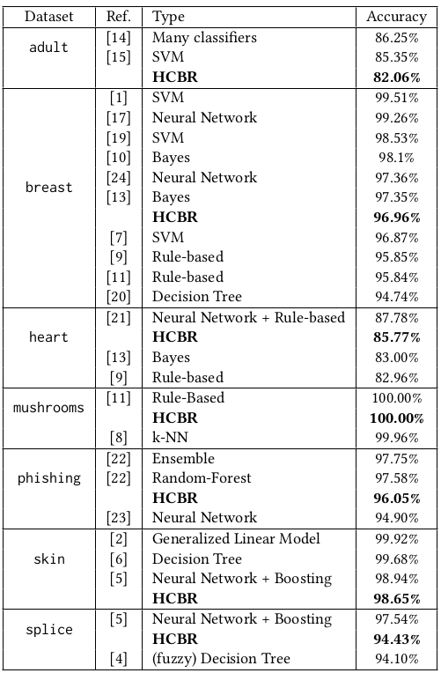
Experiments and Results
Protocol: 10 fold cross-validation, no metaparameter tuning (only training)
Contrary to the state-of-art, no assumption, no
ad-hoc feature selection or transformation.
Notes:
A video is a temporal signal on a time interval

Slide 23
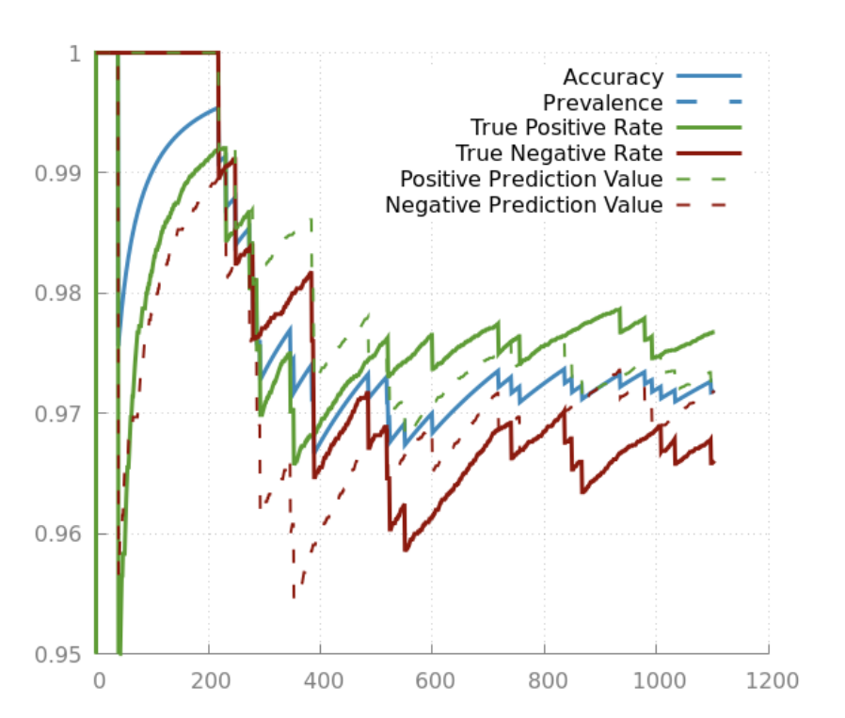
Experiments and Results
Stability of confusion matrix:
Notes:
A video is a temporal signal on a time interval

Slide 24
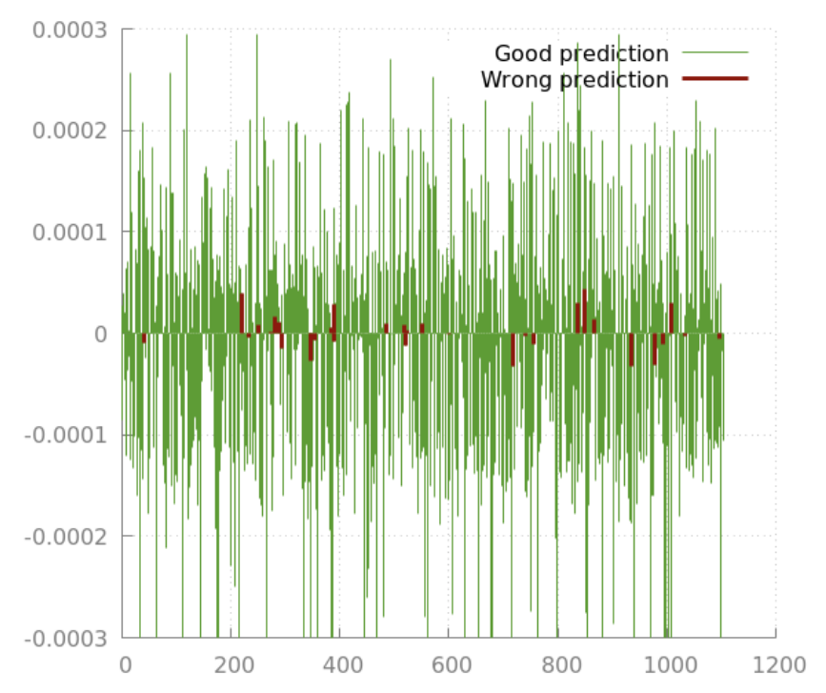
Experiments and Results
Confidence measure:
Notes:
A video is a temporal signal on a time interval

Slide 25
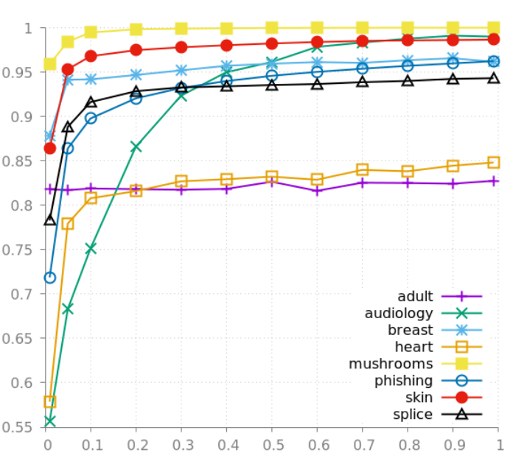
Classification problem
Very few examples needed + does not overfit:
Accuracy
Training set size (%)
Notes:
Actually, maybe it does underfit for adult or heart to be honest.

Slide 26
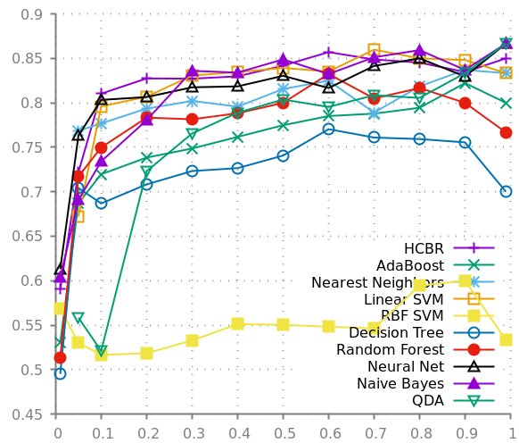
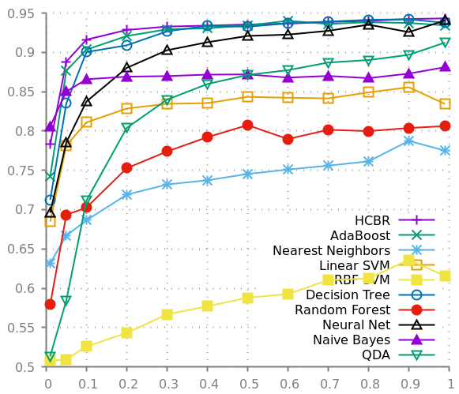
Classification problem
Comparison to standard implementation with Scikit Learn:
Notes:
Actually, maybe it does underfit for adult or heart to be honest.

Slide 27
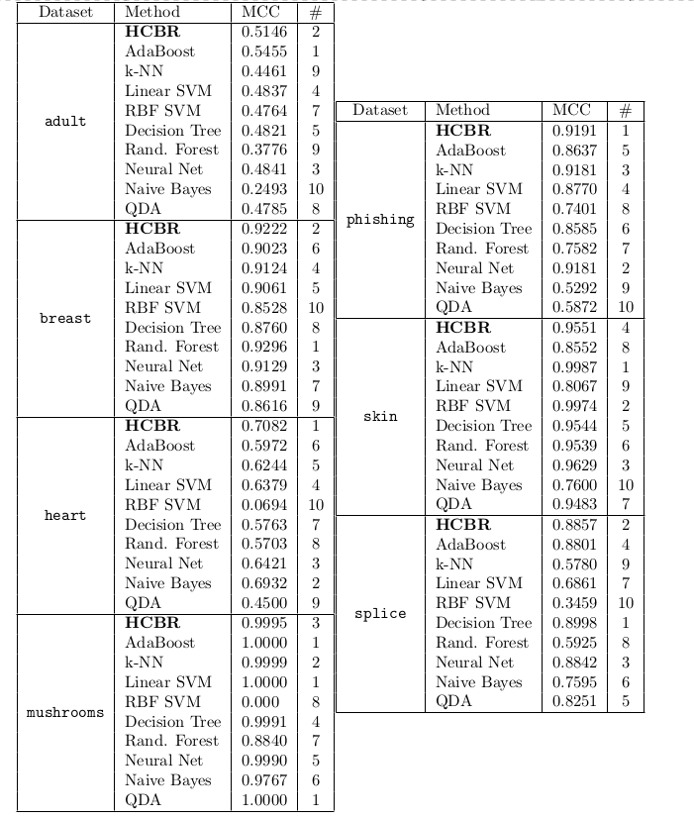
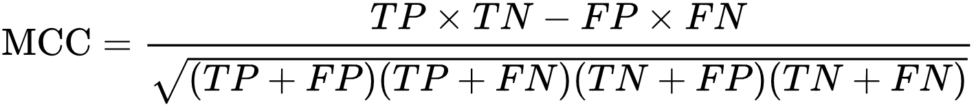
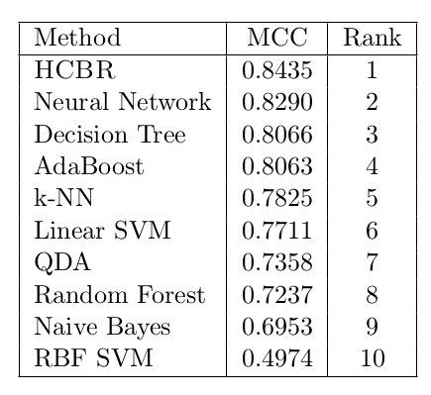
Classification problem
Notes:
Actually, maybe it does underfit for adult or heart to be honest.

Slide 28
Improvements, WIP
and Future plans

Slide 29
Improvements, WIP and future work
Multiclass and multilabel support:
Straigthforward time-linear extension of mu
Fully online and scalable version:
Online: Semi-online: training after each decision but the input vector not added to the hypergraph Fully online: new hyperedge, then weights adjustment
Vertical and horizontal scalability:
Vertical: adding more cases (i.e. fully online) Horizontal: add more atoms to some cases without starting from scratch
Notes:
Well, very large model space, product of two functional spaces. It seems that what prevents HCBR to obtain good results on adult dataset for instance is the „expressivity” or „model complexity” we defined.

Slide 30
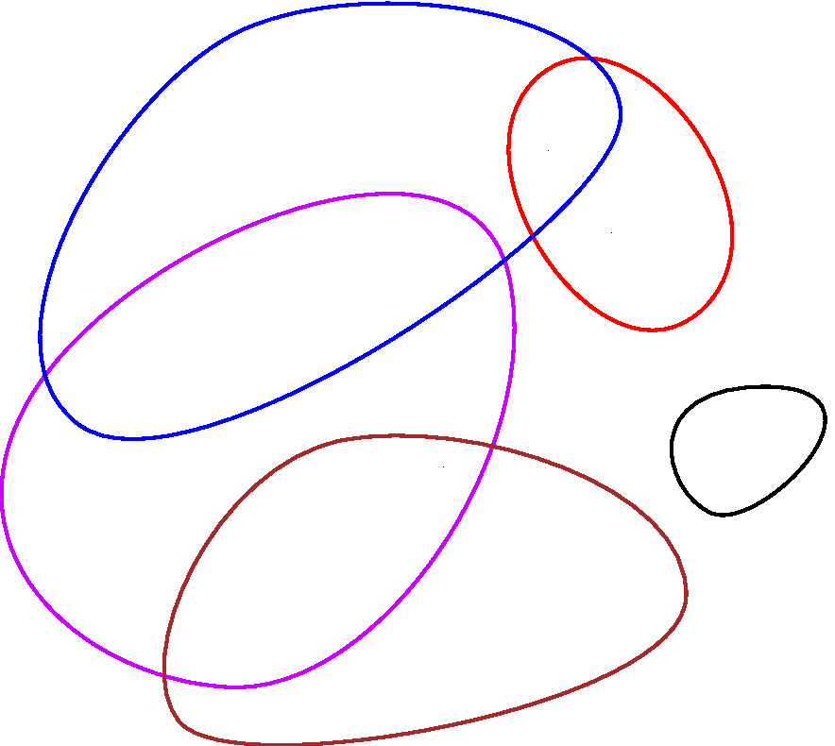
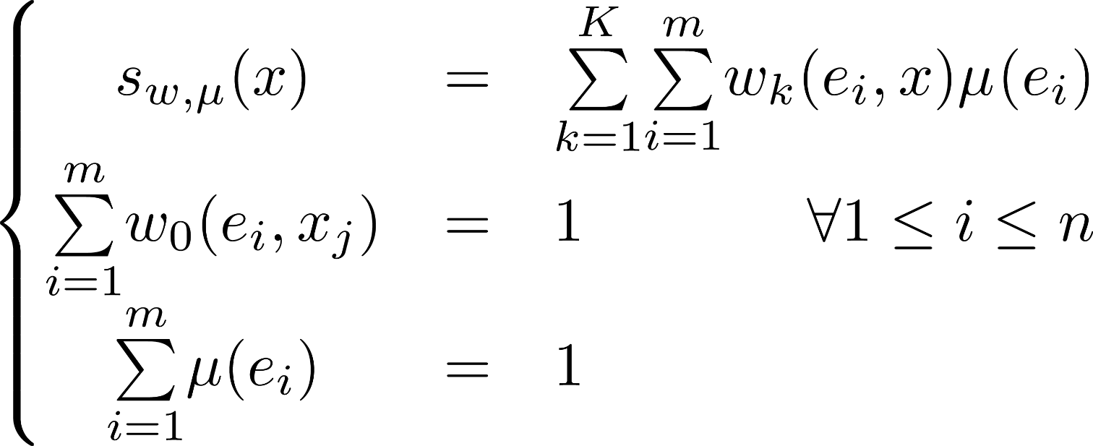
Improvements, WIP and future work
Model Space extension:
Notes:
It seems that what prevents HCBR to obtain good results on adult dataset for instance is the „expressivity” or „model complexity” we defined.

Slide 31
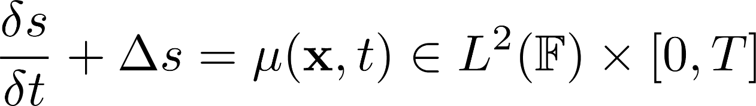

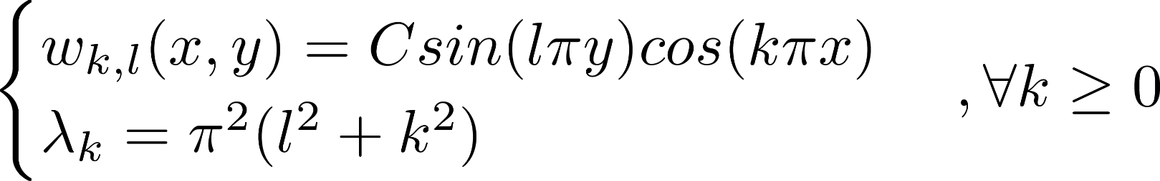
Improvements, WIP and future work
Handling continuous values in Hilbert space:
Discretization, estimation of the model + Laplacian
+ initial conditions (Dirichlet? Neuman?)
(associated spectral problem) Some mathematical magic (canonical injection from Hilbert to Sobolov, Lax-Milgram-Lions on continuous bilinear symmetric coercive forms, Riesz-Fredholm spectral decomposition):
+ Normalization of the Hilbert base
Notes:
Well, very large model space, product of two functional spaces.

Slide 32
Improvements, WIP and future work
Handling continuous values in Hilbert space:
Discretization, estimation of the model + Laplacian
+ initial conditions (Dirichlet? Neuman?)
By linearity of Laplacian and derivative: Equivalent to solve easy ODE:
Notes:
Well, very large model space, product of two functional spaces.

Slide 33
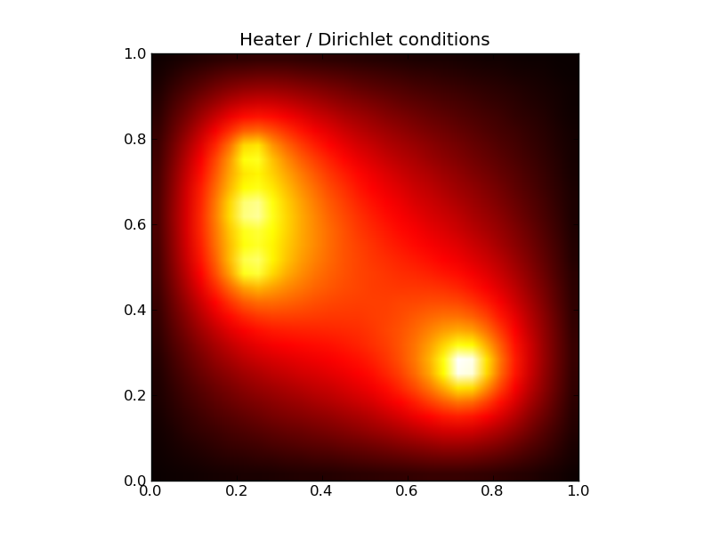

Improvements, WIP and future work
Handling continuous values in Hilbert space:
Notes:
Well, very large model space, product of two functional spaces.

Slide 34
Thank you
Notes:
Within this demo session we will show how Node.js application can use and display data from previously created model for customer satisfaction prediction.

