Slide 1
With a little help from my (AI) friends Machine Learning for human rights research and practice
Helga Molbæk-Steensig (EUI, Law) & Alexandre Quemy (Poznan, AutoML)

Slide 2
Three problems in Europe and beyond
Slow and cumbersome judicial systems | Biased and ‘noisy’ judicial systems | Problems with transparency, accountability and bias in ML applications in current judicial decisionmaking
Length of proceedings complaint in 1/3 of all cases before the ECtHR Backlogs at national and international courts | Chen et al.: asylum decisions predictable 71% of the time with no input form application Englich et al: Anchoring bias Kahneman et al: Gambler’s falacy, pattern noise, level noise, occasion noise | O’Neil’s Weapons of Math destruction State v Loomis SyriCase

Slide 3
Suggested solution: theoretically informed bridging of law-data knowledge gap
Step 1 | Step 2 | Step 3
Legal-Theoretical foundation in the ‘Right answer’ thesis Dworkin Kelsen Alexy Scheinin etc | Clear understanding of what AI can/cannot do Causation/correlation problem Dynamic/static problem Garbage in Garbage Out Losses in pre-processing Private information problem | Division of labour between Human and Computer Where volume matters: reading, searching, determining probability Systematizing and forcing lawyers to consider inference and questions asked Providing overview of all caselaw Demanding explications of private information

Slide 4
Proof of concept: The ECHR-OD-project
ML-algorithms first and foremost for pre-processing
Natural language modelling for extraction of semantic entities
Names, dates, places
Implicit and explicit case references
Different parts of judgments (facts of the case, deliberations, separate opinions etc)
On the basis of this: providing input for the answering of questions currently bothering legal scholarship

Slide 5
Proof of concept: Tackling the margin of appreciation
Problems | How the ECHR-OD application can help
(very) different assumptions about empirical facts about the margin (potentially due to concious or unconcious cherry-picking in doctrinal research), including: Degree of usage over time Connection with deference to states Different or similar usage with different fundamental rights Which actors use the margin at the court | Descriptive statistics on the whole body of ECtHR caselaw Citation networks (in connection with margin-mentions) to determine most important cases Differentiations between usage by different actors, reponses from different states

Slide 6
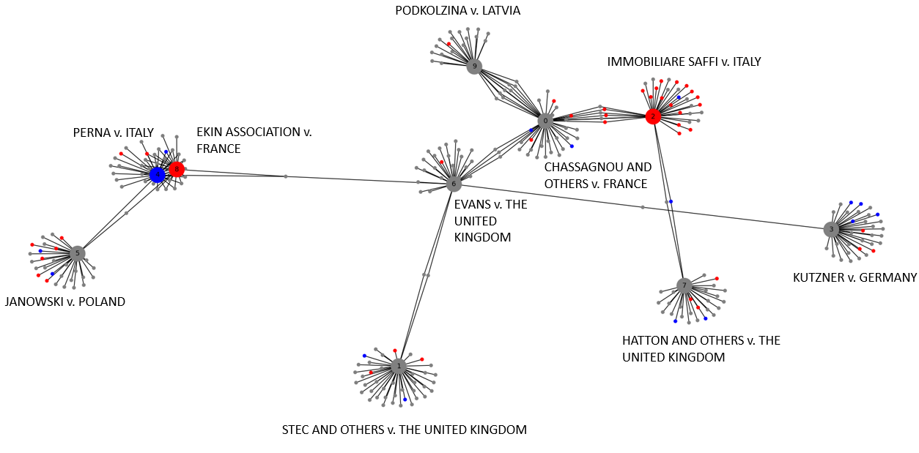
Example: citation network for margin of appreciation cases

Slide 7
Thank-you for your attention
Contact about the paper and research:
helga.molbaek-steensig@eui.eu

