Slide 1
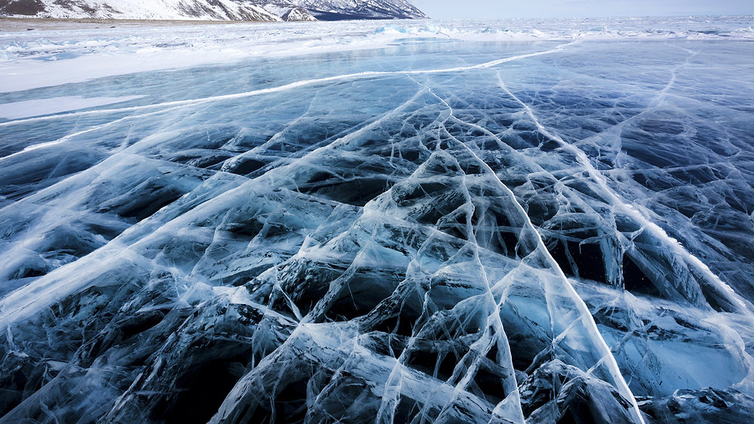
FROZEN LAKE PROJECT
PABLO MARTINEZ URONES
ALEJANDRO QUESADA SUAREZ

Slide 2
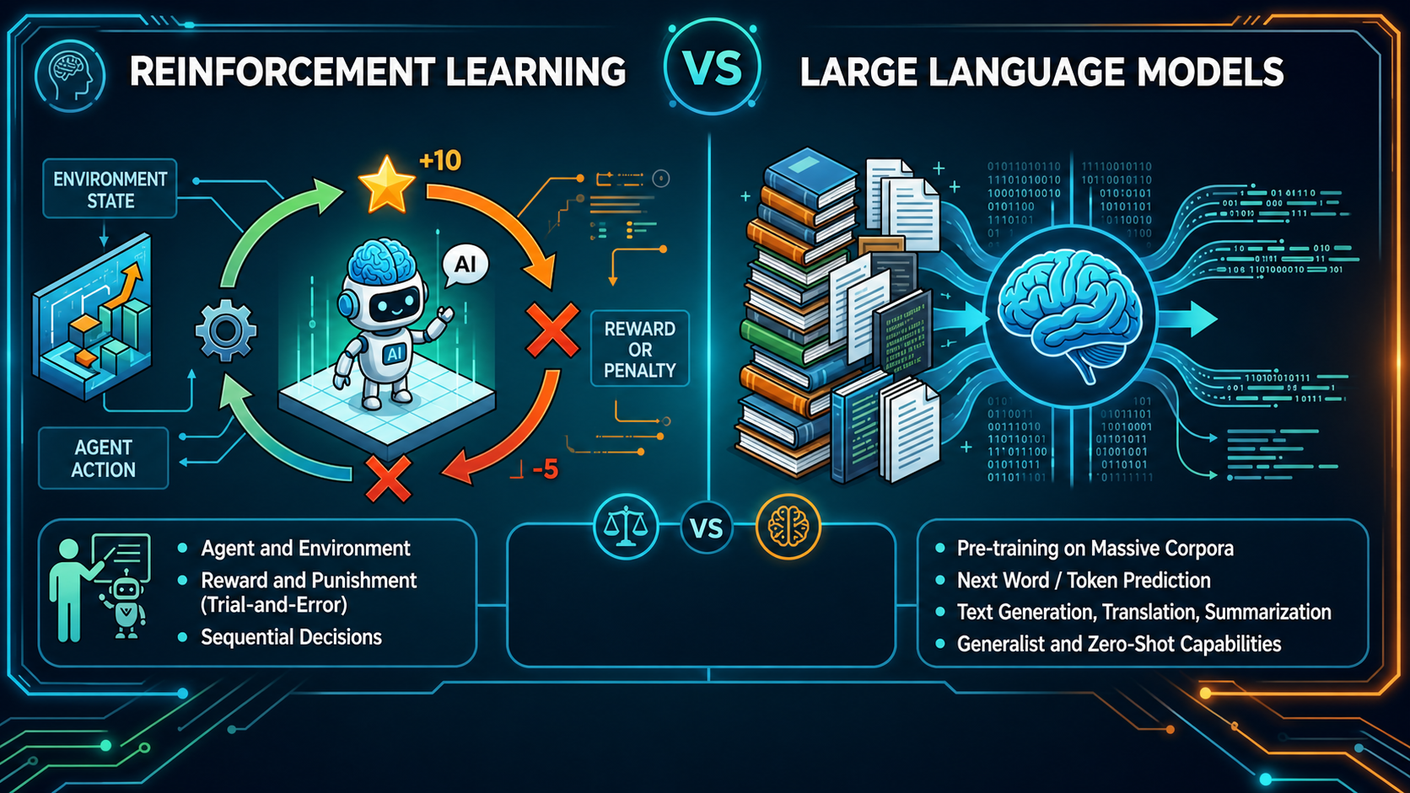

Slide 3
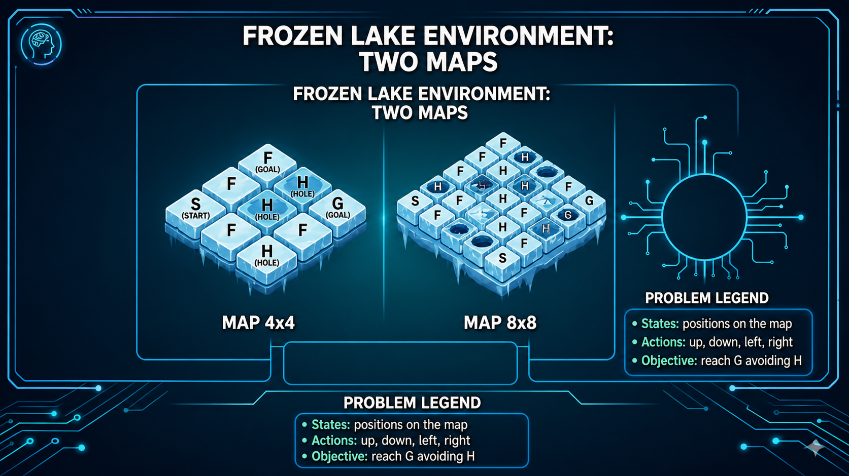

Slide 4
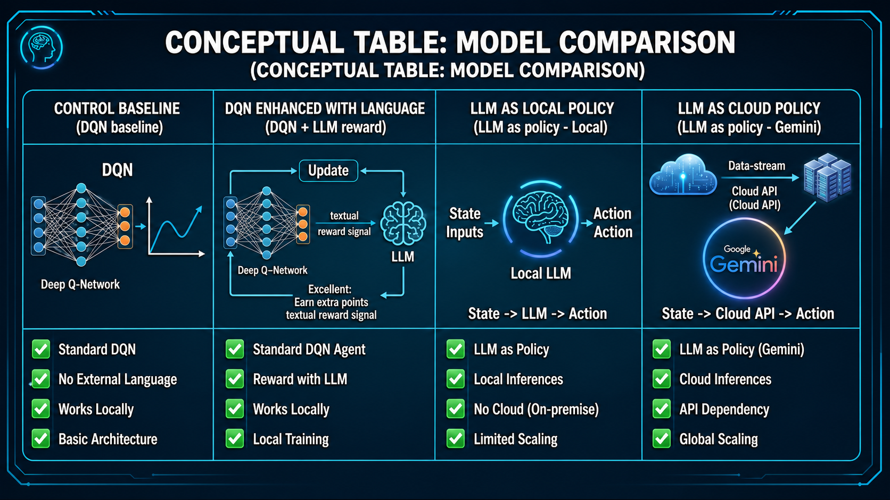

Slide 5


Slide 6
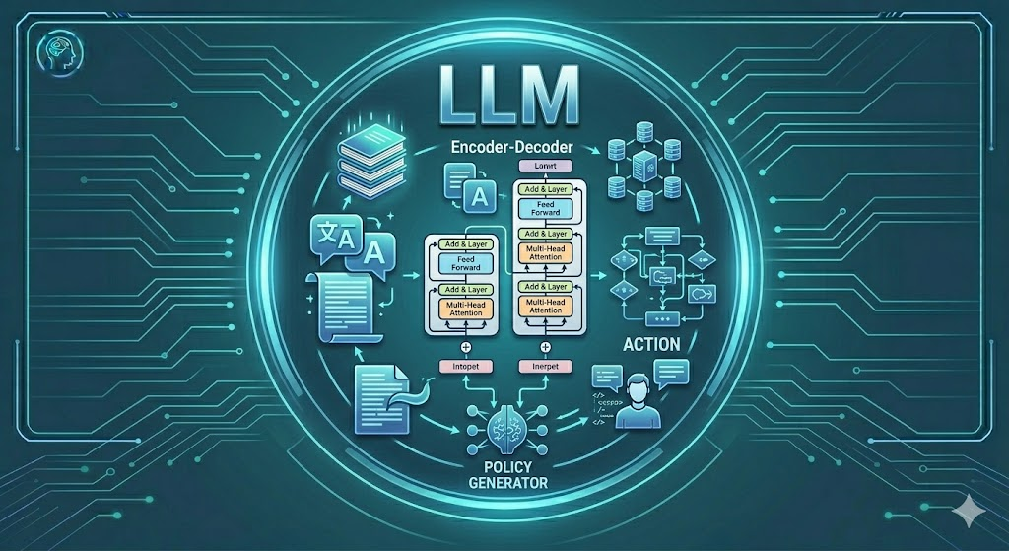

Slide 7
