Slide 1

Product Roadmap
March 2026

Slide 2





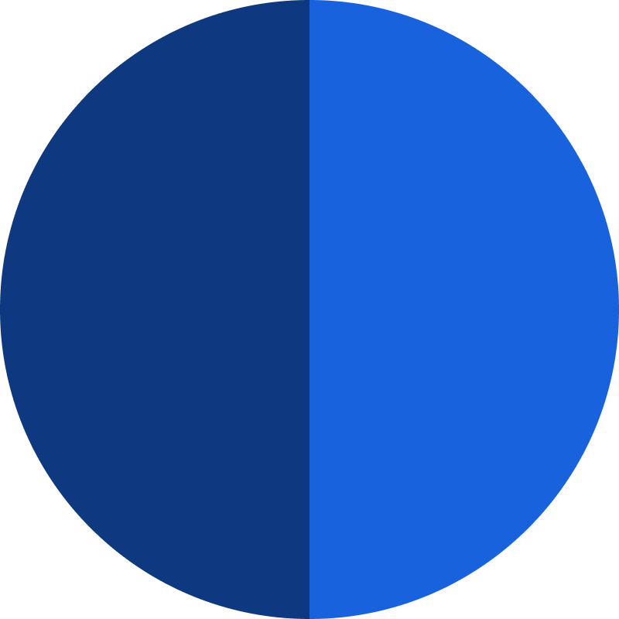


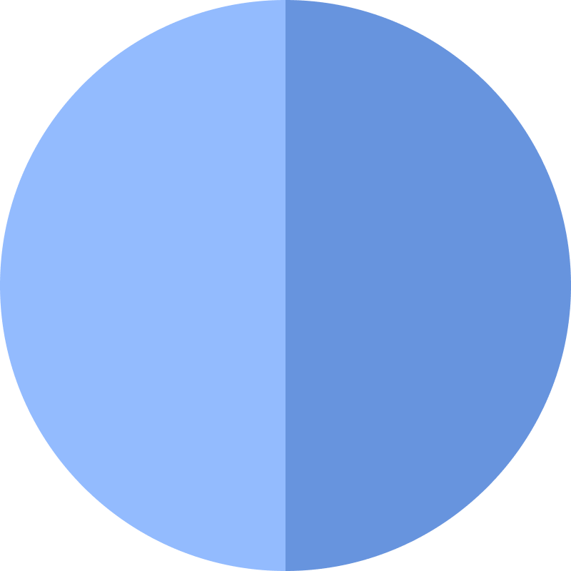

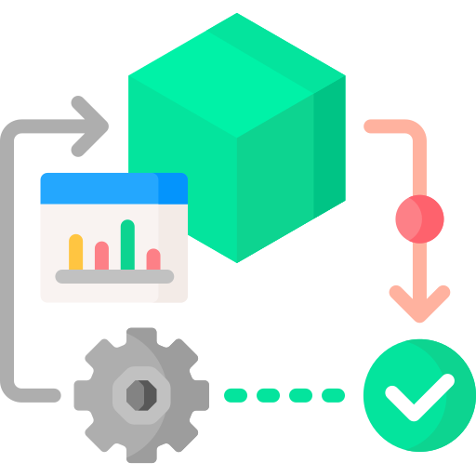

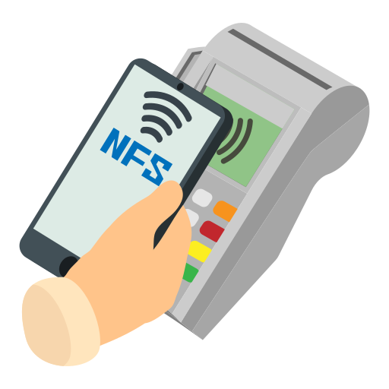







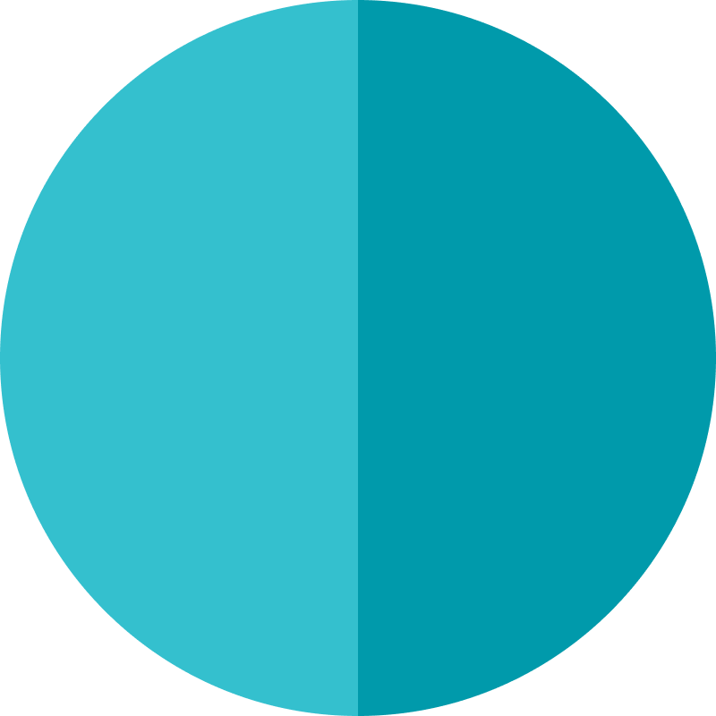



Technology Roadmap (FY 25-26)
Fresh Produce Buying & Distribution System
Theft Control
System with
Video Analytics
Corporate Customer Management Platform with Salesman App
Category & Vendor Management Platform
Outlet wise Sales Forecasting
(Phase 1)
CRM Platform with Customer Complaint Tracking
Retail Store Management Platform
Q1
(Jul’25)
Q2
(Oct’25)
Q3
(Jan’26)
Q4
(Apr’26)
Jun’26
DC Product Processing & Expiry Management System
Self
Checkout
Shelf wise Product Shelving & Refilling Management System
Supply Chain & Planning Management Platform
Omni Channel App with New Loyalty Integration
Shwapno Marketplace
Target wise Automated Task Generation System
Business Investment Platform

Slide 3





Ongoing Development Tasks
Fresh Buying &
Distribution Network v2.0
Operations App
v2.1
Shwapno Central Management System
Shwapno
Survey App

Slide 4
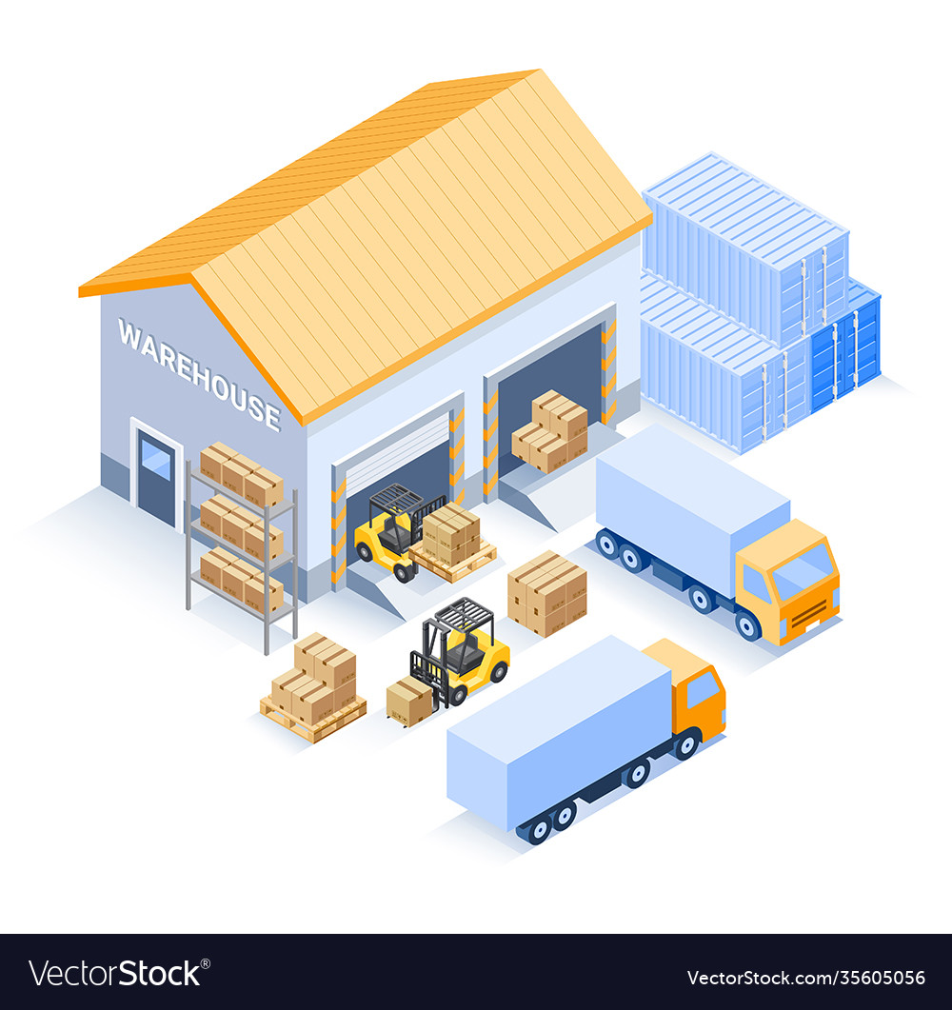




Operations App
DC | Outlet | Dark Store
v1.0, v1.1 Launched ; v2.1 & 2.2 Development Ongoing
445,000+ GRN Created (Till Date)
For Aug’25
67% GRN Created for CG PO in 597 Outlets
51% GRN Created for All PO in All Outlets
Link

Slide 5


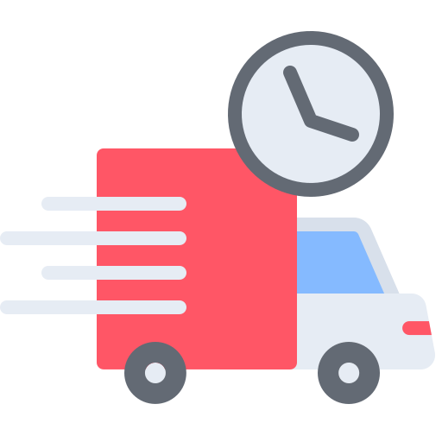
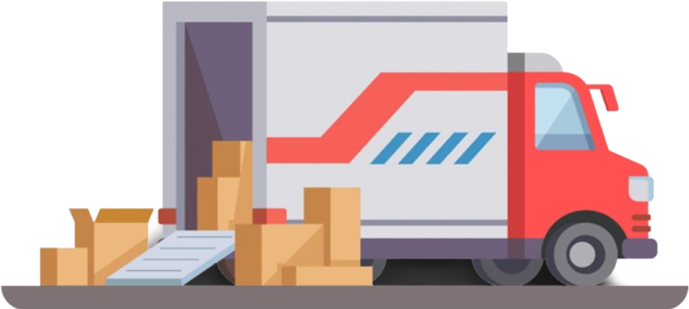


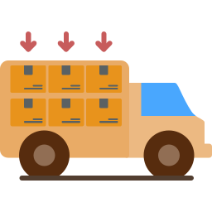


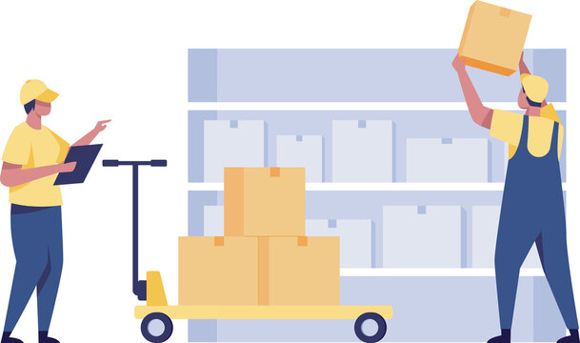










Operations App v2.1 - Flowchart
Product Unload
PO Barcode Scan & Product Receive
Auto GRN create in SAP
Product Shelving in Designated Shelf
DC Delivery Plan Ready
STOs Combined into a Single DN
Product Loading & Dispatch
Final Delivery Note Update in SAP
Product Packing & Receipt Print
DN wise Product Picking
DN wise Picker & Packer Assign
Outlet DN Scan & Packing List show
Product Receive per Packing List
Missing/Damage update
Acknowledgement from Delivery Man
Auto GRN & TPN create in SAP
Auto RTV, TPN, Wastage create in SAP
Mark as
RTV/ TPN/ Wastage
Send to Non Conforming Zone
BIN & Article Scan
Deshelving Task Create (Near Expiry)
Link

Slide 6
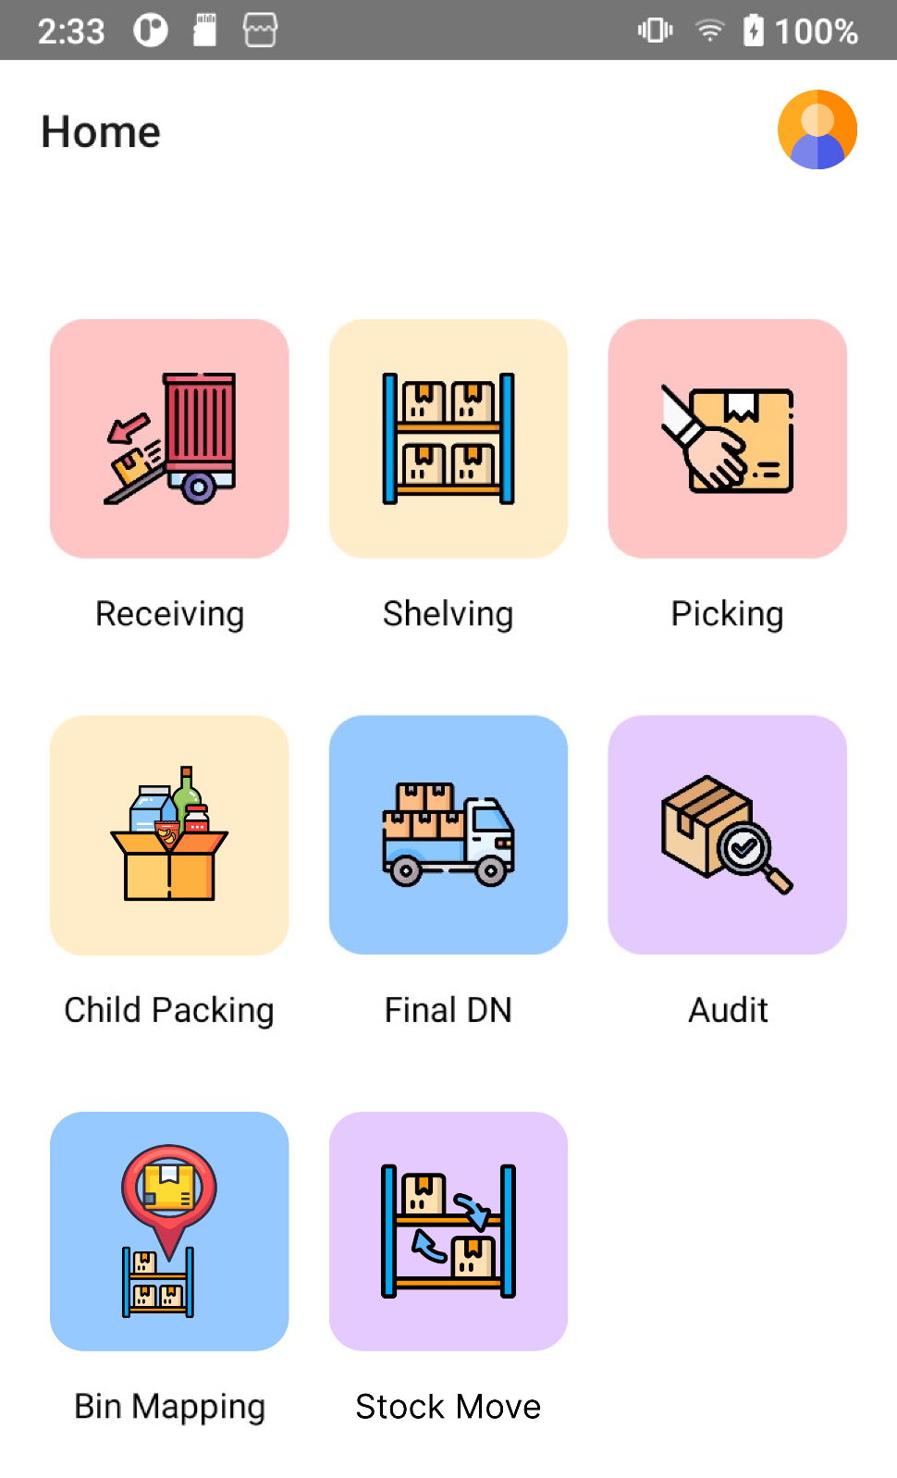
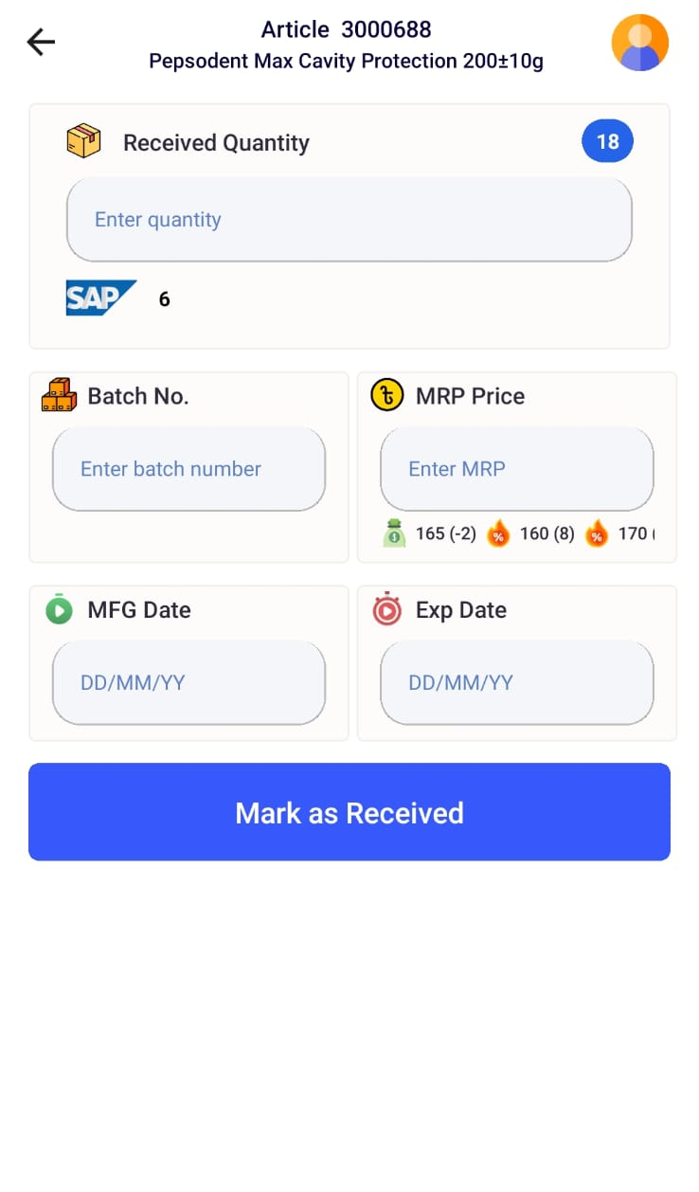
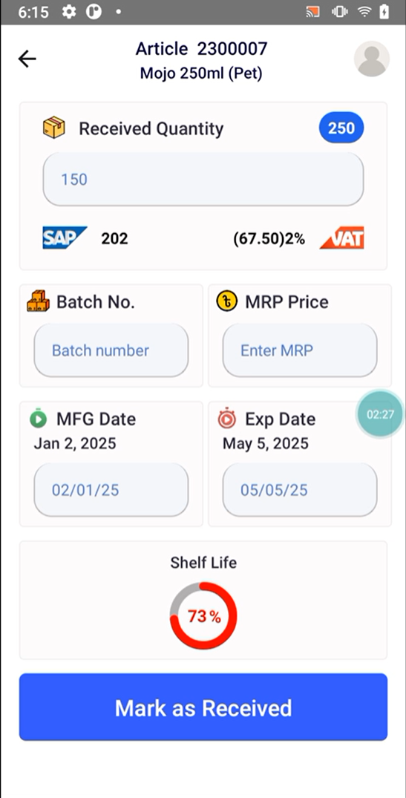
Developed Features
Launched & Used
  Purchase Order Receiving with GRN create
  Vendor Challan Information Capture
  Show SAP Stock, EPS MRP with Stock
  Survey (Physical Stock, Picture Collection)
Launched but Not Used
  Site wise BIN, Gondola creation
  BIN wise Product Shelving
  Product Discrepancy Report
  Product wise BIN Mapping & Adding Old Inventory
  Delivery Note Receiving with Auto GRN & TPN create
  Outlet Damaged Item acknowledgement by Delivery Man
  Mobile Application with Camera Scanner
Link

Slide 7

Operations App - Roadmap
Outlet & DC Visit
- Issue Find out
- Epic Documentation Start
Development Start
- DC App Development
- BIN Creation Development
v1.1 Pilot Re-Launching
- DC Processing Part Full Launching
- User Training
v2.0 Launching
- Outlet Deshelving, RTV, TPN, Wastage Creation Process Launch in all Outlet
- Mobile Application
Start working on v3.0
- Product Shelving, Refilling
- Physical Stock Counting
v1.0 Launching
- PO Receiving & Shelving Production Server Launch
- UAT on Receiving & Shelving
- Outlet App Pilot Launch
- User Training
21 Dec
16 Jan
24 Sep
8 Jan
20 Sep
TBD
14 Dec
1 Jan
24 Jun
31 Dec
20 Jul
TBD
Process Final & Design
- Create PRD
- UI Design
v0.1 Launching
- BIN Creation Launch
- User Training
v1.1 Pilot Launching
- DC Processing Full Testing in Production
- UAT on Picking & Packing, Audit
v2.0 Pilot Launching
- Deshevling, TPN & RTV in SAP
- User Feedback Collection
v2.1 Launching
- DC Processing Part Full Launching
- Outlet DN Receiving Full Launch in All Outlet
- User Onboarding
Start working on v4.0
- Outlet Demand Forecasting with PO, STO Creation
- Available Offers & Information Showcase
Engineer: Sayed, Upol
Link

Slide 8
Shwapno Survey Application
MVP Launched ; v1.0 Development Ongoing

Slide 9
Fresh Buying v2.0 - Flowchart
Source
Buying (KB)
DC
Outlet
5 AM - 6 AM
Tentative Demand upload
3 AM - 3:30 AM
Compiled Actual Demand List Upload
11 AM - 11 PM
STO Create
Product Receives
Extra Item Receives with price
Item Buy with Price
Item Received and Create GRN
Quality Check by QAA Team
Product Received
Product Dispatch
Product Picking (Outlet Wise) and Delivered
Next day
PO Create
Extra Product stored at DC
Damage Entry
Item Received & Handover to DC
GRN create from TPN
TPN & GRN Create
As stock in SAP
On Platform
Remaining Item Buy
Missing as wastage
Rejected & sell price
DSD
DC Verification
Manually Input
In SAP
Finance team
Stock Revaluation
Wastage off set

Slide 10
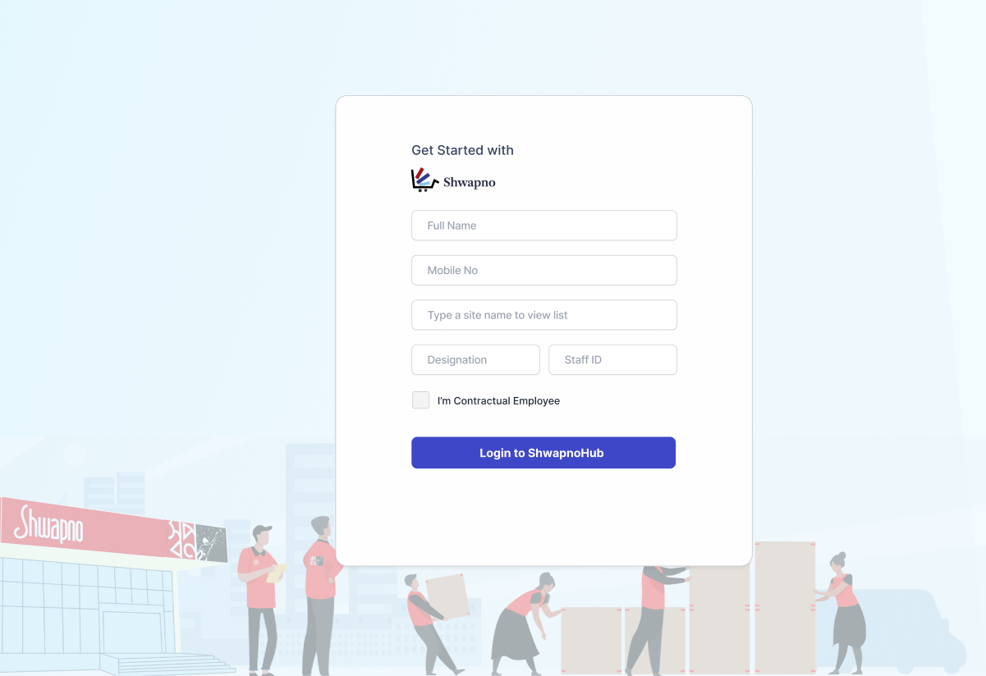
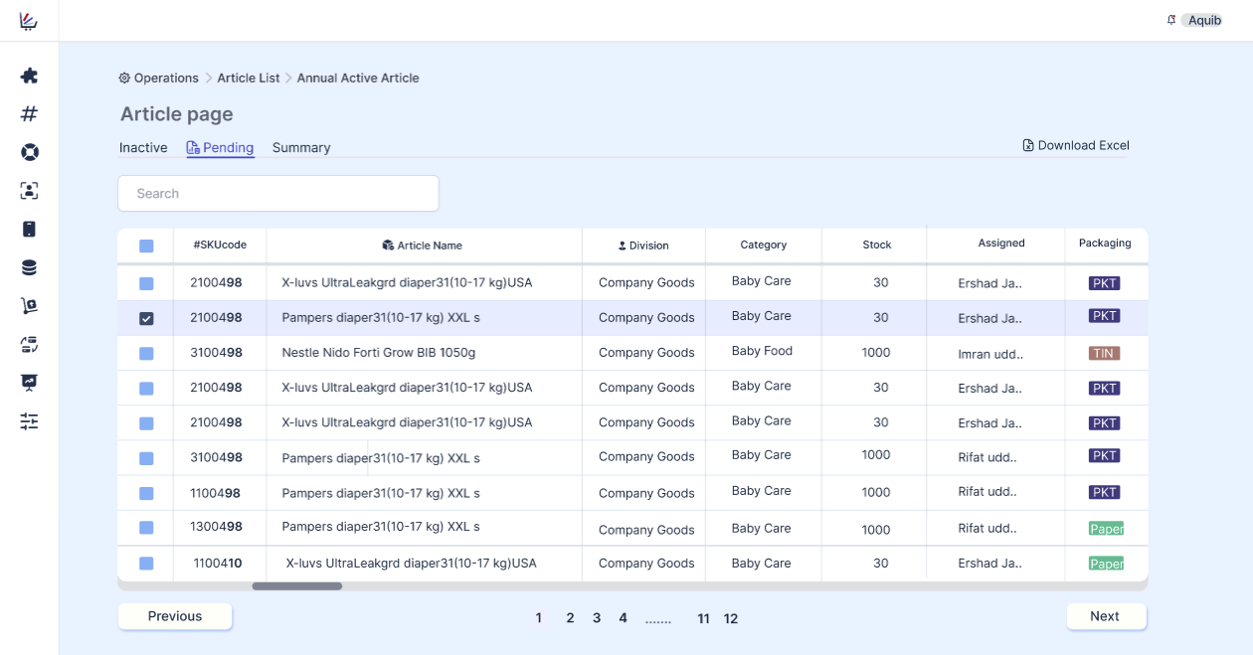
Shwapno Hub
Centralized Authentication System; to Control User Access
Central Backend System Architecture; for Structured Application Management
Single Database; to Improve Efficiency
Reusable Frontend Component Set; to Reduce Development Time
Central Framework for Third Party Integration; to Reduce Different Integration Process
Inventory Management System with State Machine; for Better Stock Tracking
Product: Aquib | Engineer: Sadman, Upol, Sayed
Link

Slide 11





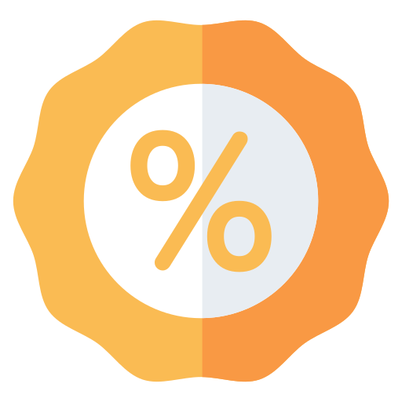




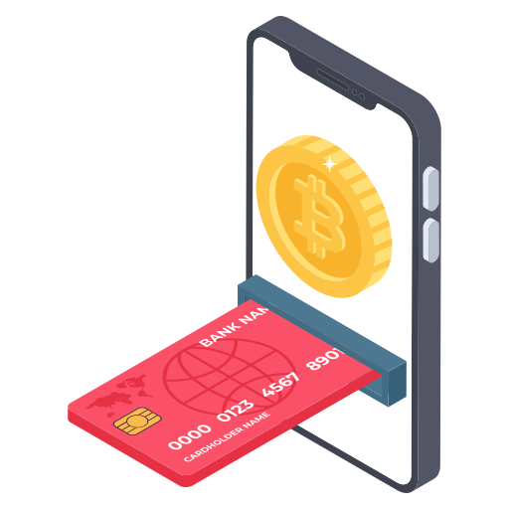




Retail Store User Flow Diagram
Notifications
Switch to Store Mode
Check In
Retail Digital Offer
Search product Location
Digital Invoice
Payment
Auto Added to Cart
Scan Product
Locate Product
Product: Rafa, Sadia

Slide 12

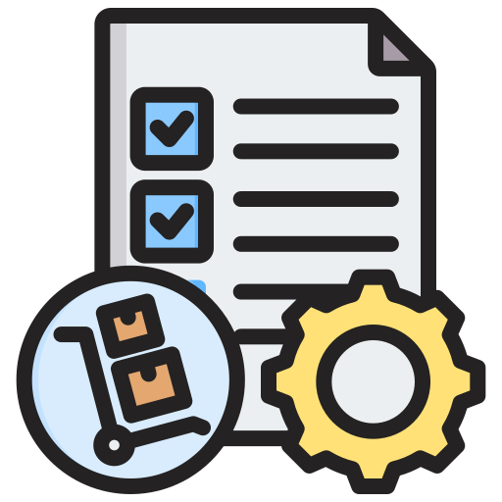


Concept
A comprehensive software solution designed to streamline small retail store operations
Improved Efficiency & Decision-Making
Streamline manual tasks from generated insights
Simplified Procurement
Product sourcing from multiple suppliers
Enhanced Customer Experience
Customer wise automated reminders & offer create
Access to Funding
Leverage crowdfunding to secure capital for growth
Link

Slide 13




Competitor Services Category
TallyKhata
sManager
Hishabee
Sales Entry
Expense Entry
Due Calculation
Top Up (MFS/Mobile)
Online Payment Collection (QR)
Stock Management
Customer/Supplier Details
EMI Collection
Reminder SMS (Marketing, Due)
E-Commerce
POS Printer
Loan
Stock

Slide 14








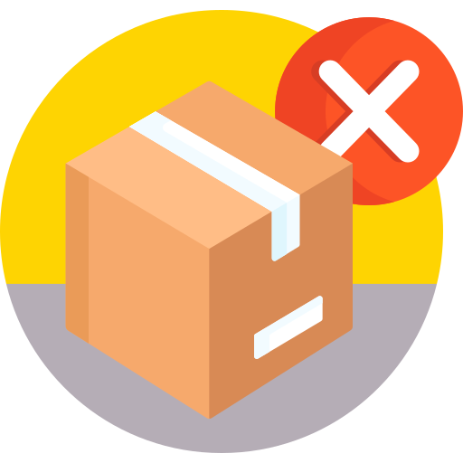




Our Services/Features
Sales
Entry
Expense
Entry
Due
Calculation
Inventory Management
Customer/Supplier Details
Reminder
SMS
Product Ordering Management
Product Removal Suggestion
Shwapno Product Sale
Mobile/Bill
Top Up
Online
Payment
Loan/ Crowdfunding
Link

Slide 15

Possible Future Products
Customer Calling (CRM) Platform
Engaging with Outlet
STO & PO Demand Forecasting
Vendor Management & Reporting Platform
Procurement Management Platform
Category Management Platform
Building Data Collection Platform
Retail Automation Platform
Task Management Platform
Meeting Scheduler Platform
Link

Slide 16

Store Count
408
New Outlets Will Be Added
1,091
683
Monthly Store Opening Run Rate FY 2025-26
494
FY 2023-24
FY 2024-25
FY 2025-26

