Slide 1
Website / Institute | Price approx. | No. of Courses | Course Categories | Certificates | Certificates | Direct Link | Rating | Medium Team (21-100 People) | Large Enterprise (100+ People) | Best Team Feature
1. Udemy Business | ₹24,000 - ₹30,000 | 25,000+ | IT, AI, Design, Soft Skills, Marketing | Yes (Completion) | Yes (Completion) | Visit Site | 4.7/5 | ₹28,000 / user | Custom (Big Discount) | Course Assignment & Tracking
2. Coursera for Biz | ₹33,000 - ₹38,000 | 7,000+ | AI, Data Science, University Degrees | Yes (University) | Yes (University) | Visit Site | 4.8/5 | ₹32,000 / user | Custom Quote | Skills Graph (Skill Gap Analysis)
3. LinkedIn Learning | ₹18,000 - ₹22,000 | 22,000+ | Business, Creative, Tech, Leadership | Yes (Skill Badge) | Yes (Skill Badge) | Visit Site | 4.6/5 | ₹20,000 / user | Volume Based Pricing | LinkedIn Profile Integration
4. Simplilearn | ₹80,000 - ₹1.5 Lakh* | 400+ | AI, Cloud, Cyber Security, Data | Yes (Industry) | Yes (Industry) | Visit Site | 4.6/5 | ₹1.2L / user | Custom Corporate Deal | Live Instructor-led Sessions
5. upGrad Enterprise | ₹1.2 Lakh - ₹4 Lakh* | 200+ | MBA, Data Science, AI Strategy | Yes (Degree/PG) | Yes (Degree/PG) | Visit Site | 4.5/5 | ₹1.5L / user | Custom Managed Learning | Industry Mentorship
6. Pluralsight | ₹35,000 - ₹65,000 | 7,000+ | IT Ops, Software Dev, Cyber Security | Yes (Technical) | Yes (Technical) | Visit Site | 4.5/5 | ₹35,000 / user | Custom (Skills Strategy) | Hands-on Coding Labs
7. edX for Business | ₹40,000 - ₹1.2 Lakh* | 4,000+ | Academic, AI, Engineering, Science | Yes (Executive) | Yes (Executive) | Visit Site | 4.7/5 | ₹40,000 / user | Custom (Degree paths) | Academic Rigor (Top Univs)
8. TalentSprint | ₹1.5 Lakh - ₹8 Lakh* | 50+ | Deep Tech, GenAI, Fintech, Management | Yes (IIT/IISc) | Yes (IIT/IISc) | Visit Site | 4.8/5 | ₹2L+ / user | Premium Exec Training | Elite IIT/IISc Certificates
9. NIIT Digital | ₹60,000 - ₹2.5 Lakh* | 100+ | Banking, IT, Digital Marketing | Yes (Diploma) | Yes (Diploma) | Visit Site | 4.4/5
10. Great Learning | ₹1.0 Lakh - ₹3 Lakh* | 1,000+ | Business Analytics, AI, Cloud | Yes (Global Univ) | Yes (Global Univ) | Visit Site | 4.7/5 | ₹1.0L / user | Custom Program Design | Career Support & Capstone

Slide 2
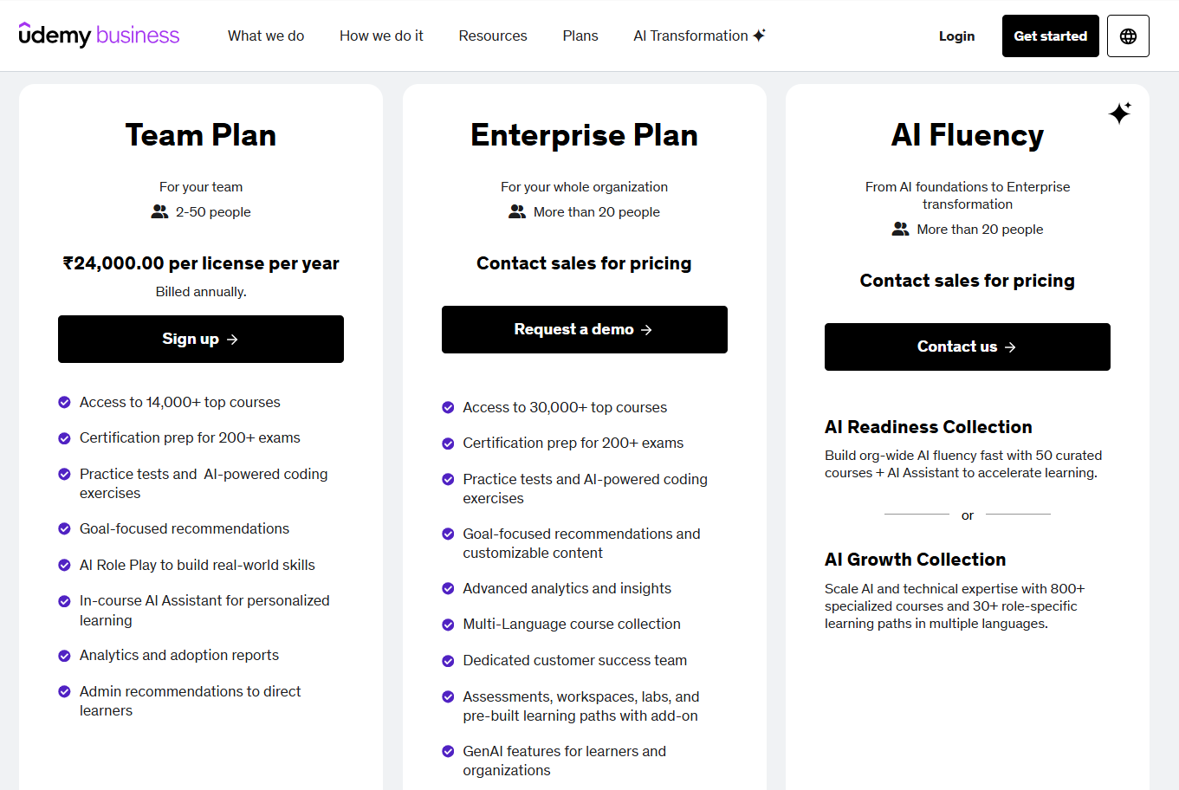
For Link : Ctrl+Right Click

Slide 3
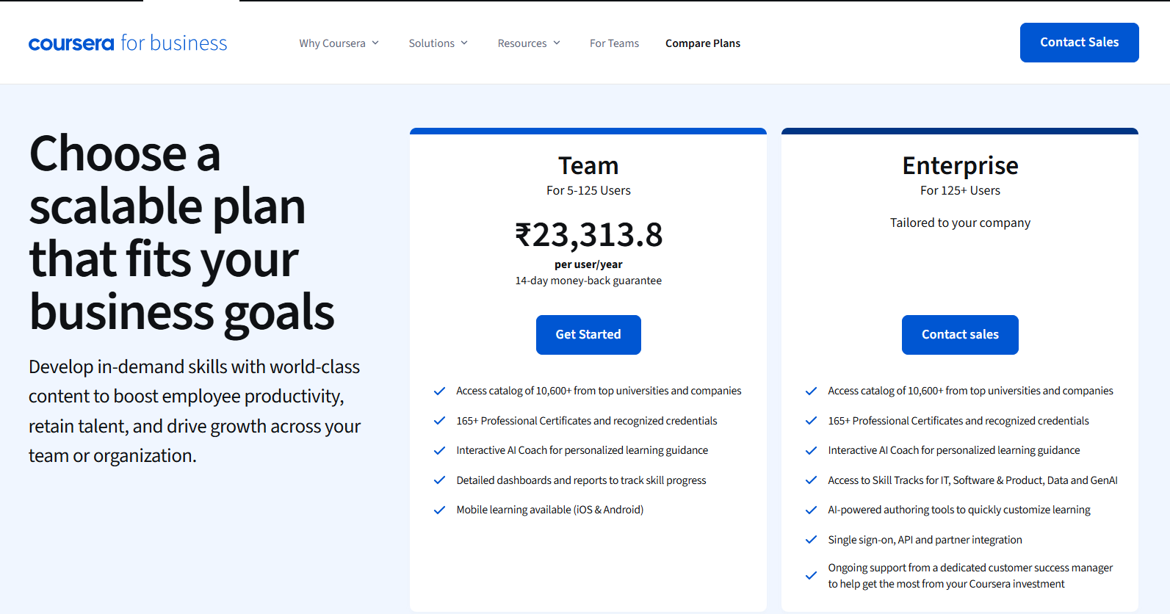

Slide 4
