Slide 1
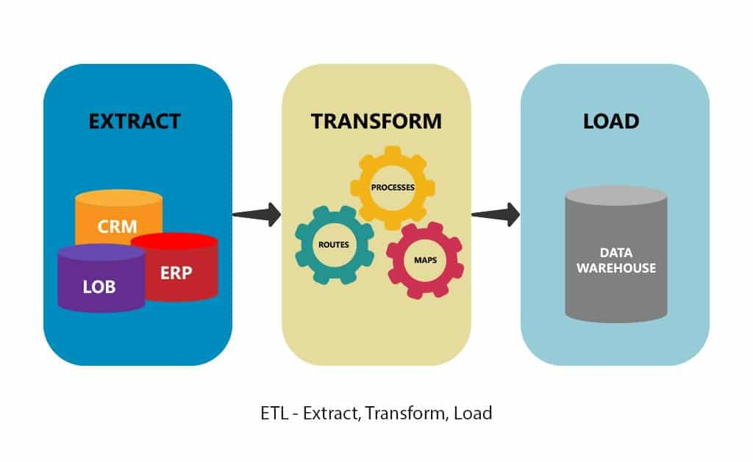

ETL Circular Data Process Extract And Verify

Slide 2
Agenda
Extract
Transform
Load
Original data sources
How the data was formatted (CSV, JSON, pgAdmin 4, etc)
What data cleaning or transformation was required
The final database, tables/collections
Why this was chosen

Slide 3


Extract : Original Data Source
Data Source: https://www.bls.gov

Slide 4
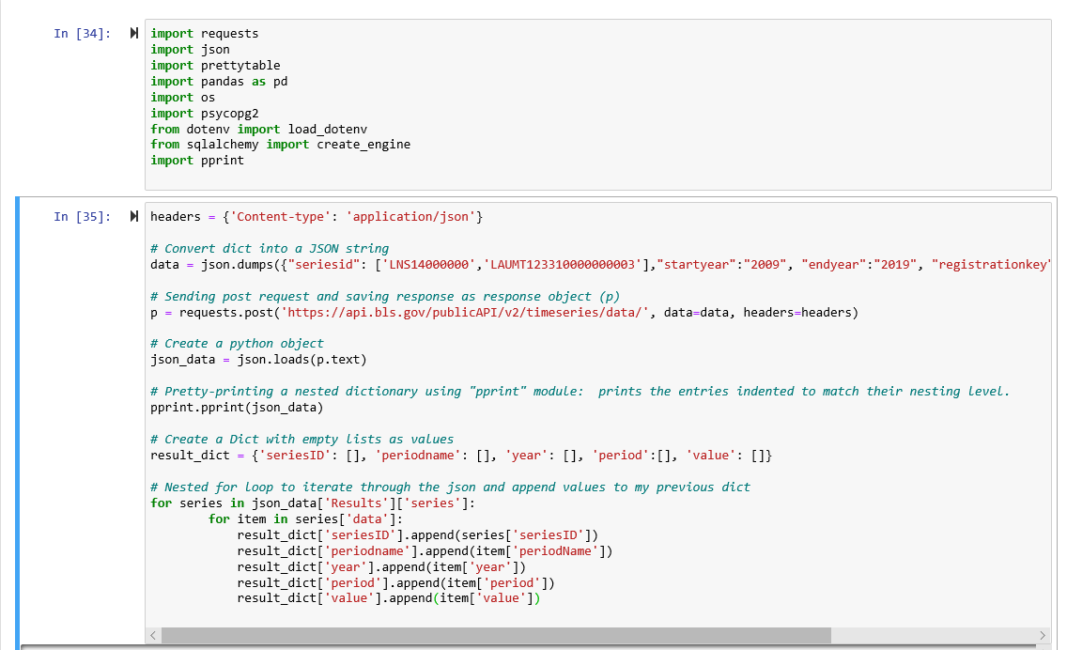
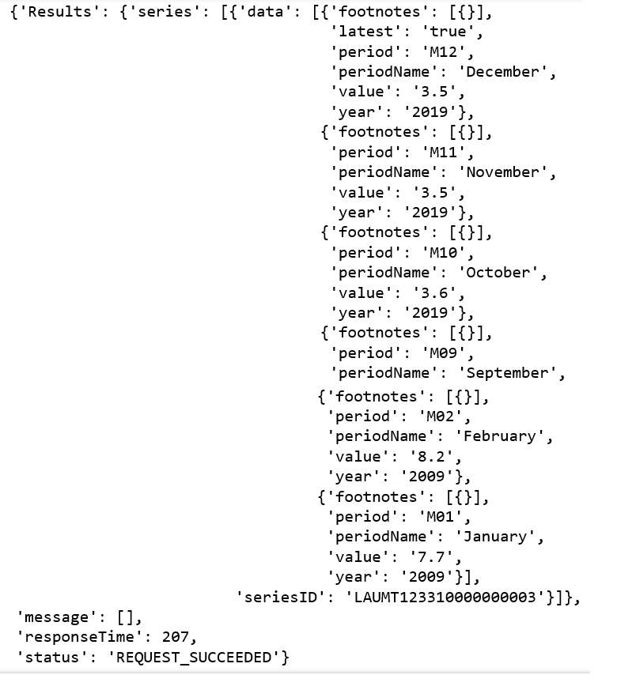
Extract : How the data was extracted and formatted
Json’s response sample
Using the API available version at bls (API Version 2.0), and python sample code, we execute the following code :
Labor Force Statistics from the Current Population Survey
Local Area Unemployment Statistics

Slide 5
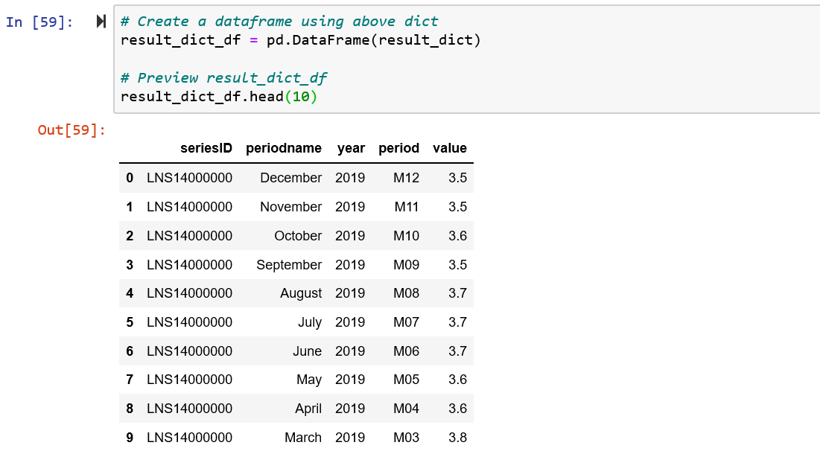
Extract : How the data was extracted and formatted
Once our dictionary ‘result_dict’ was populated with the JSON selected values, we created the first data frame :

Slide 6
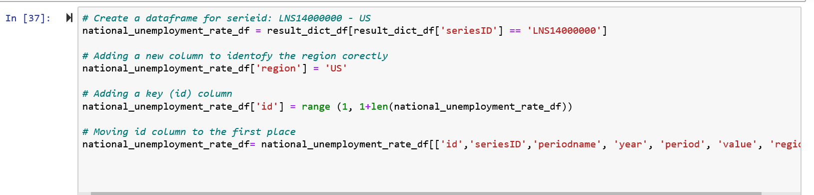
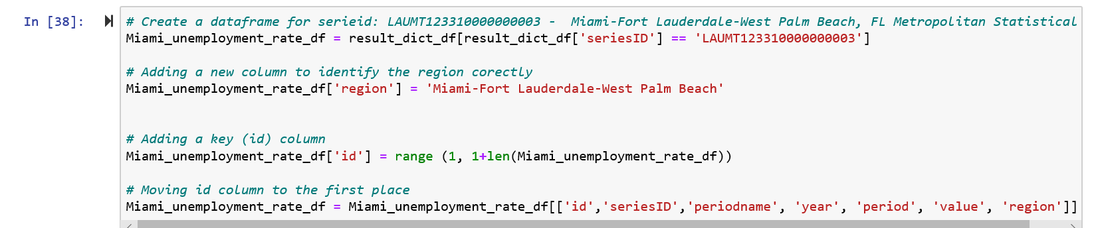
Transform : What data cleaning or transformation was required
First, we created two data frames, one for national and another one for Miami region unemployment filtering by the corresponding seriesID. Additionally, as you can see in the code we did different transformations such as : 1. Adding a new column to identify regions clearly, 2. Creating a new key ID column, 3. Moving the Key ID column to first place.

Slide 7
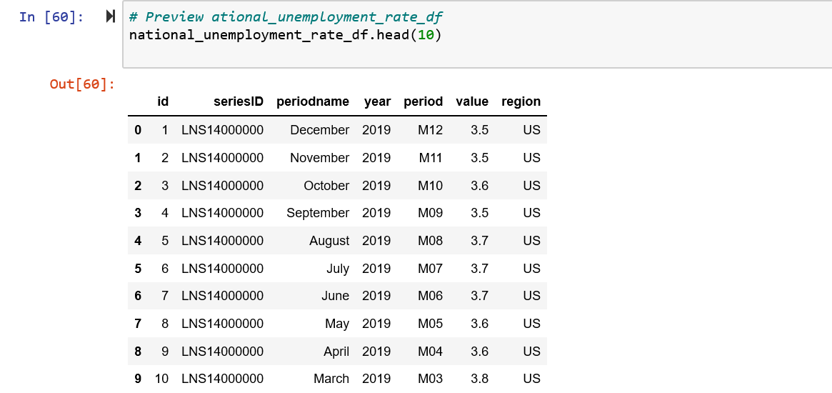
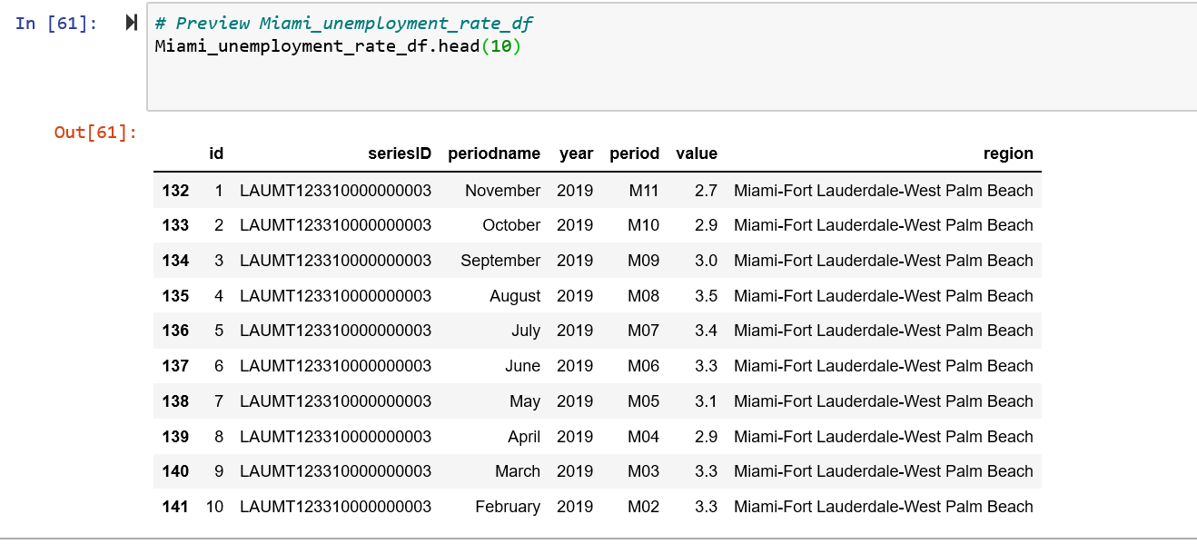
Transform : What data cleaning or transformation was required
We previewed each filtered data frame to make sure the implementation was correct

Slide 8
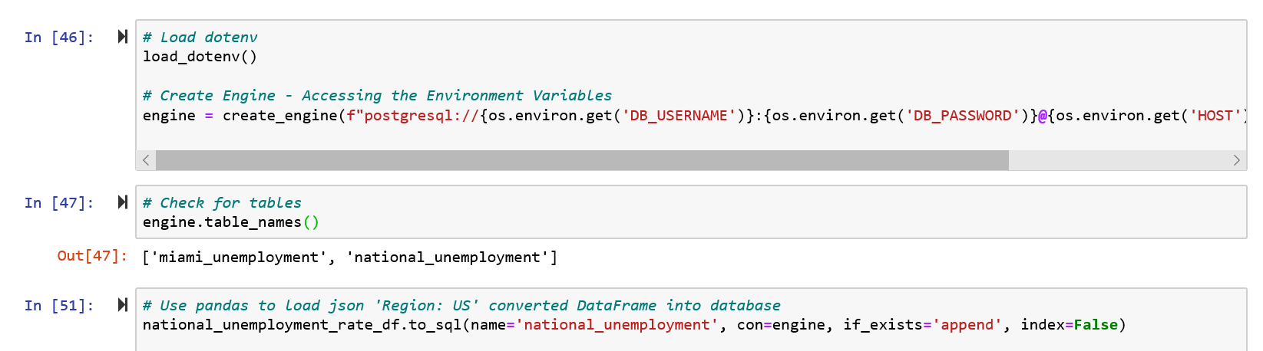
Load : The final database, tables/collections
At this point we did the following steps:
we created an engine connection with our created data base in PgAdmin using load_dotenv() method to access the environment variables that we don’t want to be exposed to the public due to security reasons.
Once the connection was established, we check that our tables were correctly created in PgAdmin
We used pandas to load both Json (Regions: US, Miami-Fort Lauderdale-West Palm Beach ) converted to DataFrame into database

Slide 9
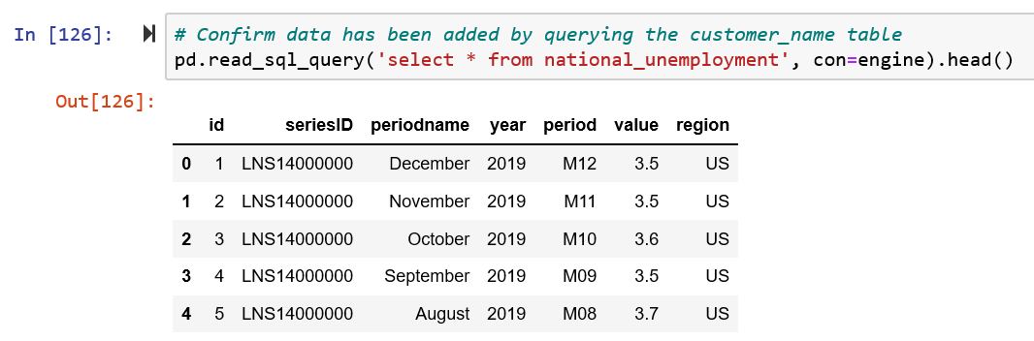
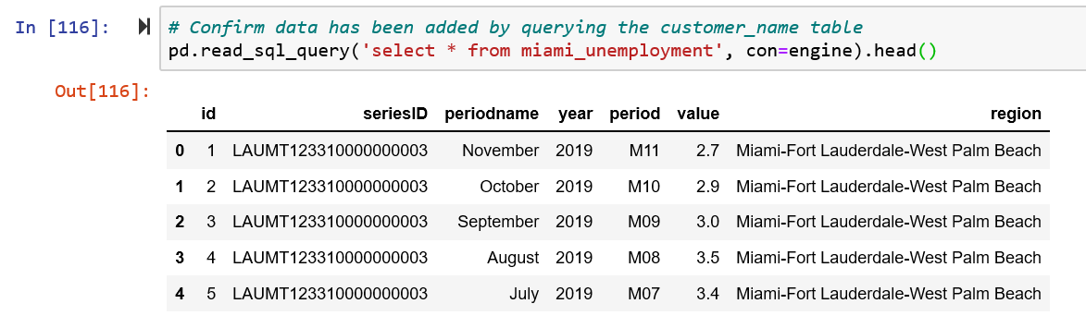
Load : tables
Tables were checked in Jupyter Notebook

Slide 10
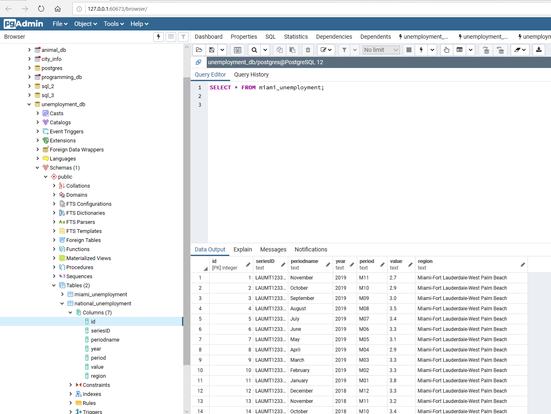
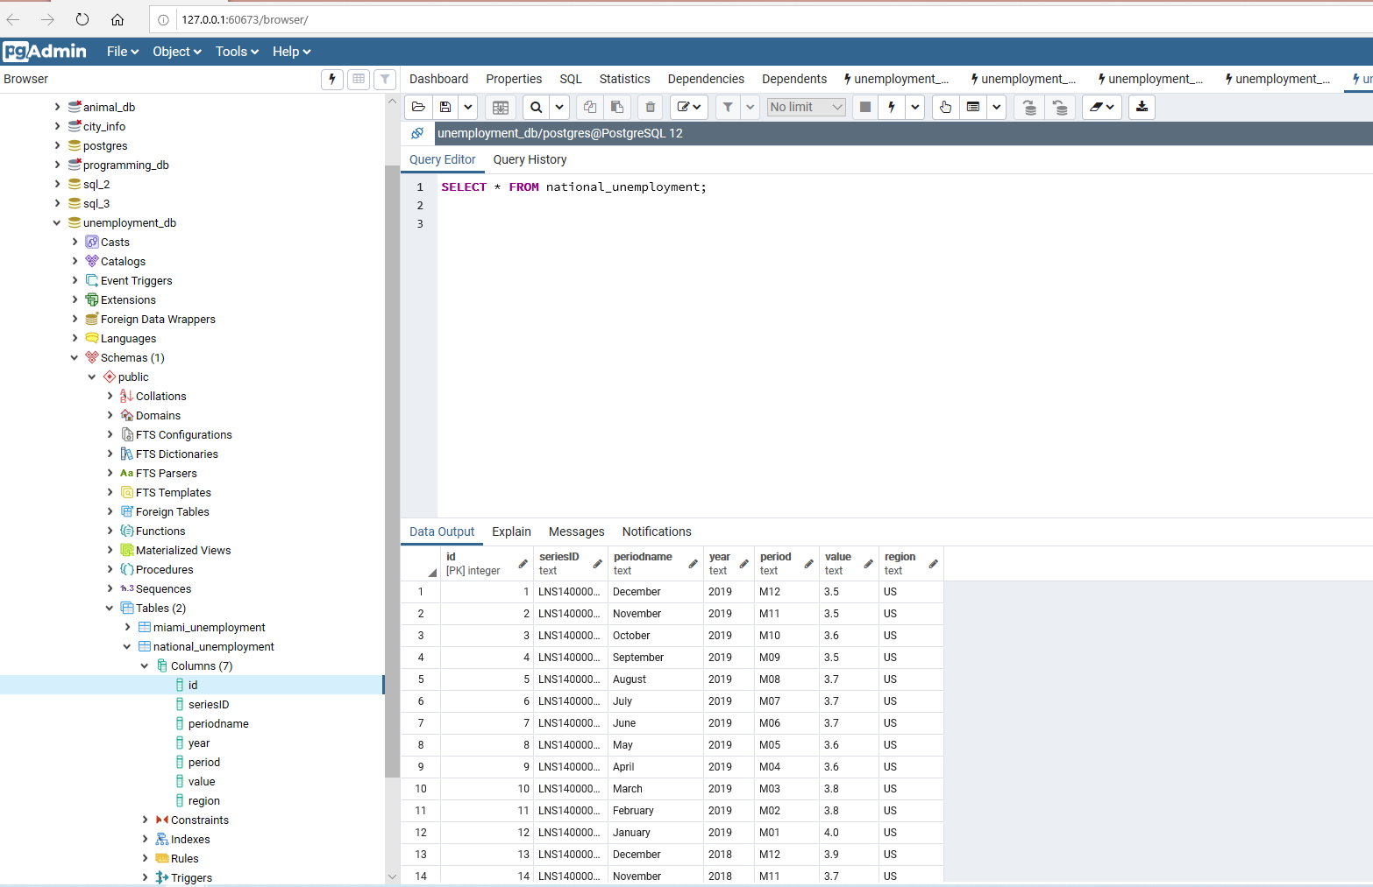
Load : tables
Tables were checked in PgAdmin

Slide 11
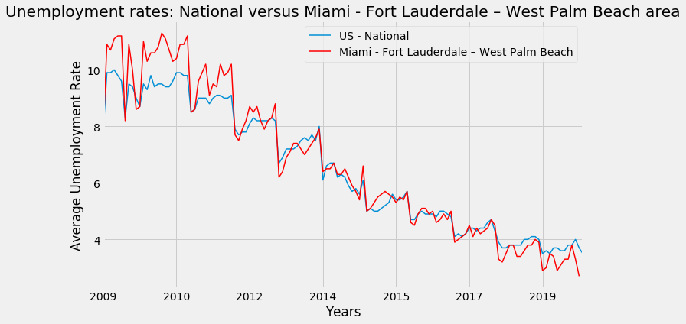
Load : Why this project was chosen
Practice the execution of the entire ETL process
Compare the possible variations between unemployment rates averages by year at national level versus unemployment rates at Miami - Fort Lauderdale – West Palm Beach area. According to the comparison graph below, there was a period from 2009 to 2012 were we can observe a significant variation between National and Miami area unemployment rates (Miami above National). However, since 2012 up to 2019 the variations look very stable (even).

