Slide 1
Drexel University
Department of Environmental
& Occupational Health
Dornsife School of Public Health
AI WORKSHOPS FOR DSPH
Workflow Enhancement
Start from your own plan, then let ChatGPT Edu or Copilot Chat draft or refine
Alex Quistberg, PhD, MPH
Associate Research Professor · Department of Environmental & Occupational Health
Core 2 · Fall 2026 · on Zoom
Notes:
On Zoom. Paste the Core 2 page link, the demo-file links, and m365.cloud.microsoft/chat in the chat now. Two ideas run through the hour: plan first, then decide whether AI drafts or refines.

Slide 2
WHAT YOU'LL LEAVE WITH
Today's Goals
1
Pick a weekly task where AI can save you time.
2
Start from your own plan, then decide: should AI draft it, or refine what you wrote?
3
Get a document, email, or spreadsheet into Copilot Chat or ChatGPT Edu.
4
Use AI as an editor: tighten language, catch inconsistencies, find what's missing.
5
Check the answer before you use it, and save one prompt you can reuse.
Environmental & Occupational Health
Dornsife School of Public Health
Notes:
Five goals. The real ones: a plan before any AI, and knowing when to let AI draft versus refine.

Slide 3
WELCOME BACK
How Did Your Core 1 Task Go?
In the Zoom chat, one line
How today works on Zoom
What task did you try after Core 1?
Did it help? What did you have to fix?
Didn't get to it? Type the task you'll try today.
Put Zoom and your browser side by side.
React with a thumbs-up when you finish a step.
Stuck? Say so in the chat and we'll help.
Demo file links are in the chat.
Environmental & Occupational Health
Dornsife School of Public Health
Notes:
Ask for one line in the Zoom chat. Read two or three aloud. Then cover the right box: Zoom and browser side by side, thumbs-up reaction when done, questions in the chat.

Slide 4
SECTION 01
Plan First, Then Draft or Refine
Your plan comes before any AI draft. Then decide what AI should do with it.

Slide 5
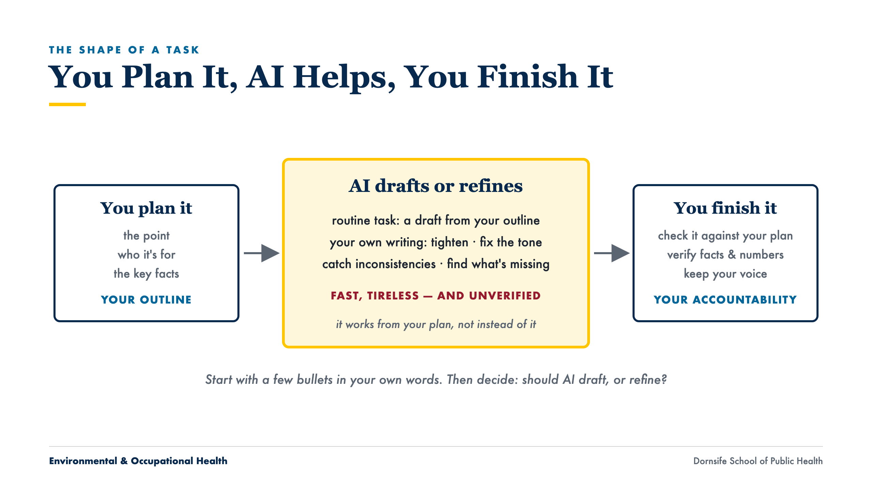
Notes:
Before AI, write a few bullets: the point, who it is for, the key facts. Two minutes. AI then drafts from your plan or refines what you wrote, and you check the result against your plan.

Slide 6
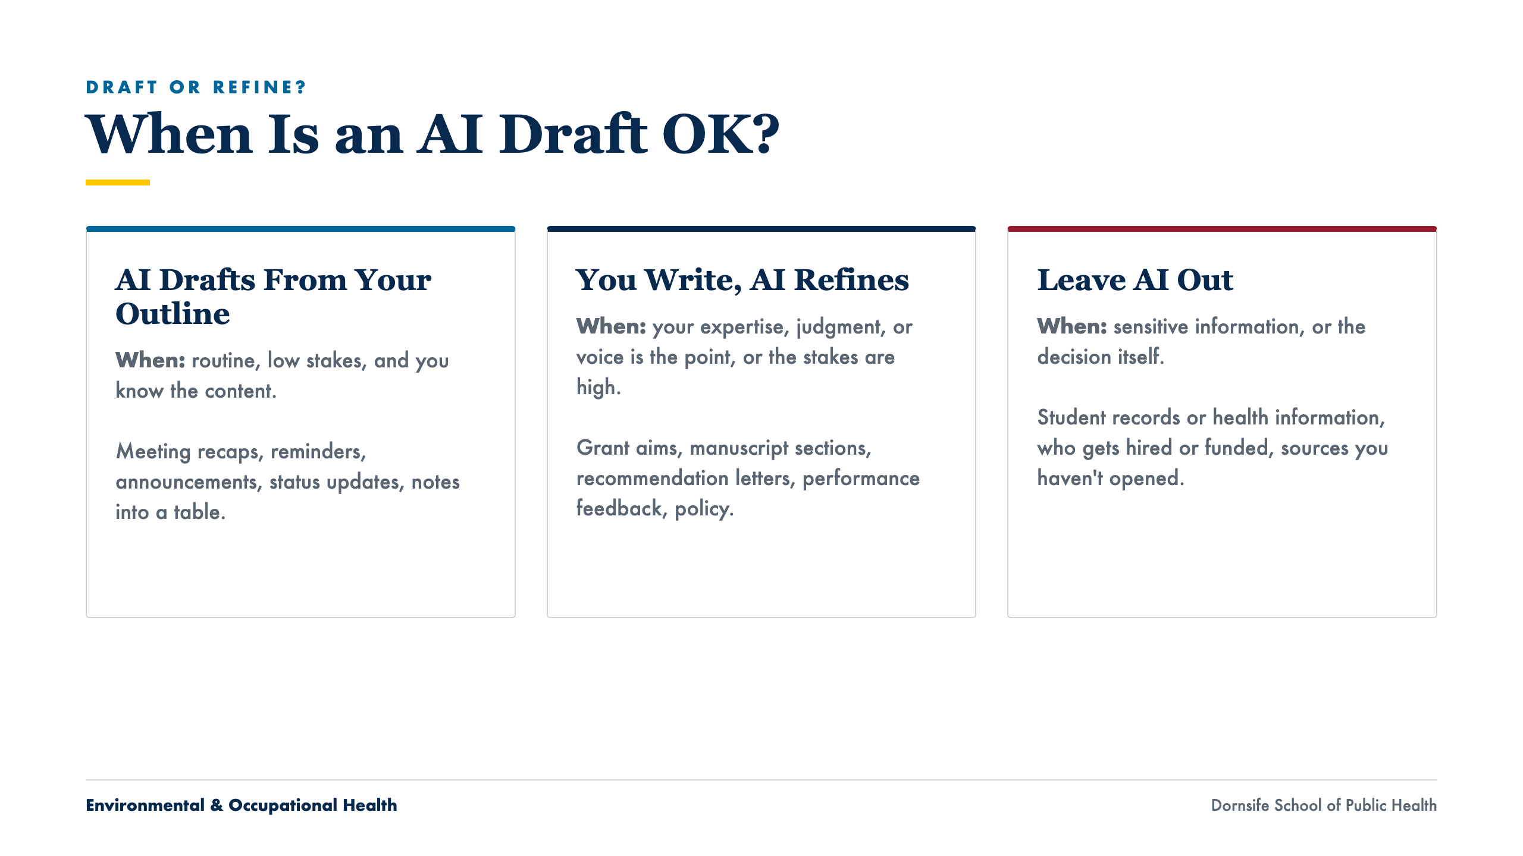
Notes:
The center of the session. AI drafts from your outline: routine, low stakes, you know the content. You write, AI refines: your expertise, judgment, or voice is the point, or the stakes are high. Leave AI out: sensitive information and the decision itself. Ask in the chat for one task per column.

Slide 7
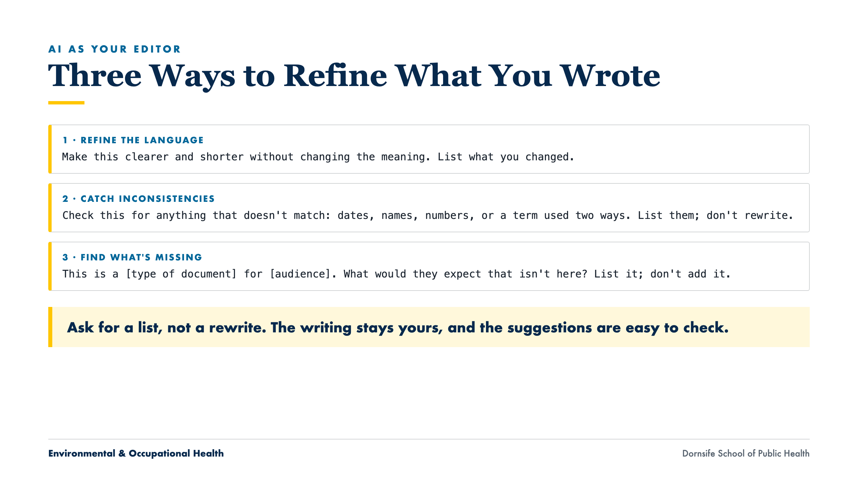
Notes:
Each prompt asks for a list, not a rewrite. You stay the author; AI is the second reader. Inconsistencies are the sleeper hit: dates that do not match, a name spelled two ways, a number that changes between sections.

Slide 8
WHICH TOOL TO OPEN
Two Tools, Same Steps
Copilot Chat
ChatGPT Edu
Same Steps in Both
m365.cloud.microsoft/chat, signed in with your Drexel account. Good for quick summaries and edits of Drexel documents and email.
The Drexel workspace you used in Core 1. Good for longer drafting, going back and forth, and (in Core 3) saved assistants.
Paste the text, or upload the file with the + button. Ask. Check. Copy the answer back into your document.
No Copilot inside Word or Excel at Drexel. You don't need it: upload the file or paste the text, then copy the answer back.
Environmental & Occupational Health
Dornsife School of Public Health
Notes:
Brief. Both take pasted text or an uploaded file. If asked about Copilot inside Word or Excel: Drexel does not have that license, and you do not need it. In Outlook, the Summarize button works for everyone.

Slide 9
TOOLS & DATA
Same Data Rule as Core 1
Fine to use
Never paste in
Your own drafts, notes, and announcements
Committee and project email without sensitive details
Public documents and published papers
Made-up versions of anything sensitive
Health information about a person
Student records or Social Security numbers
Identifiable research data
When in doubt, leave it out or make the details up
Environmental & Occupational Health
Dornsife School of Public Health
Notes:
Same rule as Core 1. Drexel lists Copilot Chat (signed in) as approved for High Risk Data, but for this session keep the simple rule.

Slide 10
SECTION 02
Check Before You Use It
Three quick questions before anything leaves your hands.

Slide 11
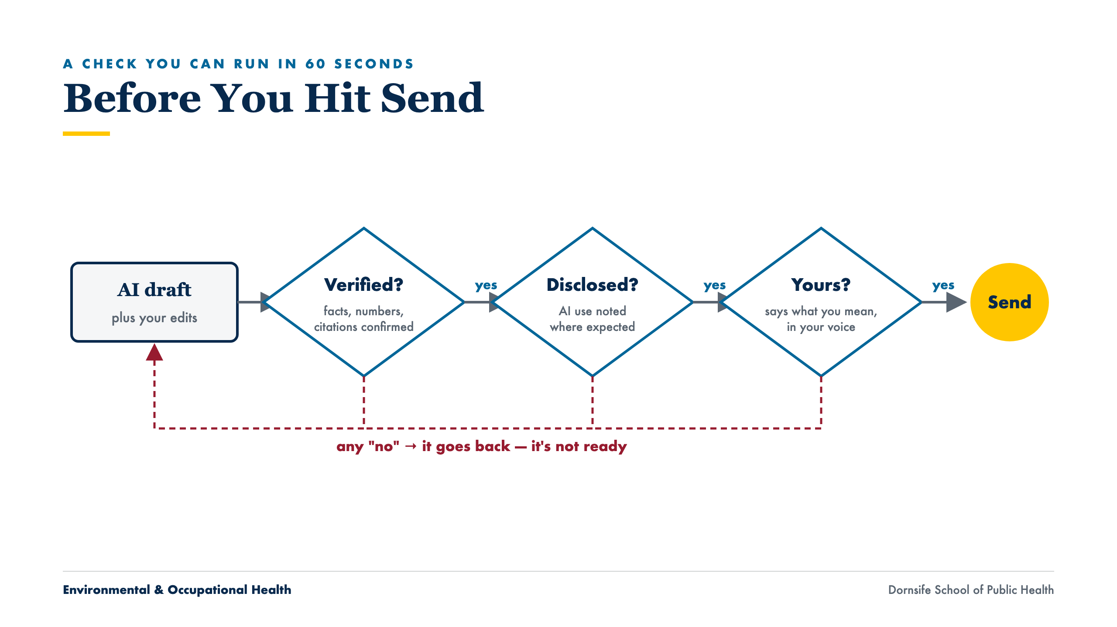
Notes:
Trace one draft through the three diamonds. Verified: check it against your plan and the original. Disclosed: official, research, or external work. Yours: does it say what you mean? Any "no" sends it back. Core 4 covers this in depth.

Slide 12
“
If you can’t open it, you can’t cite it.
A rule worth keeping
Treat every AI-supplied figure as unverified until you’ve confirmed it
Notes:
Applies to numbers as much as citations. If you cannot trace it to a source you opened, it does not go in.

Slide 13
SECTION 03
Hands-On
Upload a file together, then pick one everyday job, then your own task. Demo file links are in the Zoom chat.

Slide 14
GUIDED START · ~5 MIN · FOLLOW ALONG
Upload a File to Copilot Chat
1
Download Workshop2_Demo_StudyDescription.docx (link in the Zoom chat).
2
Go to m365.cloud.microsoft/chat and sign in with your Drexel account. Look for the shield icon.
3
Click + next to the message box and upload the file (or paste the text).
4
Type: “Summarize this document in 5 bullet points for a project status update.”
5
Follow up: “Now make it 3 bullets for a busy dean.”
React with a thumbs-up in Zoom when you have an answer. The same steps work in ChatGPT Edu.
Environmental & Occupational Health
Dornsife School of Public Health
Notes:
Do each step on your shared screen and pause. Ask for a thumbs-up reaction after the upload step. Summarizing is a safe first job: the content already exists, so every bullet can be checked. No shield icon: personal Microsoft account. Upload fails: paste the text. Cannot find the file: repost the link.

Slide 15
ACTIVITY 1 · ~19 MIN
Three Everyday Jobs: Pick One
Use Copilot Chat or ChatGPT Edu, on your own screen. Upload the demo file or use your own non-sensitive material. Questions go in the Zoom chat.
Job A · A Document
Job B · An Email Thread
Job C · A Spreadsheet
Summarize a study description, rewrite a paragraph for a community board, then find what's missing.
Find the decisions and open questions, make an action-item table, then draft a reply from your outline.
Find what stands out, get an Excel formula to flag rows, pick a chart.
Environmental & Occupational Health
Dornsife School of Public Health
Notes:
Ask people to type A, B, or C in the chat. Leave the slide for the most common choice on screen; switch if the chat asks.

Slide 16
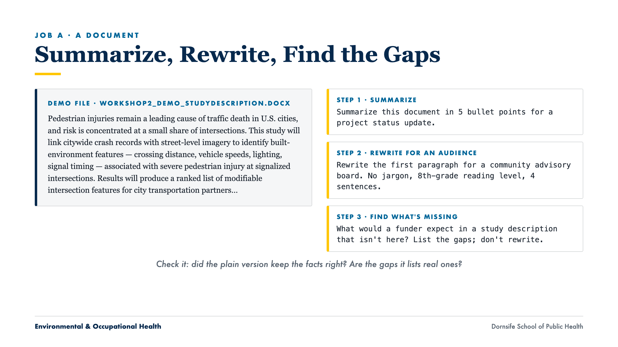
Notes:
Find what is missing: the description has aims, methods, products, and partners, but no timeline, budget, sample size, team roles, or plan for privacy in street imagery. Ask people to post one gap in the chat and whether it is real. AI lists gaps; the author decides what to add.

Slide 17
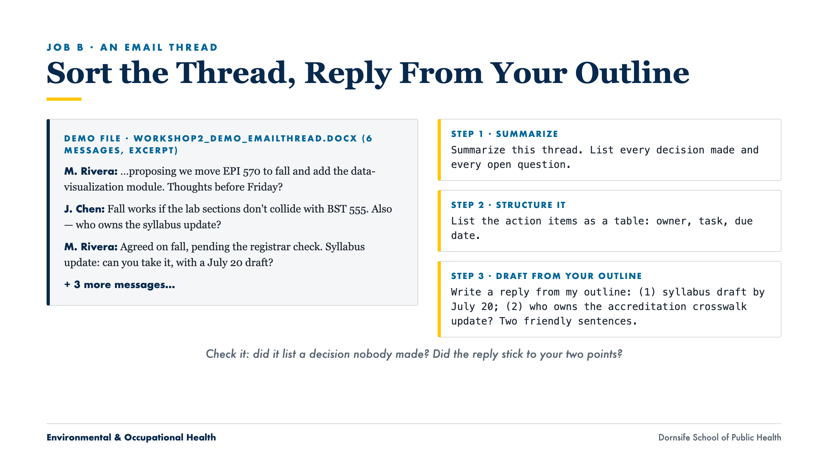
Notes:
The person supplies the two points; AI only turns them into sentences. Did the reply add anything they did not say? The accreditation crosswalk was put on the September agenda with no owner: decision, action item, or open question?

Slide 18
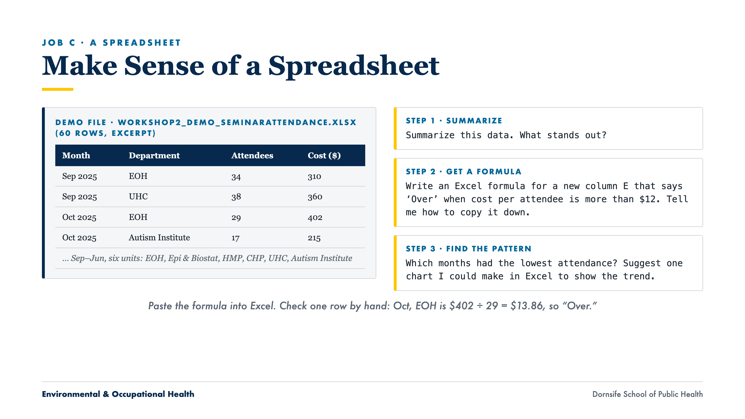
Notes:
17 of 60 rows are over $12 per attendee: Oct EOH, HMP, and Autism Institute; all of Dec except Epi & Biostat; Jan HMP, CHP, and Autism Institute; all six in June. Nov HMP is exactly $12.00 ($300 ÷ 25): a formula with > will not flag it, >= will. Check the formula, not just the answer.

Slide 19
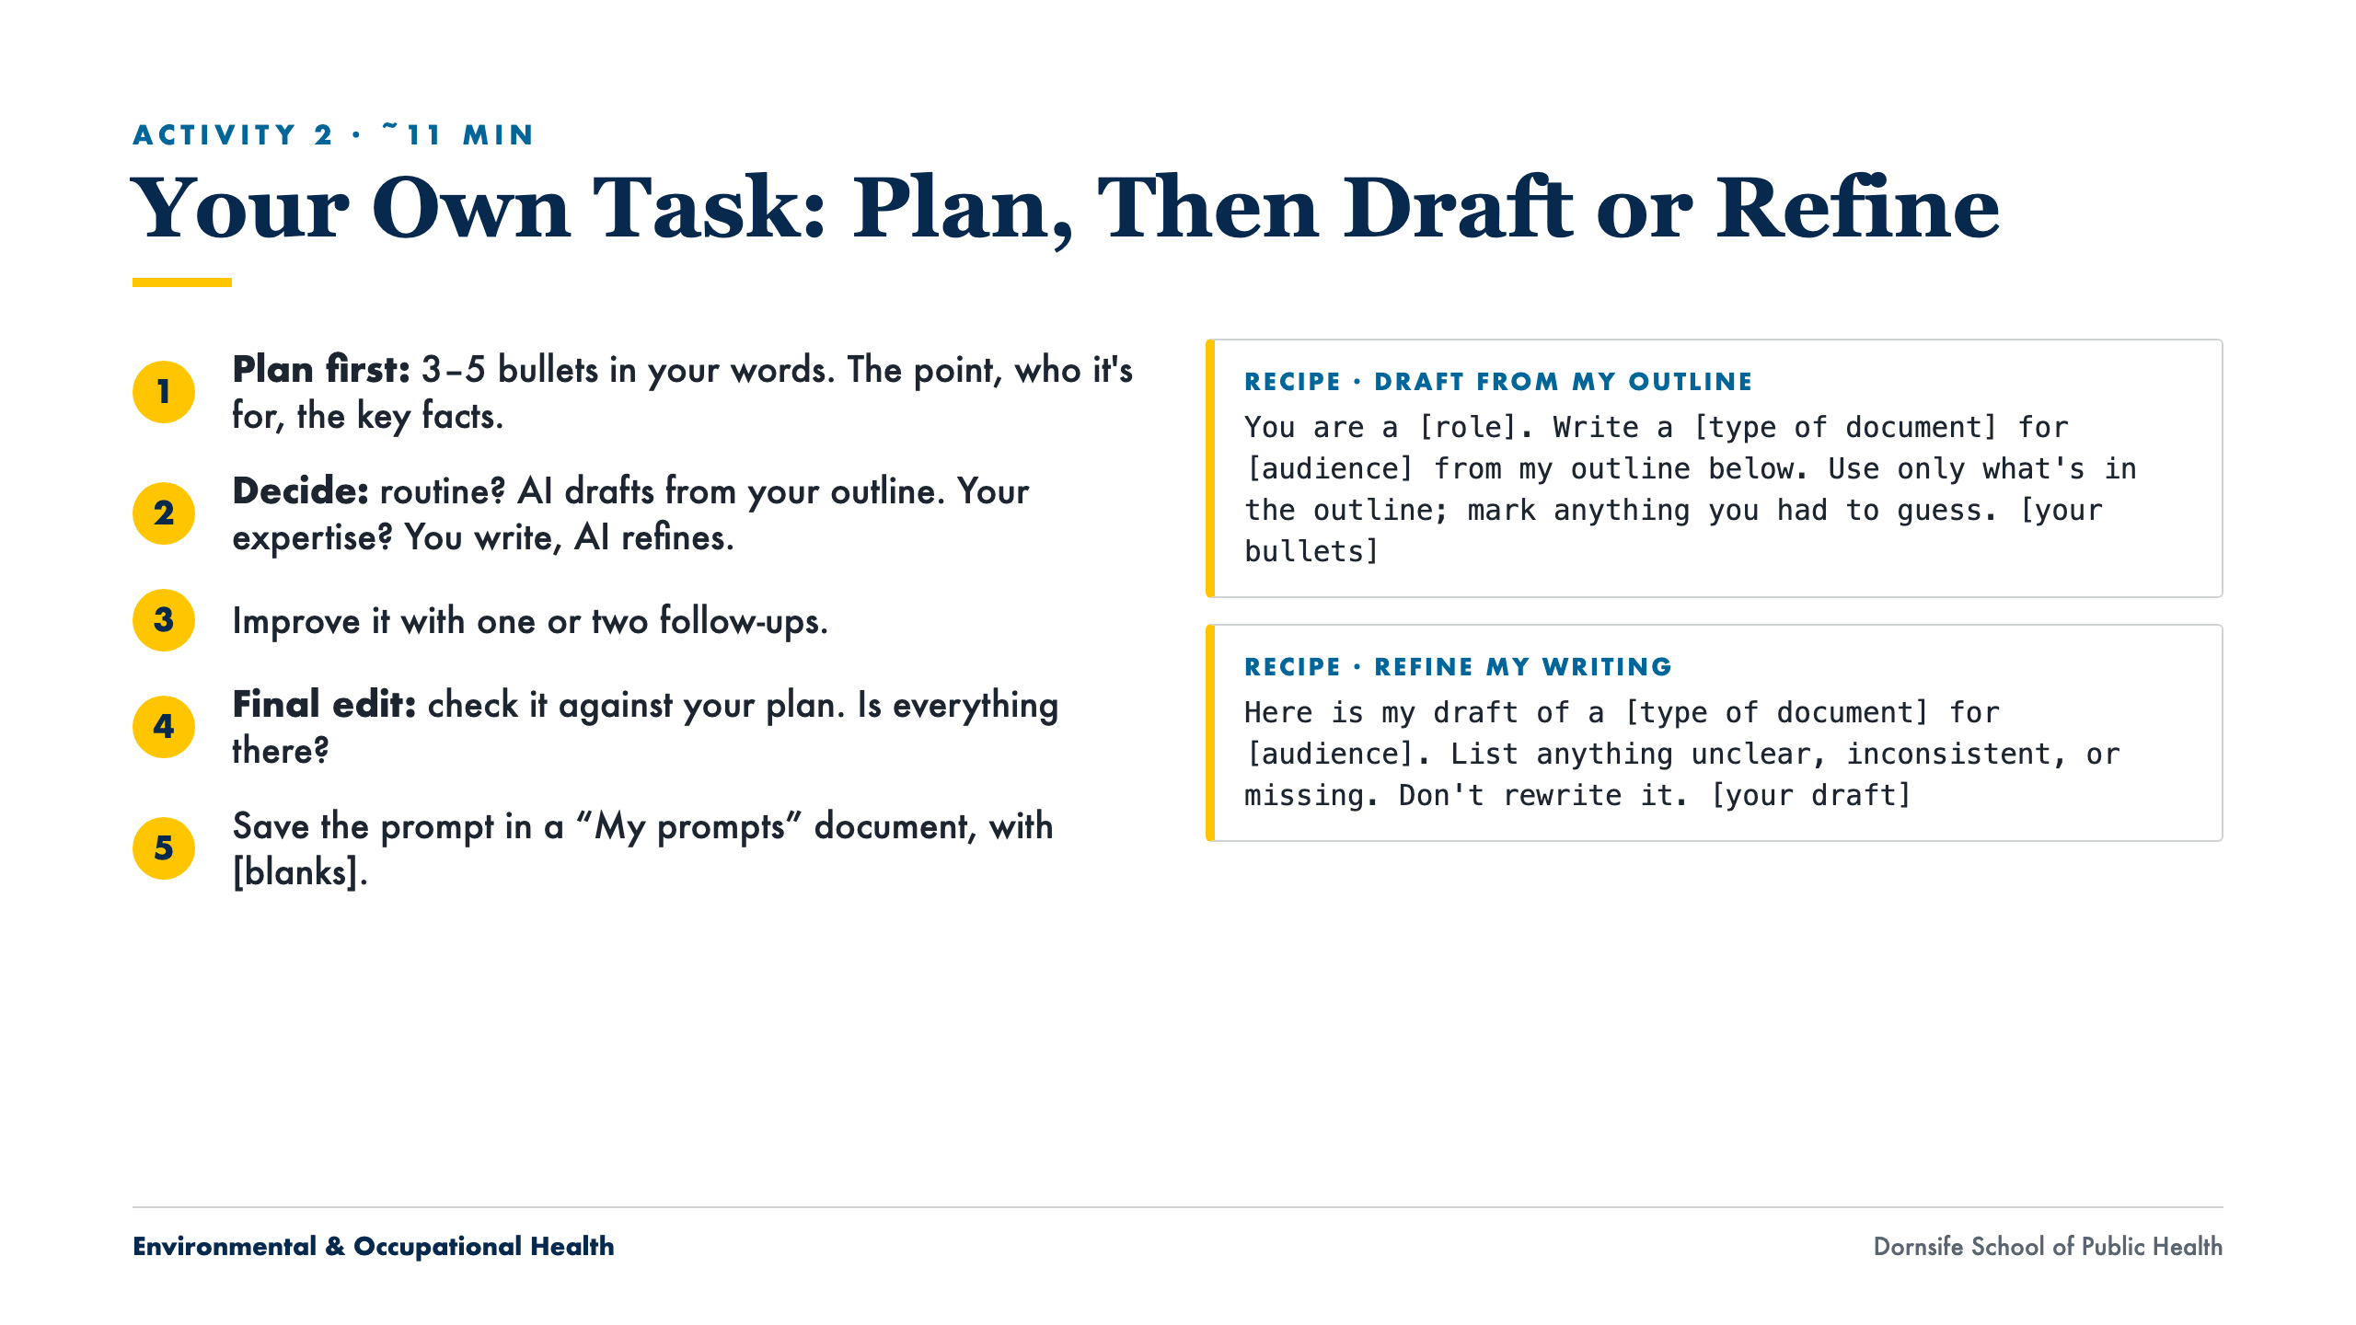
Notes:
Hold people to step 1: a plan before AI. Ask them to type "plan done" in the chat before opening AI. Routine task: recipe 1. Expertise or high stakes: write it, then recipe 2. Everyone saves at least one recipe before leaving.

Slide 20
WRAP-UP
What to Take Away
Plan first. Then AI drafts from your outline, or refines what you wrote. Then you check it.
Routine and low stakes: AI drafts from your outline. Your expertise or high stakes: you write, AI refines.
As an editor, AI tightens language, catches inconsistencies, and finds what's missing. Ask for a list, not a rewrite.
Before you use it: Verified? Disclosed? Yours?
Before Core 3: save two recipes (one draft, one refine) and use one again next week.
In the Zoom chat: one thing you'll try this week.
Environmental & Occupational Health
Dornsife School of Public Health
Notes:
Ask for one line in the chat: one thing they will try this week. Paste the feedback form link (bottom of the Core 2 page) in the chat.

Slide 21
Drexel University
Dornsife School of Public Health
THANK YOU
Questions & Discussion
Next: Core 3 — Reusable Assistants. Turn your saved recipes into shared Projects and custom GPTs.
Alex Quistberg, PhD, MPH
daq26@drexel.edu
Department of Environmental & Occupational Health

