Slide 1
Drexel University
Department of Environmental
& Occupational Health
Dornsife School of Public Health
AI WORKSHOPS FOR DSPH
Workflow Enhancement
Turn tasks you do every week into quick routines with ChatGPT Edu and Copilot Chat
Alex Quistberg, PhD, MPH
Associate Research Professor · Department of Environmental & Occupational Health
Core 2 · Fall 2026
Notes:
This picks up where Core 1 left off. Everything today works in Copilot Chat or ChatGPT Edu by pasting text or uploading a file. Drexel does not have the Microsoft 365 Copilot license, so there is no Copilot button inside Word or Excel.

Slide 2
WHAT YOU'LL LEAVE WITH
Today's Goals
1
Pick a weekly task where AI can save you time.
2
Get a document, email, or spreadsheet into Copilot Chat or ChatGPT Edu.
3
Use three everyday moves: summarize, rewrite for an audience, make a table.
4
Check the answer before you use it.
5
Save one prompt you can reuse.
Environmental & Occupational Health
Dornsife School of Public Health
Notes:
Five goals. The real one: leave with one task set up as a routine and one saved prompt.

Slide 3
WELCOME BACK
How Did Your Core 1 Task Go?
At the end of Core 1 you tried one weekly task with ChatGPT Edu. Turn to a neighbor:
What did you try?
Did it save time? What did you have to fix?
Didn't get to it? Today is the day. Pick the task now.
Environmental & Occupational Health
Dornsife School of Public Health
Notes:
Show of hands: who tried a task after Core 1? Take one or two examples. If few did, say so lightly: "Today you leave with two tasks set up."

Slide 4
SECTION 01
Where AI Fits
Which tasks to start with, and which tool to open.

Slide 5
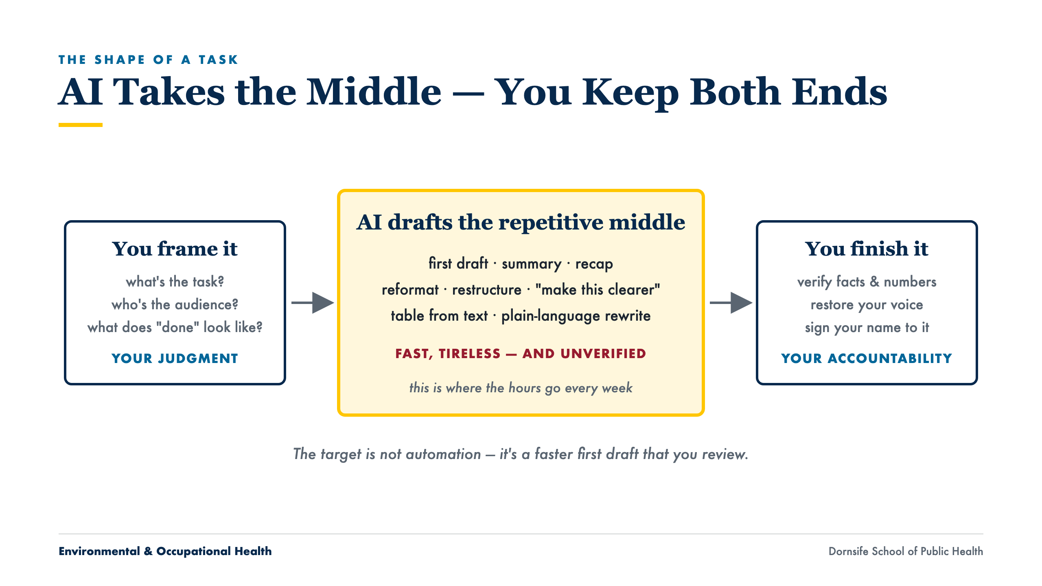
Notes:
You frame it, AI drafts the middle, you finish it. The middle is where the weekly hours go.

Slide 6
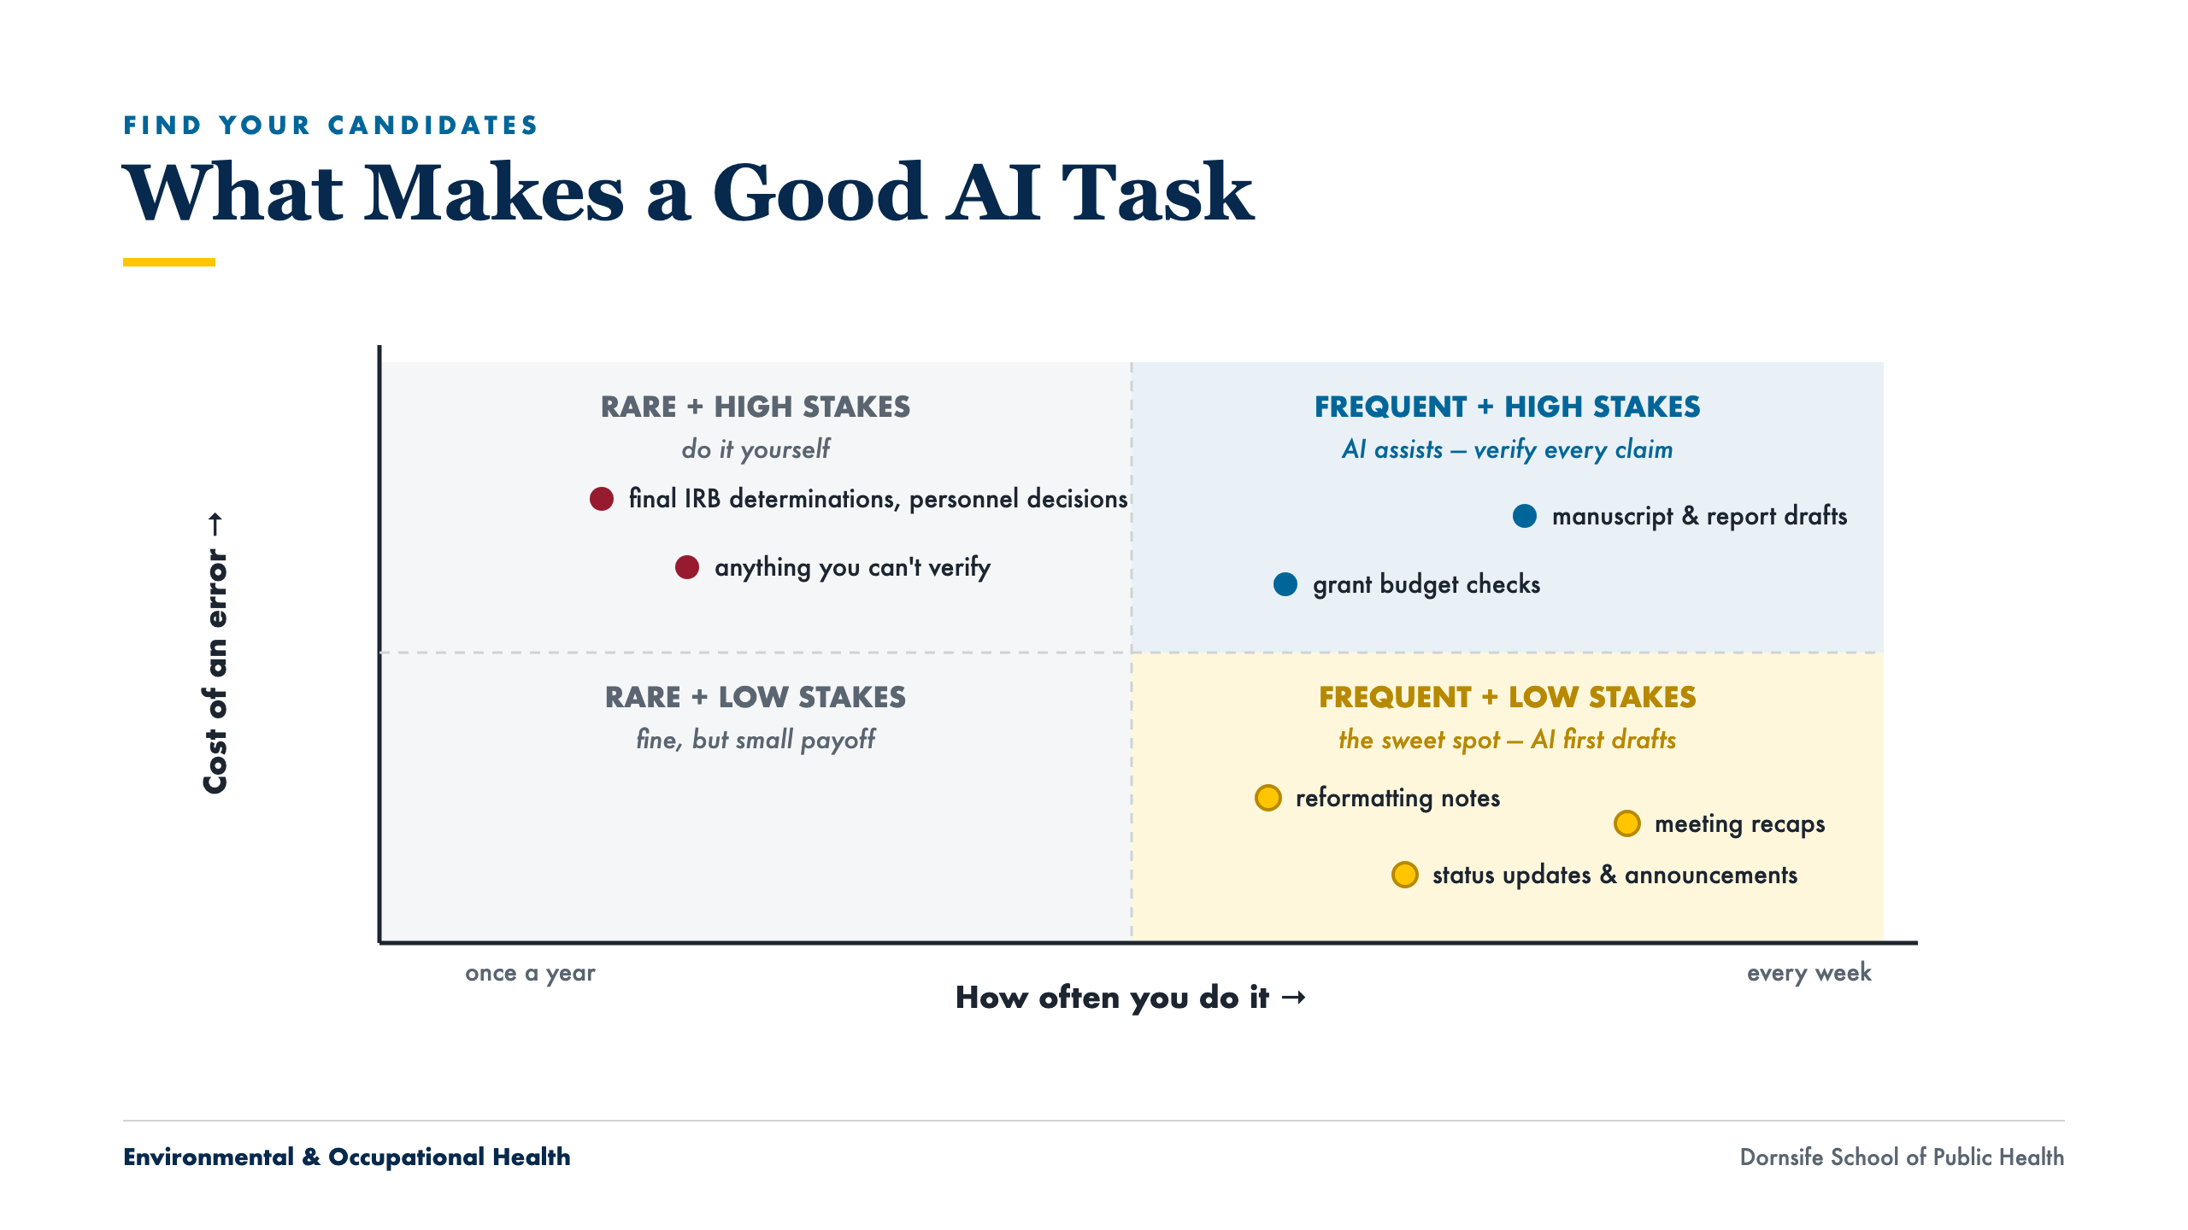
Notes:
Point at the gold quadrant: frequent and low-stakes is where to start. Ask the room to name one task that fits there.

Slide 7
WHICH TOOL TO OPEN
Two Tools, Same Steps
Copilot Chat
ChatGPT Edu
Same Steps in Both
m365.cloud.microsoft/chat, signed in with your Drexel account. Good for quick summaries and rewrites of Drexel documents and email.
The Drexel workspace you used in Core 1. Good for longer drafting, going back and forth, and (in Core 3) saved assistants.
Paste the text, or upload the file with the + button. Ask. Check. Copy the answer back into your document.
No Copilot inside Word or Excel at Drexel. You don't need it: upload the file or paste the text, then copy the answer back.
Environmental & Occupational Health
Dornsife School of Public Health
Notes:
Both take pasted text or an uploaded file. Use whichever you like. If asked about Copilot inside Word or Excel: Drexel does not have that license, and you do not need it. In Outlook, the Summarize button at the top of a thread works for everyone.

Slide 8
TOOLS & DATA
Same Data Rule as Core 1
Fine to use
Never paste in
Your own drafts, notes, and announcements
Committee and project email without sensitive details
Public documents and published papers
Made-up versions of anything sensitive
Health information about a person
Student records or Social Security numbers
Identifiable research data
When in doubt, leave it out or make the details up
Environmental & Occupational Health
Dornsife School of Public Health
Notes:
Same rule as Core 1. Drexel lists Copilot Chat (signed in) as approved for High Risk Data, but for this session keep the simple rule.

Slide 9
SECTION 02
Check Before You Use It
Three quick questions before anything leaves your hands.

Slide 10
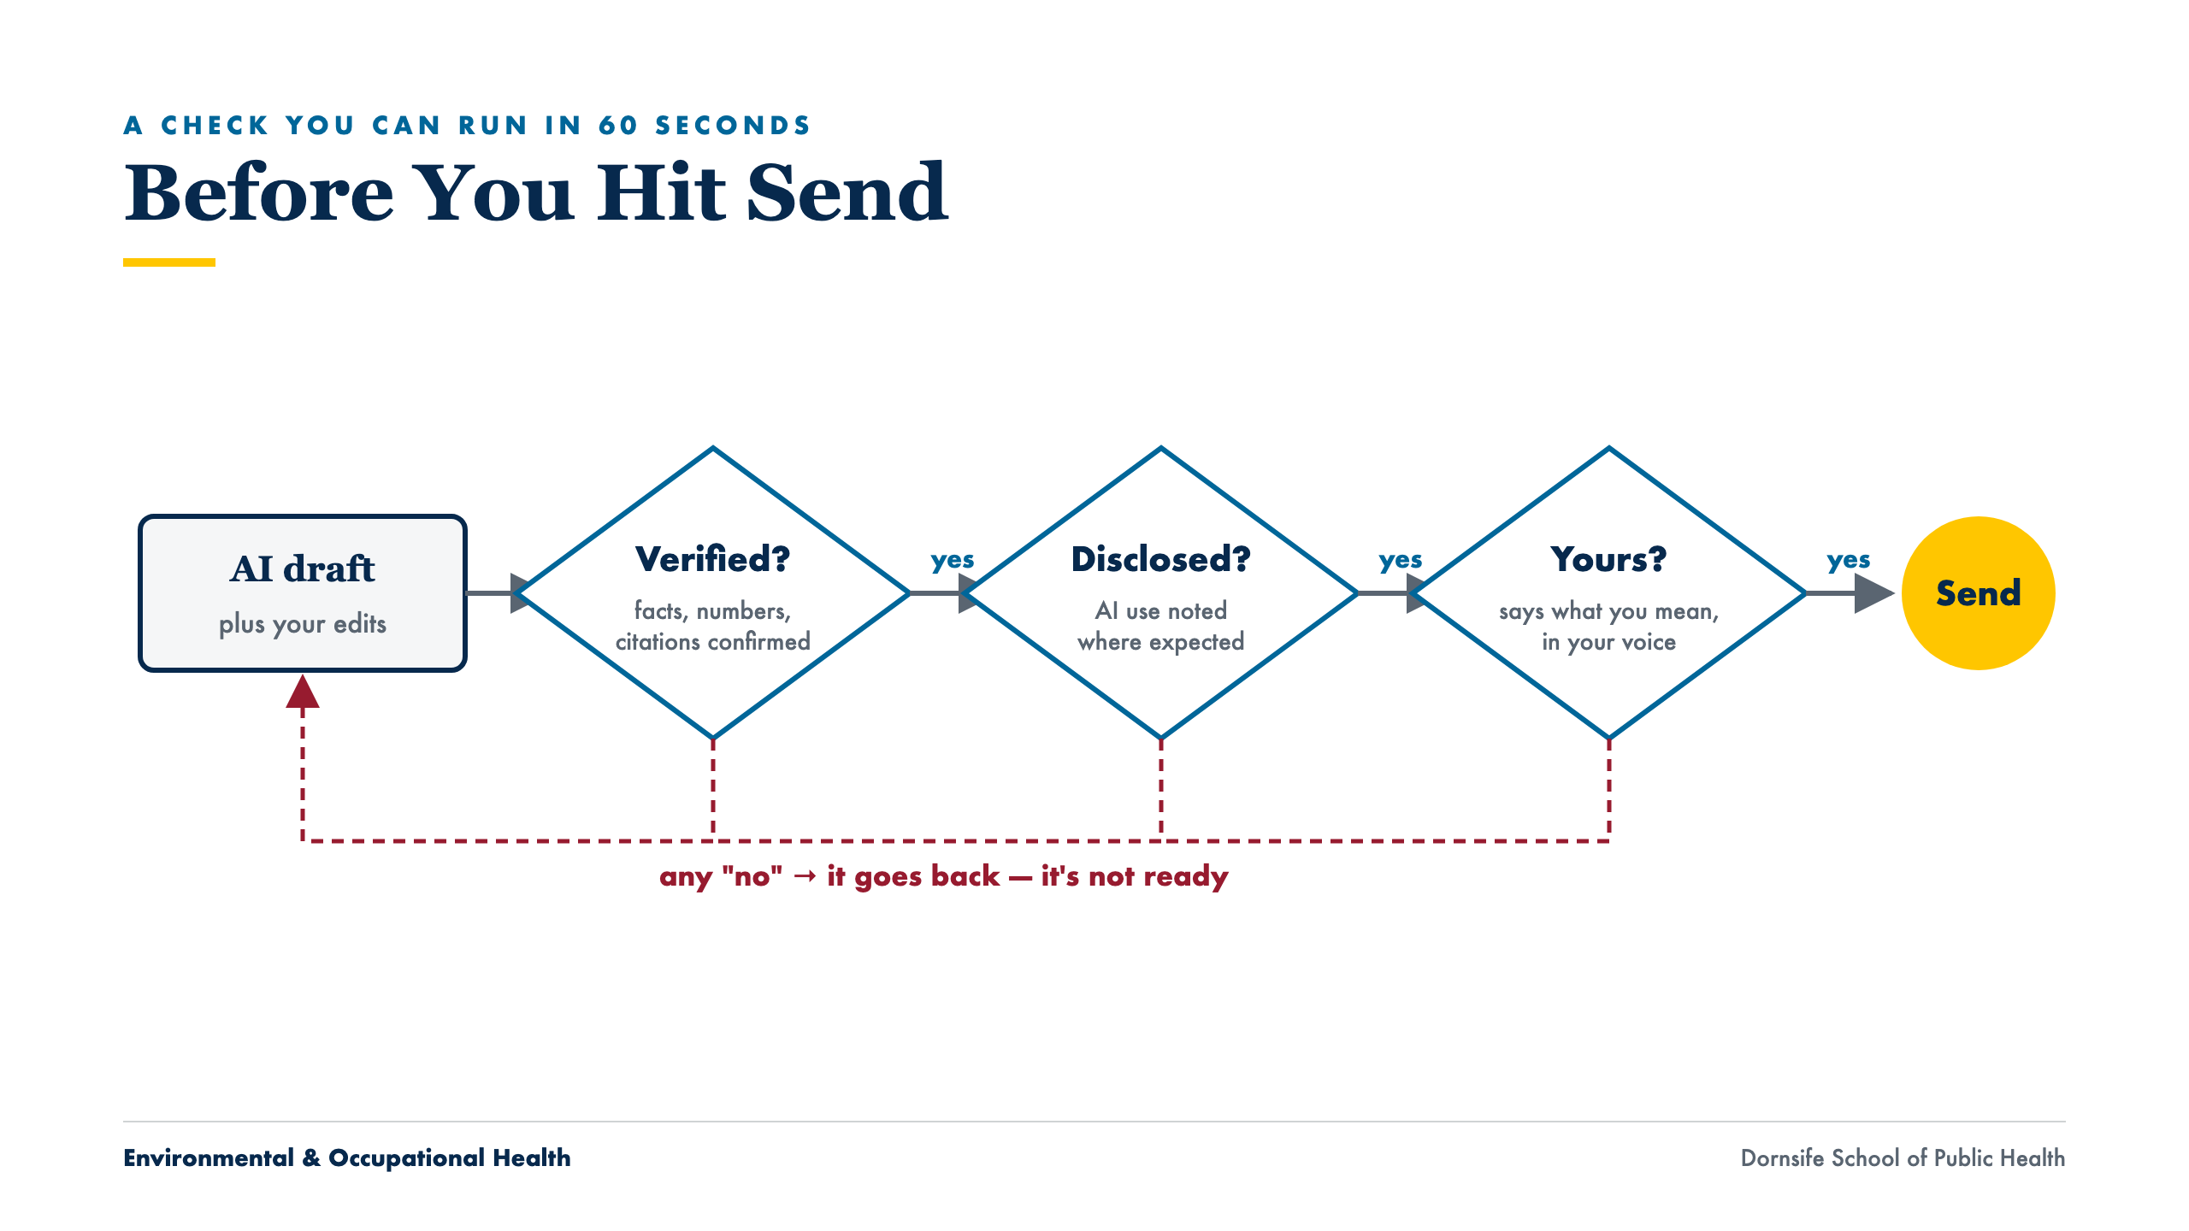
Notes:
Trace one draft through the three diamonds. Verified: names, dates, numbers. Disclosed: official, research, or external work. Yours: does it say what you mean? Any "no" sends it back. Core 4 covers this in depth.

Slide 11
“
If you can’t open it, you can’t cite it.
A rule worth keeping
Treat every AI-supplied figure as unverified until you’ve confirmed it
Notes:
Applies to numbers as much as citations. If you cannot trace it to a source you opened, it does not go in.

Slide 12
SECTION 03
Hands-On
Upload a file together, then pick one everyday job, then your own task. Demo files are on the workshop page.

Slide 13
GUIDED START · ~5 MIN · FOLLOW ALONG
Upload a File to Copilot Chat
1
Download Workshop2_Demo_StudyDescription.docx from the Core 2 page.
2
Go to m365.cloud.microsoft/chat and sign in with your Drexel account. Look for the shield icon.
3
Click + next to the message box and upload the file (or paste the text).
4
Type: “Summarize this document in 5 bullet points for a project status update.”
5
Follow up: “Now make it 3 bullets for a busy dean.”
The same steps work in ChatGPT Edu.
Environmental & Occupational Health
Dornsife School of Public Health
Notes:
Do each step on the projector and pause. Ask for a thumbs-up after the upload step; that is where people get stuck. No shield icon: they are signed in with a personal Microsoft account. Upload fails: open the file and paste the text.

Slide 14
ACTIVITY 1 · ~20 MIN
Three Everyday Jobs: Pick One
Use Copilot Chat or ChatGPT Edu. Upload the demo file or use your own non-sensitive material. Three prompts each; the next slides show them.
Job A · A Document
Job B · An Email Thread
Job C · A Spreadsheet
Summarize a study description, rewrite it for a community board, draft next steps.
Find the decisions and open questions, make an action-item table, draft the reply.
Find what stands out, get an Excel formula to flag rows, pick a chart.
Environmental & Occupational Health
Dornsife School of Public Health
Notes:
Ask people to pick within one minute. Leave the slide for the most popular job on screen while they work.

Slide 15
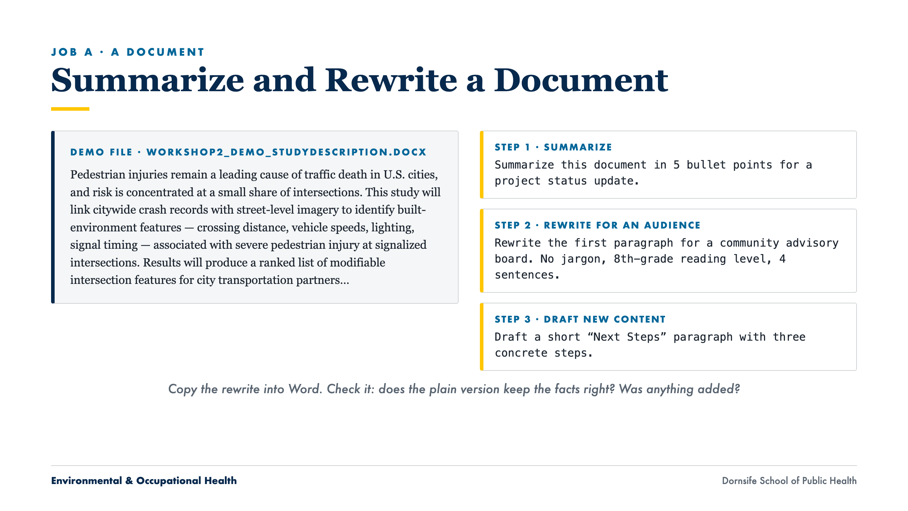
Notes:
Read one sentence of the plain-language rewrite aloud and check a fact against the original. The Next Steps are invented by the AI; fine for a draft, and exactly why you edit.

Slide 16
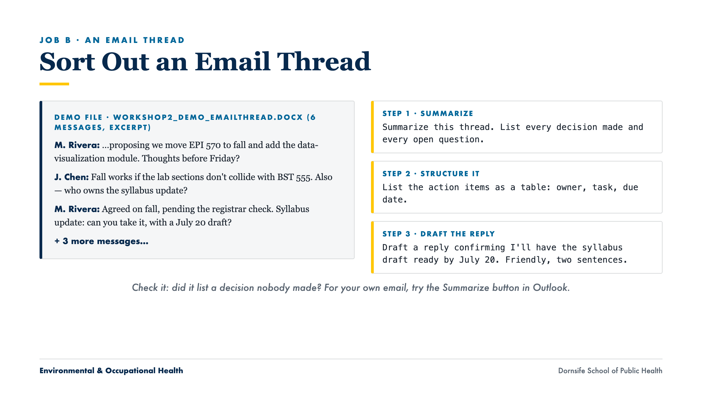
Notes:
The accreditation crosswalk was flagged and put on the September agenda, with no owner. Ask: decision, action item, or open question? Summaries often file it wrong.

Slide 17
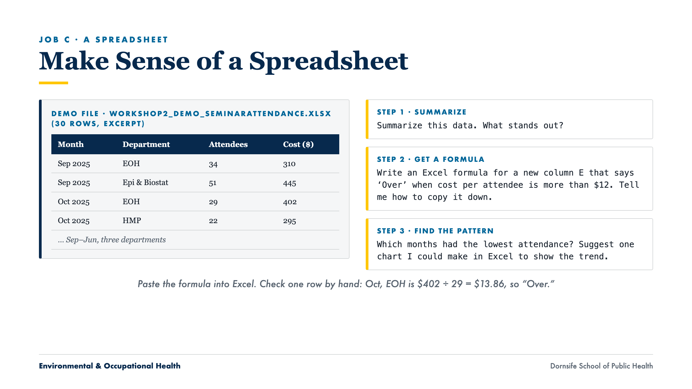
Notes:
8 of 30 rows are over $12 per attendee (Oct EOH and HMP; Dec EOH and HMP; Jan HMP; all three in June). Nov HMP is exactly $12.00: a formula with > will not flag it, >= will. Check the formula, not just the answer.

Slide 18
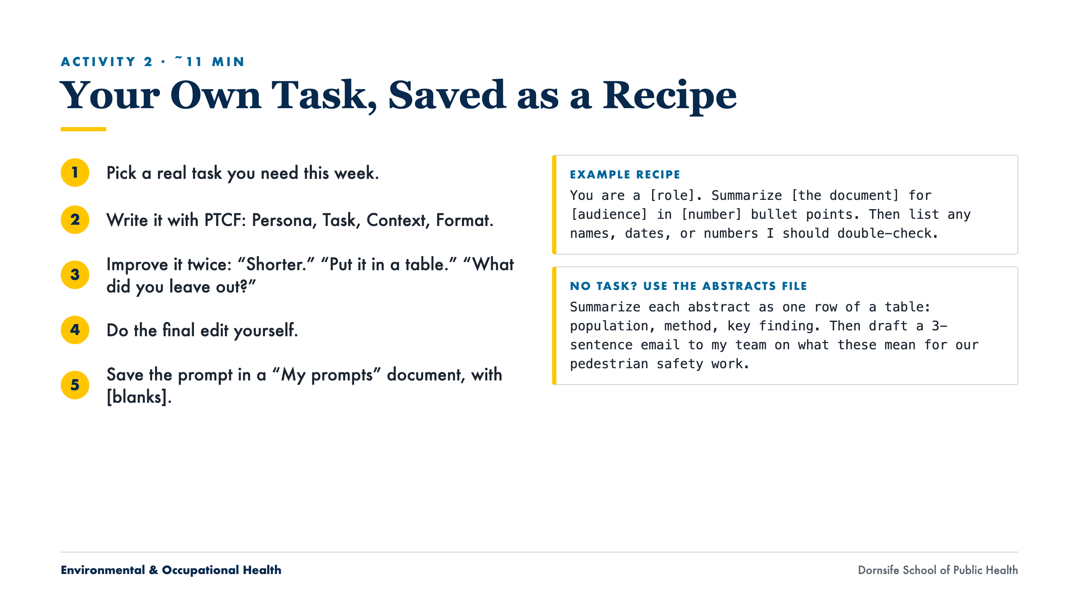
Notes:
Push two or three rounds of follow-ups. Make sure everyone saves at least one recipe in a "My prompts" document before leaving; Core 3 builds on these. For the abstracts fallback, check the confidence intervals live.

Slide 19
WRAP-UP
What to Take Away
Paste or upload, ask, check, copy the answer back. Copilot Chat or ChatGPT Edu both work.
Three moves cover most weekly tasks: summarize, rewrite for an audience, make a table.
Before you use it: Verified? Disclosed? Yours?
Save the prompts that work as recipes.
Before Core 3: save two recipes and use one again next week. Bring them.
Environmental & Occupational Health
Dornsife School of Public Health
Notes:
Two recipes before Core 3. Point to the feedback form at the bottom of the workshop page.

Slide 20
Drexel University
Dornsife School of Public Health
THANK YOU
Questions & Discussion
Next: Core 3 — Reusable Assistants. Turn your saved recipes into shared Projects and custom GPTs.
Alex Quistberg, PhD, MPH
daq26@drexel.edu
Department of Environmental & Occupational Health

