Slide 1
Drexel University
Department of Environmental
& Occupational Health
Dornsife School of Public Health
AI WORKSHOPS FOR DSPH
Foundations & Capabilities
What generative AI is, which Drexel tools to use, and how to ask for what you need. No experience needed.
Alex Quistberg, PhD, MPH
Associate Research Professor · Department of Environmental & Occupational Health
Core 1 · Fall 2026 · on Zoom
Notes:
No experience needed. If you have never opened ChatGPT, you are in the right room. By the end of the hour, everyone will have used ChatGPT Edu for a real task.

Slide 2
WHAT YOU'LL LEAVE WITH
Today's Goals
1
Say in one sentence what tools like ChatGPT do, and what they get wrong.
2
Know which Drexel tools to use and what never goes into them.
3
Sign in to ChatGPT Edu, type a request, and ask a follow-up.
4
Use four simple questions (PTCF) to get a better answer.
Environmental & Occupational Health
Dornsife School of Public Health
Notes:
Four goals for the hour. The point is one safe, useful habit started, not every feature.

Slide 3
SECTION 01
What AI Is
What these tools do, which ones to use, and the one data rule.

Slide 4
THE MENTAL MODEL
AI Drafts, You Decide
ChatGPT and Copilot write text by predicting what words should come next, based on patterns in a huge amount of writing.
Good at drafting, summarizing, rewriting, and explaining.
Can sound confident and still be wrong. They are not search engines or databases.
Think of a fast, eager assistant who has read a lot but is sometimes wrong. You check the draft before you use it.
Environmental & Occupational Health
Dornsife School of Public Health
Notes:
These tools write by predicting what words come next. That makes them good at drafts and summaries. It also means they can sound sure of themselves and still be wrong. You are the quality check. Do not explain model architecture, training, or tokens. If asked, give a one-sentence answer and offer to talk afterward.

Slide 5
A FEW WORDS YOU'LL HEAR
Four Terms
Prompt
Chat
What you type into the box: a question, a request, or instructions.
One conversation. It remembers earlier messages in the same chat, not other chats.
Model
Hallucination
The AI system underneath the tool. You can use the default.
When the AI states something false as if it were true.
Environmental & Occupational Health
Dornsife School of Public Health
Notes:
Read each term and definition aloud. Hallucination is the one that matters most for safety.

Slide 6
TOOLS & DATA
Which Tool, and the One Data Rule
Which tool to use
Never paste in
ChatGPT Edu, signed in with your Drexel account
Copilot Chat, signed in with your Drexel account
Personal ChatGPT, Claude, Gemini: public or low-risk information only
Health information about a person
Student records or Social Security numbers
Identifiable research data
When in doubt, leave it out or make the details up
Environmental & Occupational Health
Dornsife School of Public Health
Notes:
For Drexel work, use ChatGPT Edu or Copilot Chat, signed in with your Drexel account. Personal accounts and other tools are for public information only. The rule: no health information about a person, no student records, no Social Security numbers, no identifiable research data. When in doubt, make the details up. Point to the Tools & Access page for the full list; do not walk through every tool and data classification here.

Slide 7
SECTION 02
What It Can Do
Six real tasks from public health work: analyze data, review a draft, build slides, sort an inbox, find sources, form student groups, and one look past the chat box.
Notes:
Transition: before you try it, here is what it can do on work like ours. About 8 minutes; one live demo.

Slide 8
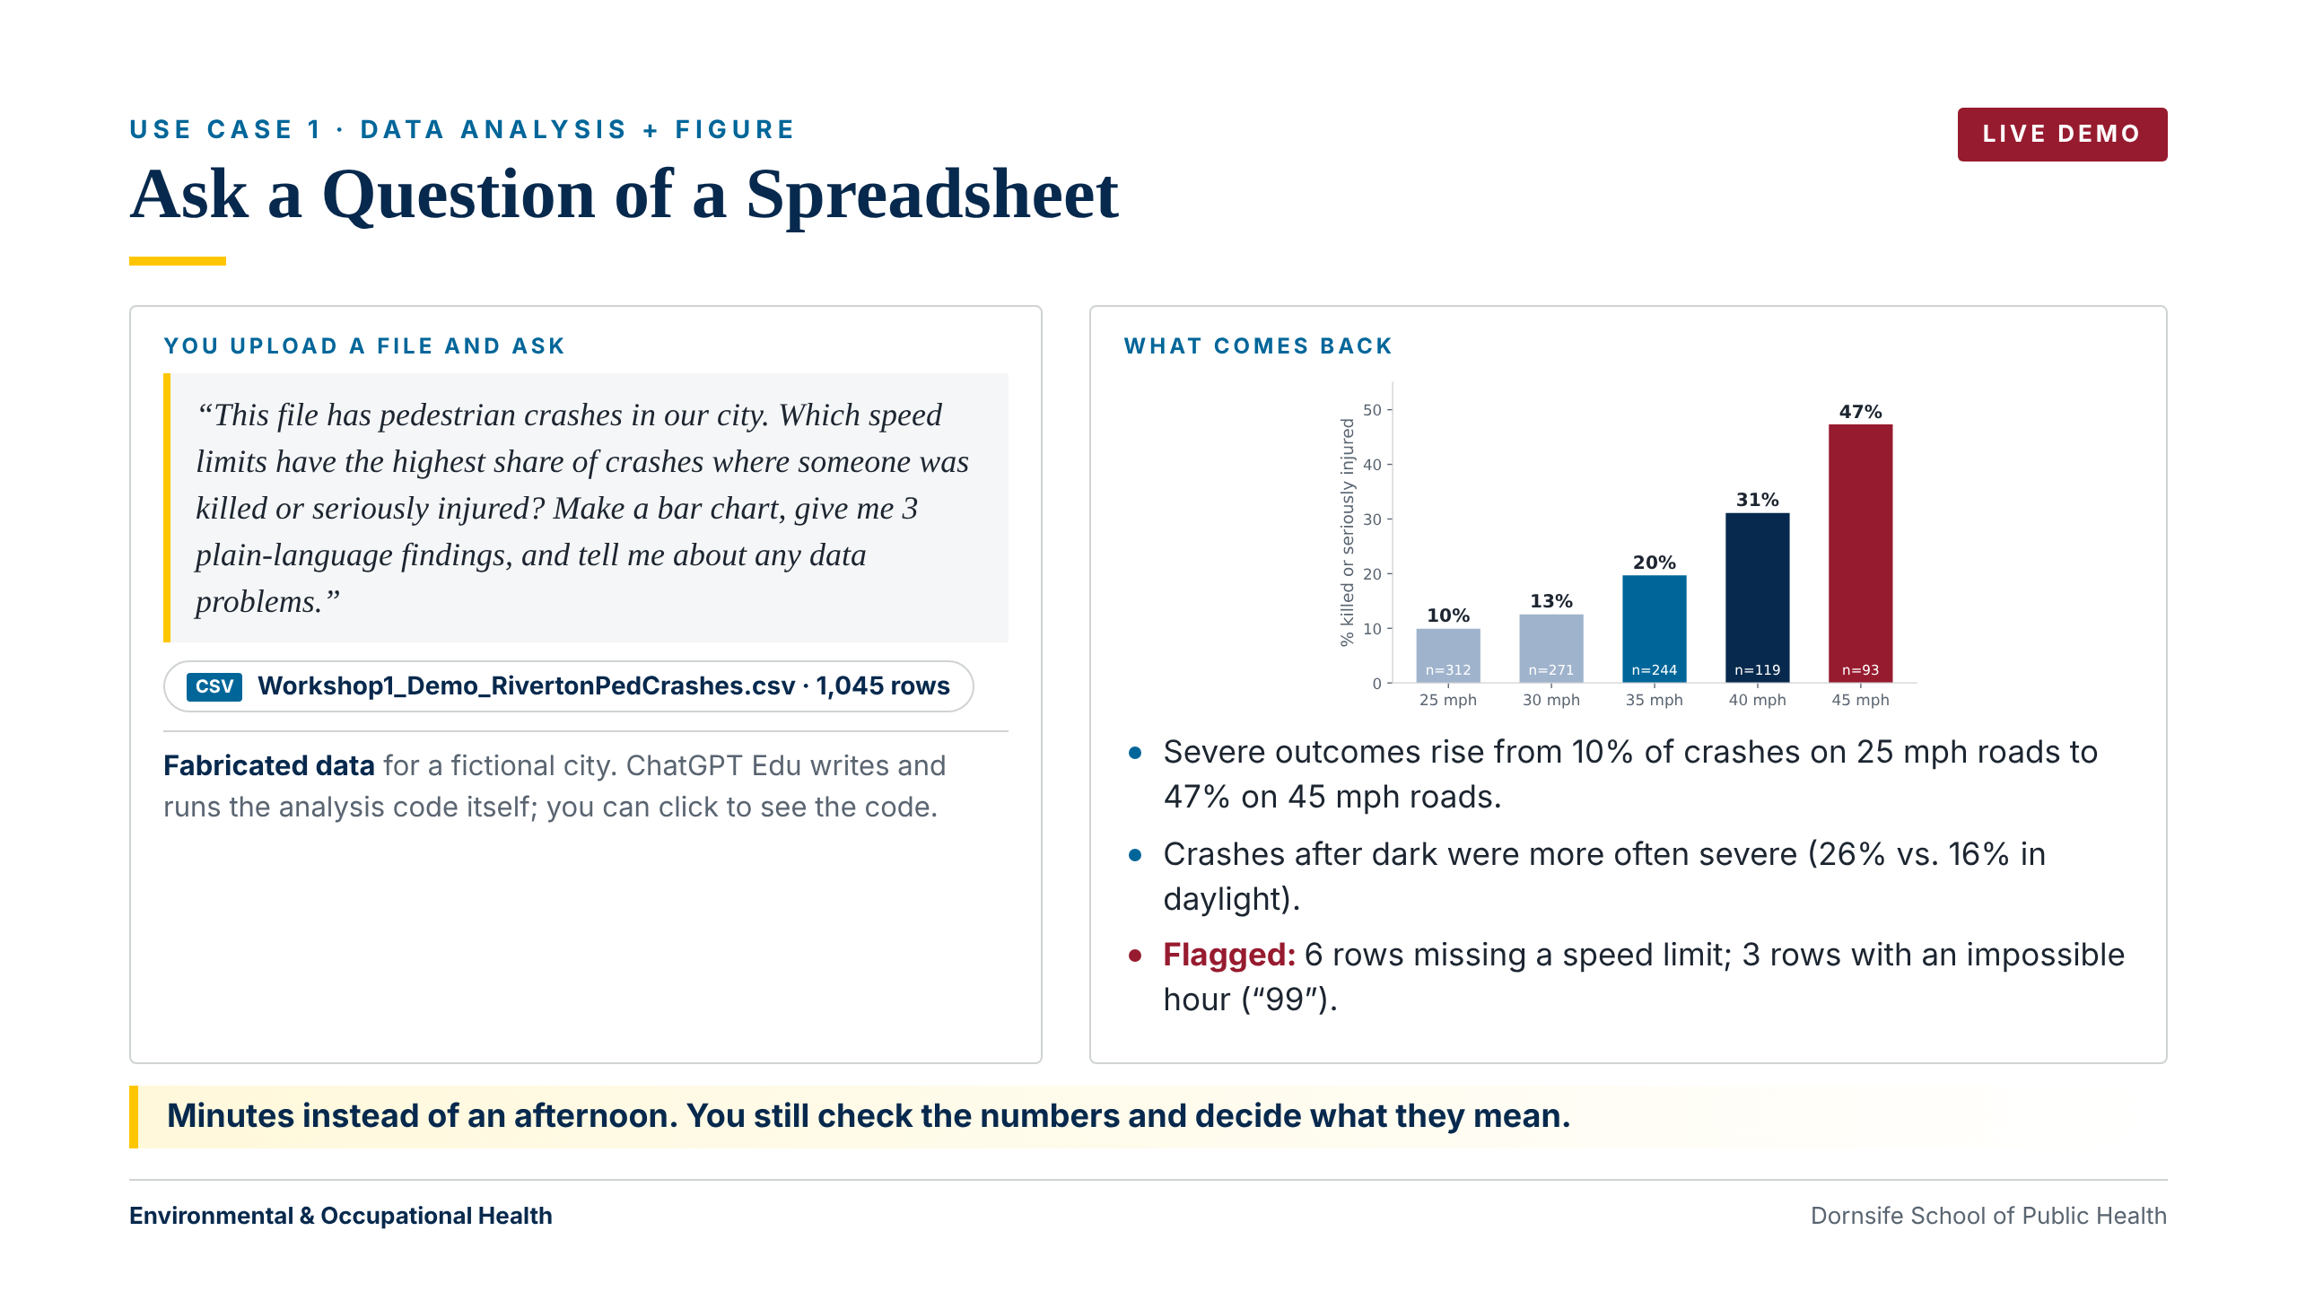
Notes:
LIVE (~3 min). Upload demo-materials/Workshop1_Demo_RivertonPedCrashes.csv to ChatGPT Edu and paste the prompt on the slide. While it works: 'It is writing and running analysis code. You can click to see it.' Point to the flagged problems (6 missing speed limits, 3 rows with hour = 99). If it misses them, ask: 'Are there any missing or impossible values?' If the network fails, use this slide; it shows a real result from the same file.

Slide 9
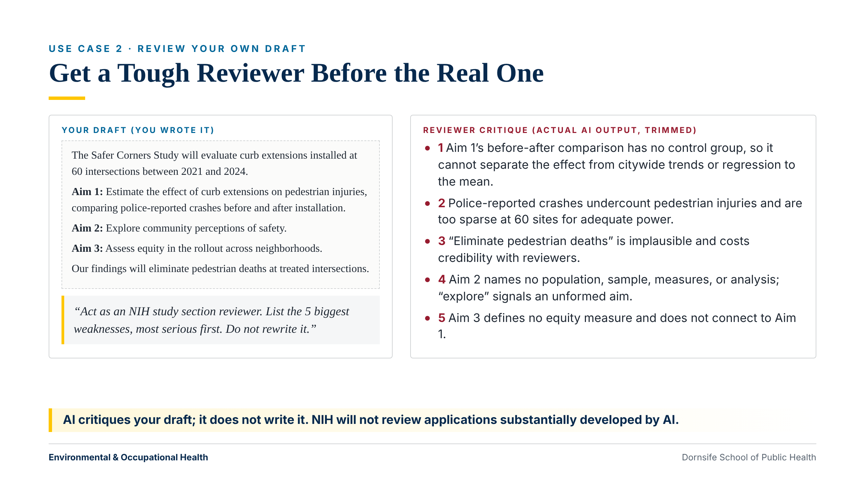
Notes:
~1 min. 'This is my draft, not the AI's. I ask it to act like a study section reviewer and to not rewrite anything.' The critique is real model output, trimmed. NIH will not review applications substantially developed by AI (NOT-OD-25-132). Use it to critique, not to write.

Slide 10
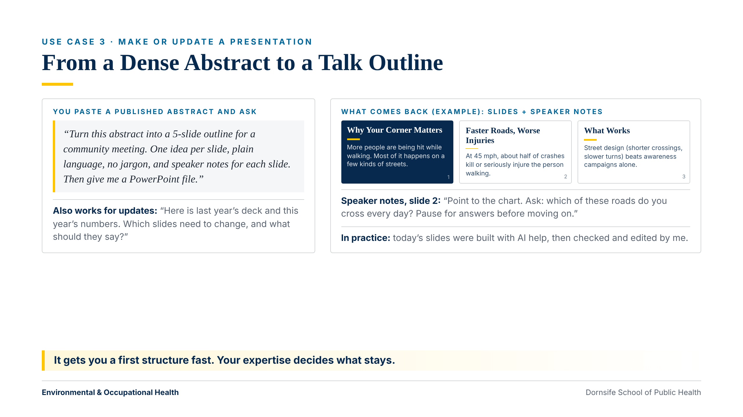
Notes:
~1 min. The mini-slides are an example. ChatGPT Edu can produce a PowerPoint file directly. It also works for updating last year's deck with new numbers.

Slide 11
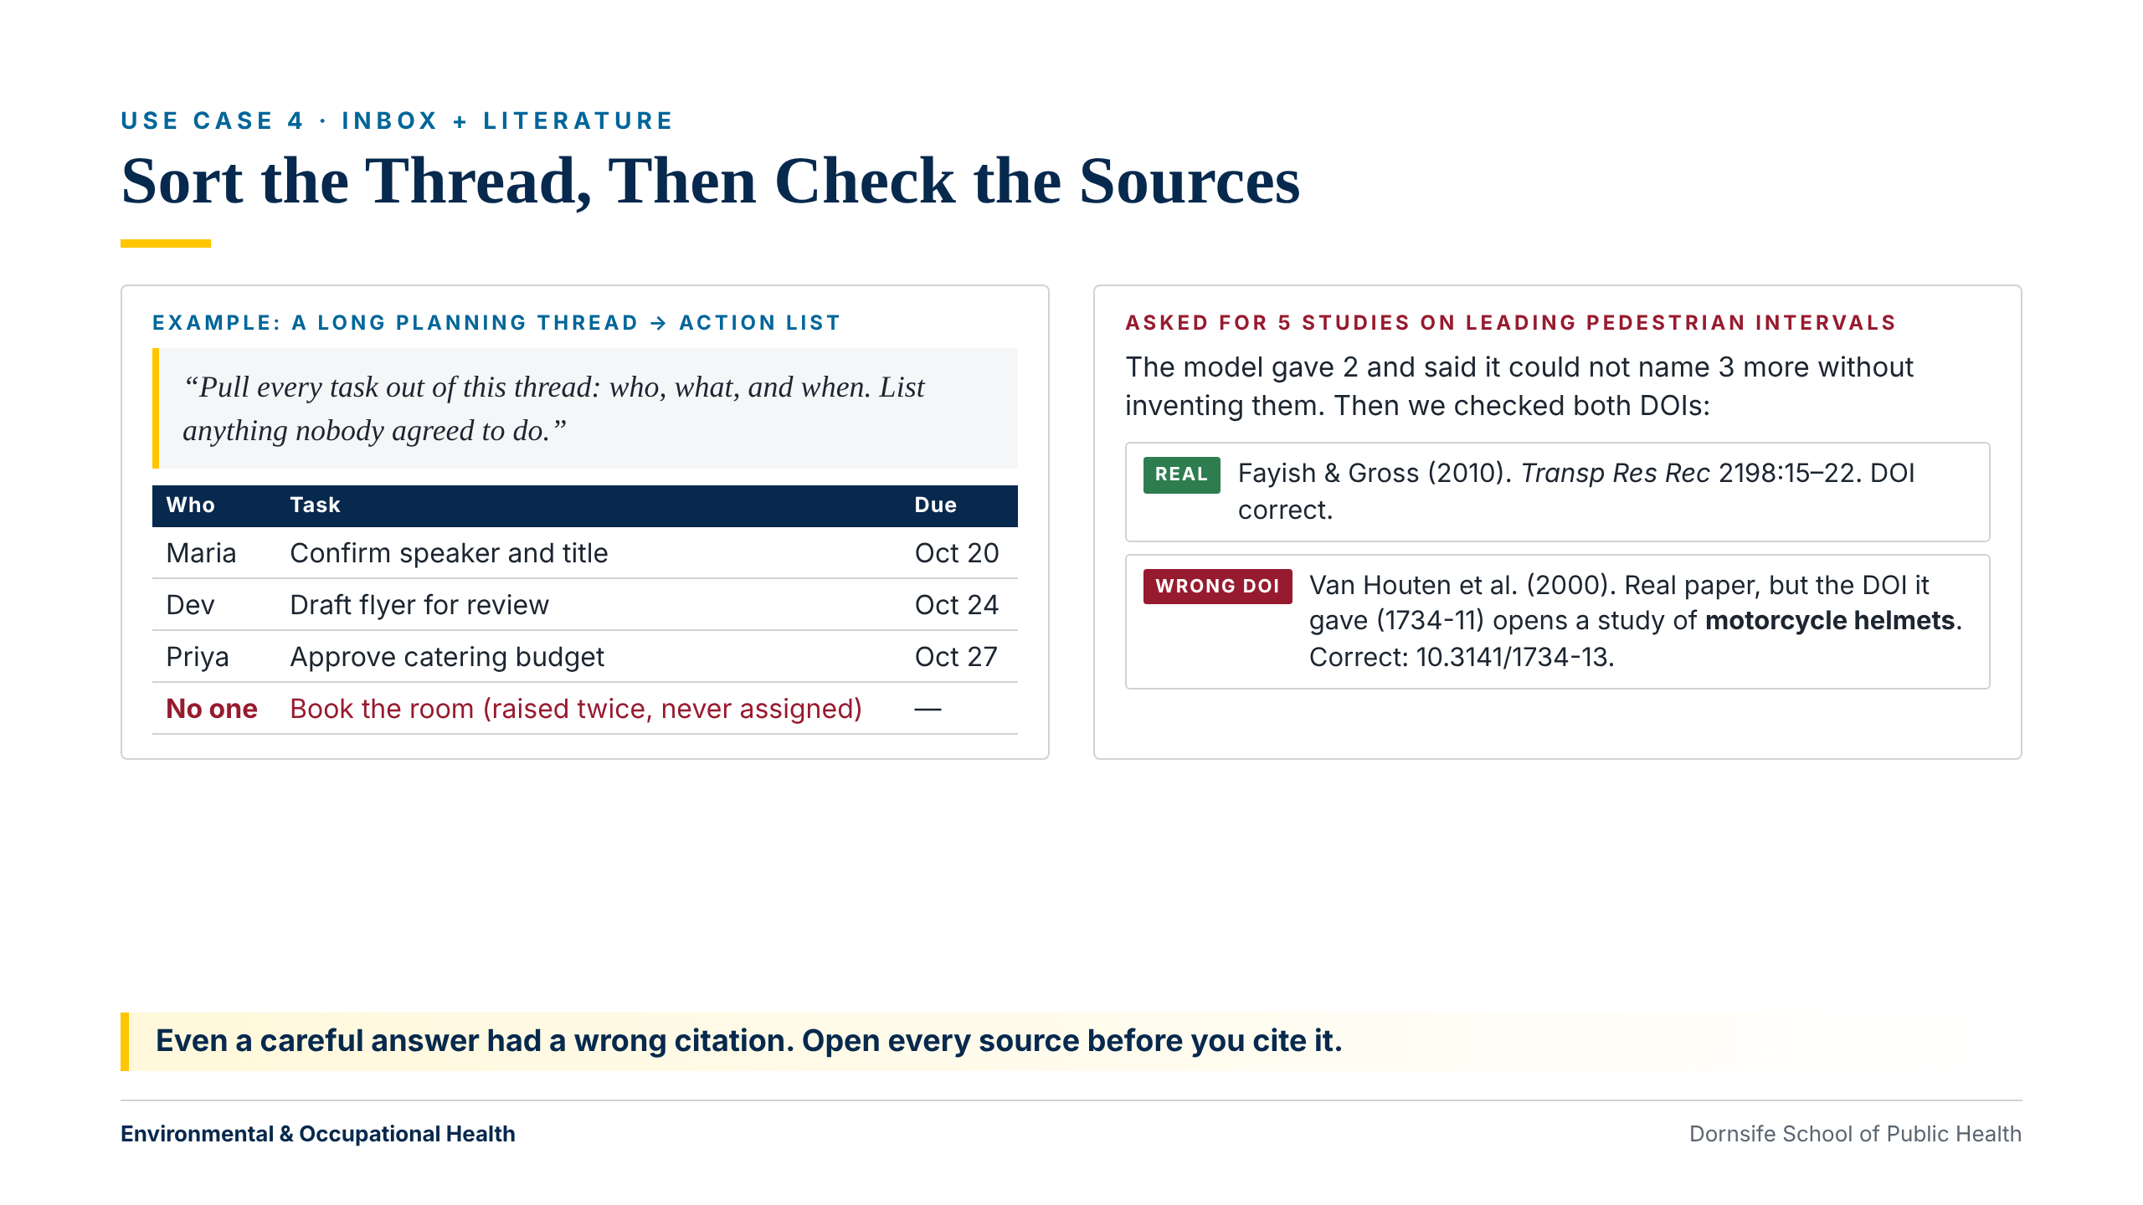
Notes:
~1.5 min. Email triage is the easy win for staff. Citations: a model was asked for 5 LPI studies, gave 2, and declined to invent the rest. Fayish & Gross 2010 (10.3141/2198-03) is correct. Van Houten et al. 2000: it gave 10.3141/1734-11, which resolves to a motorcycle helmet paper; correct is 10.3141/1734-13. 'Even a careful answer had a wrong citation.'

Slide 12
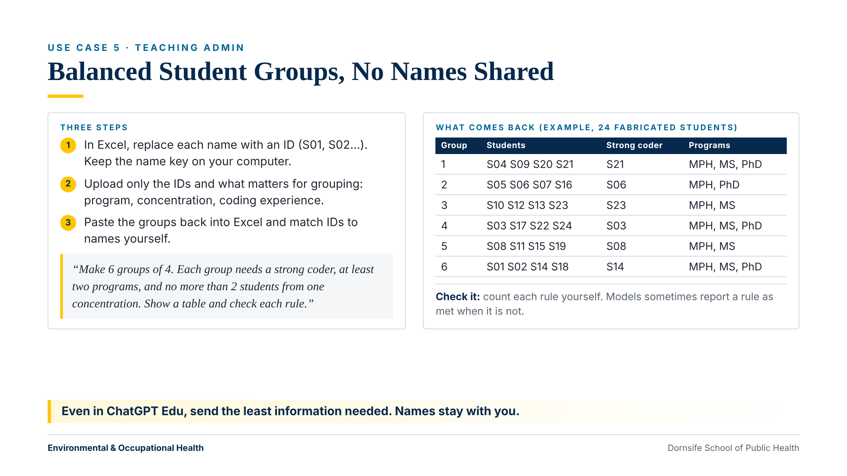
Notes:
~1 min. 'Even in ChatGPT Edu, I don't upload names. I swap names for IDs in Excel, upload only what matters for grouping, and match the names back myself.' Point to 'check each rule' in the prompt and tell them to count anyway. Roster is fabricated (demo-materials/Workshop1_Demo_AnonymizedRoster.csv); the groups shown meet all three rules.

Slide 13
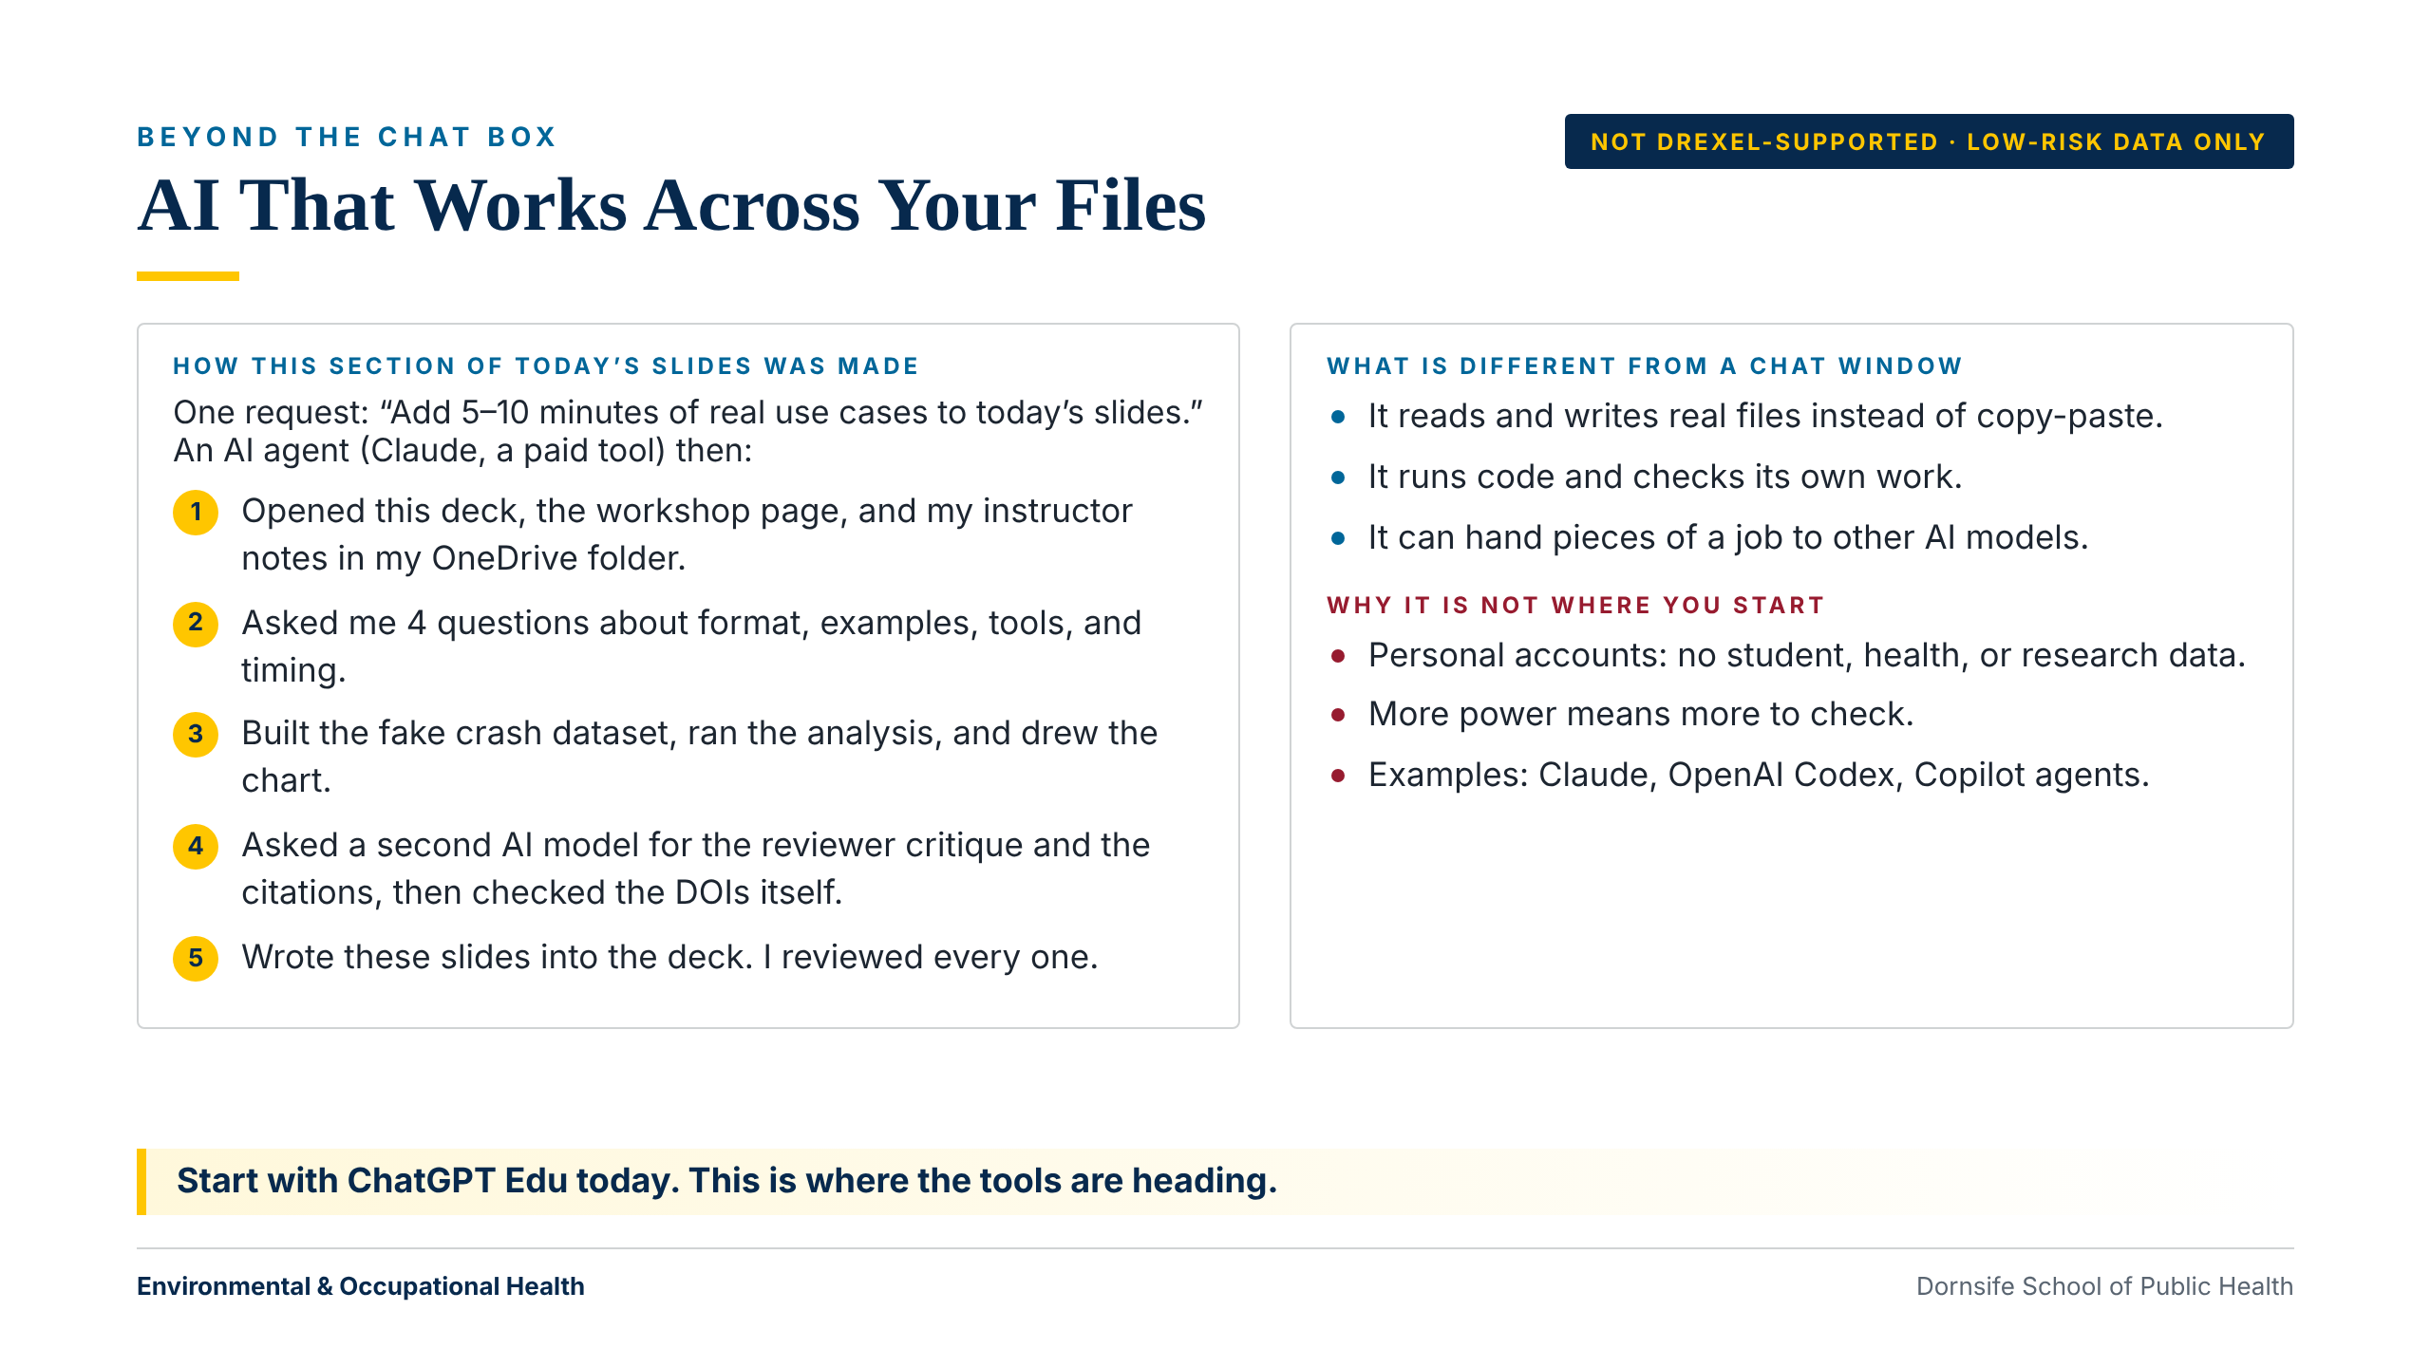
Notes:
~1 min. This section was built by an agentic tool working in my OneDrive folder. Stress the label: not Drexel-supported, low-risk data only. Everyone starts with ChatGPT Edu today.

Slide 14
SECTION 03
How AI Gets Things Wrong
And who is responsible when it does.

Slide 15
THREE THINGS TO REMEMBER
Wrong, Biased, and Yours
It Makes Things Up
It Can Be Biased
You Are Responsible
It predicts likely-sounding text, so it can invent facts, numbers, and citations. Check anything that matters.
It learned from writing that reflects society's inequities, so answers can repeat stereotypes. Our work affects real communities.
If your name is on it, you own it: accuracy, fairness, and tone. “The AI wrote it” is never the answer.
Environmental & Occupational Health
Dornsife School of Public Health
Notes:
It can invent facts and citations. Check anything that matters. It learned from writing that reflects society's inequities, so it can repeat stereotypes. In public health our work affects real communities. If your name is on it, you own it. 'The AI wrote it' is never the answer. Core 4 covers verification and disclosure in depth; the Bias & Equity Audit track covers bias.

Slide 16
SECTION 04
Hands-On
A guided tour, three first requests, and a simple recipe for better answers.

Slide 17
GUIDED TOUR · ~10 MIN · FOLLOW ALONG
ChatGPT Edu, Step by Step
1
Sign in with your Drexel account. Check you are in the Drexel workspace.
2
Find the message box at the bottom of the screen.
3
Type: “In two sentences, what can you help a public health staff member with?”
4
Follow up in the same chat: “Give me three examples.”
5
Copy the answer with the copy icon.
6
Click “New chat.” It does not remember the old one.
7
Find past chats in the list on the left.
React with a thumbs-up in Zoom after each step. Stuck? Say so in the chat.
Environmental & Occupational Health
Dornsife School of Public Health
Notes:
Do each step on your shared screen and pause. Ask people to react with a thumbs-up in Zoom when they have finished a step. Steps 4 and 6 teach the most important idea: a chat remembers earlier messages, and a new chat starts fresh. Backup if sign-in fails: Copilot Chat with a Drexel account. Ask people who are stuck to say so in the chat.

Slide 18
ACTIVITY 1 · ~11 MIN
Your First Three Requests
Copy each prompt from the workshop page into ChatGPT Edu, one at a time. There are no wrong answers.
Summarize: a short paragraph on pedestrian deaths, in 3 bullet points.
Draft: a friendly reminder email to a committee, under 100 words.
Explain: what a “data use agreement” is, in plain language.
Then follow up: “Make it shorter,” “More formal,” or “Add a sentence about ___.”
Environmental & Occupational Health
Dornsife School of Public Health
Notes:
Participants copy the three prompts from the Core 1 workshop page, then try one follow-up. The goal is one successful answer per person. Prioritize people who have not gotten any response yet. If someone wants to use sensitive work content, have them make up a version with the same structure.

Slide 19
ACTIVITY 2 · ~11 MIN
Four Questions Before You Type
PTCF
Try both
Persona: who should it act as?
Task: what do you want it to do?
Context: what does it need to know?
Format: what should the answer look like?
Short: “Write an email about a meeting.”
Full: “You are an experienced department administrator. Write an email announcing a staff meeting Tuesday at 10 in Room 204 about the new travel policy. Under 100 words, warm tone, date and time first.”
Environmental & Occupational Health
Dornsife School of Public Health
Notes:
Run the short prompt and the full prompt on your shared screen so everyone sees the difference. Then ask everyone to write a PTCF prompt for a real email or short document they need this week, using made-up names and details. You don't need all four parts every time; adding even one or two helps. Ask people to paste their prompt in the Zoom chat, and read two or three aloud.

Slide 20
WRAP-UP
What to Take Away
AI writes drafts. You check them and decide.
For Drexel work, use ChatGPT Edu or Copilot and follow the data rule.
Before you type, ask the four questions: Persona, Task, Context, Format.
Before Core 2: do one weekly task (an email, a summary, notes) with ChatGPT Edu, and bring it.
Environmental & Occupational Health
Dornsife School of Public Health
Notes:
One task to try before Core 2. Point to the feedback form at the bottom of the workshop page.

Slide 21
Drexel University
Dornsife School of Public Health
THANK YOU
Questions & Discussion
Next: Core 2 — Workflow Enhancement. Start from your own plan, then let AI draft or refine.
Alex Quistberg, PhD, MPH
daq26@drexel.edu
Department of Environmental & Occupational Health

